Slide 1
CANON Experiment Planning
Focus: May-June

Slide 2
When?
The Main Event remains scheduled for May 21 – June 1.
Preparatory and preliminary during the preceding ~week.
Where?
Our “backyard”, i.e. the bay and immediately adjacent waters; not as far offshore as the September experiment.
More specifically where… and what and how?
The answers depend on our chosen scientific and methodological foci.

Slide 3
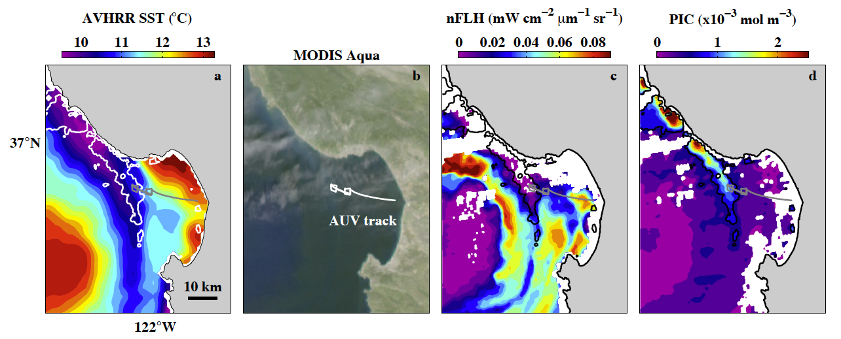
Upwelling filaments as ecosystem process integrators
[CANON April 2011 Experiment: Tethys leads Dorado in robot ballet.]
Supply of nutrients, including ventilation of subsurface ammonium maximum → phytoplankton productivity
Zooplankton aggregation → ammonium production (nutrient recycling)
Transport of sediments, with consequences for phyto / zoo ecology.
Establishment of primary ecosystem physical / chemical structure and processes.

Slide 4
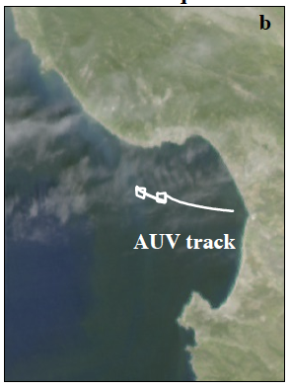
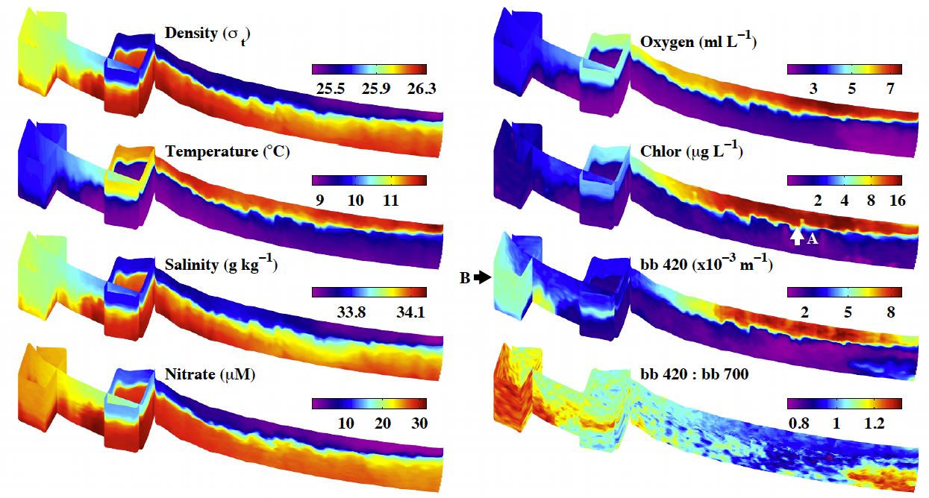
Patches are “where it’s at”.
Patch processes revealed...

Slide 5
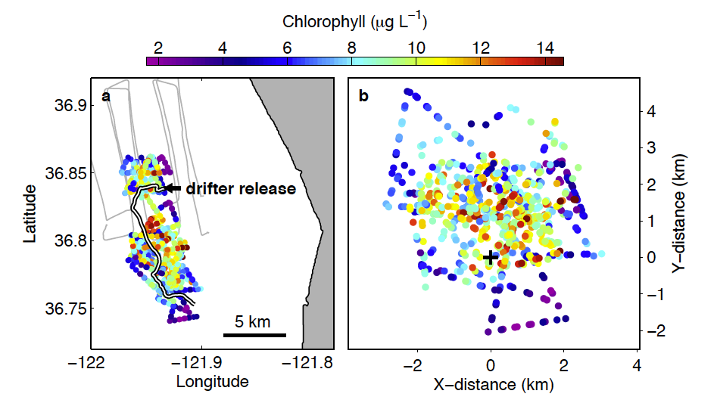
Patch processes from CANON, October 2010

Slide 6
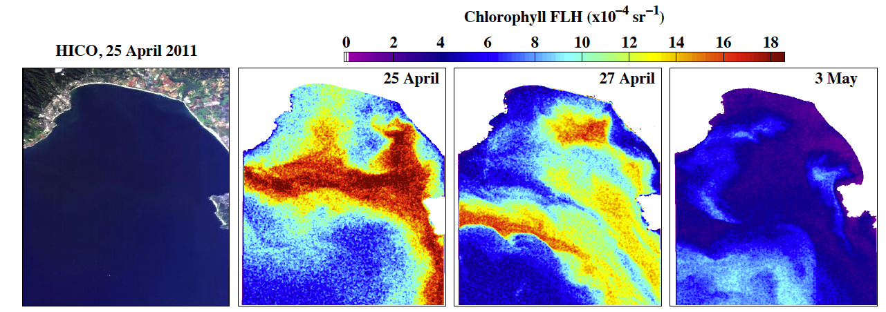
Process signals are large and highly variable.
Effective study requires intelligent sampling.
[CANON April 2011 Experiment: HICO / ISS imaging.]
Physical: Destratification, advection, mixing
Chemical: Nutrient concentrations and composition
Biological: Aggregation / trophic interaction

Slide 7
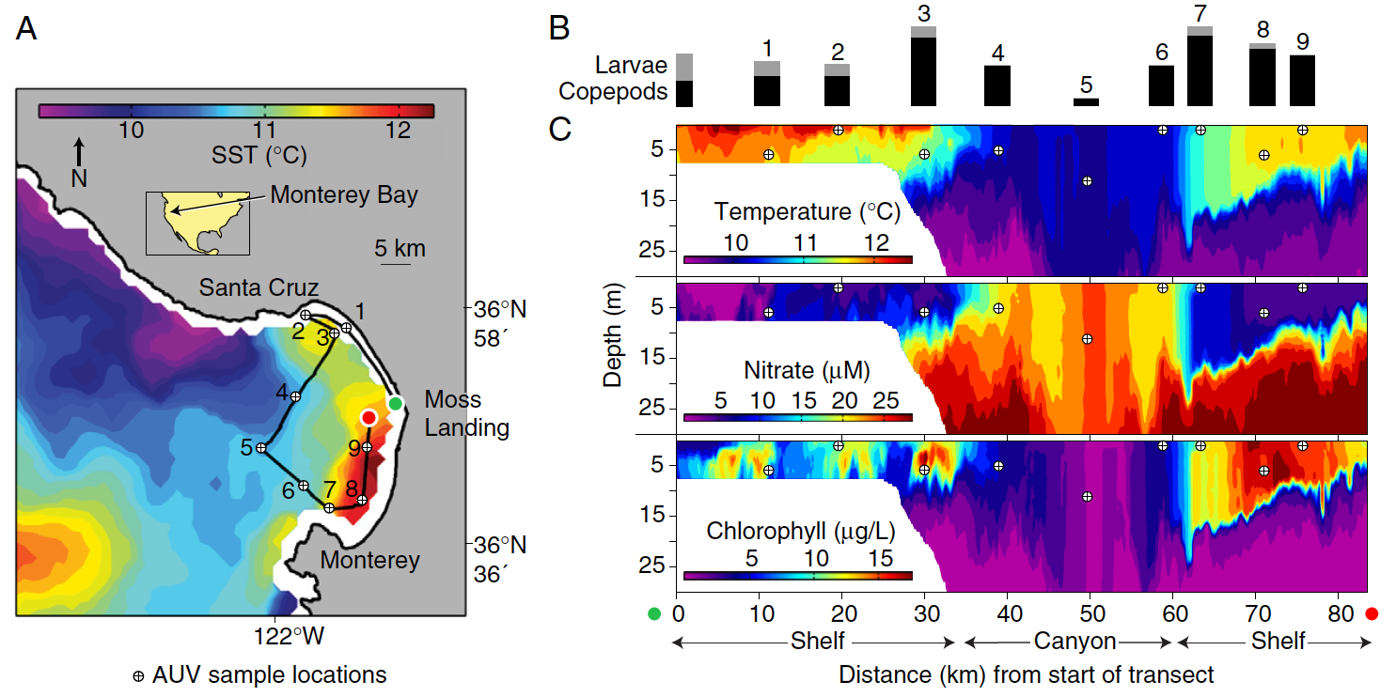
One focus: zooplankton aggregation
Certain copepods appear to be aggregated in upwelling frontal zones (Harvey et al., 2012).
Are specific zooplankton consistently aggregated in the fronts of upwelling filaments? If so, what are their ecological roles and interactions?
No “surgical sampling”, just luck.

Slide 8
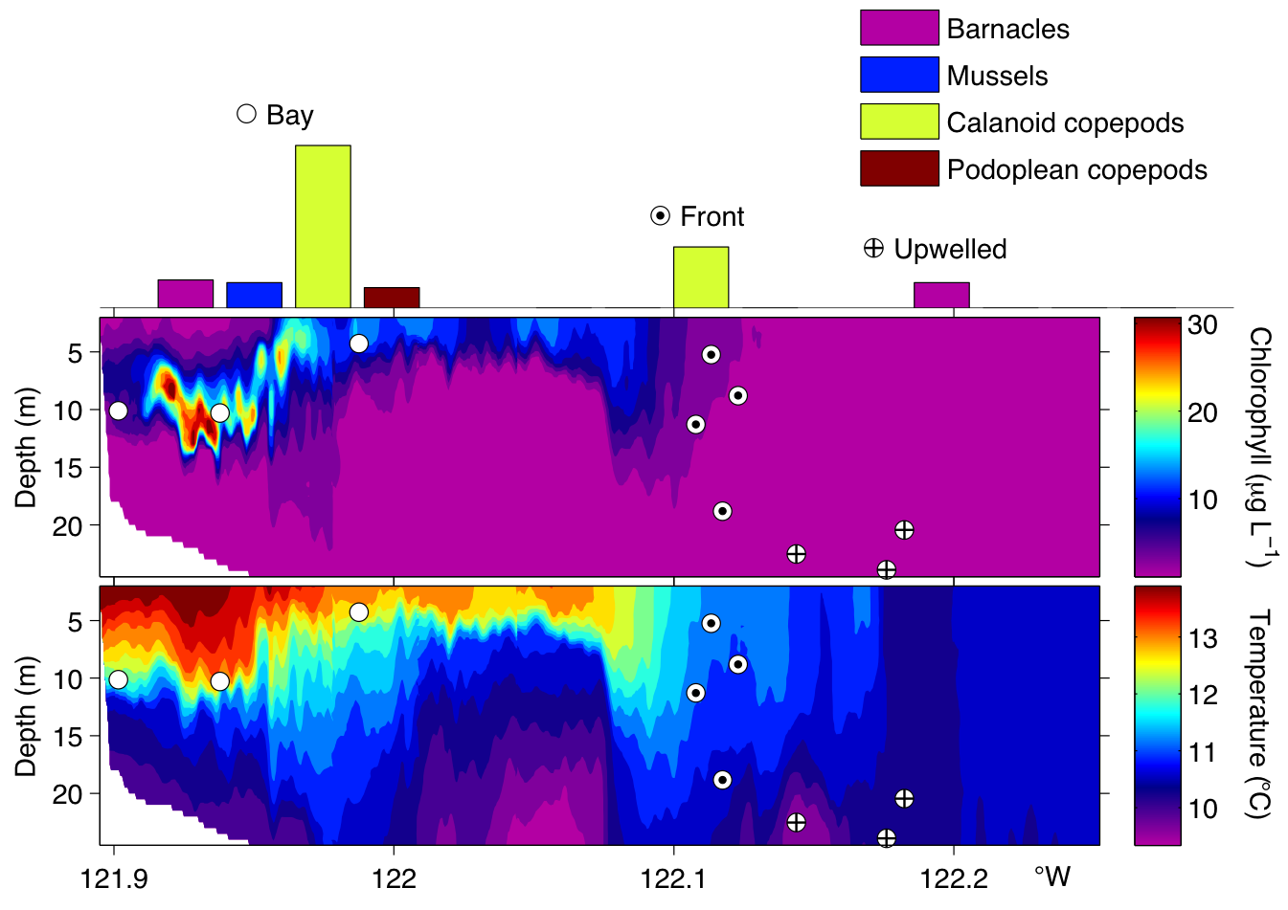
Surgical Sampling
Zhang et al., in prep.

Slide 9
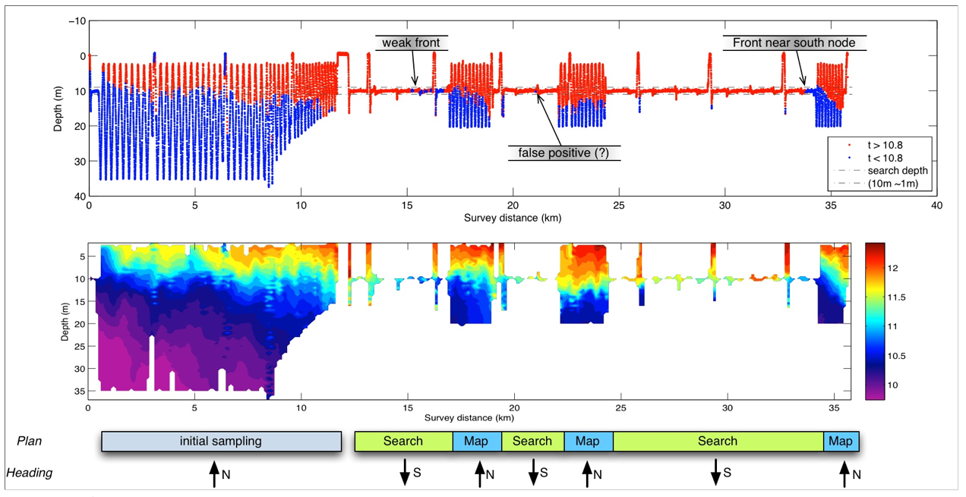
Mixed Initiative
Rajan Lab

Slide 10
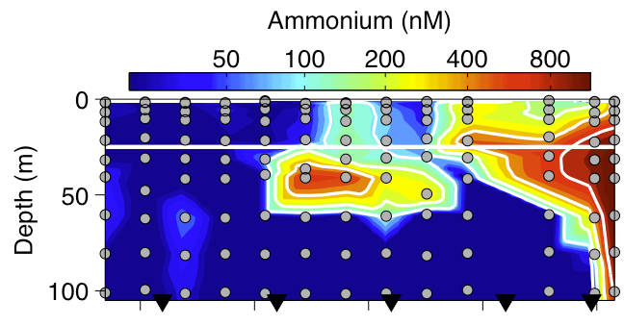
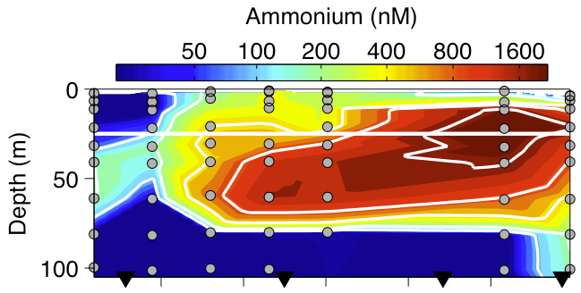


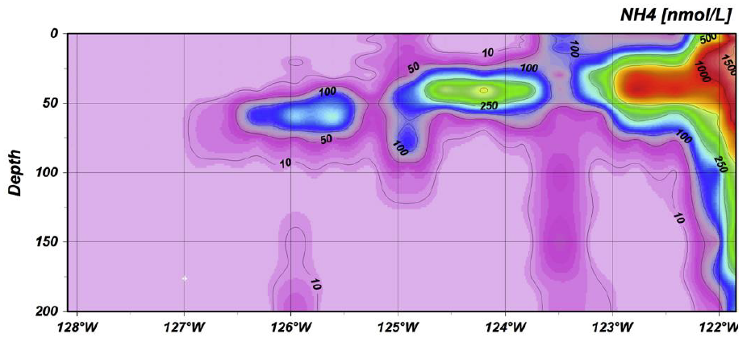
Ammonium Maximum
It is present within the bay, where its intensity and vertical extent are evidently greatest.

Slide 11
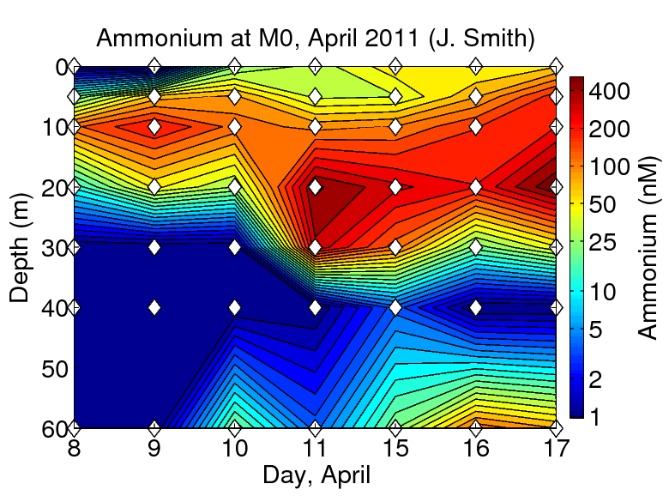
Ammonium maximum in the bay
Shallow relative to offshore
Variable in depth: targeting

Slide 12
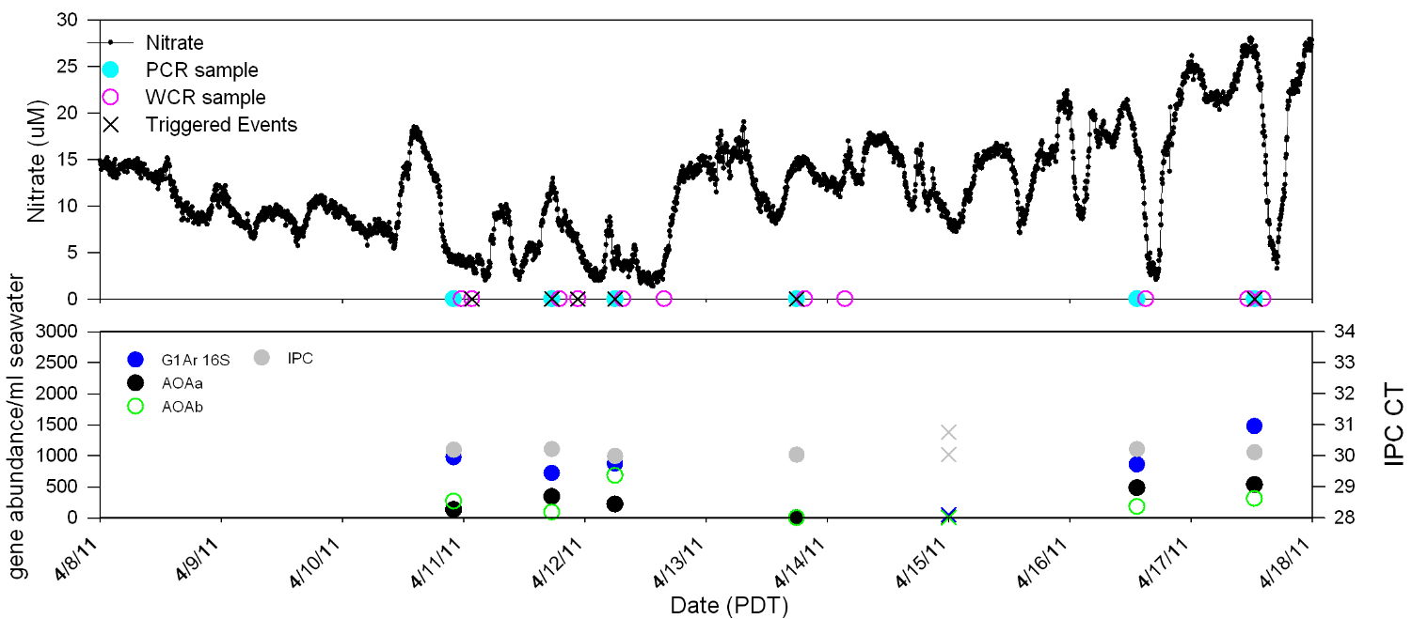
ESP: riding the top of the NH4 max
C. Preston

Slide 13
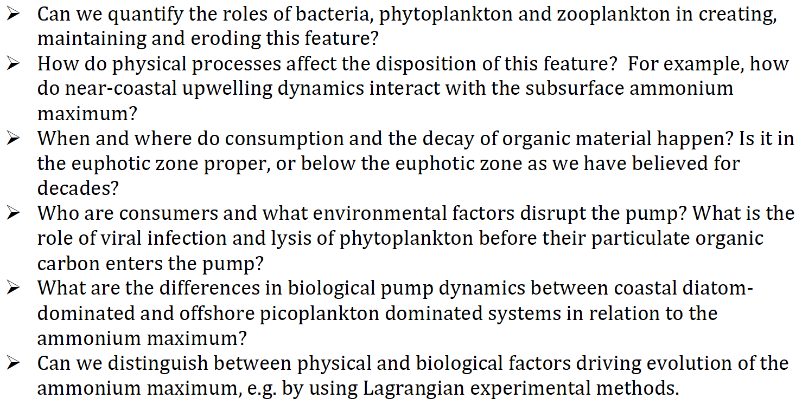
Ammonium maximum in the bay:
Which questions to focus on?
Specifically where, what and how.
Adaptable plans, dependent upon conditions.

