Slide 1

OCEANOGRAPHIC DECISION SUPPORT SYSTEM
(ODSS)
A TOOL TO IMPROVE EFFICIENCY OF BIOLOGICAL OCEAN PROCESS STUDY
ODSS Project Update
8 May 2012
ODSS Team: Duane Edgington, Kevin Gomes, Mike McCann, Danelle Cline, Tom O’Reilly, Thom Maughan, and
Francisco Chavez (CANON PM)
Notes:
The Controlled, Agile, and Novel Observing Network (CANON) team at MBARI is creating new ways to remotely assess biological ocean conditions and collect samples of microorganisms. In addition to science, the CANON program has an engineering component.
The coordination of multiple science objectives and multiple mobile platforms provides a rich problem domain for engineering.
MBARI engineering studied the workflow of the CANON science campaigns created requirements for an Oceanographic Decision Support System (ODSS).
The tool provides a set of perspectives that map to the workflow of the experiment. The high level functionality provided in the tool:
1) Situational Awareness: platform trajectory and real time data
2) Logistics and planning of asset deployment.
3) Collaborative discussion workspace
4) Real-time mobile platform control and coordination
5) Data access and analysis.
The engineering team is following an iterative development process and is hosting the software as an open source project. The presentation will cover the high level requirements, architecture, implementation overview and lessons learned in the CANON experiments.
The team has fielded various iterations of the ODSS software tool in several CANON experiments starting in 2010. The ODSS has successfully facilitated scientists in their efforts to adaptively follow, sense and sample the changing conditions of upwelling driven algal bloom.

Slide 2
Who 2012
Kevin Gomes, Web applications (GUI), Web services
Danelle Cline, Backend server, data access and visualization automation
Mike McCann, Database, web services, communication backplane
Tom O’Reilly, communication backplane, mobile apps
Mike Godin, Web App, AOSN tools integration, update
Duane Edgington, engineering execution management
Thom Maughan, continuity, high level requirements and priorities, ‘customer interface’ to CANON PI’s, PM and Lead Engineer
Francisco Chavez, CANON Project Manager
Jim Bellingham, CANON Lead Engineer
Kanna Rajan, Distributed Autonomy PI, ODSS Commissioner, CANON PI

Slide 3
TOC
What the heck is CANON? (done)
Why do we need a Decision Support System?
  Patch id, tracking
What decisions?
  Where is it?
  where is the best place to put our stuff?
  Which water samples are the good ones?
Drawing on AOSN and Mixed Initiative experience
Components of the ODSS
  Web application: SituA, Planning, CoSci, Data Analysis, Water
  Mobile apps: observation log, SituA
  Infrastructure: Comm backplane, Web Services, Databases, Servers and Storage.
  Autonomy Central
  It’s about the Science and the Data, Data, Data
What’s been done to date
Next…

Slide 4
Technology Trails
Rajan Lab – Planning, Distributed Autonomy, Mixed Initiative For Mars Rover at NASA
Bellingham Lab – AOSN, Collaborative Science software tools, LRAUV
MBARI Data Management – SSDS, One Stop Shopping, Upper Water Column Data Visualization

Slide 5
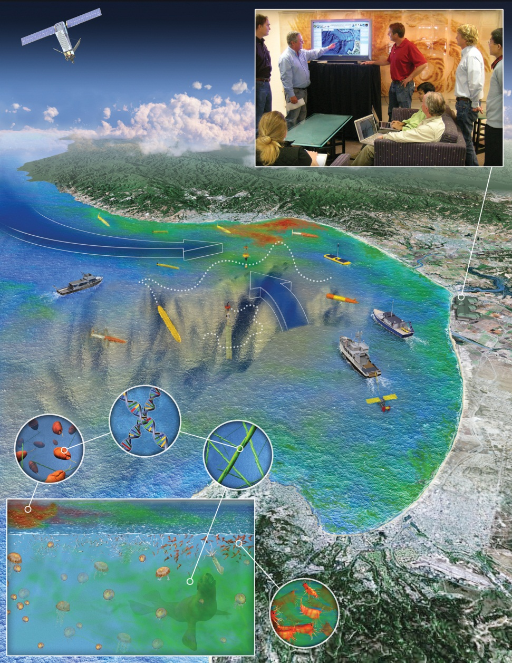
MBARI “CANON” Initiative
Controlled Agile Novel Observation Network
CANON Science
Persistent ocean presence reveals ecosystem dynamics
  Several weeks, several times a year
Four science research themes in CANON.
  Coastal phytoplankton blooms
  Zooplankton dynamics
  Oxygen minimum zones and ocean acidification
  Open ocean eddies and global primary production.
Notes:
CANON – Controlled Agile Novel Observation Network
CANON PIs: Bellingham (LE), Chavez (PM), Rajan, Ramp, Ryan, Scholin, Smith, Vrijenhoek, Worden
Multiple platforms
Multiple Science goals
‘Patch Tracking’:
Map, Tag, Track and Sample.
What tools are needed?
How to pull it all together?
Leverage research and experience from ONR funded AOSN effort.
Leverage research and technology from NASA and Distributed Autonomy effort

Slide 6
MBARI “CANON” Initiative
Controlled Agile Novel Observation Network
CANON Technology
Each CANON science theme involves:
  Process driven, ecologically oriented field experiments
  Multi-platform, multi-sensor, multi-disciplinary, multi-scale
  ‘Patch Tracking’ - Map, Tag, Track and Sample.
Technology themes in CANON
  Sampling technologies
  Experiment and Data Management
Why a Decision Support System?
  Experiment planning,
  Collaboration and communication
  Visibility on ‘what is happening’ in real time
  Logistic agility for platform planning and
  Centralized data access for analysis and data and results sharing
  Experiment logging – why, what, where, when
  Dissemination of results
Notes:
CANON – Controlled Agile Novel Oceanographic Network
Multiple platforms
Multiple Science goals
‘Patch Tracking’:
Map, Tag, Track and Sample.
What tools are needed?
How to pull it all together?
Leverage research and experience from ONR funded AOSN effort.
Leverage research and technology from NASA and Distributed Autonomy effort
Deciding when and where to sample
Hypothesis driven operational plans dynamically adjusted based on real time data analysis
“Patch Following”
Drifter, AUV, Model, Human
Deciding which water samples are best to invest for thorough analysis

Slide 7
Why a decision support system?
A decision support system (DSS) is a computer-based information system that supports business or organizational decision-making activities.
  DSSs serve the management, operations, and planning levels of an organization and help to make decisions, which may rely on rapidly changing situations and not easily specified in advance. (wikipedia)
Using AUVs, ESP drifters, Lagrangian Sediment traps, drifters, ships is challenging. Mapping then zooming in on a ‘patch’ of interest and following for days or weeks requires agile planning and vehicle operations management as well as access to archive and live data and data products.
Notes:
Active, intelligent decision support system
DSSs include knowledge-based systems. A properly designed DSS is an interactive software-based system intended to help decision makers compile useful information from a combination of raw data, documents, and personal knowledge, or business models to identify and solve problems and make decisions.
Typical information that a decision support application might gather and present are:
inventories of information assets (including legacy and relational data sources, cubes, data warehouses, and data marts),
comparative sales figures between one period and the next,
projected revenue figures based on product sales assumptions.

Slide 8
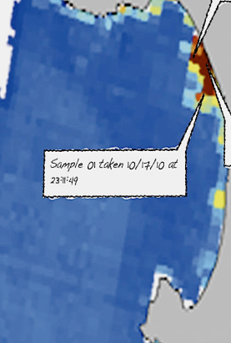

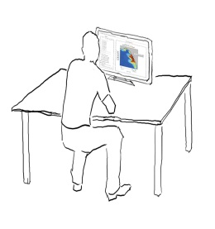
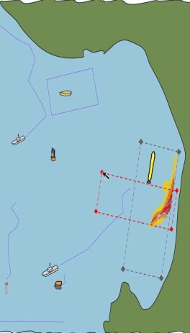
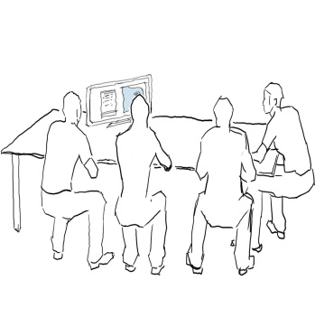

Oceanographic Decision Support System (ODSS)
Workflow
During a Field Experiment
Before
  Data collection
    recent events
    historical
  Analysis
  Planning
  Simulation experiments (VPE)
  Populating database(s)
  Situational awareness
  Planning
  Collaboration
  Annotation, Tagging
  Logistics
After
  Replay
  Analysis
  Archival use
  Dissemination
  Outreach
  Water Sample processing
Notes:
Workflow analysis of science experiment planning, execution, dissemination and data analysis for paper writing
Captured the workflow in a set of pencil sketches
Reviewed with Science one on one
Reviewed as a group to insure ‘buy in’
Built a quick prototype for 2010 – took feedback, validate requirements
Started building a next generation prototype with ‘production’ infrastructure
Three field experiments
Where we are today

Slide 9
How’d we collect and validate requirements?
Pencil sketches
1:1 with CANON PI’s
  Lessons Learned
Preliminary Design Review June 2010
Proposal process 2010
USC collaborator Jnaneswar Das built a prototype from the pencil sketches, fielded in Oct 2010 BloomEx / BioSpace

Slide 10
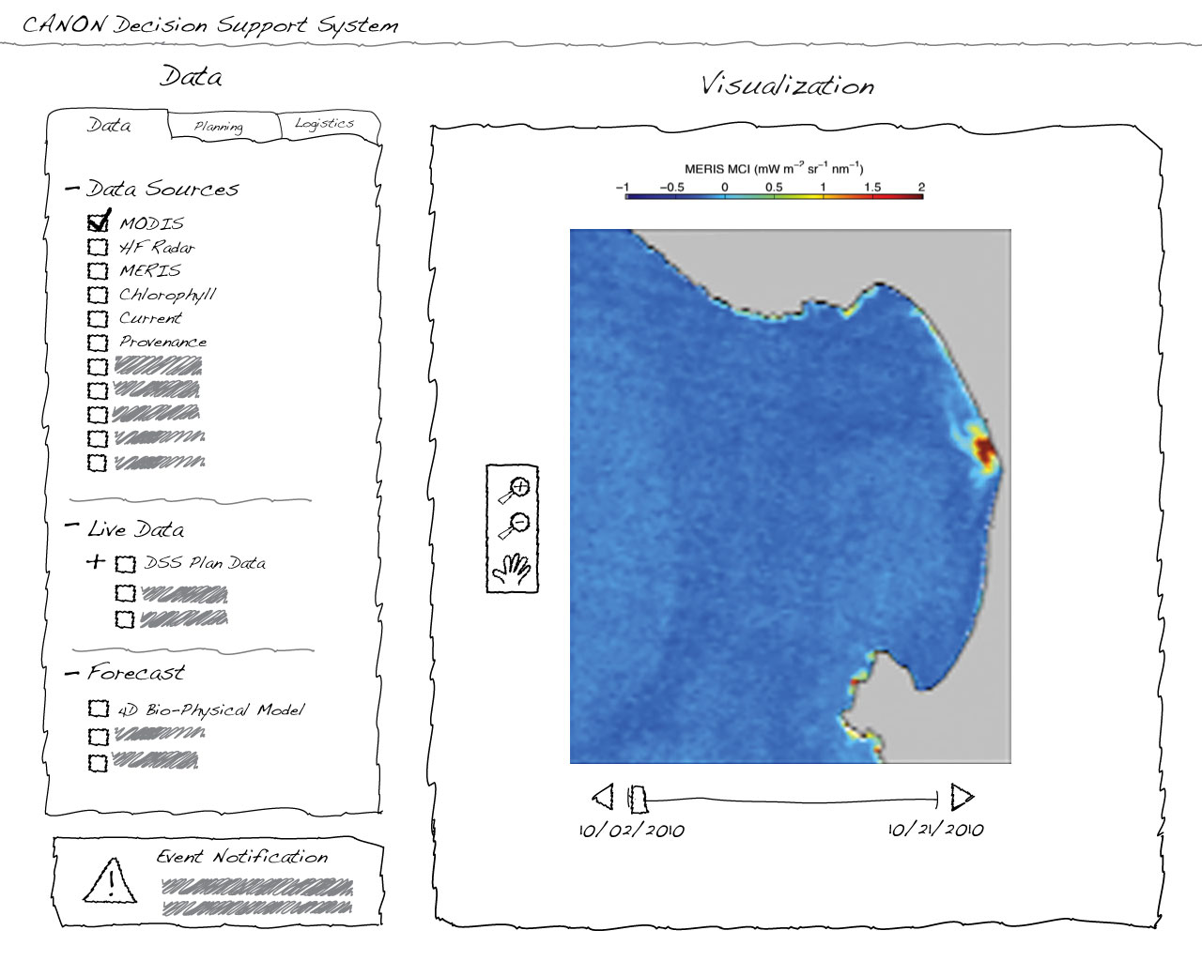

Slide 11
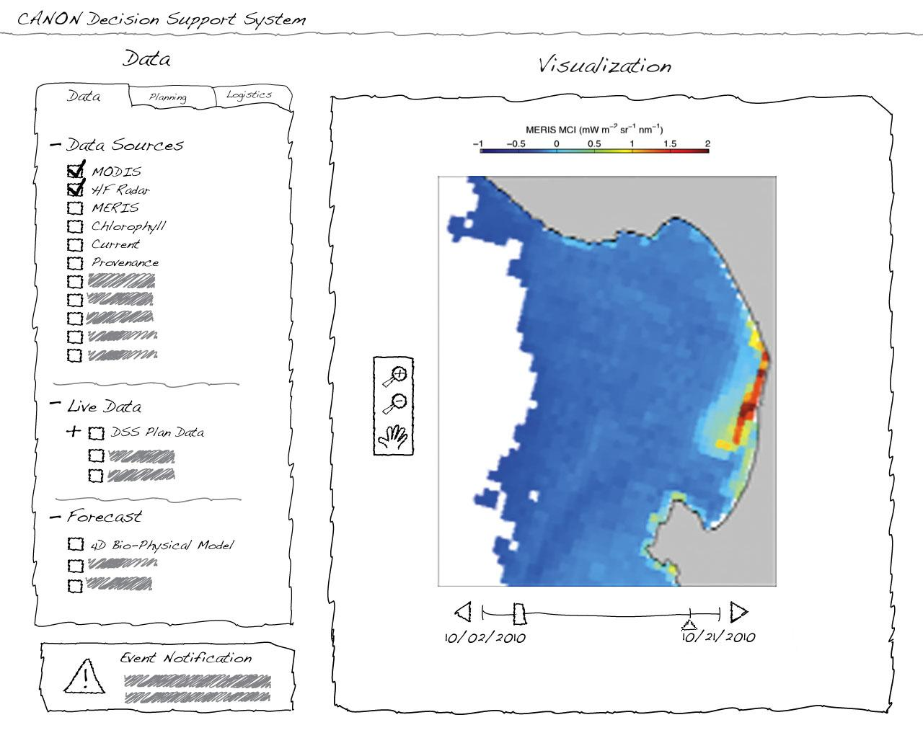

Slide 12
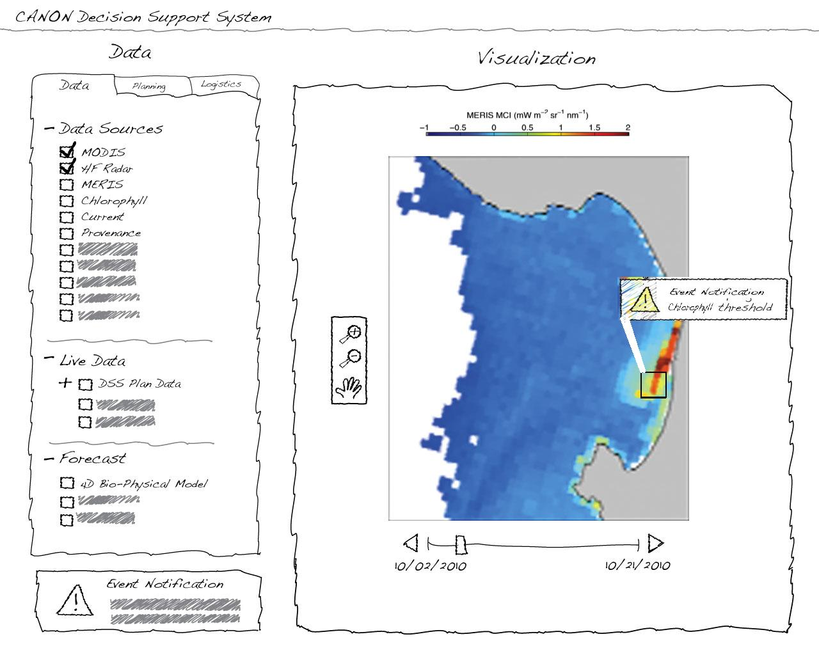
Notes:
The vehicle is deployed and as it is undertaking its survey, it returns science and engineering data captured every 5 m in the water column for field reconstruction on shore. The DSS uses this data to indicate that there is a strong likelihood of water samples being triggered given the parameters set for sampling prior to the start of the mission. However, the DSS also has the capability to re-target the vehicle with new parameters based on shore/ship side user interaction.

Slide 13
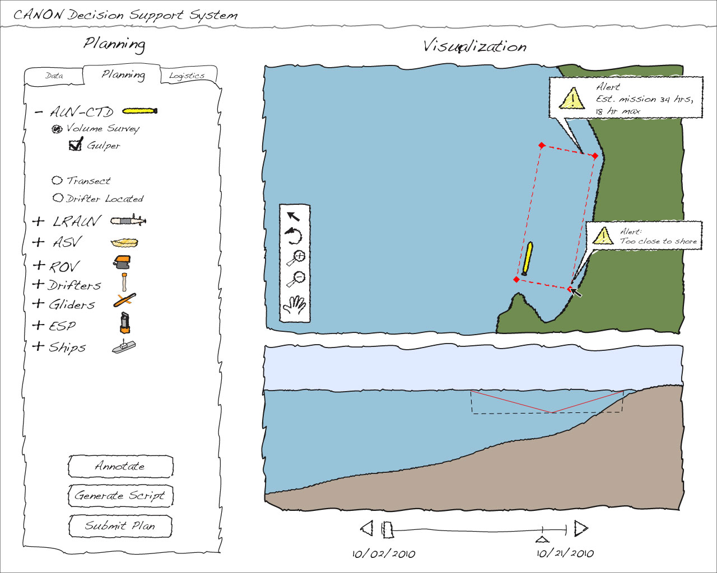

Slide 14
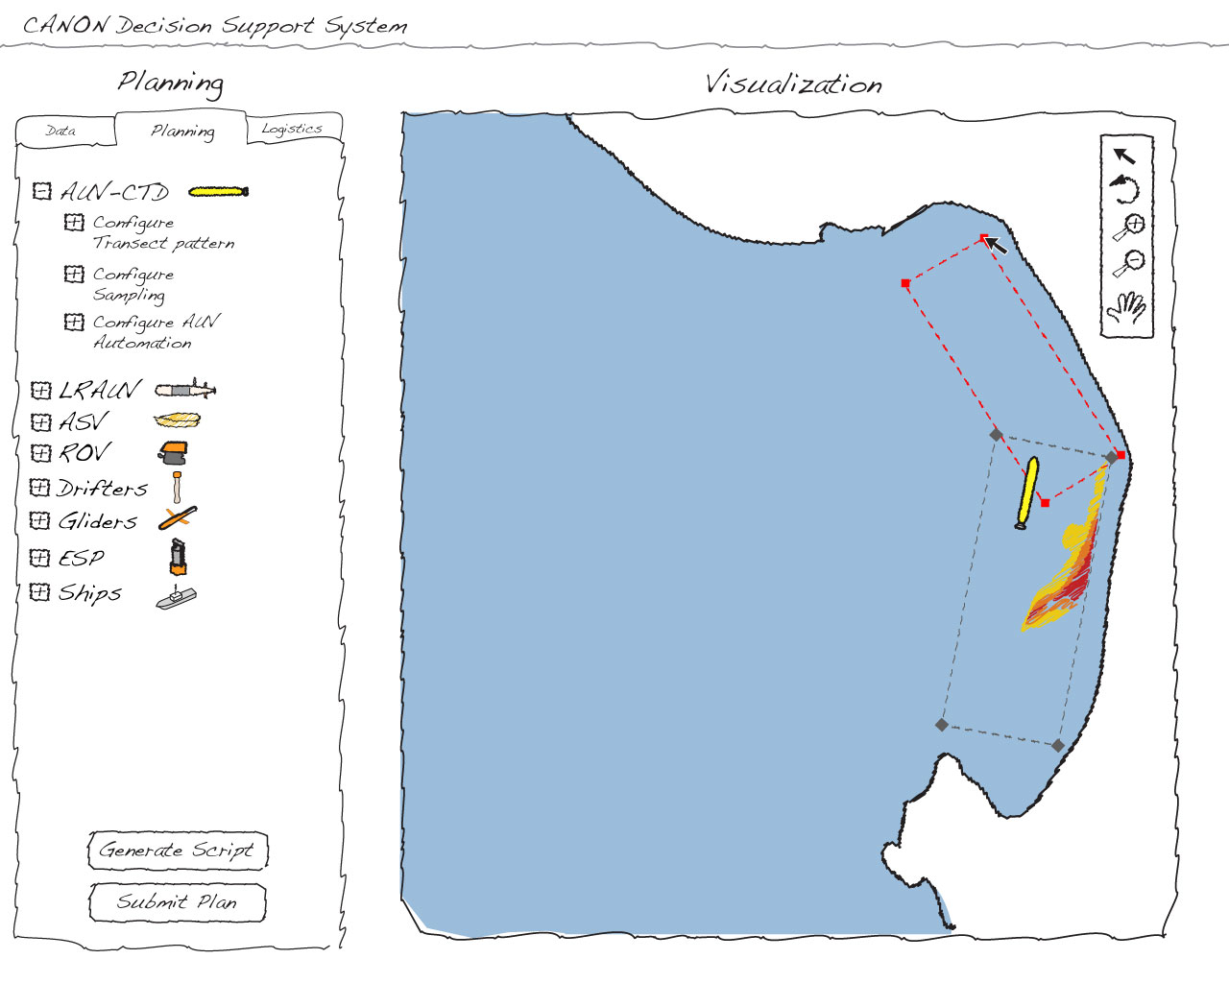
Notes:
Visually aided planning – scientists able to visually plan vehicle surveys and resolve conflicts to result in an agreed to plan

Slide 15


Slide 16
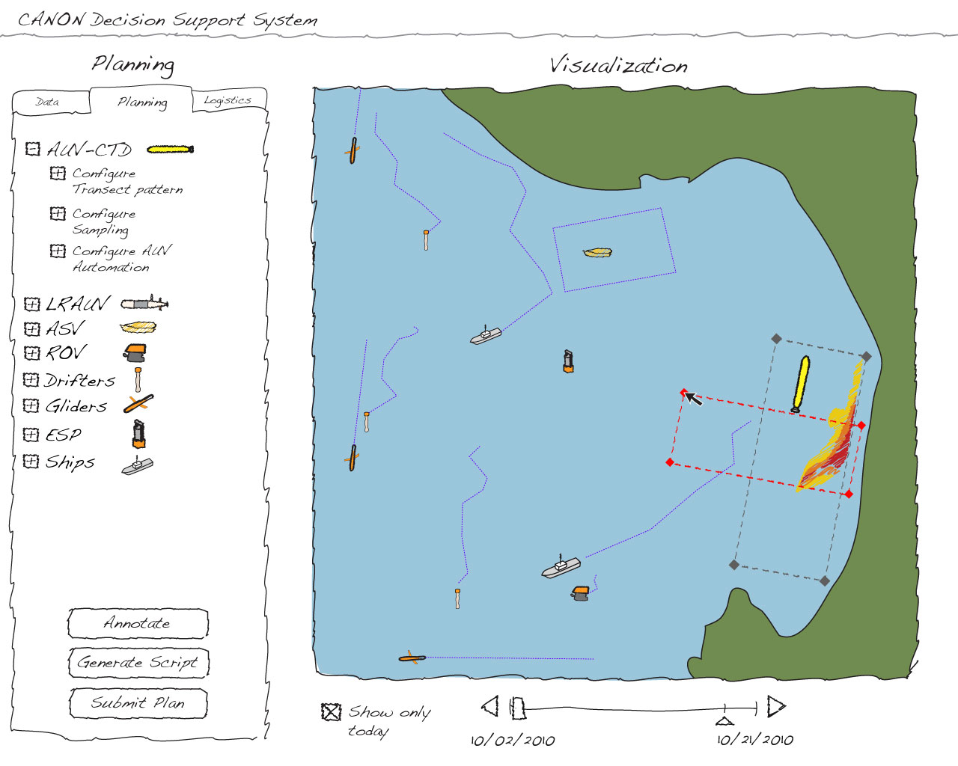

Slide 17
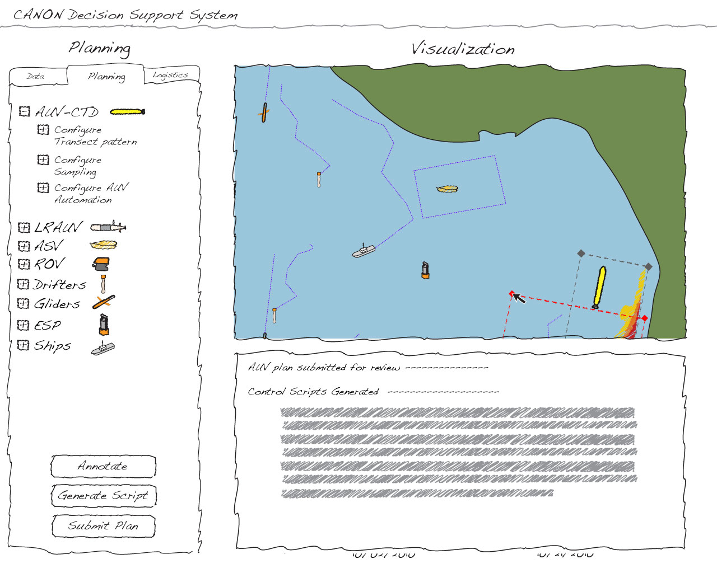

Slide 18
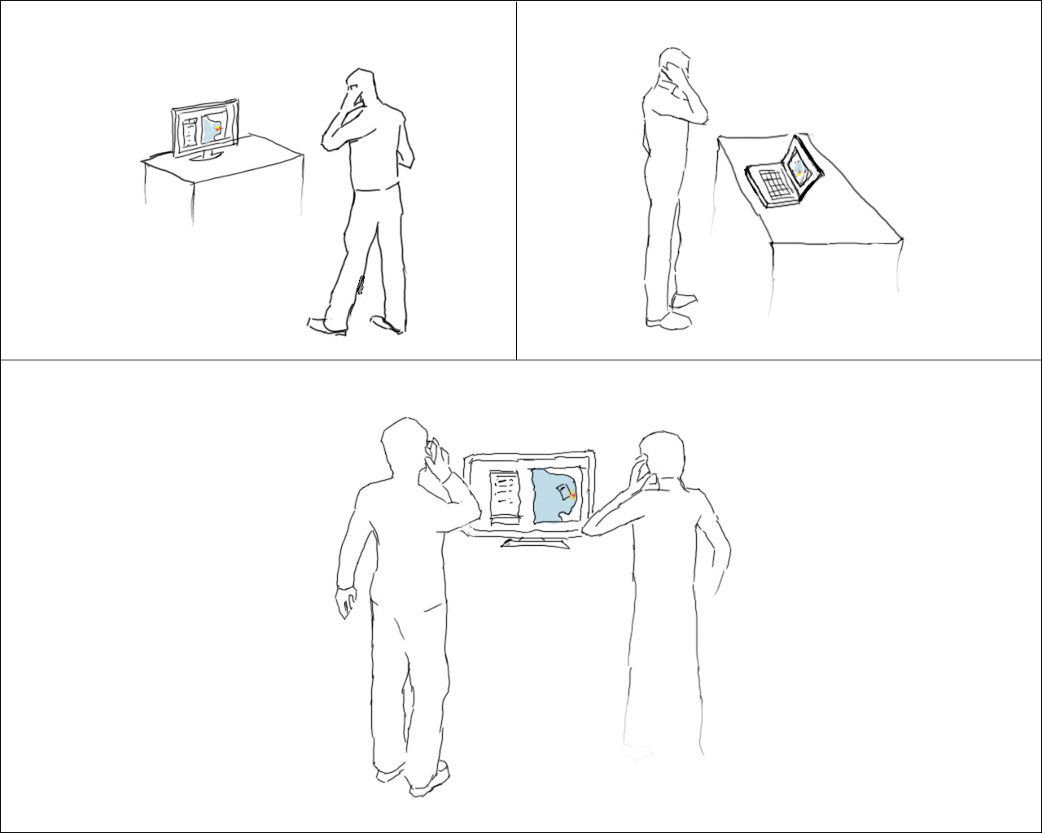
Notes:
How is the ODSS used – mobile apps, virtual meetings – no big bang meeting required, lessons learned from AOSN success.

Slide 19
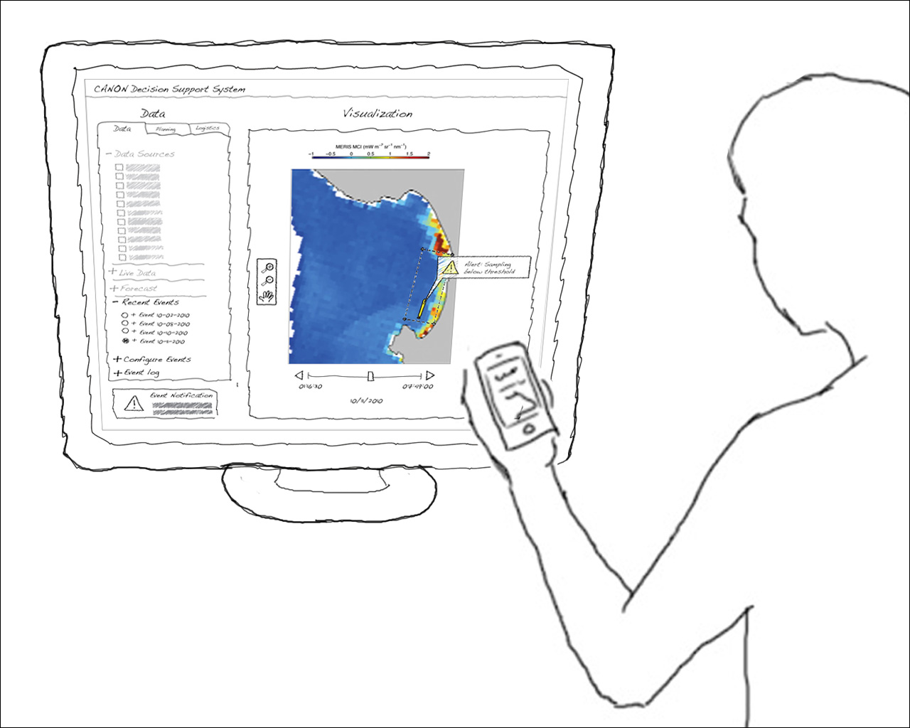

Notes:
Event detection - Subscribed events could be sent out via email/RSS feeds to a personal computing device for the user where potentially the UI (User Interface) is also available 24X7.

Slide 20
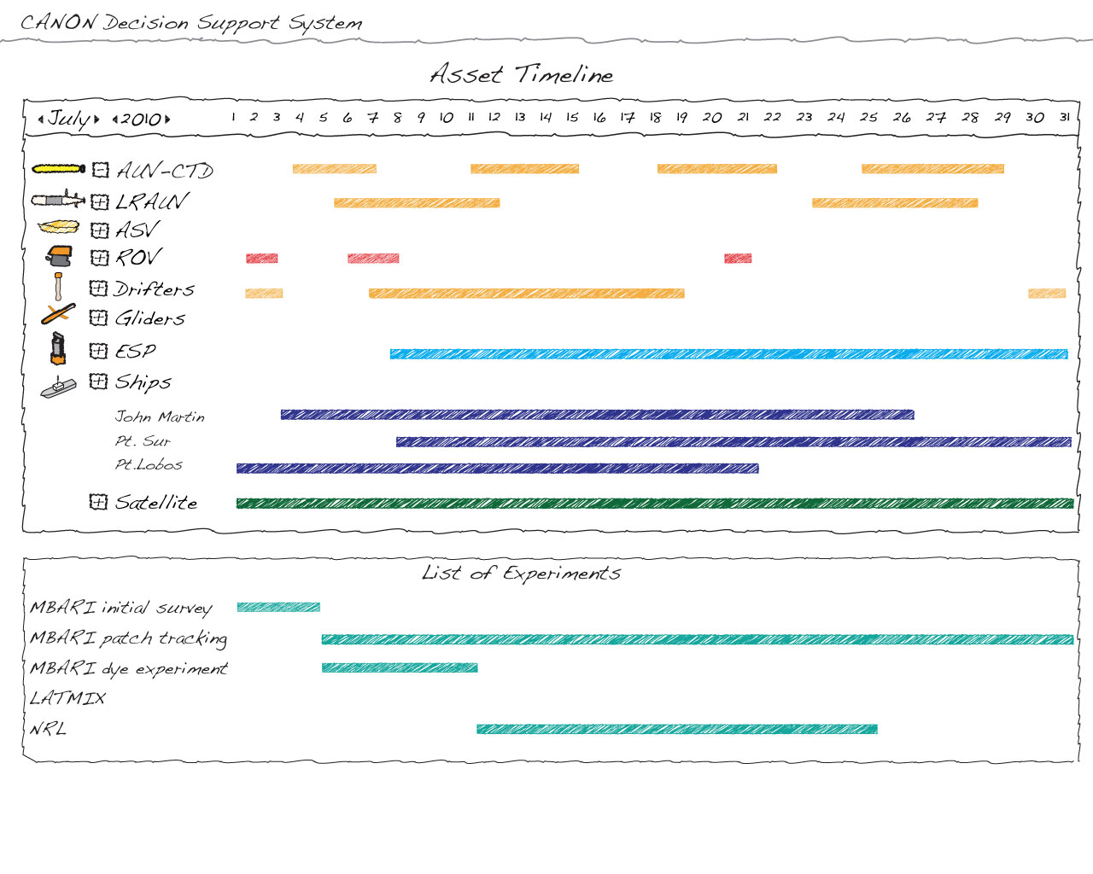

Slide 21
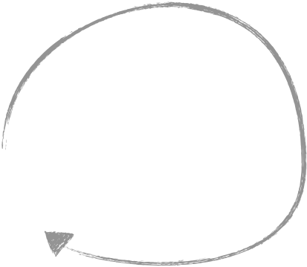

Software Development Approach
Spiral Development
Crayon
Sketches
Feasibility study started in 2010
CANON experiment workflow analysis
User requirements gathering
  Pencil sketches to aid the conversation with scientists
High level architecture specified
Prototyping and ‘agile’ software development
For the first prototype, focus on features used ‘during the experiment’
  Situational Awareness
  Planning
  Collaboration
  Data management
CANON
Discussions
Data
Mgmt
Requirements
Gathering
Eng.
Cruise
Fall
Experiment
Design
Review
Prototyping
(JD)
CANON
Tool Users
Group

Slide 22



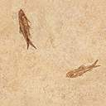

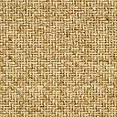

ODSS Architecture Block Diagram
Web Application
  Javascript, Sencha Ext-JS
  OpenLayers – map flexibility, printing without license
Other Apps
  Mobile Apps
  Standalone applications
  Off the shelf aps (Ocean Data Viewer, etc)
Web Services
  OGC Standards to enable ‘other tools’ (WMS, WFS via MapServer).
  Python packages to aid geo-spatial query
  Backend Python scripts
Communication Backplane Service
  Status/Control message routing
  Platform communications
  Publish / process / subscribe model
  Inter-module communications
Science Processing Interface
  Framework that allows Matlab, other science / research processing to plugin – access data, contribute results, actons or service.
  AI based Planning
  Adaptive Sampling
  Simulation / Predictive Modeling
  Automated Event detection, tagging
  ‘Crowd Sourcing
Data Management
  Spatial Temporal Oceanographic Query System (STOQS)
  Python ORM - Django
  Tracking Database for deployed assets
  General Purpose database, SSDS
  File system
Mobile /
Standalone
Apps
ODSS
Web Application
Web Services
Sci
Proc
Shore-side
Autonomy
Platform
Comm
Communication Backplane
Data Management

Slide 23
Spiral Development
2010
  Feasibility study – pencil sketches, high level requirements gathering
  First prototype leveraging USC grad student Jnaneswar Das (JD) – 6 weeks effort leveraging a web app base
2011 Second prototype
  Carlos Rueda, 4 week effort to look at viability of candidate software – SmartGWT, GWT, Open Layers
  Danelle Cline GUI
  Kevin Gomes, Web Services, Comm Backplane
  Mike McCann, Database, Web Services, Comm Backplane
  Tom O’Reilly, Comm Backplane,
2012 Production
  20% on Bug fixes (rip out SmartGwt, implement in Javascript)
  20% on Planning prototype
  60% on Data Analysis perspective

Slide 24
ODSS GUI Design
A collection of tabs called perspectives
  Situational Awareness
  Planning
  CoSci
  Data Analysis
  Water Management
Notes:
Why a web application – no install, runs in a browser. The architecture imposes a discipline that is beneficial for mobile apps and standalone apps as well.
Requirements: Up 5 nines, runs in latest versions of Safari, Firefox, IE and Chrome

Slide 25
Situational Awareness
What’s Happening?
Where are the Platforms?
Remote sensing with transparent overlay on the bay map
  What can be seen from space?
  How’s the Weather and Sea state?
  What do the models tell us?
Playback to see trends
Real time observations
‘Plan vs Actual’ vehicle tracks

Slide 26
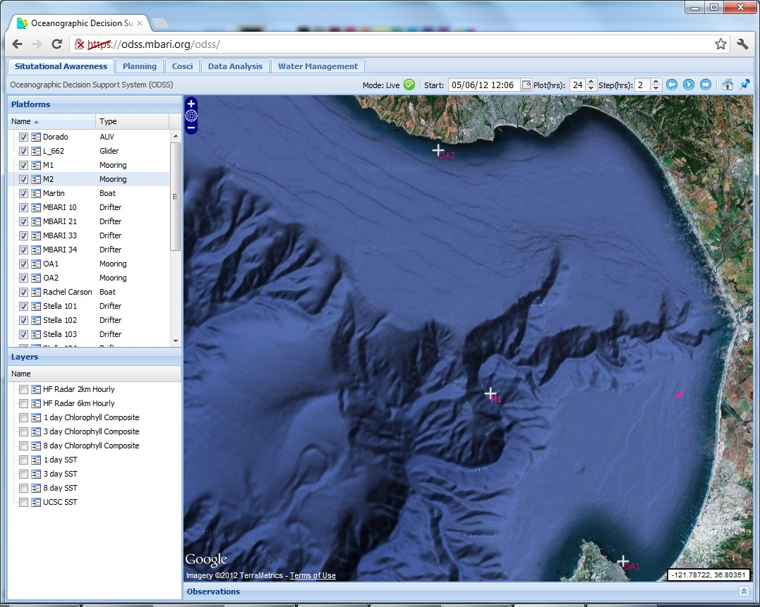

Slide 27
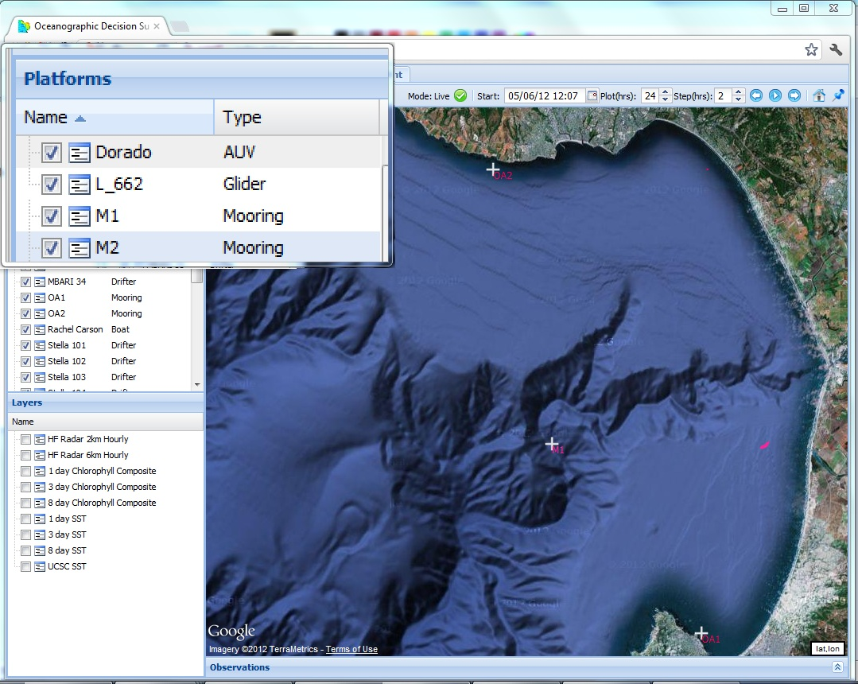

Slide 28
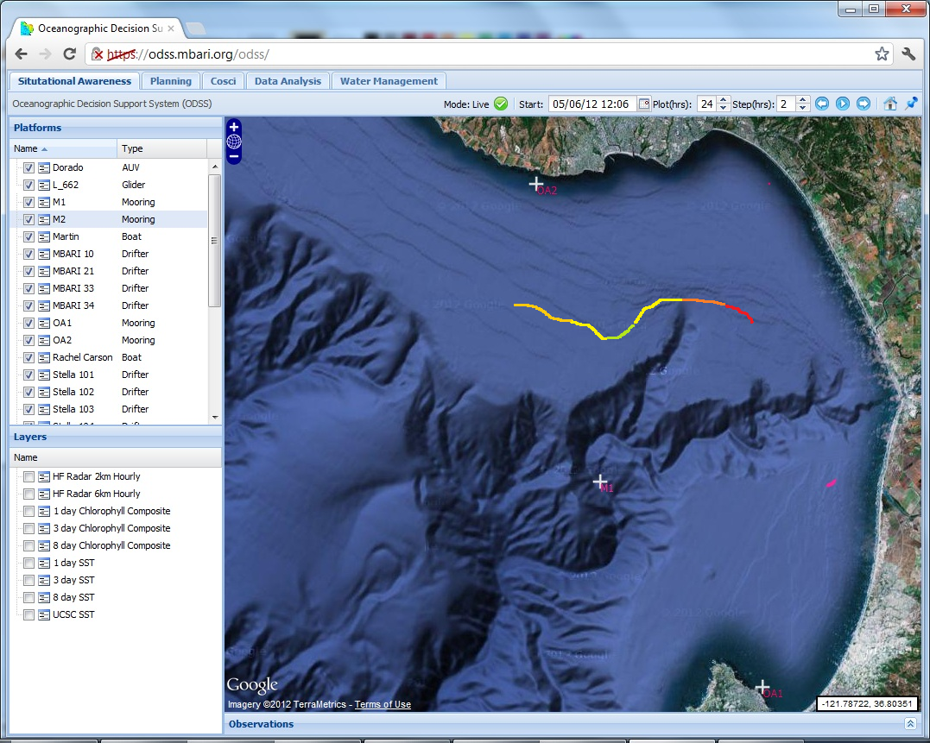
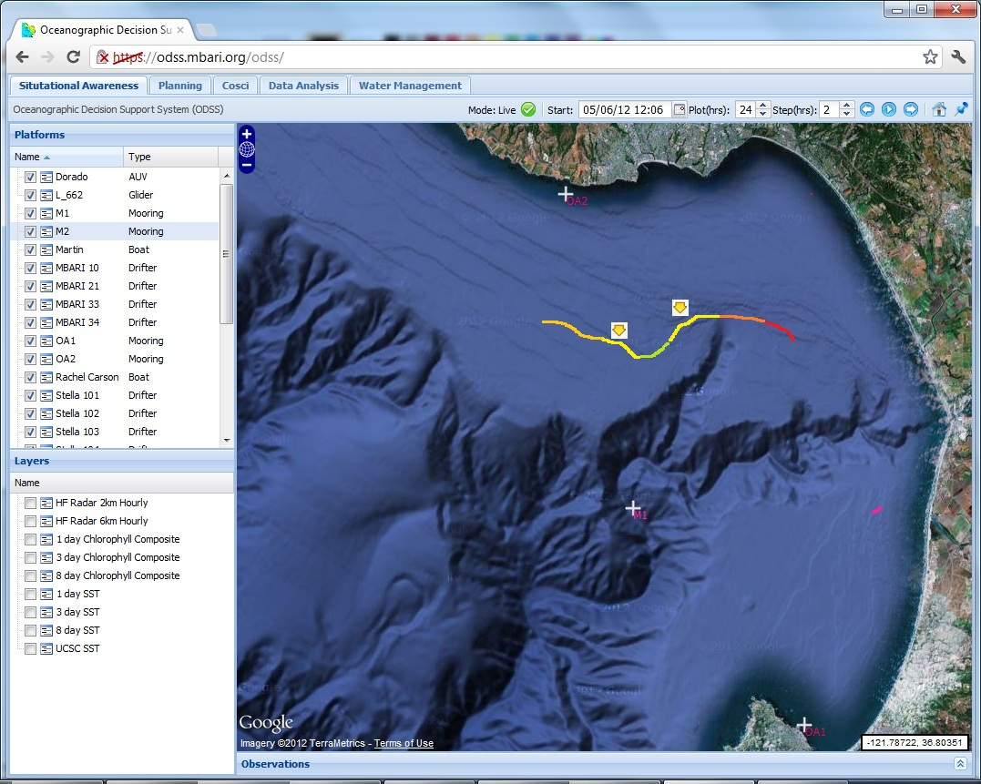
Notes:
Sensor Tracks, Water Sample locations

Slide 29
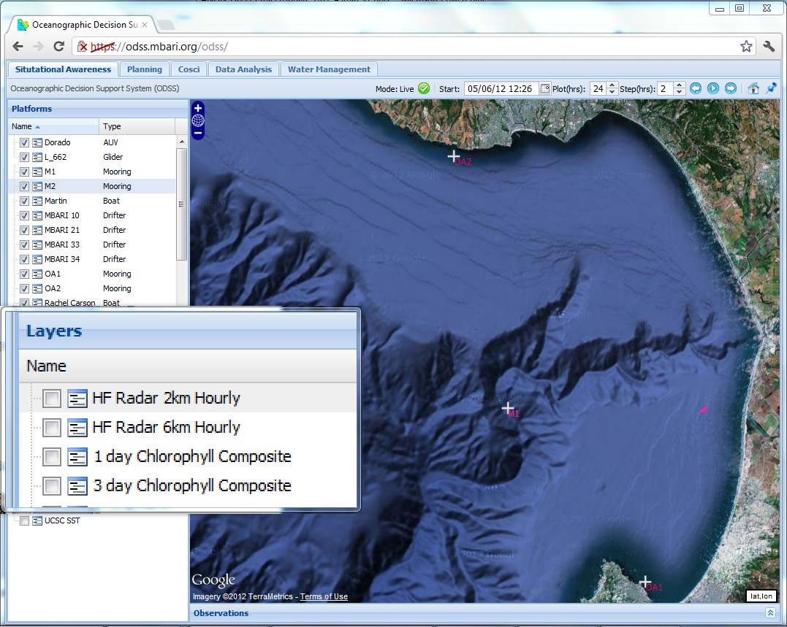
Notes:
Transparent overlays of geo-referenced ‘select’ remote sensing and science data products

Slide 30
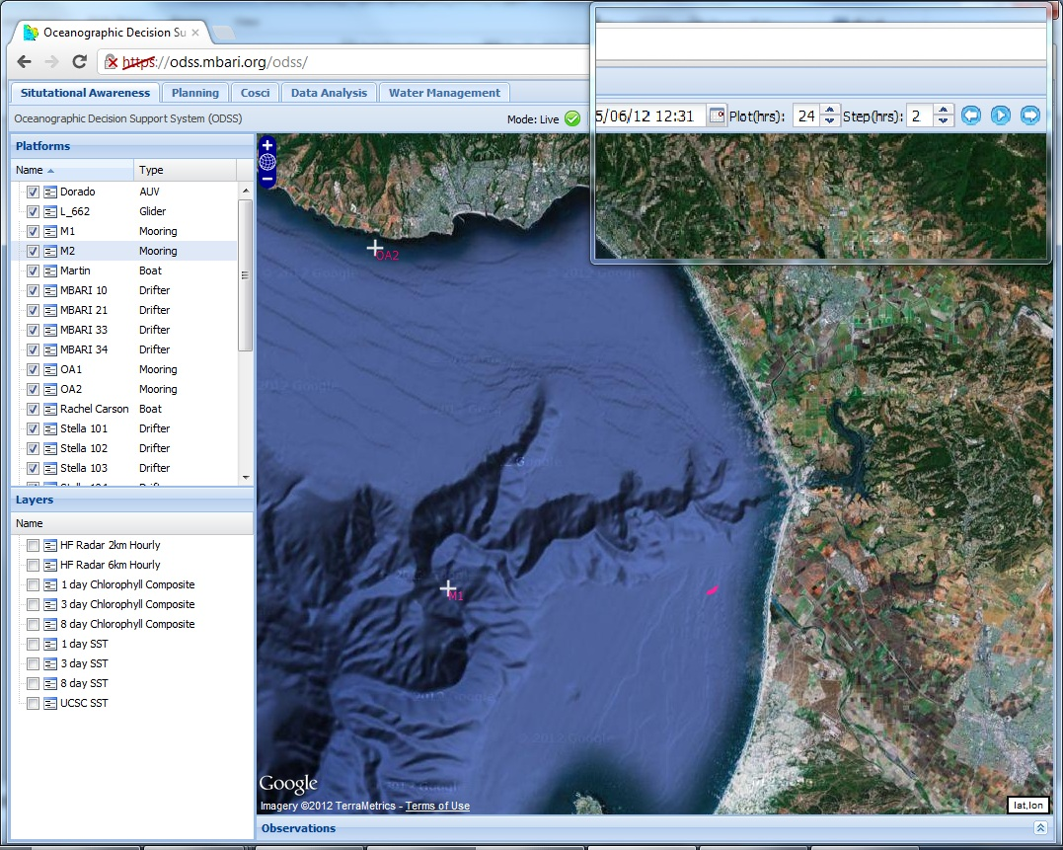
Notes:
Playback

Slide 31
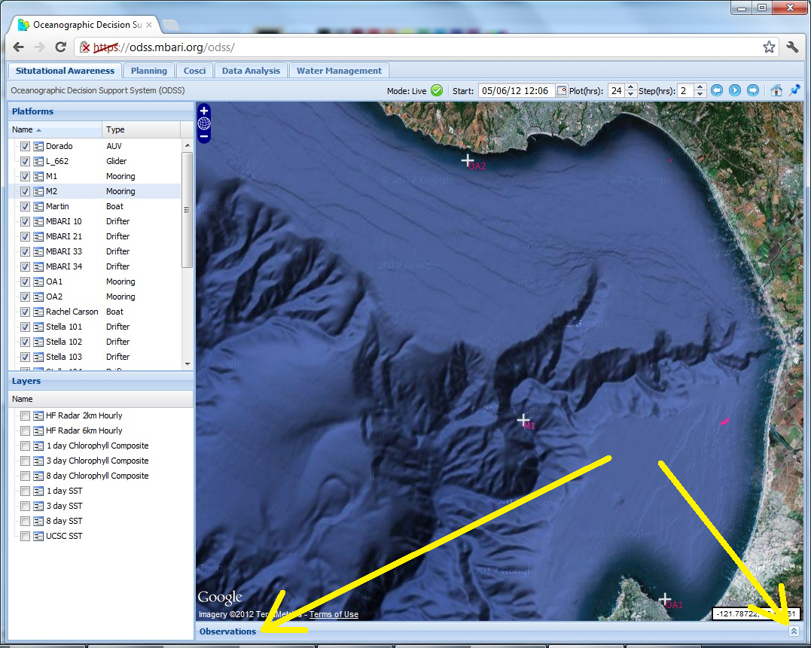

Slide 32
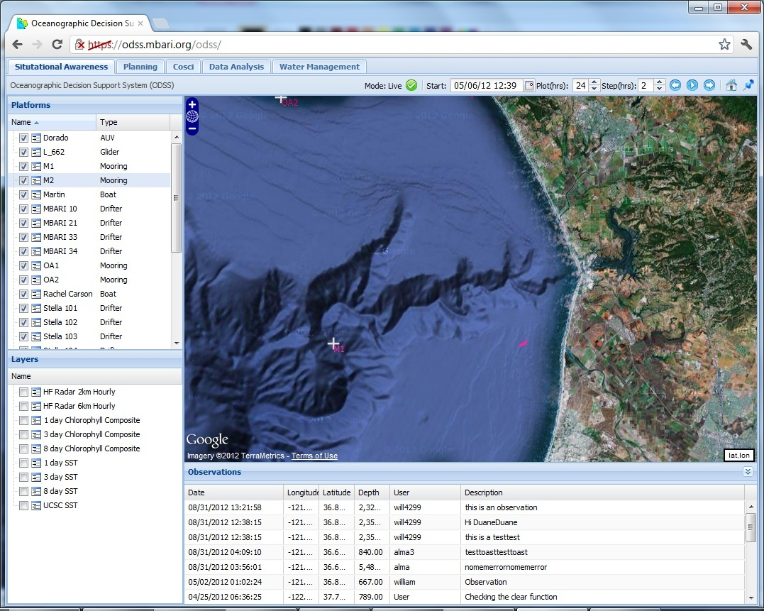
Notes:
Observation log

Slide 34
ODSS Planning Feature
Visual Planning, platform coverage calculator
  can the vehicle cover the desired area?
  Data layers inherited from Situational Awareness perspective
  Feedback on ‘keep out’ areas,
  Feedback on vehicle coverage capabilities
    AUV survey coverage as a function of yo angle/depth vs speed vs battery vs ?
  Drifter projection, compact models, other tools to look a day in the future
Sharing and annotation of draft plans and ‘what if’ scenarios
Notes:
Day Planning, Platform Planning, pull together proposed plans into ‘the plan’
‘The Plan’ -> Cruise Plan

Slide 35
ODSS Planning cont’d
Campaign Timeline. Day plans submitted to ‘the plan’ for the extent of the campaign.
Connection to DMO
  Cruise Plan, expedition database
  Ships schedule
CSUMB Capstone project as a ‘strawman’ visual calculator prototype to solicit user feedback

Slide 36
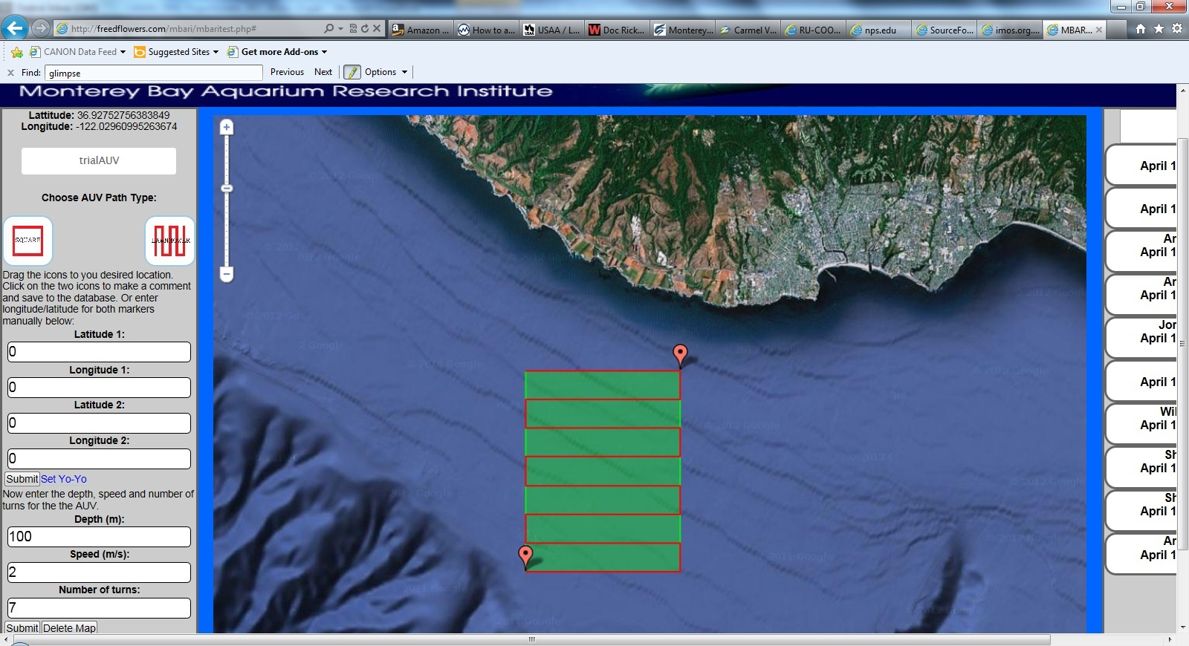
CSUMB Planning Calculator ‘proto’

Slide 38
Shore-side (server) Autonomy
Communications Backplane provides connectivity to vehicles and data
  AMQP
  Google Protocol Buffers
  STOQS-RT
Drifter Tracking App – the ‘hello world’ of autonomy written in Java choreographed the robot ballet – AUV driving boxes around a drifter
Rajan lab enabled for more sophisticated shore-side autonomy using TREX and Europa.

Slide 39
Observation Log / Tagging
Log notebook, implemented in 2011 as a web application.
  Used infrequently, need something better suited to the users
2012, CSUMB students produced prototype mobile applications built on ODSS web service

Slide 40
ODSS Data Analysis Feature
Initial draft of science user (DAC) requirements for the data analysis feature. In priority order:
  “What data is available and where is it”
    Centralized Data Archive Description accessible through the ‘Data Analysis’ tab in odss.mbari.org. Provides access to files with descriptions.
  Query access to CANON data with browsing support (Matlab user is primary 'use case')
    users want to be able to make queries against the CANON data sets and access the data via Matlab
    users want to be able to browse the CANON data sets based on space, time and instrument.
    we are planning on supporting Matlab users with the first offerings. Queries generated in a GUI tool such as MOQuA
  “Consistent” data access method across CANON data sets
  Embargo supported
  Data citation obligation associated with the data
  Notification on data updates
Notes:
Requirements Definition:

Slide 41
ODSS Data Analysis Feature (cont’d)
Basic Access:
  Find data using Data Archive Description
  Data stored in file system (“consistent”: centralized file system, minimal file types)
  Password protect embargoed data
  Data archive description documents data citation obligation
Advanced Access:
  Browse data using a GUI that builds a database query,
    that can be used in Matlab or R
    Or provides files containing the data selected via the GUI
  Data is stored in databases
  Embargo supported in the database with required authentication
    Automated embargo control via database tools and science policy
  Integration of Moqua and STOQS.
    The idea is to provide a data browser ( ‘DJ the Data’) as a means to provide efficient access spatio-temporally, with vehicle tracks, water samples and available contextual data sources
Notes:
Requirements Definition:

Slide 42
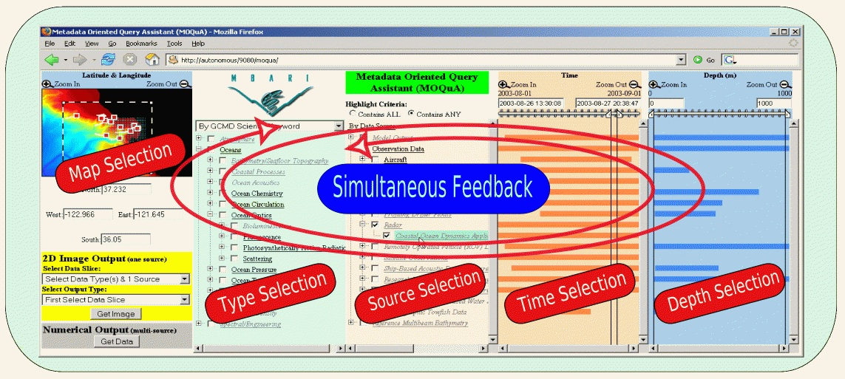
MOQUA + STOQS – “DJ the Data”
STOQS – Spatial Temporal Oceanographic Query System

Slide 43
Collaborative Science Tools
CoSci
  Threaded email discussions
  Data product sharing
COOP
  Chat and Voting
  Data descriptions, access

Slide 44
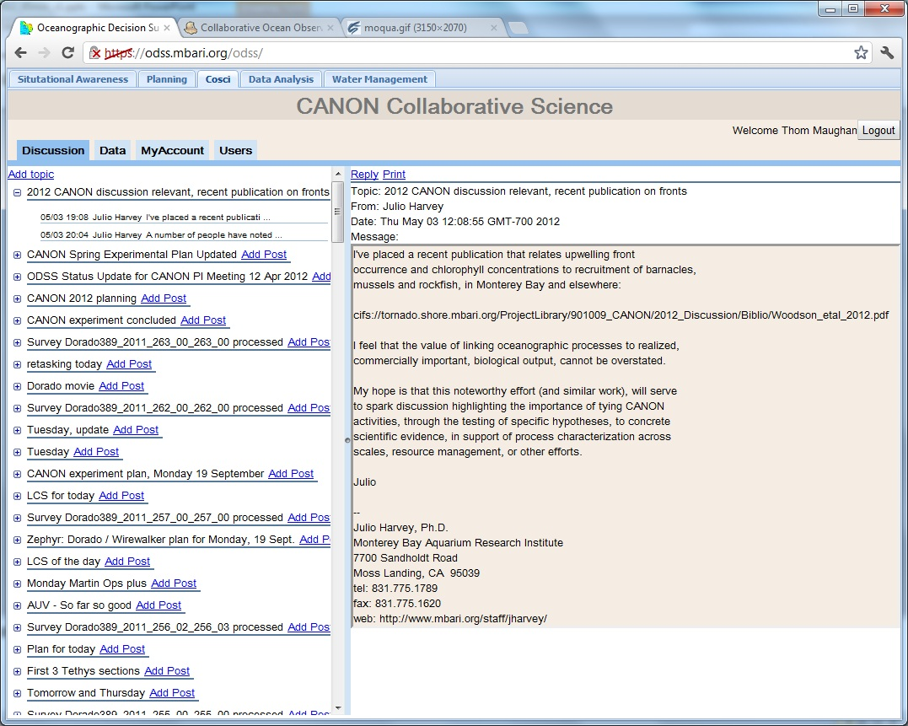

Slide 45
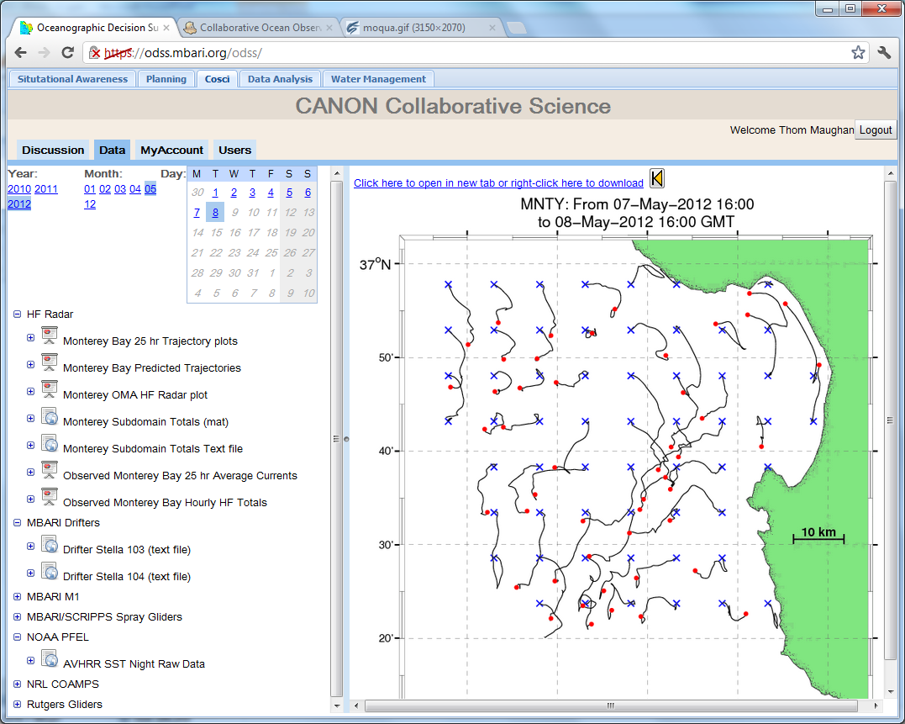

Slide 46
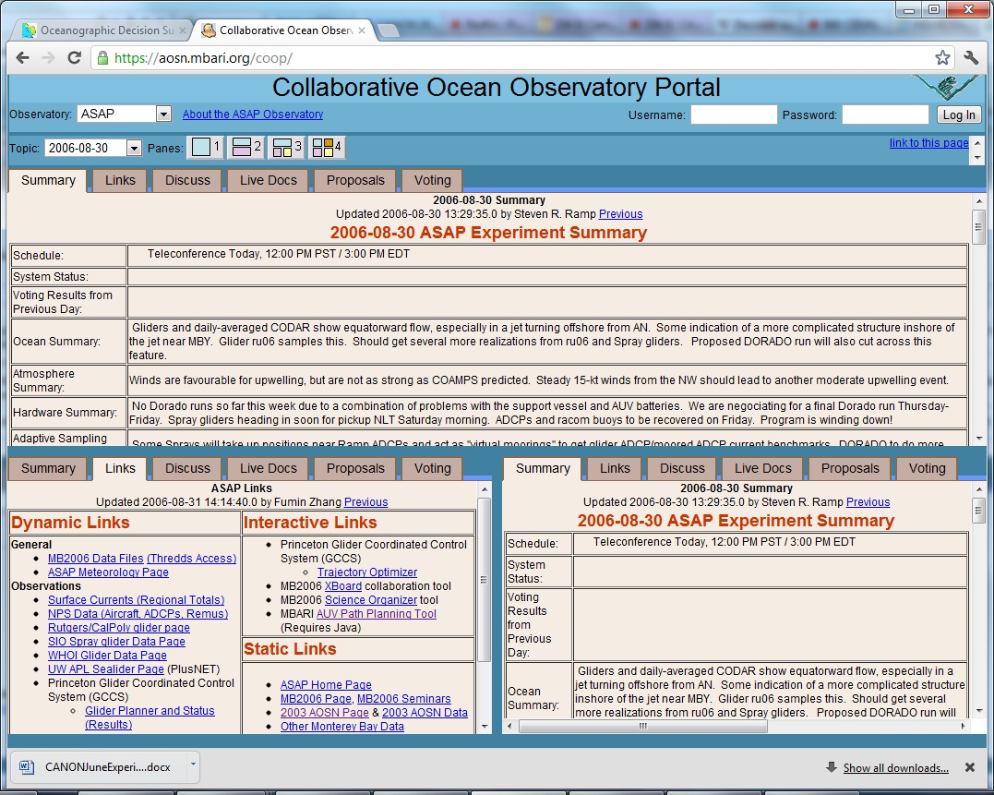

Slide 47
What’s been done today
1Q2010 – Pencil sketches, requirements gathering, Preliminary Design Review
2Q2010 – USC collaboration, Jnaneswar Das with support from MBARI cobbed together first prototype – used in Oct 2010 BioSpace
1H2011 – infrastructure development – database, comm backplane, server based autonomy (dta), web app using SmartGWT

Slide 48
Backup slides

Slide 49
First Prototype ODSS
Sep 2010, J. Das, a grad student from USC ‘volunteered’ to do a quick prototype from the pencil sketches.
  Several weeks of software investment
Feature focus
  Situational Awareness
  Integration of collaborative science tools developed in ONR funded MBARI program called AOSN

Slide 50
Situational Awareness
What’s Happening?
Where are the Platforms?
What is being seen?

Slide 51
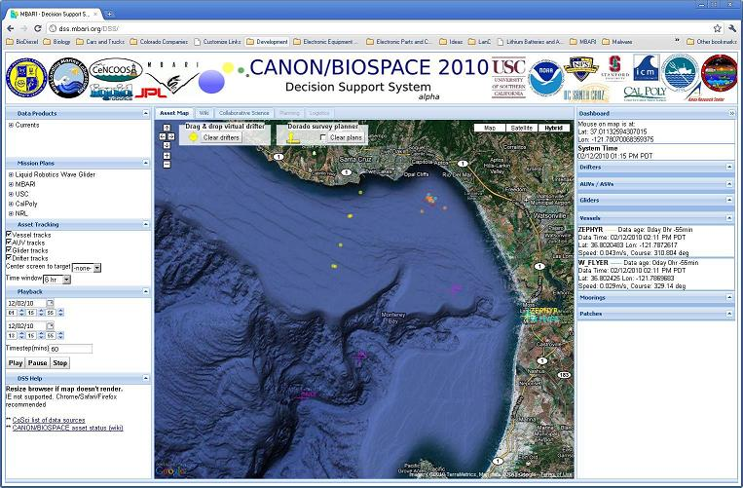
ODSS First Prototype
Situational Awareness
Notes:
Prototype by Jnaneswar Das, a grad student from USC who’s advisor is Gaurav Sukhatme, Prof. USC Robotics
“What’s Happening?” = “Where are the Platforms” + What’s being seen”
Primary Decision space: ‘what operational scenario best fits science investigation of chosen hypothesis’ based on what is being seen on a daily basis
Simple, easy to use UI. Default display for the DSS.
Data (selected by scientists) that is most relevant to making decisions about what to do next
Chlorophyll fluorescents
Show ‘real time’ tracks colored with data
Remote sensing
Data sources can come from scientists (hand drawn on screen or custom plots in matlab)
Time slider to animate for viewing trends
Transparent overlay of data planes

Slide 52
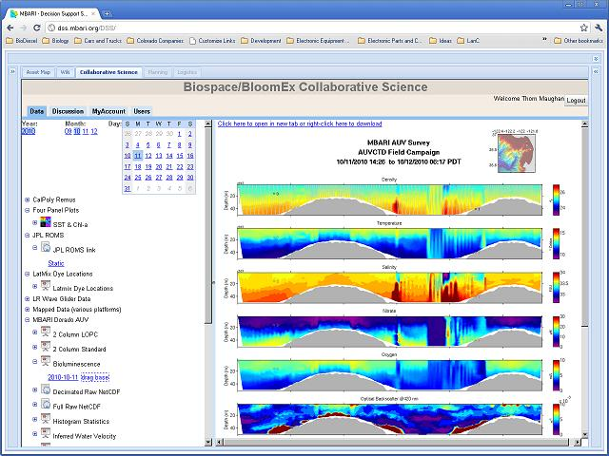
ODSS First Prototype
Collaborative Science (CoSci) Data Tools
Notes:
CoSci, collaborative science tool written by Mike Godin and developed under an ONR funded typhoon study

Slide 53
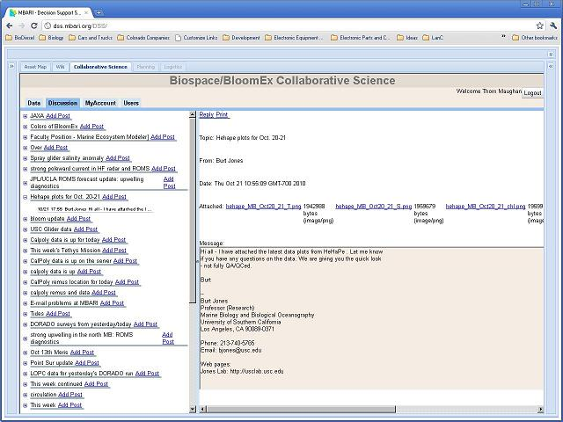
ODSS First Prototype
CoSci Threaded Discussion Tool
Notes:
Threaded discussion
Chat room
Bulletin Board

Slide 54
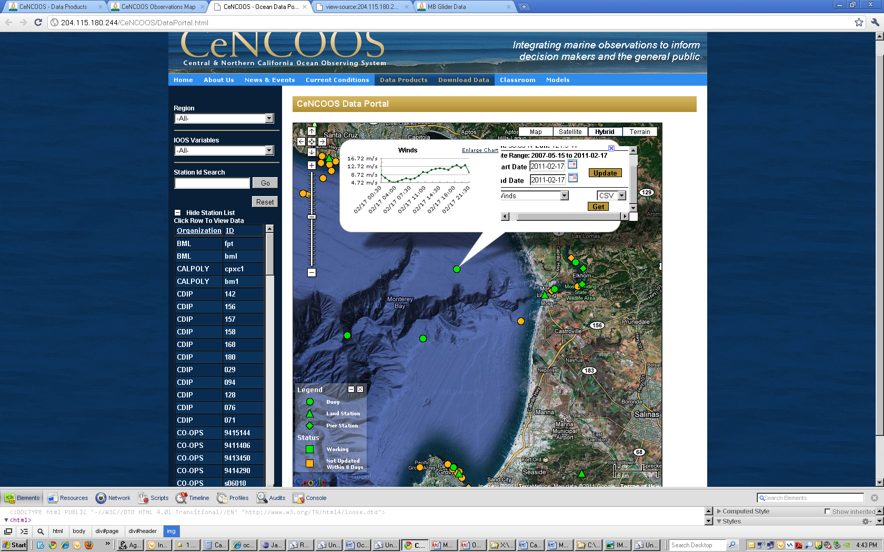
Data collaboration with CENCOOS

Slide 55
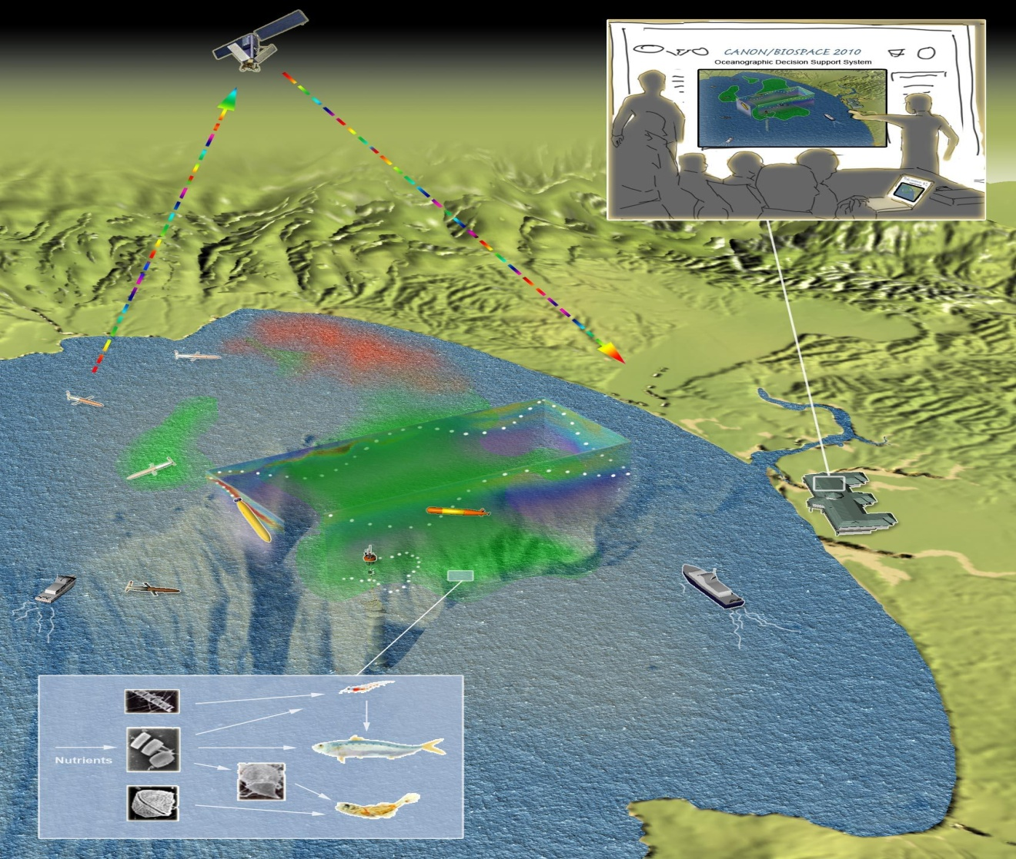
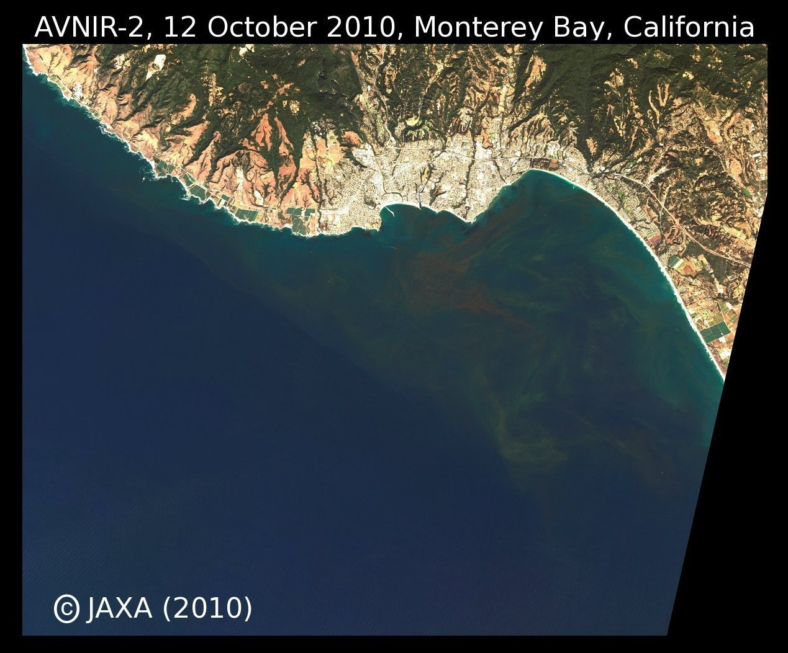
ODSS used in 2010 Oct BloomEx / BioSpace
R/V Pt. Sur
R/V John Martin
R/V Zephyr
R/V Shanna Rae
Dorado Gulper
LRAUV
Remus 100’s
Remus 600
Drifters
Moorings
Two Airplanes
Spray Gliders
UCSC Glider
Web Glider
Model ROMS
Model COAMPS
NASA Aqua
ESA MERIS
SeaWiFS
HF Radar
MBARI
NRL SSC
NRL DS
NPS
USC
UCSC
Cal Poly
Liquid Robotics
CenCOOS
Stanford
U of H
UCB
Logistics, Planning, Operations, Communications, and the data…
Can we get that in 4D, near real time?

Slide 56
2011 Activities
MBARI engineering resources added
Lessons learned from 2010
Strong data management system foundation
Standards based web services architecture
Robust messaging and communications infrastructure
Integrate ‘shore-side’ autonomy capability – “robot ballet”
Explore web app software technologies
Three field campaigns in 2011 – April, June, September

Slide 57
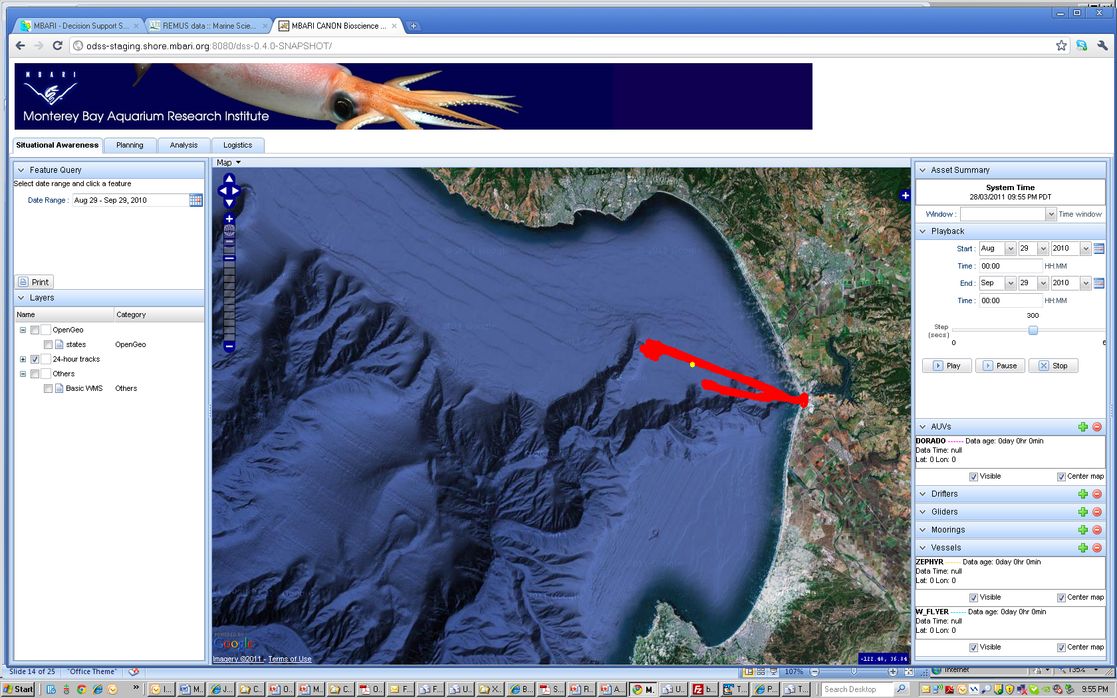
ODSS Web Application 2011

Slide 58
2012 Activities and Next Steps
Lessons learned from 2011
  Bug fixes and replace SmartGWT, etc. web components used in Situational Awareness
Start on “Data Analysis” capability
  Define requirements for data access system
    Access privileges for sensitive data
  Automate the execution of ‘select’ data analysis
Implement visual planning capability
May and September field experiments

Slide 59
Thank-you and Acknowledgements
David and Lucille Packard Foundation
Office of Naval Research
NSF funding for J. Das (2010)
MBARI engineering, science and marine operations

Slide 60
What 2012
Bug Fixes for ODSS Situational Awareness
  Kevin, Mike M, Danelle
Planning Prototype
  Kevin, Thom, CSUMB
Collaborative tools
  Mike G, Kevin Gomes
Data Analysis
  Mike M, Danelle, Kevin

Slide 61
When 2012
Situational Awareness Perspectives ‘bug fixes’ in place for May
Planning Perspective
  CSUMB concept design by April (NOT part of ODSS, primitive graphical planning calculator)
  Possible ODSS integration in Sept. – depends on engineering time remaining for GUI
Data Analysis Perspective
  High level Science User Requirements by April
    Data Access (files, thredds, matlab libraries, etc.)
  Data Archive Descriptions with pointers to data in filesystem by May
  Evaluation of Moqua on Stoqs as a means of browsing and query build support for Matlab by July

Slide 62
Abstract: AN OCEANOGRAPHIC DECISION SUPPORT SYSTEM (ODSS) , A SOFTWARE TOOL TO IMPROVE EFFICIENCY OF BIOLOGICAL OCEAN STUDY
The Controlled, Agile, and Novel Observing Network (CANON) team at MBARI is creating new ways to remotely assess biological ocean conditions and collect samples of microorganisms. In addition to science, the CANON program has an engineering component.
The coordination of multiple science objectives and multiple mobile platforms provides a rich problem domain for engineering.
MBARI engineering studied the workflow of the CANON science campaigns created requirements for an Oceanographic Decision Support System (ODSS).
  The tool provides a set of perspectives that map to the workflow of the experiment. The high level functionality provided in the tool: 1) Situational Awareness: platform trajectory and real time data 2) Logistics and planning of asset deployment. 3) Collaborative discussion workspace 4) Real-time mobile platform control and coordination 5) Data access and analysis.
  The engineering team is following an iterative development process and is hosting the software as an open source project. The presentation will cover the high level requirements, architecture, implementation overview and lessons learned in the CANON experiments.
The team has fielded various iterations of the ODSS software tool in several CANON experiments. The ODSS has successfully facilitated scientists in their efforts to adaptively follow, sense and sample the changing conditions of upwelling driven algal bloom.

