Slide 1
ODSS Engineering Status 12 Apr 2012
Requirements Definition: ODSS Data Analysis Feature
  Initial draft of science user (DAC) requirements for the data analysis feature. Done.
  In priority order:
    “What data and where is it” Centralized Data Archive Description accessible through the ‘Data Analysis’ tab in odss.mbari.org. Provides access to files with descriptions.
    Query access to CANON data with browsing support (Matlab user is primary 'use case')
      users want to be able to make queries against the CANON data sets and access the data via Matlab
      users want to be able to browse the CANON data sets based on space, time and instrument.
      we are planning on supporting Matlab users with the first offerings. Queries generated in a GUI tool such as MOQuA
    “Consistent” data access method
    Embargo supported
    Data citation obligation associated with the data
    Notification on data updates
  Basic Access:
    Find data using Data Archive Description
    Data stored in file system (“consistent”: centralized file system, minimal file types)
    Password protect embargoed data
    Data archive description documents data citation obligation
  Advanced Access:
    Browse data using a GUI that builds a database query,
      that can be used in Matlab or R
      Or provides files containing the data selected via the GUI
    Data is stored in databases
    Embargo supported in the database with required authentication
      Automated embargo control via database tools and science policy

Slide 2
Development Status
ODSS Data analysis
    STOQS provides access to in-situ data sets, both NetCDF and some non-NetCDF data such as is in the BOG database.
    For NetCDF data, the THREDDS data server provides another means to access data. THREDDS can aggregate across NetCDF data provided certain conventions are followed in the NetCDF file.
      LRAUV data management integration is planned this way
    MOQuA is being explored as a GUI for query building
    Mike Godin is investing two to three weeks integrating MOQuA on top of STOQS leveraging GUI test code written for STOQS by a contractor (i.e. get data button makes access to STOQS, which returns the data)
    Evaluating backend of ESP GUI as model for implementing a consistent file system
ODSS Situational Awareness Perspective
  Ripped out problematic SmartGWT ; have validated new version on IE, Chrome, Firefox, and Safari.
  Lean/mean maintainable implementation planned to roll out in second half of April.
  Working with Kanna’s team to plumb in Smart Sampler to get Gulper positions in ODSS Situational Awareness Display
  Mitigating amount of data flowing from shore to ship during September off-shore experiment
ODSS Planning Perspective
  CSUMB Capstone project provides a ‘proof of concept’ that we can play with and use to gather requirements for what we’d like in ODSS – demo scheduled for April 19 12:30-1:30PM
ODSS Observation Log
  ODSS team built a log web service and the CSUMB students have built mobile apps (iPhone and Android) for entering log information.
STOQS: Spatial Temporal Oceanographic Query System http://code.google.com/p/stoqs/
MOQuA: Metadata Oriented Query Assistant http://www.mbari.org/mb2006/moqua/
CoSci: Collaborative Science portal NetCDF: Network Common Data Format http://www.unidata.ucar.edu/software/netcdf/
THREDDS (Thematic Realtime Environmental Distributed Data Services) http://www.unidata.ucar.edu/projects/THREDDS/

Slide 3
ODSS Eng. Status
Thom Maughan, Requirements
Duane Edgington, Execution

Slide 4
Data Analysis Priorities
[1] CANON Data Archive Description (what’s there, where is it)
  Implemented as a confluence page – that’s fine!
  Need to work a data access policy (2 year embargo, citation requirements to users, user access, update notification (RSS), etc.)
[2] Matlab access to the MBARI Data Management System
  LRAUV integration in the MBARI Data Management System
  Drawing on AOSN experience and OSS/UWDV (onestopshop, etc) as a starting point, specifically looking at MOQUA on top of STOQS.

Slide 5
Who
Kevin Gomes, Web applications, Web services (GUI)
Danelle Cline, Backend server, data access and visualization automation
Mike McCann, Database, web services, communication backplane
Tom O’Reilly, communication backplane
Duane Edgington, engineering execution management (project management
Thom Maughan, high level requirements and priorities, ‘customer interface’ to CANON PI’s, PM and LE

Slide 6
What
Bug Fixes for ODSS Situational Awareness
  Kevin, Mike M, Danelle
Planning Prototype
  Kevin, Thom, CSUMB
Collaborative tools
  Mike G, Kevin Gomes
Data Analysis
  Mike M, Danelle, Kevin

Slide 7
When
Situational Awareness Perspectives ‘bug fixes’ in place for May
Planning Perspective
  CSUMB concept design by April (NOT part of ODSS, primitive graphical planning calculator)
  Possible ODSS integration in Sept. – depends on engineering time remaining for GUI
Data Analysis Perspective
  High level Science User Requirements by April
    Data Access (files, thredds, matlab libraries, etc.)
  Data Archive Descriptions with pointers to data in filesystem by May
  Evaluation of Moqua on Stoqs as a means of browsing and query build support for Matlab by July

Slide 8
Backup…
Don’t’ Read Beyond this point!

Slide 9
ODSS Generic Features
[1]Browser support (2011 and 2012 versions)
  Firefox
  Safari
  Internet Explorer
  Google Chrome
  iPad via browser
[1]Browsers not supported, detect and display “Your browser is not support…”
[2]Add login feature
  Single signon with CoSci and Confluence using OpenID

Slide 10
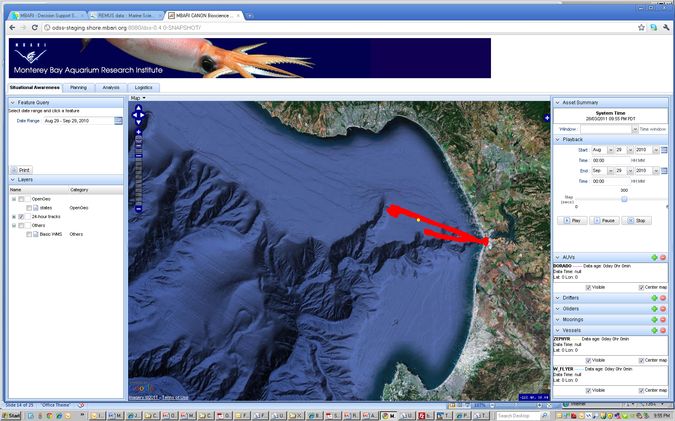
Situational Awareness

Slide 11
[1] Situational Awareness
“Make existing features work well”
[1] ‘Hit Refresh’ on browser and all platform tracks paint within 3 to 5 seconds
Show an ‘active’ map of the experiment region
  [1] Real Time platform position and tracks
    Platform track enable/disable
    Platform position in text (copy and paste-able)
  [3] Sensor Tracks
    low res sensor data as track color for mobile assets sending sensor data (AUV, Waveglider, LRAUV, gliders).
    Sensor tracks can be implemented as transparent image overlay. Sensor tracks can be ‘hard coded’ to one sensor and option to allow user selection removed if needed for performance reasons.
  [2] Gulper locations from Dorado – gulper info sent from TREX through comm backplane is displayed ‘real time’ on ODSS
‘Decision data’ transparent overlays
  [1] fixed hard coded list of remote sensing / data products
  [3] Future: we want to allow individual users to select which data products will be displayed
  [1] ‘age’ of data product
Asset plan vs actual (next ‘box’ along with actual track)
  [2 tbd] Shore based autonomy projections
  [2] Improve the ‘actual’ so that is shows the AUV track and not the surface position reporting
Playback animation
  [1]Fix unbearable slowness
  [2] Water sample locations
  [1] Work with Danelle and Mike M on backend optimizations for playback and sensor tracks (as needed)

Slide 12
ODSS Situational Awareness
Play back
  Thom to provide the high level functional requirements
  Danelle and Mike to provide the backend optimization
  Kevin to implement the front end
Extjs training by Sencha, MVC framework on the client side
  GPL license

Slide 13
[2] ODSS Planning
CSUMB Capstone project as a ‘strawman’ prototype
Data selection inherited from Situational Awareness perspective
Visual representations of proposed vehicle plans.
  Feedback on ‘keep out’ areas,
  Feedback on vehicle coverage capabilities
    AUV survey coverage as a function of yo angle/depth vs speed vs battery vs ?
Ability to save and share plans with others, use of coop-like chat to discuss reasons behind plans and voting and adoption of ‘The’ plan
Drifter projection, compact models, other tools to look a day in the future

Slide 14
[1] Data Analysis prospective
[1] Engineering will act on user requirements that are defined based on working with the DAC
  Proposal was discussed to focus on a dataset, DAC needs to specify the data set. (proposal is on the table for Oct. 2010 BloomEx/BioSpace dataset)
[2] Tactical tasks to address lessons learned in 2011
  Mike is working to put the CANON data (Sept, Oct 2010, Apr, Jun, Sep 2011) into STOQS. This data would be the in-situ data from Tethys, Dorado, Mooring, Martin,
    Estimate provided by Mike is ~4 weeks, unclear what affect refactoring STOQS will have on providing CANON data down the road.
Strategic direction is being managed by the CANON lead engineer with the idea that experiment planning is the backbone to extract the requirements for the Data Analysis perspective

Slide 15
Data Analysis – other thoughts
Previous Ideas discussed in 2010/2011:
  Previous plan was a GUI interface to ‘DJ the Data’ as a means to provide efficient access spatio-temporally, with vehicle tracks, water samples and data sources.
    Something along the lines of MOQUA with some enhanced map time controls with the get data button implemented on STOQS
  Smart Sampler framework to enable automated search, tagging and algorithm development
  Automating the oceanography report
  In general, automating relevant Matlab scripts

