Slide 1
Working Groups
Experiment Planning (Bellingham)
Biogeochemistry and modeling (Chavez)
Zooplankton (Haddock)
Genomics (Scholin)
DAC (Ryan)
ODSS (Maughan)
Sampler

Slide 2
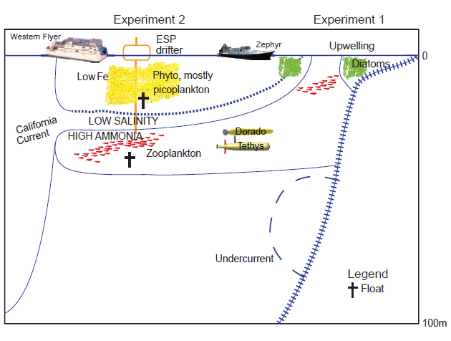
Field Experiments
with traps
200 km 0
Experiment 1, Zephyr 21 May – June 1 (8 days)
Experiment 2, Western Flyer 10-19 September
Rachel Carson 17-21 September

