Slide 1



Capturing the ephemeral:
Assessing the impacts of mesoscale eddies on ecosystem behavior of the subtropical North Pacific Ocean
Matthew Church
University of Hawaii
MBARI CANON workshop
April 15-16, 2010

Slide 2
Opportunities and challenges
Our understanding of whether or how mesoscale processes influence the biogeochemistry and ecology of the open sea remains in its infancy, largely as a result of inadequate sampling in time and space
Mesoscale eddies appear important in controlling new production (but perhaps in unexpected ways).
Mesoscale eddies present ideal case-studies for creative, autonomous sensing platforms:
  Eddies are spatially localized but dynamic in time
  Numerous biogeochemical feedbacks associated with mesoscale processes make unraveling the importance of eddies to ocean biogeochemistry challenging.
Sampling at the mesoscale is amenable to integrated sampling technologies and platforms, including satellites, ships, gliders, floats, and moorings.

Slide 3
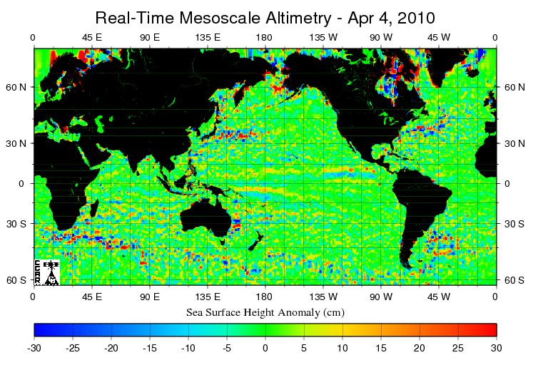
Open ocean eddies are ubiquitous, but most prevalent in physically dynamic regions of the world’s oceans
Eddies form in regions of flow instability
The biogeochemical consequences of eddy formation, evolution, and decay will differ in different regions of the world’s oceans

Slide 4
Current eddy sampling strategies
Satellites
  Sea surface height, ocean color
  high spatial areal but very low vertical resolution.
Ships
  Eulerian or Lagrangian
  sampling resolution low in time/space
  best suited for biogeochemical process studies.
Moorings
  Eulerian
  high temporal resolution, but often limited vertical resolution
  well suited for capturing time-dependent mesoscale physical forcing but limited for biogeochemistry (O₂, fluorescence, backscatter, light, nutrients)
Gliders/AUVs
  Lagrangian
  high resolution space and time resolution
  excellent physics, currently limited biology (O₂, fluorescence, backscatter, light)
Floats
  Lagrangian
  high vertical and temporal resolution
  excellent physics, currently limited biology (O₂, fluorescence, nitrate, optics)

Slide 5
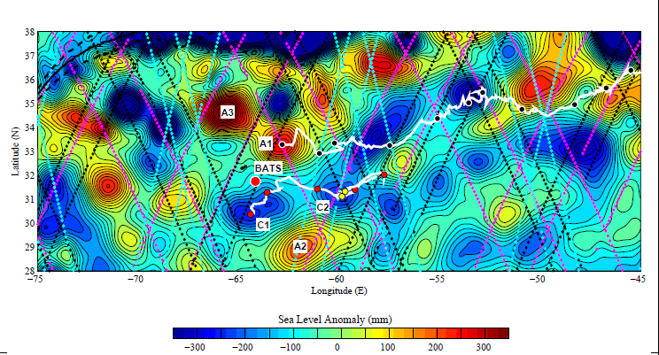
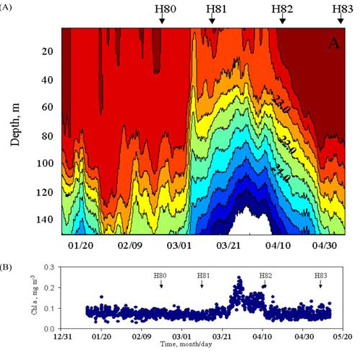
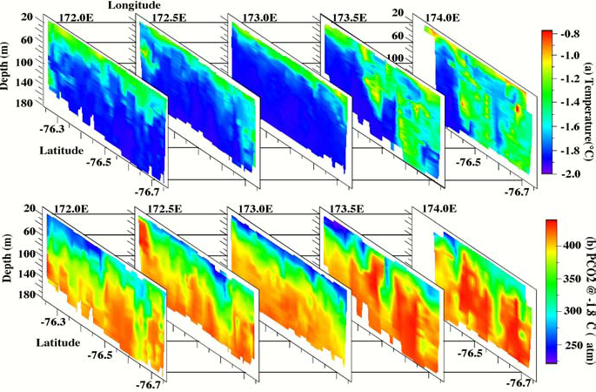
Sargasso Sea, BATS
McGillicuddy et al. 1998, 1999, 2007, McNeil et al. 1999, Sweeney et al. 2003
Cyclonic and mode water eddies fuel
40-70% of new production
A few (among many) examples of mesoscale variability in the
open sea
Ross Sea
Hales et al. (2003)
Shipboard sampling at 15 km intervals misses 2/3 of the variability in pCO₂ and temperature
Station ALOHA
Letelier et al. 2000, Sakamoto et al. 2004
Mesoscale upwelling increased Chl a by
3-fold with 1000-fold increase in NO₃⁻

Slide 6
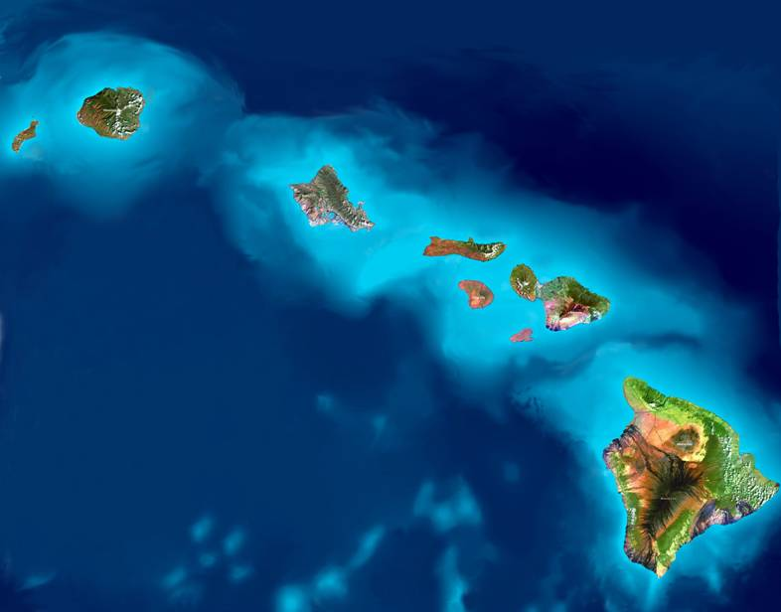
Time, water, and change
The 20+ years of Hawaii Ocean Time-series (HOT) program sampling at Station ALOHA comprise a rich history for assessing temporal variability in ocean dynamics in the oligotrophic waters of the North Pacific.
The resulting dataset provides insight into the mean ecosystem state, and variability around that mean state.
Mesoscale processes contribute to variability around the mean state.
ALOHA

Slide 7
Shallow mixing, deep penetration of light, and rapid plankton growth
Characteristic features of the upper ocean at Station ALOHA

Slide 8
Do mesoscale processes shape ocean biogeochemistry in the oligotrophic ocean?
Variations in depth of nutricline relative to euphotic zone?
Variations in plankton community structure and rates of production?
Changes in new production and carbon export?

Slide 9
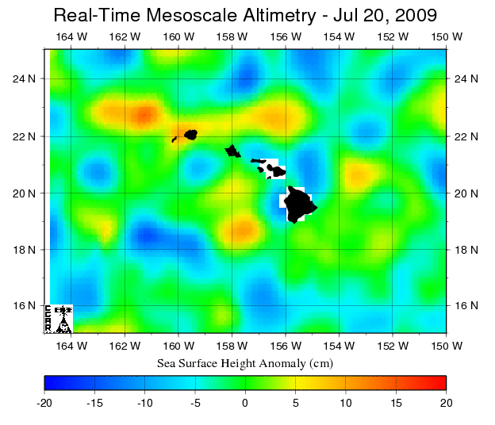
Cyclonic eddy
(negative SSHa)
Anticyclonic eddy
(positive SSHa)
ρ1
ρ2
ρ1
NO₃⁻, PO₄³⁻
ρ2
NO₃⁻, PO₄³⁻
Church et al. 2009

Slide 10
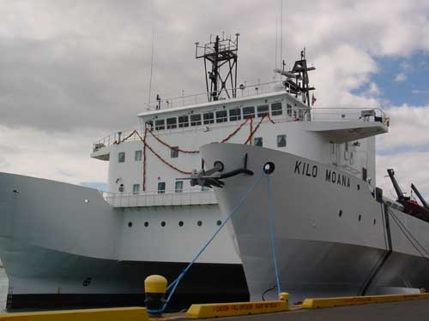
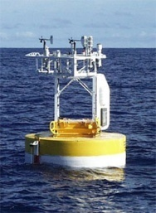
Temporal variability in physical forcing of the euphotic zone
Church et al. (2009)

Slide 11
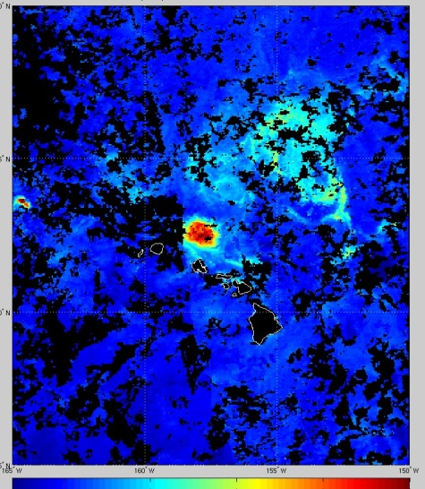
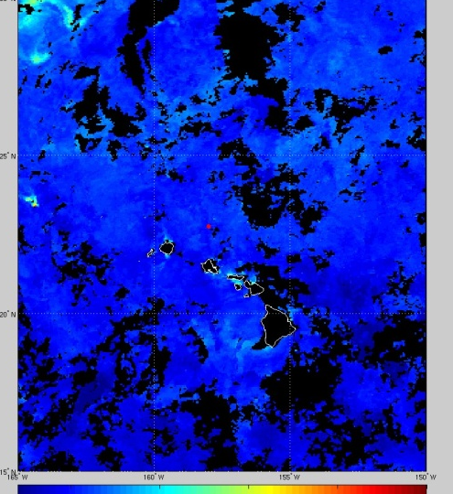
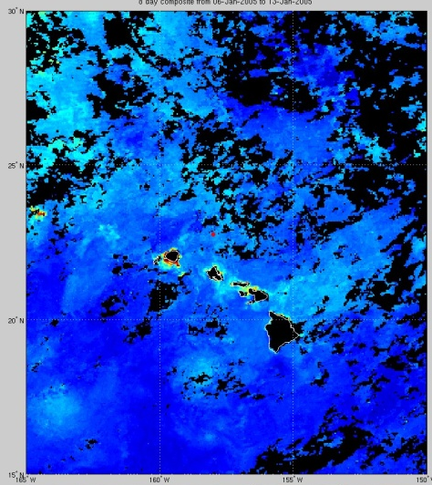
July 2005
April 2005
January 2005
Biological processes vary with the
time-history of eddy dynamics
What processes underlie the initiation, maintenance, and demise of eddy-induced plankton blooms?
Fong et al. 2008

Slide 12
How much of the variability associated with upper ocean biogeochemistry is associated with mesoscale forcing?
Decreased availability in nutrients, but no significant changes in primary production or carbon export

Slide 13
Mesoscale physical dynamics appear to influence phytoplankton community structure
Pigment biomarkers suggest cyclonic features result in increased proportion of various eukaryotic plankton, while anticyclonic events favor Prochlorococcus

Slide 14
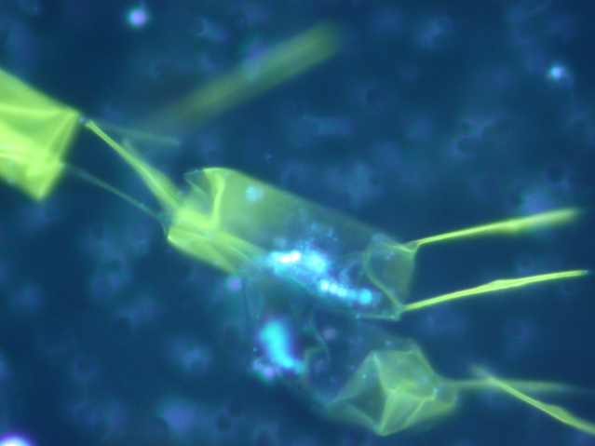

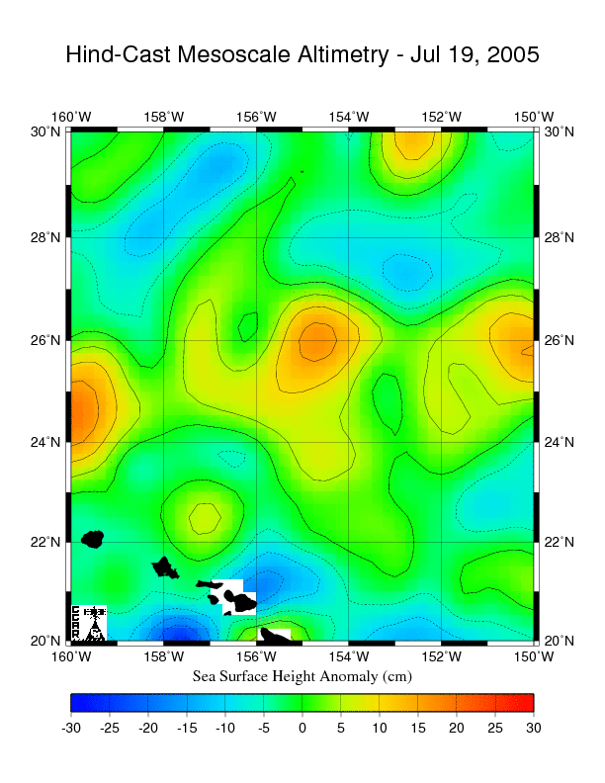
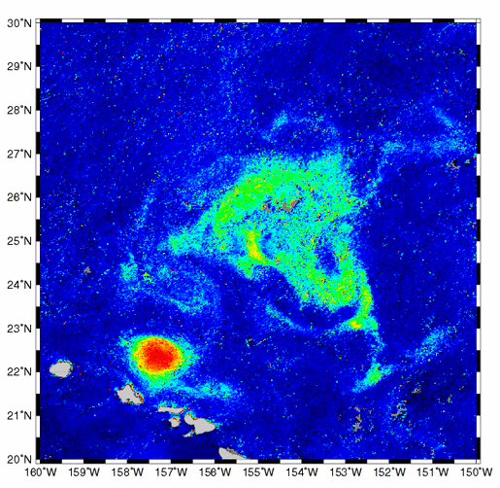
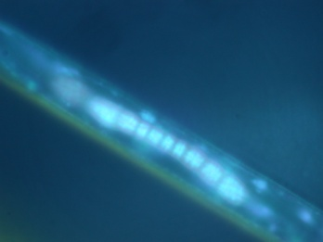
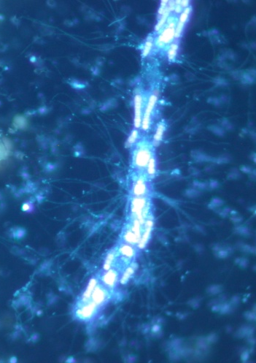
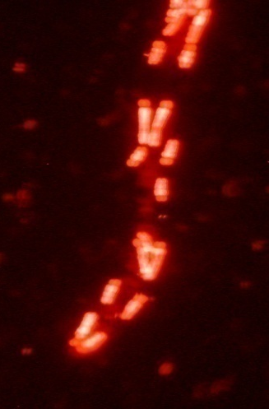
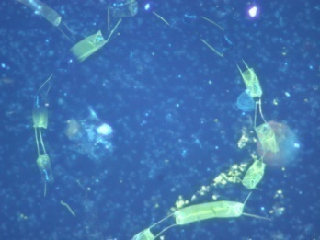
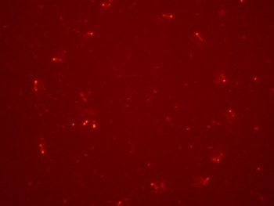
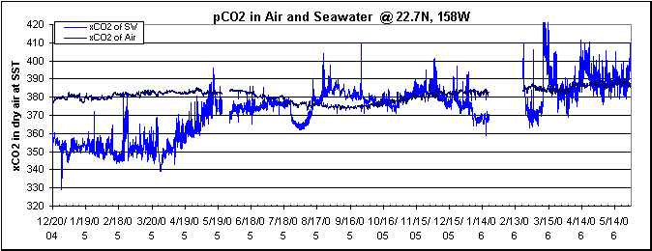
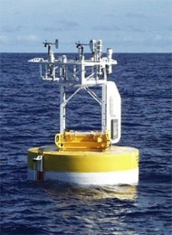

Station ALOHA Blooms - July 2005
ALOHA
July 2005
“typical profile”
Diatom bloom supported by N₂ fixing cyanobacteria associated with an
anti-cyclonic eddy
C. Sabine, PMEL

Slide 15
Time series measurements of near-surface ocean N₂ fixation at Station ALOHA
Episodic increases in N₂ fixation by diazotrophs >10 μm appear associated with mesoscale (anticyclonic) eddies.
Church et al. 2009
nmol N L⁻¹ d⁻¹

Slide 16
Property (0-200 m) | SSHa - | SSHa +
Primary production | ↔ | ↔
Carbon export | ↔ | ↔
NO₃⁻ | ↑ | ↓
NO₃⁻ : PO₄³⁻ | ↔ | ↓
Chl a | ↔ | ↔
Prochlorococcus | ↔ | ↑
Diatoms | ↔ | ↔
Pelagophytes | ↑ | ↔
Haptophytes | ↑ | ↔
N₂ fixation | ↔ | ↑
What is the time history associated with these processes?
How does such mesoscale variability influence plankton ecology?

Slide 17
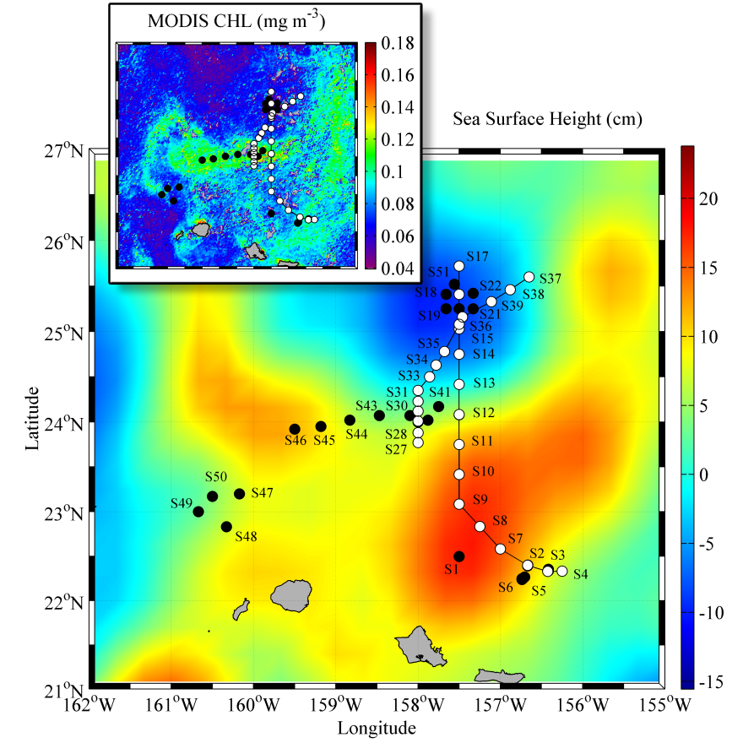




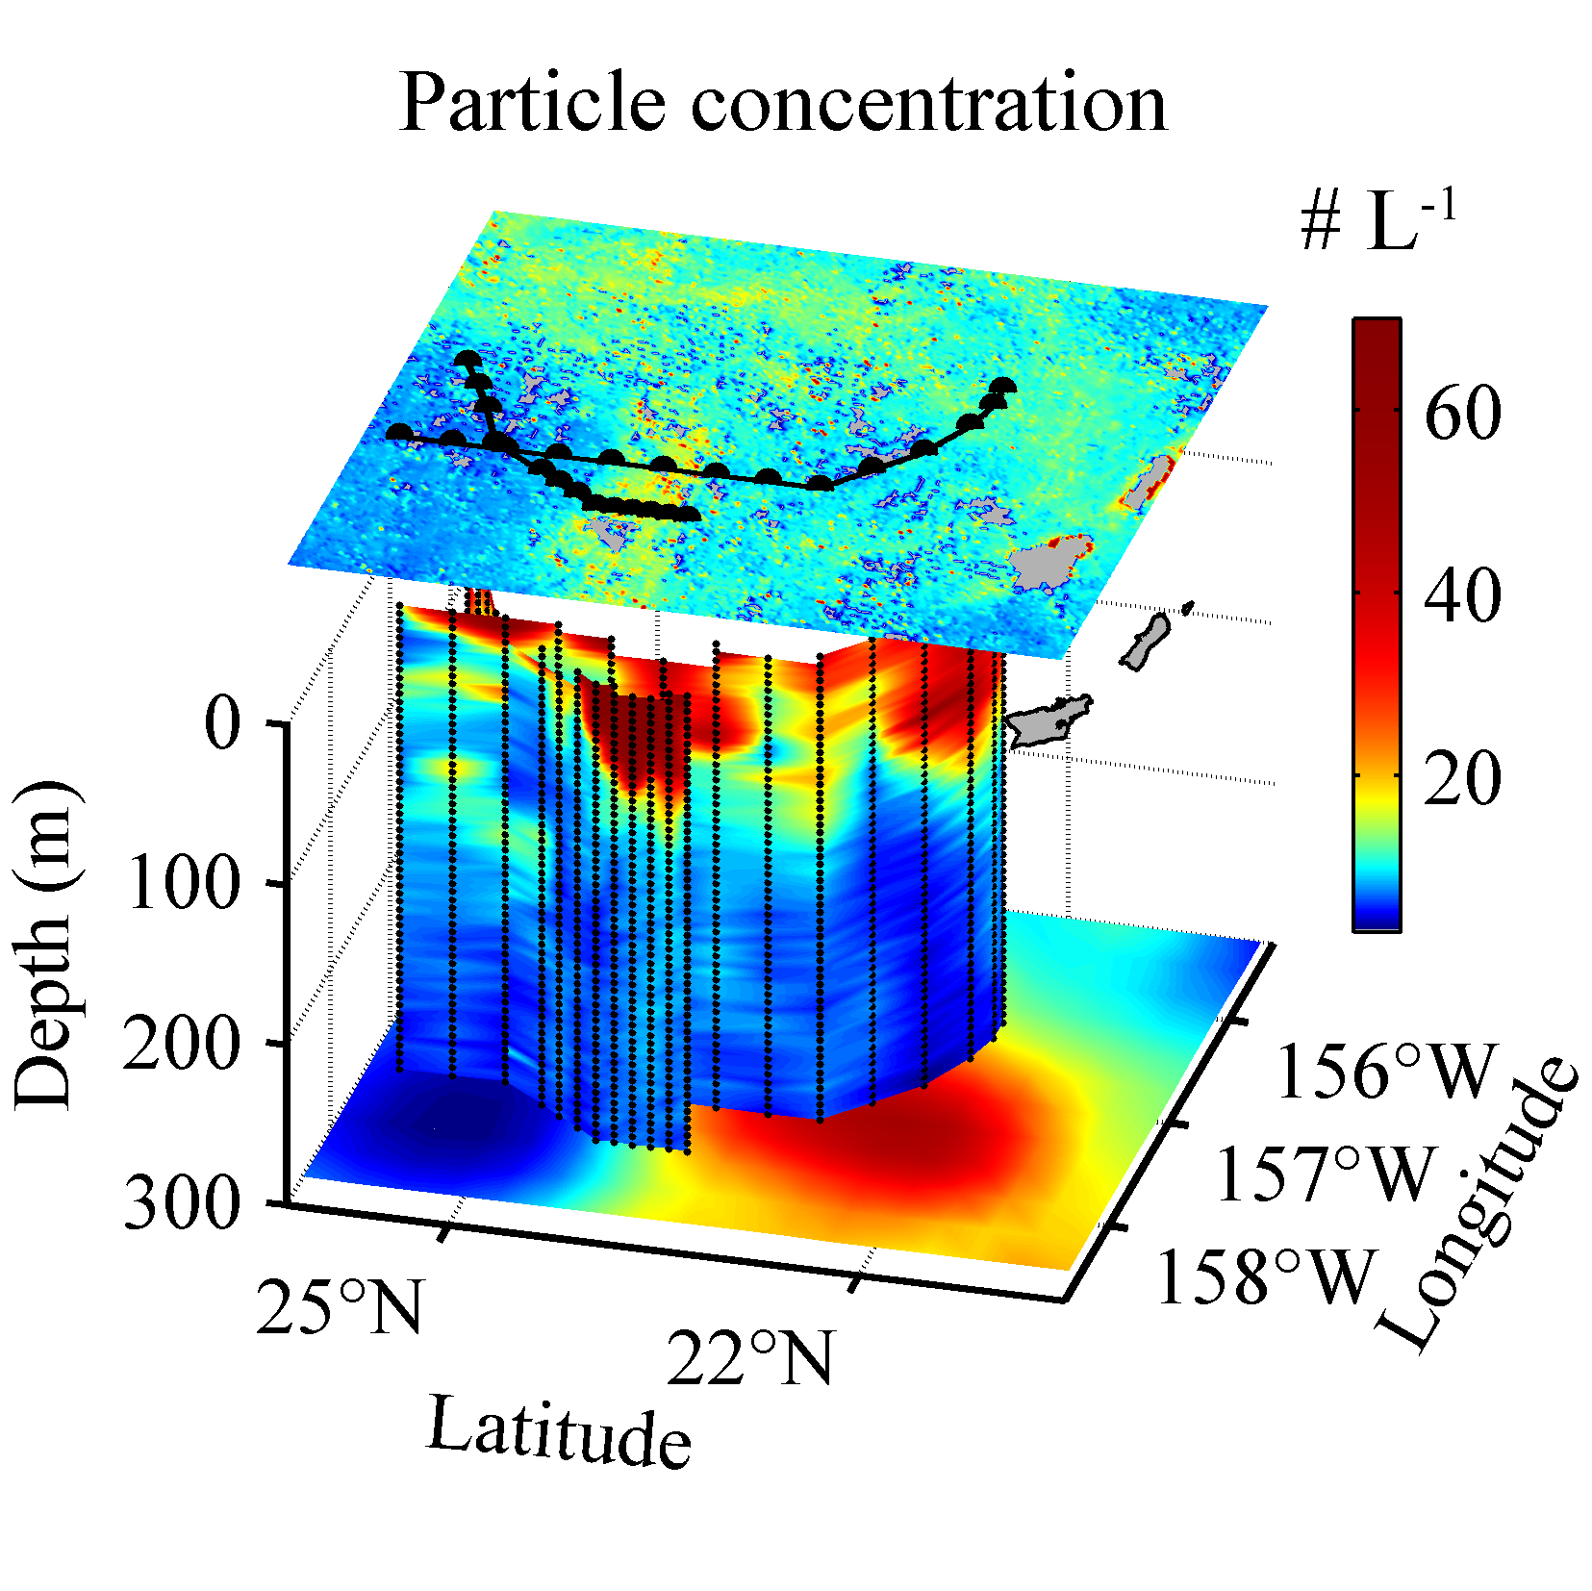
Meso- and submesoscale physical processes may drive enhanced carbon export in the open sea
OPEREX: July 2009 CMORE cruise in the subtropical North Pacific Ocean
Chlorophyll a
N₂ fixing microorganism biomass accumulation
SSHa
2 white transects
Cruise track across eddies
Lionel Guidi, Paulo Calil, et al.
Large particle concentration

Slide 18
What aspects of eddy dynamics are we currently resolving?
Variations in depth of nutricline relative to euphotic zone? – yes, well resolved by some combination of ships, moorings, floats, and gliders
Variations in plankton community structure?- yes and no; most information from shipboard collections (with insight gleamed from gliders/moorings).
Changes in primary production, new production, and carbon export? – currently not well resolved by existing sampling strategies

Slide 19
Why we need sample return
Plankton community structure
Export (dead cells, pellets, aggregates, etc.)
Nutrients (coupled with turbulence profiler could place constraints on mixing derived nutrient input and plankton growth)
Suitable platforms:
  Ships, floats, gliders, and moorings are all amenable to equipping with instrumentation for sample return.

