Slide 1
Recent Battelle Ocean Technology Developments
MBARI SAMPLING WORK SHOP
April 15-16, 2010

Slide 2
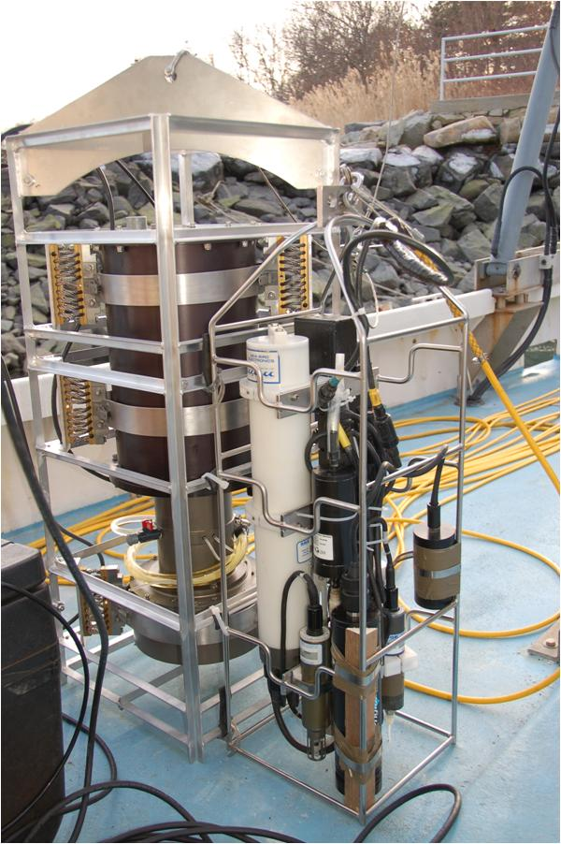
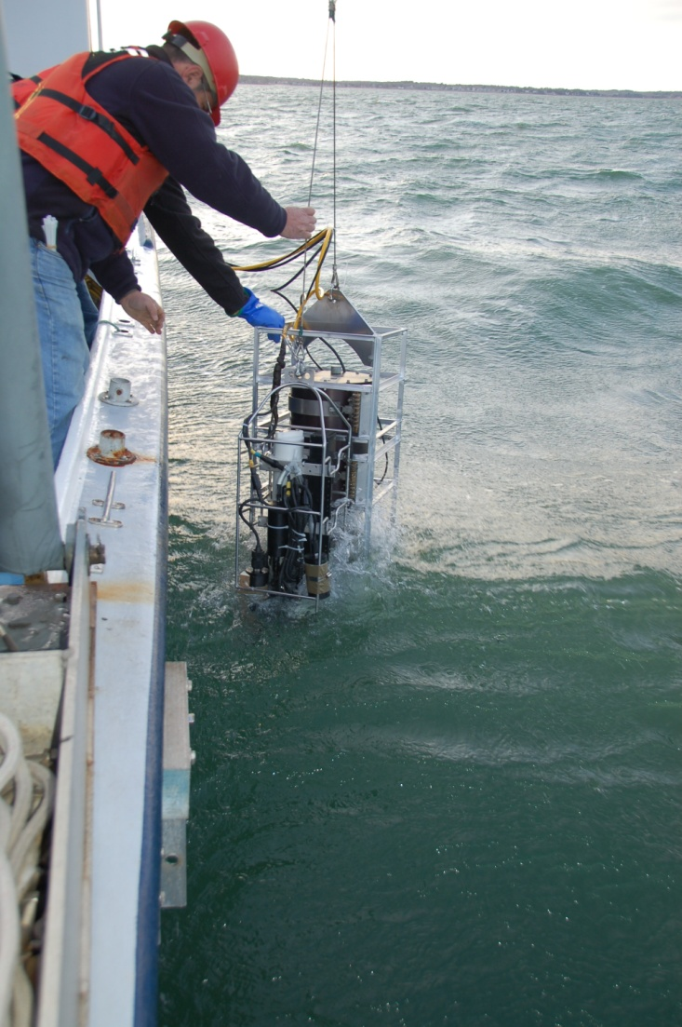
Fluid Imaging Technology Submersible FlowCAM®

Slide 3
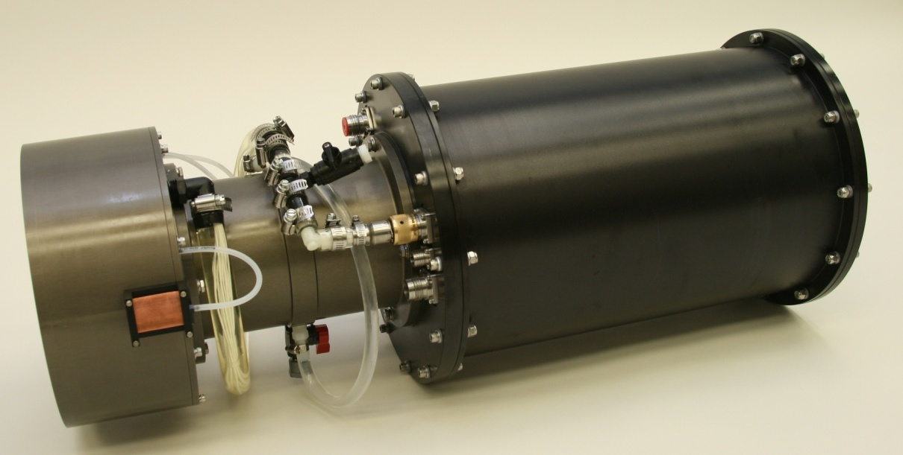
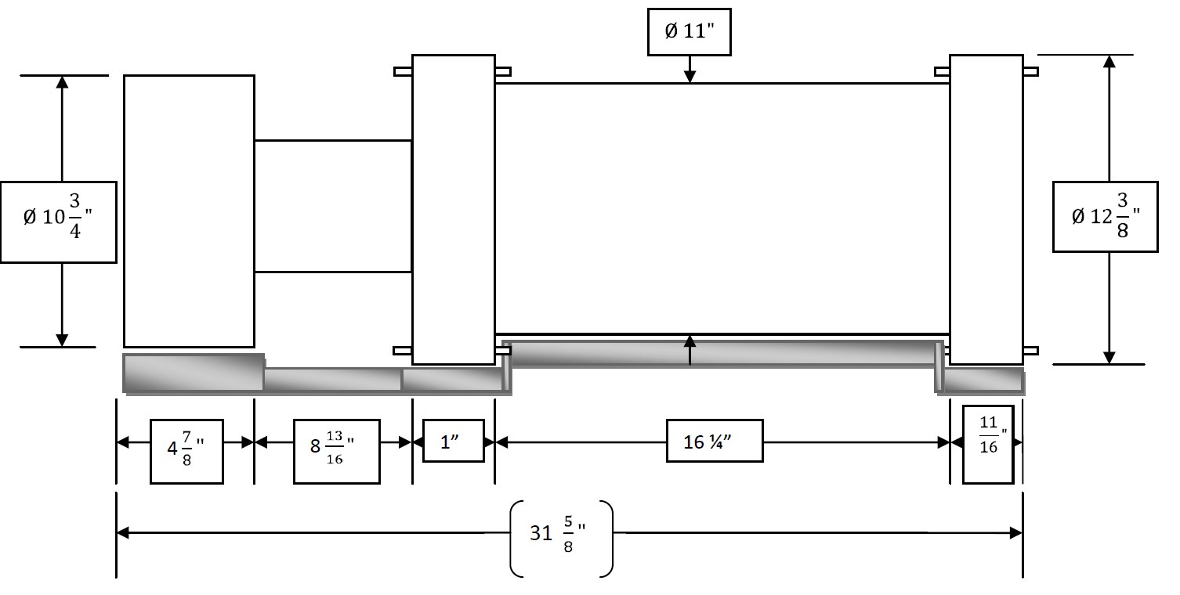
Submersible FlowCAM® Particle Analyzer
.
Diameter at the left end does not include the inlet and outlet.
Overall length does not include a zinc at the right end

Slide 4

Submersible FlowCAM® Particle Analyzer
Design Requirements
  Moorings/fixed locations
  Profiling systems (ship/autonomous)
  Autonomous vehicles
  Towed system
  Laboratory or in-situ users
Specifications
  200m design depth
  1 to 4 mL/minute through flow cell
  Continuous versus “burst” sampling (1-22 frames/sec), Color or B&W camera
  1 to 20X magnification (particle size range 3µm – 3mm)
  Multiple images per frame
  Two Channel Fluorescence/Scatter detection
    Triggering (low density sampling) or auto
  Automated Identification, Classification & Enumeration
  Weight in air 103 lbs; in water 20 lbs
Outputs
  Size and shape information all particles/cells
  Image Recognition VisualSpreadsheet© (30 Image parameters)

Slide 5
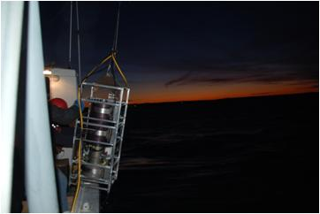
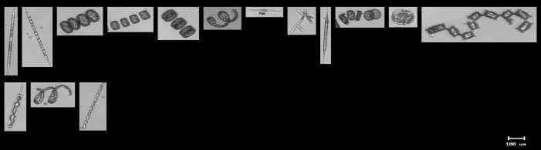
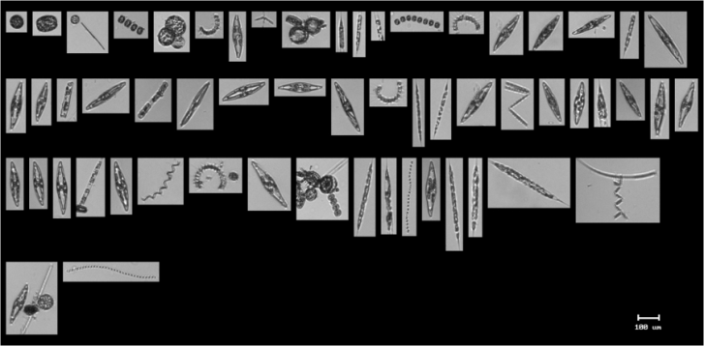
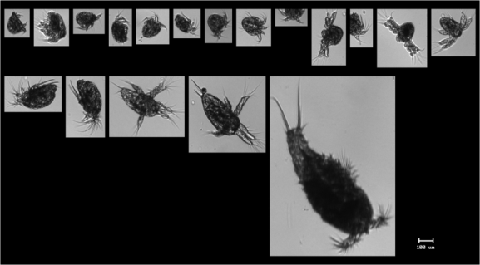
Initial Field Test
February 8, 2010
A combination of pennate and centric diatoms. Species include Rhizosolenia, Thalassiosira, Chaetoceros, Navicula, Thalassionema, Odontella, Ditylum, and Skeletonema.
The dominant organism was Navicula (boat shaped). Other species include Thalassiosira, Rhizosolenia, Thalassionema, Chaetoceros, and Skeletonema
Copepod Nauplii and some further developed copepods

Slide 6
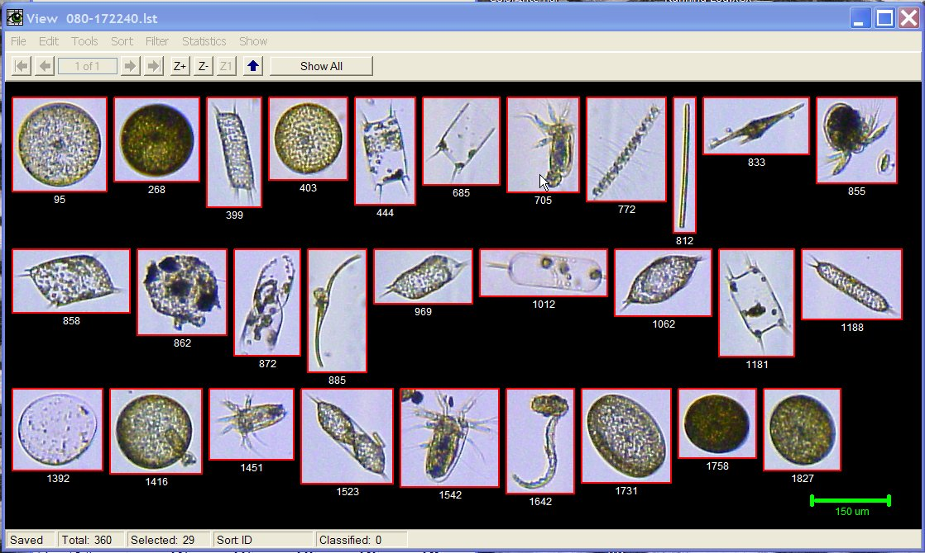
FlowCAM Images
Gulf of Nicoya, Costa Rica (10X)

Slide 7
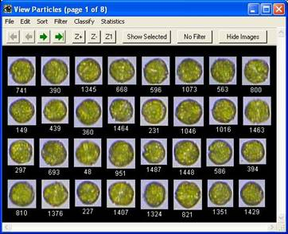
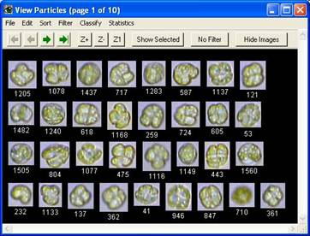
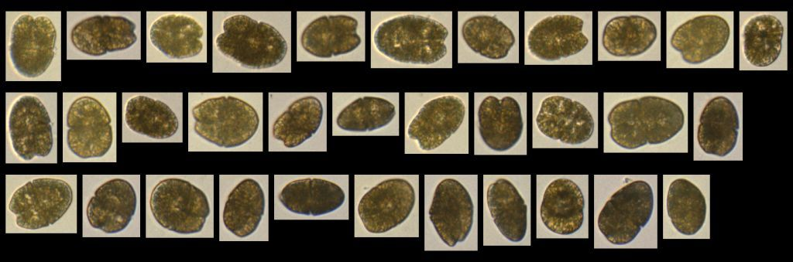
FlowCAM HAB Images
Alexandrium
Karenia brevis
Akashiwo sanguinea, Grays Harbor, WA

Slide 8
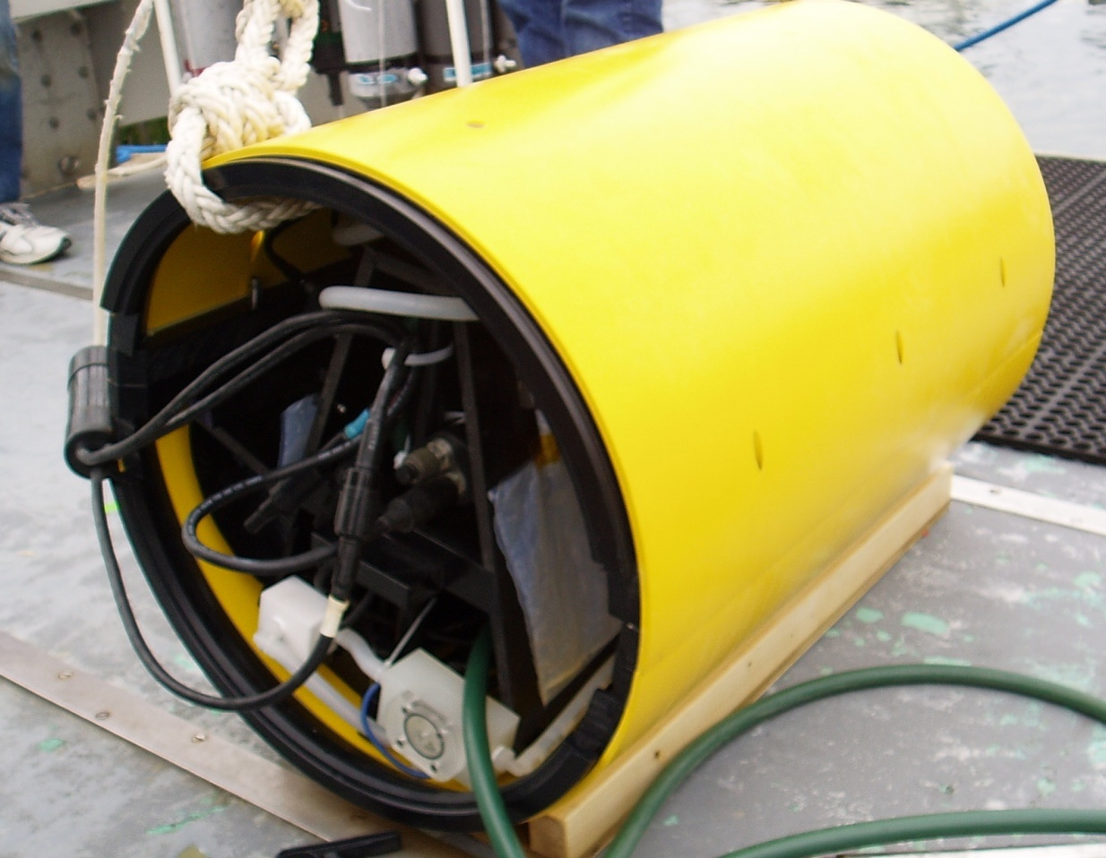
Battelle Autonomous Sampling System

Slide 9
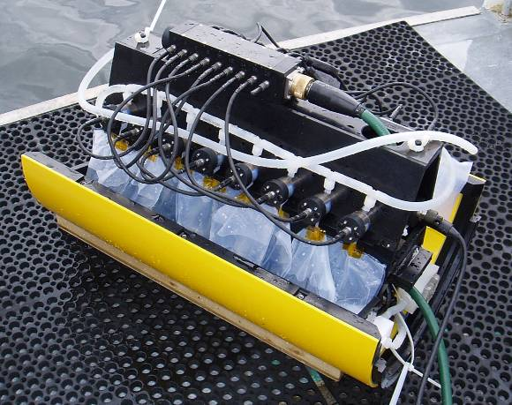
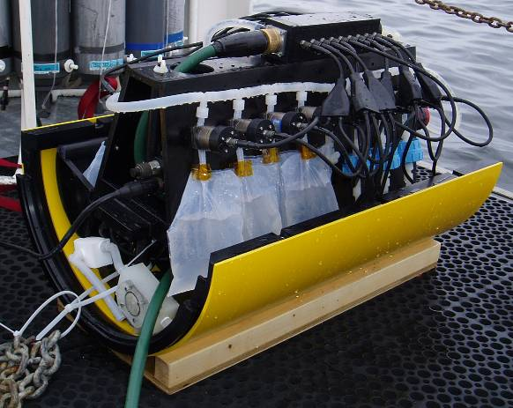
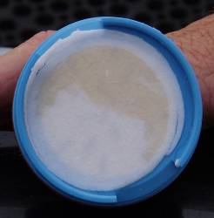
BASS
Design characteristics
  Compatible with existing UUVs
  Scalable and field reconfigurable
  Materials compatible with a broad range of chemical and biological analyses
    Metals, gases, organic chemicals, biological, nutrients
  Pressure compensated plumbing and electrical components (4,500 m depth rating)
  Simple, reconfigurable Windows software interface
  User defined sample types and collection schedule
    Capable of adaptive sampling
  Feed back of system operation and logging of data
Sample types
  Whole water
  Filtered water
  Particulates (define your filter type requirements)
  Both P & D sampling
  Live and preserved samples

Slide 10
Capabilities
Cheap, disposable bags and tubing
Software allows
  Multiple sample types/sizes in a single mission
  Flushing (user defined amount)
  Preservative addition (user defined amount)
    Can also pre-spike bags
  Collection of waste preservative in a waste bag
Prototype Specs
  21” diam x 30” long
  16 samples (bags or filters)
  Ethernet comms
  28VDC, 24W when sampling
  200 to 900 mL sample bags (user defined)

Slide 11
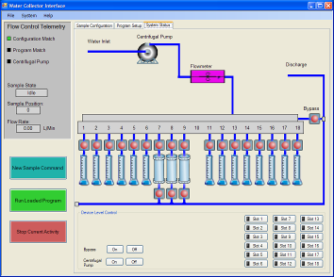
BASS
Adaptability (with engineering)
  Increase number of samples
    Up to 96 samples
  New platforms
    Mooring
    Bottom mounted
    ROV
  In situ experiments
  Bag size and materials to fit the analytical need
  Flexible sampling rates

