Slide 1
CCE BIN Status Technical Update
March 1, 2016
M.chaffey, T.O’Reilly, B.Kieft

Slide 2
Sequence of Events
Monday, Feb. 22 an acoustic signal was noticed on the MARS hydrophone (~5km N of BIN) that was in the operating frequency of a Benthos modem. Examination of the record showed that the signal was first picked up on 18Feb16 at 2019 UTC. By Wednesday, Feb. 24 Brian Kieft was able to decode the header and determine that it was a Benthos modem address 9 broadcasting to address 10 – the BIN modem configuration.
Friday, Feb. 26 Chris Wahl launched the Wave Glider with the HotSpot payload and by 3AM PST Saturday it was over the BIN location. Poor acoustic conditions over the weekend precluded making significant progress, however it was determined that the BIN was repetitively rebooting as we suspected from the acoustic signature. It appeared that the BIN was rebooting when it attempted to start the 600 or 1200 kHz ADCP. The 8 minute 52 second reboot period and the poor acoustic communications prevented us from being able to diagnose the problem further.
Tom O’Reilly was able to write a configuration script to run on the BIN that would prevent the ADCP’s from starting and by Monday morning Feb. 29, he was able to get it downloaded to the BIN. The objective of the script was to stop the continuous rebooting which would allow us access to the system to diagnose and correct the problem. The script ran on the next reboot cycle, and as hoped, the BIN completed it’s full boot-up. Tom was able to retrieve environmental data that showed the BIN internal humidity still around 3.5% and the instrument bus battery voltage as normal.
Shortly after completing these actions we completely lost all communications with the BIN and BIN modem and were not able to re-establish them over the next several hours. We then had to re-position the Wave Glider for another mission and cannot return to the site for at least another week.
Based on the evidence we have to conclude that the system is probably dead, although there is a remote possibility that only the modem failed and data on all instruments but the ADCP’s is being logged. The ADCP’s themselves have about 20 days of battery life at our sample rates, so they may still be logging internally.
The diagnostic evidence we have is very confusing. The system is designed to be very tolerant of failures occurring outside the BIN sphere itself (flooded instruments, etc.), leading one to believe there may have been water leaking into the BIN sphere, yet it’s last report was that it is completely dry. The symptoms do not seem to match any failure scenario we have been able to come up with to date.

Slide 3
History of BIN Health Reports via WaveGlider Interrogation via Acoustic Modem

Slide 4
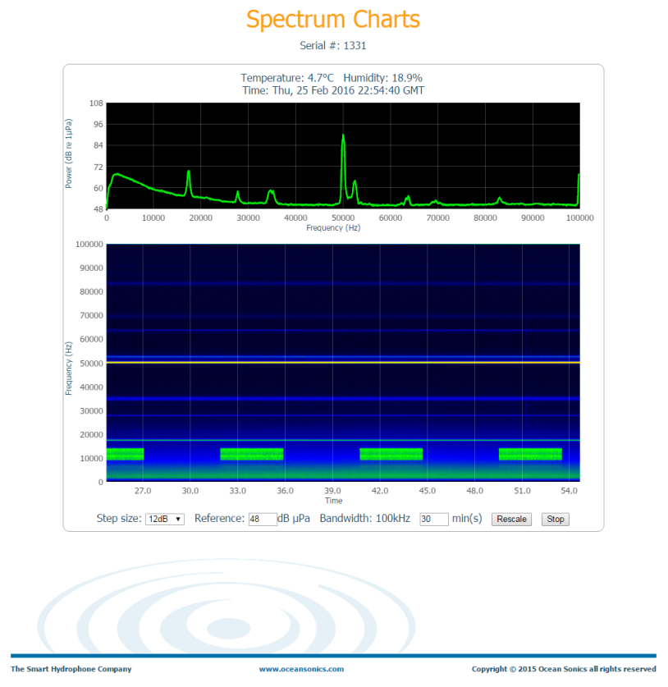
Signal Received on MARS Hydrophone (~ 5km N) Starting 18Feb16 at 2019 UTC
BIN acoustic modem sending out 4 min. long boot string every 8 minutes 52 seconds.

Slide 5
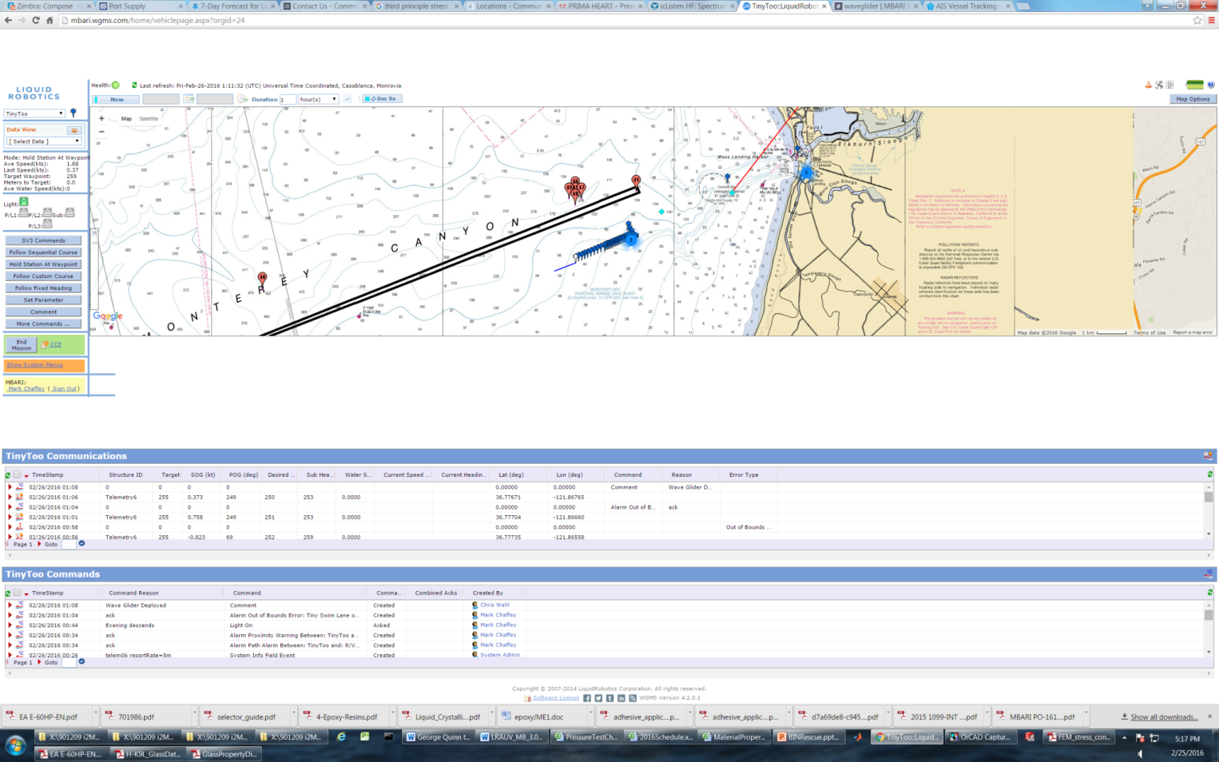
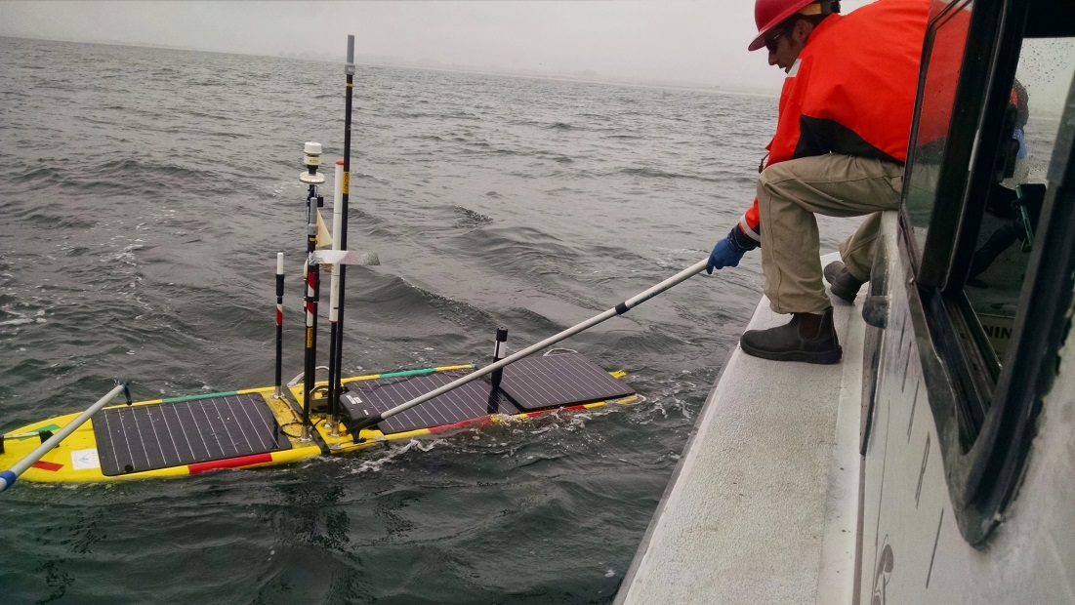
Wave Glider with the HotSpot communications payload was launched Friday afternoon Feb. 26 and was on station over the BIN by 3AM Saturday morning.

Slide 6
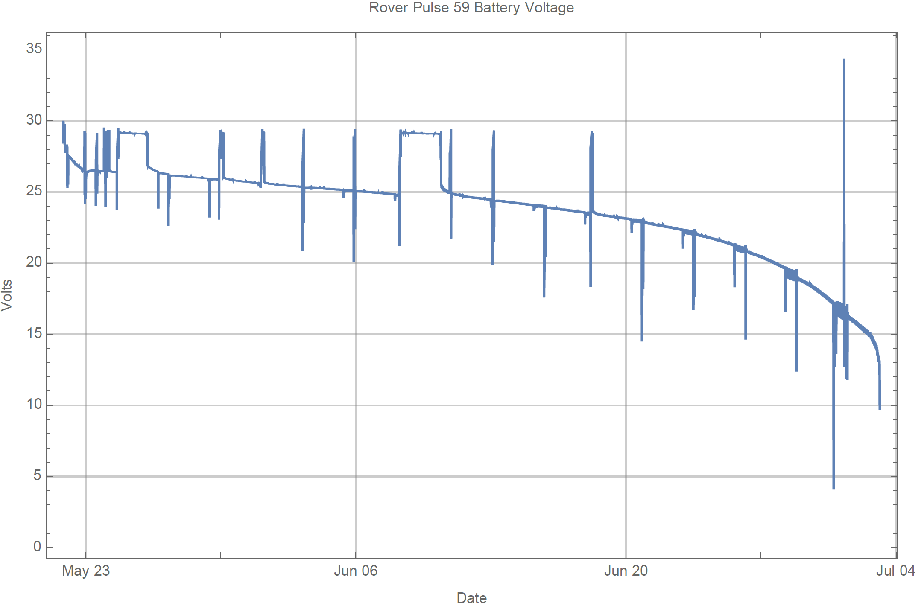
Discharge Curve from the Benthic Rover with identical batteries. Normalized CCE BIN instrument power bus readings retrieved are superimposed showing little battery voltage drop since deployment.
10/23/2015
12/15/2015
1/29/2016
2/29/2015

