Slide 1
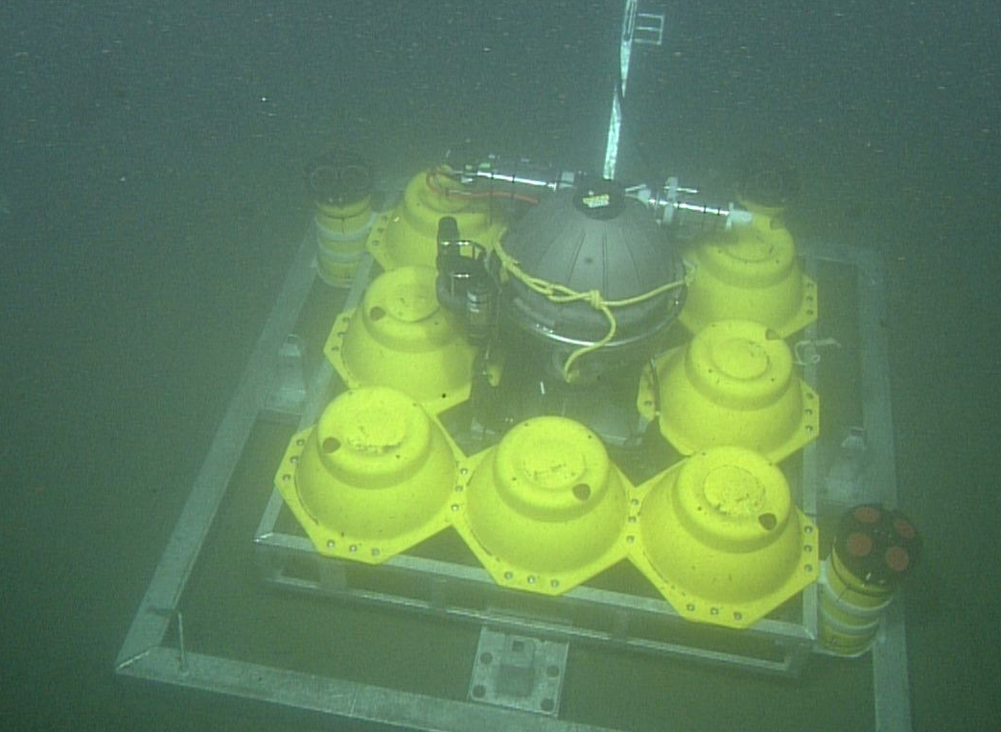
BIN deployment dive 10/14/2015
Modem transducer is undamaged

Slide 2

BIN recovery dive 4/12/2016
Modem transducer is bent

