Slide 1
SV3 WGMS Wave Glider Piloting : useful commands
Mrc 11/12/15

Slide 2
update telemetry rate
Set between 2 and 5 minutes.
  Less than two minutes can cause bottleneck and is expensive. Greater than 5 minutes not good for piloting.
Use “SV3 commands”
  telemetry06Reporter
    Set Reporting Frequency (use Iridium Communication Channel).
    Command is sent when “Set Reporting Frequency” is clicked.

Slide 3
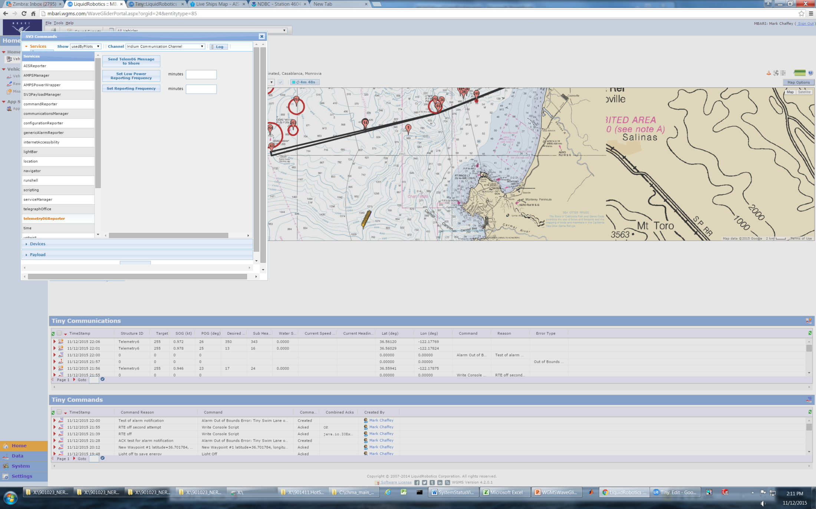
Warning! Clicking this button sends command!!

Slide 4
Command for sequential waypoints
Add a series of waypoints to follow.
  Vehicle page
    Click on Vehicle (Tiny)
      Click on Waypoints
        Click on NEW
  Add series of waypoints numbered sequentially in order of desired track.
Use “Follow Sequential Course Command”.
  Target Waypoint is closest waypoint to start sequence.
  From Waypoint is lowest numbered waypoint in sequence.
  To Waypoint is highest numbered waypoint in sequence.
  WG will start at target and follow increasing waypoint numbers to beginning and continue.

Slide 5
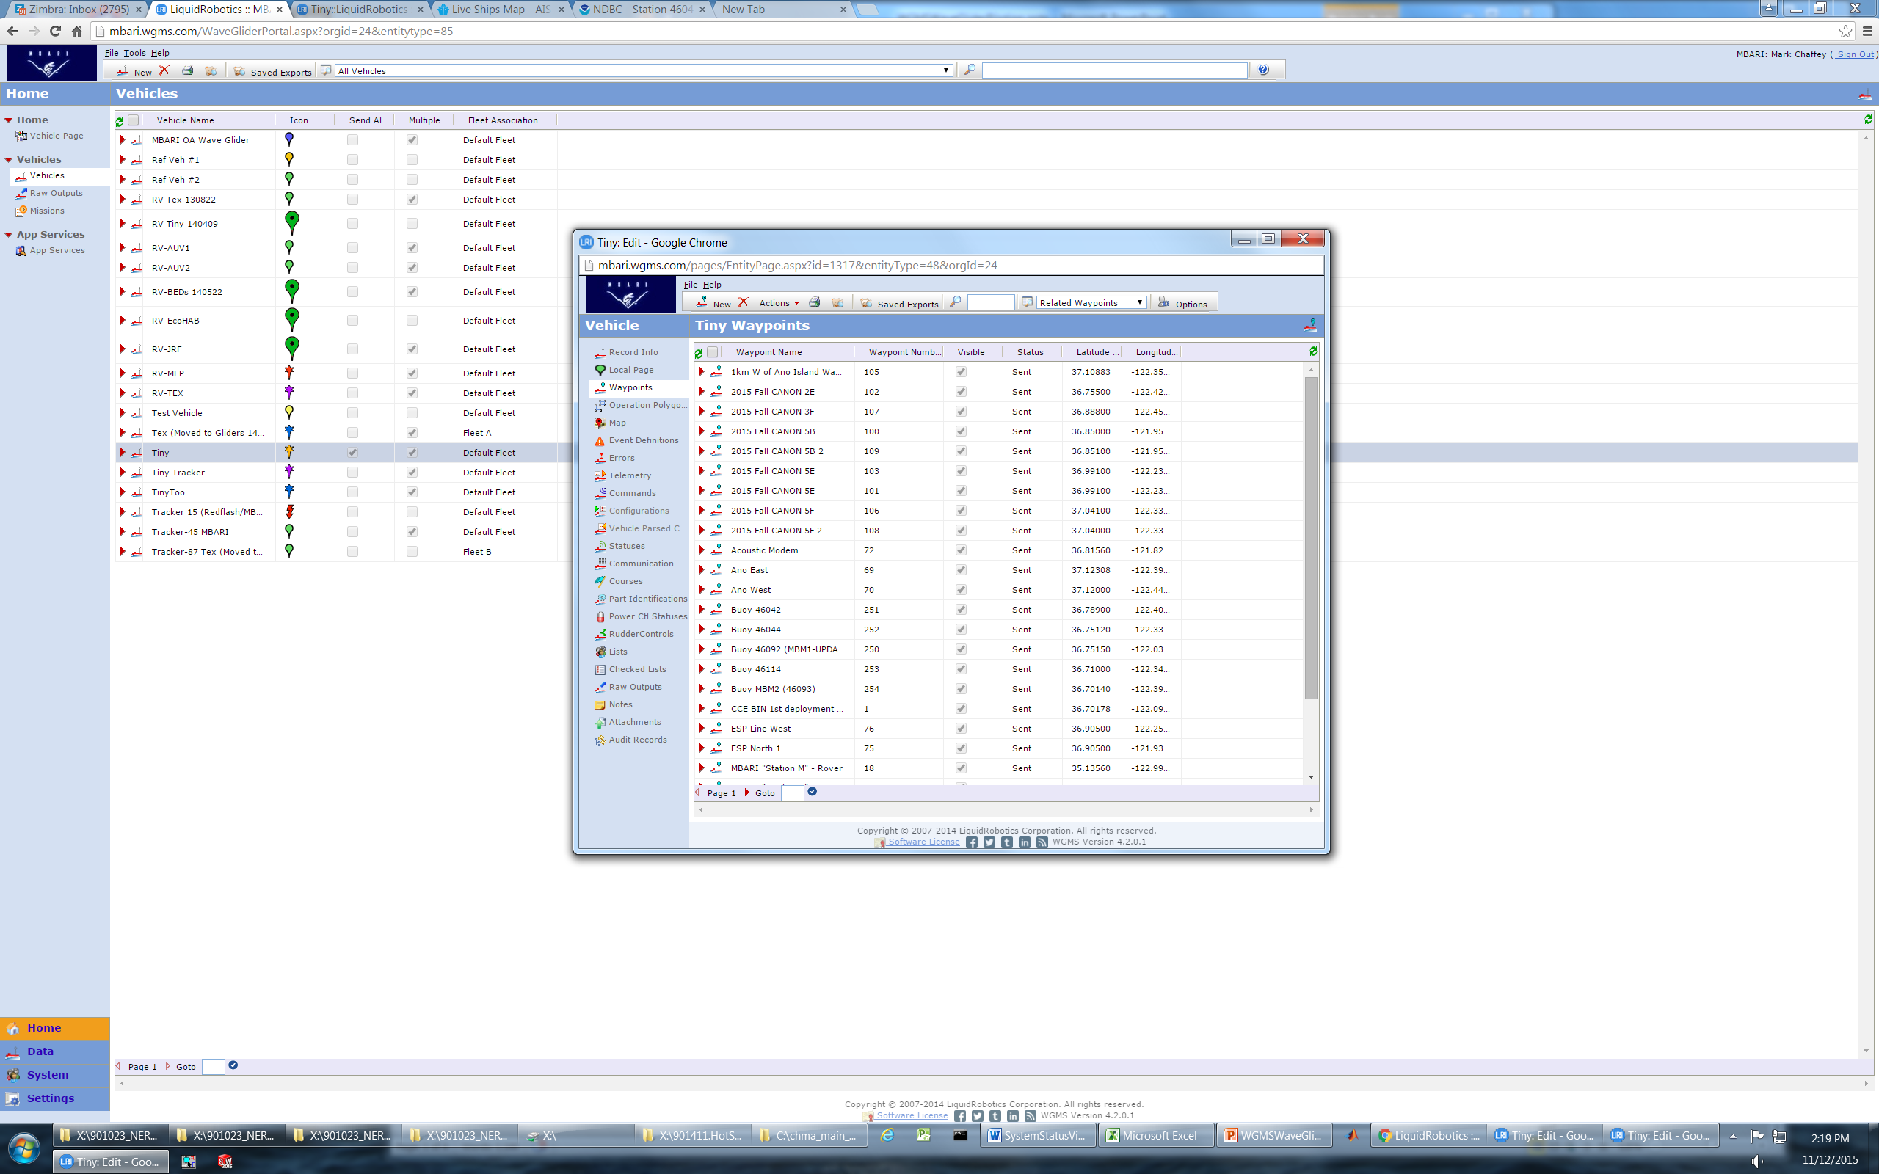

Slide 6
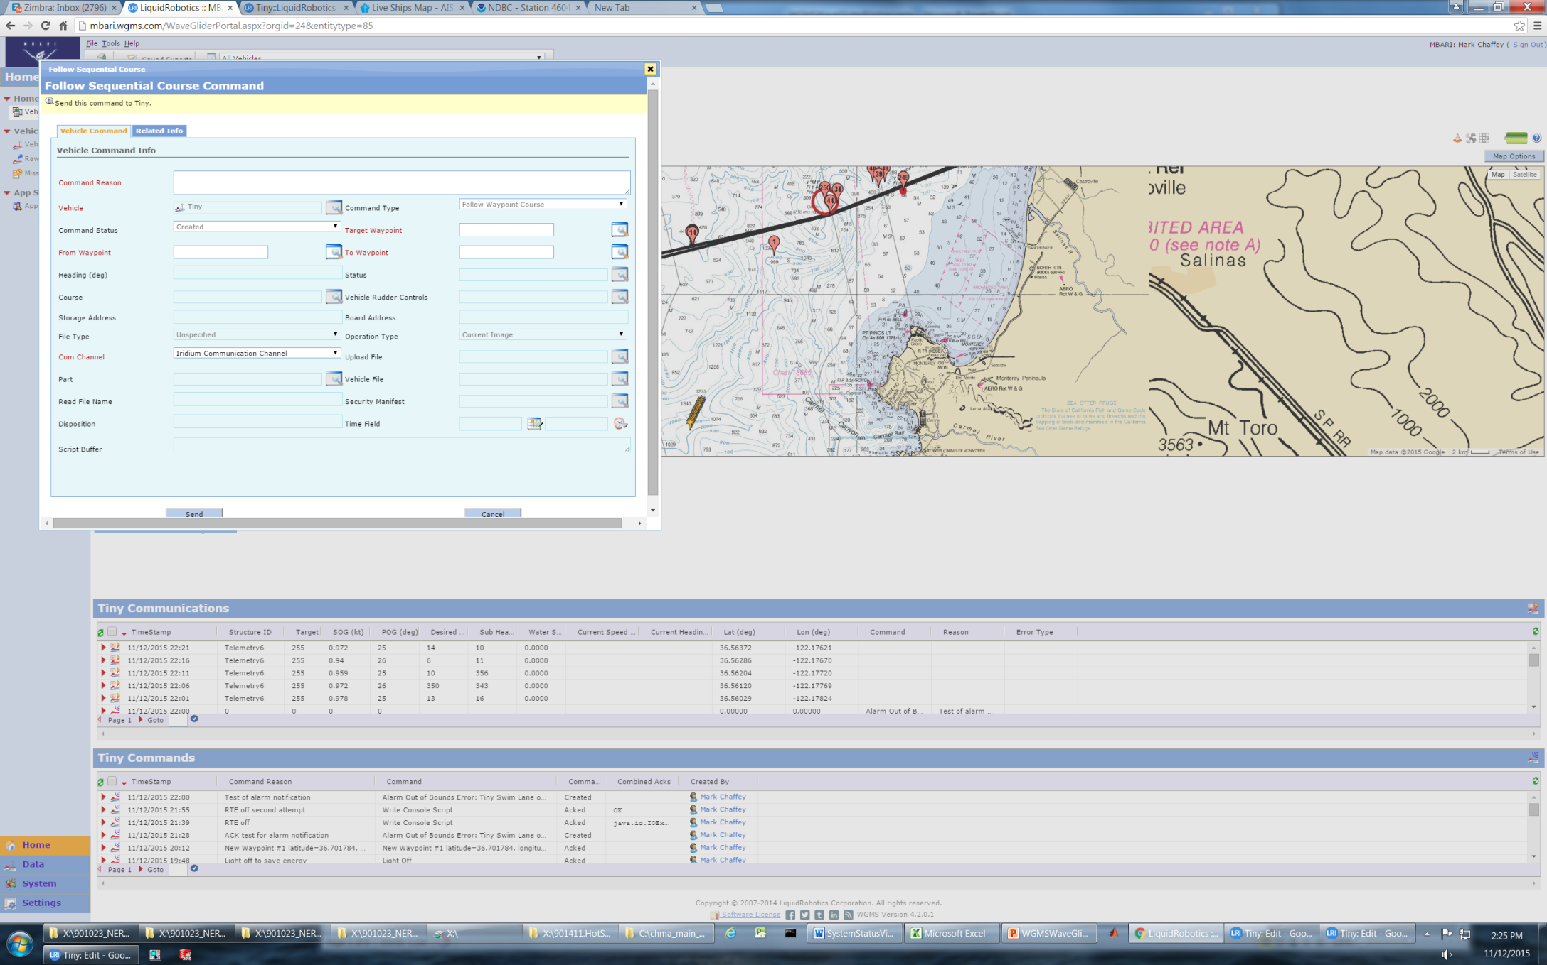

Slide 7
Command for keeping a watch circle
Enter a waypoint for watch circle center (see previous slide on adding waypoints).
Use “SV3 Commands”.
  “navigator”
    “Hold Custom Watch Circle” with Lat. Long. + watch circle radius.
    Alternative command “Hold watch circle at waypoint”. (Have not tested this command yet).

Slide 8
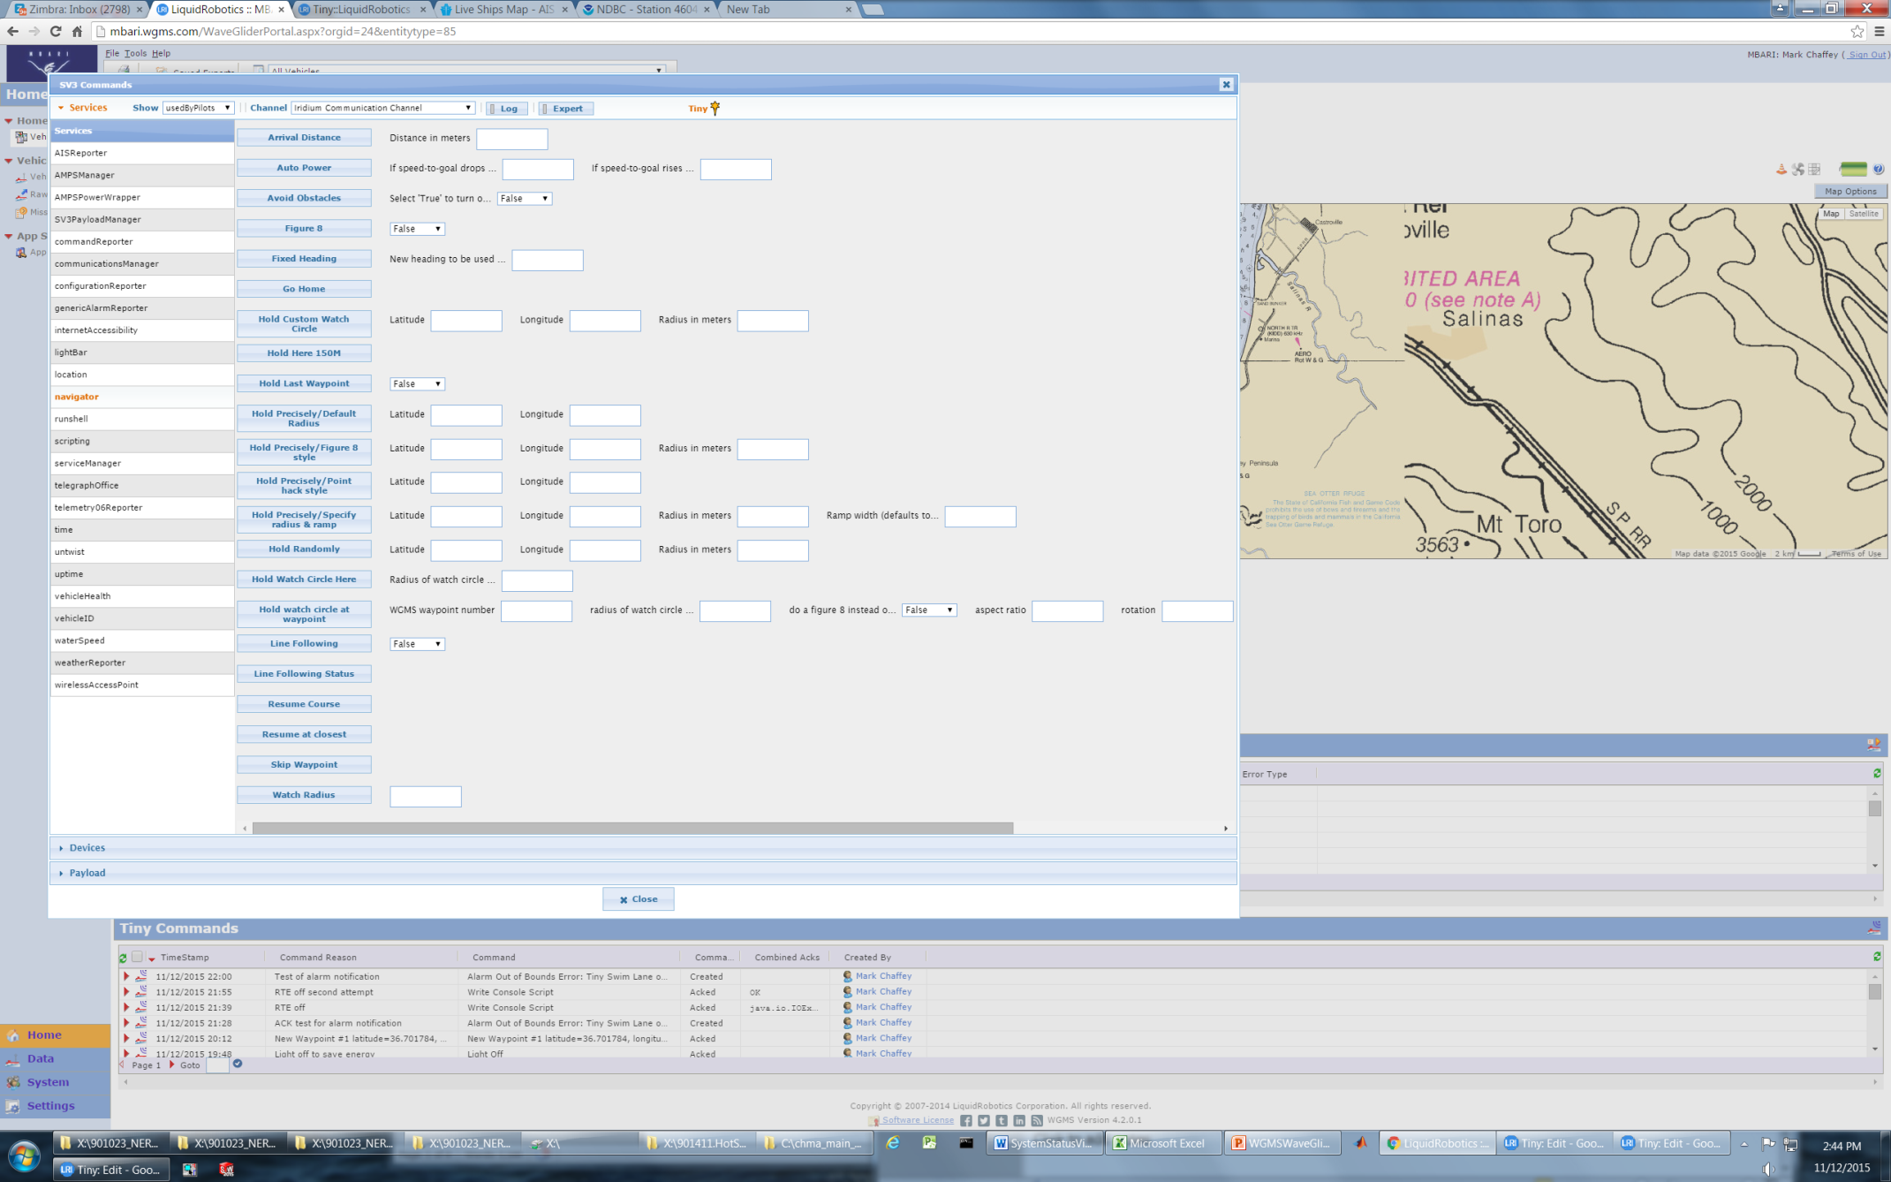
Warning! Clicking these buttons sends command!!

Slide 9
Turn on HotSpot Payload
Hotspot is on the P/L3 power switch.
  Can be turned on from main piloting panel.
  Can also use the script “Payload 3 Power=0 on vehicle: Tiny” (or Power=1)?

Slide 10
Turn On (or OFF) Radar Repeater (RTE)
Cut command from previous command entry and paste into More Commands.
  Use command “Write Console Script”
  Paste “%radarReflector.setOn(0)” or “%radarReflector.setOn(1)” into Script Buffer.
    Note: Function & Board address should both be set to 0.
  Hit “Send” button.

Slide 11
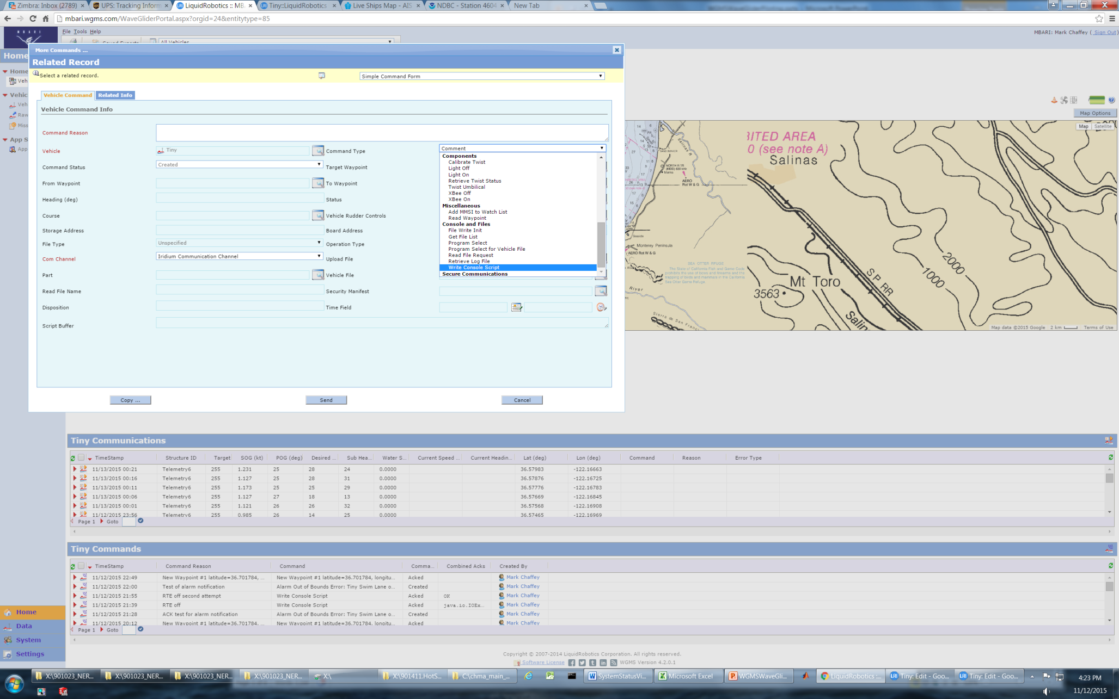

Slide 12
Getting Off and On the Phone Escalation List
When logged in click on tools – options and remove your phone number from the data record.

