Slide 1
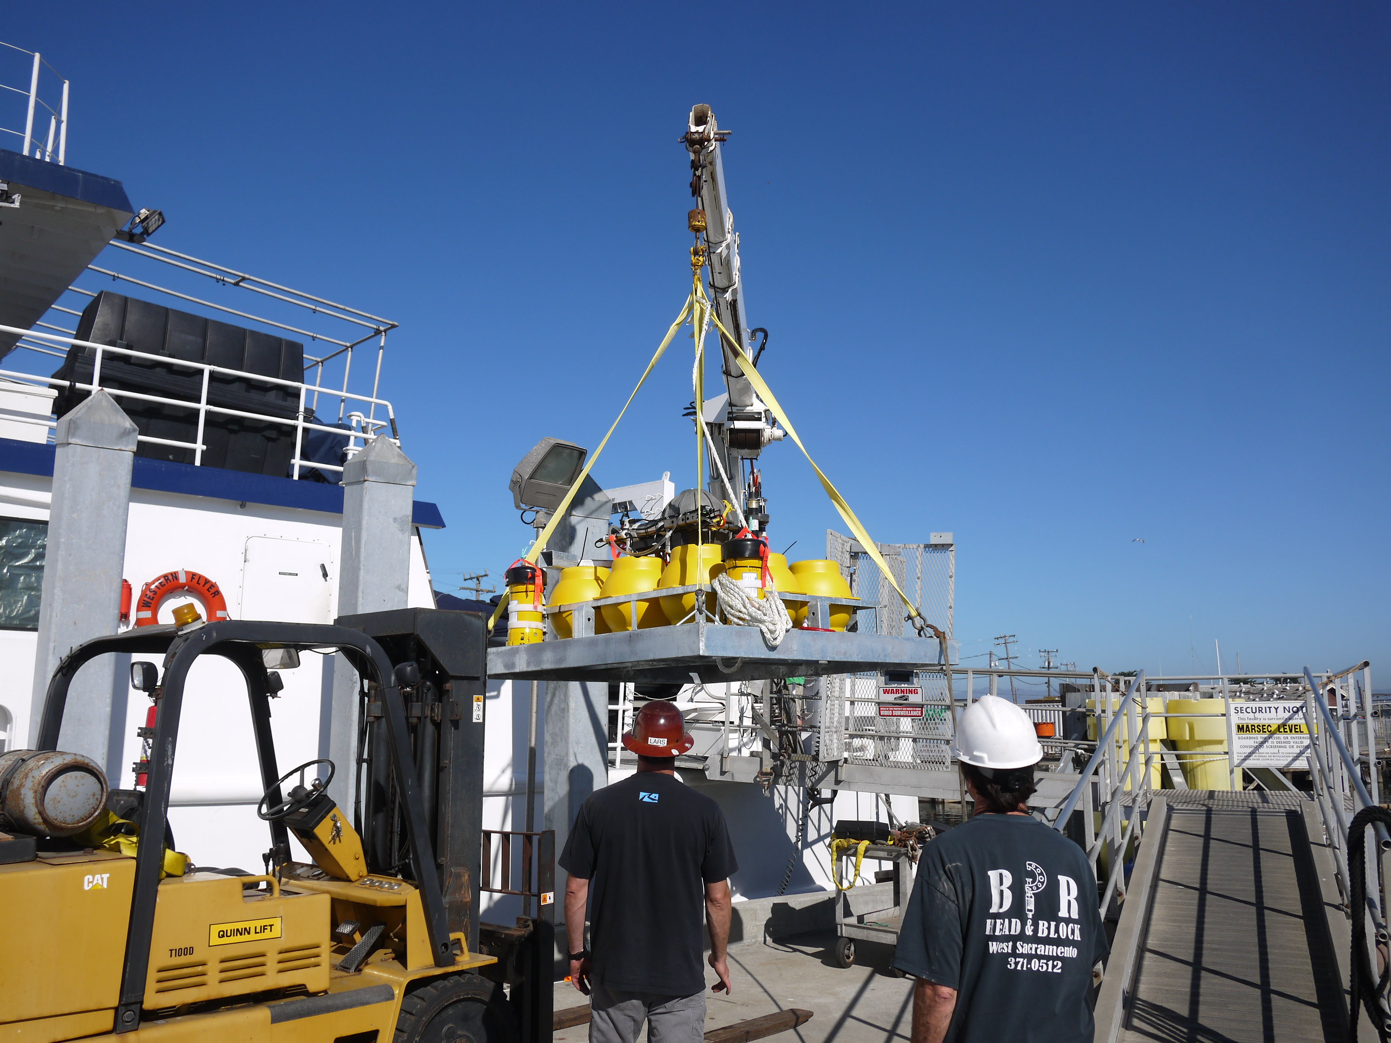

Slide 2
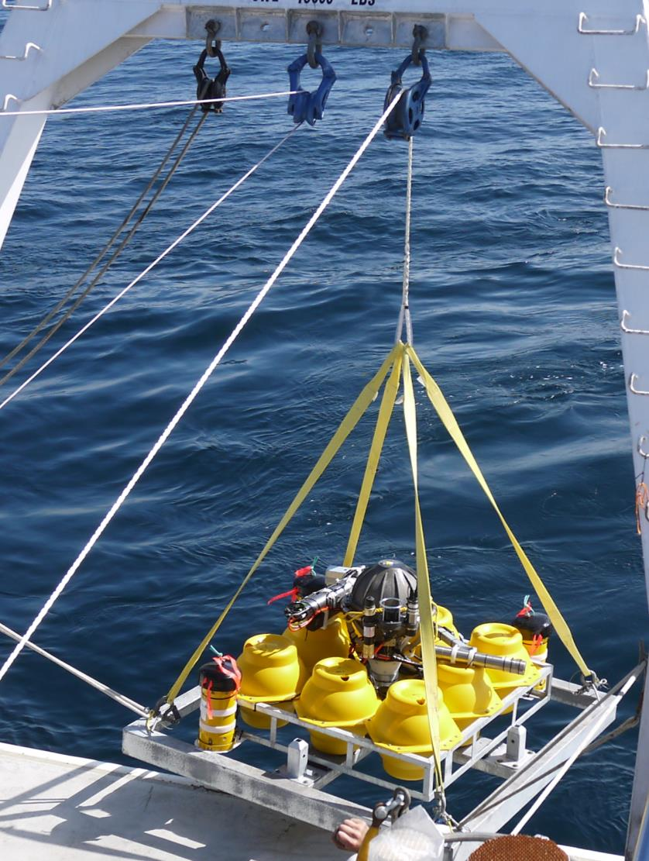
MISSING SLING
Last seen drying out in front of building B

