Slide 1
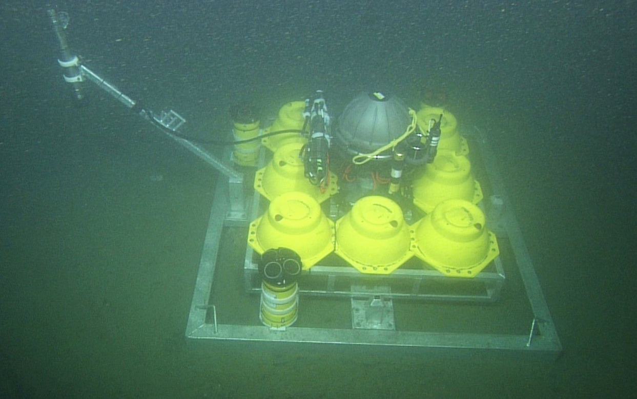
Nortek Downward Looking Doppler Micro-Profiler
Seabird Pumped CTD with Turbidity
300 kHz ADCP
600 kHz ADCP
Electronics Housing
Wetlabs Fluorometer
Acoustic Modem Transducer
Glass Spheres Housing 64 kWh of Lithium Batteries
1200 kHz ADCP
Seafloor Instrument Node operating at 1810 meters depth in the Monterey Submarine Canyon

Slide 2
Seafloor Instrument Node (SIN)
Measures turbidity, conductivity, temperature, Oxygen saturation, chlorophyll fluorescence, pressure and optical backscatter.
Multiple ADCP frequencies are supporting an experiment in estimating suspended particle size distribution in a turbidity flow from acoustic backscatter.
Sample period for all sensors is nominally 10 seconds.
64 kWh battery pack allows for six months of operation before replacement.
Acoustic modem communications to the surface allows periodic health and status checks and system maintenance.
Hardware system is designed for high reliability and includes ground fault sensing, fault isolation and redundant power paths.

Slide 3
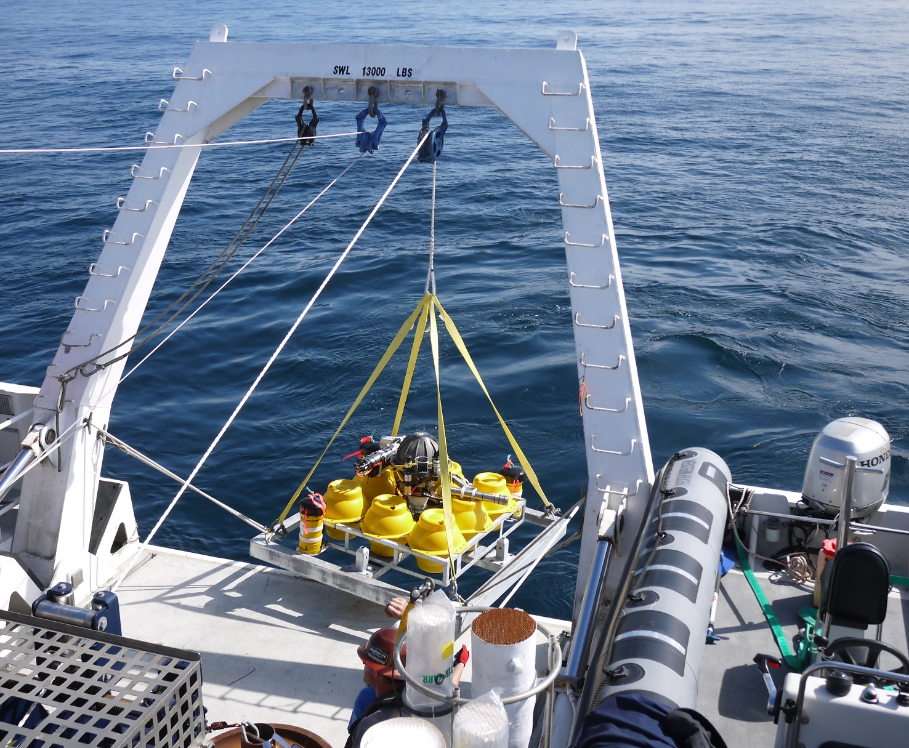
Seafloor Instrument Node Deployment

Slide 4
Seafloor Instrument Node Deployment
The 930 kg Node is lowered to the seafloor and acoustically released from the ship winch line.
A subsequent ROV dive confirms proper placement, removes the lowering sling and instrument covers.
The entire node is replaced every six months.
  ROV attaches lifting sling and “elevator” reel brings line to the surface.
  Line is retrieved by ship and placed on winch and the node is hoisted to the surface.

