Slide 1
Canyon Dynamics BIN Node Engineering

Slide 2
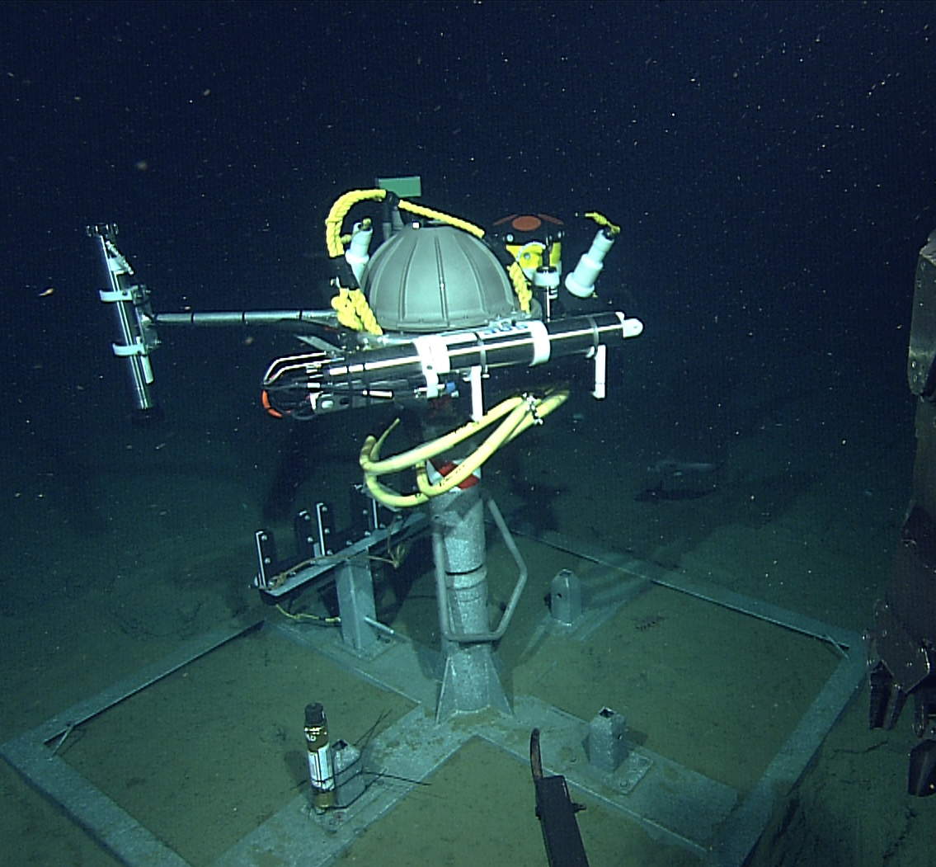
MUCE benthic instrument node (BIN)
RDI ADCP Current Sensor
Nortek “Aquadopp” micro current profiler
Wetlabs “triplet” backscatter and fluorometer
Aanderra O2 sensor
SeaBird SBE16 with CTD, backscatter and Cstar transmissometer
Notes:
This slide shows the MUCE benthic instrument node with all of it’s instruments.
The RDI sentinel ADCP measures ocean currents looking upward 100 meters above the instrument.
The Aquadopp micro profiler measures currents in the last meter to the seafloor.
The BIN is keyed to the stand so that it’s orientation exposes the instrument to the least possible wake disturbance and the orientation is maintained during replacement.
The connections to the BIN take place in the connector manifold on the far side of the frame. This manifold can be placed by the ROV in any of four locations for best access.

Slide 3
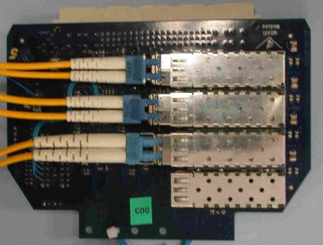
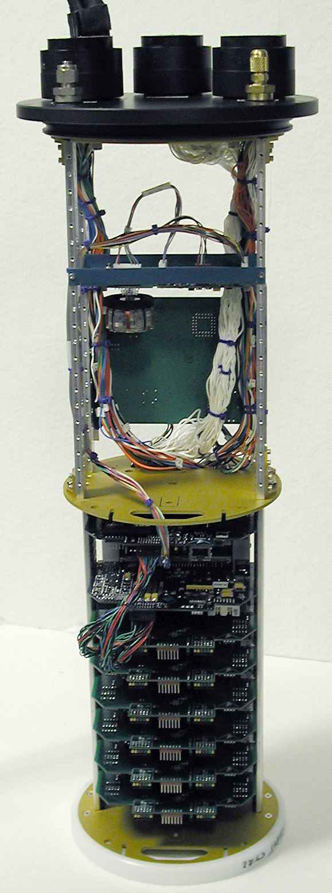
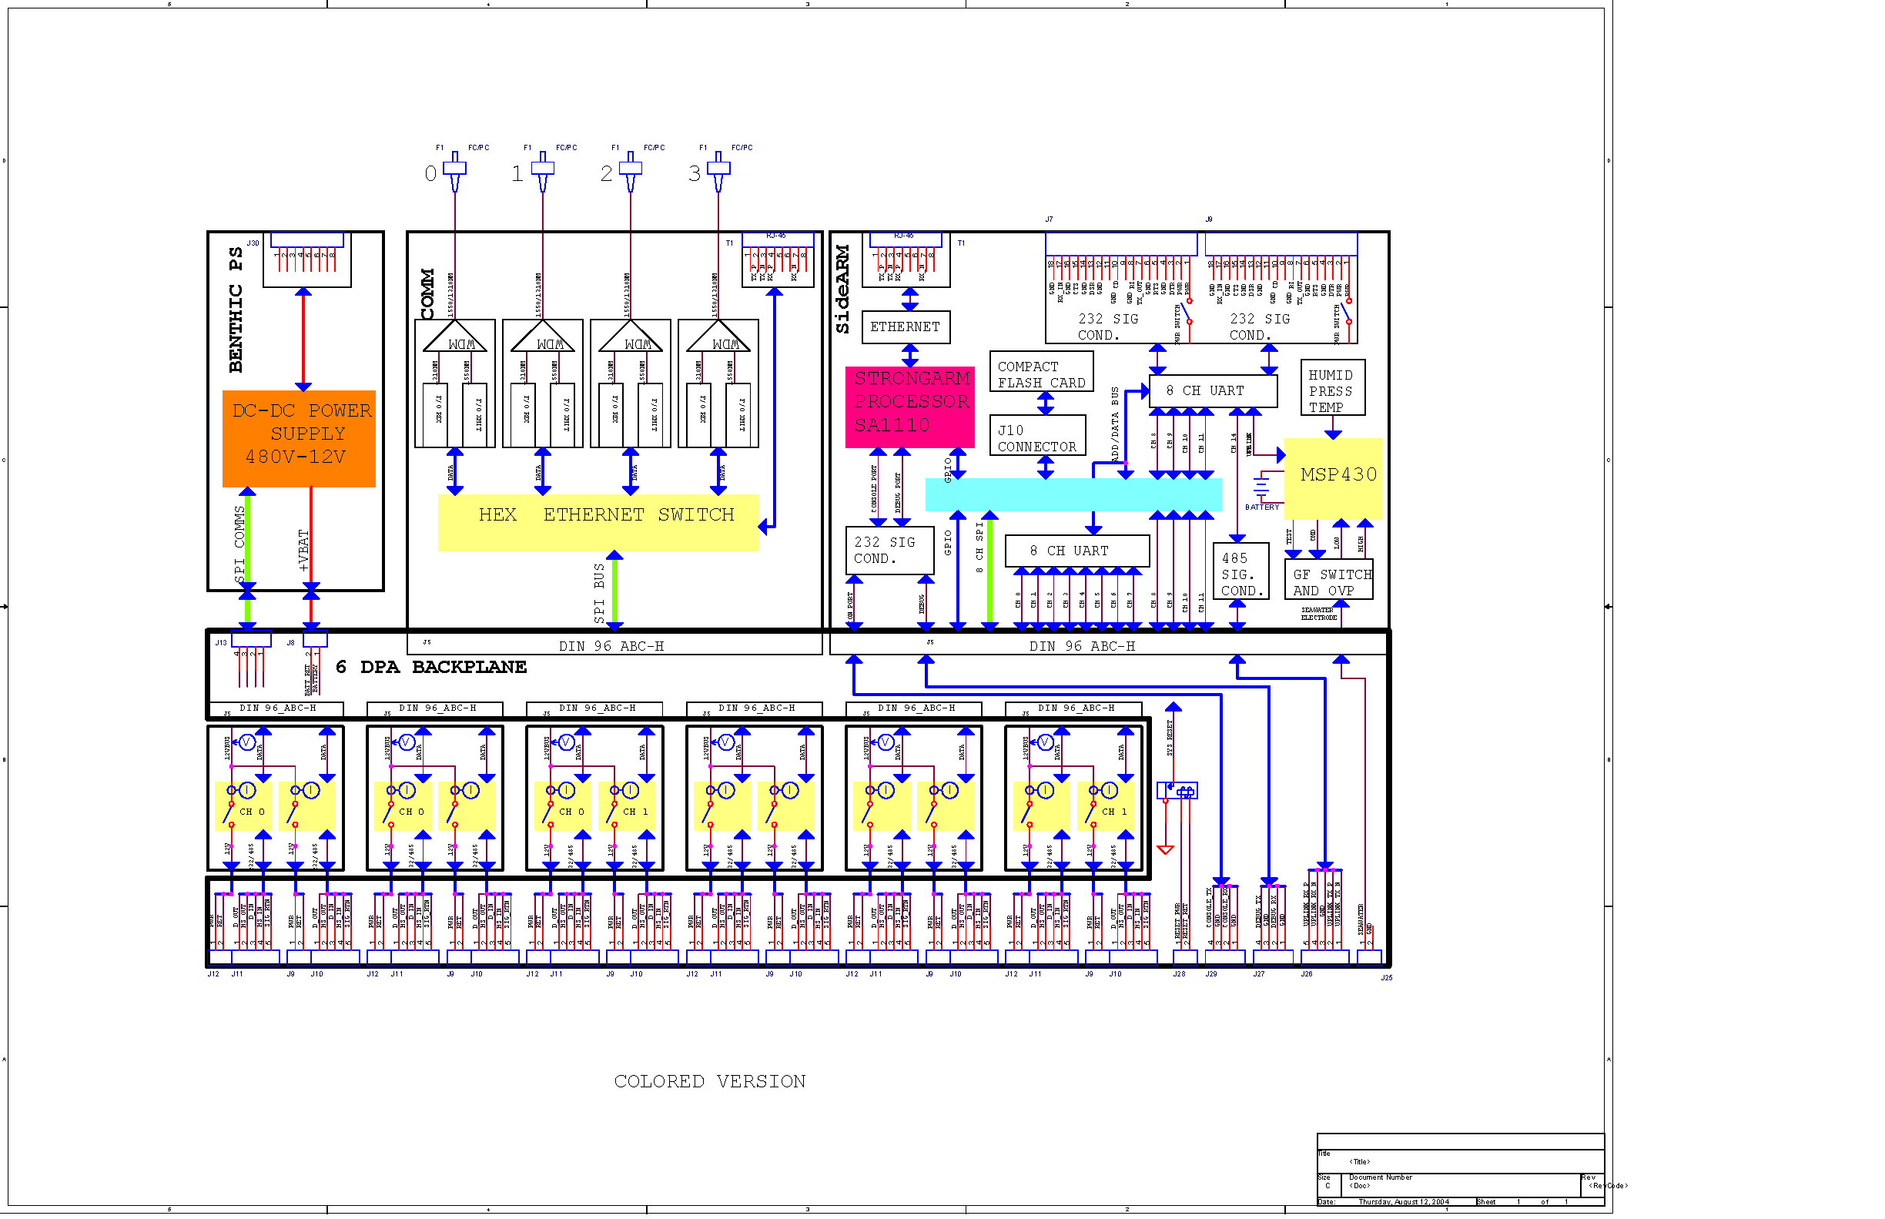
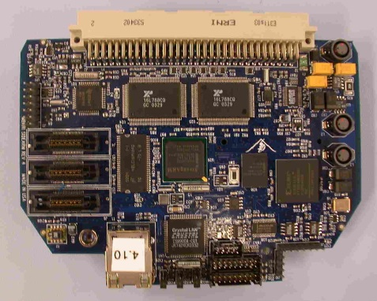
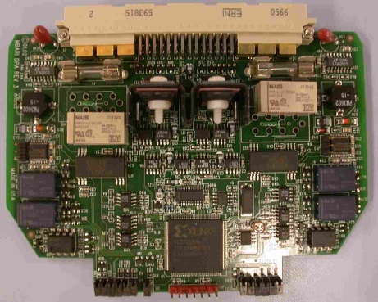
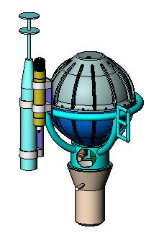
MOOS Mooring Controller
Notes:
The MOOS mooring controller hardware is shown here in more detail. It provides powerful computing capabilities to support high level languages and the computation demands of local event detection, instrument auto-configuration, mooring as “Gateway” to other platforms such as an AUV etc.
It is scalable to different numbers of instruments and low power (relatively).
The MMC consists of a network interface card that incorporates a network switch, four optical interfaces, and two 10BaseT copper interfaces.
A second card contains an SA1110 Arm 32 bit processor, UARTS and a flash memory interface for local storage of instrument data. The local storage of data is used to ensure data recovery in case of telemetry link failure and to store data that is gathered at too high a rate to economically send to shore. In this case subsets or processed data summaries are generated and sent to shore instead. When the mooring is serviced the high frequency data is recovered via high speed RF data link or during annual maintenance turn-around.
The physical instrument interface is through an additional series of cards called Dual Port Adapters (DPA cards) that can switch up to 140 Watts of power per instrument and provide a flexible and fault tolerant serial data interface.
Identical controller hardware and software is used both on the surface mooring and in the seafloor controllers called Benthic Instrument Nodes.

Slide 4
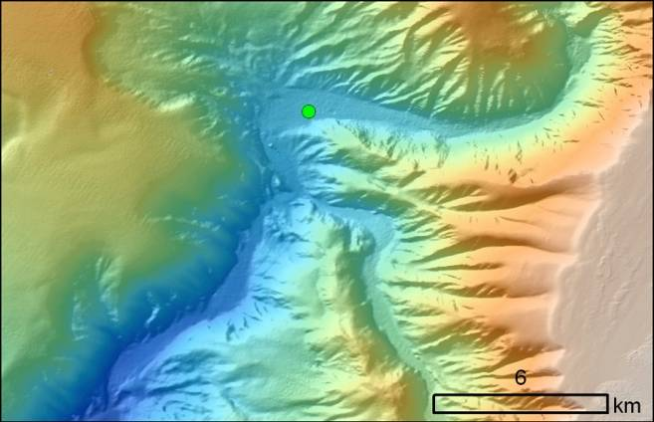
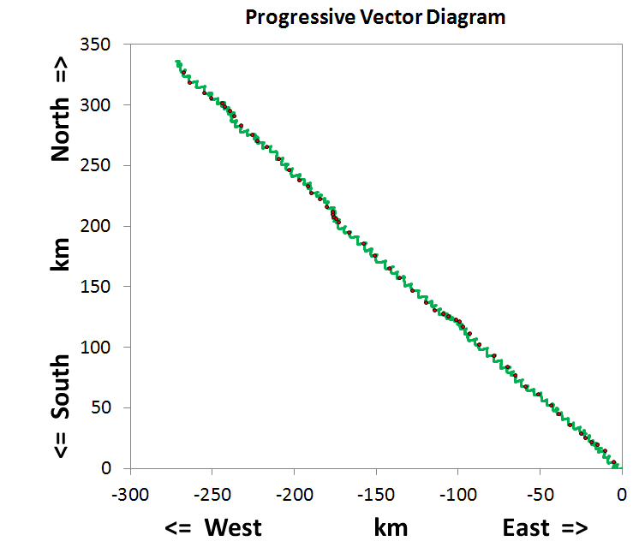
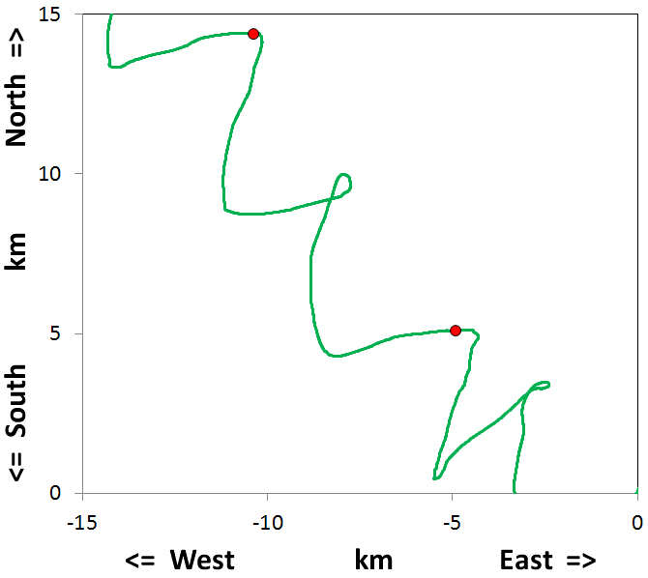
Tidal Flow Constrained by Canyon Walls
MUSE
27-April
7-March
Ebb
Flood
6-March
Ebb
Flood
6-March
Ebb
Notes:
This is a progressive vector diagram for the entire deployment period (~54 d; top right) showing that flow was quite steady in the canyon, and probably tightly constrained by the canyon walls. Because the mooring is positioned at a bend in the canyon, flow shifts in direct with the tides. Flow is WESTWARD during EBB tide (the upstream canyon channels flow along E-W). Flow is NORTHWARD during FLOOD tide, because the canyon walls upstream during flood tide are aligned principally N-S. The red dots indicate midnight each date. You can see the wider spacing of red dots (days) in the upper right plot, indicating greater flow during spring tides, and tighter spacing during neap tides when flows are weaker. Full moon (white filled circles) and new moon (grey filled circles) are indicated along the flow path.
4

Slide 5
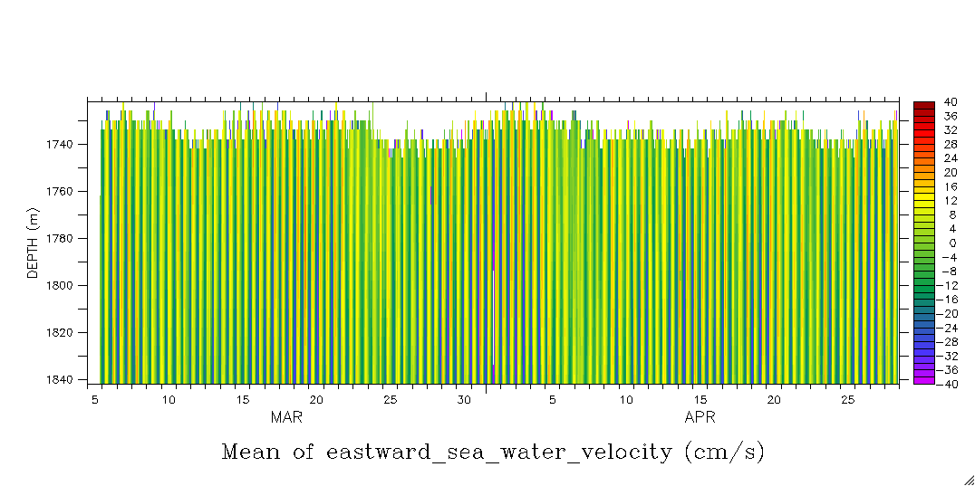
MUSE 2010: East – West Flow in the bottom 100 m
Tidal oscillation is evident, but hard to see in the entire 54 d plot
Close-up of 1 day reveals high temporal and spatial variation
Next slide
Notes:
This is the entire ADCP E-W current speed (cm/s). Can only see the oscillatory character of the data. Close up in next slide
5

Slide 6
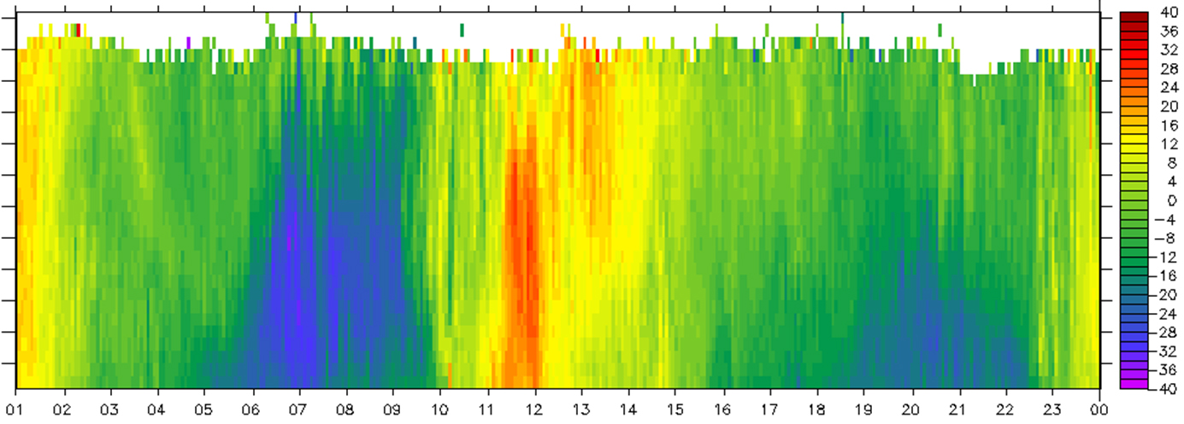
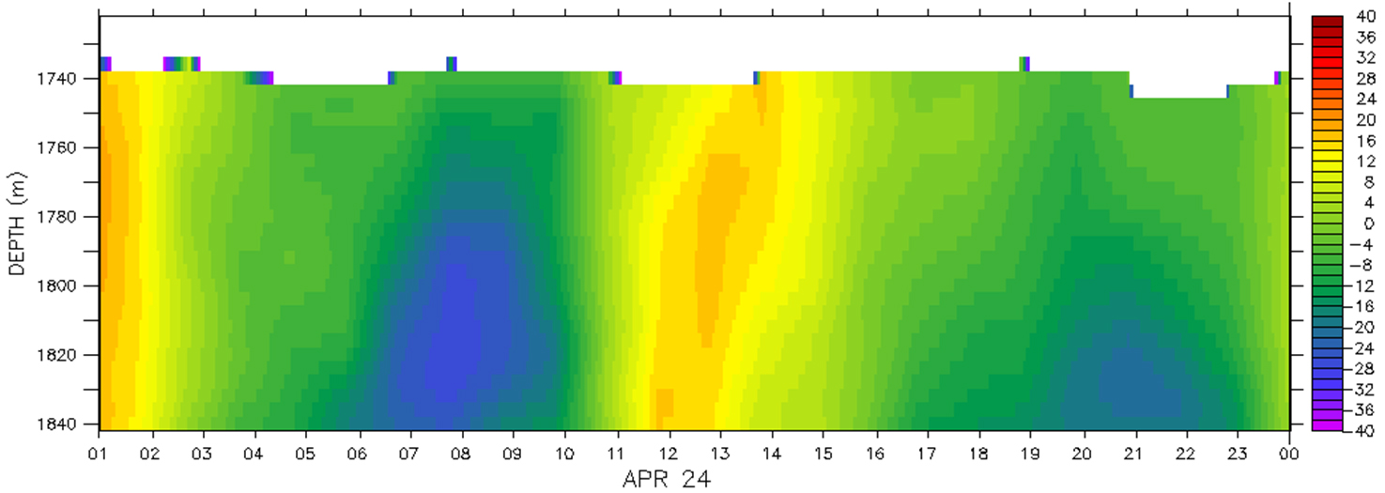
Spatial and temporal variability evident in high-frequency sampling
Fine structure not detectable in 1 h resolution data (bottom)
1740
1760
Depth
1780
1800
1820
1840
Full resolution ADCP data (1 min.)
1740
1760
Depth
1780
1800
1820
Low resolution ADCP data (60 min. from data summaries)
1840
April 24 (time of day)
Notes:
6

Slide 7
MOOS Node Instrument List
Upward looking 300 kHz RDI Workhorse Sentinel ADCP.
  Currently 1 second ping period, 60 ping ensembles (1 minute), 30 - 4 meter bins, 120 meter range. Velocity range is +/- 5m/second.
Upward looking 600 kHz RDI ADCP (Supplied by NERC).
Upward looking 1200 kHz RDI ADCP (Supplied by NERC).
Downward looking Nortek micro-profiler “Aquadopp”.
  instrument head is approximately 1 meter above the seafloor.
  At this distance the maximum measurable velocity is +/- 750mm/second.
    Is it worthwhile to include this instrument?
WETLabs ECO “Triplett”
  Fluorescence and two ranges of turbidity of 0-40 NTU and 0-400 NTU (from scatter).
  Sample period is 2 seconds.
  SBE 16+ V2 CTD.
    C-STAR 25 cm path transmissometer.
    Seapoint backscatter turbidity sensor.
      Range of 2 mV/FTU/NTU maximum scale approximately 2000 - 2500 FTU/NTU.
Oxygen Optode sensor, Aanderaa Instruments.
  Sample period 10 seconds.
  Move to a SeaBird Analog channel???
    Modify our units for analog output.

Slide 8
BIN System Design Challenges
Significant constraints
  Budget
  Engineering time allocated
  Ship “wet” over-boarding load capacities
  Data logger processing power and memory
  Individual instrument sample rate limitations
  Goal of six month deployment
Many of these constraints directly limit sampling rates
Goal is to agree on a sampling strategy for the BIN that is reliably sustainable for the service period

Slide 9
MOOS Node Sampling Rates
Preliminary test results on sampling rates
  Issues of sampling jitter.
    CPU processing limit and jitter.
  Estimate of maximum sustained rate.
    Energy budget considerations.
    Memory capacity.
  Possible strategies for sustaining high rates.
    Internal instrument logging vs SIAM logging?
      Power usage comparison?
      Adaptive sampling?
      Probably do not have software resources…
Absolute time base accuracy and requirements.
  How to reconcile event timing without GPS synchronization.
    MOOS clock accuracy and drift.
    High accuracy clock.
    +/- 2 ppm = +/- 30 seconds after six months.
  Instrument clock synchronization.
    Issue for internal instrument logging.
    How to reconstruct time records.
Estimate of additional software effort.

Slide 10
Data Verification and Snapshot Recovery
Addition of the Acoustic modem interface.
  Software and hardware effort.
  Return Data snapshots?
    Additional software effort required?
  Energy budget considerations.
HotSpot and Wave Glider use requirements.
  Schedule coordination.
  Sharing surface acoustic modem.

Slide 11
SIAM software
Java application, runs on BIN controller
Reads data through instrument serial port, logs to BIN storage
  Wraps raw data with standard header
  Summarizes data at specified intervals, summary can be retrieved via acoustic link
NOTE: BIN-SIAM not “hard realtime” system
  Instrument sampling thread contends with other system threads

Slide 12
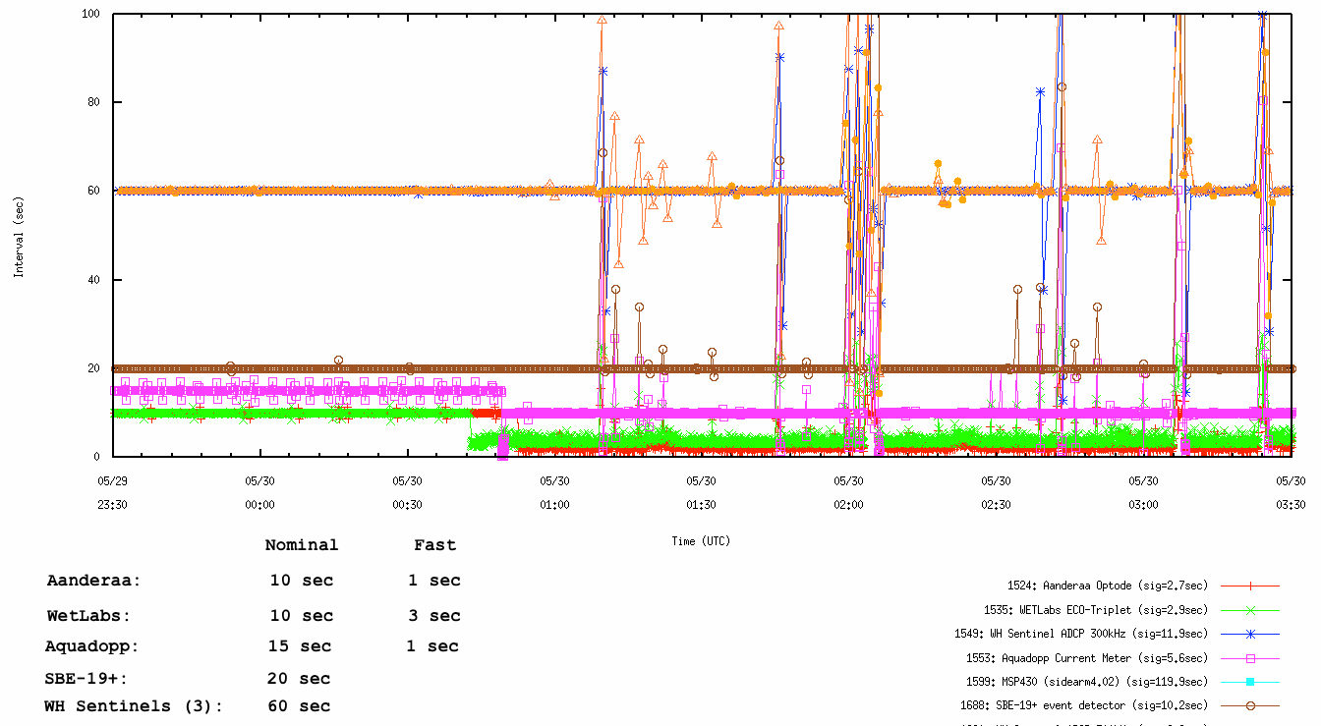
SIAM sample jitter

Slide 13
BIN-SIAM storage limit
BIN CFlash card
  32 GB standard, 128 GB max
BIN log rate = 80 MB per day
  Instrument configuration and rates at “typical” MOOS values
  SIAM debug info
  Linux logs
  Can store 400 days on 32 GB card

Slide 14
Sampling strategy
Some instruments sample rapidly, give ensemble/summary through serial port
Most instruments have internal log
  Redundant with BIN-SIAM storage
  But cannot hold entire deployment data
  When internal log full, most instruments STOP; we’d need to periodically erase log!
  Clock-sync issues

Slide 15
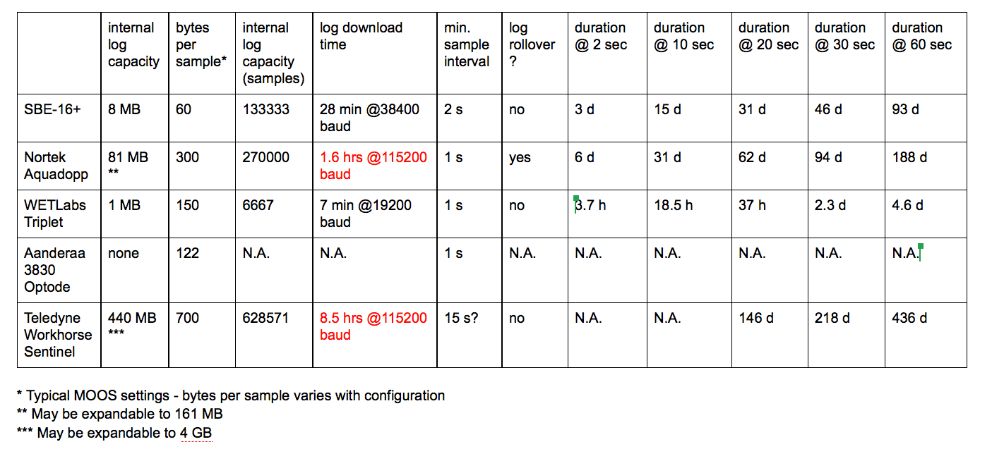
Internal instrument log duration

Slide 16
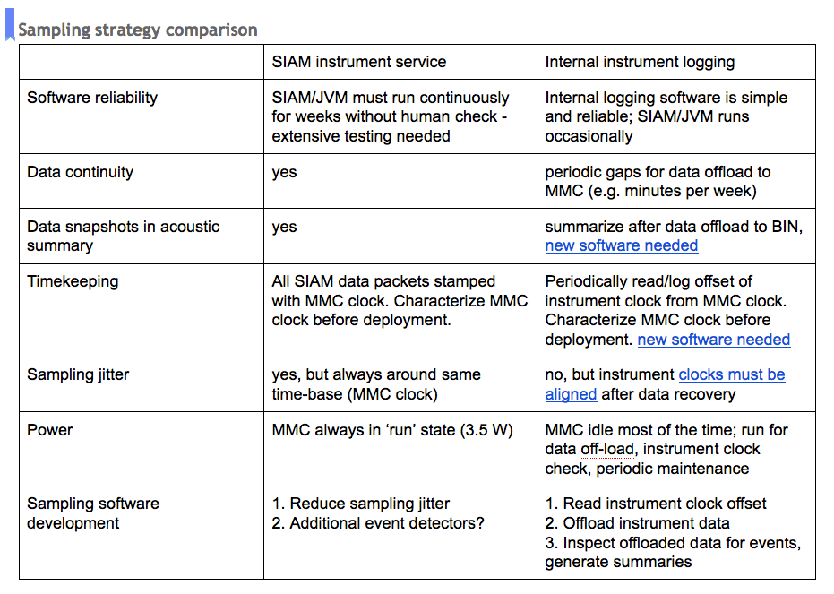

Slide 17
MOOS Platform Energy Budget
Battery Technology trade-offs.
  Li-SOCl2, alkaline or lead acid?
    Li-SOCl2 = 755 lbs.
    Alkaline = 4095 lbs.
    Wet lead acid = 5763 lbs.
  System weight and volume with Li-SOCl2 (8 spheres).
  Replacement frequency.
    Batteries are lower cost than ship time!
    Cost analysis show that 6 month service interval is less expensive overall than 3 month interval.

Slide 18
Cost Tradeoffs in ADCP Power Levels
This value was used in the proposal
Workhorse ADCP Power Levels in Watt Hours (each of 3 units) | Number of Battery Spheres Necessary | Total System Battery Cost (3 X 6 months) | Estimated Total Deployment Weight (lbs.)
1.0 | 7 | $162,000 | 1852
1.3 | 7 | $171,000 | 1874
2.0 | 8 | $196,000 | 1970
2.2 | 9 | $206,000 | 2030

Slide 19
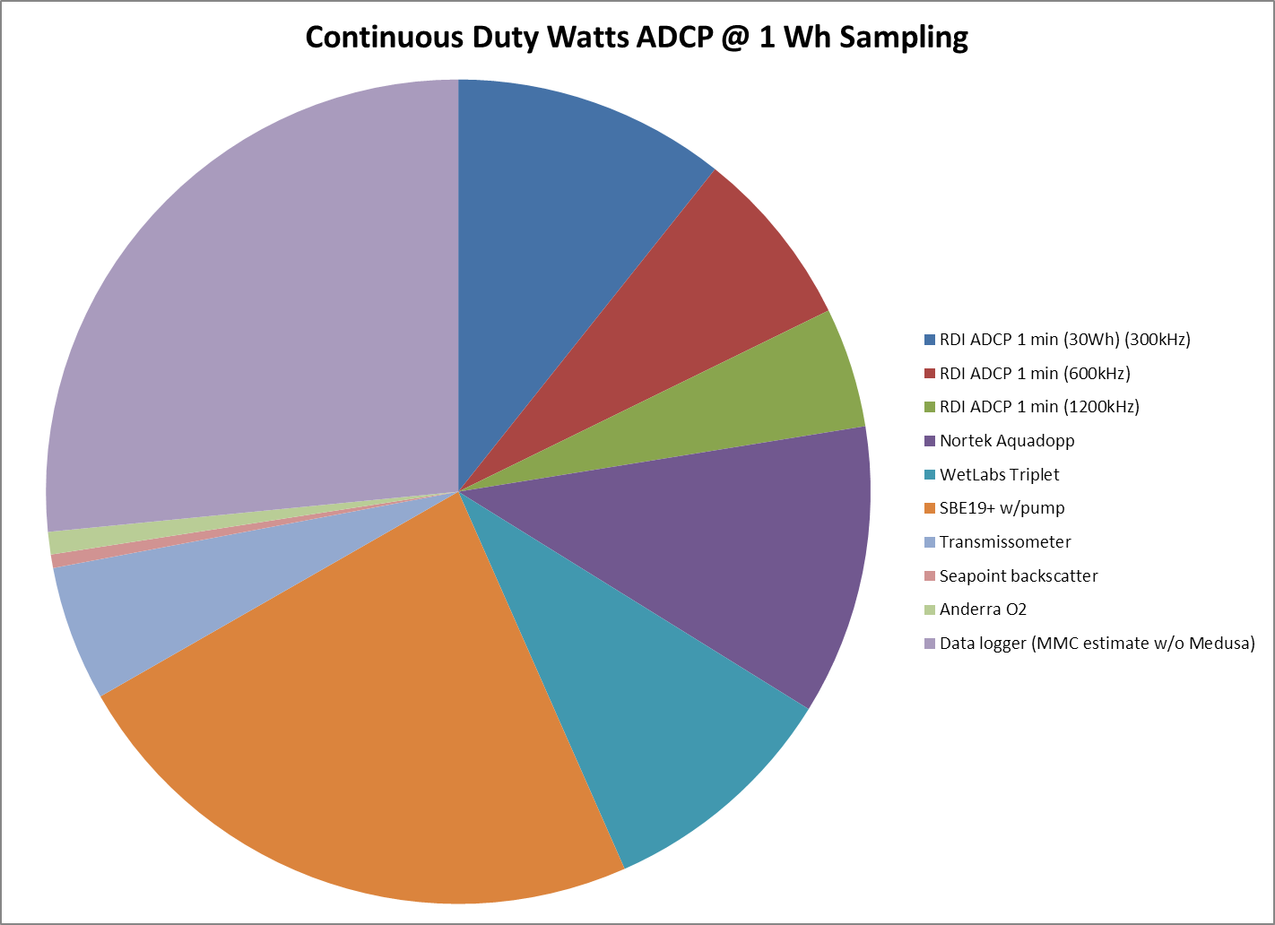
Energy Use with ADCP Sampling at 1 Wh level
Data Logger
SBE19+

Slide 20
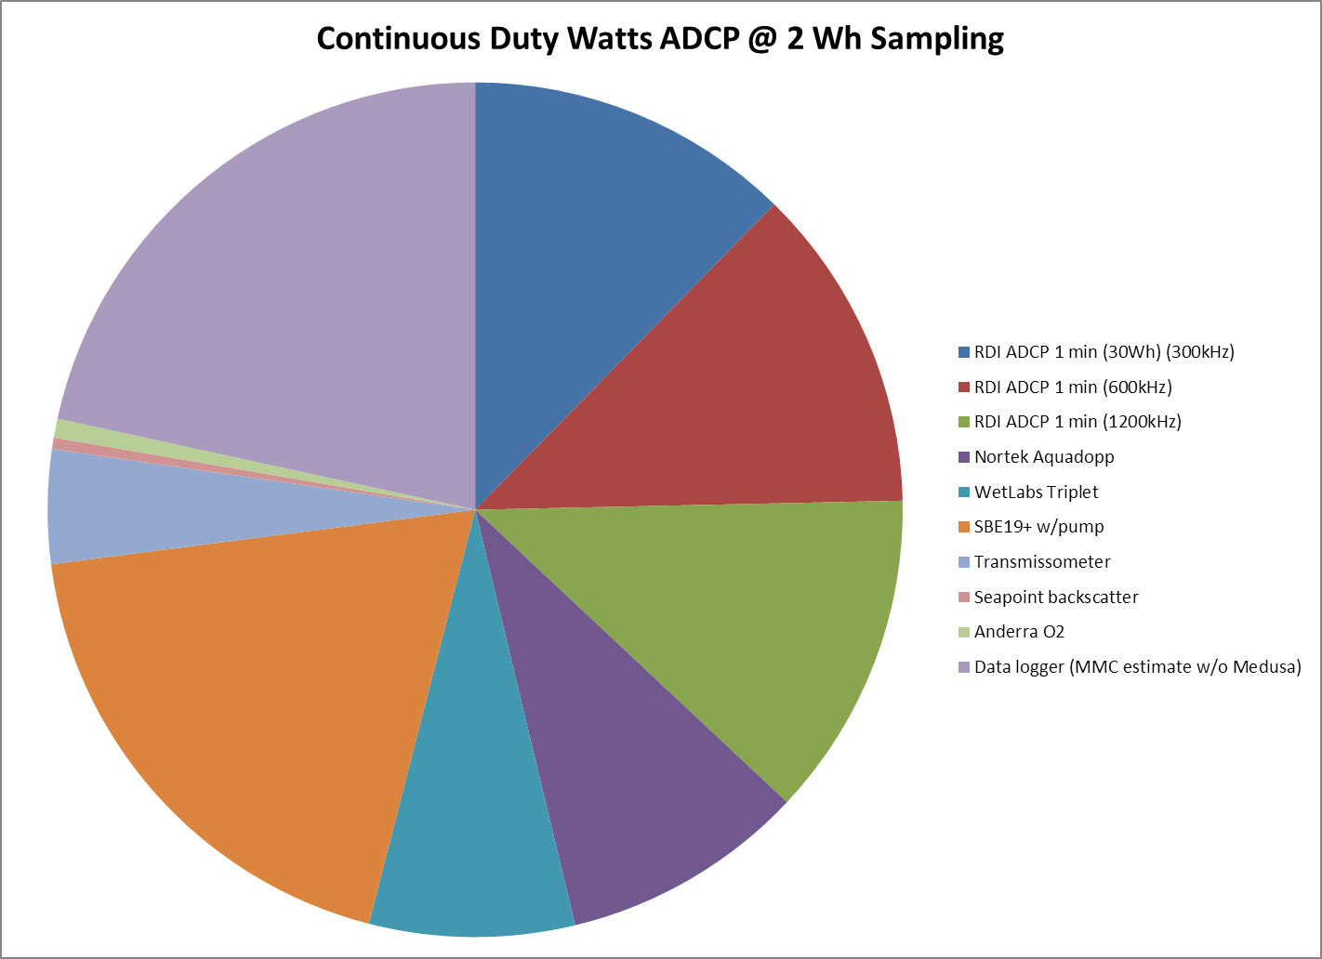
Energy Use with ADCP Sampling at 2 Wh level
Data Logger
SBE19+

Slide 21
Workhorse ADCP Cell Size vs Range

Slide 22
Maximum ADCP Ping Rate Based on Available Battery Power
Maximum Ping rate increases linearly with available power - Roberto

Slide 23
ADCP sampling decisions and considerations
Available power
Asynchronous sampling
Range and cell size for each ADCP: relationship with sed. trap heights and cell size overlap between ADCP’s
Ensemble sizes
Pings evenly spaced or at the beginning of the ensemble?
External vs. Internal Storage
Aquadopp: What’s the maximum velocity it can measure?

Slide 24
MOOS Node Platform Preliminary Design
Integrated vs separate battery module design.
  Integrated design eliminates benthic cable and ROV hookup requirement.
Structure mock-ups.
  Concept A – Similar to current design.
  Concept B – Trawl resistant bottom mount.
  Concept C – Short mooring mount?
Current measurement biasing issues (downward looking profiler).
Installation and recovery plan.

Slide 25
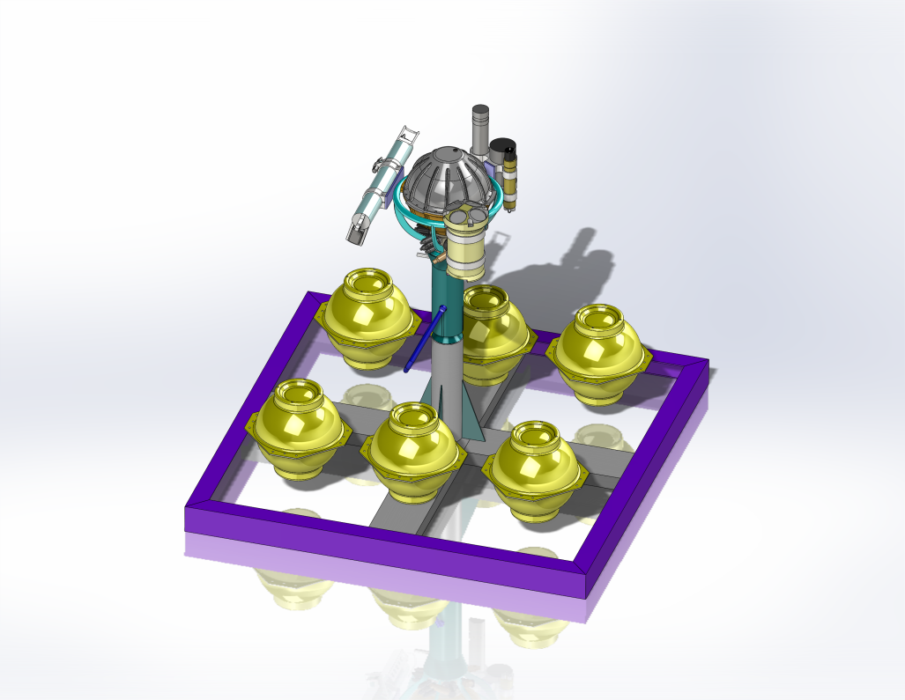
MOOS Node Platform Preliminary Design Concept A
Similar design to that used in previous deployments.
Instruments positioned above seafloor and mud.
Heavy steel frame provides anchoring weight and structure.
NOT trawl resistant!
Attachments for deployment need to be worked out.

Slide 26
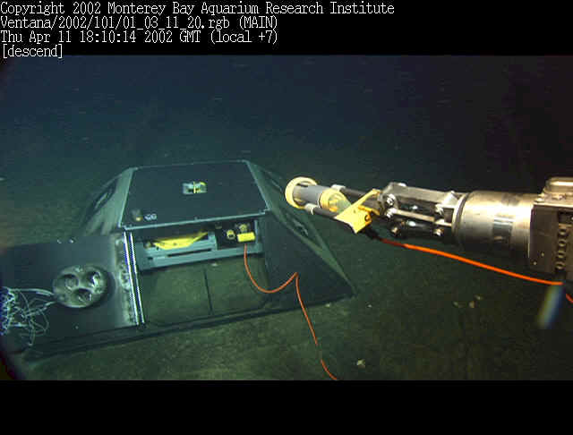
MOOS Node Platform Preliminary Design Concept B
Trawl resistant bottom mount.
Instruments positioned near the seafloor and possible contamination.
Heavy steel frame provides anchoring weight and structure.
Easier to deploy?

Slide 27
MOOS Node Platform Preliminary Design Concept C
Short mooring design.
Instruments positioned above the seafloor and possible contamination.
Deployment and recovery possible without ROV?
How to incorporate the downward looking ADCP (Aquadopp)?
Concern about tilt in tidal currents and turbidity events?

Slide 28
MOOS Node Deployment and Replacement Strategy
Similar to previous MOOS Node deployments.
  Node is deployed as one unit rather than in separate deployments for BIN and the support frame.
  Maintain identical node for lab testing and field swap.
    Provides nearly continuous experiment presence.
    Provides ready spare in case of need to replace field unit.
    Will have to download and swap two ADCP’s at sea.
    Extra cost for battery spheres is offset by lower ship time cost.
Use line spooler for BIN frame recovery.

Slide 29
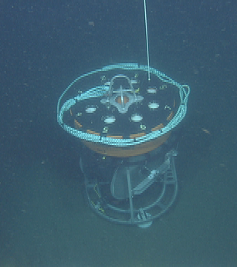
MOOS Node Recovery
Winch and line lifting capacities.
  Experience with deployment and recovery of similar loads.
  Limited by winch and deck loading to less than 2700 lbs. or 3600 lbs., depending on the winch used.
Decommissioning.
  Need to recover all hardware at the conclusion of the experiment.

Slide 30
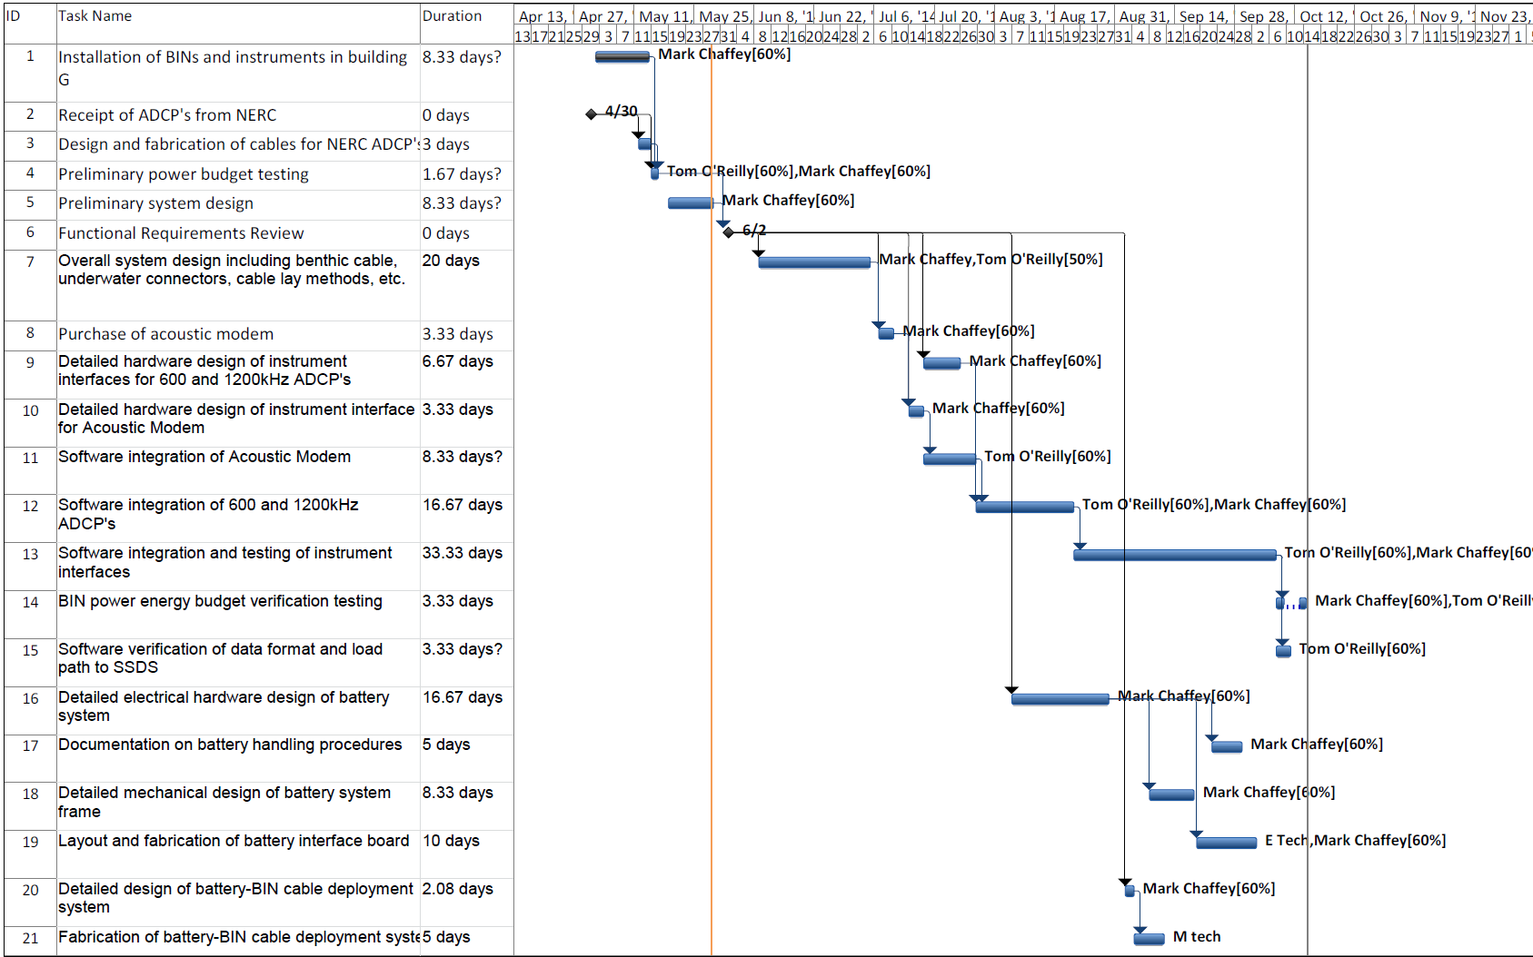
MOOS Node Development Timeline

Slide 31
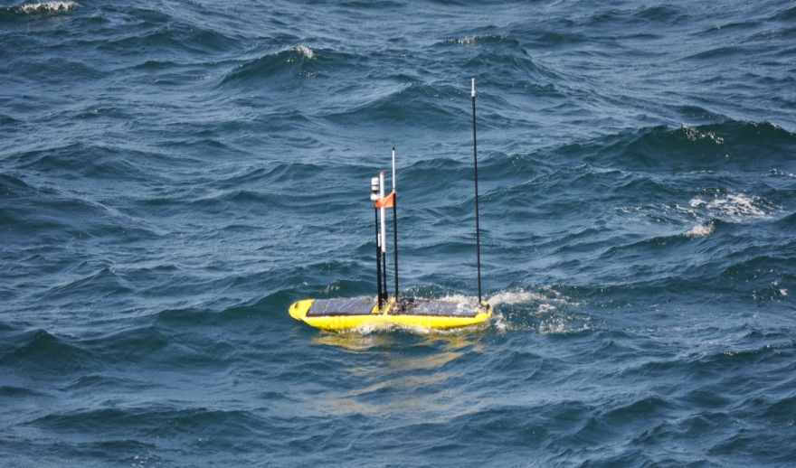
Areas of Concern
High risk areas.
  Deployment or recovery damage
    Node not landing upright on seafloor
  Mooring logger hardware or software failure
  Failure of individual instrument
Mitigation strategies.
  Design node frame for proper balance
  ROV visual check after deployment
  Periodic status checks
    Use Paragon or Wave Glider for query from surface
    Goal would be a check about every two weeks
  Spare BIN node ready for deployment

Slide 32
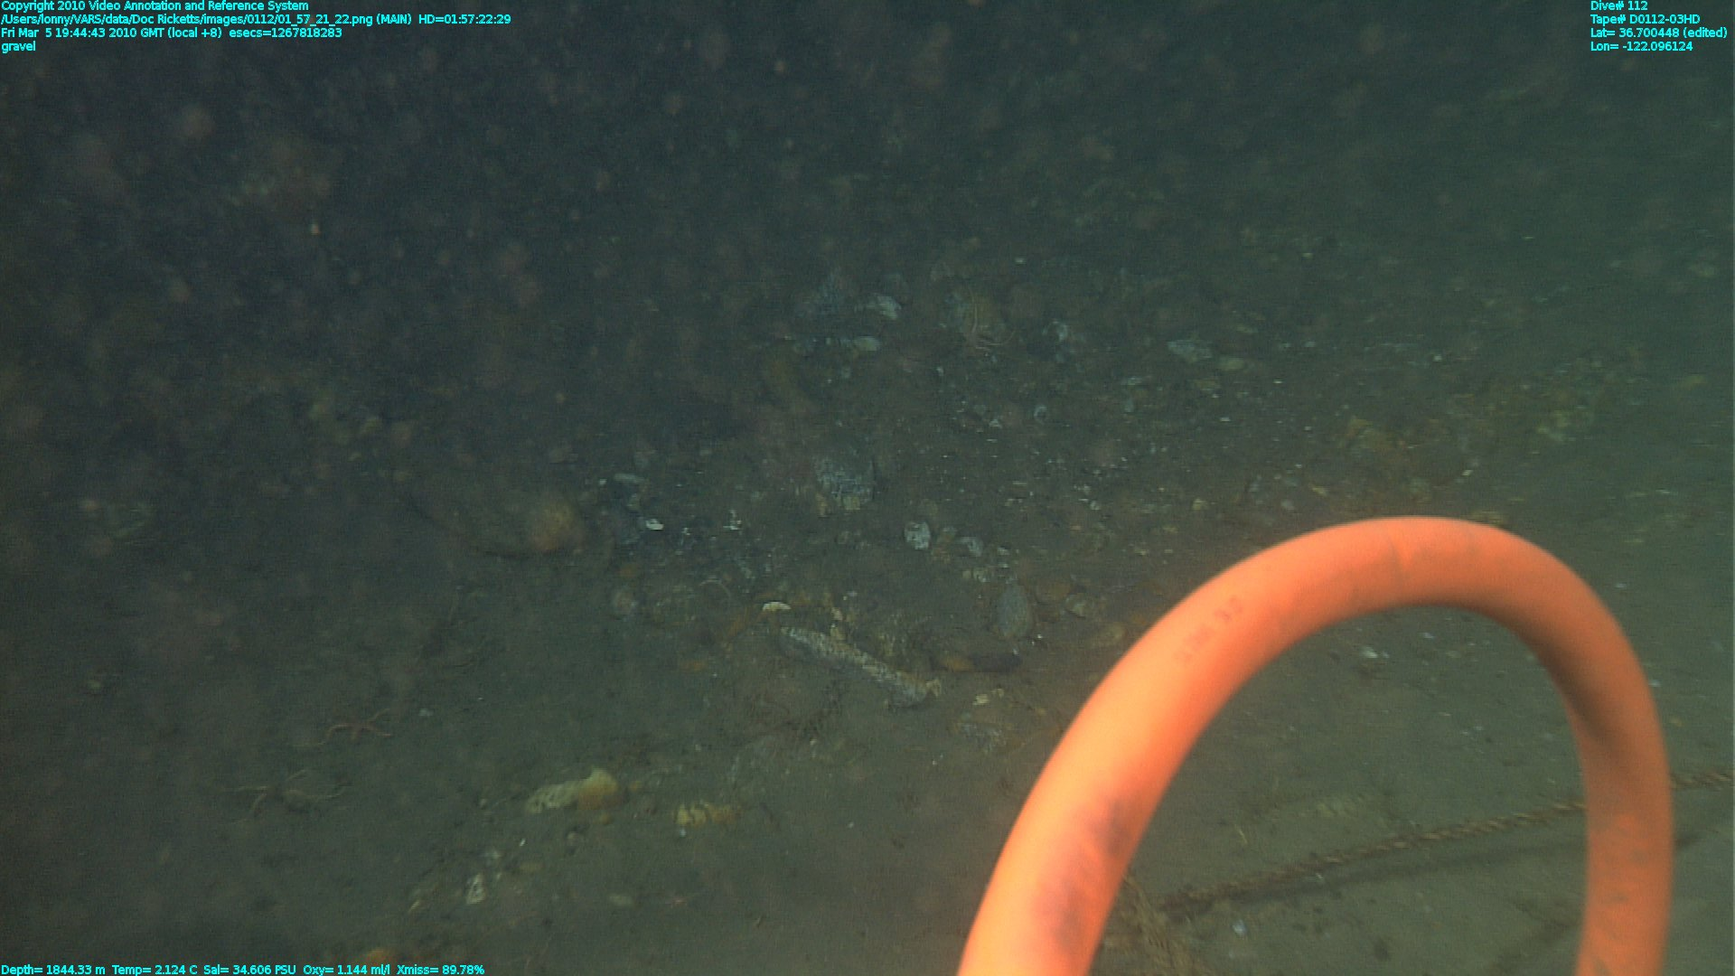
Seafloor at BIN site

