Slide 2
SIAM software
Java application, runs on BIN “MMC” controller
Reads instrument data through serial port, logs to BIN C-Flash
  Wraps raw data with standard header including system clock time
  Summarizes data at specified intervals, summary can be retrieved via acoustic link

Slide 3
Time-keeping
Realtime clock (RTC)
  Very stable: 2 ppm = 1 minute/year
  Persists through system power outage
  Set before deployment
Linux system clock (“sys clock”)
  Not as accurate as RTC
  SIAM tags received instrument packets with sys clock time
Internal instrument clocks
  Raw packets tagged with instrument clock time
  Differing precision
  Set before deployment
  Not all instruments have internal clock

Slide 4
Time-keeping
BIN boot: sync sys clock with RTC
BIN running:
  SIAM stamps acq data with sys clock time, logs data
  Occasionally logs difference between sys clock and RTC:
  System time: Sun Jun 7 18:41:51 2015
  RTC Time: 07/06/2015 06:41:49 PM
Post deployment: adjust instrument data times using SIAM timestamp, sys-RTC log

Slide 5
Science instruments
 | Sample interval sec | Internal log | Internal clock | note
Workhorse 300 | 10 | Y | Y | streaming
Workhorse 600 | 10 | Y | Y | streaming
Workhorse 1200 | 10 | Y | Y | streaming
Aquadopp | 10 | Y | Y | streaming
Seabird | 2 | N | N | streaming
Aanderaa | 10 | N | N | Polled after each Workhorse 1200 sample
WETLabs | 10 | N | Y | Polled after each Aanderaa sample

Slide 6
Workhorse configuration
 | Ensemble sec | #bins | Bin size (cm) | #pings | Sec/ping
300 KHz | 10 | 81 | 100 | 17 | 0.58
600 KHz | 10 | 74 | 50 | 20 | 0.50
1200 KHz | 10 | 43 | 25 | 58 | 0.17
All other parameters are factory default

Slide 7
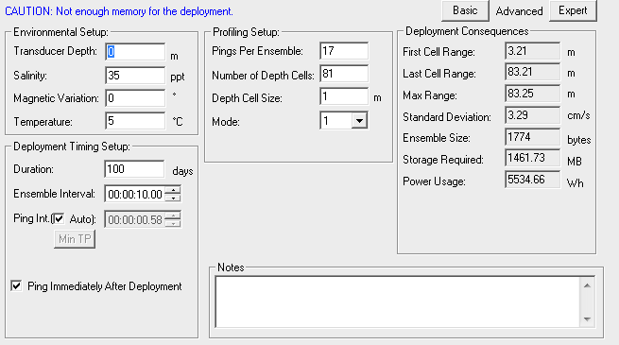
Workhorse 300KHz configuration

Slide 8
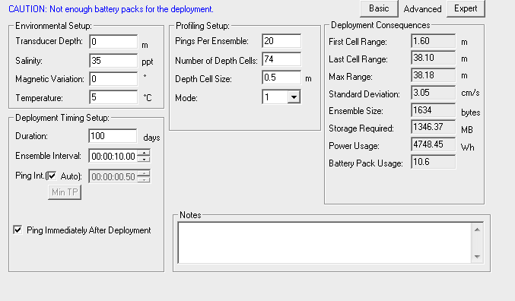
Workhorse 600KHz configuration
Details here

Slide 9
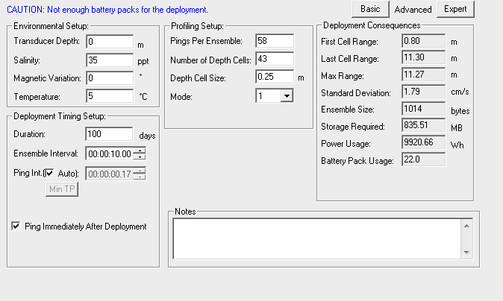
Workhorse 1200KHz

Slide 10
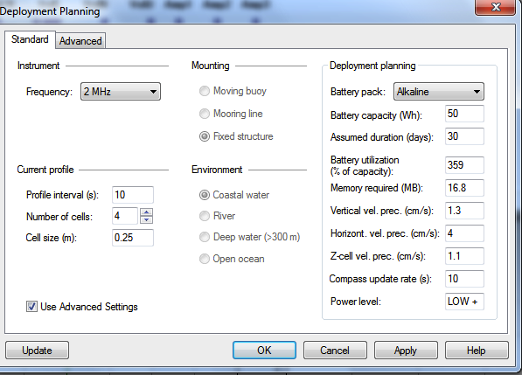
Aquadopp configuration

Slide 11
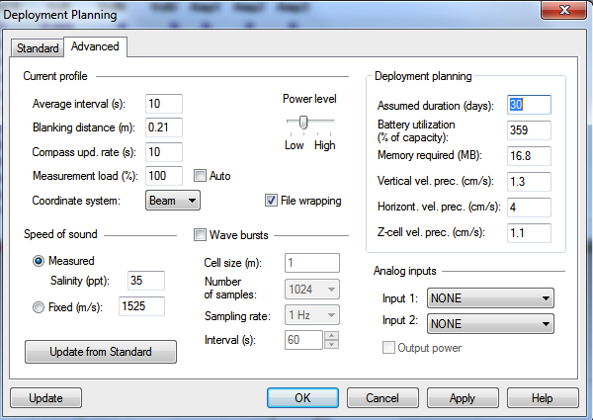
Aquadopp configuration

Slide 12
Seabird configuration
SeacatPlus V 1.6c SERIAL NO. 4952 04 Jun 2015 22:51:32
status = not logging
number of scans to average = 8
mode = profile, minimum cond freq = 500, pump delay = 3 sec
autorun = no, ignore magnetic switch = yes
battery type = alkaline, battery cutoff = 7.3 volts
pressure sensor = quartz with temp comp, range = 6000.0
Ext Volt 0 = yes, Ext Volt 1 = yes, Ext Volt 2 = yes, Ext Volt 3 = yes
echo commands = yes
output format = converted decimal
output salinity = no, output sound velocity = no
No internal timestamp

Slide 13
Seabird configuration
Sample:
Temp Press conduc volt0 volt1 volt2 volt3
transm unused turbid unused
23.4441, 0.00553, -0.206, 0.0551, 0.0000, 0.0001, 0.0000
23.4443, 0.00556, -0.183, 0.0552, 0.0000, 0.0001, 0.0000
23.4445, 0.00560, -0.253, 0.0553, 0.0000, 0.0001, 0.0000
23.4447, 0.00563, -0.192, 0.0554, 0.0000, 0.0002, 0.0000
23.4448, 0.00566, -0.221, 0.0555, 0.0000, 0.0001, 0.0000
23.4450, 0.00570, -0.201, 0.0556, 0.0000, 0.0002, 0.0000
23.4452, 0.00574, -0.235, 0.0558, 0.0000, 0.0002, 0.0000
23.4453, 0.00577, -0.206, 0.0557, 0.0000, 0.0001, 0.0000
23.4456, 0.00580, -0.221, 0.0557, 0.0000, 0.0001, 0.0000
23.4458, 0.00583, -0.192, 0.0558, 0.0000, 0.0001, 0.0000

Slide 14
WETLabs configuration
ave 20 number of measurements for each reported value
pkt 5 number of reported average measurements
set 1 number of packets in a set
int 00:00:00 interval between packets in a set (h:m:s)
rec 0 internal log disabled
Sample:
FLUOR SCAT1 SCAT2
06/04/15 22:54:27 506 13896 17333
06/04/15 22:54:27 16777 13896 17333
06/04/15 22:54:28 16777 13896 17333
06/04/15 22:54:28 16777 13896 17333
06/04/15 22:54:28 16777 13896 17333
packet = set

Slide 15
Aanderaa configuration
Protect 3830 677 0
PhaseCoef 3830 677 -2.327995E+00 1.136473E+00 0.000000E+00 0.000000E+00
TempCoef 3830 677 2.249353E+01 -3.107436E-02 2.934541E-06 -4.165899E-09
FoilNo 3830 677 1023
C0Coef 3830 677 4.270190E+03 -1.327240E+02 2.156300E+00 -1.402760E-02
C1Coef 3830 677 -2.297299E+02 5.742419E+00 -6.853580E-02 1.886120E-04
C2Coef 3830 677 5.064020E+00 -9.620850E-02 5.221810E-04 7.708902E-06
C3Coef 3830 677 -5.263319E-02 7.154669E-04 3.311850E-06 -1.861240E-07
C4Coef 3830 677 2.109169E-04 -1.840888E-06 -4.286460E-08 1.111200E-09
Salinity 3830 677 0.000000E+00
CalAirPhase 3830 677 3.148408E+01
CalAirTemp 3830 677 1.021084E+01
CalAirPressure 3830 677 1.018100E+03
CalZeroPhase 3830 677 6.597456E+01
CalZeroTemp 3830 677 1.068855E+01
Interval 3830 677 0
AnCoef 3830 677 0.000000E+00 1.000000E+00
Output 3830 677 0
SoftwareVersion 3830 677 3
SoftwareBuild 3830 677 7
Sample:
MEASUREMENT 3830 677 Oxygen: 238.10
Saturation: 93.52 Temperature: 25.65

Slide 16
Internal instrument logs
 | Internal log capacity (MB) | Bytes per sample | Sample interval (sec) | Log endurance
Workhorse 300 | 4091 | 1774 | 10 | 266 d
Workhorse 600 | 4091 | 1634 | 10 | 290 d
Workhorse 1200 | 2302 | 1014 | 10 | 263 d
Aquadopp | 161 | 68 | 10 | 274 d
Seabird | 8 | 62 | 2 | 3 d, disabled
WETLabs | 1 | 150 | 10 | 18 h, disabled
Aanderaa | 0 | 91 | 10 | N.A.

Slide 17
SIAM instrument logs on BIN
Instrument data logged to 32 Gbyte C-Flash
  Total 29054656 1K blocks available
  Measured log rate = 80832 blocks/day
  C-Flash fills in 359 days
Raw data “wrapped” with header, including BIN system clock time-stamp
Utility to unwrap raw data – process with manufacturer software
Notes:
Log rate includes instrument logs, software log

Slide 18
Sampling “jitter”
BIN Linux and SIAM java app are not “hard realtime”
Multi-threaded application. Sampling threads contend with
  Other SIAM threads
  Java garbage collection
  Linux processes
Jitter is deviation from nominal sampling interval (ideally 0!)

Slide 19
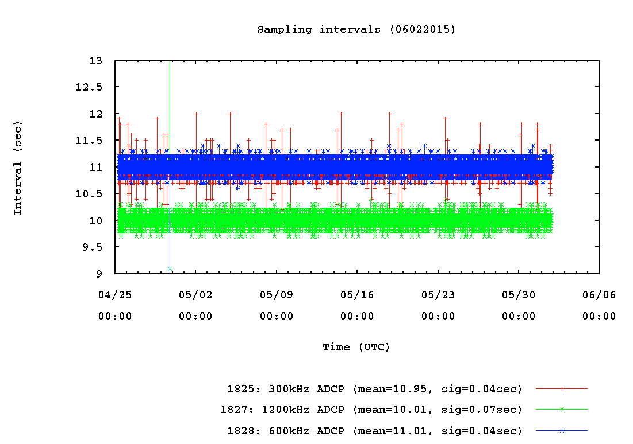
Workhorse ADCP sampling jitter
300, 600KHz take 11 s at 9600 baud
Notes:
Baud=9600 – 300KHz and 600KHz unable to output at 10 sec intervals. If baud increased to 115200, they can.

Slide 20
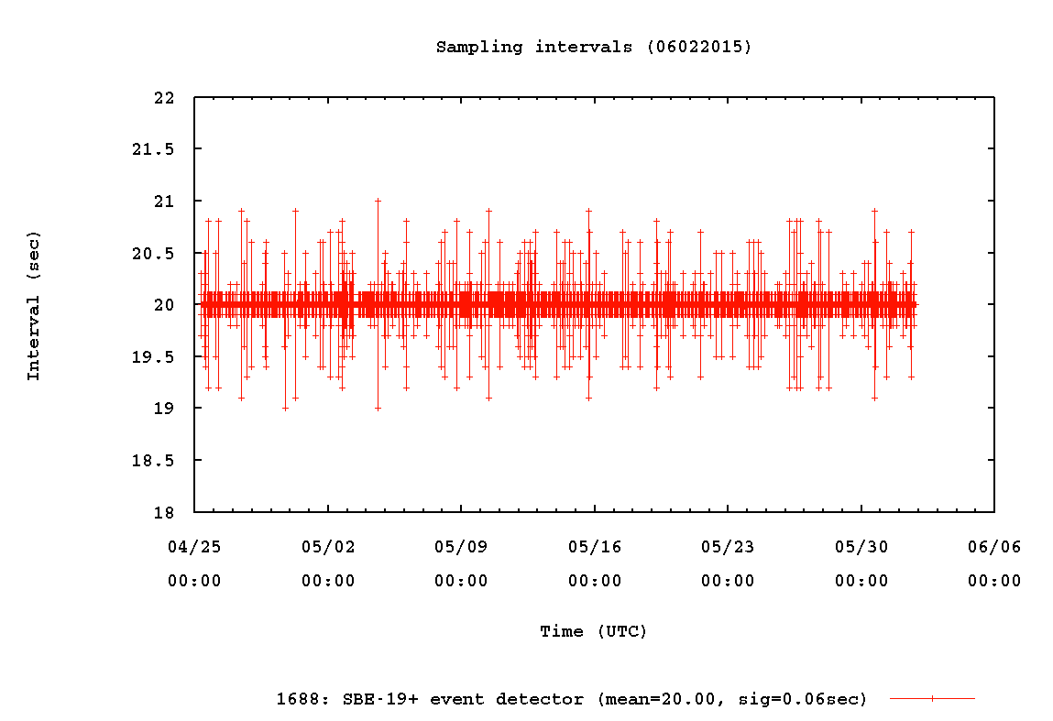
Seabird sampling jitter

Slide 21
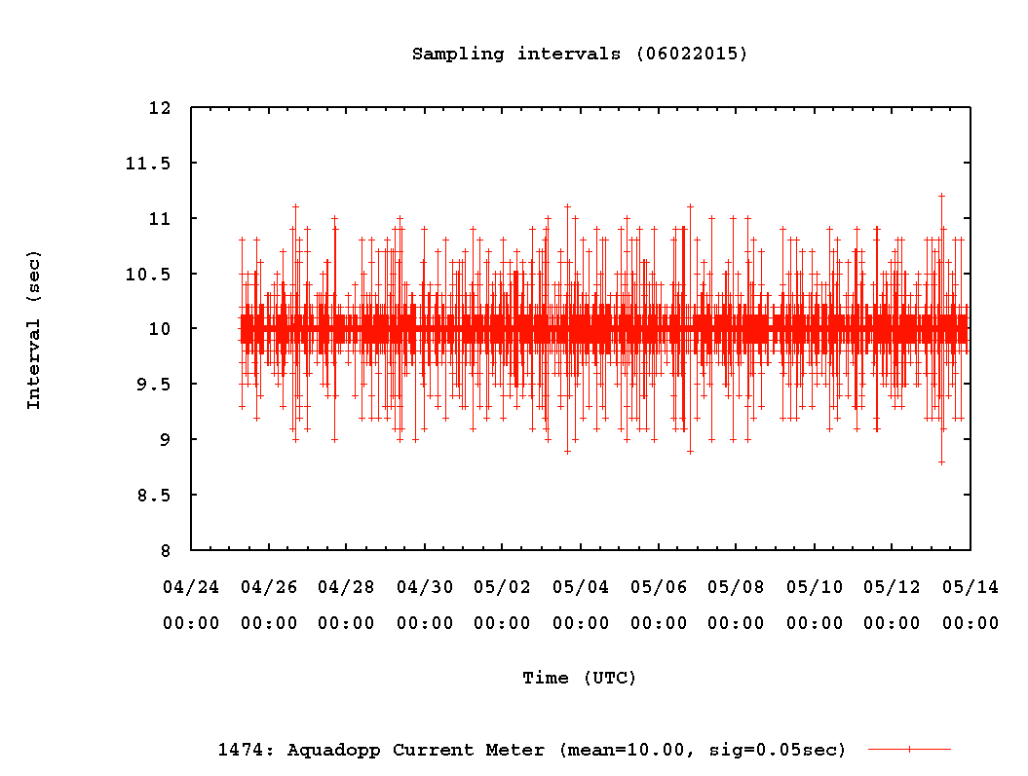
Aquadopp sampling jitter

Slide 22
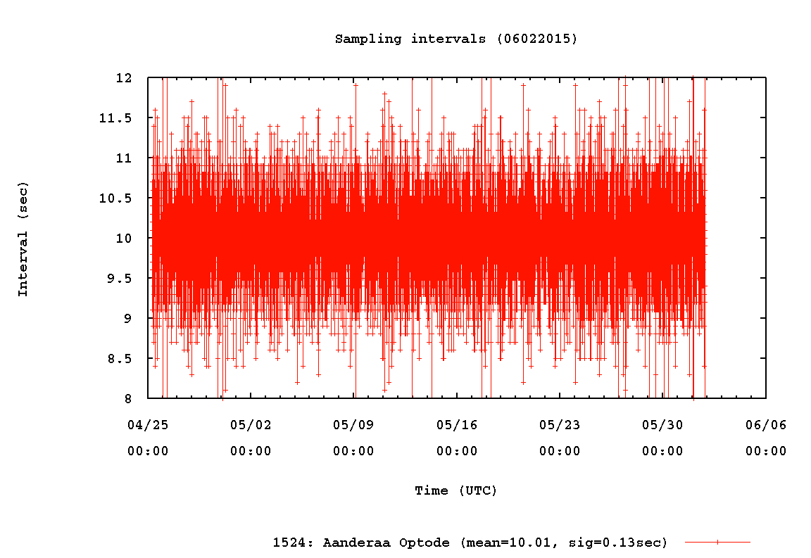
Aanderaa sample jitter

Slide 23
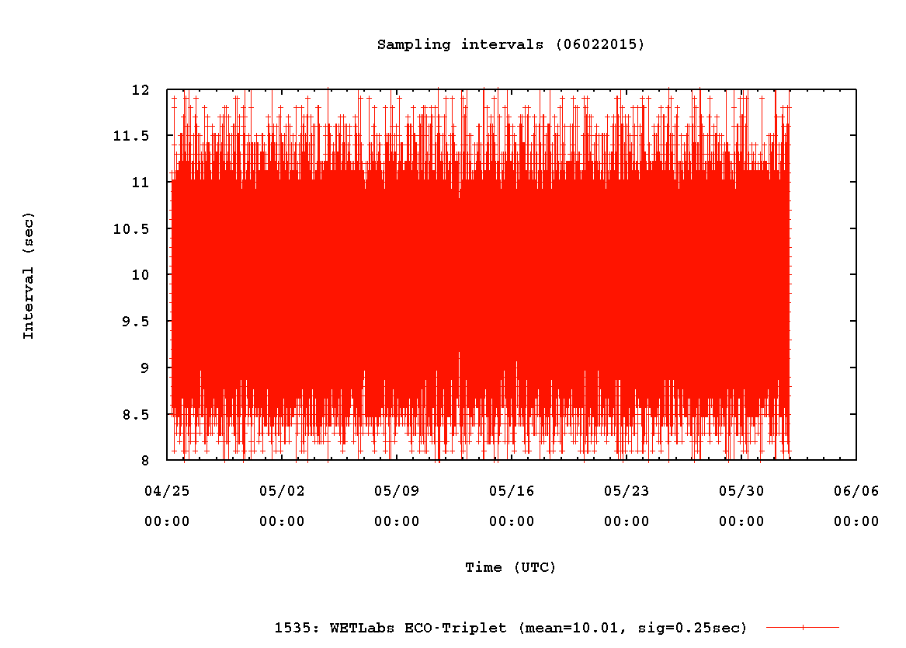
WetLabs sample jitter

Slide 24
Instrument calibrations
Info goes here

Slide 25
Instrument issues to be addressed
Address Workhorse ensemble time issue
Set up spare BIN, instruments
Data validation in test tank
Validate processing of SIAM instrument logs
  Existence proof from previous MOOS deployments
Verify instrument overcurrent trip settings
Aquadopp data outage; stopped sampling after 2.5 weeks after configuration in May

