Slide 1
MBARI WISSL Update 9/18/2024

Slide 2
Status Update
Optics/Optical Bench Functional
  8 week lead time for few components
Integrating in Parallel - Electronics/Optics - PCBs, Optics, Optical Bench, test, start Calibration, add in final part
Emergency Shut off - tested without laser, need to order PCB - not critical schedule item
SW - Most items 90% - TEC, Bias control for Tx, Rx board (almost complete)
Pressure Test - Near end of October
Temp Sensing – Expectation: Functional but not including final algorithms – to update schedule
FAT Planning – to commence

Slide 3
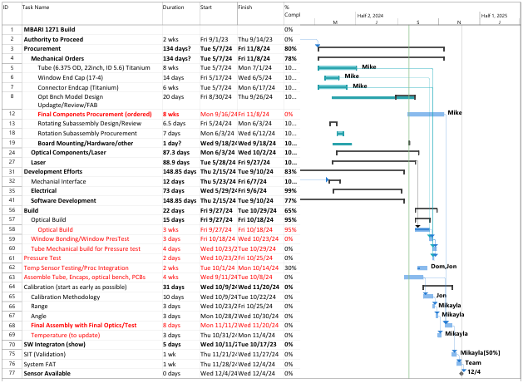

Slide 4
Actions:
Nelson determine if MBARI requires a laptop – communicate with Eric
Nelson work with Eric for power supplies at 18V, 26V
Current requirements
Dom – to update SW part of FAT prior to meeting with Eric
Nelson – to update FAT and review with Eric to complete document

Slide 5
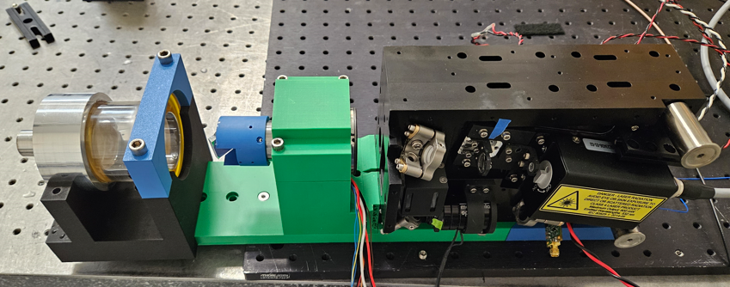
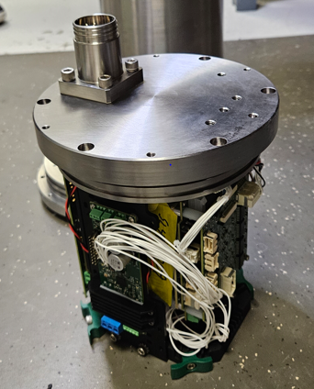
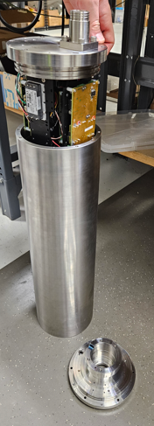
Photos

