Slide 1
MBARI WISSL Mechanical Housing Design Review
December 19, 2023

Slide 2
Background / Topics
Requirements /Goals
Mechanical Housing with Connector
Mechanical Analysis
MBARI Feedback

Slide 3
PROPRIETARY INFORMATION
NOTICE: This presentation contains 3D at Depth Confidential and Proprietary information.
In order to better describe some of the design decisions and options, this presentation contains details about the internal architecture and design decisions for 3D at Depth’s current 3D laser scanning products. Therefore, this information should ONLY be shared with MBARI employees who need to read and evaluate the presentation. 3D at Depth appreciates our customers taking the appropriate safety measures when distributing this information internally.

Slide 4
Requirements – WiSSL Gen 2
Reference WiSSL Upgrades Wishlist_R1_1.PDF
Highlighted Requirements | Must | Goal | Currently | 6000m Option
Depth Rating | 4000m |  | 4000m | 6000m
Size | < 20” diameter, < 3ft long | 6.25” diameter, < 20” long, 26.6” tip to tip discussed | 6.25” Diameter, 22” Tube Length, 28.1” Tip to tip | 6.375” Diameter, 22” Tube Length, 28.1” Tip to tip
Field of View (FoV) | 80° | 90° (360° possible) | 360° | 360°

Slide 5
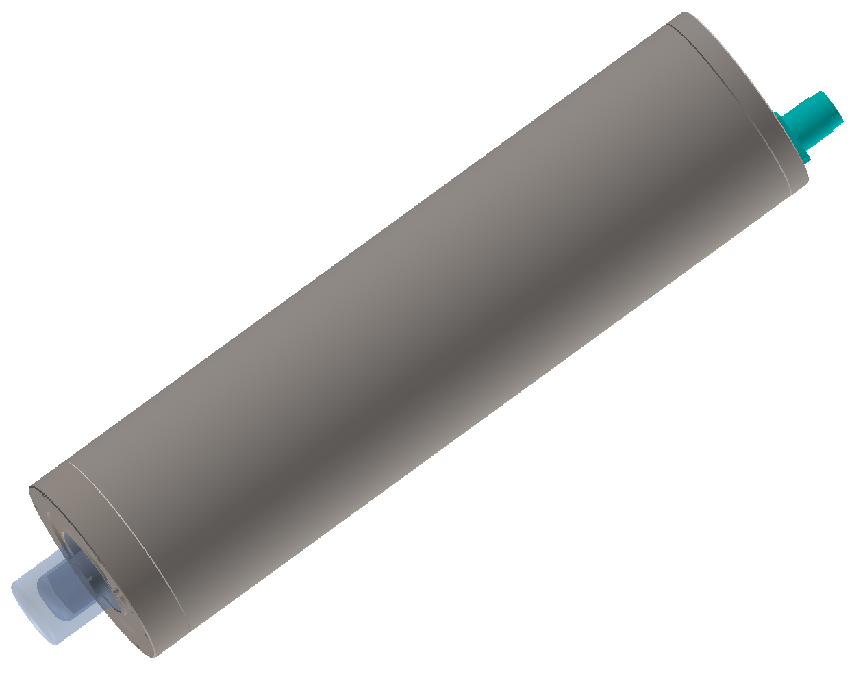
Design Goals
Primary Design Goal
  Single housing capable of full 90° FOV (360° possible) that includes both optical components and electronics. This bottle connects directly to the ROV/AUV.
ROV /AUV Connection: 1x 13 pin connector (DFCR2013M)
4000m and 6000m consideration

Slide 6
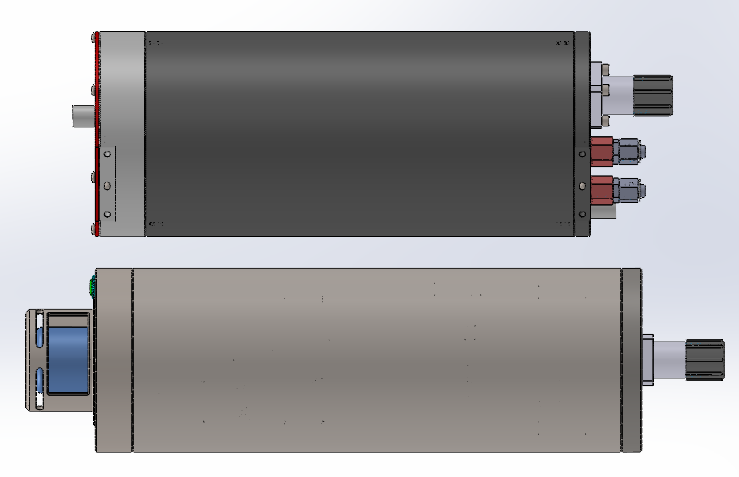
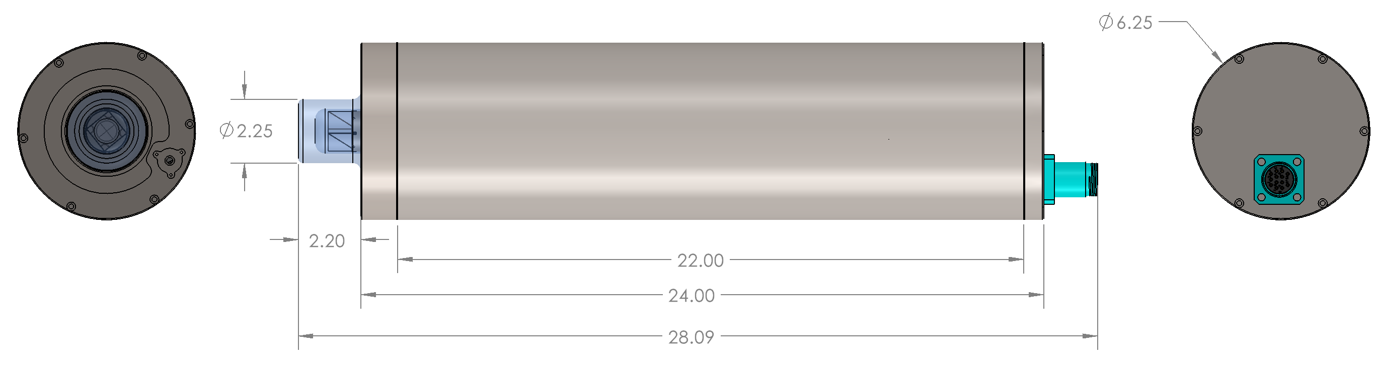
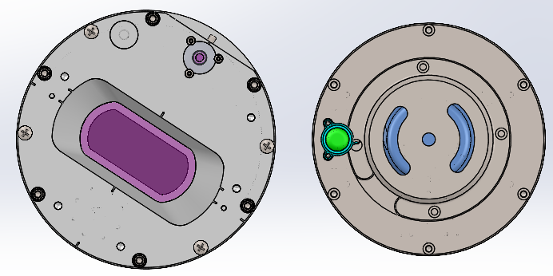
Comparison to WiSSL Gen 1 Optical Sensor
Old Optical Bottle (x2)
New All In One
OD: 6.94”
Endcaps + Tube Length: 16.625”
Tip-to-tip Length: 20.29”
Weight of tube + endcaps: 42.41 pounds
OD: 6.25”
Endcaps + Tube Length: 22.37”
Tip-to-tip Length: 28.10” (28.5”)
Weight of tube + endcaps: 42.9 lbs, 4000m (49.8 lbs, 6000m)
Tube material: TI-6AL-4V Grade 5
Output Endcap material: 17-4 PH H1025
Connector Endcap material: TI-6AL-4V Grade 5
Add .4 inches OAL for 6000m capability
Old Optical Bottle (x2)
Old Optical Bottle (x2)

Slide 7
Housing Analysis

Slide 8
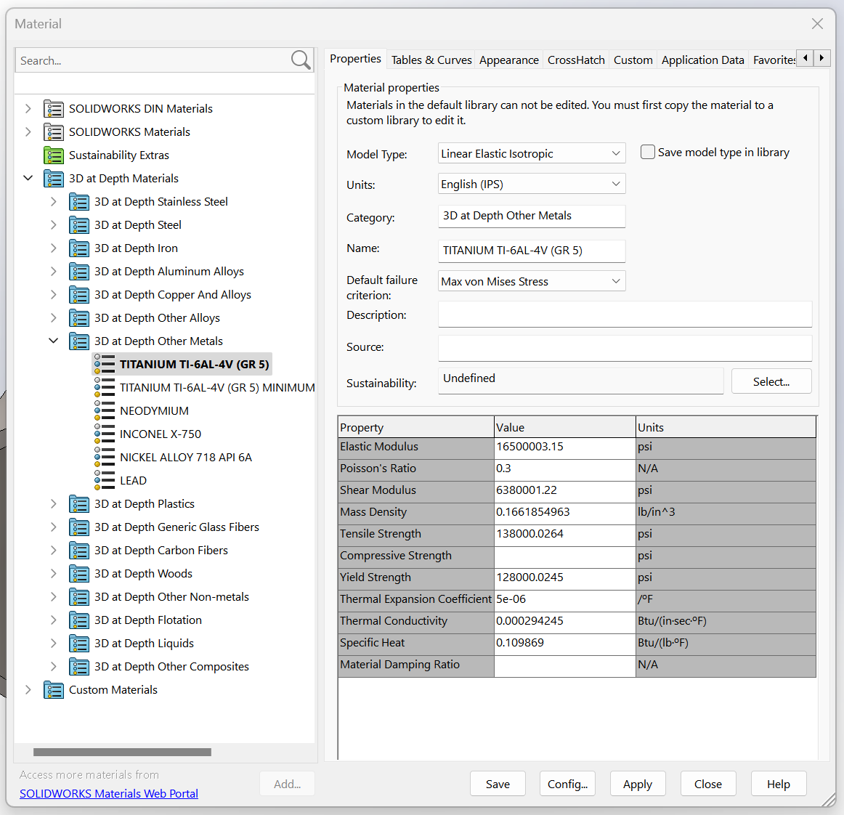
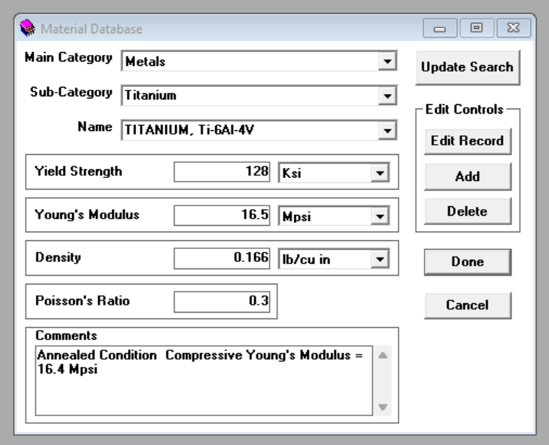
Simulation Parameters: Material
Ti-6Al-4V (Gr 5) [all simulations]
  Yield strength: 128 ksi
  Young’s Modulus: 16.5 Mpsi
  Density: 0.166lb/in³
  Poisson’s Ratio: 0.3
SolidWorks Material Properties:
Under Pressure Material Properties:
(used as reference check)
CONTAINS CONFIDENTIAL AND PROPRIETARY INFORMATION – FOR 3D AT DEPTH INTERNAL USE ONLY

Slide 9
Simulation Conditions: Depth
Factor of Safety (FOS): 1.15
Initial target depth: 4000m
  Actual pressure: 5,846 psi
  4000m x 1.15 FOS = 4600m
  Initial test pressure: 6,723 psi
Goal target depth: 6000m
  Actual pressure: 8,735 psi
  6000m x 1.15 FOS = 6900m
  Goal test pressure: 10,045 psi
Window tube end fixed
Hydrostatic pressure applied to outer shell walls
CONTAINS CONFIDENTIAL AND PROPRIETARY INFORMATION – FOR 3D AT DEPTH INTERNAL USE ONLY

Slide 10
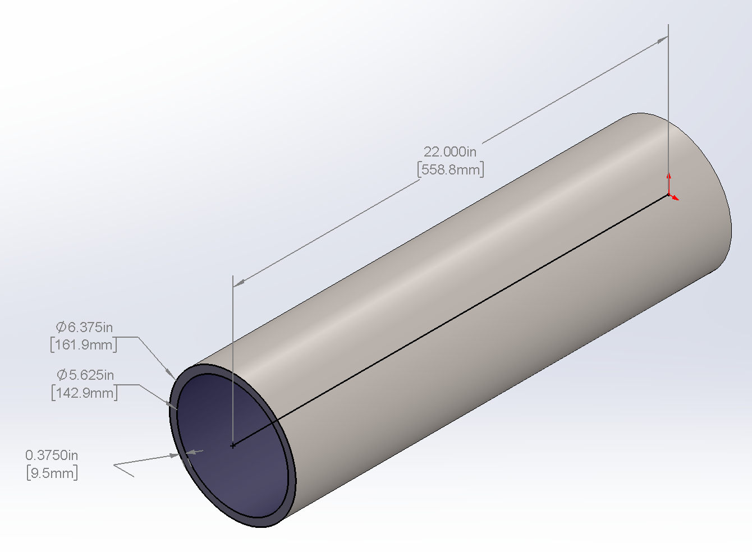
Results Summary
Recommended
for 4000m:
Recommended
for 6000m:
Parameters | 4000m | 6000m
ID (in) | 5.600 | 5.600
OD (in) | 6.25 | 6.375
Wall (in) | 0.325 | 0.3875
Length (in) | 22 | 22
Test Pressure (psi) | 6,723 | 10,045
End area: | 30.68 in^2 | 31.92 in^2
End force: | 206,255 LBF | 320,627.1 LBF
Max Stress (psi) [SW] | 59,675 | 79,069
Max Displacement (mm) [SW] | 0.699 | 0.699
Buckling Failure at (psi) [UP] | 7,464.9 | 10,875
Maximum Depth Rating (m)[UP] | 5067 | 7346
Yield FOS | 2.14 | 1.54
Buckling FOS [SW] | 1.45 | 1.33
Note: Buckling FOS is relative to test pressure, not actual pressure. Test pressures include an additional 15% safety margin.
CONTAINS CONFIDENTIAL AND PROPRIETARY INFORMATION – FOR 3D AT DEPTH INTERNAL USE ONLY

Slide 11
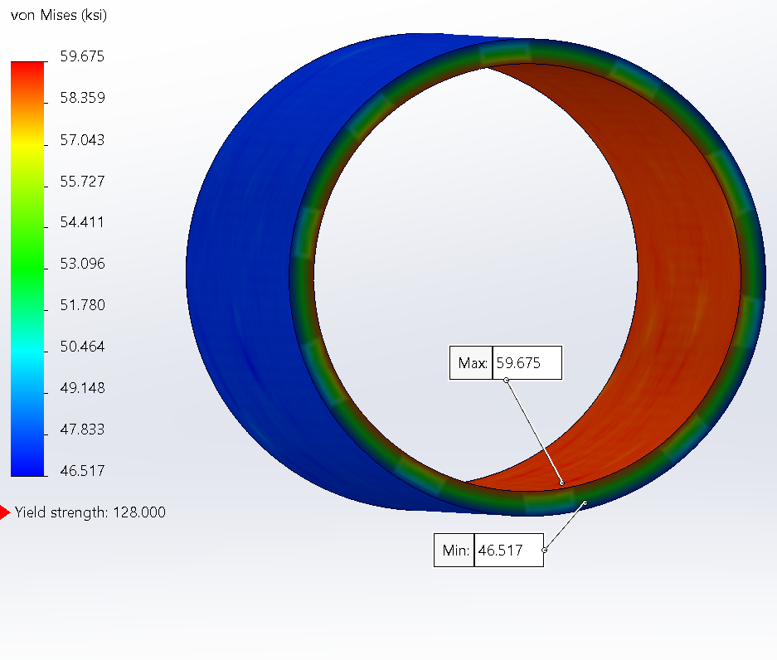
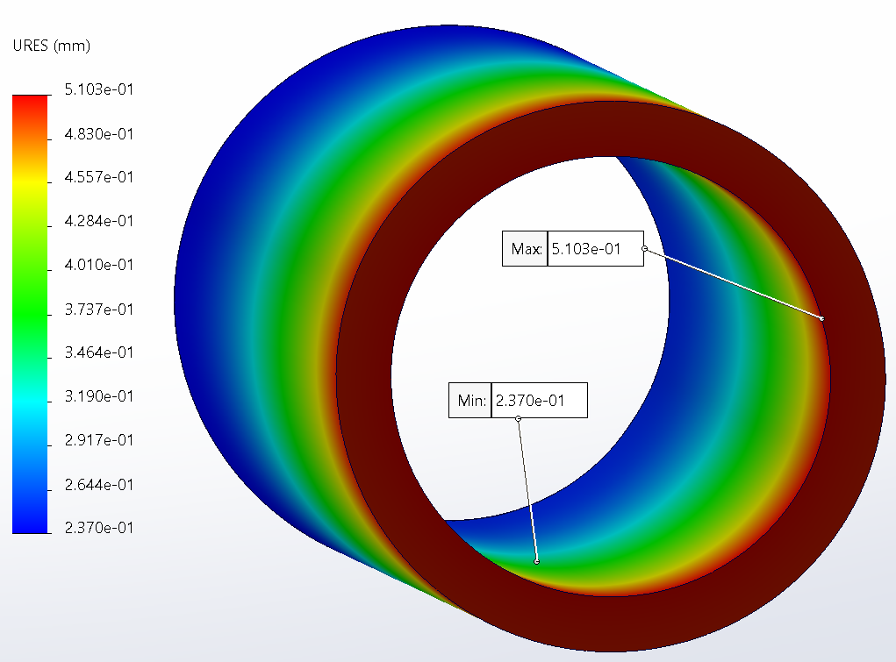
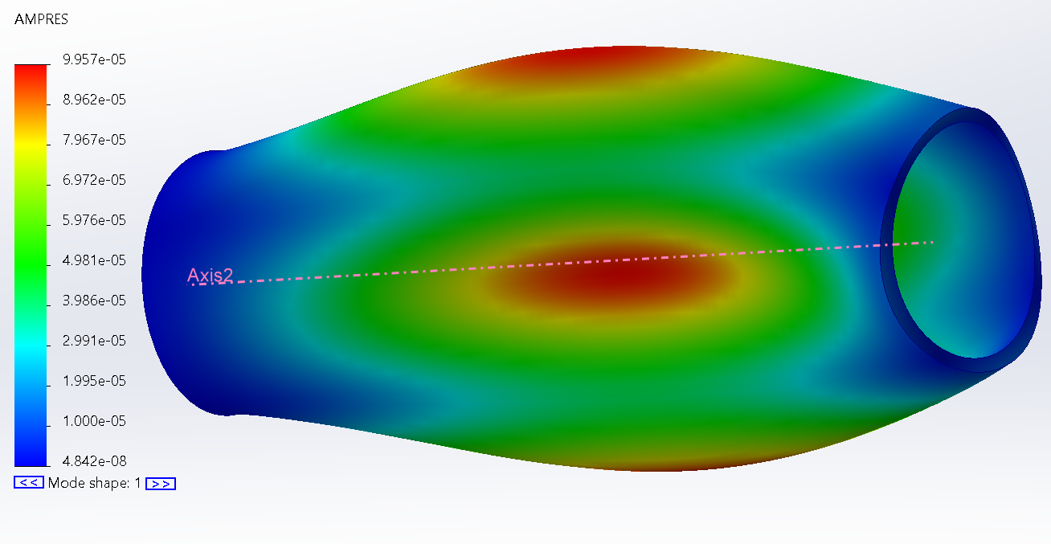
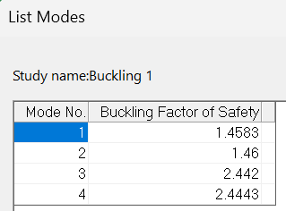
Case 1 (4000m): SolidWorks Simulation Results
Case 1 Static Stress Plot:
Air Weight: 22.078 lbs.
Min stress: 46517 psi
Max stress: 59,675 psi
Maximum deflection: 0.510mm
Result: PASS
Case 1 Displacement Plot:
Case 1 Buckling mode 1 Plot:
Results: Simulations show pass
CONTAINS CONFIDENTIAL AND PROPRIETARY INFORMATION – FOR 3D AT DEPTH INTERNAL USE ONLY

Slide 12
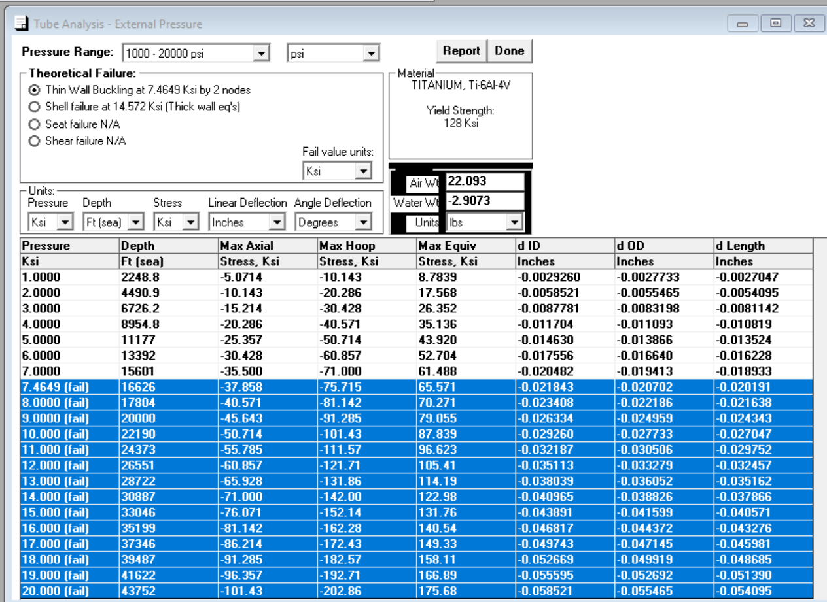
Case 1: Under Pressure Results
Test 1 Results:
Buckling Failure Pressure: 7,464.9 psi
Equivalent Depth: 5,067.6m [16,626FT]
Air Weight: 22.093lbs (TUBE ONLY)
Water Weight: -2.9073lbs
4000m Result: PASS
6000m Result: FAIL
Results: Simulations show
Fail for 6000 (underpressure)
CONTAINS CONFIDENTIAL AND PROPRIETARY INFORMATION – FOR 3D AT DEPTH INTERNAL USE ONLY

Slide 13
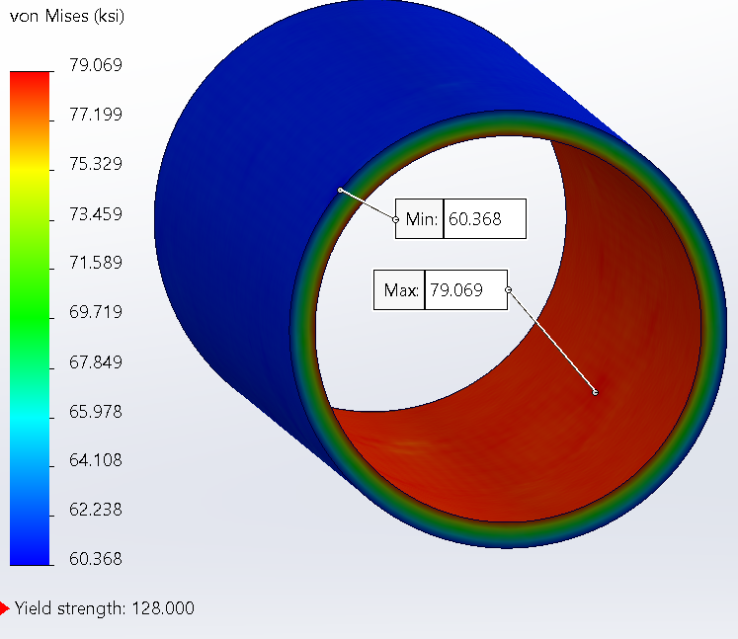
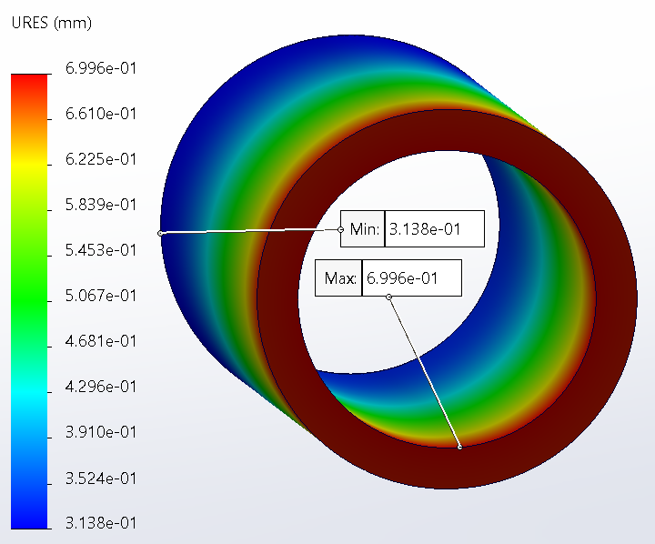
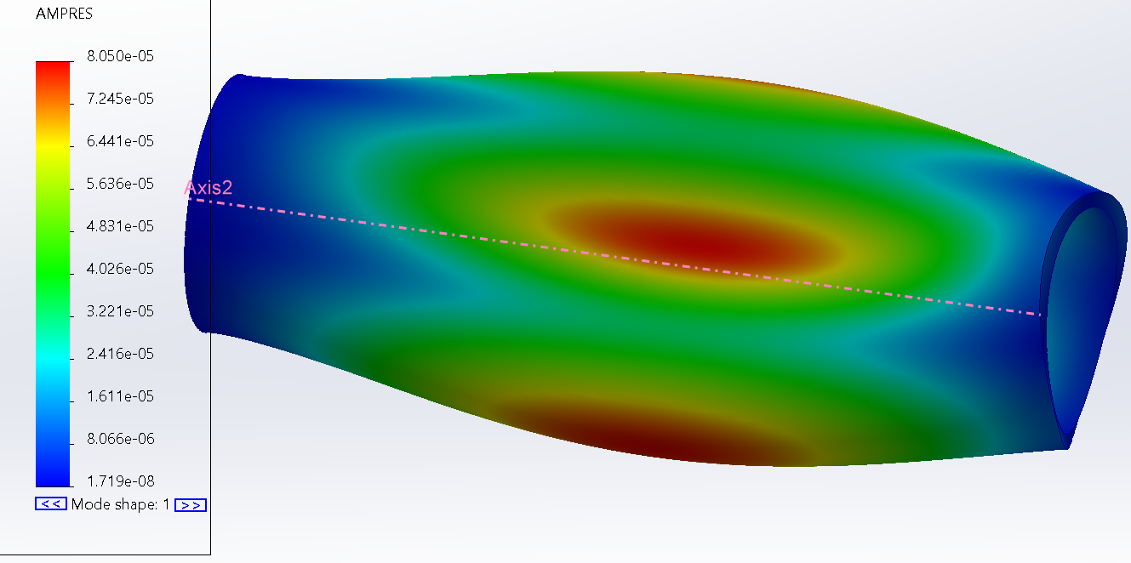
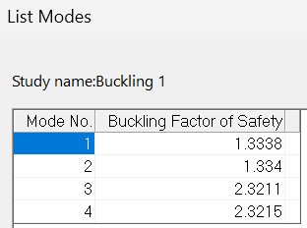
Case 2 (6000m): SolidWorks Simulation Results
Air Weight: 26.609 lbs
Min stress: 60,368 psi
Max stress: 79,069 psi
Maximum deflection: 0.699mm
Result: PASS
Case 2 Static Stress Plot:
Case 2 Displacement Plot:
Case 2 Buckling mode 1 Plot:
Results: Simulations show pass
CONTAINS CONFIDENTIAL AND PROPRIETARY INFORMATION – FOR 3D AT DEPTH INTERNAL USE ONLY

Slide 14
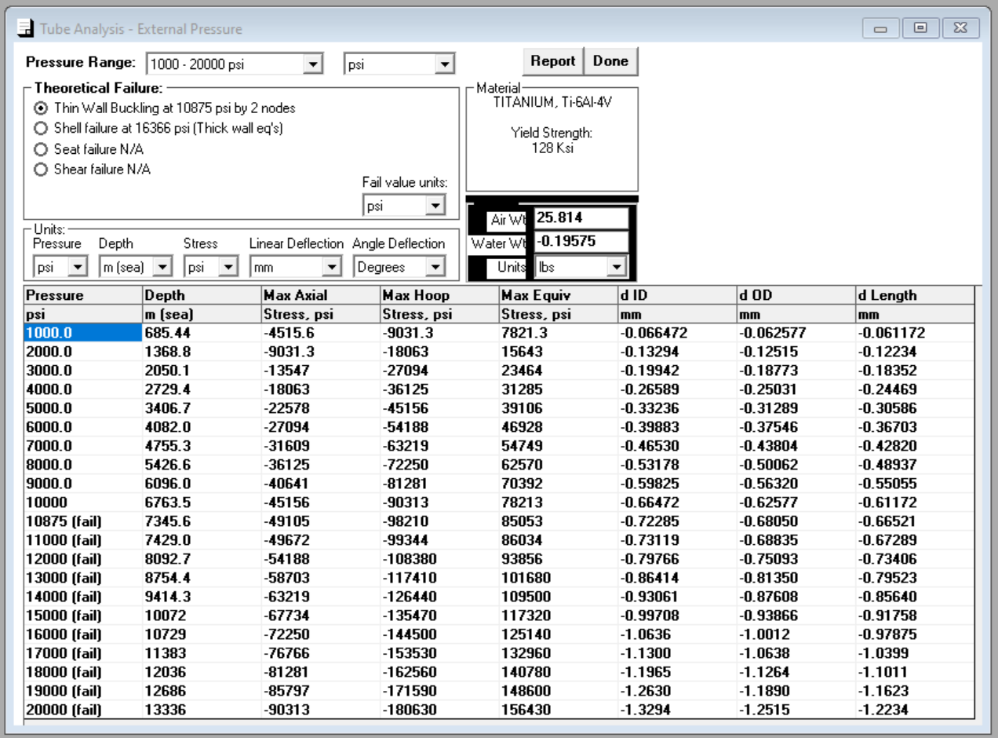
Case 2: Under Pressure Results
Test 5 Results:
Buckling Failure Pressure: 10,875 psi
Equivalent Depth: 7345.6m
Air Weight: 25.814lbs
Water Weight: -0.196lbs
4000m Result: PASS
6000m Result: PASS
Note: Under Pressure output is the same for Test 4 and Test 5
Results: Simulations and underpressure show pass for 6000m
CONTAINS CONFIDENTIAL AND PROPRIETARY INFORMATION – FOR 3D AT DEPTH INTERNAL USE ONLY

Slide 15
Conclusions for housing tube
Pressure vessel passes stress and bucking for 4000m with tube of OD from 6.25in and ID of 5.60
Pressure vessel passes stress and bucking for 6000m with tube of OD from 6.375in and ID of 5.60
Increasing the length of the tube has a negligible effect on maximum stress and displacement
CONTAINS CONFIDENTIAL AND PROPRIETARY INFORMATION – FOR 3D AT DEPTH INTERNAL USE ONLY

Slide 16
Output Endcap Features (by Product Line)
Parameter | MBARI (Next Gen) 4000m | MBARI (Next Gen) 6000m
Part number | M000404 revE | 3DDINT-ME-PA-0640 revA
Front face/tube OD (in) * | 6.375 | 6.375
Front face thickness (in) | .7 | .9
Rear boss OD (in) * | 5.597 | 5.597
Rear boss thickness (in) | 2.8 | 2.8
Total thickness (in) | 3.5 | 3.5
Material | 17-4 PH H1025 | 17-4 PH H1025
Yield strength (ksi) | 165 | 165
Rotating cube | √ | √
Safety light | √ | √
Counterbores | √ | √
Front gasket | √ | √
Fasteners | #10-32 (qty 6) | #10-32 (qty 6)
Depth rating (m) | 4000 | 6000
CONTAINS CONFIDENTIAL AND PROPRIETARY INFORMATION – FOR 3D AT DEPTH INTERNAL USE ONLY

Slide 17
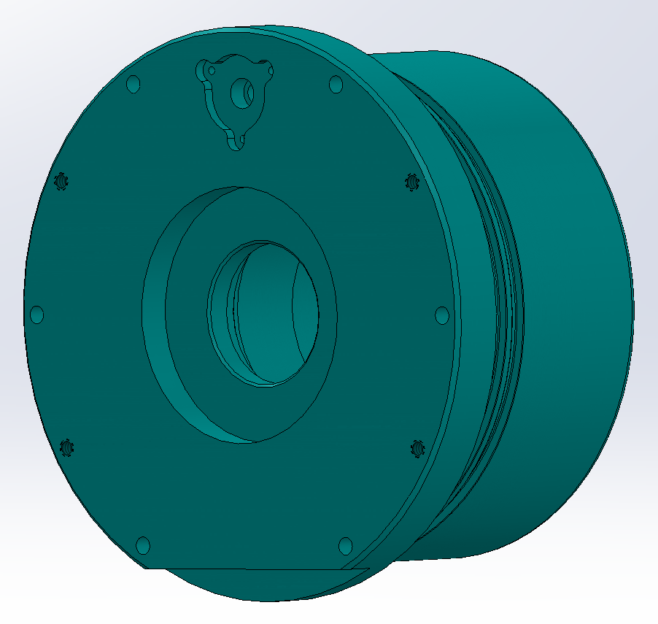
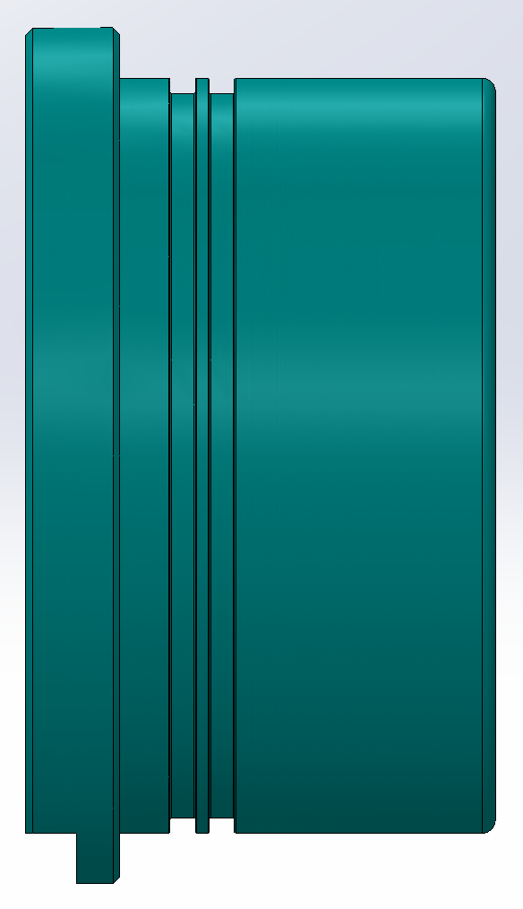
Next Gen MBARI Output Endcap Features
Part number: 3DDINT-ME-PA-0640 revA
Front face OD: 6.375in
Front face thickness: 0.700in
Rear boss OD: 5.597in
Rear boss thickness: 2.8 in
Total thickness: 3.5in
Material: 17-4 PH H1025
Yield strength: 165 ksi
Rotating Cube: Yes
Safety Light: Yes
Front Gasket: Yes
Fasteners: #10-32 (qty 6)
Air Weight: 13.964 LBS (6000m 15.275 LBS)
Safety Light
CONTAINS CONFIDENTIAL AND PROPRIETARY INFORMATION – FOR 3D AT DEPTH INTERNAL USE ONLY

Slide 18
MBARI Output Endcap Simulation Parameters
Parameter | Case 1 (4000m) | Case 2 (6000m)
Front face/tube OD (in) | 6.375 | 6.375
Front face thickness (in) | 0.700 | .900
Boss 1 OD (in) | 5.597 | 5.597
Boss 1 thickness (in) | 2.800 | 2.800
Total thickness (in) * | 3.500 | 3.500
Distance to 1st o-ring (in) | .375 | .375
Material | 17-4 PH H1025 | 17-4 PH H1025
Yield strength (ksi) | 165 | 165
CONTAINS CONFIDENTIAL AND PROPRIETARY INFORMATION – FOR 3D AT DEPTH INTERNAL USE ONLY

Slide 19
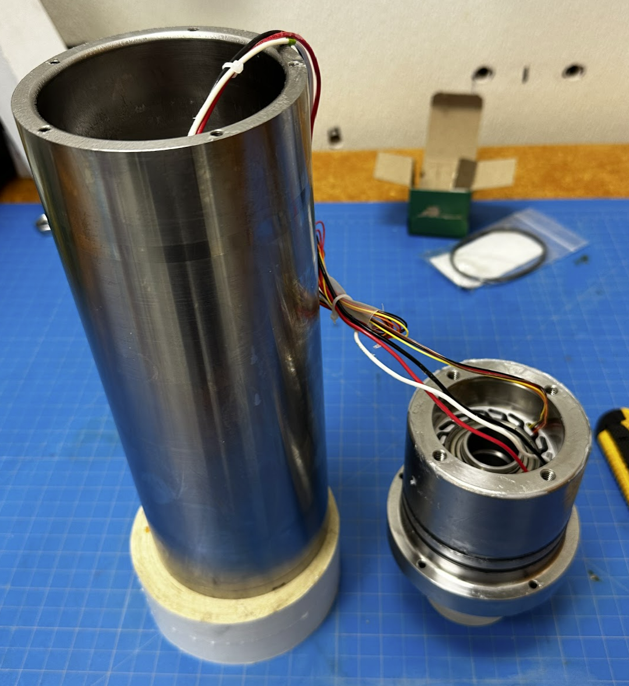
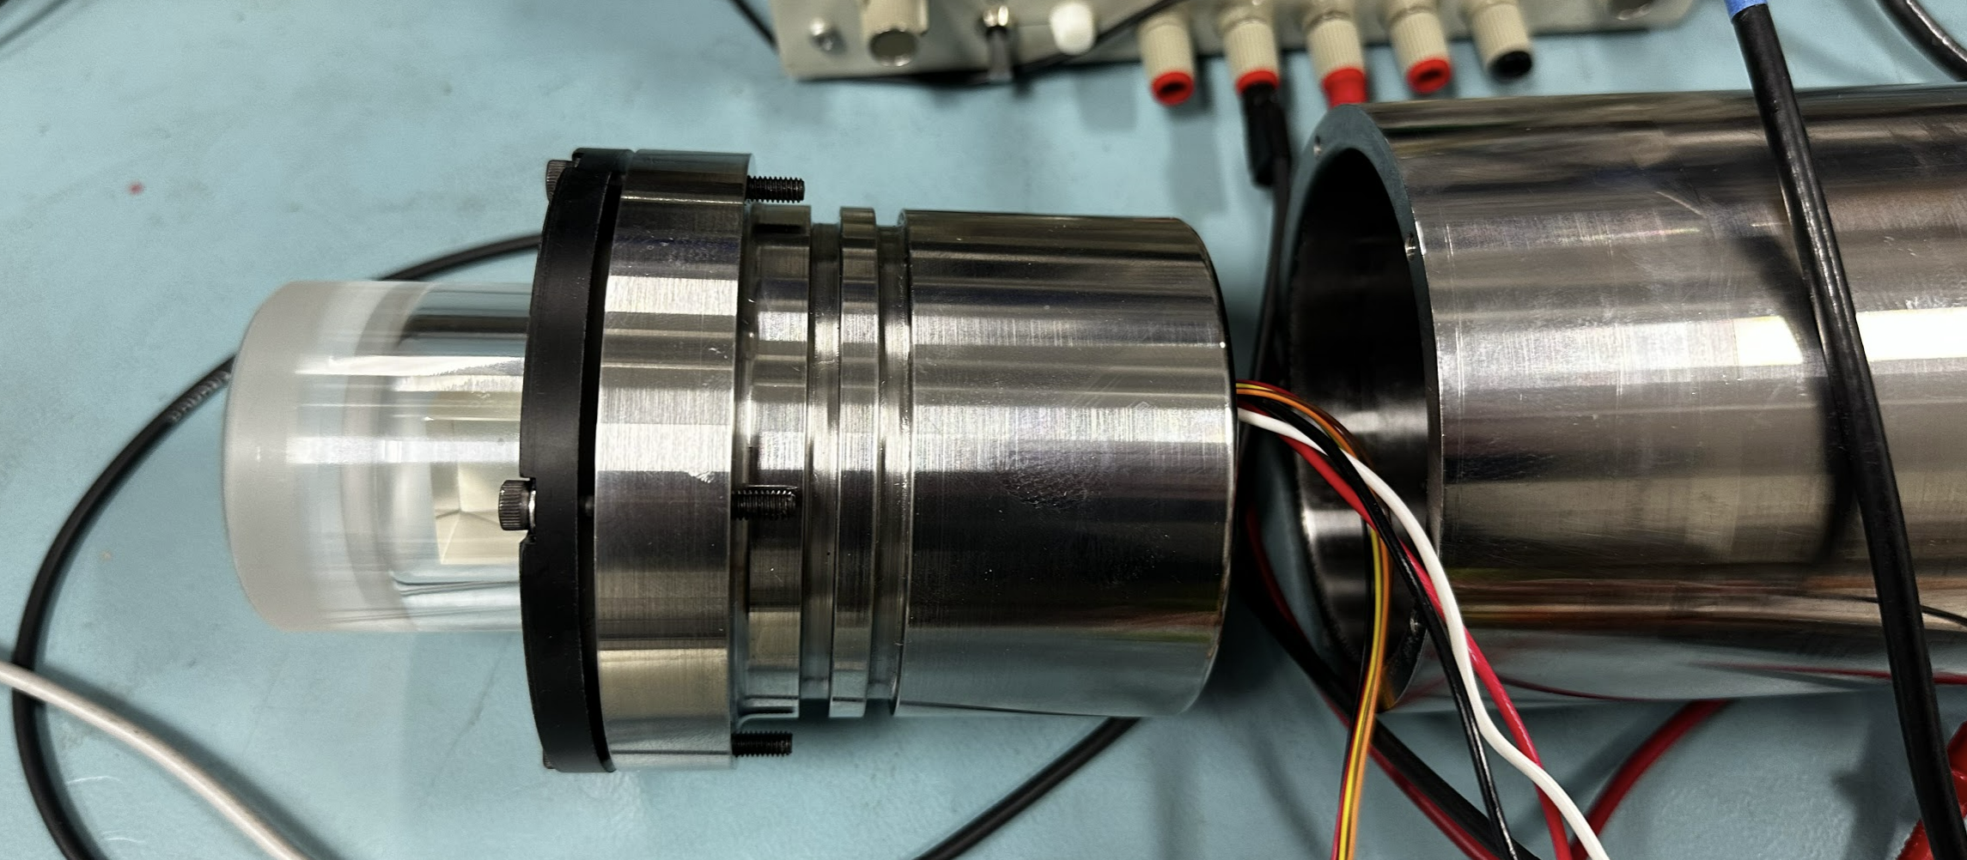
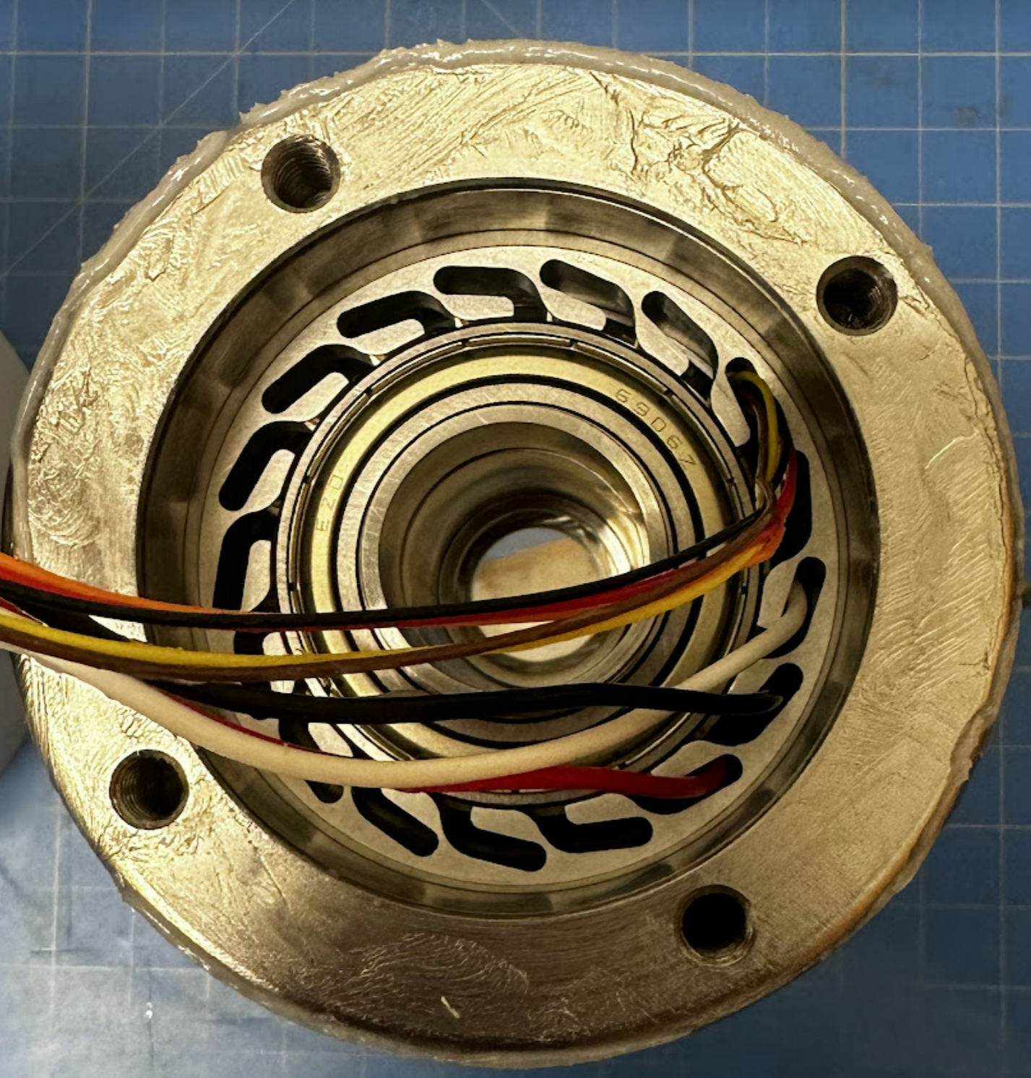
Scanner Assembly + Pressure Housing
*(built and tested with non-MBARI funding)

Slide 20
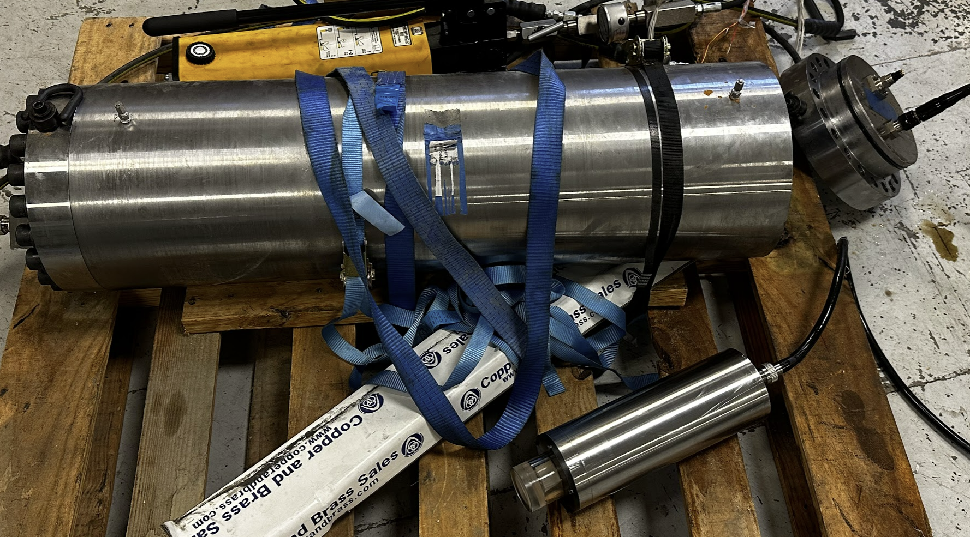
Window - Pressure Testing Results
Pressure (PSI) | Motor Current (mA) | Notes
0 | 0.42
1,000 | 0.41
2,000 | 0.42
3,000 | 0.42
4,000 | 0.42
5,000 | 0.41
6,000 | 0.41
7,000 | 0.42
8,000 | 0.42
9,000 | 0.41
10,000 | 0.41 | Initial
10,000 | 0.40 | After 30-minute hold
10,500 | 0.40 | Initial
10,500 | 0.40 | After 30-minute hold
0 | 0.41 | After de-pressure
0 | 0.41 | After removed from vessel
Pressure test at 3,000m
  Two 10-minute holds and one 1hour hold
Pressure test at 4,000m
  Two 10-minute holds and one 1hour hold
Pressure test at 10,500psi
  Two 10-minute holds and one 1hour hold
Pressure test with motor running
  No increase in motor torque at 10.5 ksi
  See table
*(built and tested with non-MBARI funding)

Slide 21
Output Endcap Results Summary
Parameter | Case1 (4000m) | Case2 (6000m)
Front face/tube OD (in) | 6.375 | 6.375
Front face thickness (in) | 0.700 | 0.900
Boss 1 OD (in) | 5.597 | 5.597
Boss 1 thickness (in) | 2.800 | 2.800
Boss 2 OD (in) | N/A | N/A
Boss 2 thickness (in) | N/A | N/A
Total thickness (in) | 3.500 | 3.500
Distance to 1st o-ring (in) | 0.161 | 0.250
Material | 17-4 PH H1025 | 17-4 PH H1025
Yield strength (ksi) | 165 | 165
Test pressure (psi) | 10,045 | 10,045
Air weight (lbs) | 21.8 | 21.8
Max stress (ksi) | 105.4 | 84.6
Yield FOS | 1.04 | 1.30
Max displacement (in) | 0.00300 | 0.00289
Window ledge Δ (in) | 0.00077 | 0.00077
*: Specified Wide Swath yield strength was later revised to 110 ksi. Yield FOS indicated on table is taken relative to the 125 ksi yield strength used in Brandon’s legacy simulations.
CONTAINS CONFIDENTIAL AND PROPRIETARY INFORMATION – FOR 3D AT DEPTH INTERNAL USE ONLY

Slide 22
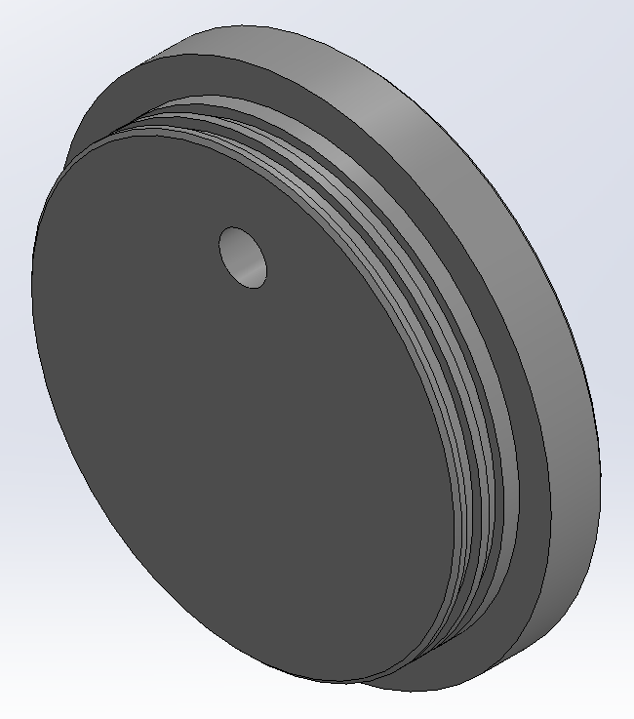
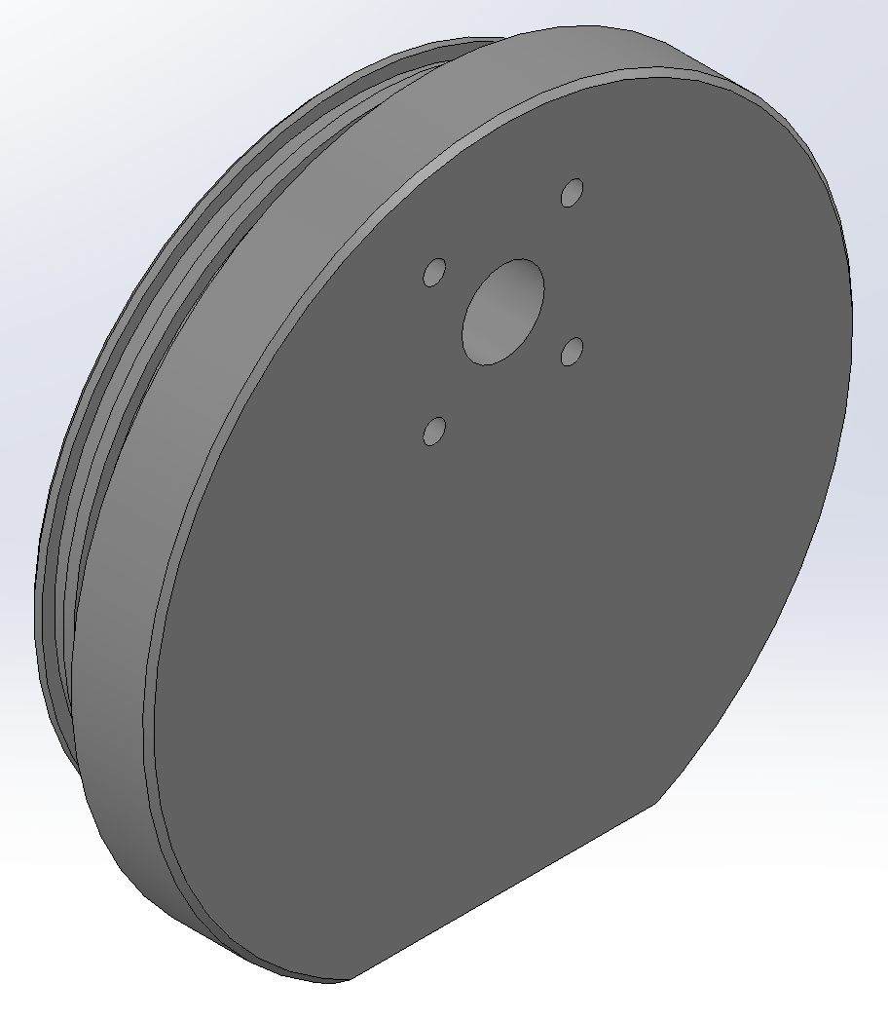
Connector Endcap Simulation Failure Criteria
Local stresses shall not exceed material yield strength
Maximum permissible resultant displacement (URES) across connector o-ring seal (discrepancy between “near side displacement” and “far side displacement” values): ≤0.006in (with ≤0.005in preferred)
  “Near side” and “far side” locations refer to the approximate locations of the face seal o-ring affiliated with the connector
Rear boss OD
Point: Far side displacement
*
Point: Near side displacement
*
Front face OD
CONTAINS CONFIDENTIAL AND PROPRIETARY INFORMATION – FOR 3D AT DEPTH INTERNAL USE ONLY

Slide 23
MBARI Endcap Simulation Conditions
SolidWorks Material Properties:
Model: 3DDINT-ME-PA-0656.sldprt (revA)
Design requirements:
  Rear boss OD: 5.597in (per Parker)
  O-rings: 2-253 (per Parker)
  Connector: DFCR2013M (Macartney)
Material: Ti-6Al-4V (Gr 5)
  Yield strength: 128 ksi
  Young’s Modulus: 16.5 Mpsi
  Density: 0.166lb/in³
  Poisson’s Ratio: 0.3
CONTAINS CONFIDENTIAL AND PROPRIETARY INFORMATION – FOR 3D AT DEPTH INTERNAL USE ONLY

Slide 24
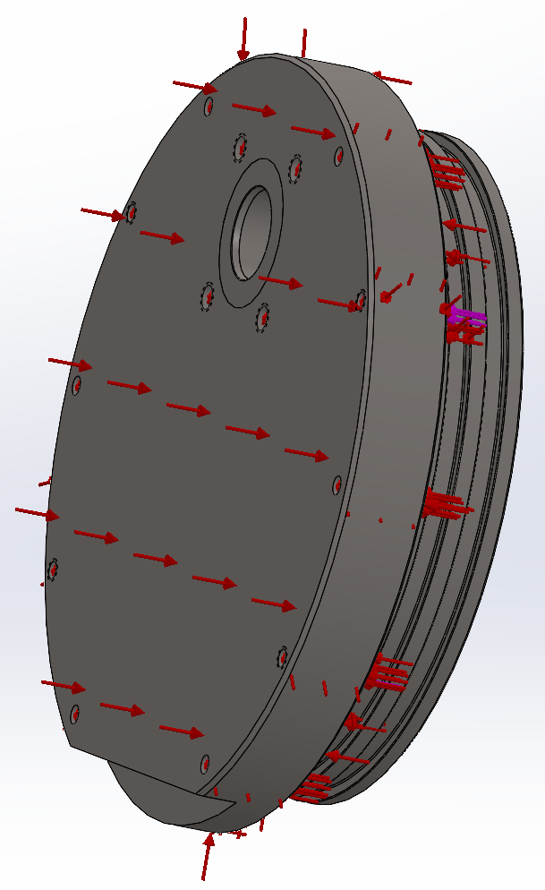
MBARI Endcap Simulation Conditions Case 2
Simulation Loading:
Depth Factor of Safety (FOS): 1.15
Goal target depth:
  Case 1: 4000m
    4000m x 1.15 FOS = 4600m
    Goal test pressure: 6,723 psi
  Case 2: 6000m
    Actual pressure: 8,735 psi
    6000m x 1.15 FOS = 6900m
    Goal test pressure: 10,045 psi
Bulkhead inner edge is fixed
CONTAINS CONFIDENTIAL AND PROPRIETARY INFORMATION – FOR 3D AT DEPTH INTERNAL USE ONLY

Slide 25
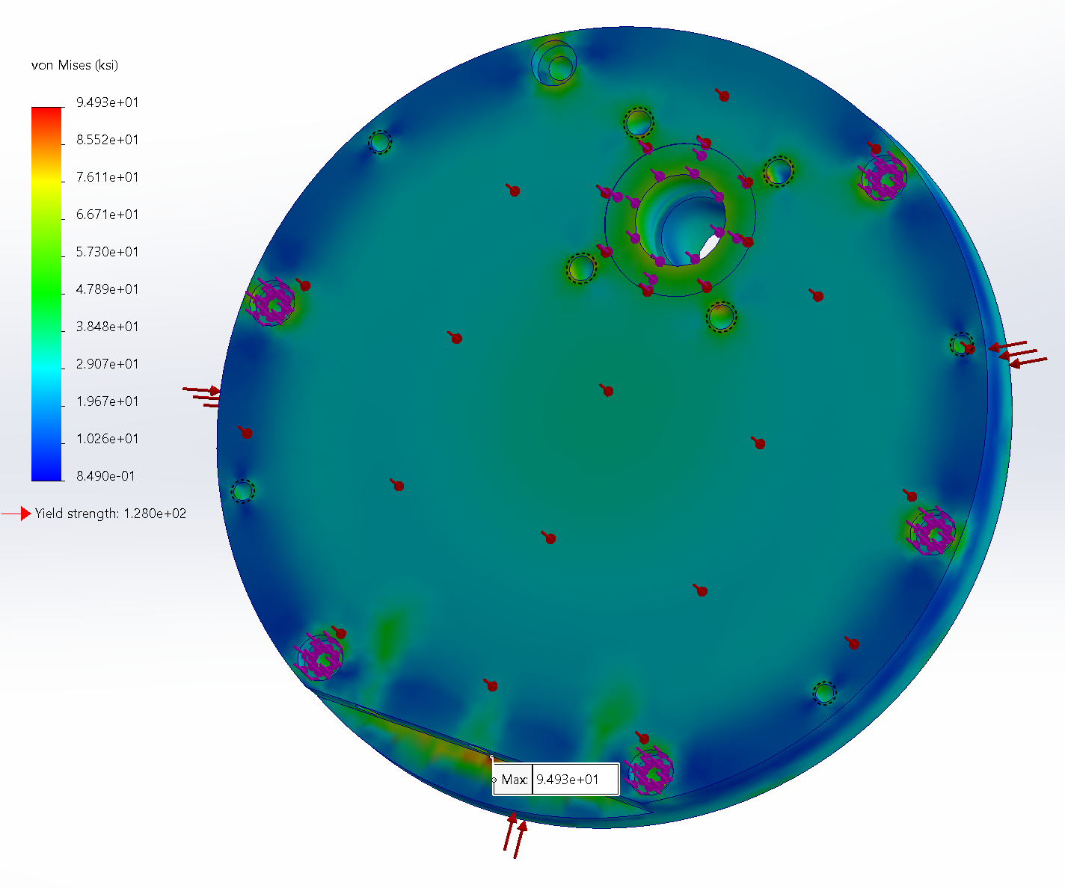
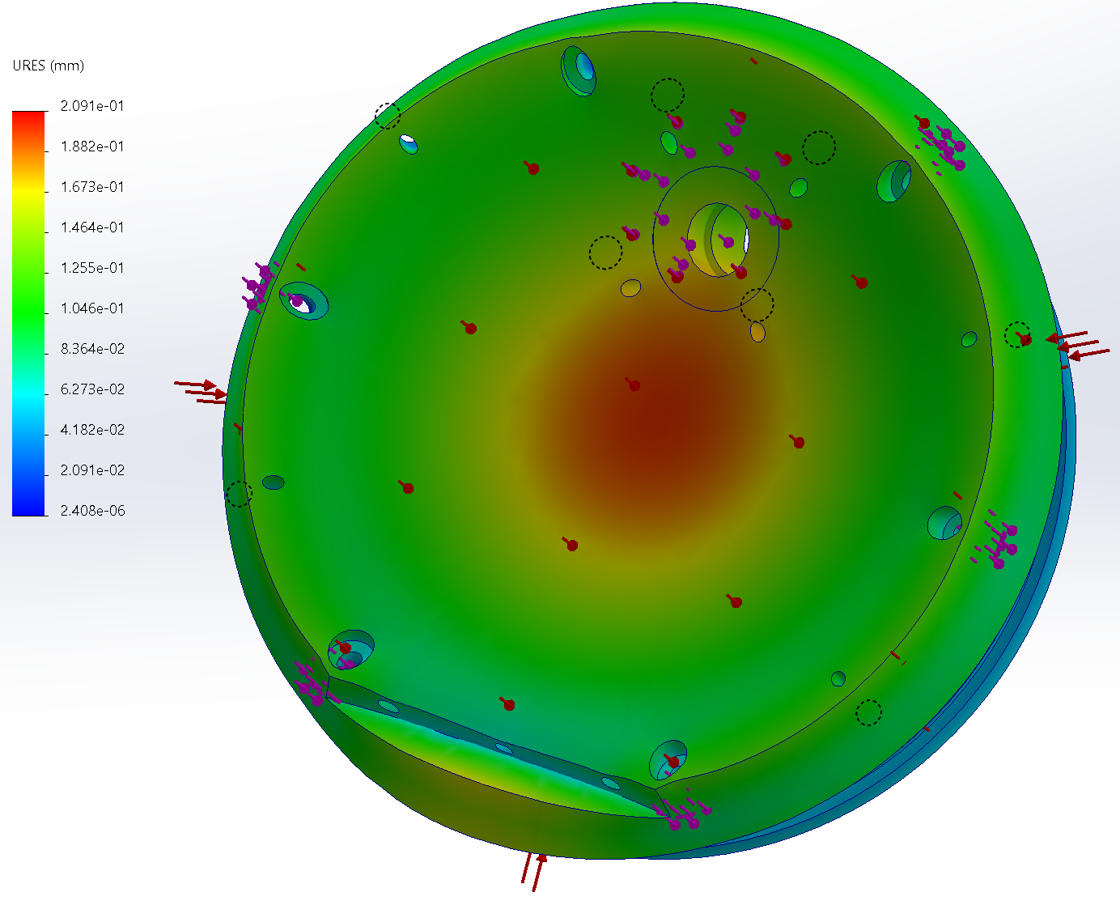
MBARI Endcap: Test 1 4000m
Test 1 Stress Results:
Parameters
Face OD: 6.375in
Face thickness: 0.7in
Boss OD: 5.597in
Boss thickness: 0.875in
Total thickness: 1.575in
Connector distance: 1.775in
Test 1 Displacement Results:
Results
Air weight: 6.935 lbs
Max stress: 94.9 ksi (PASS)
Yield FOS: 1.34
Max displacement: 0.0078in
Displacement across seal: 0.0023in (PASS)
CONTAINS CONFIDENTIAL AND PROPRIETARY INFORMATION – FOR 3D AT DEPTH INTERNAL USE ONLY

Slide 26
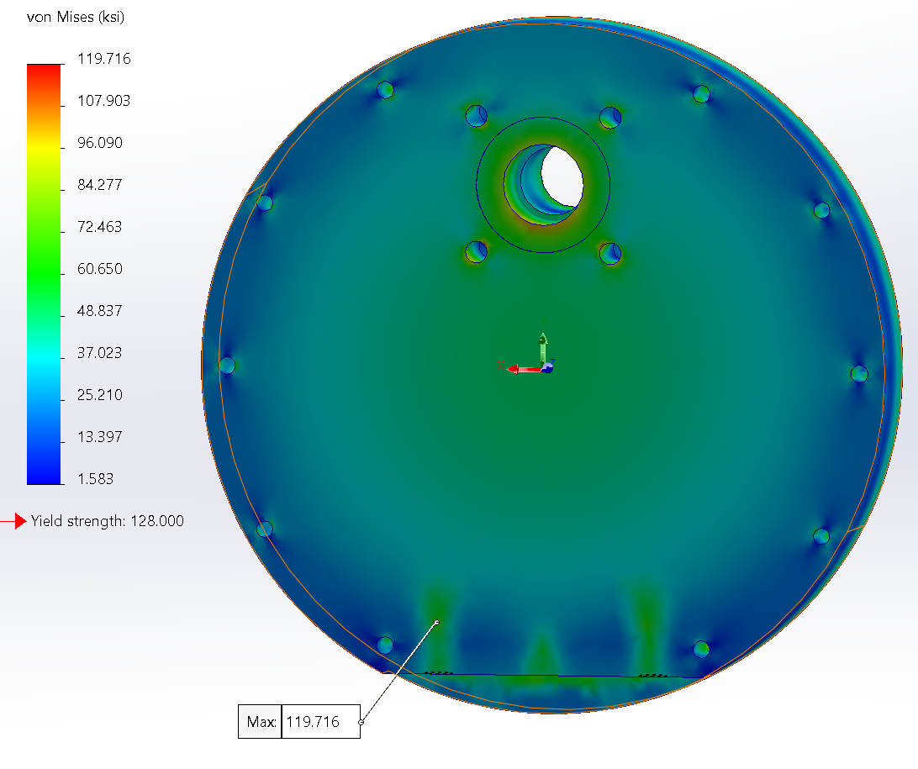
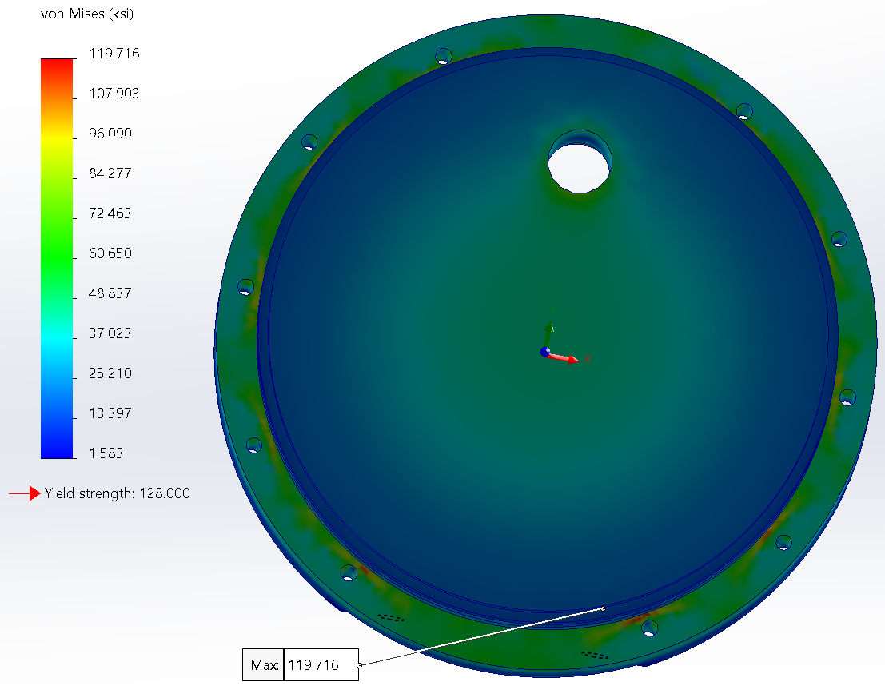
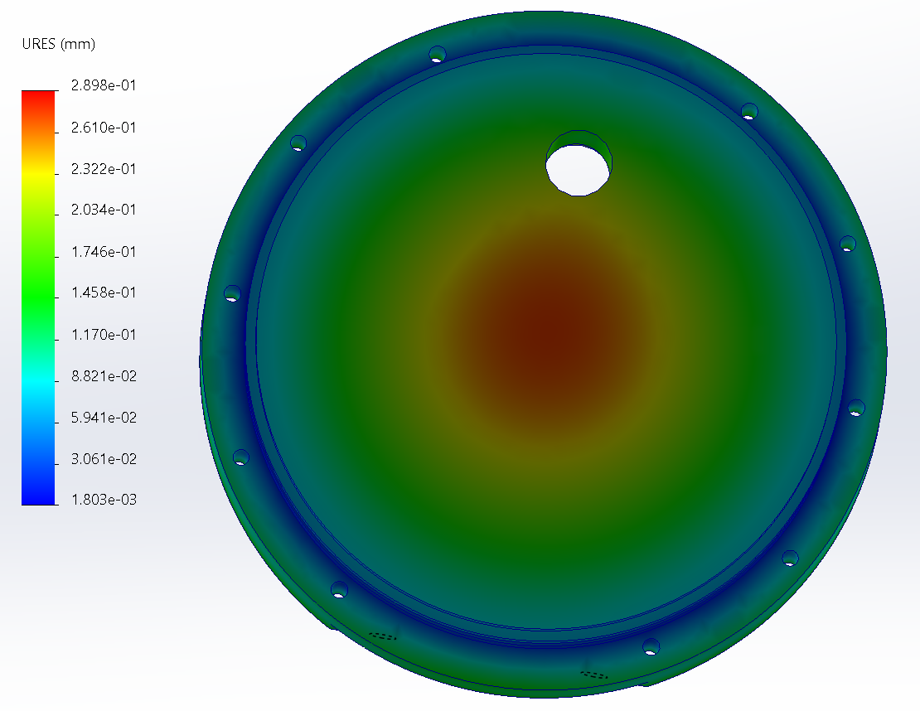
MBARI Endcap: Test 2 6000m
Test 2 Stress Results:
Parameters
Face OD: 6.375in
Face thickness: 0.9in
Boss OD: 5.597in
Boss thickness: 0.875in
Total thickness: 1.775in
Connector distance: 1.875in
Max stress shows artifact of fixturing. Stresses below yield for part.
Test 2 Displacement Results:
Results
Air weight: 7.977 lbs
Max stress: 119.7 ksi (PASS)
Yield FOS: 1.06
Max displacement: 0.0111in
Displacement across seal: 0.0043in (PASS)
CONTAINS CONFIDENTIAL AND PROPRIETARY INFORMATION – FOR 3D AT DEPTH INTERNAL USE ONLY

Slide 27
Conclusions
Stress levels are well below the yield stress limit for the 4000m connector end cap.
The 6000m connector end cap is below yield stress limit, but .2 inches thicker.
Face seal displacement is acceptable for connector o-ring.
An endcap OD of 6.375in is viable with the caveat that the fasteners are not centered relative to the shell walls.
CONTAINS CONFIDENTIAL AND PROPRIETARY INFORMATION – FOR 3D AT DEPTH INTERNAL USE ONLY

Slide 28
MBARI Feedback/Action Items
Calculate difference in wt. 6000m from 4000m
Add Safir protective cover
Provided cost for 6000m
6000m is desired by MBARI based on review
Update typos in power-point presentation
Change to 10-32 all screw/bolts
Output Endcap
  Only pressure tested 4 OD endcap
  Add the Sapphire Cover and securing screws for it.
  Space apart o-ring grooves (already done)
4000m
13.964 LBS - Output End Cap
6.935 LBS - Connector End Cap
22.078 LBS – Tube
----------------
42.977 LBS - TOTAL
6000m
15.275 LBS - Output End Cap
7.977 LBS - Connector End Cap
26.609 LBS – Tube
----------------
49.861 LBS - TOTAL

