Slide 1
OI Camera Selection
Requirements:
  Color
  Good sensitivity, wide dynamic range
    Ideally lens is not wide-open to increase depth of field; ~ f8
    Pre-set cameras for average lighting; minimize saturated and black areas of image
  Combine for stereo pairs to yield photogrametry
  Able to generate “Pretty” pictures
    2-4 mm/pixel at 3m altitude
  up to 2 Hz frame rate (?)
  Isolated trigger input
  Strobe trigger output (?)
  3 to 4 m wide image swath at 3m altitude

Slide 2
Cameras compared
Prosilica GC 1380, 1.4 MP
Prosilica GC2450, 5 MP
Prosilica GX 1920, 2.8 MP
Prosilica GX 2300, 4.0 MP
Manta G504, 5 MP
Basler Pilot PIA-3400, 5 MP
Pt. Gray Grasshopper 2, 5 MP

Slide 3
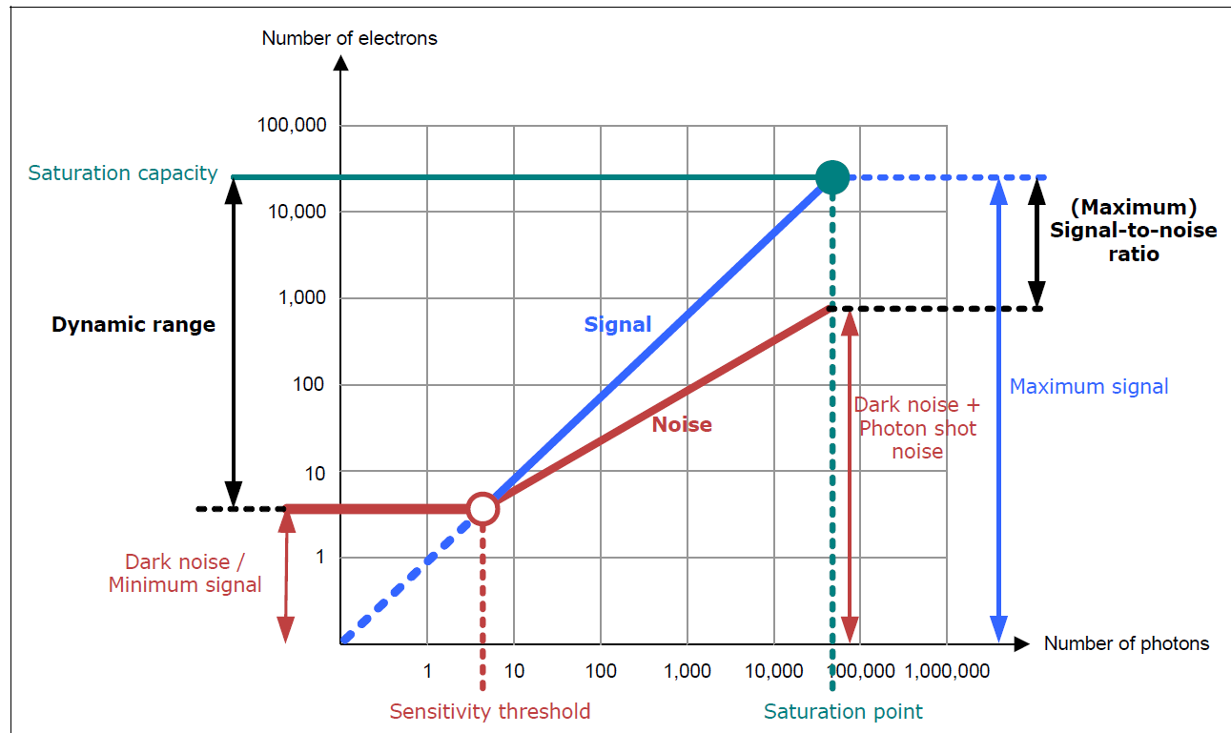
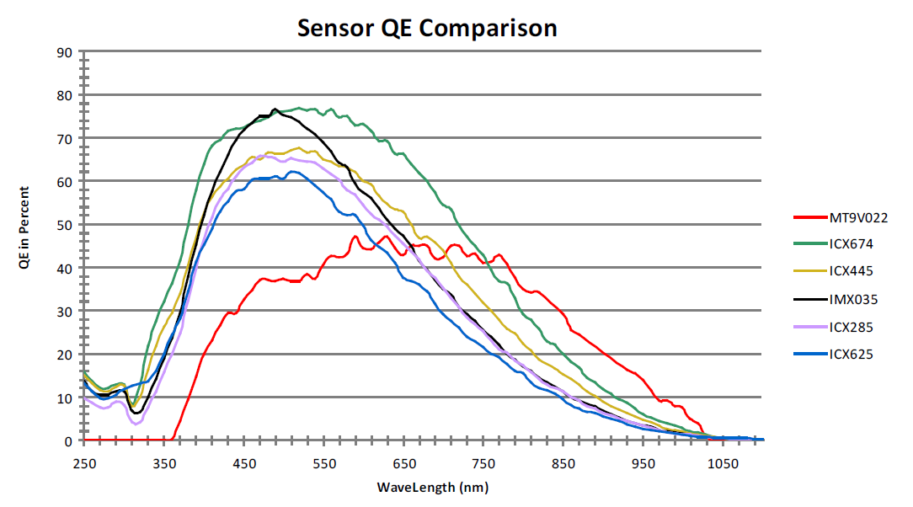
General Camera Notes
All were CCD Imagers
At 5 MP, the 2/3 format restricted the pixel size and reduced sensitivity. 1” size sensors need f-mount lens which needs a bigger housing
  no 5 MP C-mount available for 1”

Slide 4
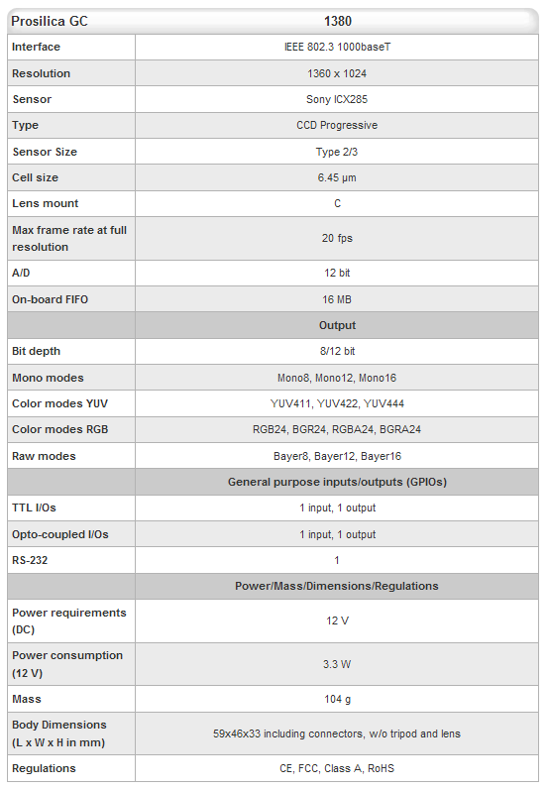
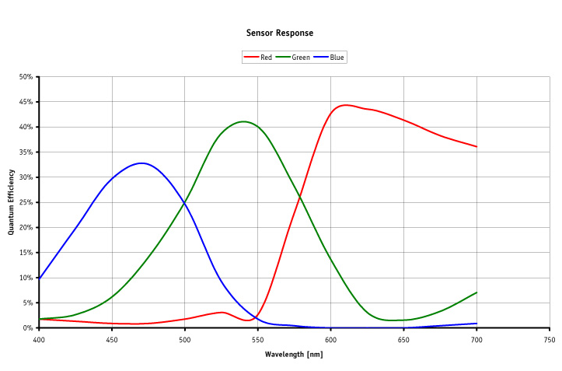
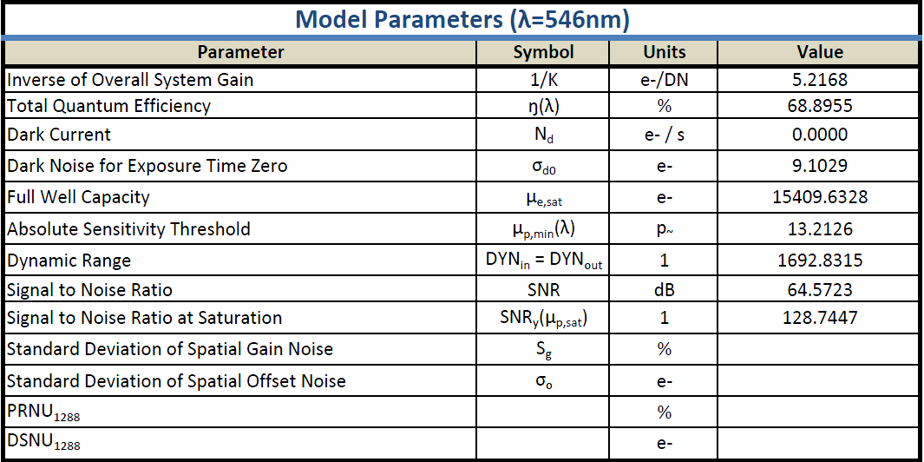
Prosilica GC-1380 1.4 MP
Camera that Hanu, Chris Roman, Jon Howland (?) and others use.
Good sensitivity and dynamic range – low resolution

Slide 5

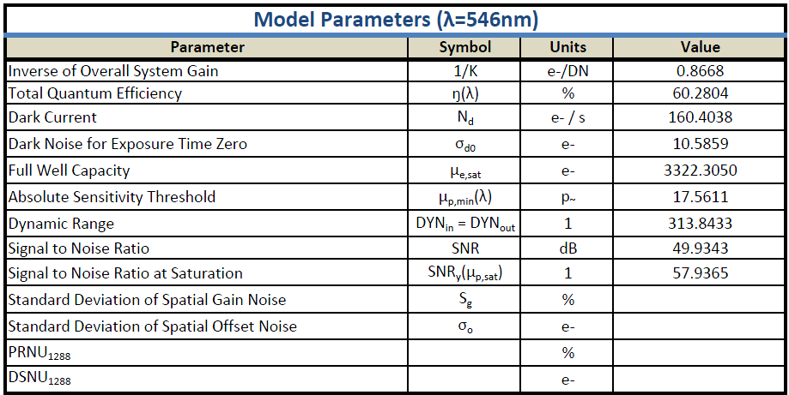
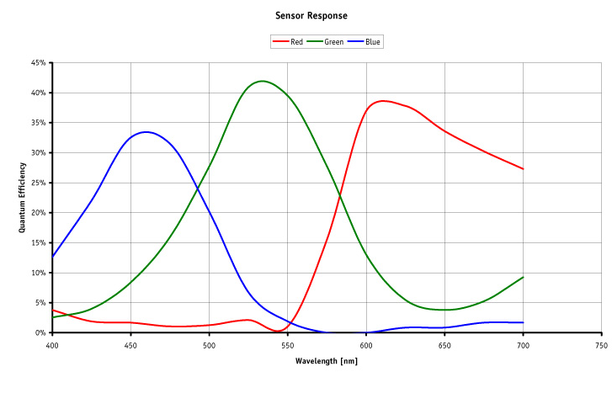
Prosilica GC 2450, 5 MP
High res; small pixels in 2/3 format yield low sensitivity

Slide 6
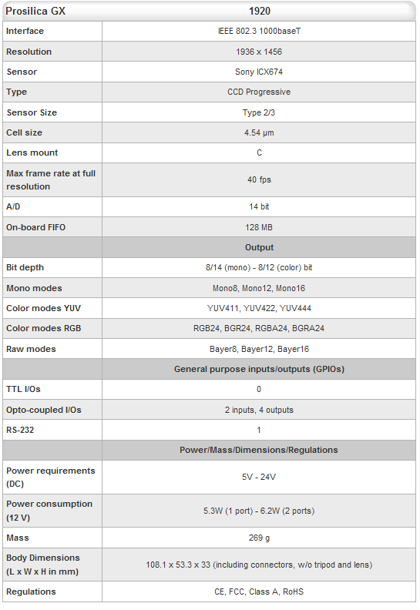
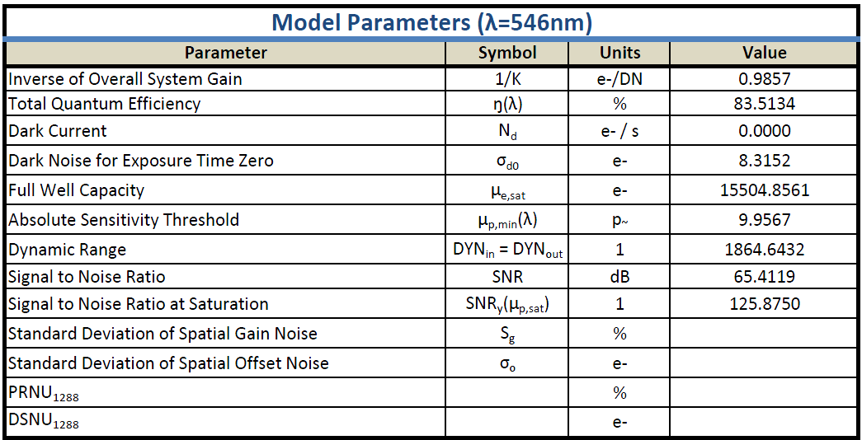
Prosilica GX1920 2.8 MP
Same Sony ExView HAD sensor as the GC1380
  Newer SonyICX285; more sensitive, higher dynamic range
  faster, higher power: 5.3 W vs 3.3 W
  Requires 2” longer housing

Slide 7
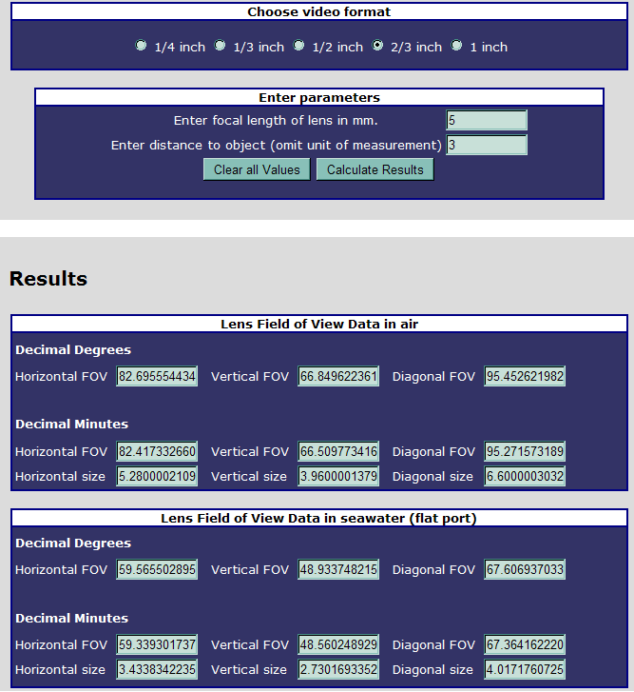
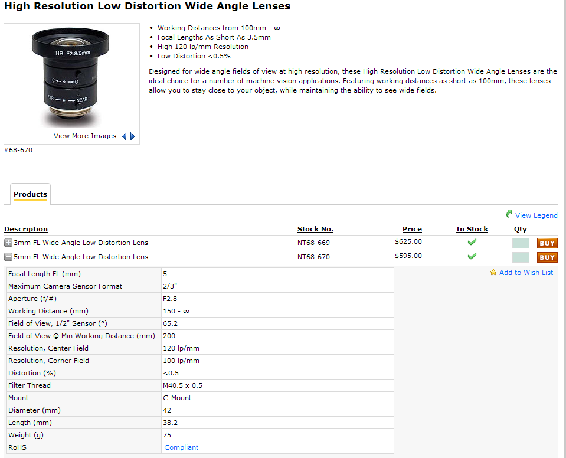
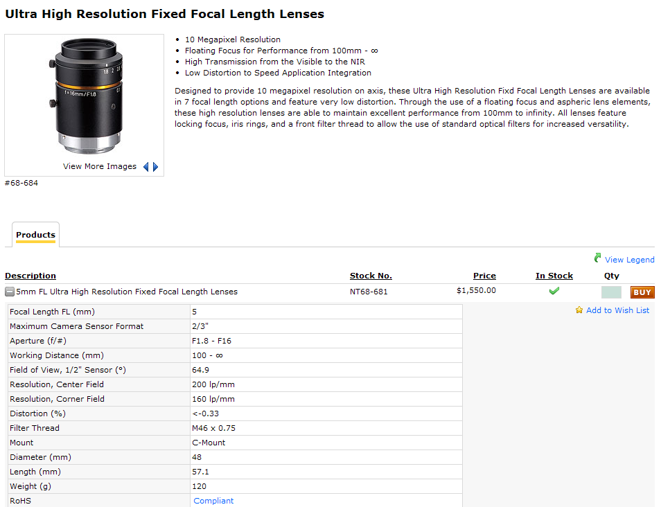
Lens
2/3” format, 67 deg FOV with flat port now
  Yields a 3.4 m wide, 2.7m tall image @ 3m
  Upgrade later to dome optics for 90 degree FOV
Required bandwidth: vertical resolution * horizontal resolution * fps * 1 (for 8 bits) or 2 (for 16)
- e.g. For 5Mpixel: 11 MB/camera@ 1 Hz

Slide 8
Light
On the IAUV we use ~25J of light for ~.05 ms
  If left on continuously, it is equivalent to 50,000 W
    25W-sec * 1/1000 sec
    Draws 32 watts for 1.5 seconds

Slide 9
Cost and schedule
Lead-time for cameras, housings and connectors is about 4 weeks
We can use the existing IAUV strobes

Slide 10
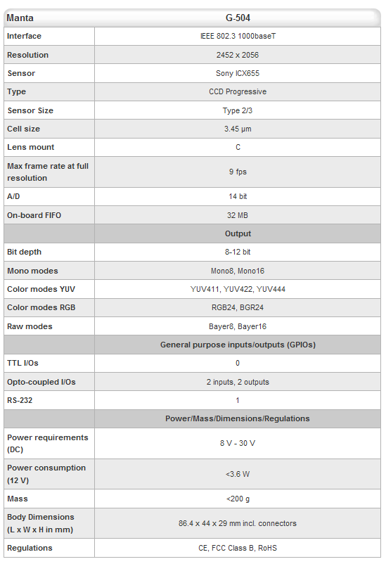
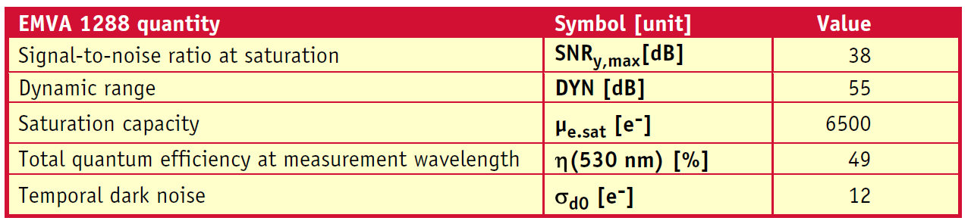
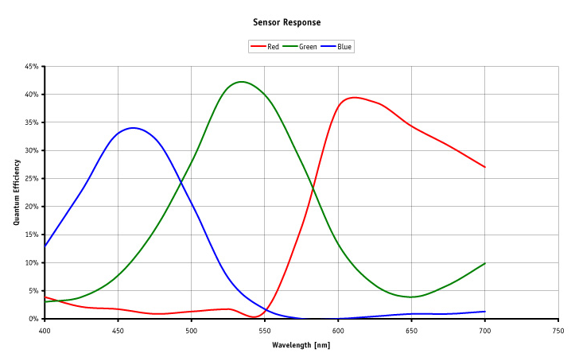
Manta 5 MP
Single Tap Sony ICX655
3.6 W, 8-39 vdc input; POE option

Slide 11
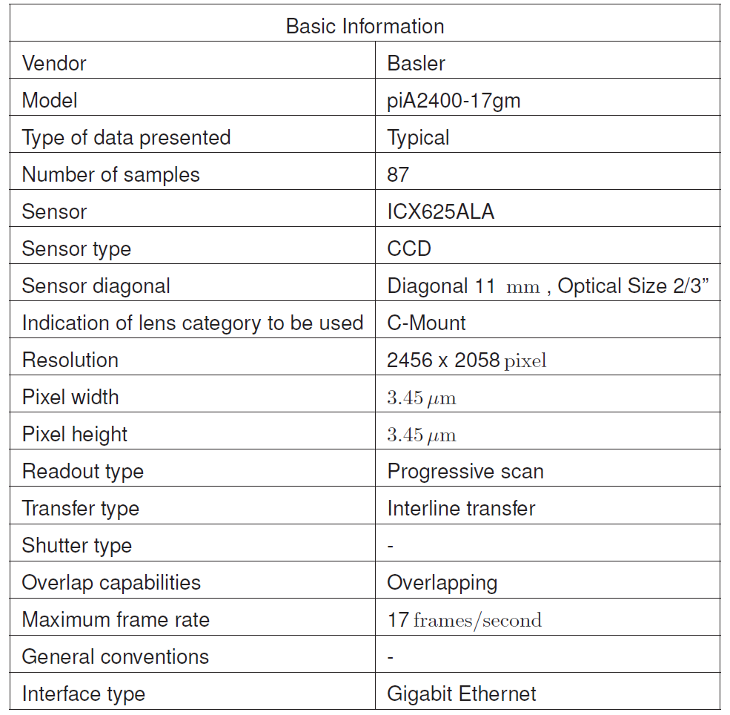
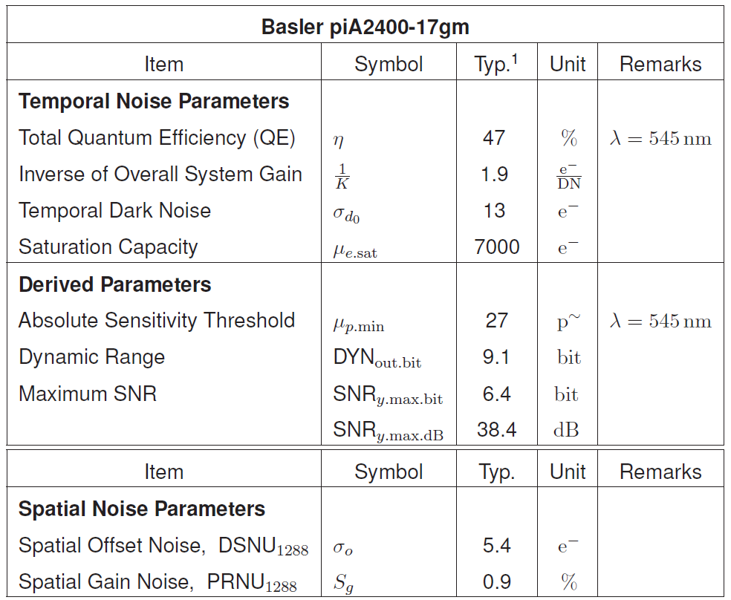
Basler Pilot 5 MP

Slide 13
5mm Kowa Lens
82 deg Hoz FOV – 5.3m wide @ 3m
67 deg Vert FOV – 4m tall
95 deg Diag FOV
~ 2.7 mm/pixel
59 deg wide, 48 deg tall
3.43m wide, 2.7m tall
1.77 mm/pixel

Slide 15
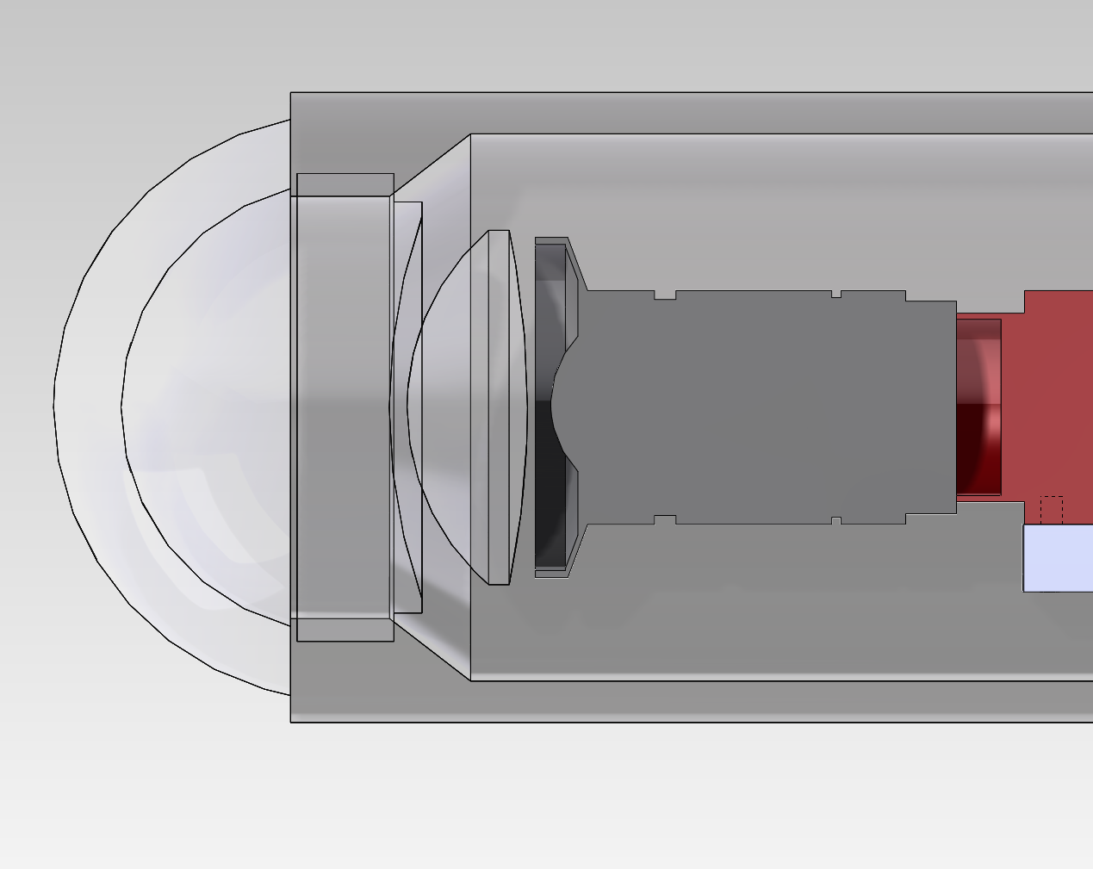
8.5mm Kowa Lens
54 deg hor, 42 deg v
3.1m wide, 2.3m tall
1.6 mm/pixel

