Slide 1
MBARI WISSL G2 Detailed Design
December 2022 Update

Slide 2
TOPICS
Proprietary Information
Requirements
Design Architecture Goal
Point Spacing Calculations
Old vs New Housings
Eye Safety – Class IV
Subsea Connector
Internal Optical Bench – Initial Designs
Receiver Optical Design
Scanner Detailed Design
MBARI Feedback

Slide 3
PROPRIETARY INFORMATION
NOTICE: This presentation contains 3D at Depth Confidential and Proprietary information.
In order to better describe some of the design decisions and options, this presentation contains details about the internal architecture and design decisions for 3D at Depth’s current 3D laser scanning products. Therefore, this information should ONLY be shared with MBARI employees who need to read and evaluate the presentation. 3D at Depth appreciates our customers taking the appropriate safety measures when distributing this information internally.

Slide 4
Requirements – WiSSL Gen 2
Reference WiSSL Upgrades Wishlist_R1_1.PDF
Highlighted Requirements | Must | Goal
Depth Rating | 4000m
Size | < 20” diameter, < 3ft long | 6.25” diameter, < 20” long
Field of View (FoV) | 80° | 90° (360° possible)
Range | 1-meter to 7-meter NADIR, (10-meter LOS max) | 1-meter to 7-meter NADIR, (10-meter LOS max)
Range Precision | Same as Gen 1 (<3mm)
Angular Precision | Same as Gen 1 (<100μrad)
Electrical Interface | 18-36VDC Isolate all peripherals Less than Gen 1 (~400W) | Less than 200W while scanning (Probably < 100W)
Timing Requirements | Same as Gen 1 (ZDA + PPS) | PTP – baseline PPS
Software Interface | SL3 plus updates as defined in Documentation
Scan Rate | < 1cm spacing at 0.5m/s. Current surveys at 3m altitude and 0.2m/s | < 9mm spacing at 0.5m/s at max altitude < 5mm spacing at 0.5m/s at 3m altitude
Temperature |  | -2.5° C to 350° C per pulse Precision: +/-1° C

Slide 5
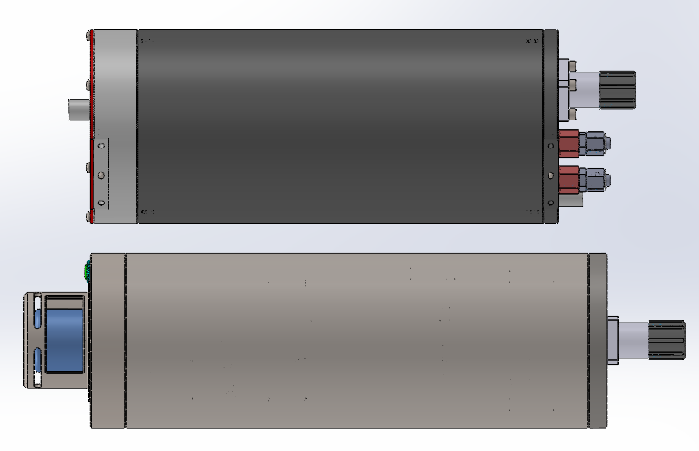
Design Architecture Goal
Primary Design Goal
  Single housing capable of full 90° FOV (360° possible) that includes both optical components and electronics. This bottle connects directly to the ROV/AUV.
ROV /AUV Connection: 1x 12 pin connector
  18 – 36 VDC (4 wire)
  10/100 TCP/IP Ethernet connection (2 twisted pair)
  1PPS Timing connection (1PPS twisted pair)
If can implement PTP timing then can switch to 1Gbps TCP/IP Ethernet connection with same connector
  WiSSL Gen 2 could support PTP directly
  Will require MBARI to convert from ZDA & PPS to PTP for WiSSL G2
  Identified two options for generating PTP using Raspberry Pi4
    Real time hat: https://innoroute.com/realtimehat/
    Pi4 can also be used directly to measure/generate PTP https://github.com/raspberrypi/linux/issues/4151
  NOT a major focus at the moment

Slide 6
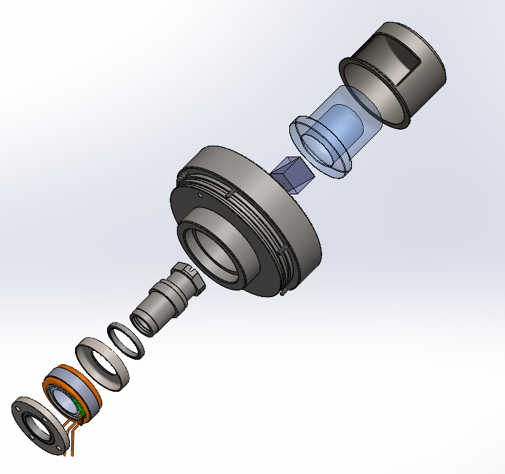
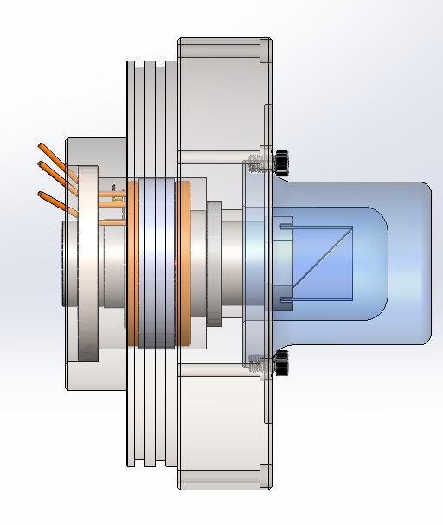
Point Spacing Calculations
Desired
FOV = 90° (can go up to 360°)
NADIR = 7 meter
Speed = 0.5m/s
Desired Point Spacing = 10mm
Given scanner implementation
Forward Track Point Spacing = 10mm
Cross Track Point Spacing = 8mm at 7m altitude
Cross Track Point Spacing = 5.7mm at 5m altitude
Cross Track Point Spacing = 3.4mm at 3m altitude
Speed = 0.3m/s
Forward Track Point Spacing = 6mm
Calculations
LOS = 10m
Swath = 14m
Number of points per Swath = 1,400
Number of Forward Track Points per Second = 50
Goal PRF = 350kHz

Slide 7
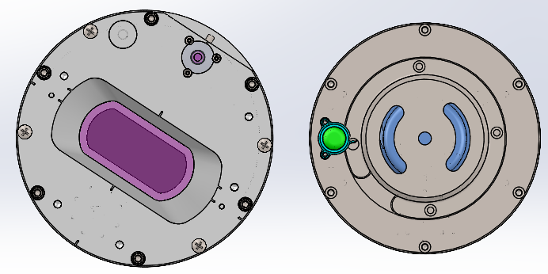
Old vs. New Optical Bottles
Old Optical Bottle (x2)
New All-in-One
OD: 6.94”
Endcaps + Tube Length: 16.625”
Tip-to-tip Length: 20.29”
Weight of tube + endcaps: 42.41 pounds
OD: 6.25”
Endcaps + Tube Length: 18.45”
Tip-to-tip Length: 23.60”
Weight of tube + endcaps: 38.67 pounds
Tube material: TI-6AL-4V Grade 5
Output Endcap material: 17-4 PH HH1150
Connector Endcap material: TI-6AL-4V Grade 5

Slide 8
Class 4 Laser Product Requirements
CDRH and IEC Requirements Unique to Class 4 Lasers
Other Recommendations
Reset: A manual reset is required after an interruption due to interlock activation or power loss for more than 5 seconds.
  Response: No change. Manual resets already required on WiSSL system.
Protective Clothing: While personnel may be exposed to radiation levels above the Maximum Permissible Exposure (MPE) for skin, flame and heat resisting clothing should be worn.
  Response: When final pulse and power parameters are chosen 3D at Depth will determine if levels are above MPE for skin and if protective clothing will be recommended.
Laser Safety Glasses: Depending on the emission levels, new laser safety glasses may be recommended.
Scan Areas: Ensure that scan areas in air do not contain flammable materials

Slide 9
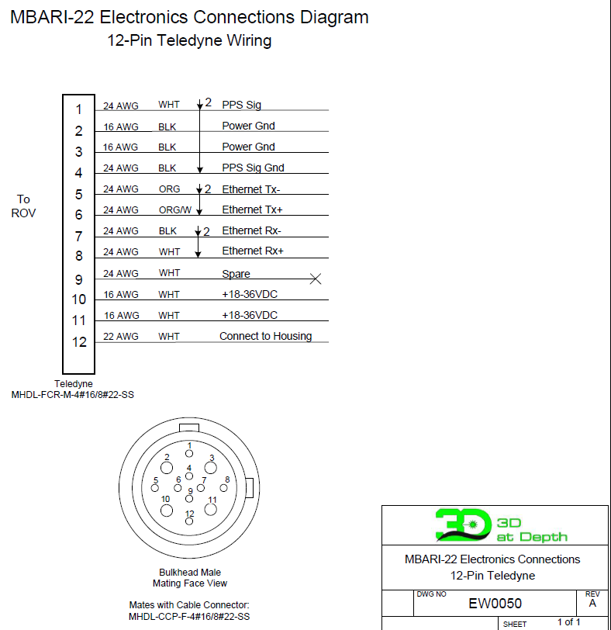
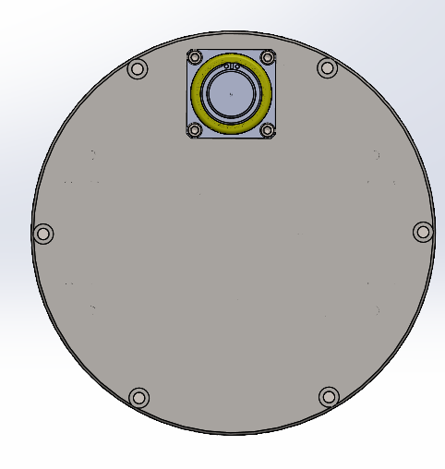
Single Connector
Reduction from 12 connectors across 3 bottles!!
Teledyne Connector MHDL-CCP-F-4#16-SS
12 pins
Flange: 316 SS
Body: Polyurethane
2x Power
2x Power Ground
4x 100Mb Ethernet (2x twisted pairs)
1x PPS Signal
1x PPS Gnd
1x Cable Shield
1x Spare

Slide 10
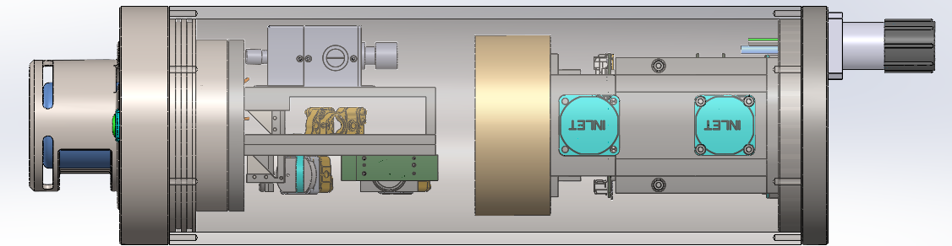
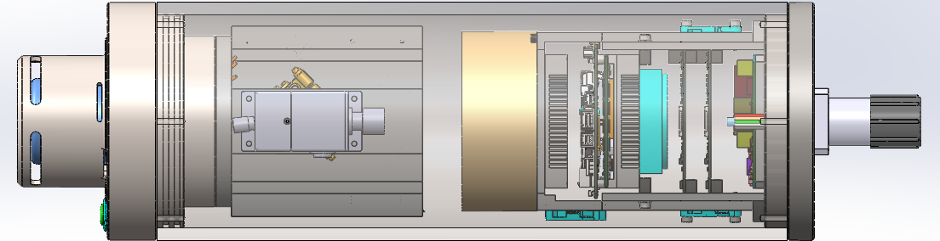
Screenshots of Internals – Initial Designs

Slide 11
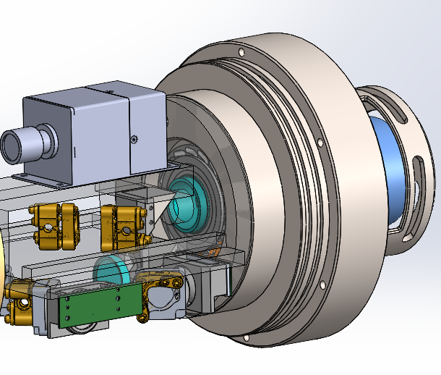
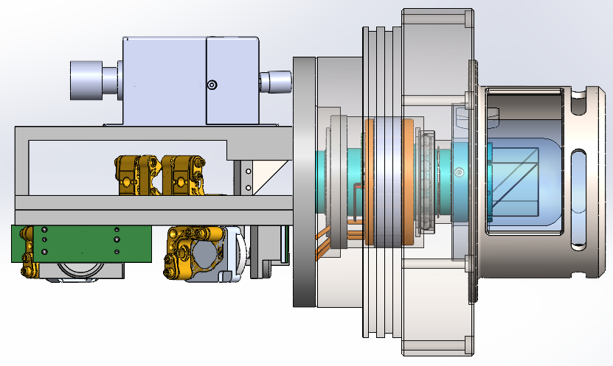
Screenshots of Internals – Initial Designs

Slide 12
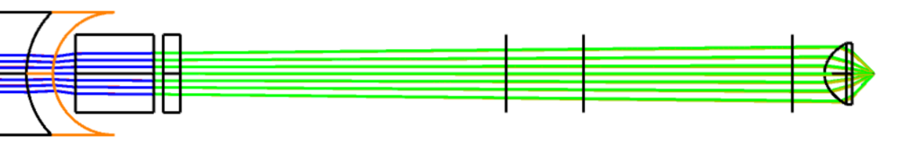
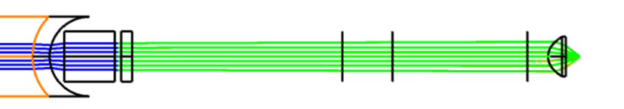
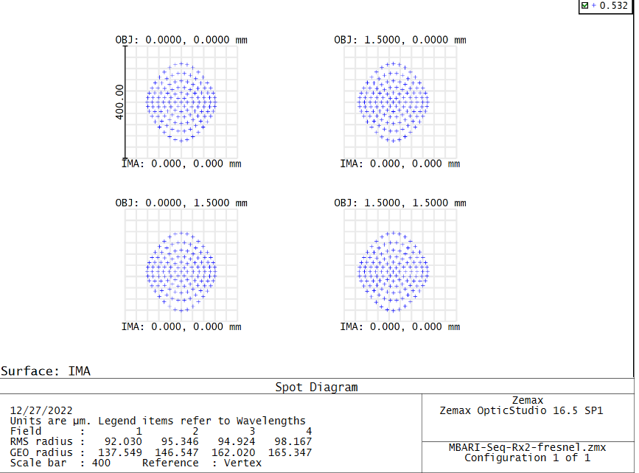
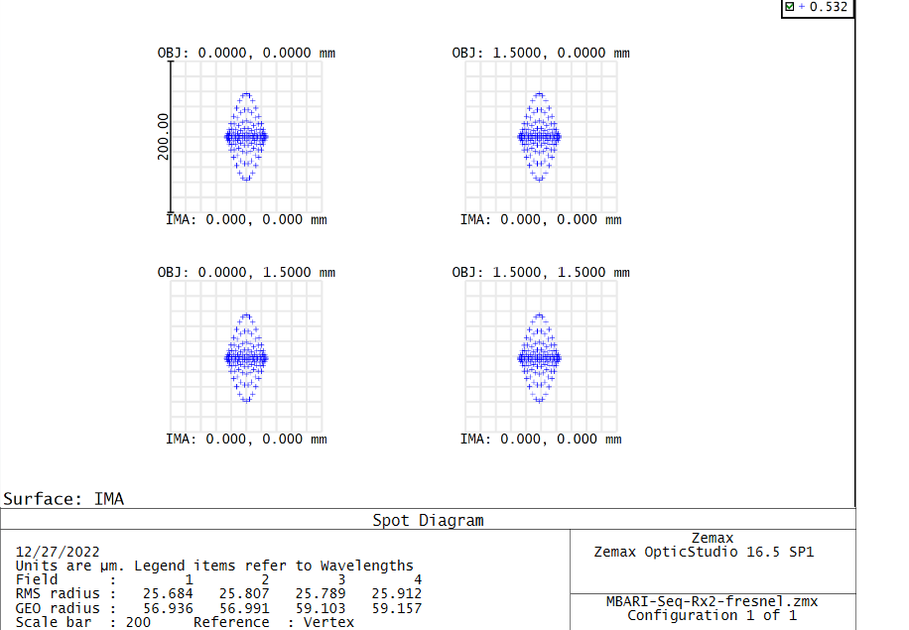
Receiver Optical Design
Goal1 - not require active focus from 1m to 10m LOS range - achieved
Goal 2 – corrector lens as close to output window as possible – achieved (design – need to find supplier)
Next step – reduce internal beam to allow for efficient implementation of multi-receiver temperature system
Next Step – analysis for Tx side
Next Step – implement internal beam direction system (mirrors)
1 Meter Target Distance
10 Meter Target Distance

Slide 13
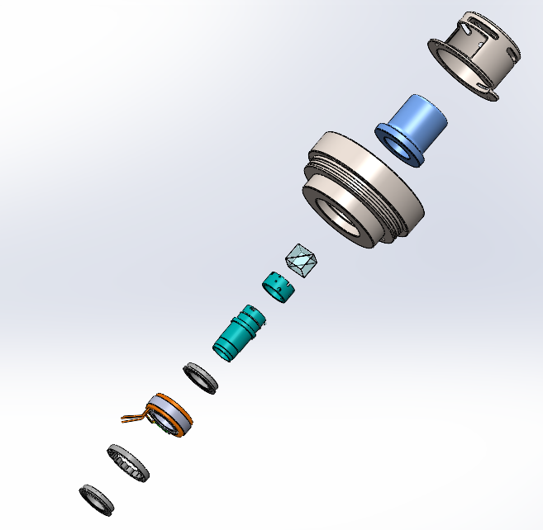
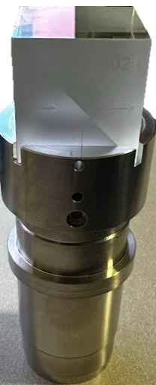
Exploded View – Scanner Assembly
Shroud
Window
Output Endcap
Prism
Shaft part 1
Shaft part 2
Ball bearing
Motor
Deflection reduction
Ball bearing
1
2
3
5
4
6
7
8
9
10

Slide 14
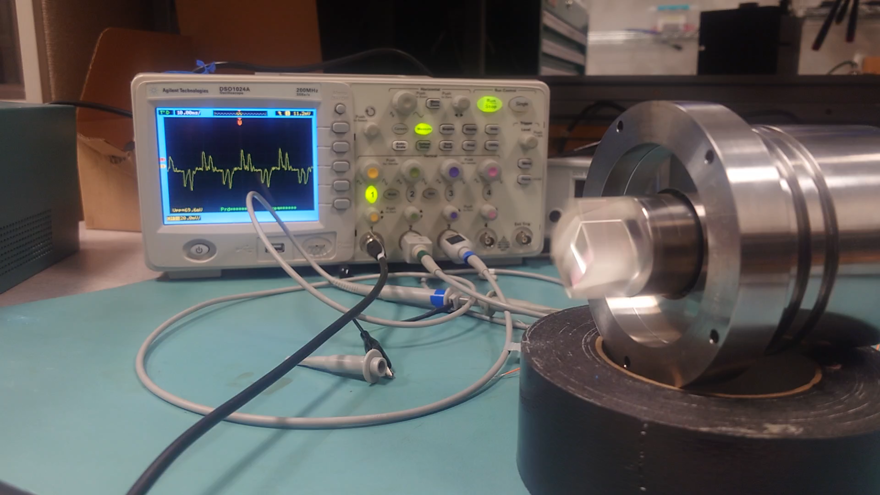
Scanner Assembly – In Action

Slide 15
MBARI Feedback
Investigate using SubConn 13 pin flange SS connector
PPS baseline – will not work on PTP for now.
MBARI investigate implications of Class IV lasers

Slide 16



Colorado
1900 S. Sunset St.,
Suite 1-D
Longmont, CO 80501
USASales@3DatDepth.com
Houston
2901 W Sam Houston Pkwy N, Suite A-150
Houston, TX 77043, US
USASales@3DatDepth.com
UK, (South) EAME
Unit 261, Scottow Enterprise Park,
Lamas Road, Badersfield,
Norwich, NR10 5FB
EAMESales@3datdepth.com
UK, (North) EAME
Neo House,
Riverside Drive, Aberdeen
Scotland, NR10 5FB
EAMESales@3datdepth.com
Questions ?

