Slide 1
Ocean Imaging Articulating Sled
Concept Design Review
Andrew Hamilton, Eric Martin
MBARI

Slide 2
Requirements
The following survey systems must have their active components mounted to an articulated frame:
        RESON Seabat 7125 Sonar Receiver and Projector
        3D @ Depth SL-1 OR 3D @Depth Wide Swath Lidar optical heads
        Stereo Camera Housings (2)
        Strobe Lamps (2)
        Kearfott SeaDeViL
        Depth Sensor
The articulation must achieve rotation across a horizontal axis, ranging from downward looking to forward or side looking.
Must integrate with the Ventana ROV system, and have manual position control available in the control room.
Position of the articulated frame be known relative to the vehicle frame.

Slide 3
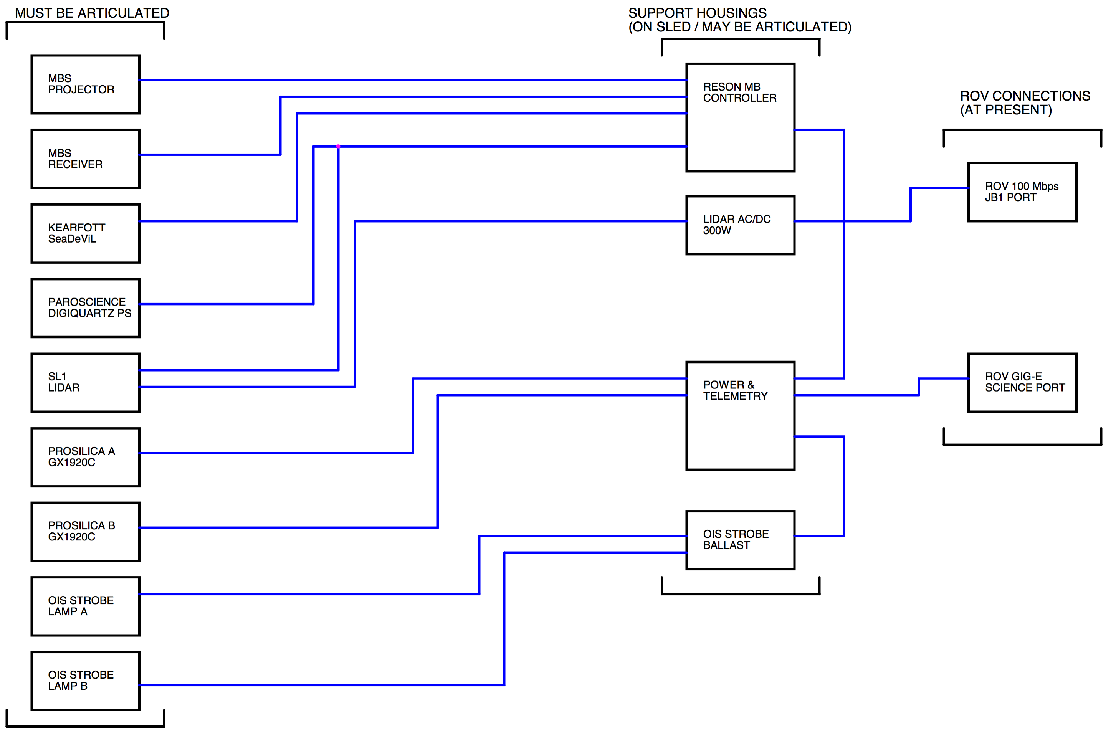
Sled
Components

Slide 4
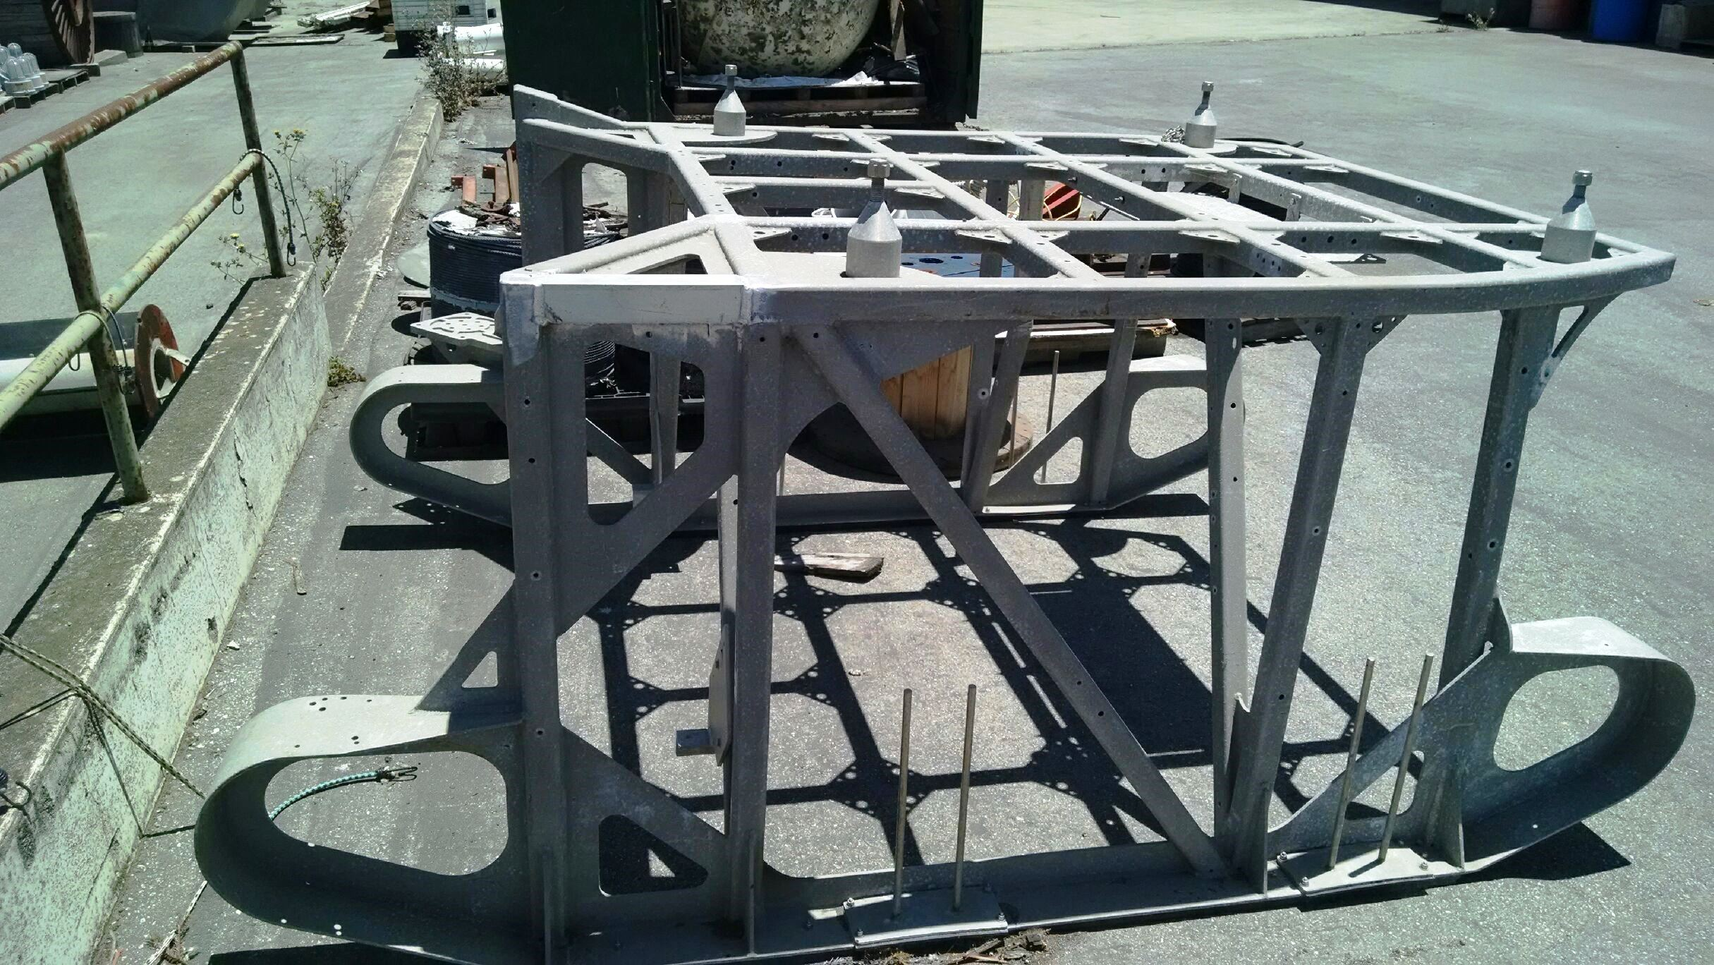
Existing Ventana Cable Sled

Slide 5
Item | Air Weight | Displacement | Water Weight | Specific Gravity | Notes
Kearfot | 95.0 lbs | 676.54 in^3 | 70.0 lbs | 3.80 | Weights from SEADeViL spec sheet for 6000m unit
Lidar w/o Mount Plate | 86.0 lbs | 1380.00 in^3 | 35.0 lbs | 1.69
Lidar Mount Plate | 13.0 lbs | 132.00 in^3 | 8.1 lbs | 2.67
Multibeam Projecter | 7.0 lbs | 72.00 in^3 | 4.3 lbs | 2.63
Multibeam Receiver | 24.0 lbs | 165.00 in^3 | 17.9 lbs | 3.94
Strobe Lamps (each) | 2.5 lbs | 13.00 in^3 | 2.0 lbs | 5.20
Camera+Bar+Cable | 41.0 lbs | 380.00 in^3 | 27.0 lbs | 2.92
Strobe Ballast Can | 23.0 lbs |  | 14.7 lbs |  | 14" Long, 5" Diam
ROV Interface Can | 23.0 lbs |  | 14.7 lbs |  | 19.5" Long, 6.875" Diam
Reson Controller Can |  |  |  |  | 19.5" Long, 6.875" Diam
Lidar/ROV Interface Can |  |  |  |  | 14" Long, 5" Diam
Parascientific pressure sensor. |  |  |  |  | Mounts to Kearfott
Inner Frame | 100.0 lbs |  | 65.0 lbs
Total | 414.5 lbs |  | 258.7 lbs
Max Distance Below Skids = 18 inches
Ram Speed = 30 deg/sec at 5 GPM
150 deg/sec at 25 GPM

Slide 6
Electrical Requirements
Use Existing Cabling if Possible
Wires must reach throughout rotation without strain.
  This is possible if all items are mounted on the frame.
  If not, the strobes are the limiting condition, with lamp to ballast cables of 6’.
No new power requirements.
Cable Purpose | Length | Notes
Strobe Ballast to Power Can | 5' | Inexpensive & quick to replace, high power draw however.
Strobe Lamp to Ballast | 6' | Inexpensive & quick to replace, high power draw however.
Power Can to Cameras | 8' | Expensive assembly on specialty cable avoid replacement.
Reson Interface to Receiver | 9' | Hans has many spares, there could be longer lengths
Reson Interface to Power Can | >10'
Power Can to ROV (GIGE) | 10' | Expensive assembly on specialty cable avoid replacement.
Reson Interface to Kearfott | ?? | Needs to be remade / Inexpensive
Reson Interface to Parosci & Lidar | ?? | Needs to be remade / parts on hand

Slide 7
Software Requirements
For November Trials, manual control of the frame position.
Develop algorithms for using the Kearfott INS and the Octans Gyro (or Sonardyne Sprint) to determine frame inclination.
Develop a software tool to determine the normal vector of the bottom from available data as feedback to manual control of the frame.

Slide 8
Frame Control
Goals:
  Provide manual control through a unified interface that displays frame position and bottom normal vector.
  On Ventana, this means publishing PCOMM messages via LCM that instructs the proportion rate of the valve.
  This requires a feature added to the core GSS that will disable the pilot control and allow an external control interface.
  Support:
  Max 1 week from Rich Schramm for new external interface incorporation.
  Some knowledge transition required from Mike Risi regarding:
    PCOMM message generation
    LCM Datatypes (already obtained)
  Fall Backs are manual controls that already exist in the GSS GUI or the potentiometer control at the pilots station.

Slide 9
Frame Position Resolution
We would like to use the Kearfott’s INS data in real-time against the available data from the ROV’s gyro.
This is a software effort that requires integration of data from Hans’ PC-DAS software and data available from the ROV control system.
  No matter the gyro, the ROV data is available via a published network packet transported using the LCM middleware. This is a pub-sub architecture.
  The PC-DAS software already has hooks to transport data via udp or tcp to network targets. We would need to add one more.
A matlab solution is already developed, and would need to be transcoded into some GUI that performs the math to determine the offsets. A display would output frame angle to help inform manual control.
Recommend addition of cameras to ground-truth system.

Slide 10
Determining the Bottom Normal Vector
  Leverage previous work from Rob McEwen to integrate this into the same display software being developed for the frame position problem.
  First strike would be to use the four beam ranges of the Kearfott DVL. This is an overdetermined system.
  Data from the Kearfott obtained the same way as in the frame position.

Slide 11
Schedule
  July/August:
    Complete mechanical design.
    Simulation / Software
  September:
    Manufacturing
    Software Testing with Ventana for valve control (& potential frame angle measurement)
  October:
    Assembly, Integration
  Late October/November:
    Testing in Building D
    Testing in Test Tank
  November 17th : Mobilization
  November 18th / 21st: Test days
    Day 1: System tests, rotation speed and control system ruggedizing.
    Day 2: Conduct a Survey with various angles (not sure if static/dynamic control requested)

