Slide 1
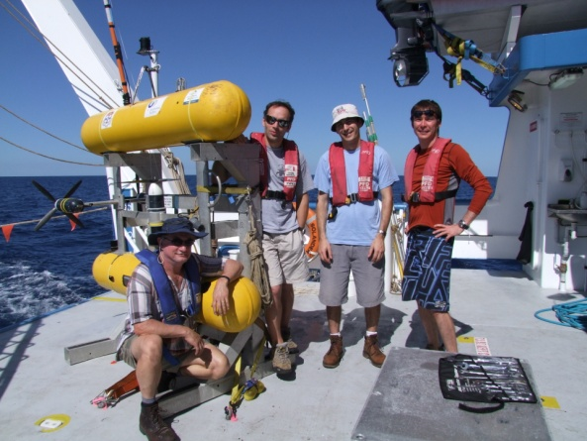
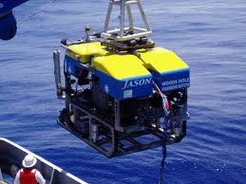
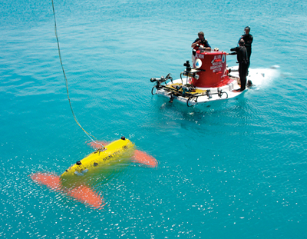
Featureless Approaches to Efficient Bathymetric SLAM
Stephen Alexander Barkby

Slide 2
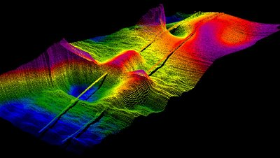
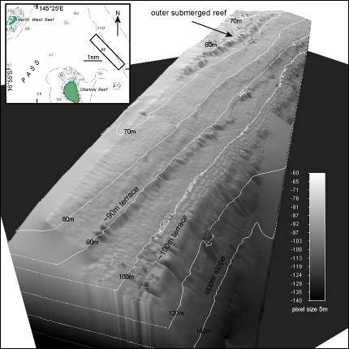
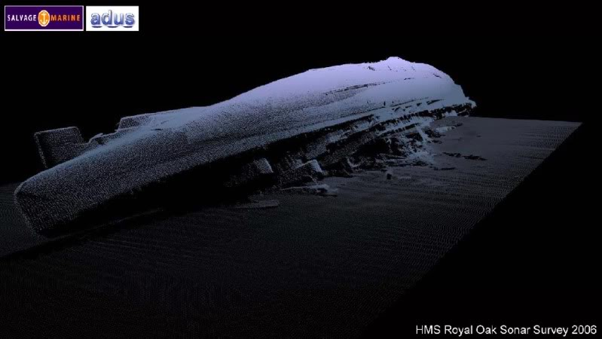
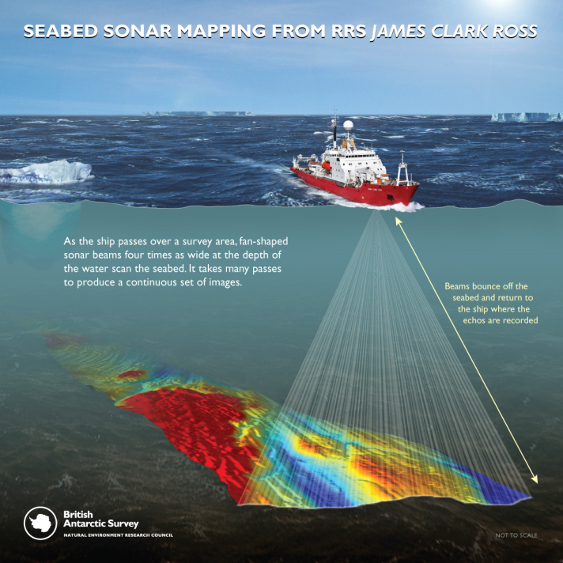
Motivation
We want to create accurate high resolution bathymetric maps. They are very useful …
Several options for collecting bathymetry: Airborne? Shipborne/Towed Sensor? Unmanned Underwater Vehicle (UUV)?
http://geosolutions.blogspot.com
Pipeline Surveys
http://seawavesmagazine.blogspot.com/2010_10_01_archive.html
http://marinesciencetoday.com
http://media.photobucket.com
Salvage Missions
Environmental Surveys
Shipborne Surveys
Notes:
Ok you’ve got me sitting down at 8am in the morning. First off what I want to know is what are you trying to achieve and why?
We want accurate high resolution maps -> Maintenance/Planning for pipeline surveys, Biological/Scientific Assessments of Marine Ecosystems, Salvage/Inspection.
What platform do we use?
Airborne: Lidar system 50 m or less, depending on water clarity.
Shipborne: restricted to operating at the ocean's surface and so provide maps whose resolution decreases as seabed depth increases.

Slide 3
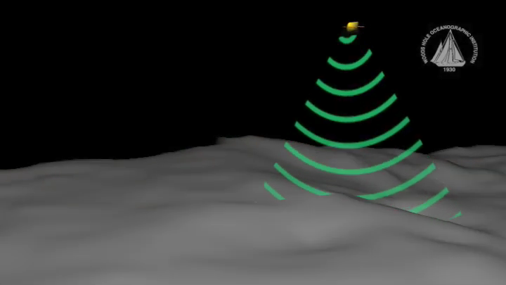
Unmanned Underwater Vehicles
UUVs can operate away from the ocean surface, allowing for the collection high resolution and/or proximal sensor data.
Example: AUV Sentry equipped with
Multibeam sonar
CTD
Camera with Strobe
Magnetometers
Mass Spectrometer
Problem: GPS denied, navigation error accumulates without a form of absolute positioning.
Animation Courtesy of Jack Cook, WHOI
Notes:
Ok so I now know the problems with traditional mapping platforms. How do UUVs help matters?
- Ability to operate away from the ocean's surface, maintain close proximity to the seafloor regardless of depth. (This allows for higher map resolutions to be achieved and other sensors, such as stereo cameras, to be utilized.
- Requires less personnel for operations (particularly with AUVs),
Allows mission operations to be conducted with smaller support ships.
Maintain operations in rough seas, whereas this can affect the quality of shipborne surveys and may even cause them to be aborted.

Slide 4
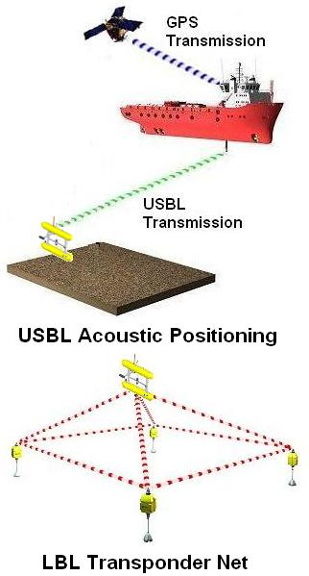
Underwater Navigation
Ultra Short Base Line (USBL) acoustic positioning system
  Requires active tracking from
  support ship.
  Precision reduces with depth.
Long Base Line (LBL) transponder net
  Requires additional logistics for deployment, setup and retrieval.
  Observations can suffer from multipath and/or occlusions.
Notes:
Sounds like a tricky problem, how can you correct for navigation error?
INS,AHRS,DVL,GPS,USBL,LBL advantages/disadvantages
There is something else that is stand alone that could work … SLAM

Slide 5
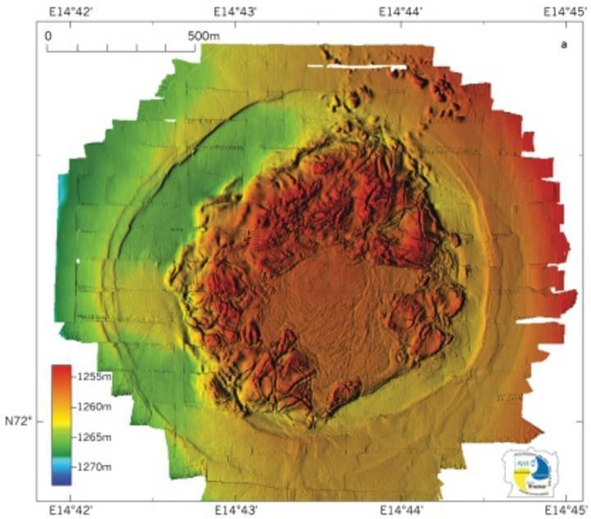

Underwater Navigation
Errors in navigation create error in generated map.
Example: data collected by ROV Victor 6000 completing grid survey with N/S/E/W tracklines.
More precise navigation required for full benefit of high resolution bathymetry.
Misalignment of overlapping swaths from neighboring tracklines has created map artifacts.
SLAM
Error in map can also be strongly suggested even when no map overlap exists.
Haakon Mosby Mud Volcano 2006 (Image Source:www.uib.no/geobio)
Notes:
I believe you, to create accurate high res maps UUVs sound like the way to go. Are their any problems with using UUVs that have to be overcome?
UUVs GPS denied when submerged.
Errors in nav makes errors in map.
Map errors noticeable in 2 ways, when overlapping section are inconsistent and when neighboring sections are discontinuous (assuming some amount of spatial correlation in the environment).

Slide 6
General SLAM Framework
SLAM = Simultaneous Localisation And Mapping.
Use the map being built to enforce nav. corrections.
Online SLAM generally consists of 3 stages repeated iteratively: Predict, Observe then Update.
Stage 1: Predict to t=t₁ (time of next observation)
Stage 2: Observe features, match to those already mapped
Stage 3: Update estimated locations of vehicle and features
Observed Features
Noise in prediction, uncertainty increases
Uncertainty in position
Mean position estimate at t=t₀
New map feature
UUV
Previously mapped features
New uncertainty in position
Data Association
New uncertainty in feature position
Notes:
SLAM you say? What is SLAM? What is Online SLAM? How does it generally work?

Slide 7
Approaches to Feature-based SLAM
Feature-based SLAM has been researched using a variety of sensors and platforms:
  Track vehicle and feature positions in Extended Kalman Filter(Thrun, 2005) .
  Track past vehicle poses, construct pairwise constraints between poses viewing common features(Eustice &Singh, 2005) .
  FastSLAM(Thrun, 2005) , track vehicle position with particle filter, each particle constructs its own feature map based on its position hypothesis.
  GraphSLAM(Thrun, 2005). Collect all navigation measurements, feature observations and control inputs. Define corresponding constraints and optimise.
Notes:
Sounds like SLAM is pretty awesome, but what you’ve described is very general. What specific form will it take?
Have to base form of SLAM on the mapping sensor and the environment
Environment:see above
Sensor: see above
Effective data association challenging issue (whole papers are devoted to this problem) if were to use feature-based approaches.
Leads us to examine methods of SLAM that attempt to resolve misregistrations in the map by manipulating the surface generated as a whole, rather than explicit features identified therein.

Slide 8
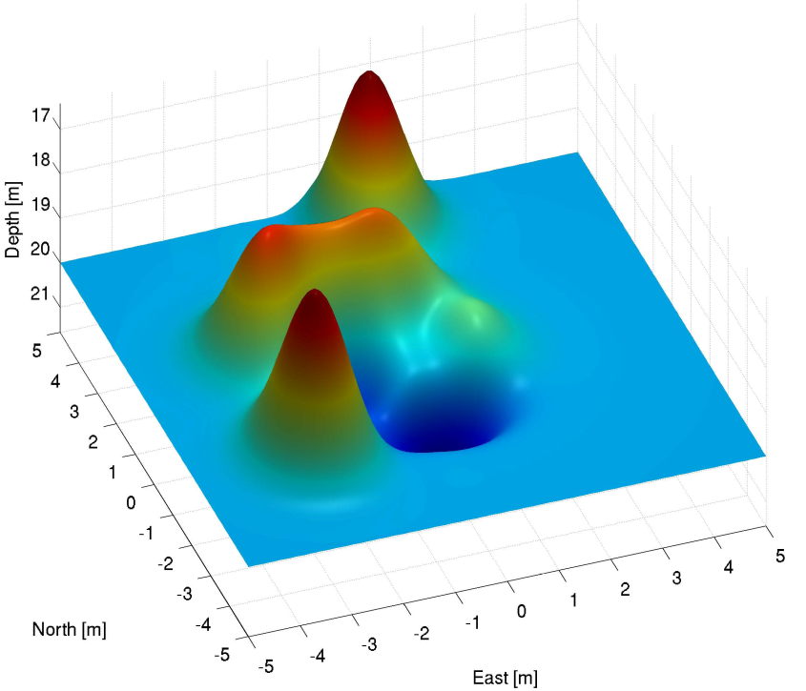
Feature Identification/Data Association
Feature identification and data association tricky for feature-based SLAM with bathymetry.
UUV uncertainty in position
Seabed full of natural formations. What constitutes a feature and at what scale can be very ambiguous.
Mapping sensor provides range/bearing observations. Swath may still not provide clear association to features currently tracked.
Incoming Observation
Across Track (m)
-1
0
+1
+4.5
UUV direction
Depth (m)
Which feature do we associate to?
+6.5
Example Map. How many features in this seabed mound?
Notes:
Sounds like SLAM is pretty awesome, but what you’ve described is very general. What specific form will it take?
Have to base form of SLAM on the mapping sensor and the environment
Environment:see above
Sensor: see above
Effective data association challenging issue (whole papers are devoted to this problem) if were to use feature-based approaches.
Leads us to examine methods of SLAM that attempt to resolve misregistrations in the map by manipulating the surface generated as a whole, rather than explicit features identified therein.

Slide 9
Featureless SLAM
Resolve misregistrations by using the whole surface.
Key Framework: Rao Blackwellized Particle Filter (RBPF) to track UUV position.
Position update achieved by resampling particles based on how well their observations agree with the map.
If each particle builds their own map RBPF SLAM.
Particles
Unlikely Position
Possible Position
Likely Position
Primary Thesis Contribution
But how do we represent and interact with the map ? …
Notes:
Ah crap, feature identification and then data association are really tough problems! Is there any way around it?

Slide 10

Presentation Outline
Section 1. Introduction.
Section 2. Featureless SLAM – current approaches.
Section 3. RBPF SLAM – particle setup.
Section 4. The Grid Map representation.
Section 5. The Trajectory Map representation.
Section 6. Conclusions/Future Work.
Bathymetric Maps + RBPF SLAM = BPSLAM
Notes:
Ahh so that’s what you’ve been working on. So what happens next?

Slide 11
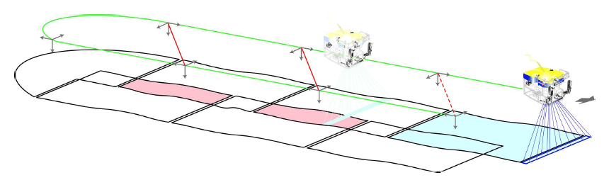
Featureless SLAM – Current Approaches
Submapping with pairwise constraints(Roman, 2005)
  Temporal sequence of bathymetry divided into submaps of point clouds, assumed to be error free.
  Pairwise matching of overlapping submaps constrains the vehicle trajectory and submap origins using a delayed state Kalman Filter.
  Expensive run time, errors within submaps cannot be corrected.
Relative position constraints
Regions of map overlap
Notes:
Yes before you get ahead of yourself are there other methods of Featureless SLAM available? And if so why not use them?
The basic concept behind the sub-mapping algorithm. The vehicle has own the green trajectory above the bottom and the survey swath has been broken into a series of sub-maps. The reference frames along the trajectory indicate the vehicle positions where the sub-maps were started. The red regions indicate where the maps cover a common area of the seafloor and the potential exists to establish a link, shown in red, which constrains the relative position of the previously visited positions.
Correlation for initial matching then ICP for further refinements
However it cannot address errors within the individual submaps that link together to form the overall map. In addition, the tradeos in complexity, accuracy and matching performance based on the size and number of submaps are only partially understood.

Slide 12
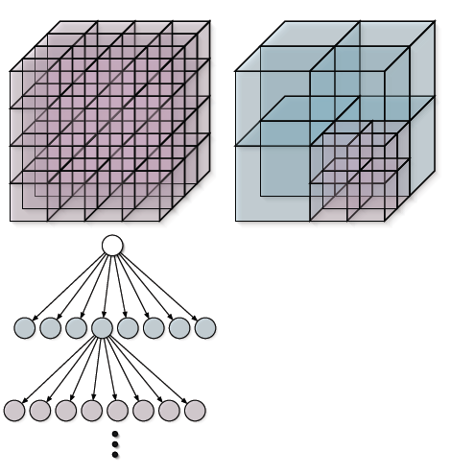
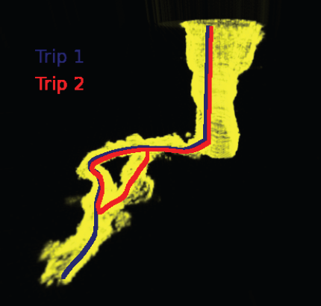
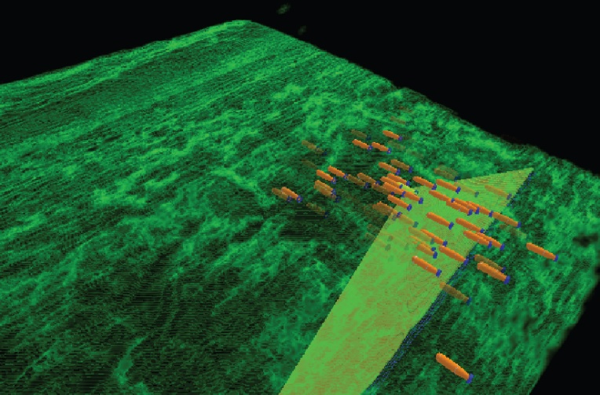
Featureless SLAM – Current Approaches
3D occupancy grids managed using Deferred Reference Counting Octrees(Fairfield, 2006) .
  Also uses RBPF as its foundation.
  Continuous SLAM achieved in closed environments.
  In open environments only navigation was improved.
  Opportunities to localise typically not as abundant as in these two trials.
Octree Structure
Synthetic Wakat´on 3D map
Localisation using RBPF and Occupancy grids.

Slide 13

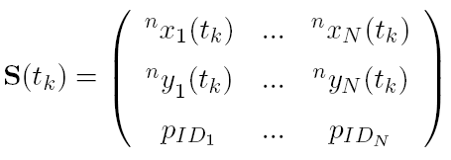
RBPF SLAM: Particle Structure
Directly observable states tracked by EKF:
States most prone to drift included as particle states.
Decoupling states reasonable approximation for relatively slow moving UUVs with low noise in attitude observations.
Each particle also maintains its own map.
Notes:
By reducing the state space we have to sample over

Slide 14
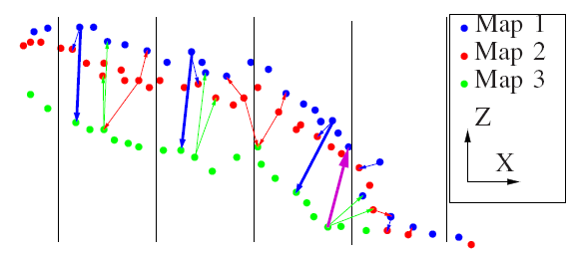
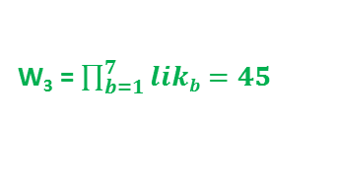
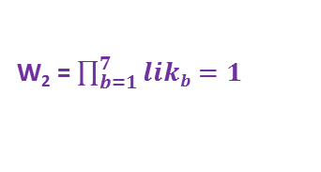
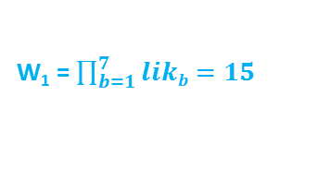
RBPF SLAM: Filter Steps
Step 1: Initialisation
  Randomly sample N different position hypotheses (x,y) of vehicle from initial distribution.
Step 2: Particle Propagation
  Approximate vehicle dynamics with constant velocity model subject to noise.
  Predict EKF and Particle Filter forward to time of next observation.
Step 3: Particle Weighting
  Find where observations land in each particle’s map, extract depth estimates stored in those locations.
  Weight each particle by likelihood that observation matches map estimate.
Step 4: Particle Resampling
  Resample particles with probability directly proportional to their normalised weights.
Step 5: Map Update
  Remove unsampled particles and their maps.
  Update surviving particle maps with current swath.
  Repeating Steps 2-5 until end of mission progressively converges particles onto navigation solution with most self-consistent map.
Step 6: Final Particle Selection
  Online Method: Compile histogram of all likelihood measurements encountered by each particle so far, score by median.
  Offline Method: Generate point cloud map for each particle. Segment cloud into submaps, grid area and find closest distance between submaps in each cell, return worst case.
Multibeam Sonar
W₁ = $\prod_{b=1}^{7}{likb}=15$
W₂ = $\prod_{b=1}^{7}{likb}=1$
x3
Depth map estimates
with uncertainty
x3
x1
W₃ = $\prod_{b=1}^{7}{likb}=45$
x2
x4
x1
x3
x10
x3
Depth
Cloud collapses onto particles with most self-consistent maps.
Across Track
Image taken from Roman & Singh (2006)
Particle Maps
Depth observations with uncertainty
Notes:
Map-to-map error example sketch. This illustrates
the calculation of the map-to-map error in equation (4). The
colored points represent members of individual maps and the
vertical divisions represent bins. Within each bin, a point is
chosen at random from each map. The thin arrows indicate the
closest pairs of all points from the other maps. The bold blue
arrows indicate the maximum misregistration error within each
bin. Note that when determining the closest points allowing
the search to also consider points outside of the immediate bin
will avoid bin size related artifacts. For example, the magenta
arrow indicates how a nearest green→blue point pair would
incorrectly be used if searching was only allowed inside a given
bin. Finally, note that the right most bin with pairings does not
show any Map 3 (green) pairings. This is because there are no
Map 3 points in both surrounding bins.

Slide 15
RBPF SLAM: DP Mapping
Standard RBPF SLAM requires entire maps to be copied during resampling O(N²) operation.
Use Distributed Particle Mapping (DPM)
  Key idea: ID each particle. Store original (parent) particles and their maps in an ancestry tree. Any particles resampled from parent point to original map rather than copying it.
  Particle reconstructs its map from entries made by itself and its ancestors, filter iteration becomes O(N) operation.
  To maintain O(N) complexity, tree must be pruned of dead particles/maps. Singular children merge with parents.
  Filter can be initialised with prior map, assign prior map to the root particle and all particles automatically inherit it.
Map available to Particle 10
Ancestry Tree
Great Grandparent
Root Particle
0
0
Grandparents
1
1
2
Current Particle Set (Parents)
3
6
3
4
5
7
y
8
10
11
New Particle Set (Children)
9
10
12
x
Notes:
Reality check
Up until this point I get how RBPF SLAM will work
Here is the particle set
Say it gets resampled as follows
Instead of P3 map getting copied three times why not just point to it
We progressively do this we form an ancestry tree as show
.

Slide 16
Grid Map: Introduction
Grid maps allow relatively fast map access at the cost of reducing resolution through map discretisation.
Each particle represents map as a 2D grid, each cell containing a depth estimate with corresponding uncertainty.
Maintain and update each estimate with 1D Extended Information Filter (EIF).
Treat each cell as independent.
Height (m)
1D Information Vector & Matrix: (ξ, Ω)
Depth estimate (µ_{i,j}) = Ω_{i,j}⁻¹ξ_{i,j}
Uncertainty (σ²_{i,j}) = Ω_{i,j}⁻¹
Easting index ( j )
Each cell stores (ξ_{i,j} , Ω_{i,j})
Northing index ( i )

Slide 17
Grid Map: Structure
Use single global grid to store all map estimates from all particles, each estimate keyed with ID of particle that made it.
If multiple estimates available to particle, use most recent.
Estimates from all particles that have previously observed this cell.

Slide 18
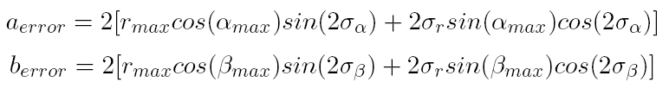
Grid Map: Data Association problem
Each particle hypothesis is treated as truth. However uncertainty in sonar observation creates uncertainty in observations x,y location.
Introduces risk of accessing/updating incorrect cell.
Error introduced can be bounded by limiting mapping resolution:
Ensures that error introduced is on the order of that produced by map discretisation.
3D Confidence bound of Observation
Depth Observation
Cell Observed
Depth Uncertainty
Possible cells observed

Slide 19
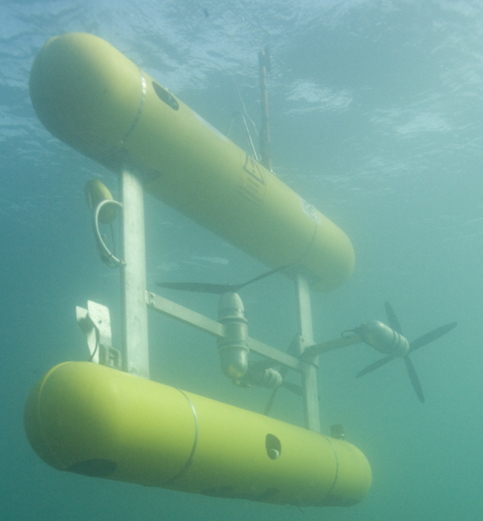
Grid Map: Pockmark Results
Small scale mission scenario undertaken by our in house research class AUV Sirius.
Two overlapping grid transects over relatively flat seabed with Ø30 m pockmarks scattered throughout.
Sensors:
  Roll/pitch Inclinometers
  Calibrated magnetic compass.
  High precision depth sensor
  Doppler Velocity Log (DVL) (±3mms⁻¹)
  Imagenex Delta T multibeam sonar
  USBL (For comparison purposes only)
Sirius AUV operated by ACFR

Slide 20
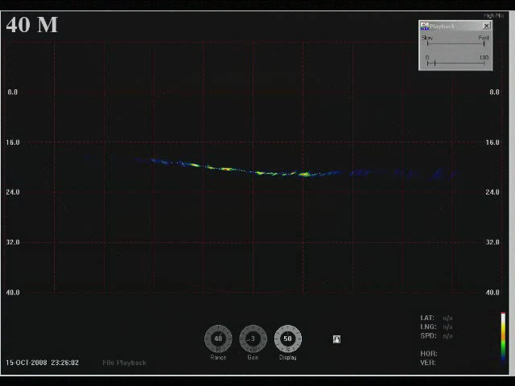
Grid Map: Pockmark Results
Mission Replay

Slide 21
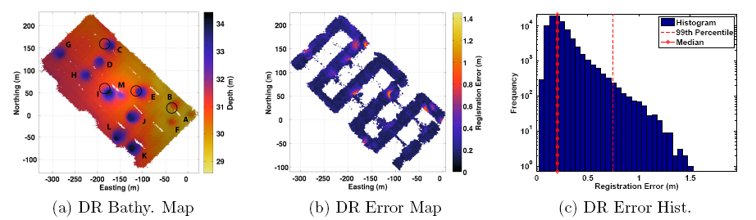
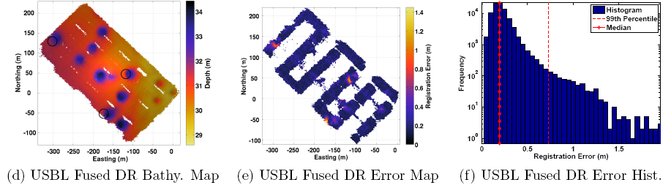
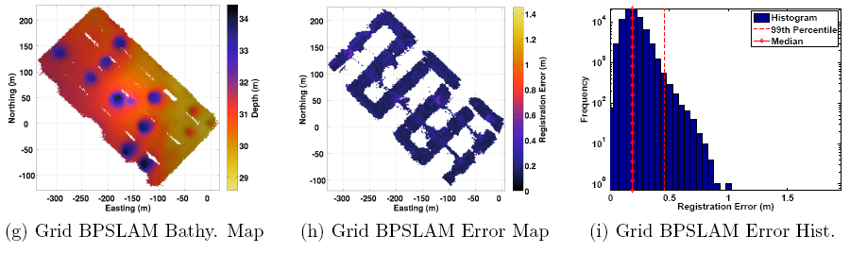
Grid Map: Pockmark Results

Slide 22
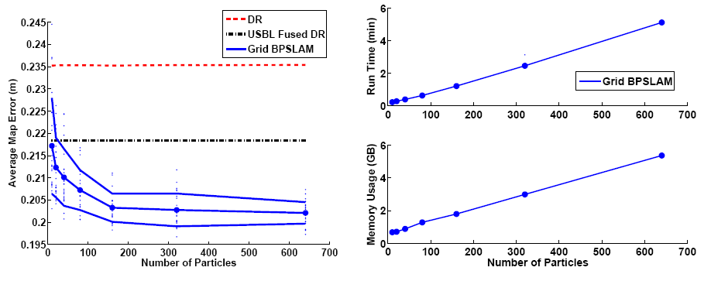
Grid Map: Pockmark Results
BPSLAM involves random sampling so results may vary.
Investigate this and effect particle size has on consistency of result.
Accuracy, Consistency and Efficiency Analysis

Slide 23
Grid Map: TAG Results
Large scale mission scenario undertaken by JASON ROV(Roman, 2005) . Results of Submapping Filter available.
Survey taken in Trans Atlantic Geotraverse (TAG) hydrothermal field, several passes over large hydrothermal vent. 17,500 m² survey area.
Sensors:
  Roll/pitch Inclinometers
  Fiber Optic Gyroscope
  High precision depth sensor
  DVL (±3mms⁻¹)
  SM2000 multibeam sonar
  LBL transponder net (For comparison purposes only)
JASON ROV operated by US National Deep Submergence Facility

Slide 24
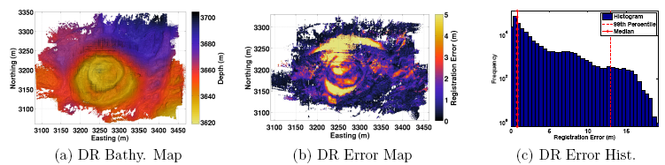
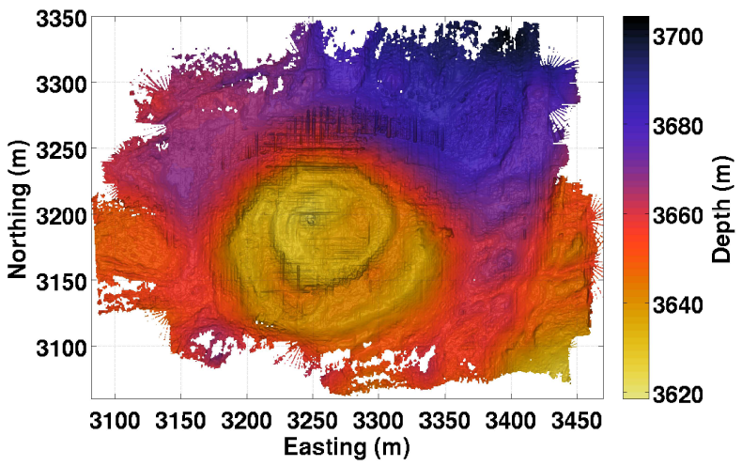
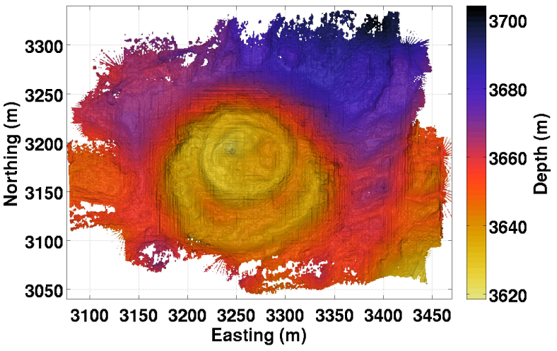
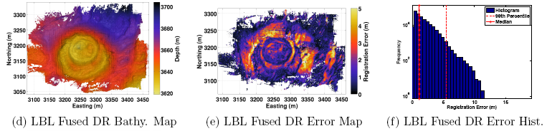
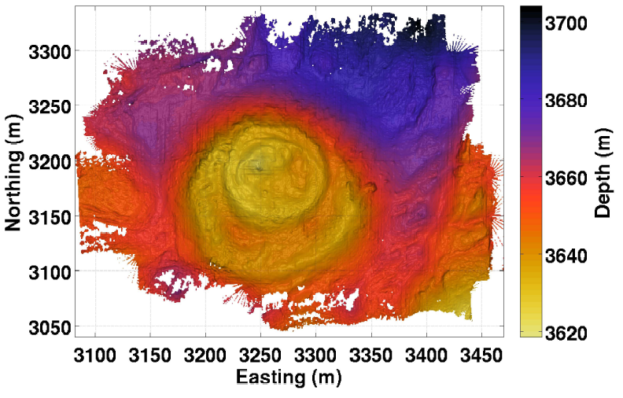
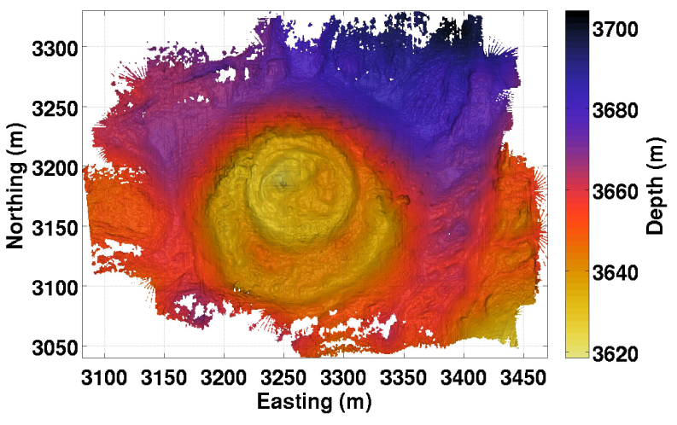
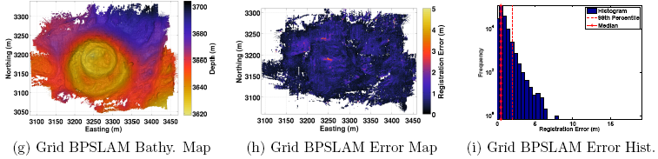
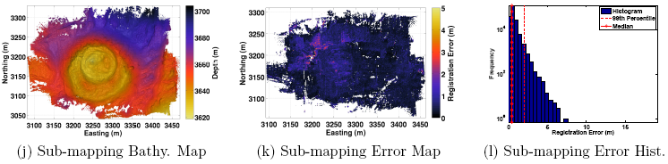
Grid Map: TAG Results
Difference in Run Time:
DR
LBL
BPSLAM
6 min
Submapping
Overnight
BPSLAM
Submap SLAM

Slide 25
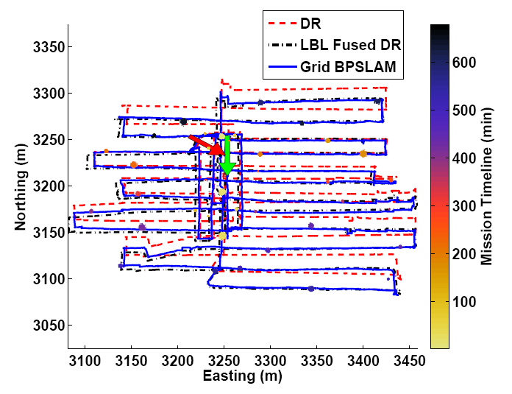
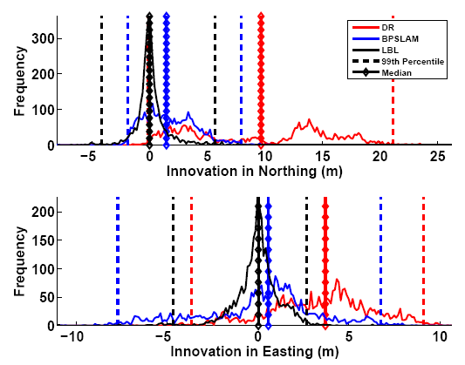
Grid Map: TAG Results
Raw LBL observations available, can also investigate accuracy of navigation produced.
Innovations demonstrate BPSLAM navigation within reasonable limits of LBL observations.
Histogram of innovations from LBL observations
Navigation Solutions

Slide 26
Grid Map: Limitations
Memory requirements of grid map limit the processing of datasets larger than those presented so far.
Accuracy lost through map discritisation.
Accuracy lost through data association problem.
Spatial correlation between cells ignored, direct observations required for matching.
a new map representation
This motivates … that:
  Is memory efficient.
  Better handles the data association problem described previously.
  Accommodates for spatial correlation in the environment.

Slide 27

Trajectory Map: Introduction
Important Observation: Every particle map is generated from an identical log of bathymetric observations, only the underlying trajectories are different.
Store each particle’s trajectory instead and link it to a common log of bathymetric observations.
P swaths in list
P multibeam swaths per map
P poses per map
+
N particle maps
B beams per swath
Fraction of memory used: $\frac{\text{NP}\text{ + }\text{BP}}{\text{BNP}}$ = $\frac{1}{B}+\frac{1}{N}$

Slide 28
Trajectory Map: Extracting Maps
Particle now reconstructs its map by tracing back through ancestry and concatenating the trajectories of its ancestors. Bathymetric observations are then overlayed onto this trajectory.
Each particle updates its map by adding new poses to the end of its trajectory
Map available to Particle 10
Ancestry Tree
0
0
1
1
2
3
3
y
8
10
9
10
x
Notes:
Reality check
Up until this point I get how RBPF SLAM will work
Here is the particle set
Say it gets resampled as follows
Instead of P3 map getting copied three times why not just point to it
We progressively do this we form an ancestry tree as show
.

Slide 29
Trajectory Map: Weighting
Map needs to be locally reconstructed during each particle weighting attempt.
New observations will not overlap with previous estimates.
Spatial correlation in the environment can be exploited to predict map estimate at observation.
Gaussian Process Regression provides a method to do this in addition to calculating the estimate’s uncertainty.
x
New observation, match to which estimate?
y
z
Predicted map estimate
Map estimate

Slide 30









Trajectory Map: GP Regression
Model seabed as continuous function
Training Points :
  Input points:
  Noisy output points:
  Noise covariance:
Covariance function models the spatial correlation in the seabed.
Mean function dictates what predictions converge to as distance from training set is increased.
Above quantities allow us to compute the predictive distribution of at test points .

Slide 31
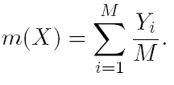
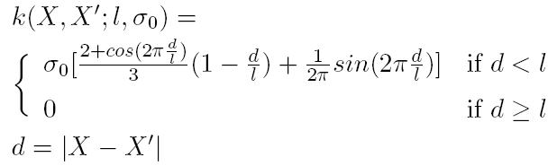

Trajectory Map: GP Model
Must be periodically relearnt as new observations are received.
Each particle uses different training set, approximations required for computational tractability:
  Simple stationary covariance function that is periodically relearnt(Melkumyan & Ramos, 2009) .
  Use only recent bathymetry to relearn hyperparameters.
  Use local training subset for regression
  (within of test points).

Slide 32

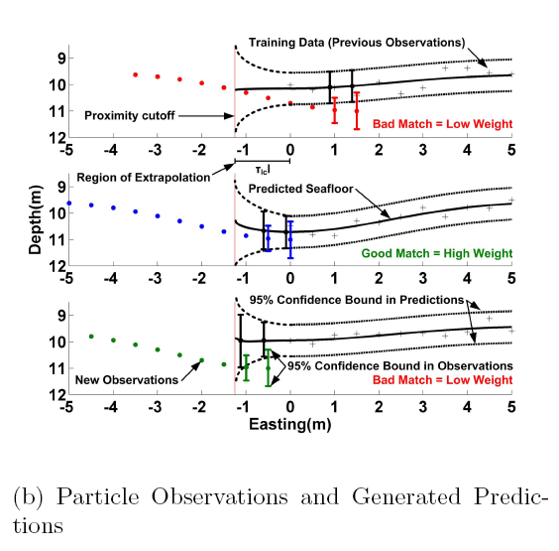
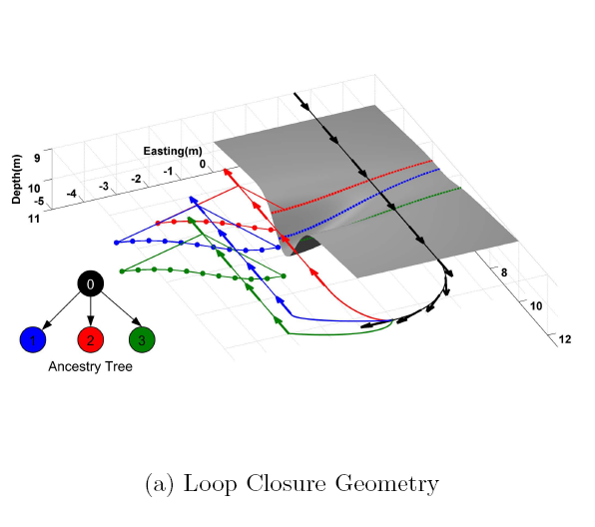
Trajectory Map: When to weight?
Naively map estimates can be predicted any distance away from training data.
Only weight particle with observations that fall within of training set.

Slide 33
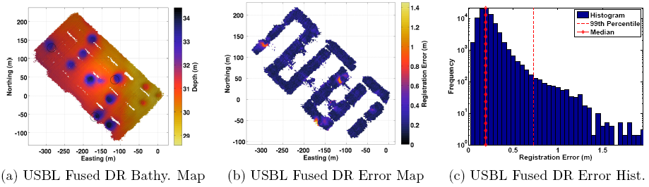
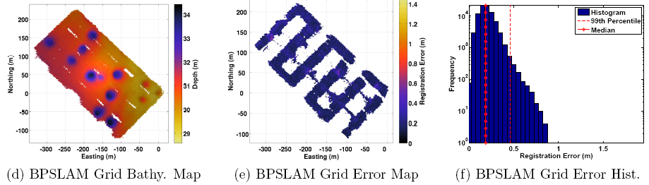
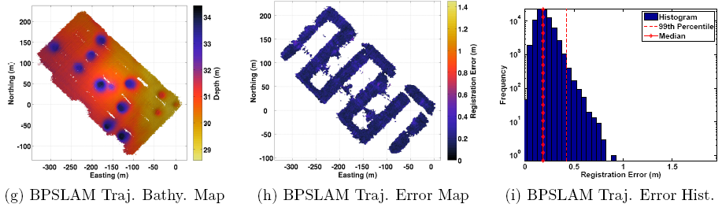
Trajectory Map: Pockmark Results

Slide 34
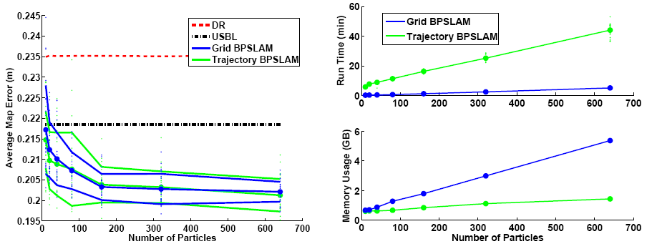
Trajectory Map: Pockmark Results
Accuracy, Consistency and Efficiency Analysis

Slide 35
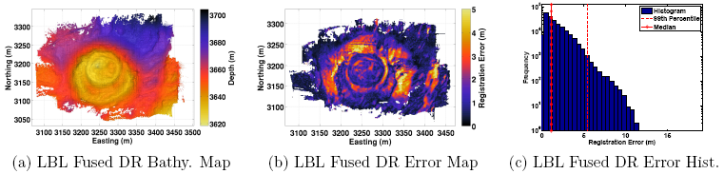
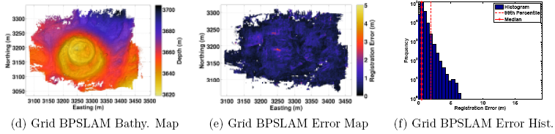
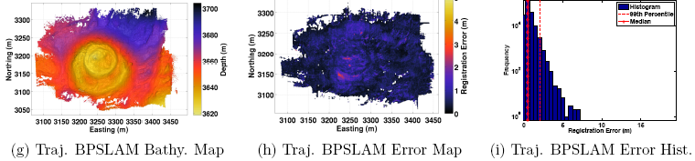
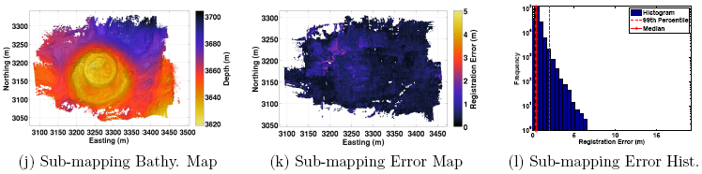
Trajectory Map: TAG results

Slide 36
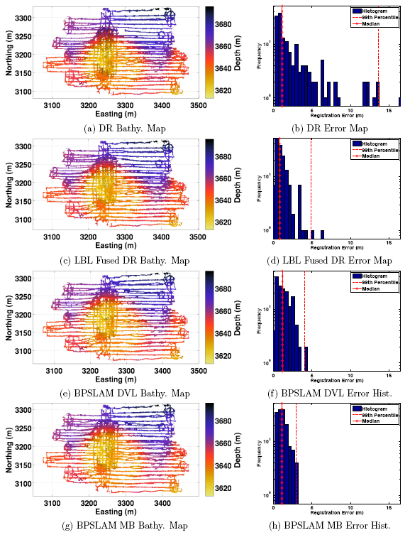
Trajectory Map: TAG DVL results
With ability to interpolate/extrapolate how dense does bathymetry need to be to provide corrections?
Rerun TAG mission, swapping multibeam bathymetry with bathymetry from 4 beam DVL.

Slide 37


Trajectory Map: TAG DVL results

Slide 38


Trajectory Map: Haakon Mosby Results
Large scale mission scenario undertaken by Sentry AUV. Sensor suite similar to JASON.
Survey taken of Haakon Mosby Mud Volcano
Survey consists of only NS tracklines, total coverage is 122%
Sentry AUV operated by Woods Hole Oceanographic Institute
Haakon Mosby Mud Volcano 2006 (Image Source:www.uib.no/geobio)

Slide 39

Trajectory Map: Haakon Mosby Results
Navigation in this case very precise, DR only deviates from LBL fused solution by 12m after traveling 36km.

Slide 40




Trajectory Map: Haakon Mosby Results

Slide 41

Trajectory Map: Haakon Mosby Results

Slide 42

Trajectory Map: Haakon Mosby Results

Slide 43

Trajectory Map: Haakon Mosby Results
What happens to corrections when map overlap between neighboring swaths is reduced?
Run filter several times with different overlap.

Slide 44






Trajectory Map: Haakon Mosby Results
Noticeable improvement even with no overlap!

Slide 45
Contributions
A novel grid map representation
  run time and memory requirements scale linearly with N.
  Computational speed attained by this form of BPSLAM is on the order of 2% of the mission time.
A novel trajectory map representation
  run time and memory requirements scale linearly with N.
  Computational memory required allows for processing very large datasets (≈1.65 km²).
  Computational speed attained by this form of BPSLAM is on the order of 25% of the mission time.
  A method to provide interpolation and extrapolation of terrain predictions in unobserved regions by learning and exploiting the spatial correlation in the seabed.

Slide 46
Conclusions
Navigation and maps produced by bathymetric surveys can be improved by enforcing self consistency in the map.
SLAM can be conducted efficiently using bathymetry without requiring features to be explicitly identified or tracked.
The improvements provided by bathymetric SLAM exceed those produced by state of the art navigation without SLAM.
The added ability of trajectory map SLAM allows for map corrections even when map overlap does not exist.

Slide 47

Questions?

Slide 48

Transforming from Range to Depth
GP Regression in polar domain allows calculation of probability of receiving particular range observation for any given bearing.
Map depth axis to polar domain. Probabilities along this curve provide uncertainty in depth.

