Slide 1
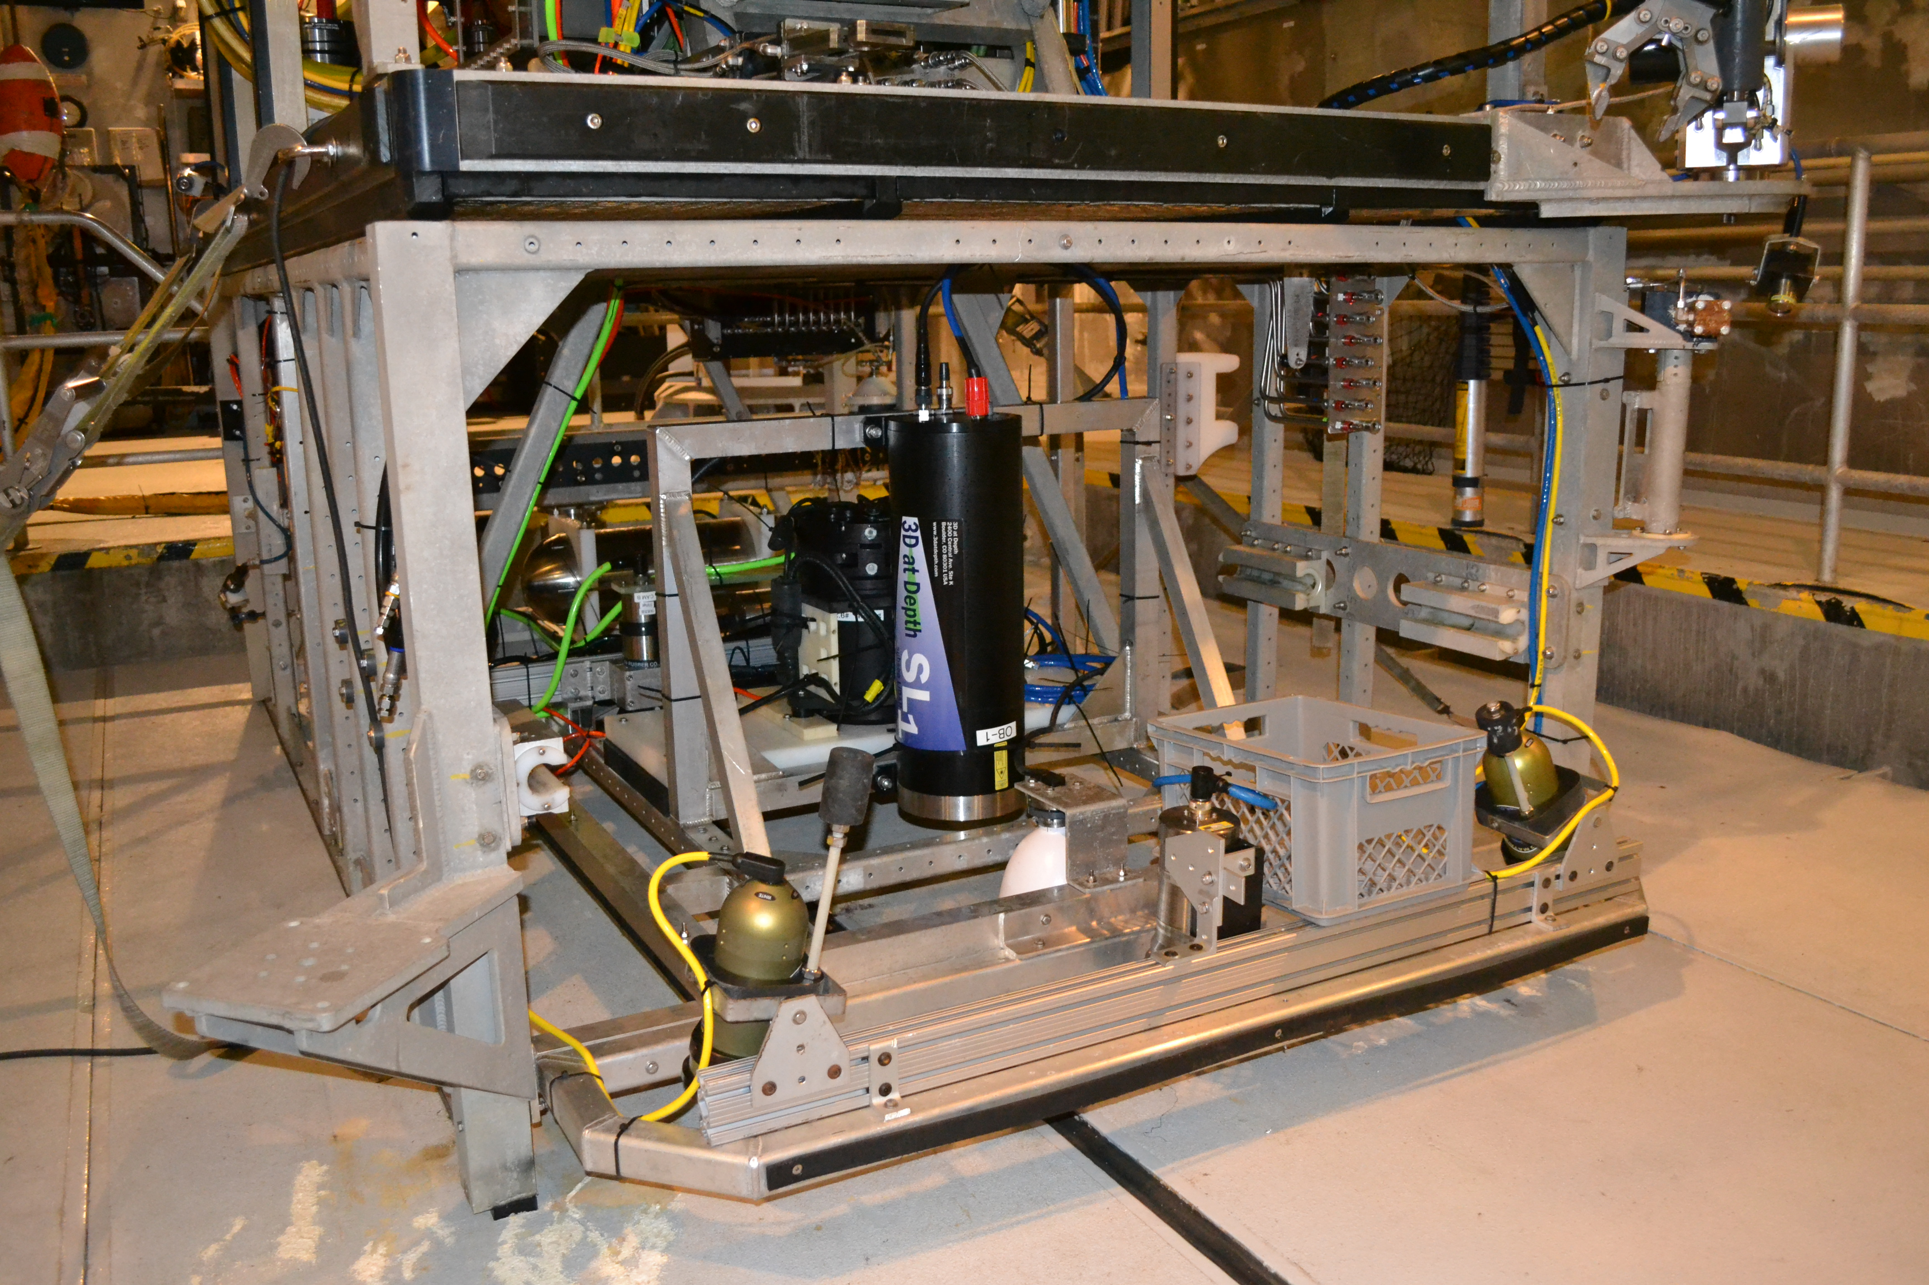
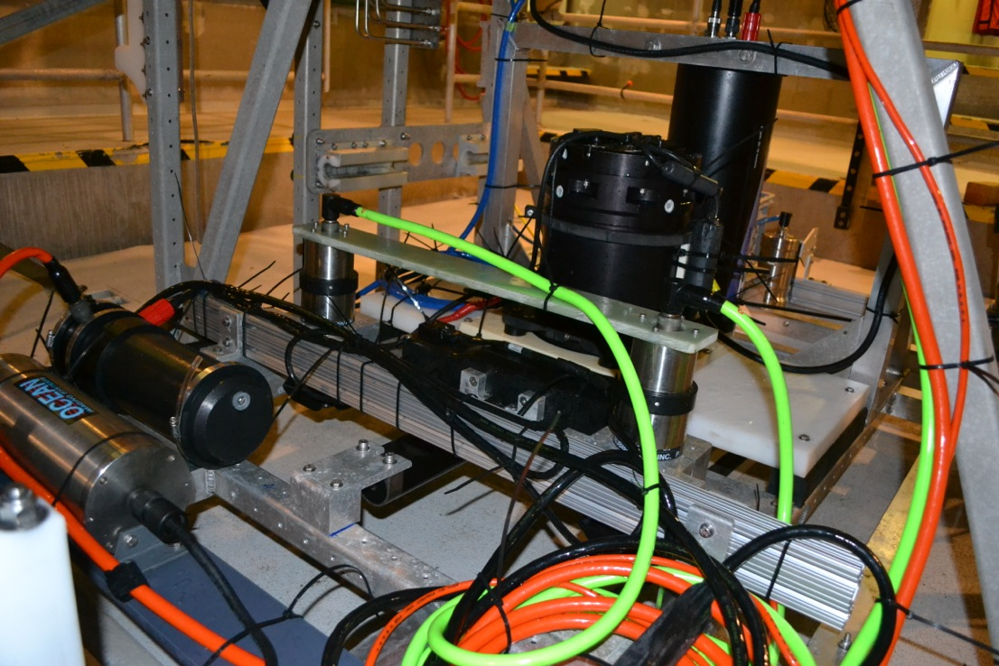
Ocean Imaging Project:
Current Status & 2015 Proposal
David Caress, Hans Thomas, Brett Hobson, Rich Henthorn, Eric Martin, Larry Bird, Giancarlo Troni, Mike Risi, Steve Rock, Charlie Paull
High resolution seafloor surveys combining acoustic and optical sensing
Topography
  Multibeam sonar: 5-cm lateral-resolution
  Lidar: 1-cm lateral-resolution
Photographic Imagery
  2-mm resolution
Low (2-3 meter) altitude
Now operated from either ROV Doc Ricketts or ROV Ventana
Autonomous control of ROV during survey using INS data to control path and altitude
Multibeam Sonar
Cameras
INS
Lidar

Slide 2
MBARI Low Altitude Survey Tests
Repeated surveys at three sites in Monterey Canyon around 2850 m depth starting in 2012

Slide 3
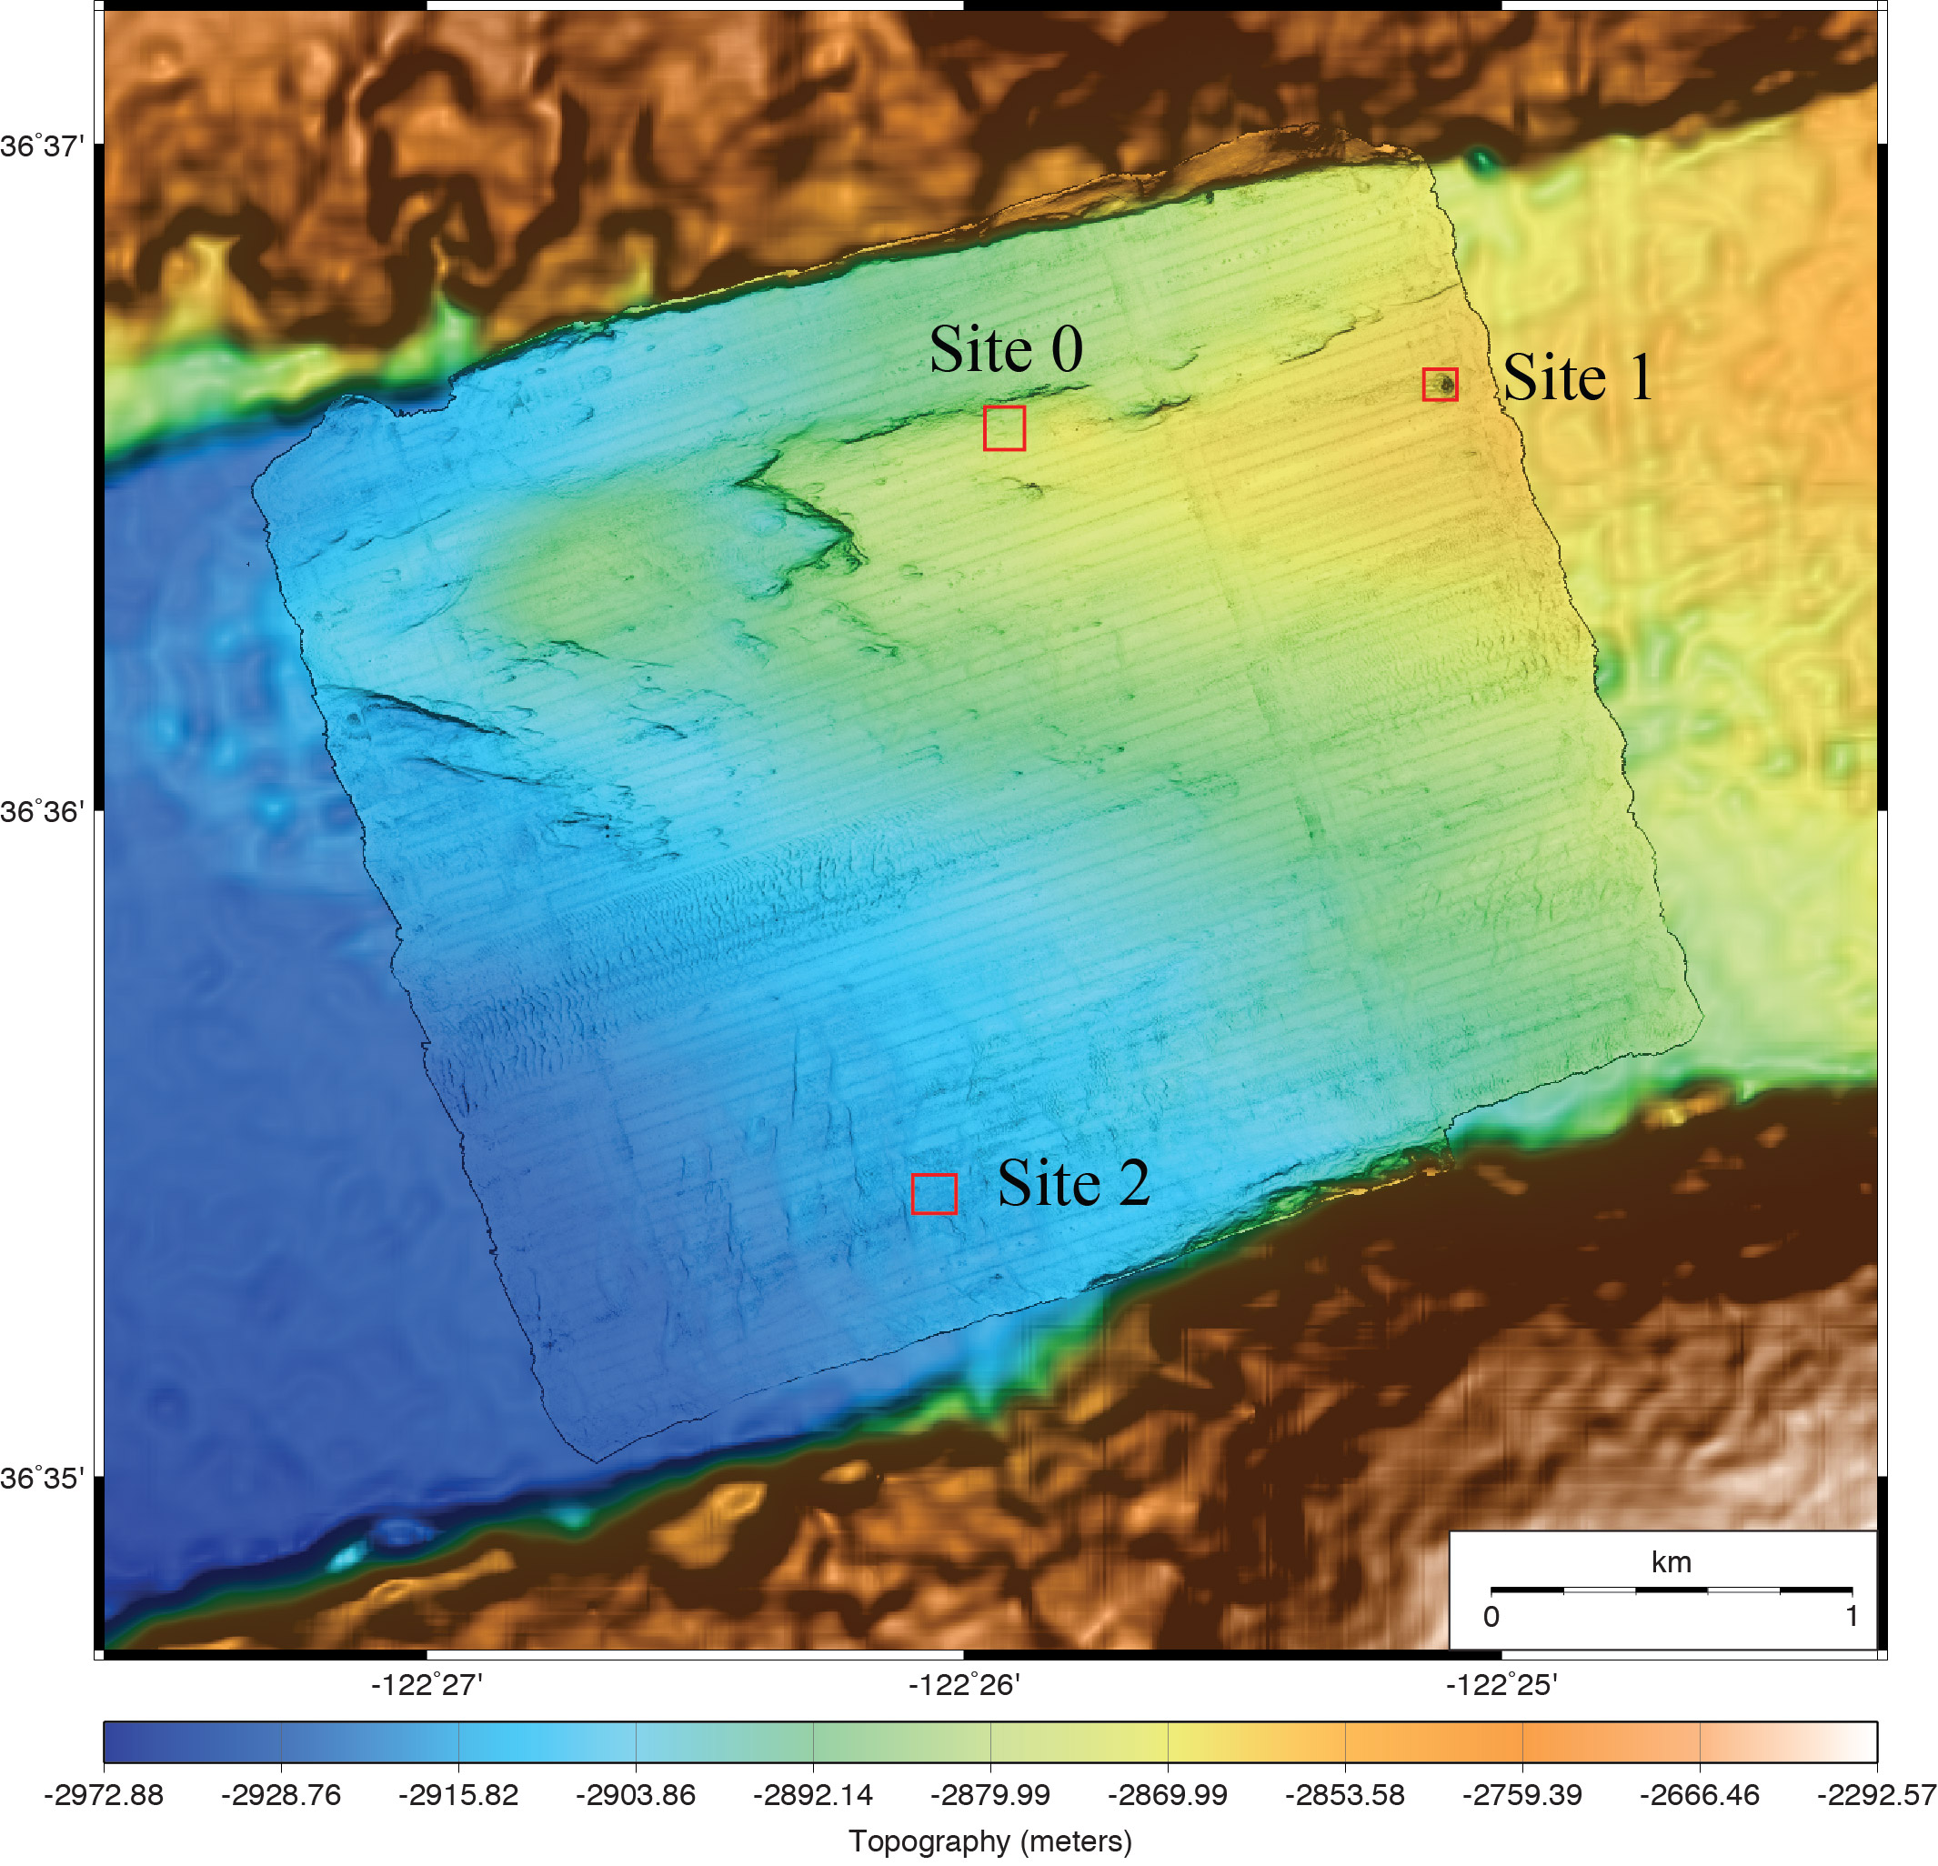
MBARI Low Altitude Survey Tests
80-m by 80-m surveys at 2-3 m altitude from ROV Ricketts
5-cm lateral-resolution multibeam bathymetry
1-cm lateral-resolution LIDAR bathymetry
2.5-mm resolution photomosaics

Slide 4
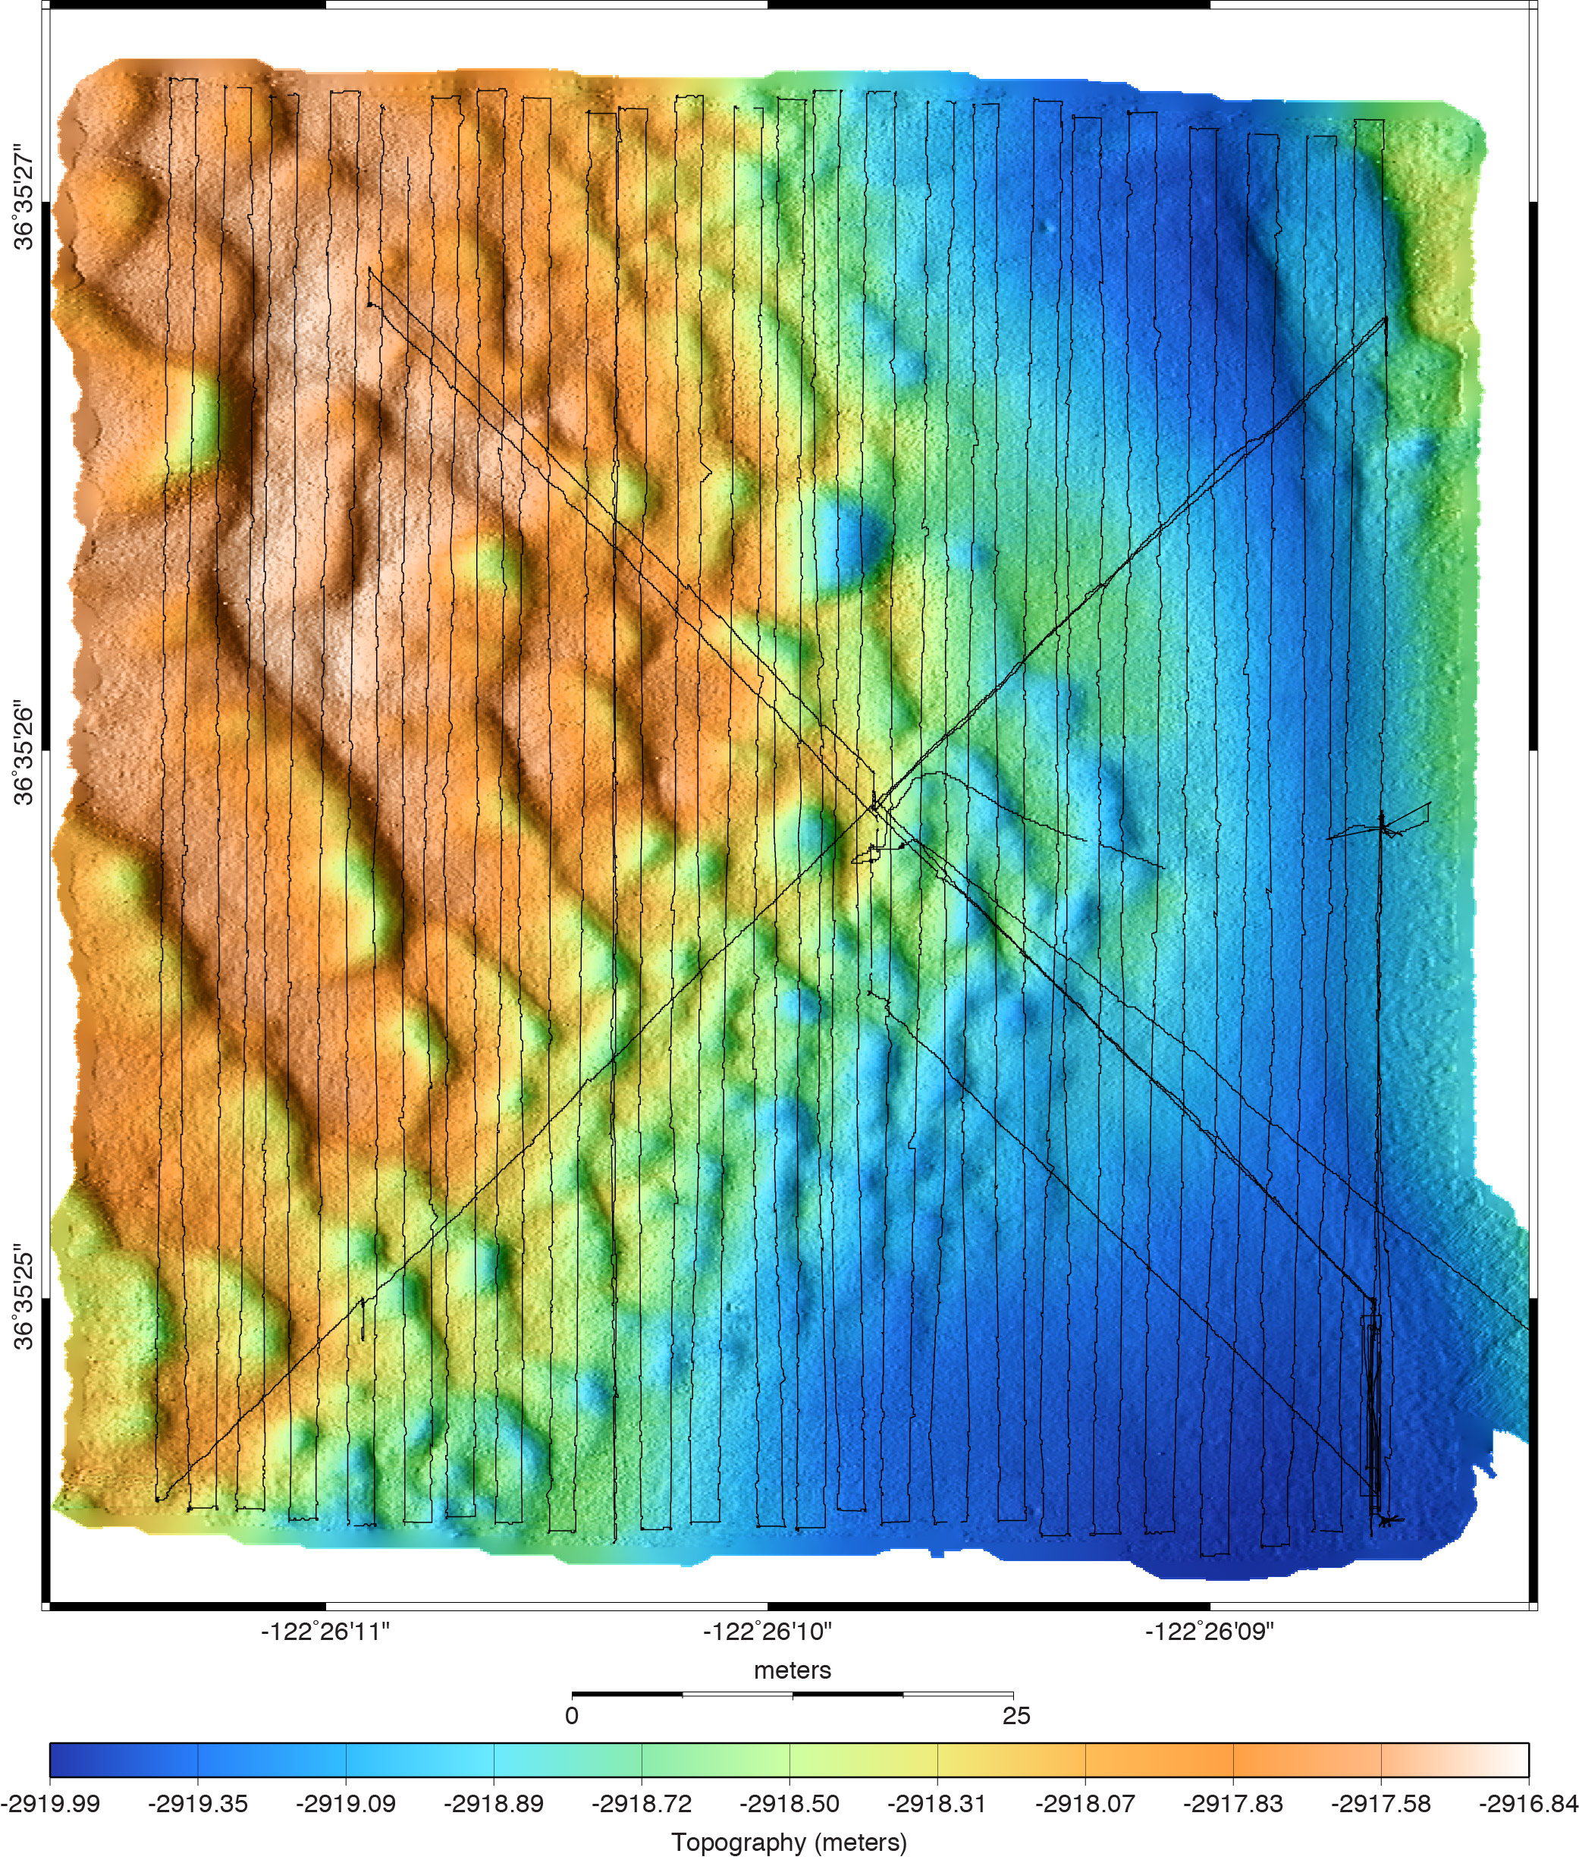
Ocean Imaging Site 2:
Bedforms
5-cm resolution multibeam bathymetry
2-mm resolution photography
50 cm
50 cm
50 meters
50 meters

Slide 5
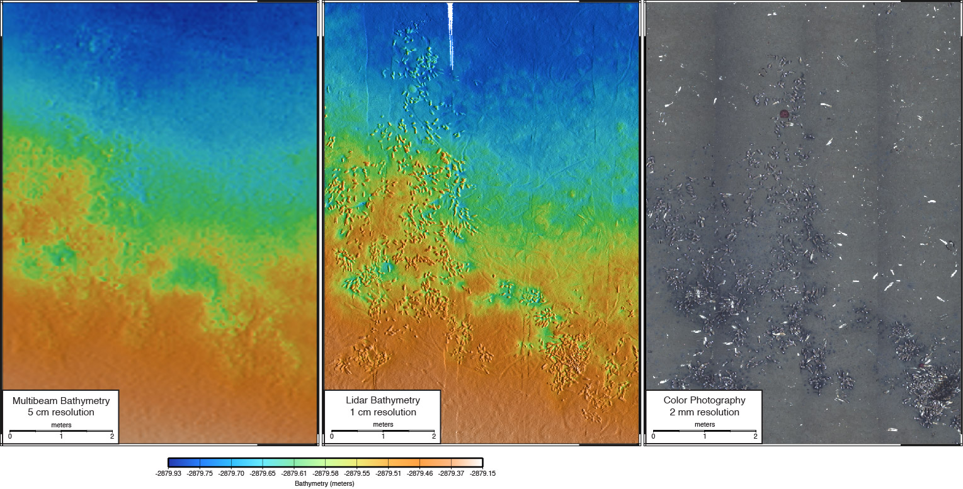
Example Data from Ocean Imaging Site 0:
Chemosynthetic Clam Community at 2850 m Depth

Slide 6
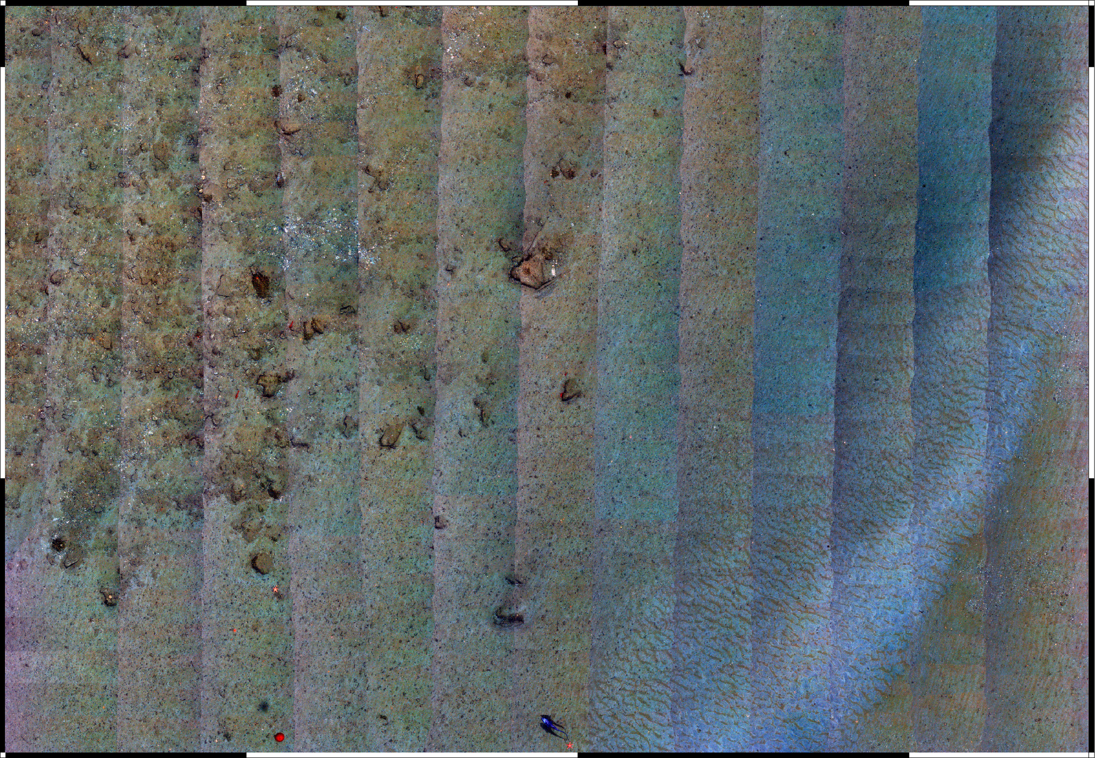
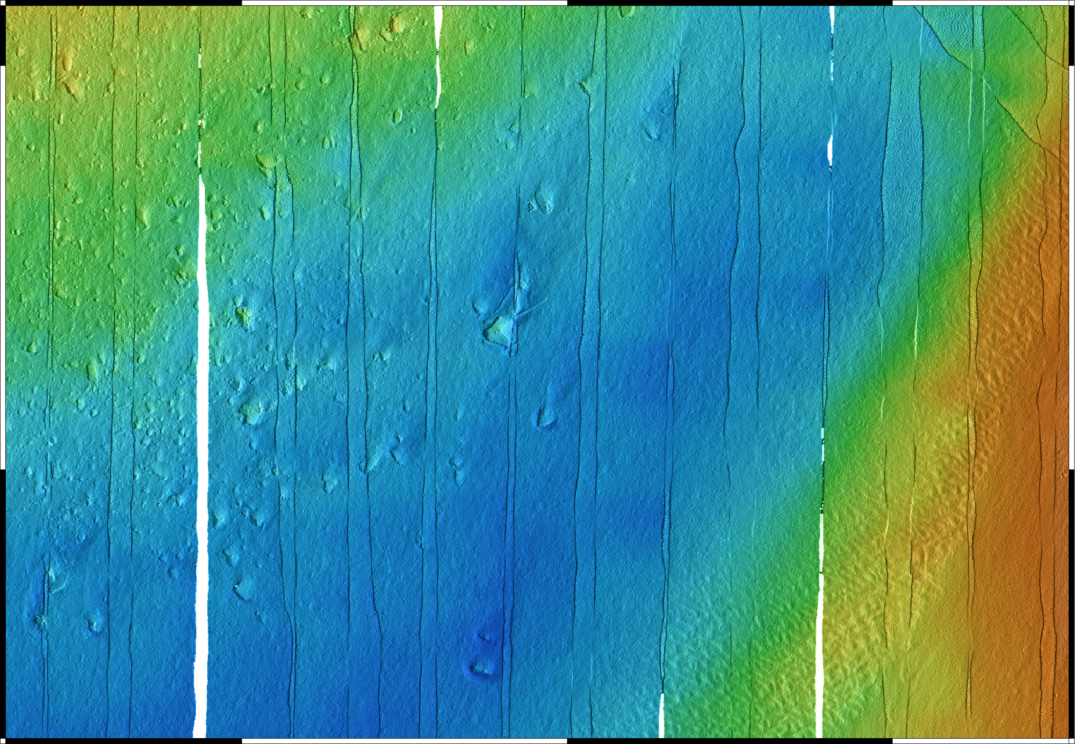
Ocean Imaging Survey:
Planned BIN Site at 1850-m Bend in Monterey Canyon
(11 May 2014)
Photomosaic – 2-mm resolution
Mapping AUV Bathymetry 1-m resolution
500 meters
5 meters
Lidar Bathymetry 1-cm resolution
Poorly sorted sediments, no scouring
Scouring around boulders
Fine sediments deposited and reworked into small ripples
Seafloor smooth at 1-cm scale
5 meters

Slide 7
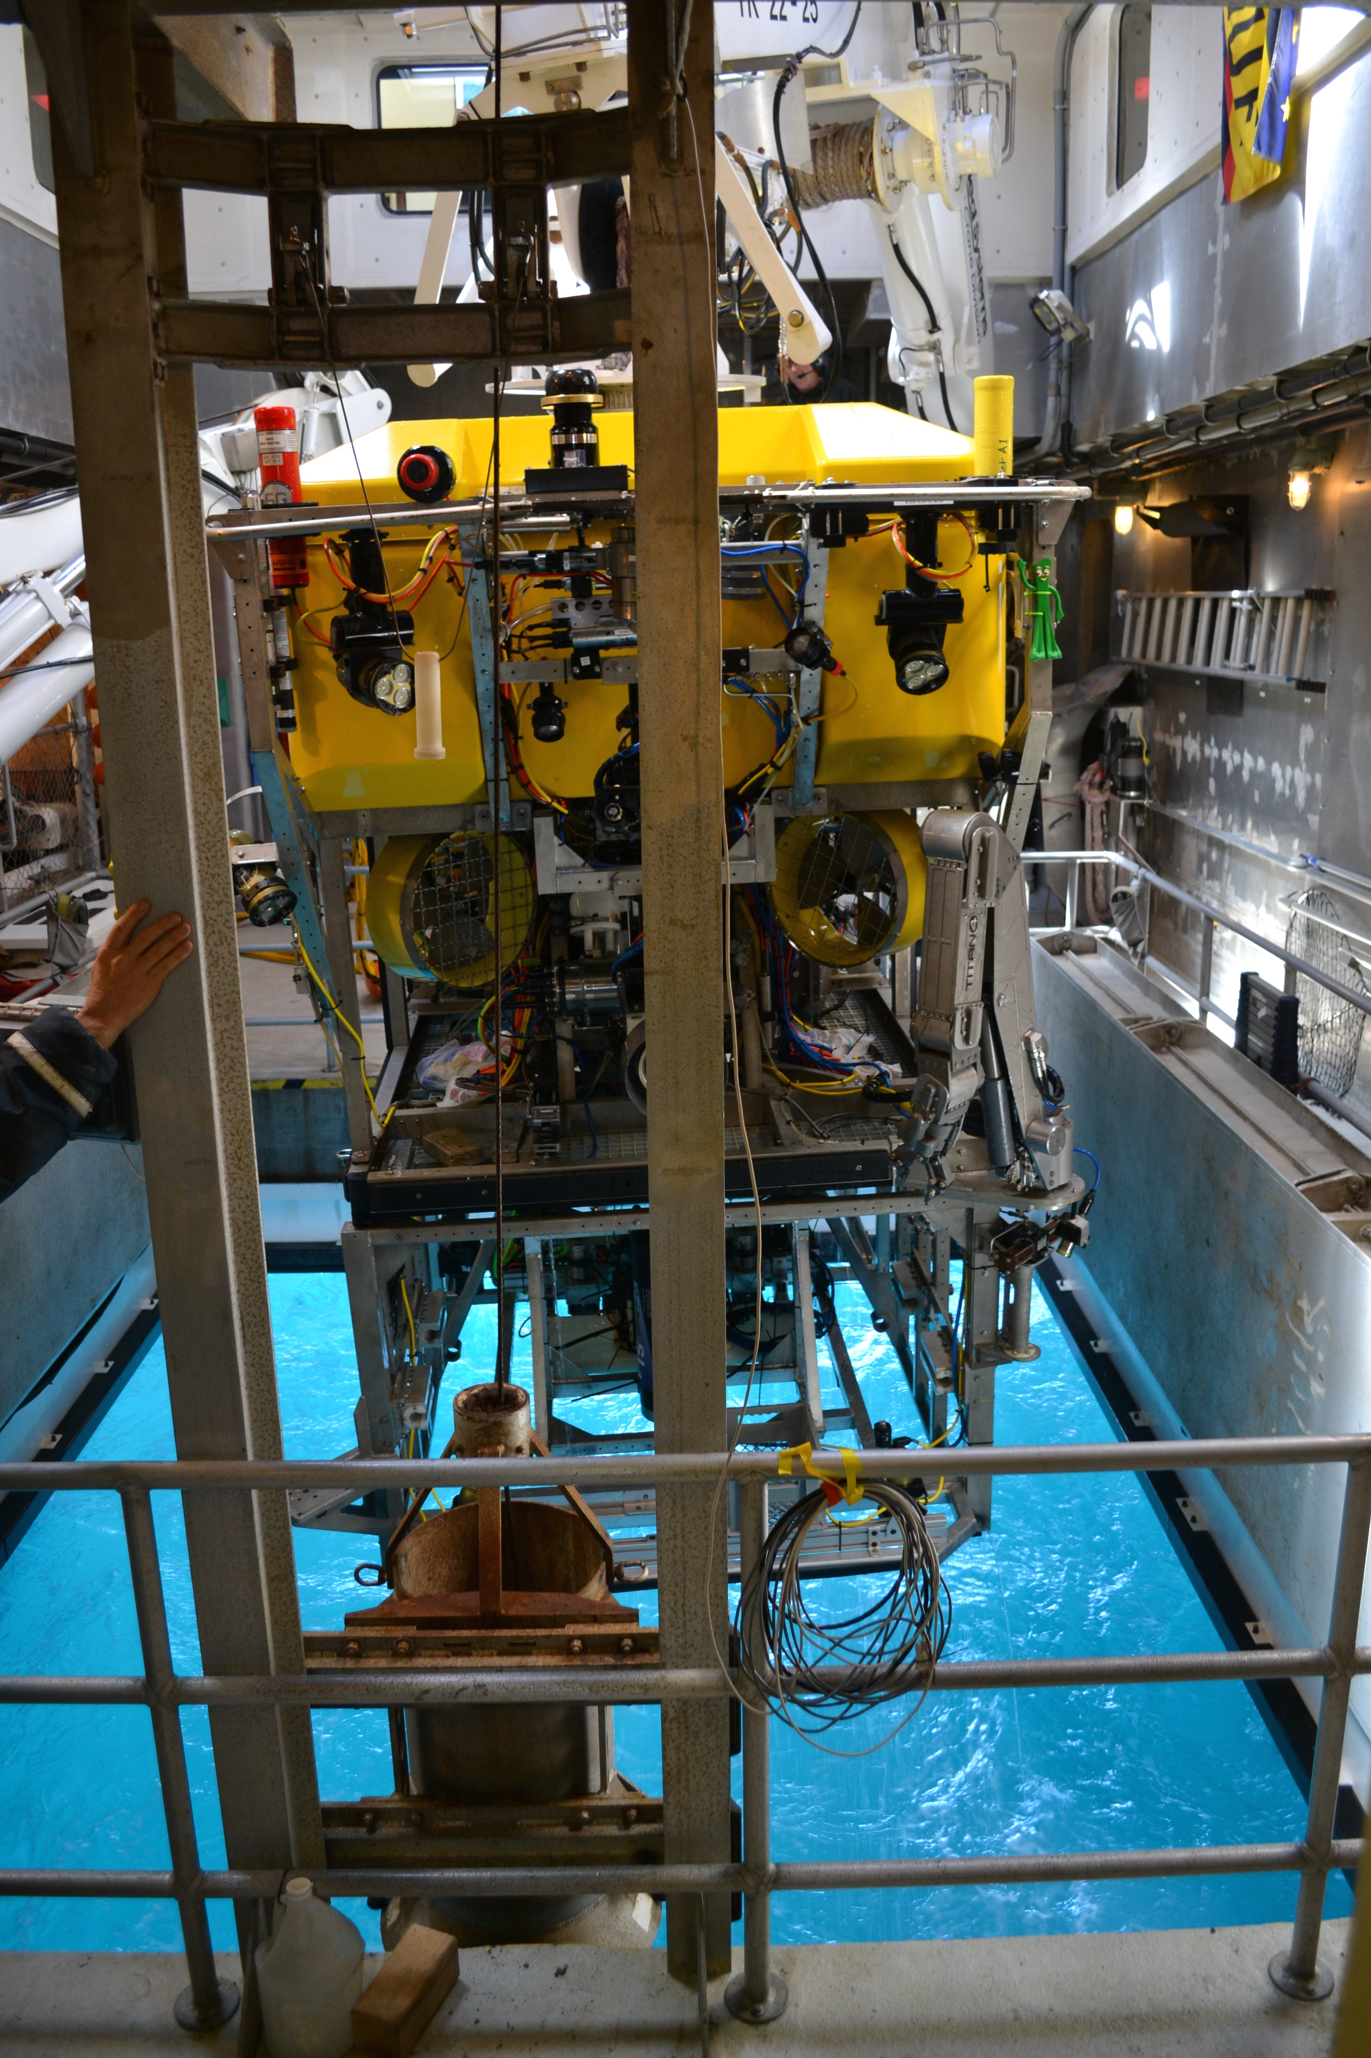
Ocean Imaging Project:
Remainder of 2014
In August we will perform a multibeam and photomosaic survey of the Ashes Hydrothermal Vent Field on Axial Seamount from ROV Ventana
  This site has OOI instrumentation
In December we have another 5-day Western Flyer Cruise
  Planned surveys of three 2850-m-depth sites plus the new 1830-m-depth BIN site.

Slide 8
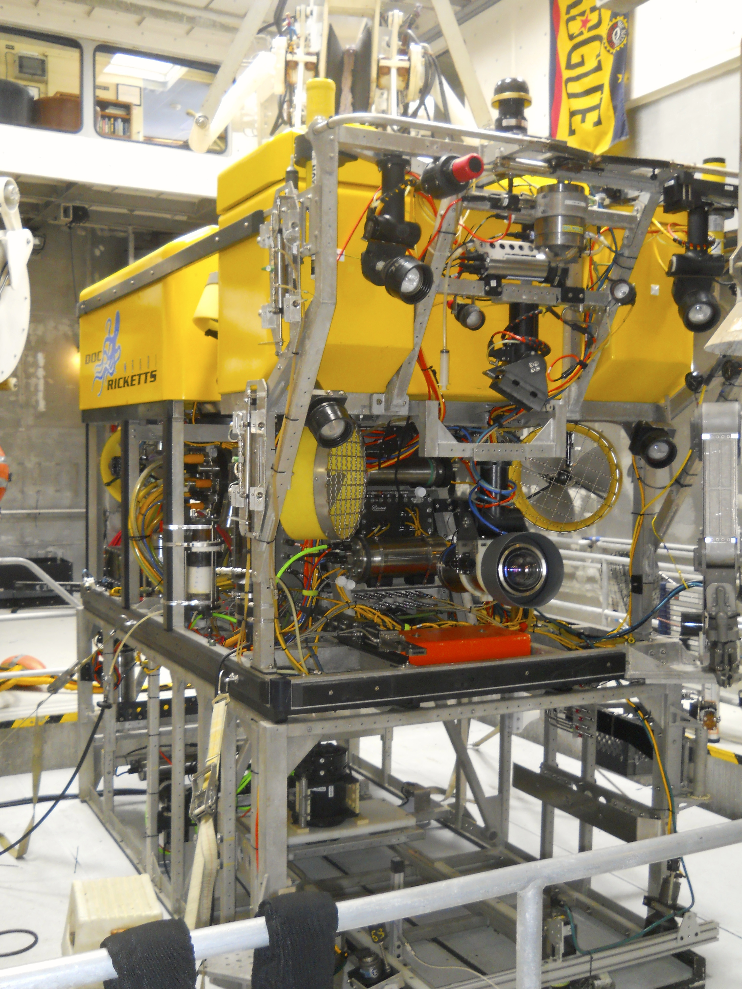
Ocean Imaging Project:
Proposal for 2015
Continue 5-day Western Flyer cruises with repeated surveys at the 2850-m sites and the 1830-m BIN site
Contract for staged development of a 90°-field-of-view swath mapping LIDAR by 3DatDepth
Scoping effort to begin the acquisition or development of an AUV optimized for low-altitude surveys of complex terrain

Slide 9
Lidar Development
Current LIDAR tests involve leasing a prototype unit optimized for 30°x30° 2D scans rather than swath mapping
3DatDepth is interested in designing and building for us a new 90° field-of-view system optimized for swath mapping
  90° yields a swath 2 X altitude wide, which is similar to the 80° field-of-view achieved by our cameras with corrective optics
  Development can staged with milestone payments and cancelation rights
  Packaging and form factor can be tailored to AUV packaging
  Development can be accomplished in one year or spread out over two years
  Estimated cost is $400K to $500K

Slide 10
AUV Scoping Effort
Limited manpower availability in 2015 due to GOC, Iceberg AUV build/test, LRAUV development
Develop specification for vehicle system and sensor payload
  Concepts of operation
  Depth/endurance/size/maneuverability
  ROM cost ($$$, resources, cost of ownership)
Trade-off between COTS vehicles, modifications of in-house systems, new build

