Slide 1
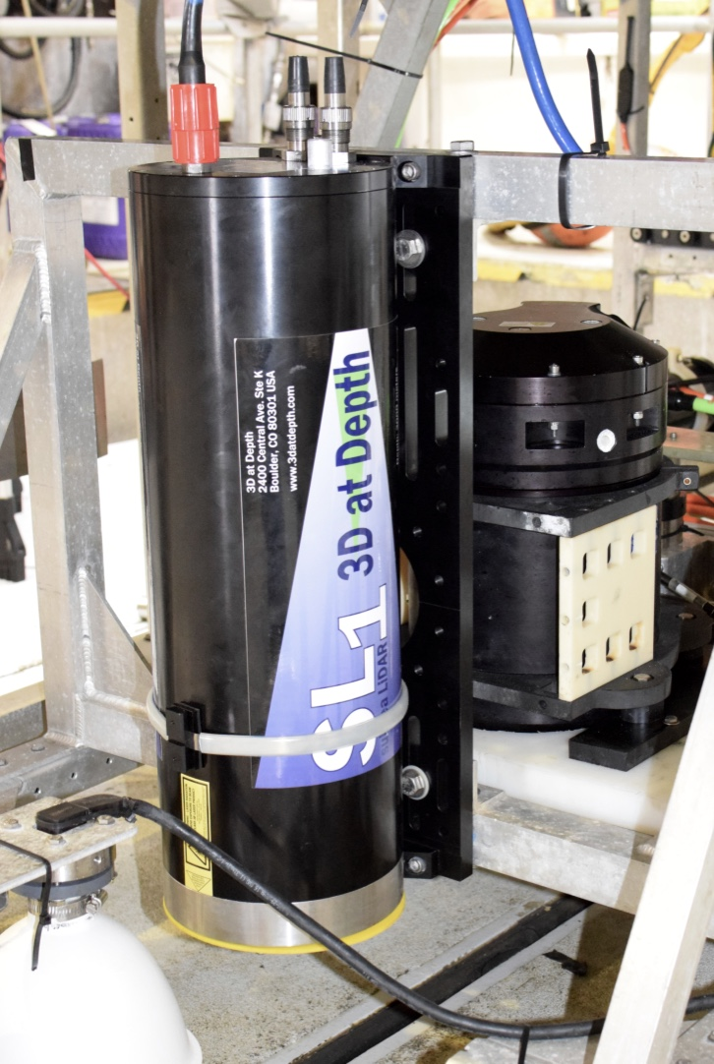
Wide Swath Lidar :
Joint development by 3DatDepth and MBARI
David W. Caress
1 meter
1 meter
Bathymetric Mapping at 1-cm Scale

Slide 2
Small startup
  Formed 2009
  Boulder Colorado
  < 15 people
Focus on subsea lidar
  Time-of-flight laser scanning yields topography
  Prototype SL1 intended to scan horizontally from ROVs
  Primary market scanning hydrocarbon industry seafloor infrastructure
SL1 scanning USS Arizona wreck in Pearl Harbor
Composite point cloud from multiple lidar scans of oilfield infrastructure

Slide 3
Ocean Imaging Project
Low altitude surveys ➔ 1 cm resolution bathymetry
+ 2 mm color photography
New survey technology enables
exploration and discovery,
understanding of globally important processes,
and measuring change in the oceans
through autonomous, very high resolution, repeatable surveys of complex seafloor terrain
Three examples using prototype Lidar:
Monitoring change of benthic biological communities.
Sediment transport down canyons
Quantitatively measuring benthic communities

Slide 4
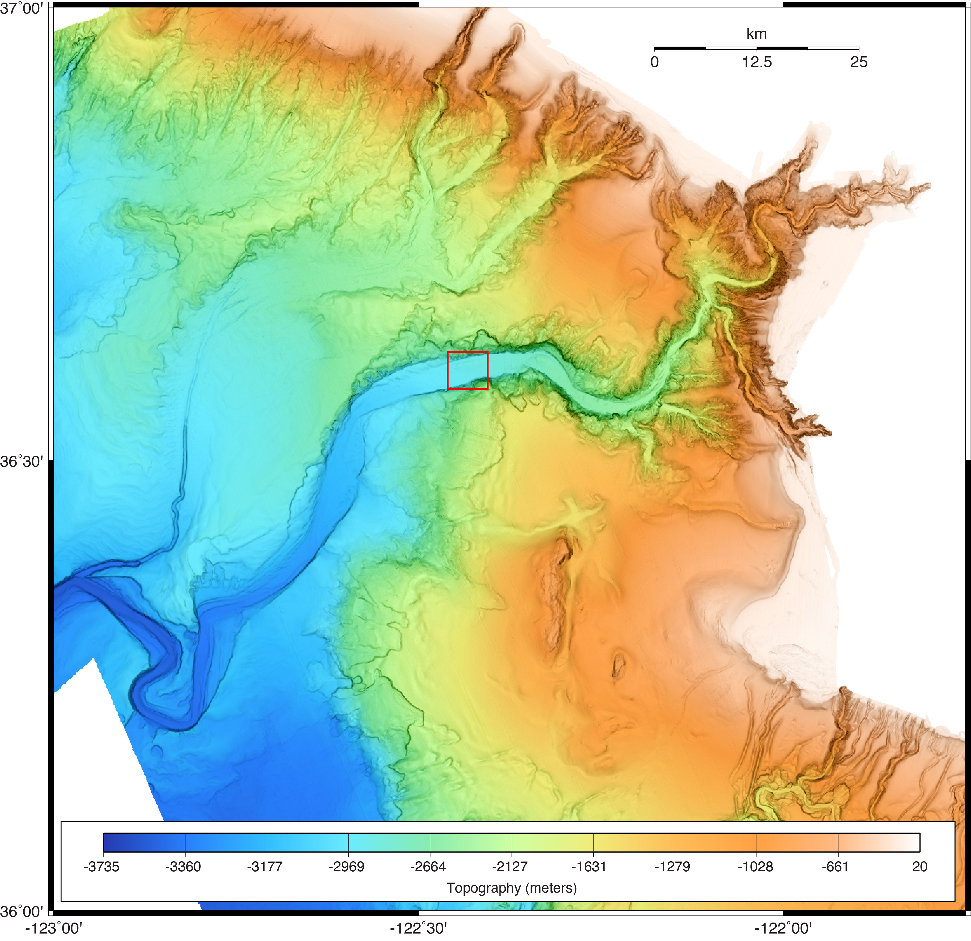
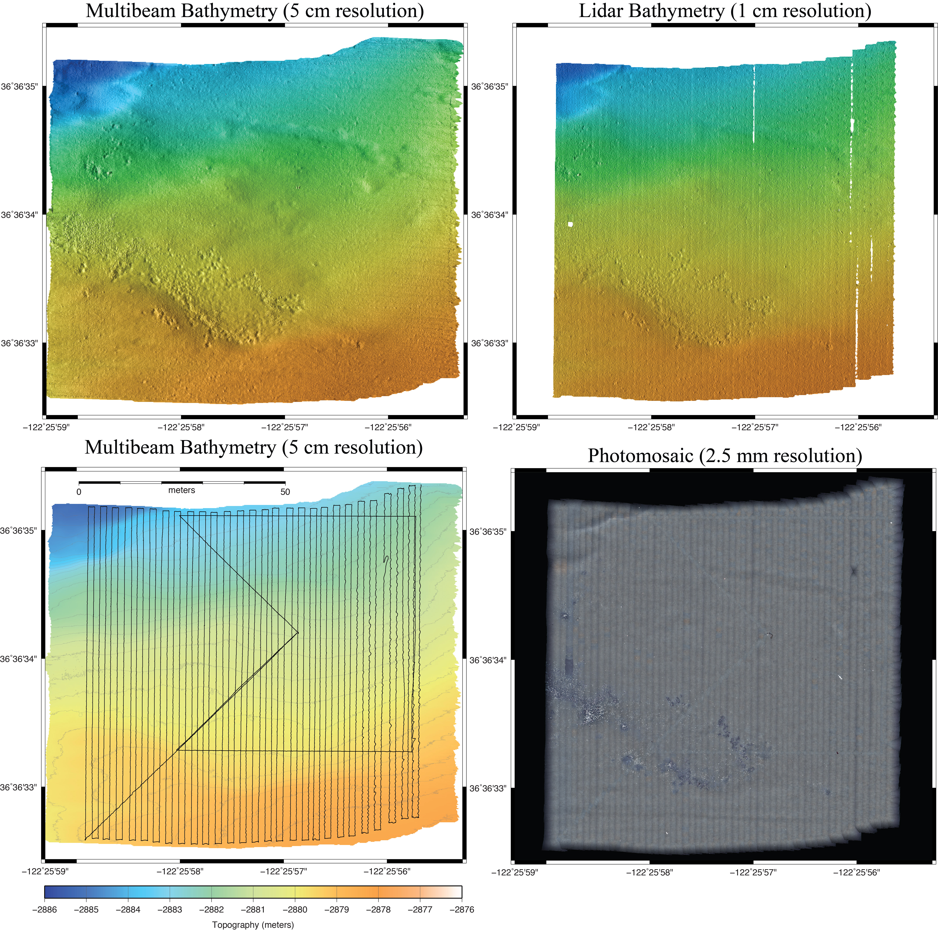
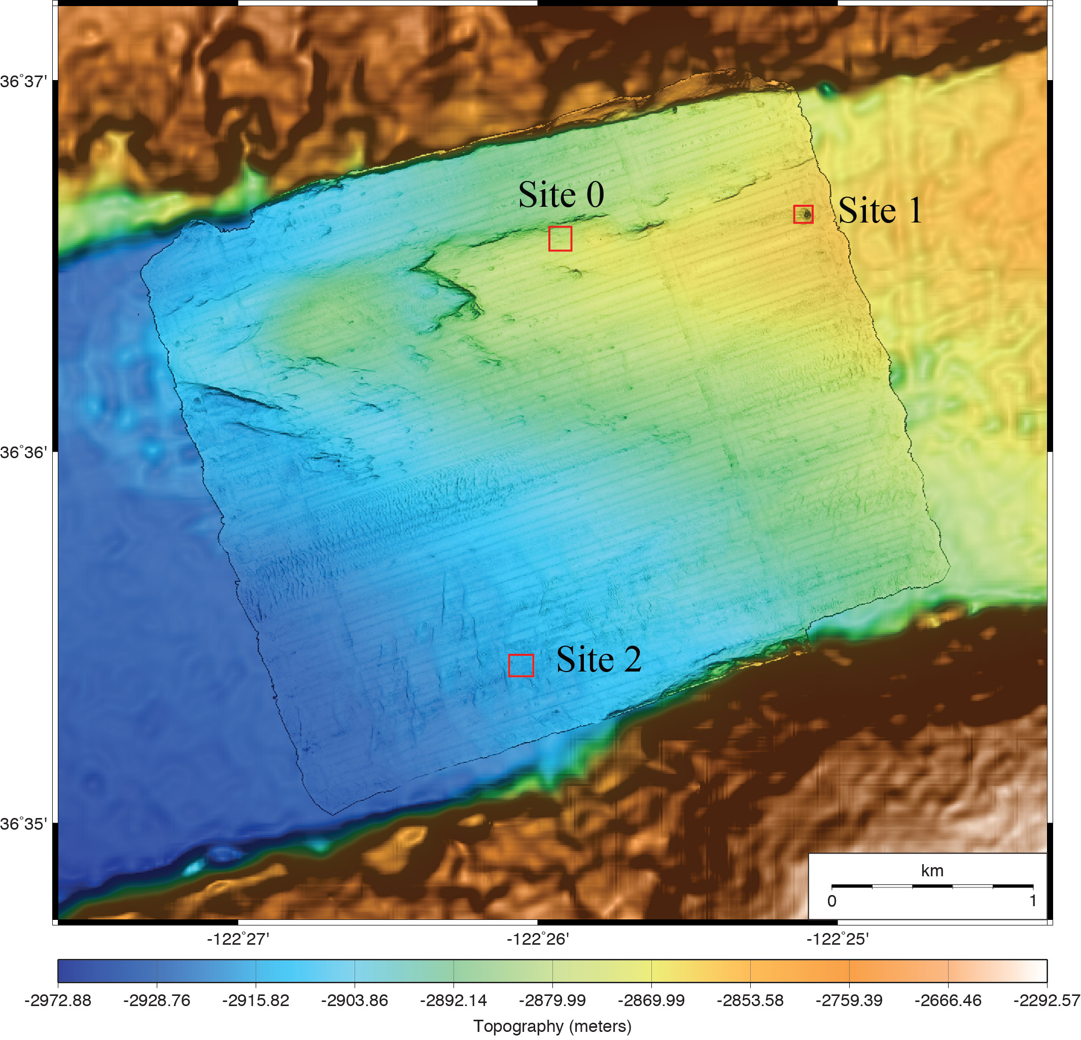
Mapping Change in a Benthic Community
Chemosynthetic clam community in Monterey Canyon axis at 2850-m depth
50 meters

Slide 5
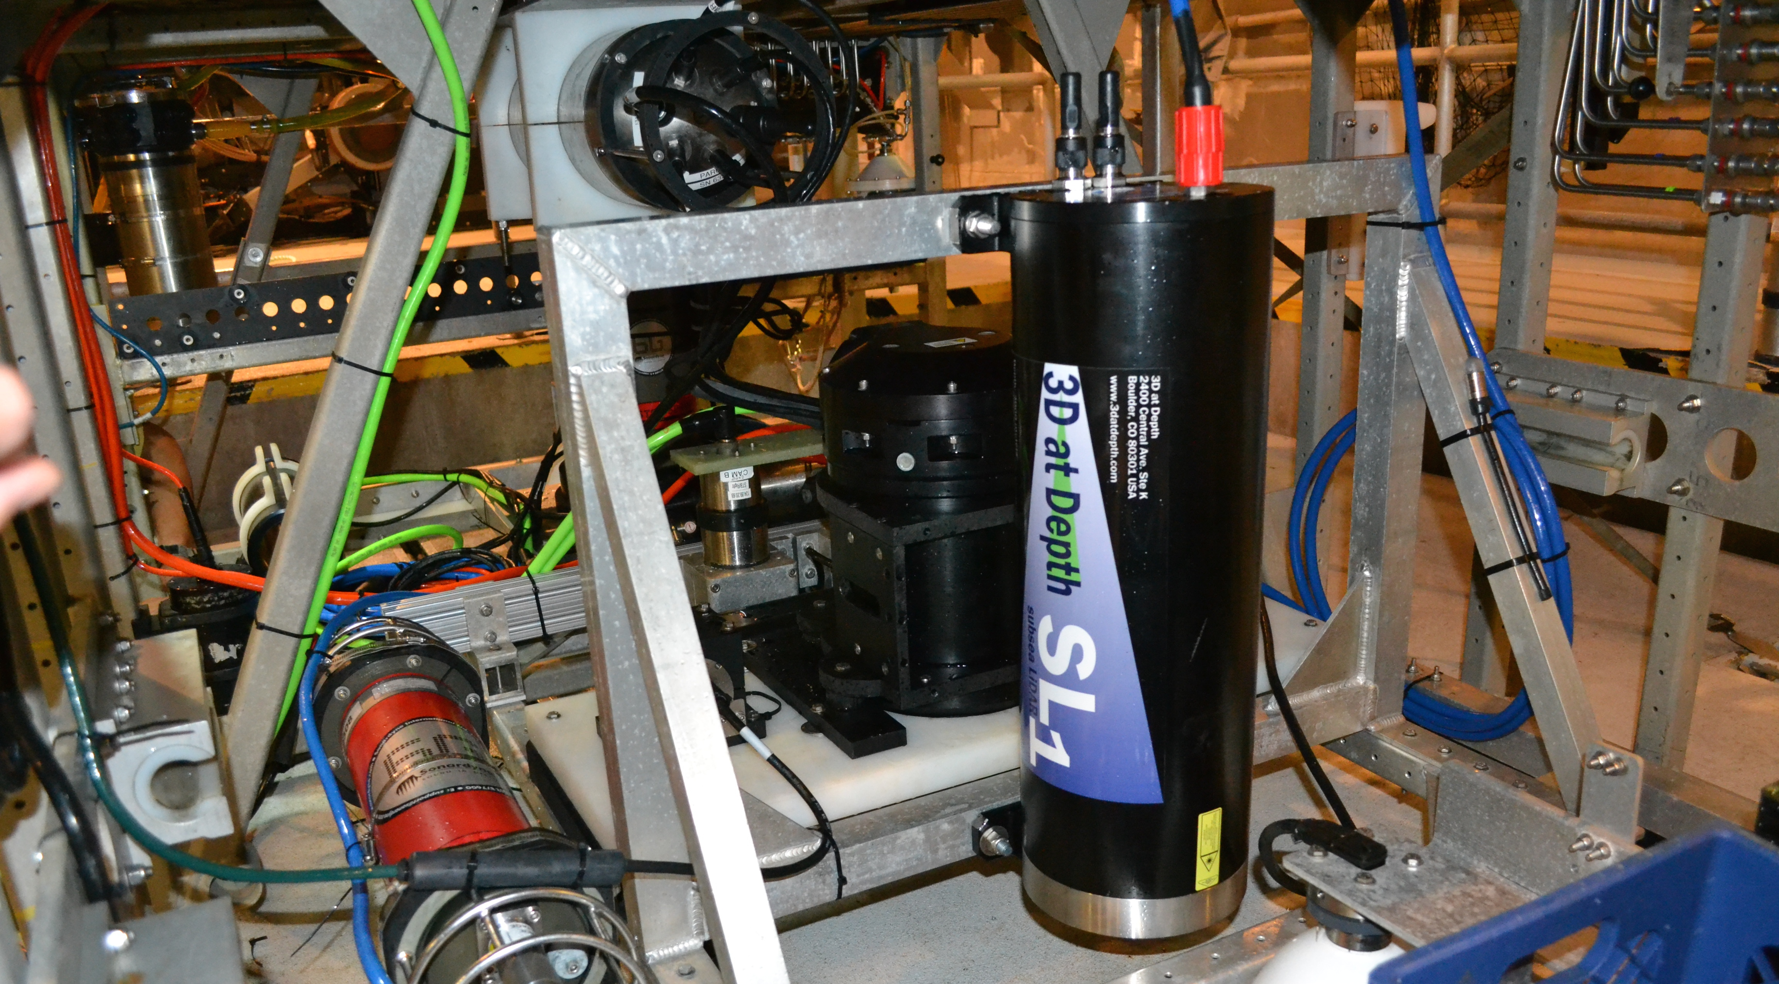
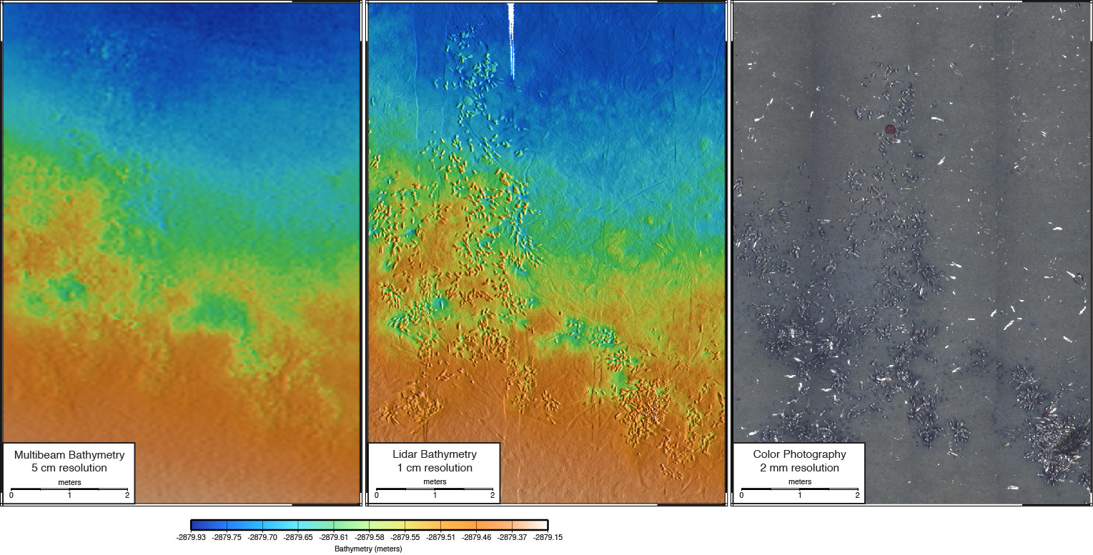
Initial Tests of 3DatDepth Prototype Lidar
Mapped individual clams with 1 cm resolution bathymetry

Slide 6
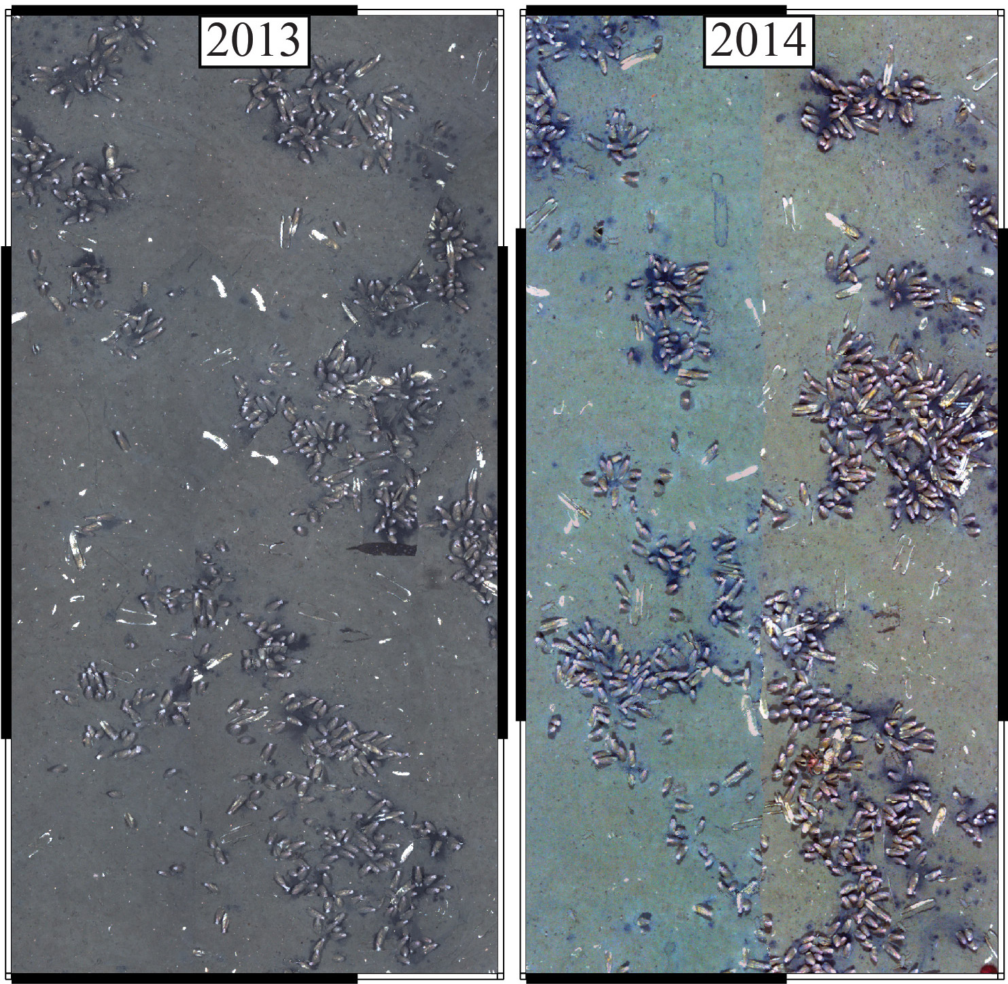
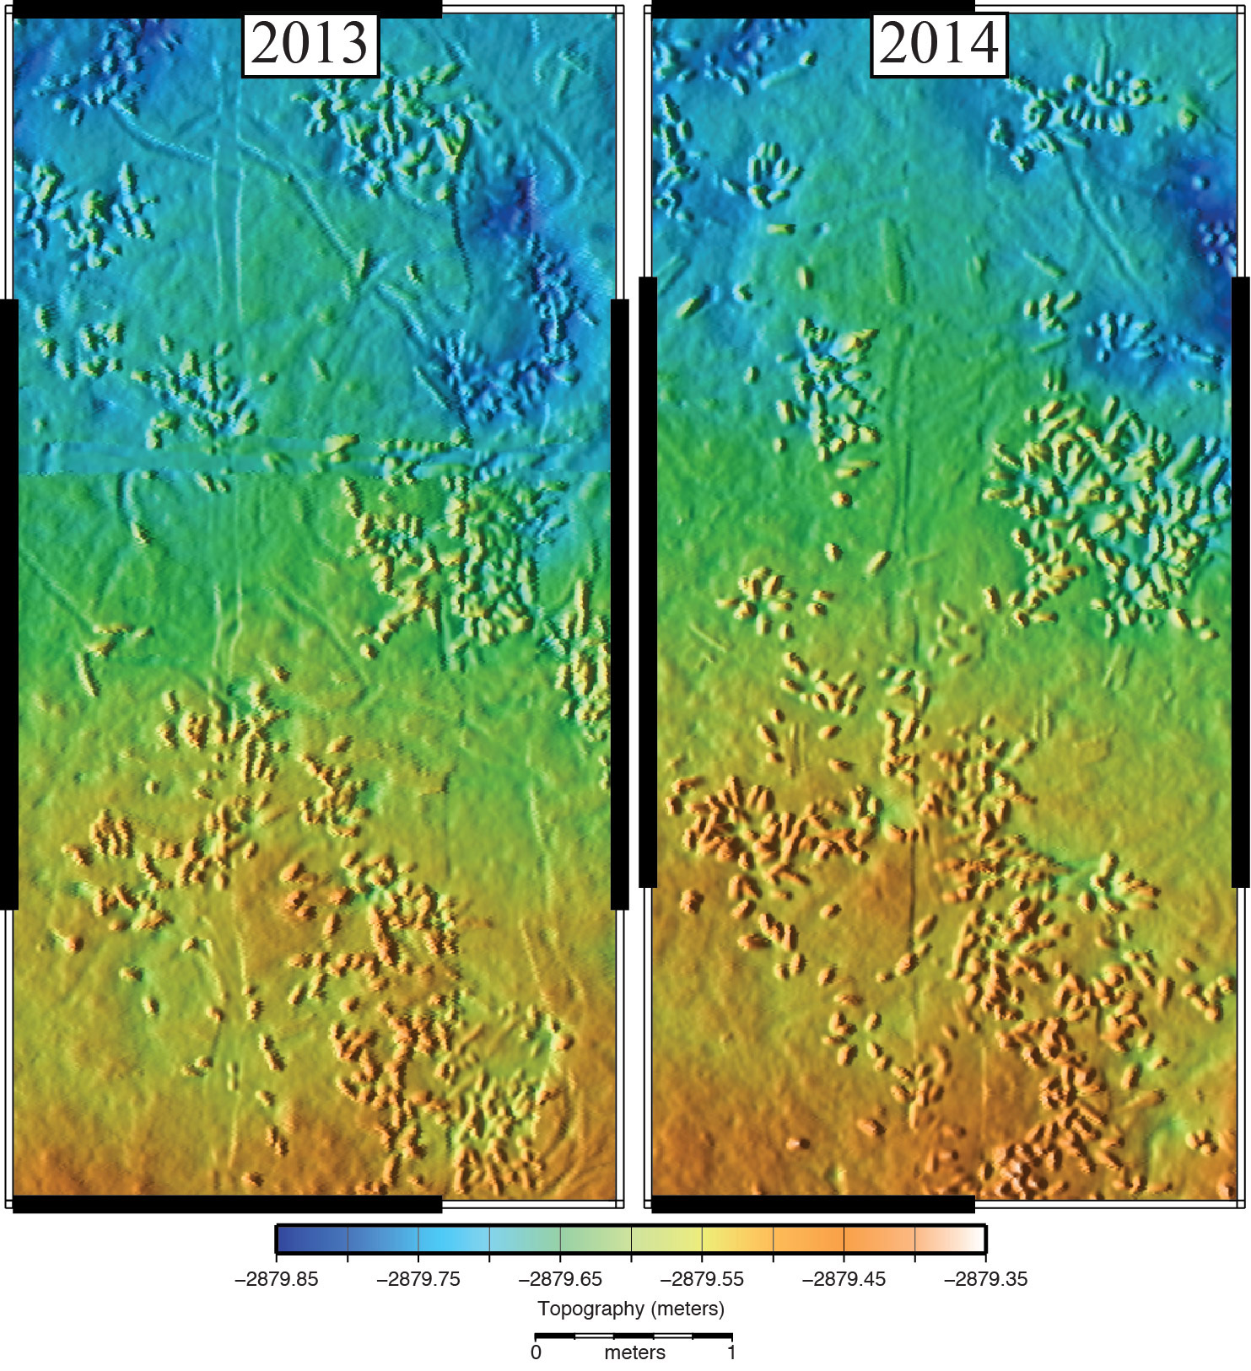
Ocean Imaging Project - 2014
Demonstrated monitoring change in a benthic community
1 meter
1 meter
1 meter
1 meter

Slide 7
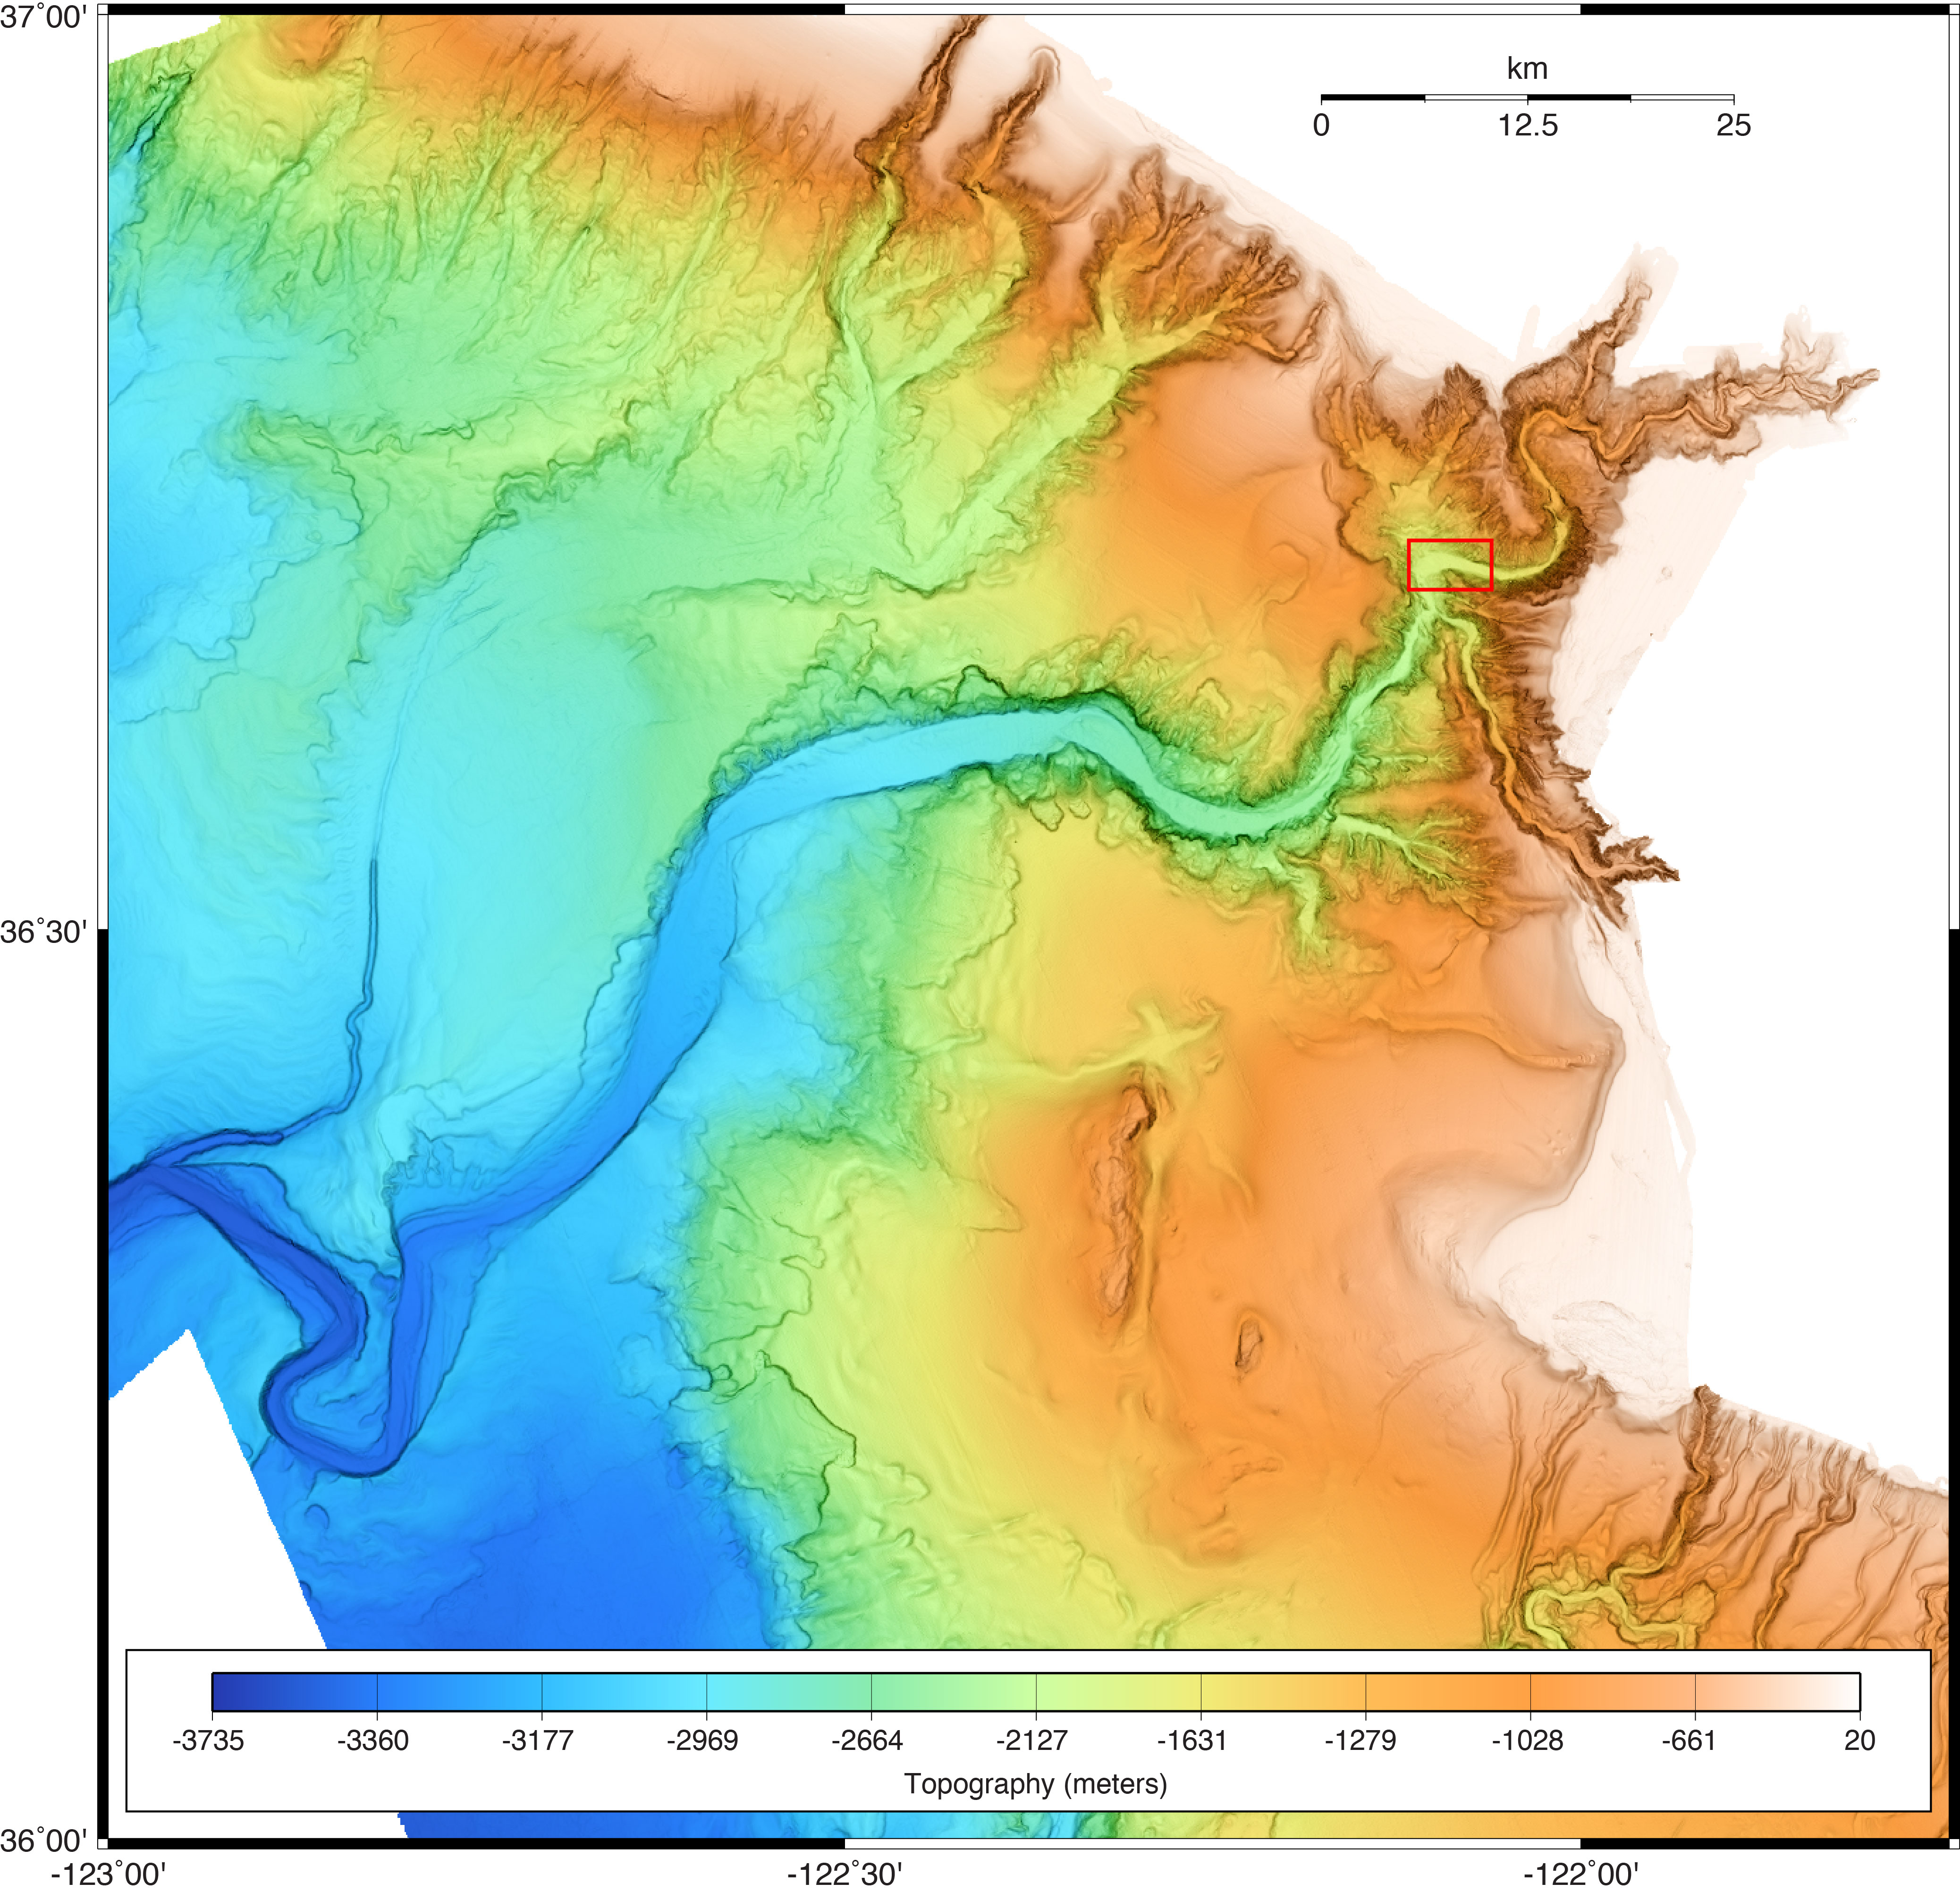
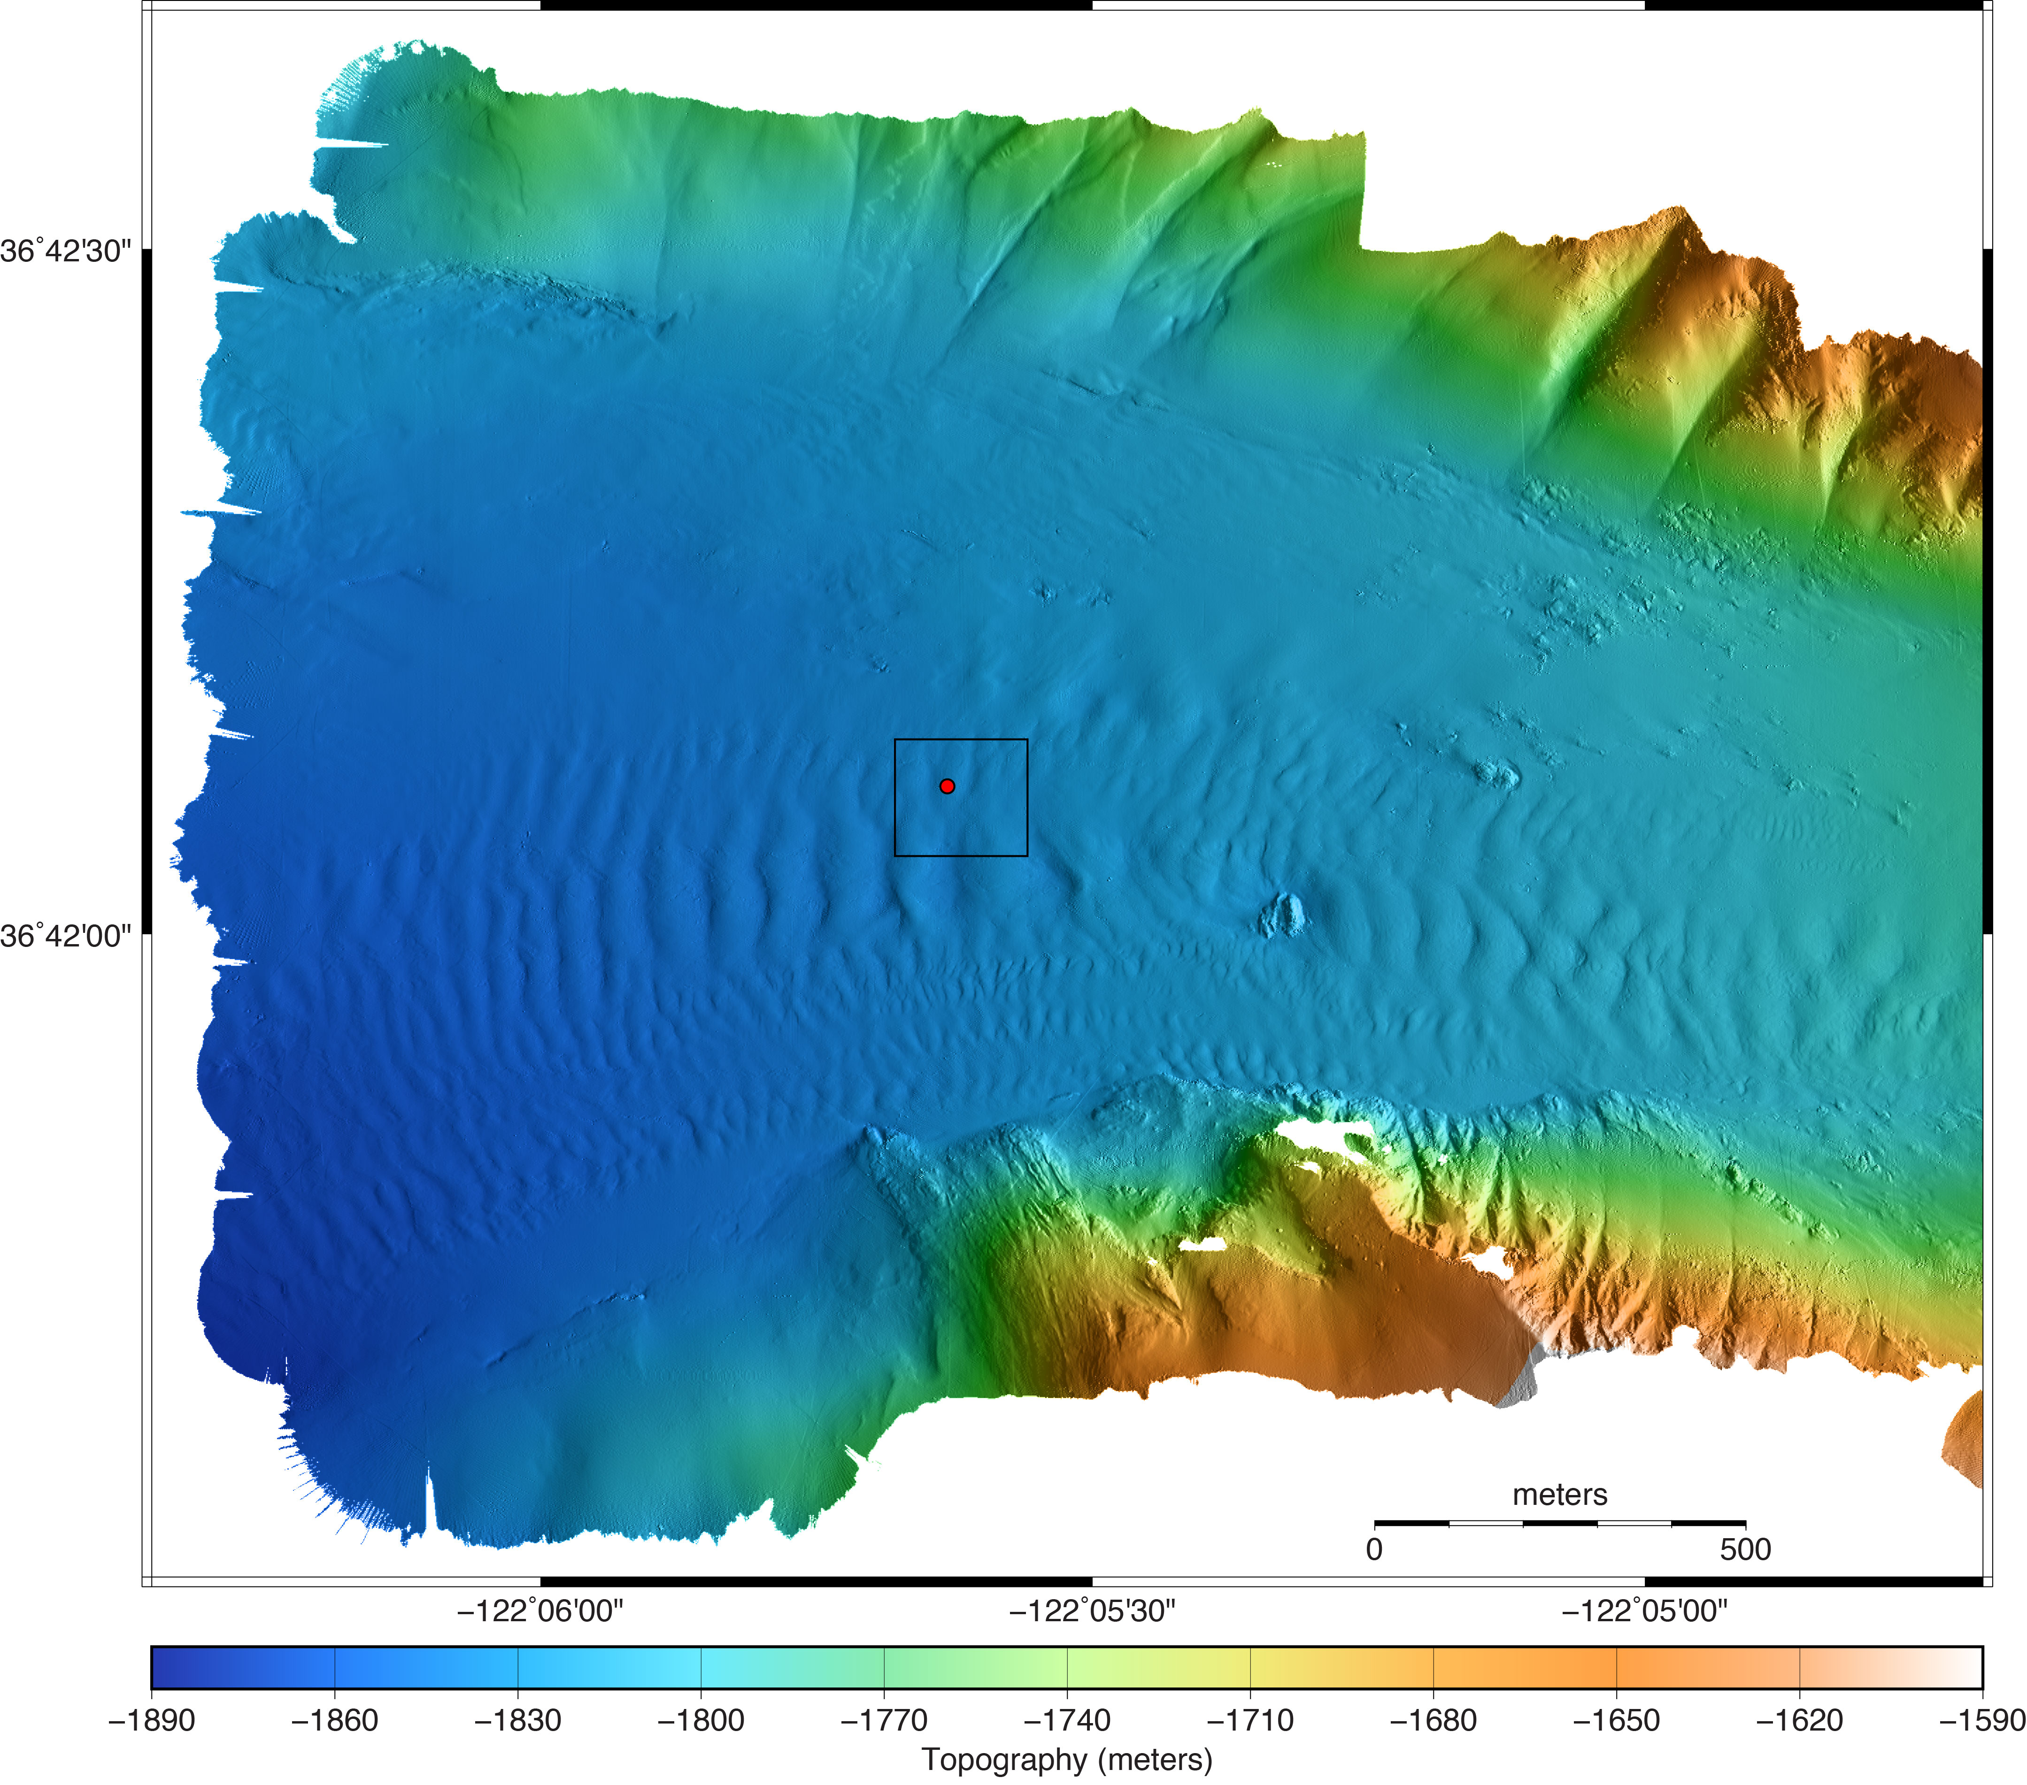
Mapping erosion and deposition in Monterey Canyon
Low altitude surveys associated with the Coordinated Canyon Experiment (CCE)
CCE Benthic Instrument Node at 1850-m depth

Slide 8
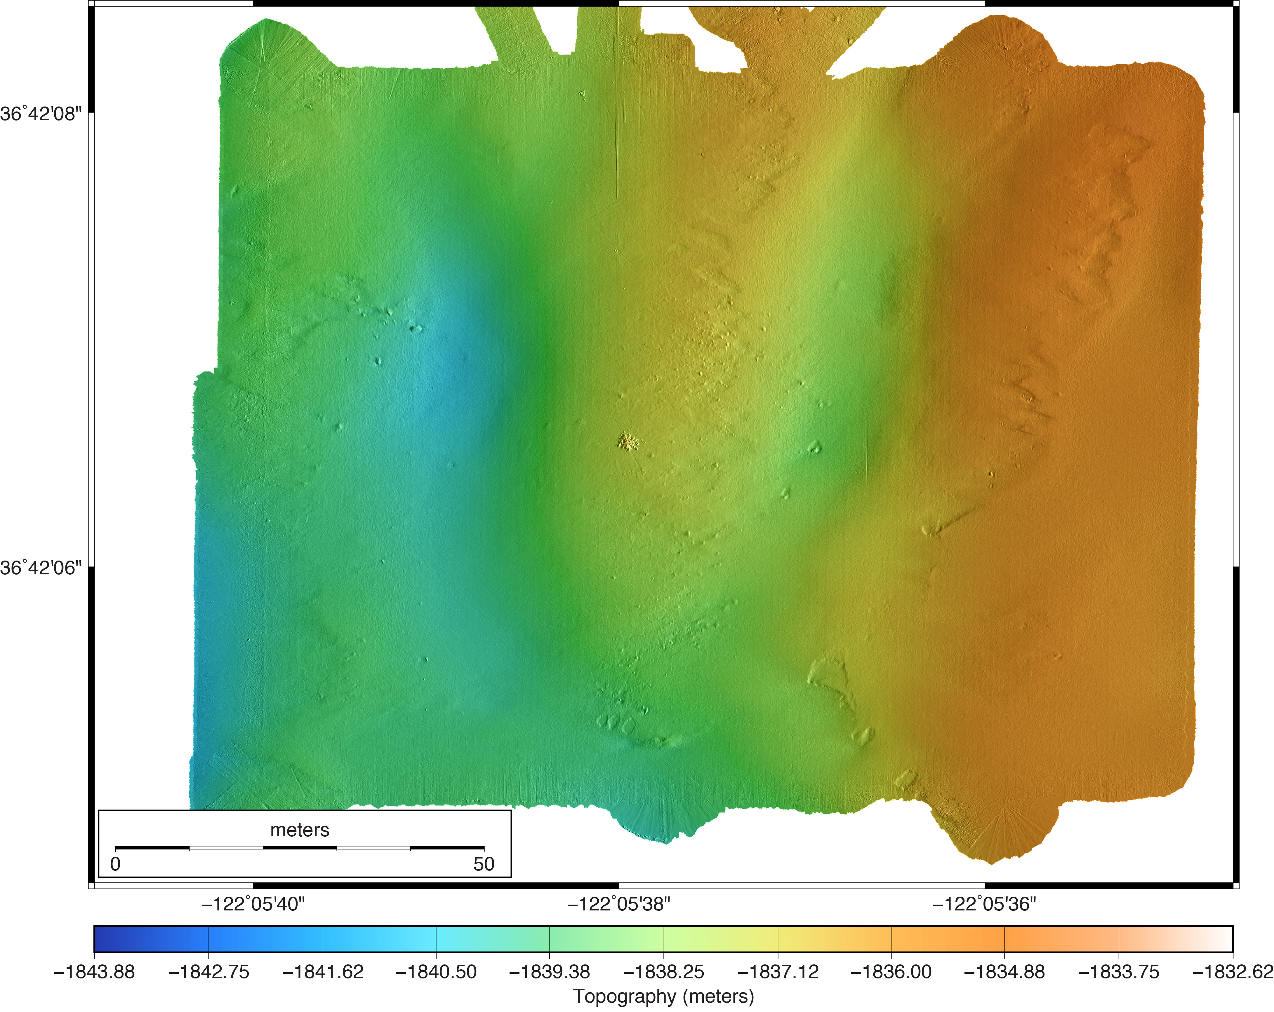
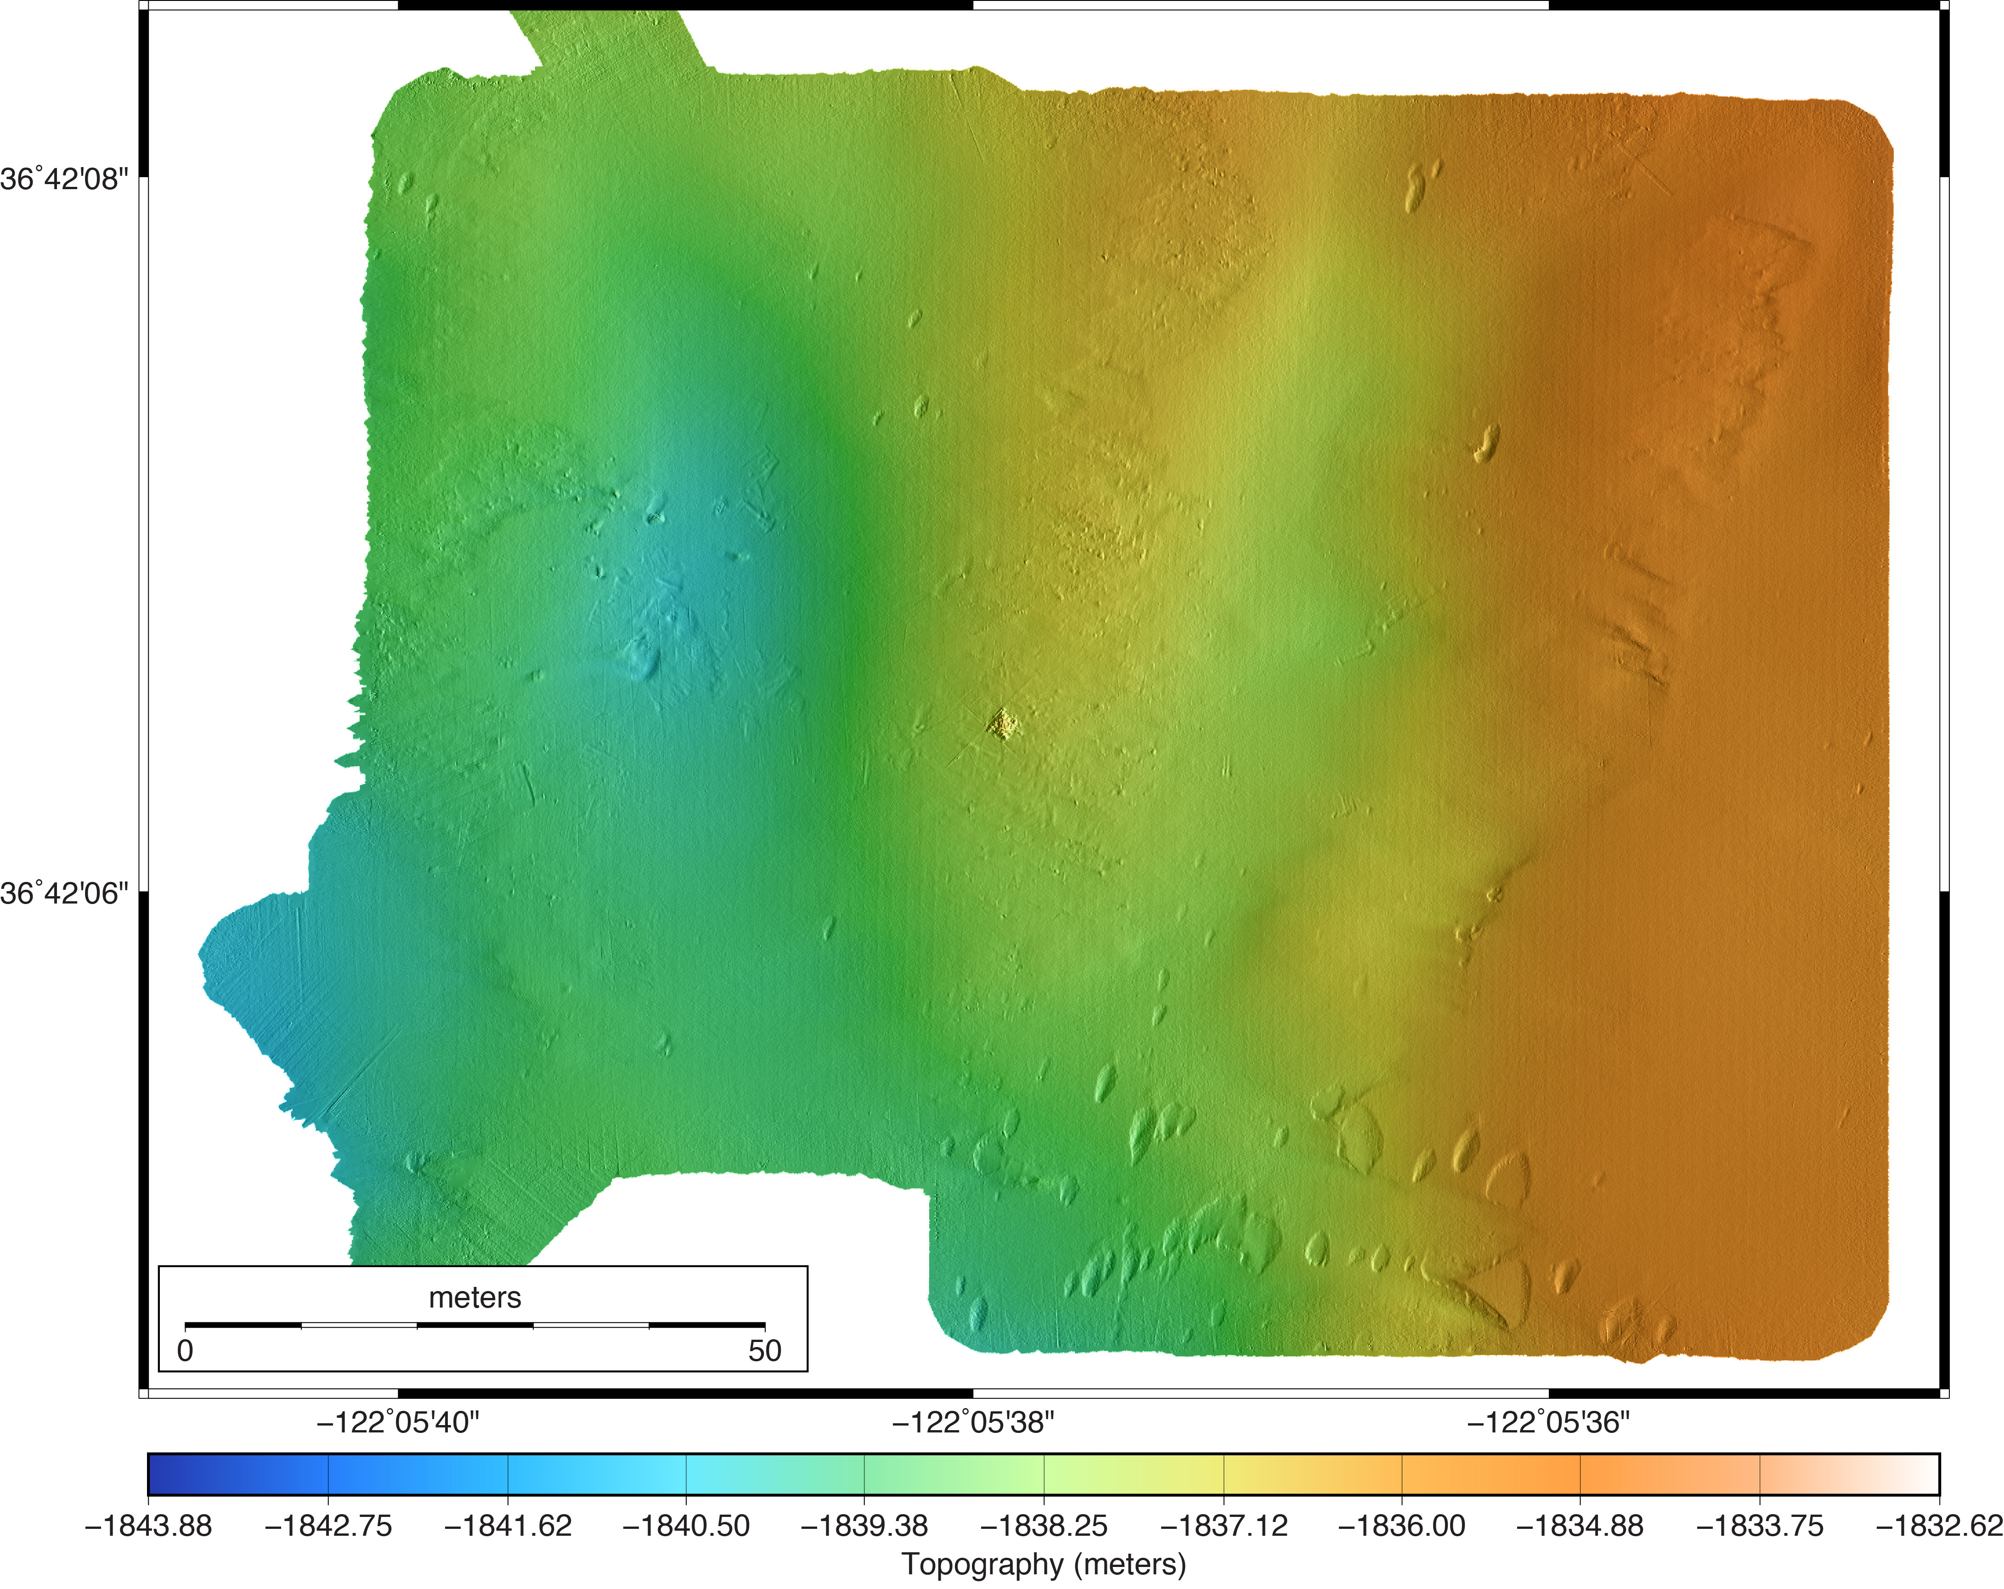
Low altitude surveys around CCE BIN:
5 cm resolution multibeam
November 2015
May 2016
A major sediment transport event occurred on January 16, 2016
Before and after maps appear largely the same, until one looks at a difference map….

Slide 9
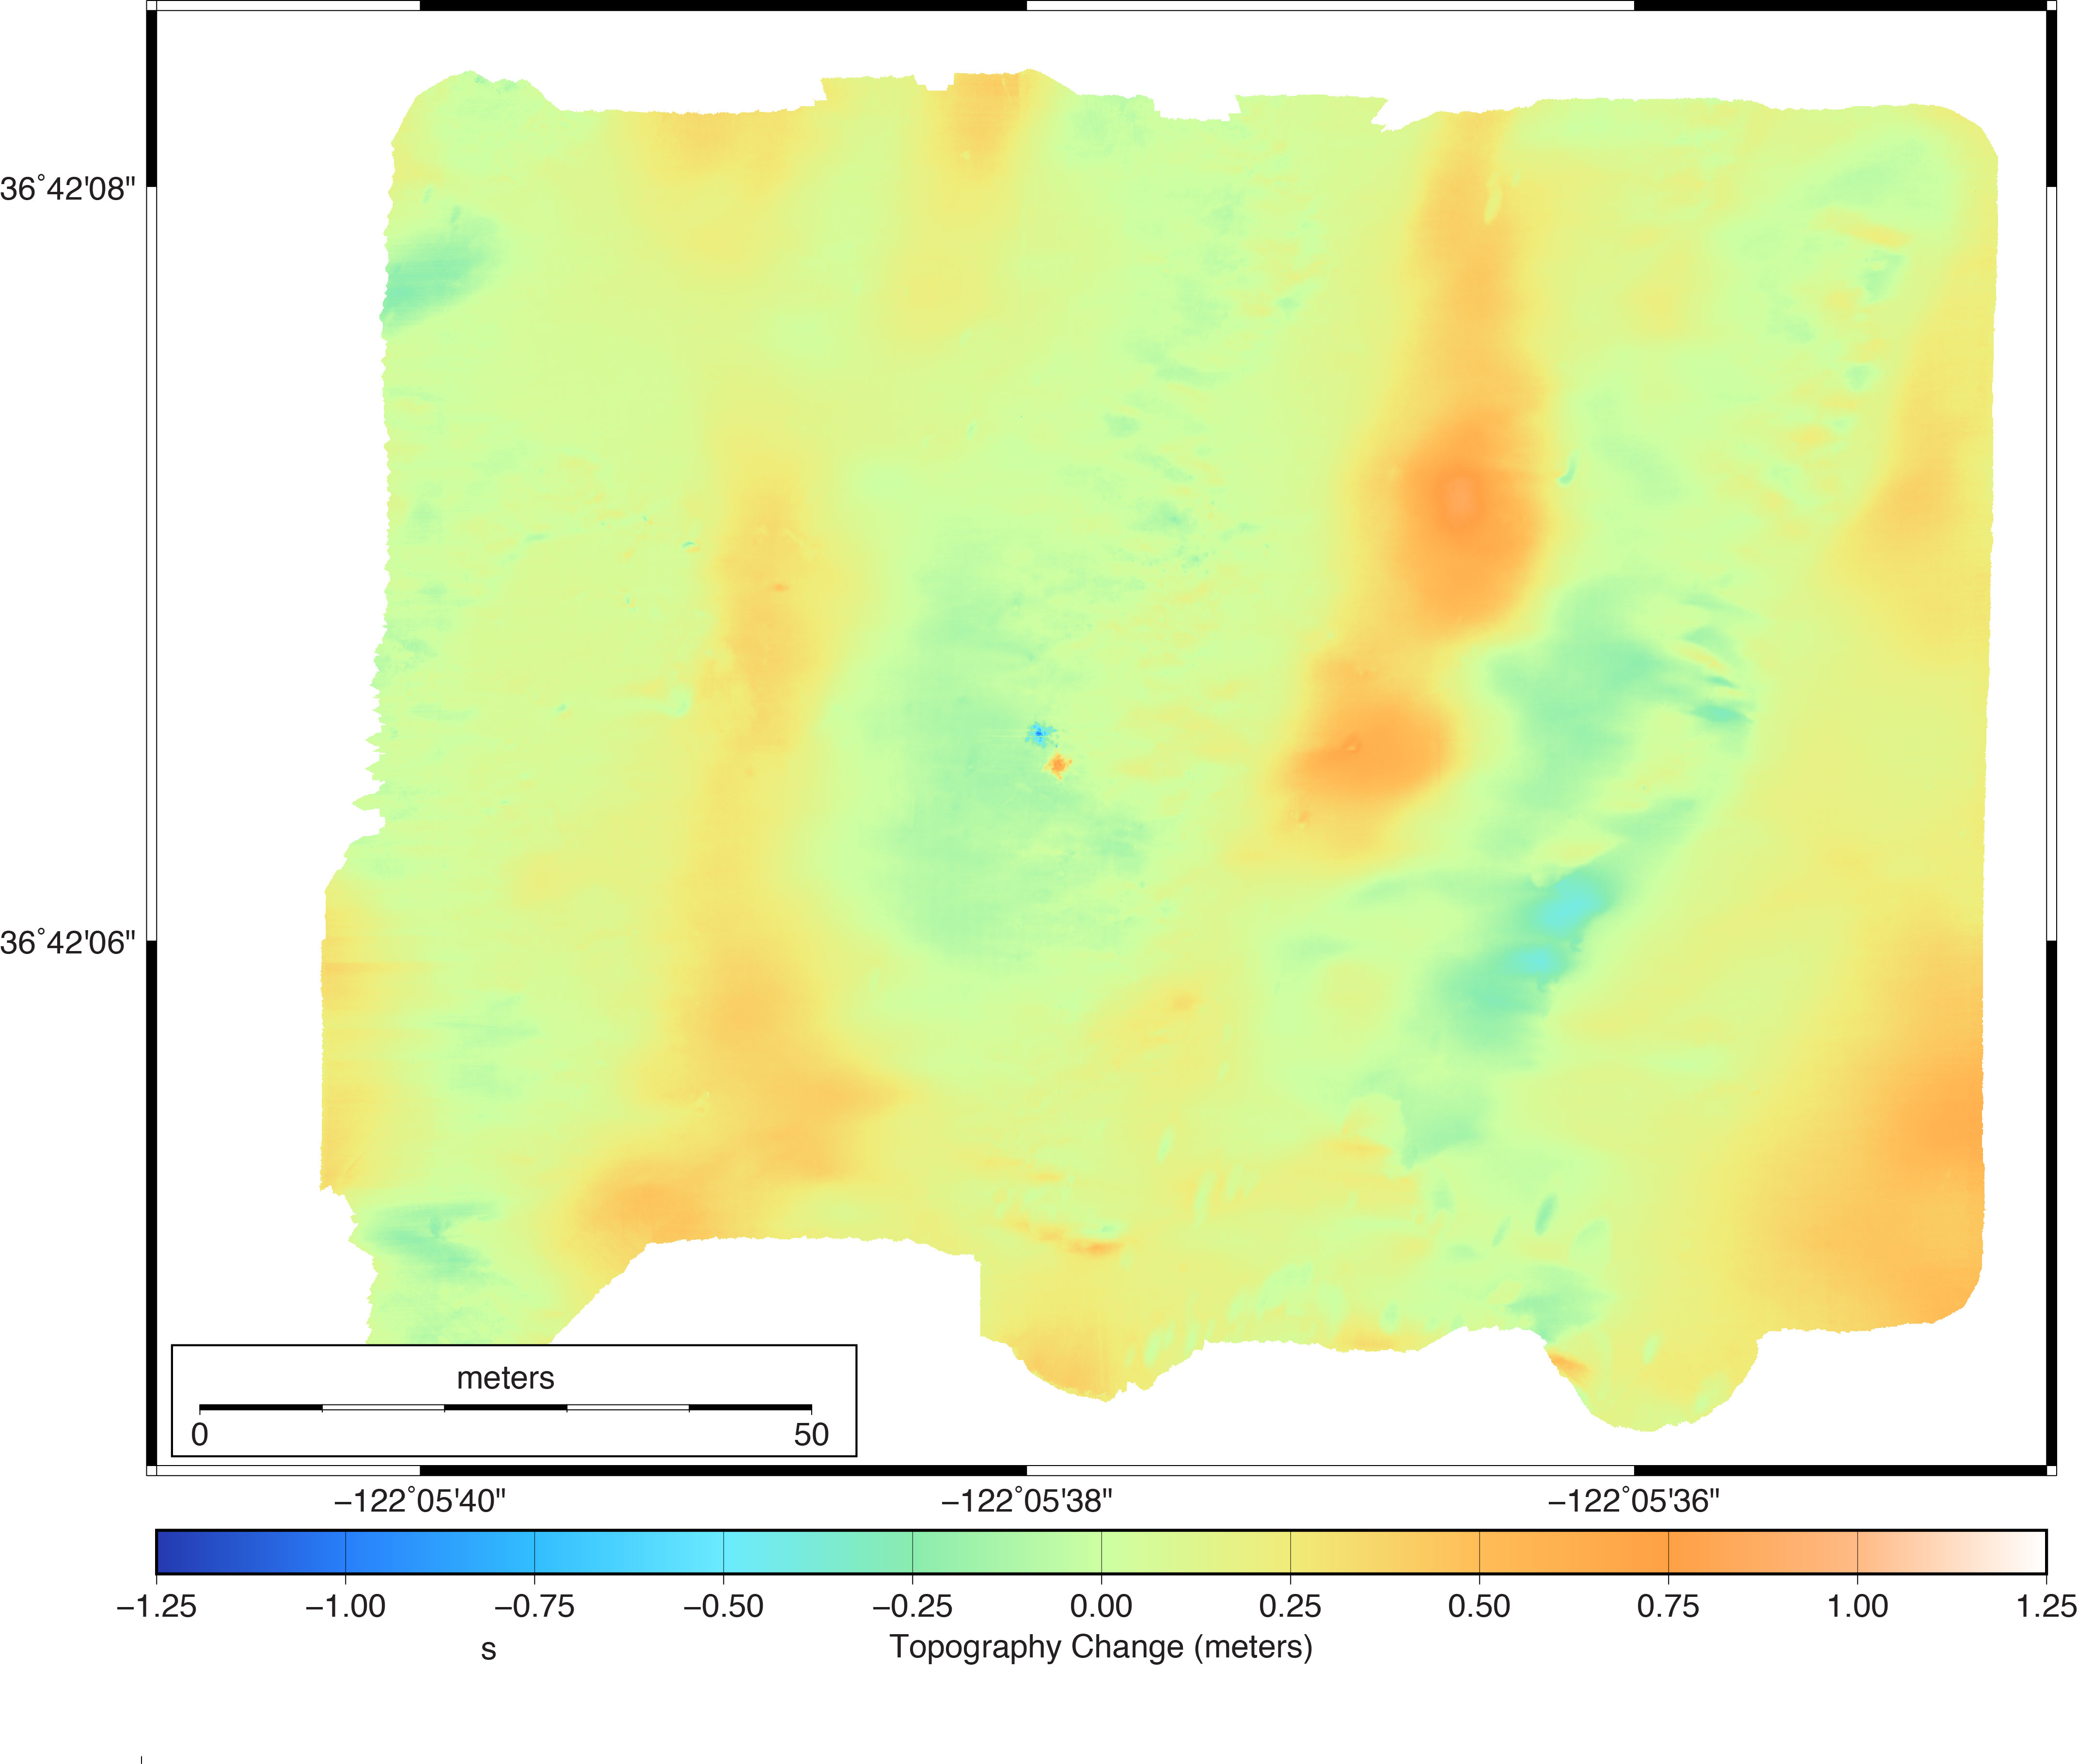
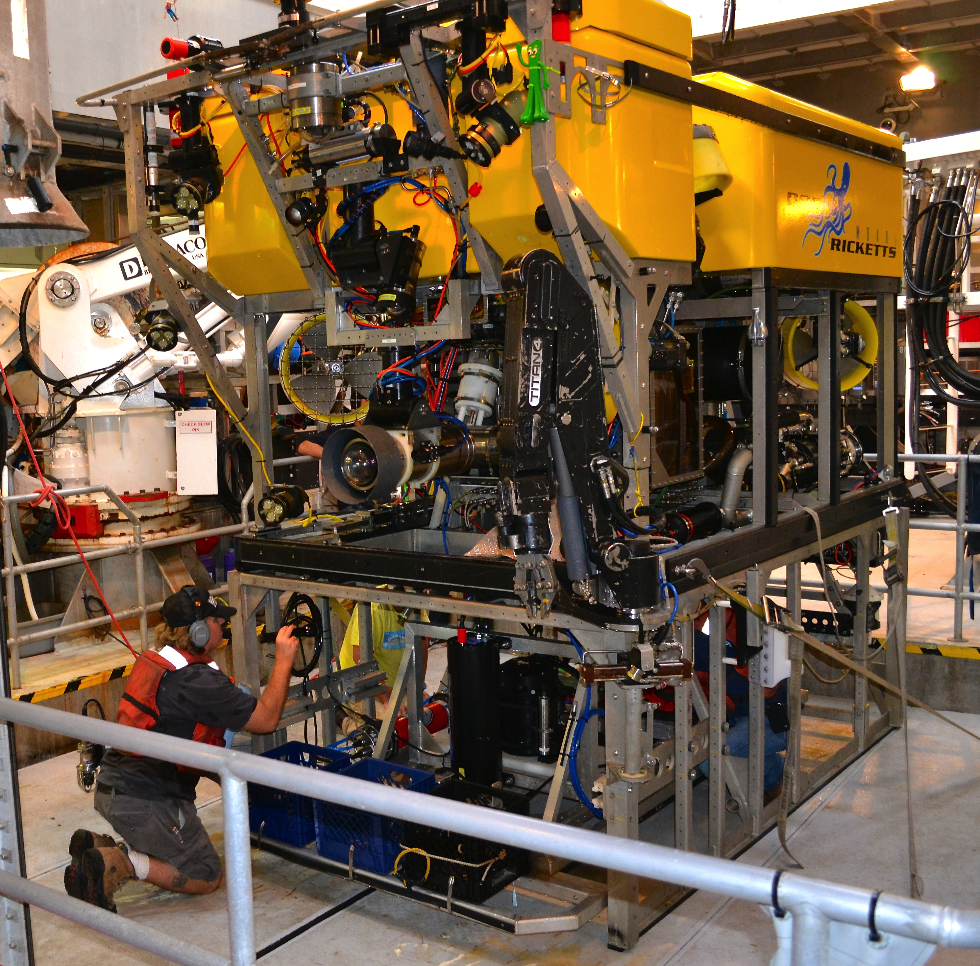
November 2015
May 2016
Bathymetric
Change
Major sediment
transport event January 16, 2016

Slide 10
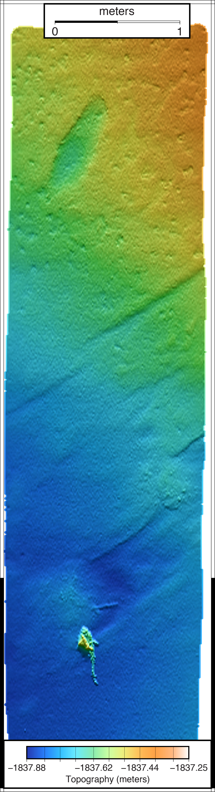
1 cm resolution lidar bathymetry

Slide 11
Lidar images fish – but the fish don’t always sit still to be imaged
Lidar map
of a single scour

Slide 12

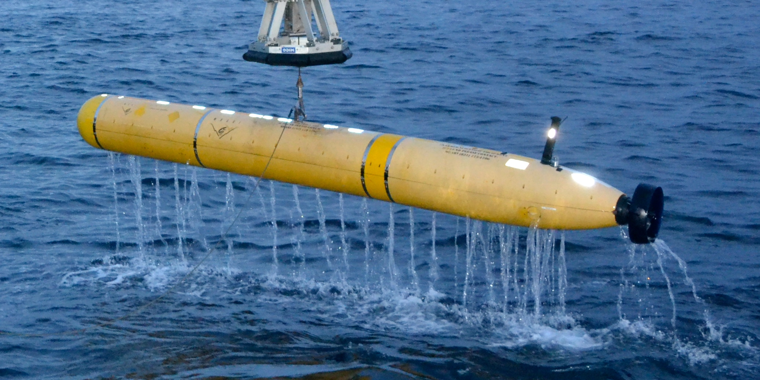
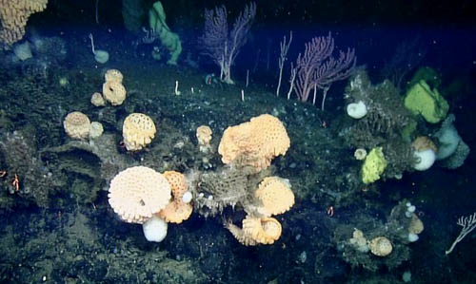
Sur Ridge
Ridge crest covered by 1-m resolution Mapping AUV surveys
Two 1-cm resolution ROV low altitude surveys
Low
altitude
surveys

Slide 13
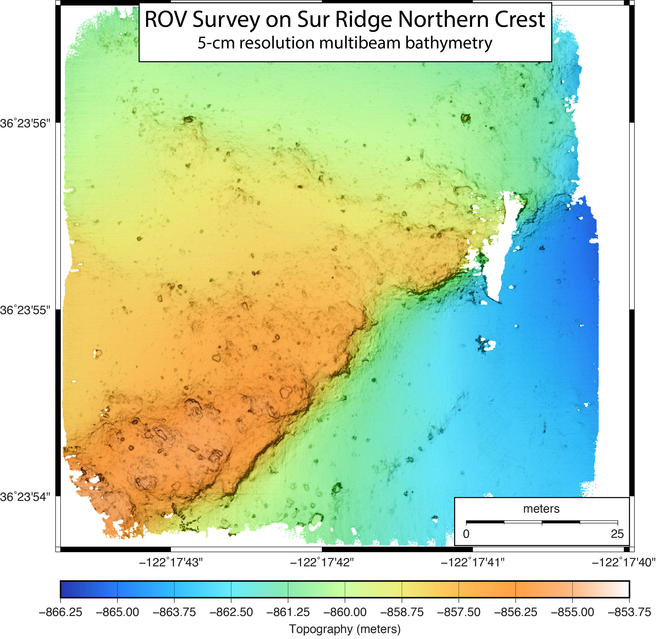
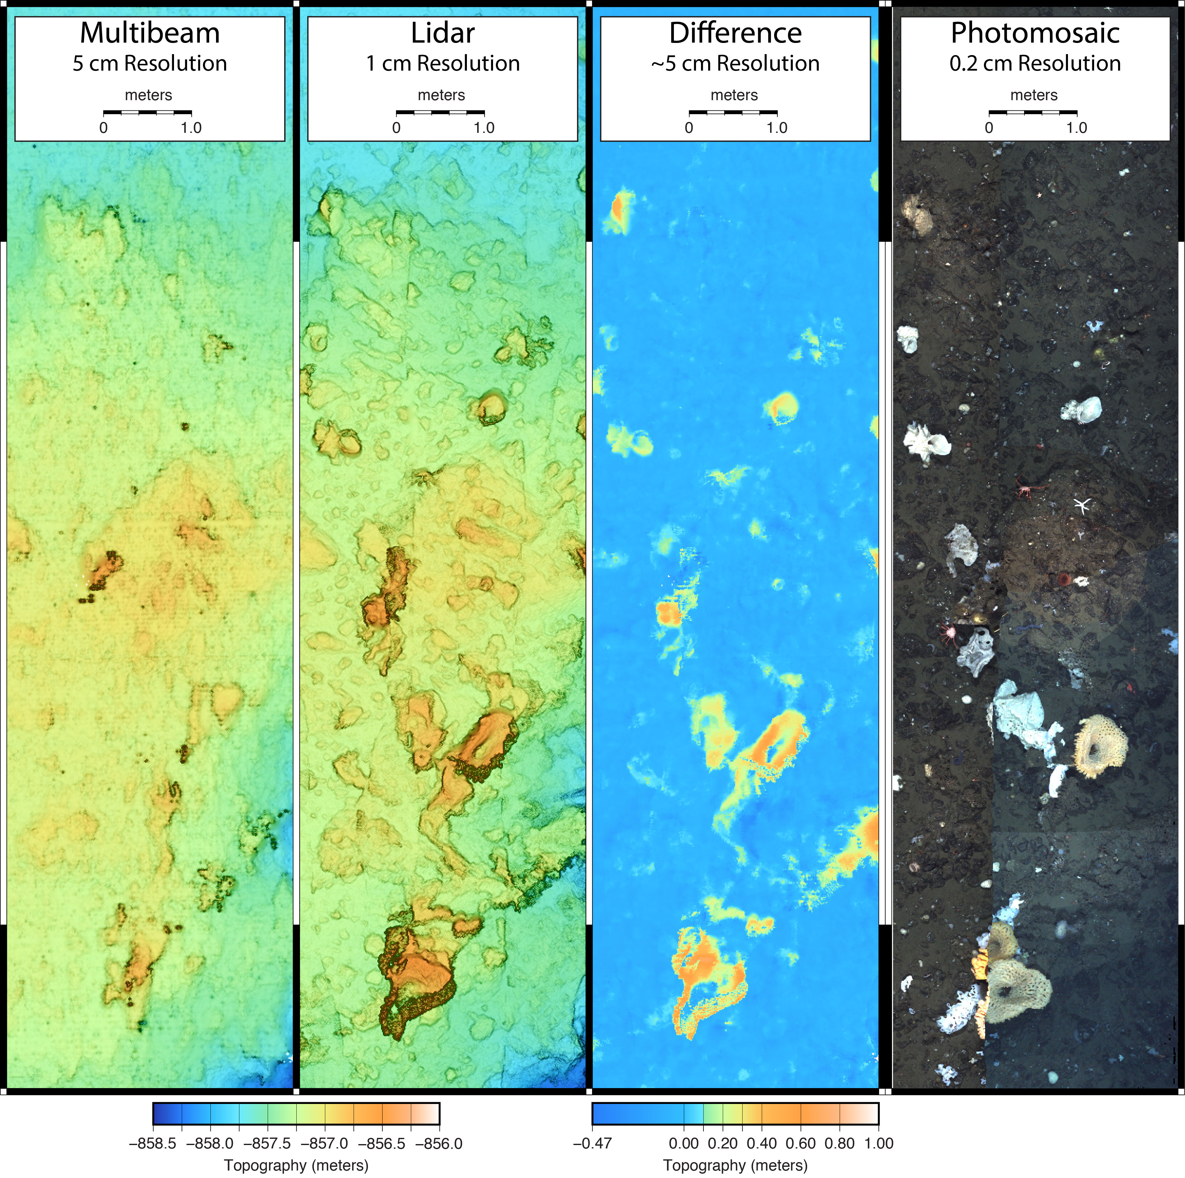
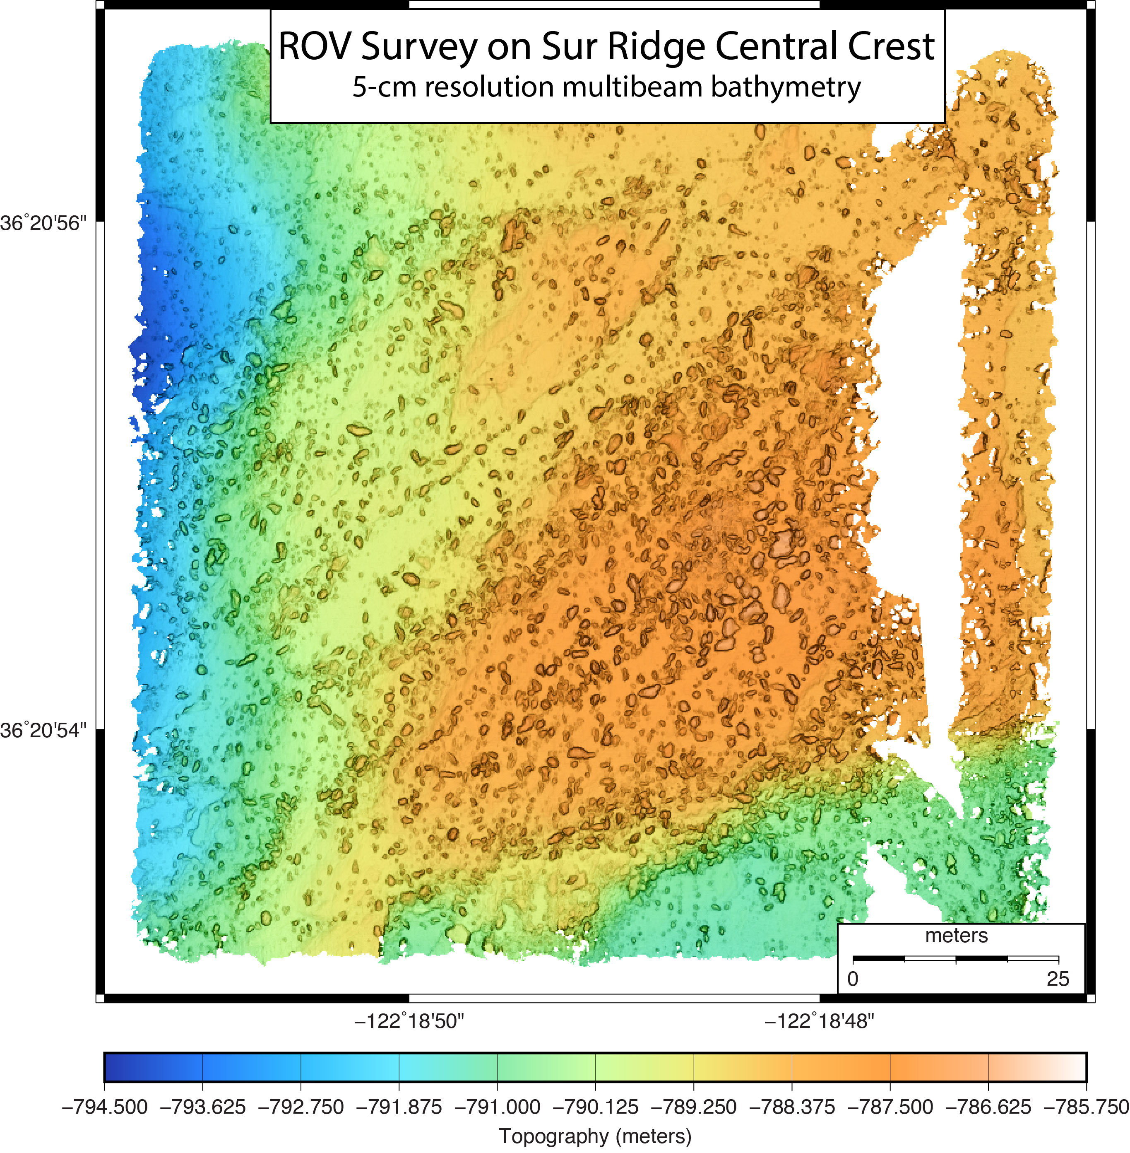
Low Altitude Surveys on Sur Ridge
Multibeam, lidar, & stereo photography from 2-3 m altitude on ROV Doc Ricketts

Slide 14
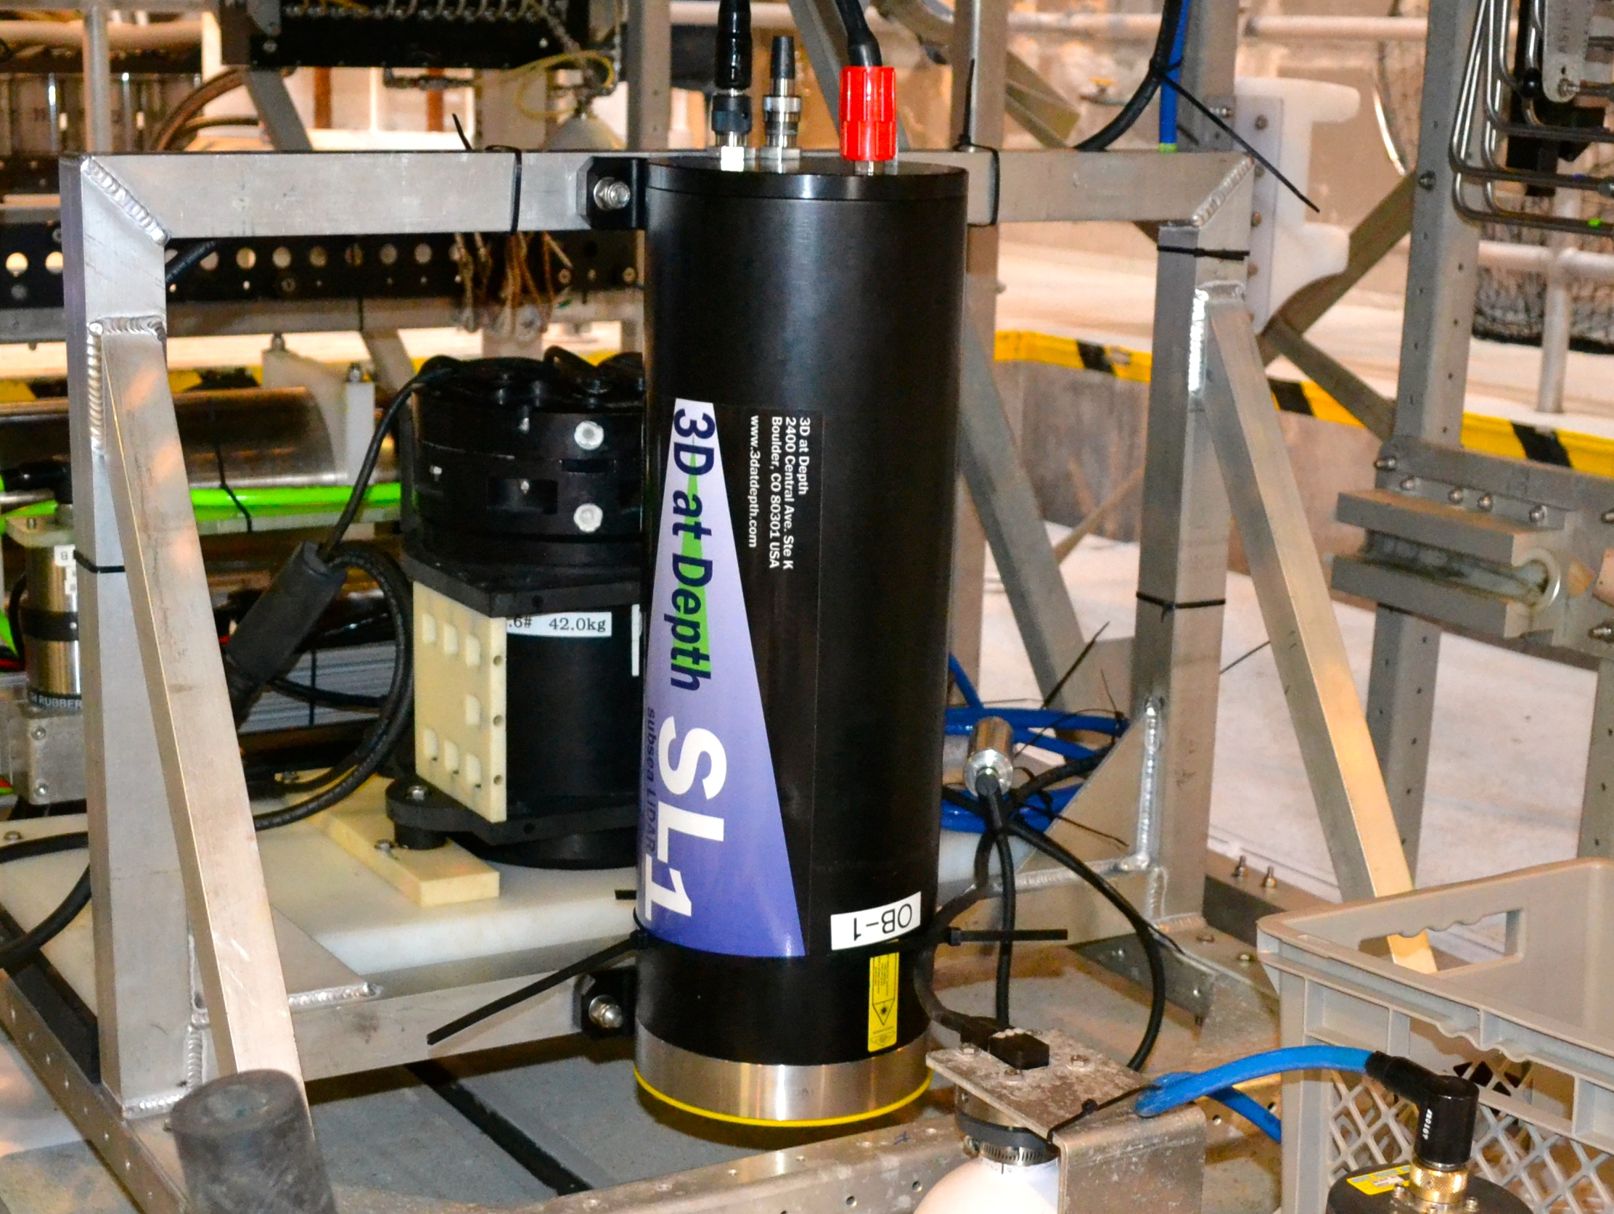
Limitations of Prototype Lidar (SL1)
Lidar has proved to be a hugely enabling technology, but the existing system is not optimized for seafloor mapping
Complex design
  Two mirror optical bench to achieve 2D scans
Limited field of view
  30°by 30° area
Slow scan rate
  1 cm resolution only achievable at speeds of 0.2 m/s or less
3DatDepth Prototype SL1 Lidar

Slide 15
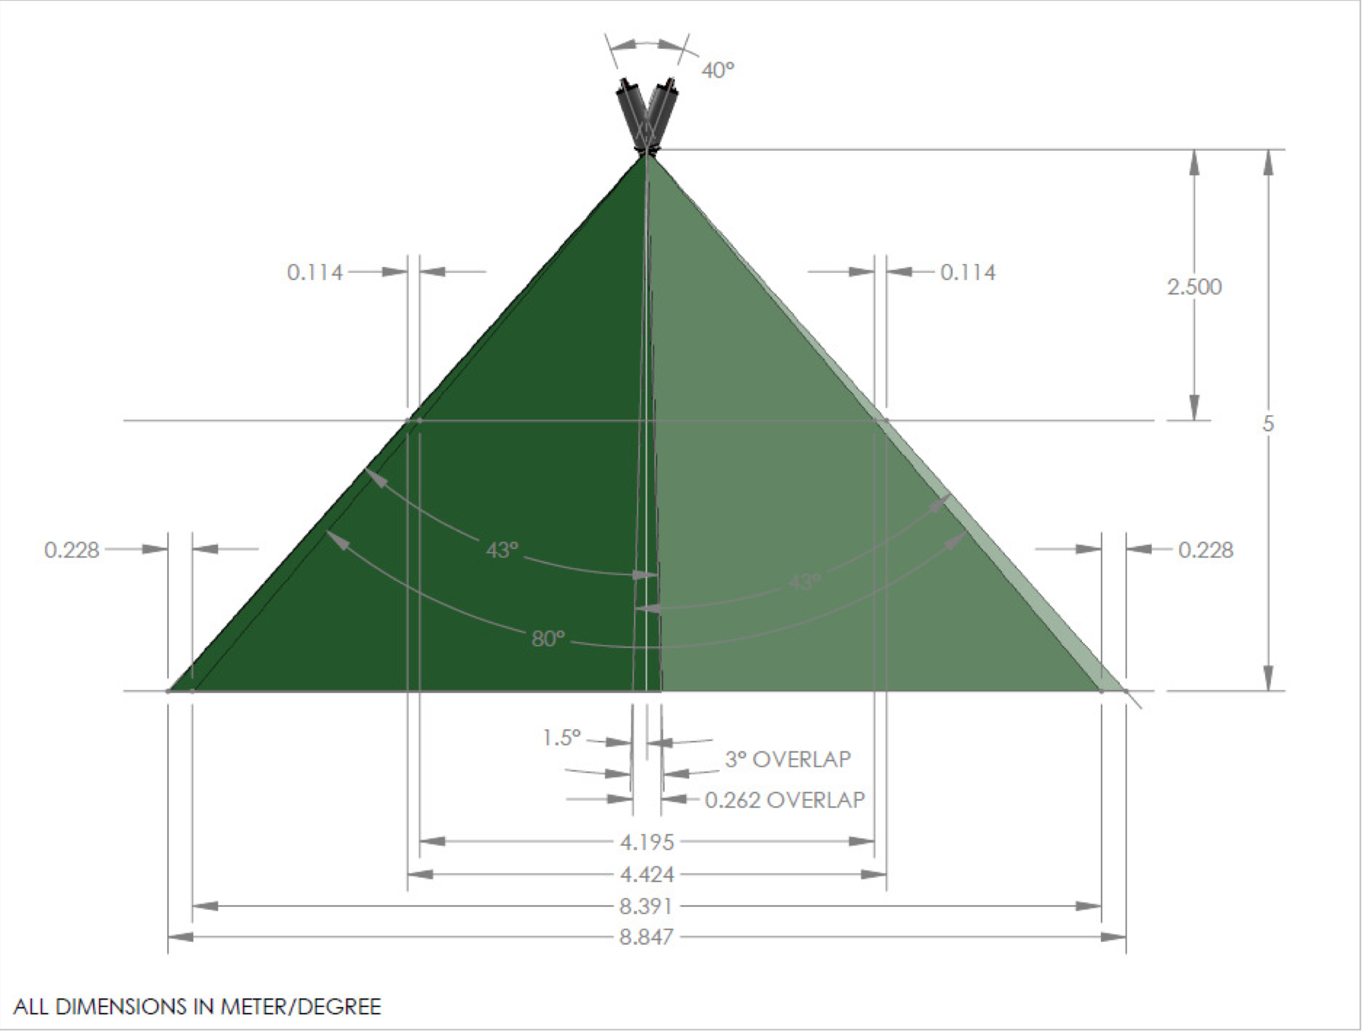
Wide Swath Lidar Requirements:
Optimizing Lidar for Swath Mapping
Single mirror optical bench
  1D acrosstrack scanning
Larger (>= 80°) field of view
Faster scan rate
  Achieve 1 cm resolution at 0.5 m/s (1 knot) survey speed
Same range performance as SL1 prototype
Conceptual design completed 2015
  MBARI requirements achievable
  Two optical-head design
  Separate electronics housing
80°field of view of
two-head design

Slide 16
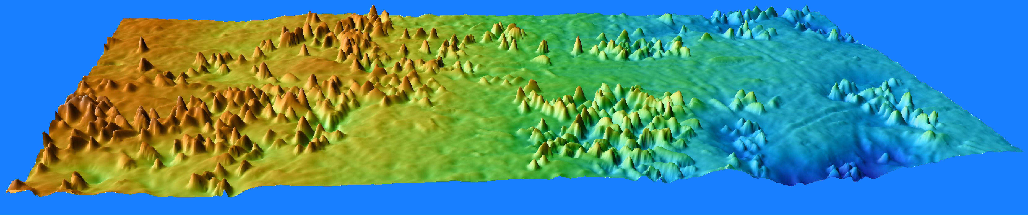
Wide Swath Lidar: Current Status
Detailed design phase underway
  MBARI requirements achievable with two-optical-head design
  Design review scheduled for August
Build phase to follow successful design review
Delivery and sea trials in early 2017

Slide 17
Ocean Imaging Project Timeline
Development
Build articulating frame to survey vertical cliffs
Modify AUV for 6000-m
Design & build AUV payload
Wide swath lidar
detailed design
3DatDepth build wide swath lidar
Corrective optics for cameras, rebuilt for ROV Doc Ricketts
Single frame mount for both ROVs
Test
3000-m AUV
First survey system with stereo cameras & multibeam
for ROV Ventana
3DatDepth deliver wide swath lidar
wide swath lidar
design review
3DatDepth conceptual design for wide swath lidar
Test 6000-m AUV
Added lidar
3000-m AUV
delivered
2011
2012
2013
2014
2015
2016
2017
2018
2019
Sur Ridge
Sea trials wide swath lidar
Pescadero Basin GOC on R/V Falkor
?
Portuguese Ledge
Test articulating system in Monterey Canyon
Monterey Canyon 2850-m
Monterey Canyon CCE 1850-m
SoCal offshore faults
Monterey Canyon 2850-m
& Monterey Canyon 1850-m
& Sur Ridge
Field Programs
Ashes Vent Field, Axial Seamount
Monterey Canyon CCE 1850-m

Slide 18
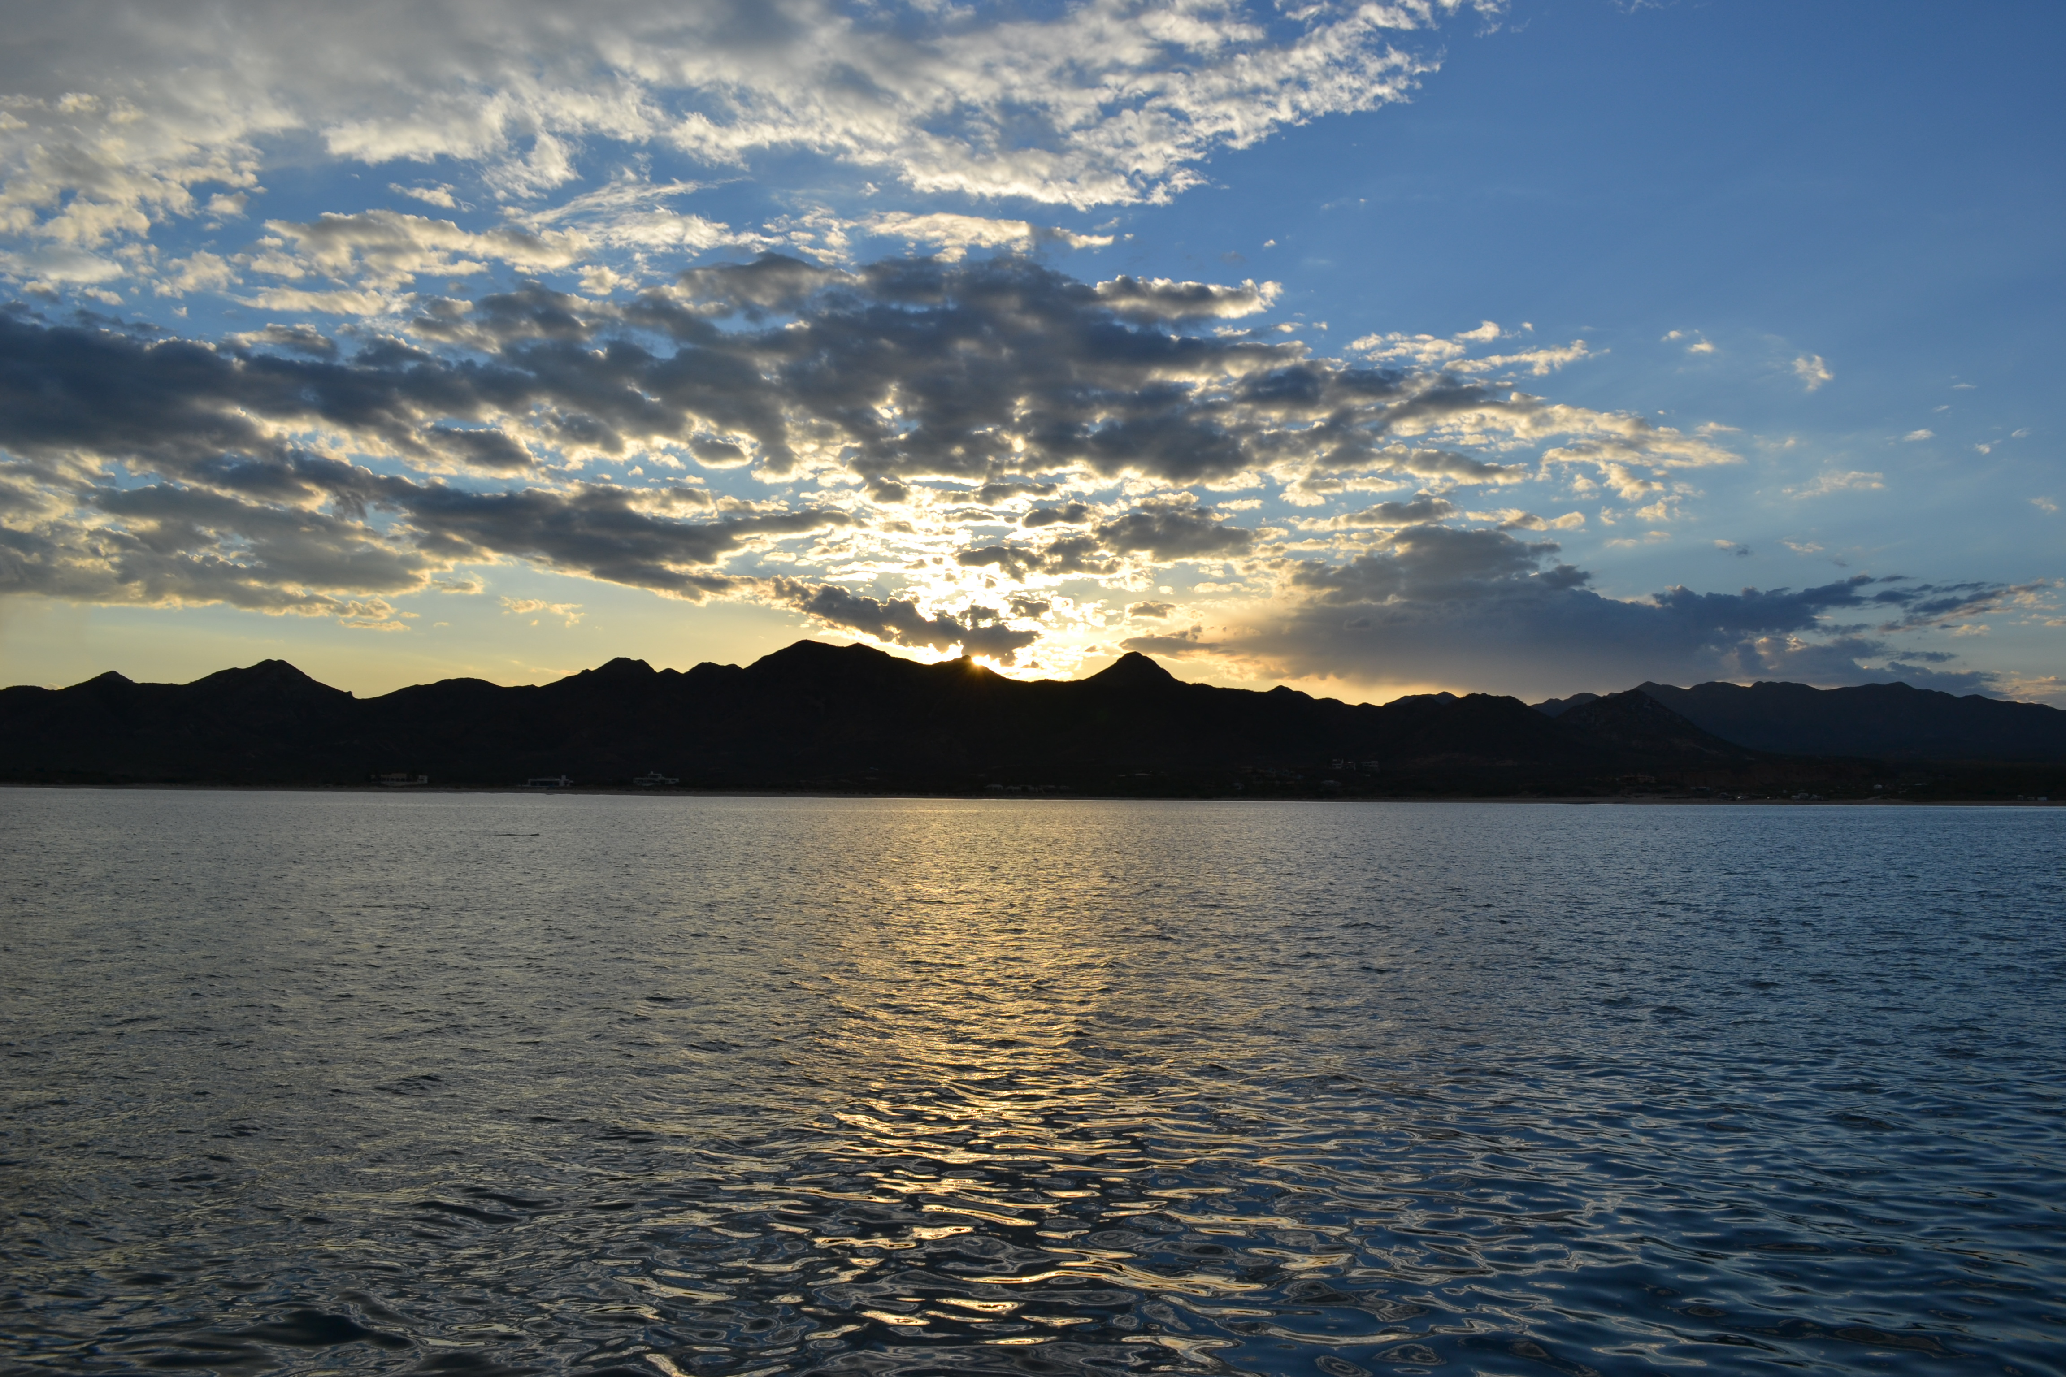
Ocean Imaging Project Team:
David Caress, Hans Thomas, Brett Hobson, Eric Martin, Rich Henthorn, Mike Risi, Steve Rock (Stanford), Giancarlo Troni (PUCC, Chile), Larry Bird, Andy Hamilton, Charlie Paull, Doug Conlin, Bill Kirkwood, Doc Ricketts Pilots, Ventana Pilots

