Slide 1
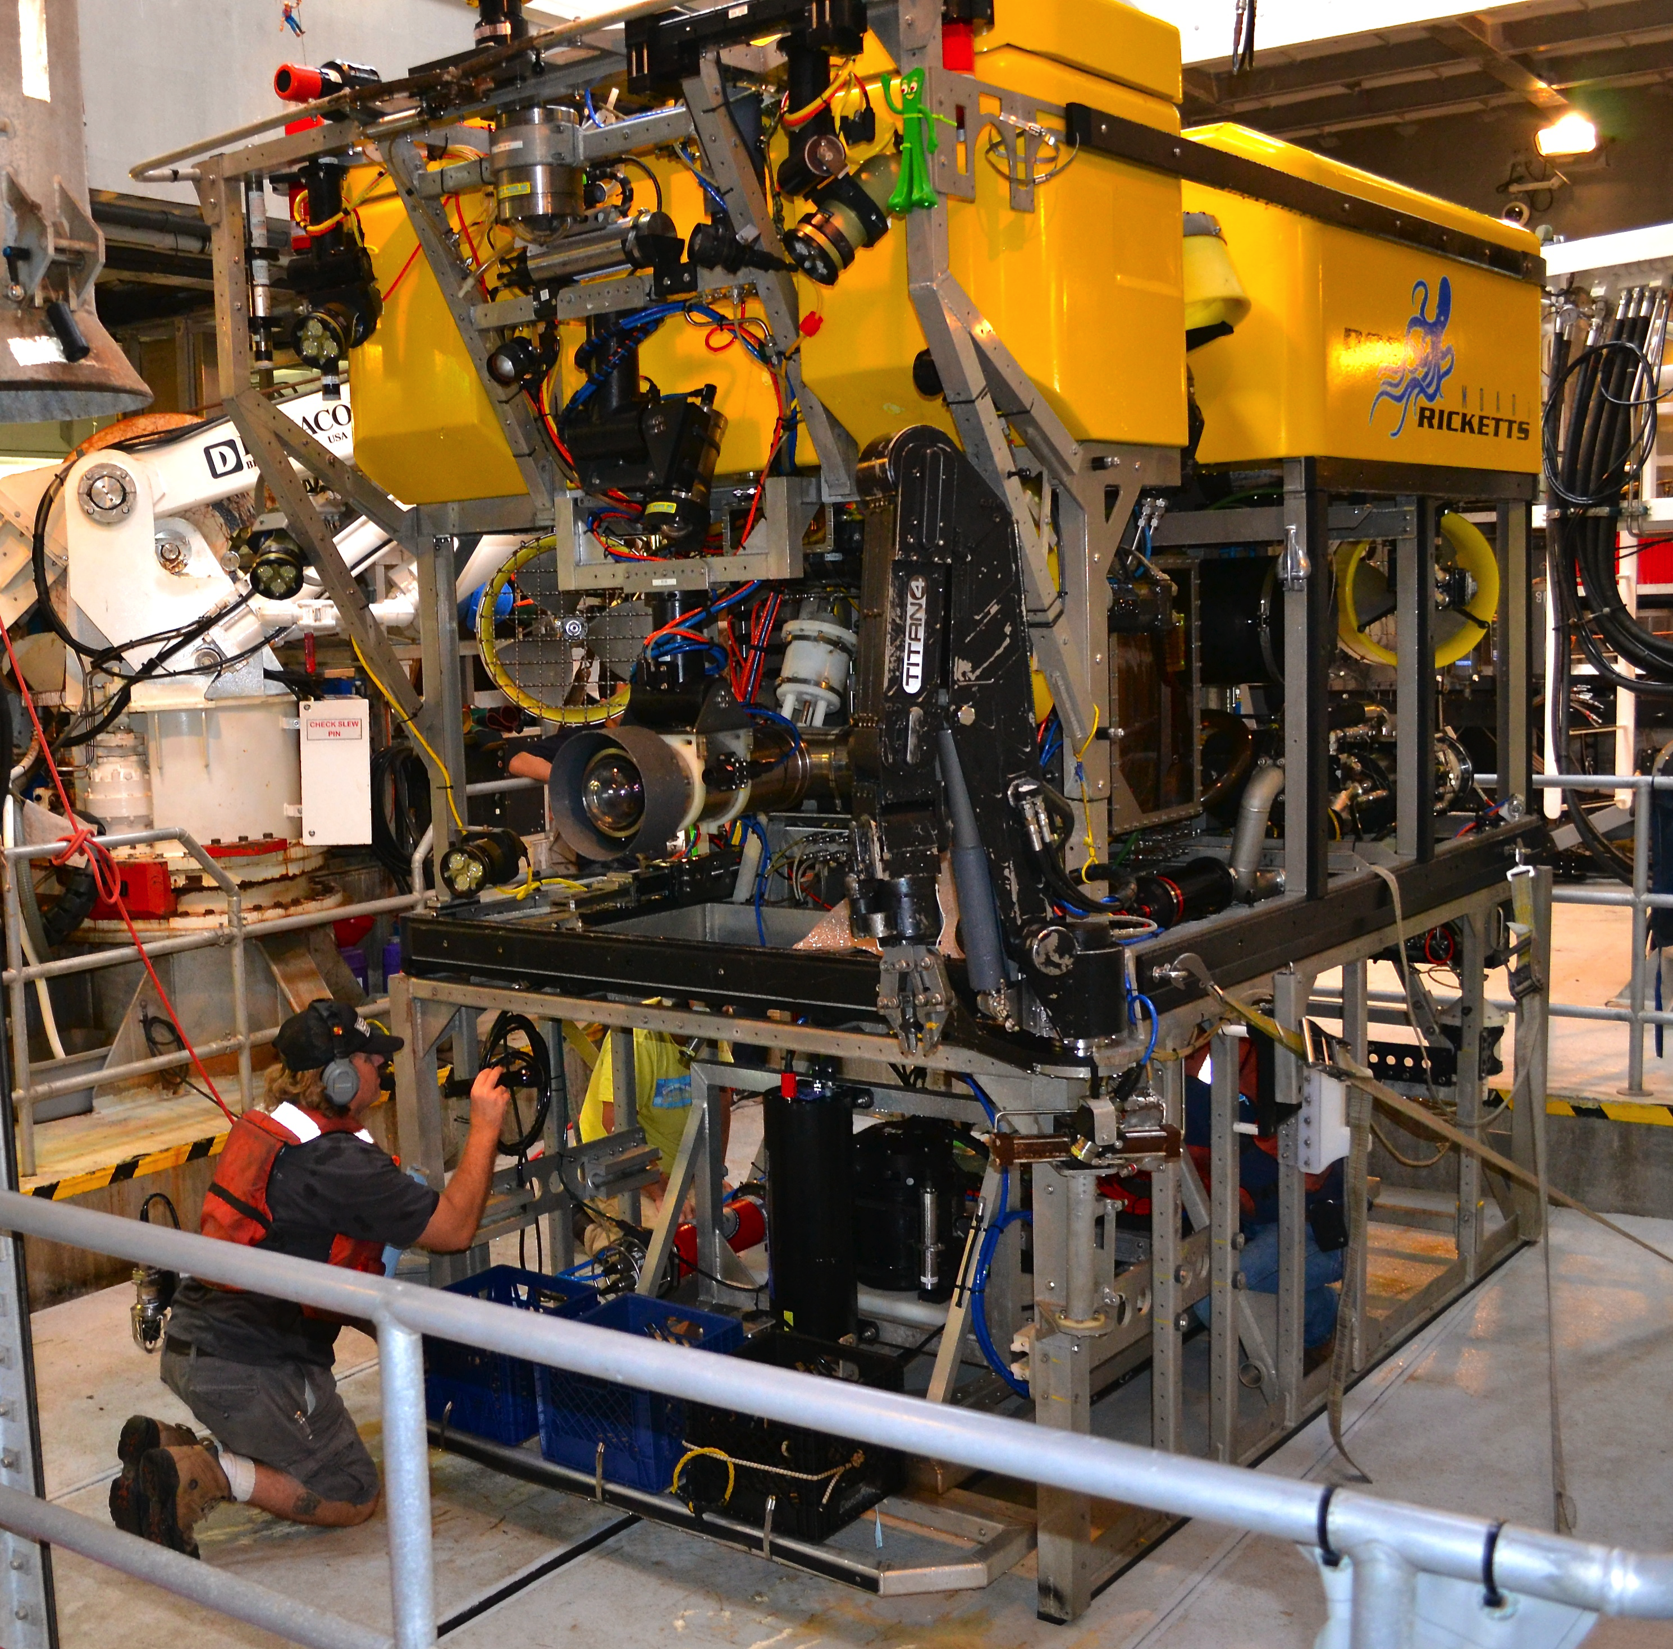
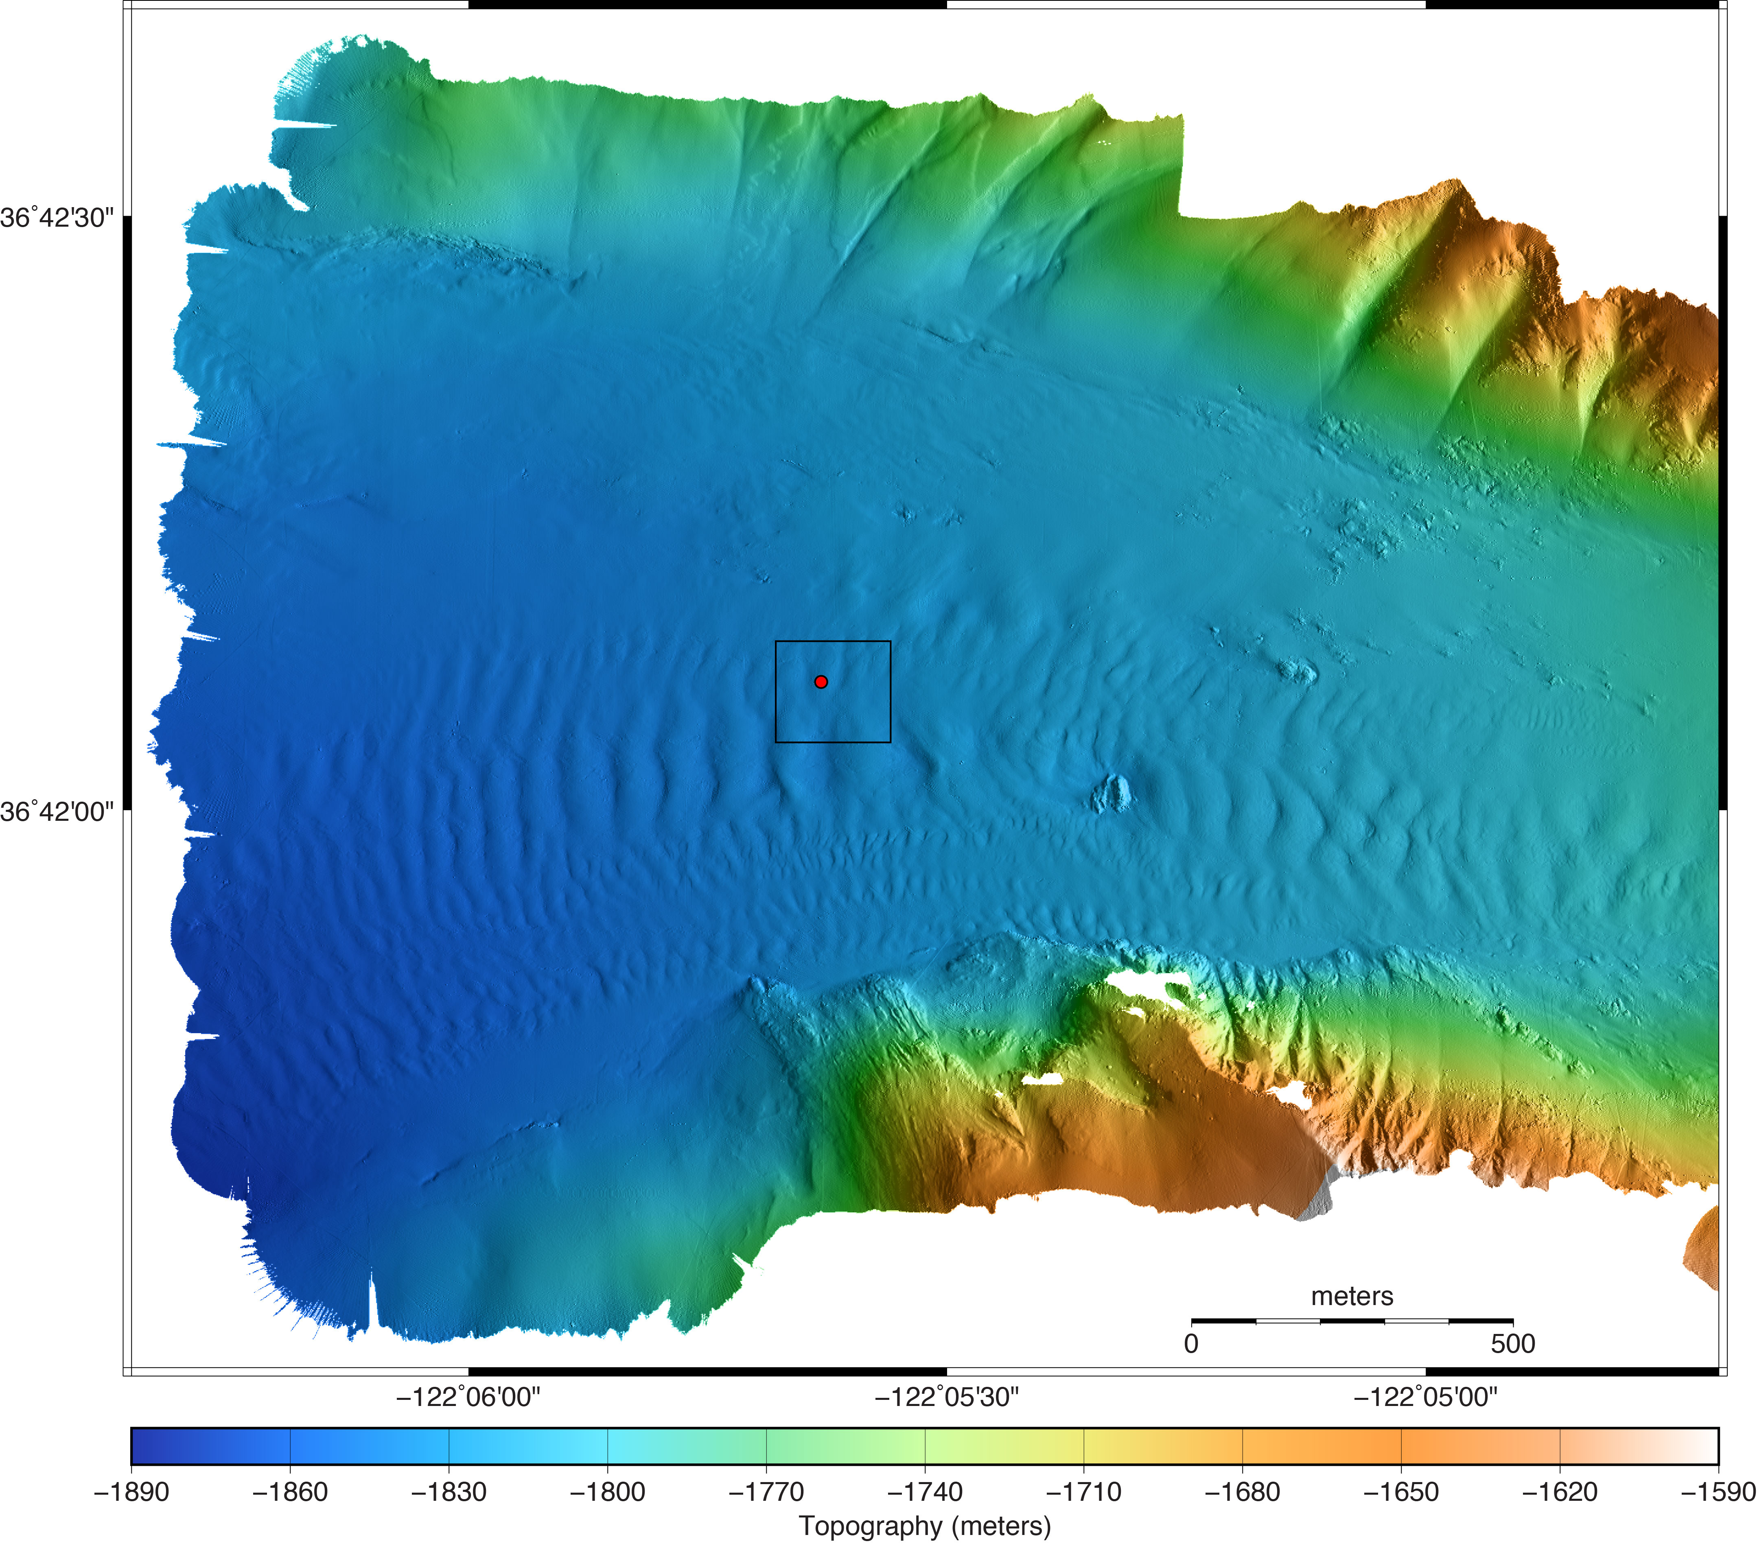
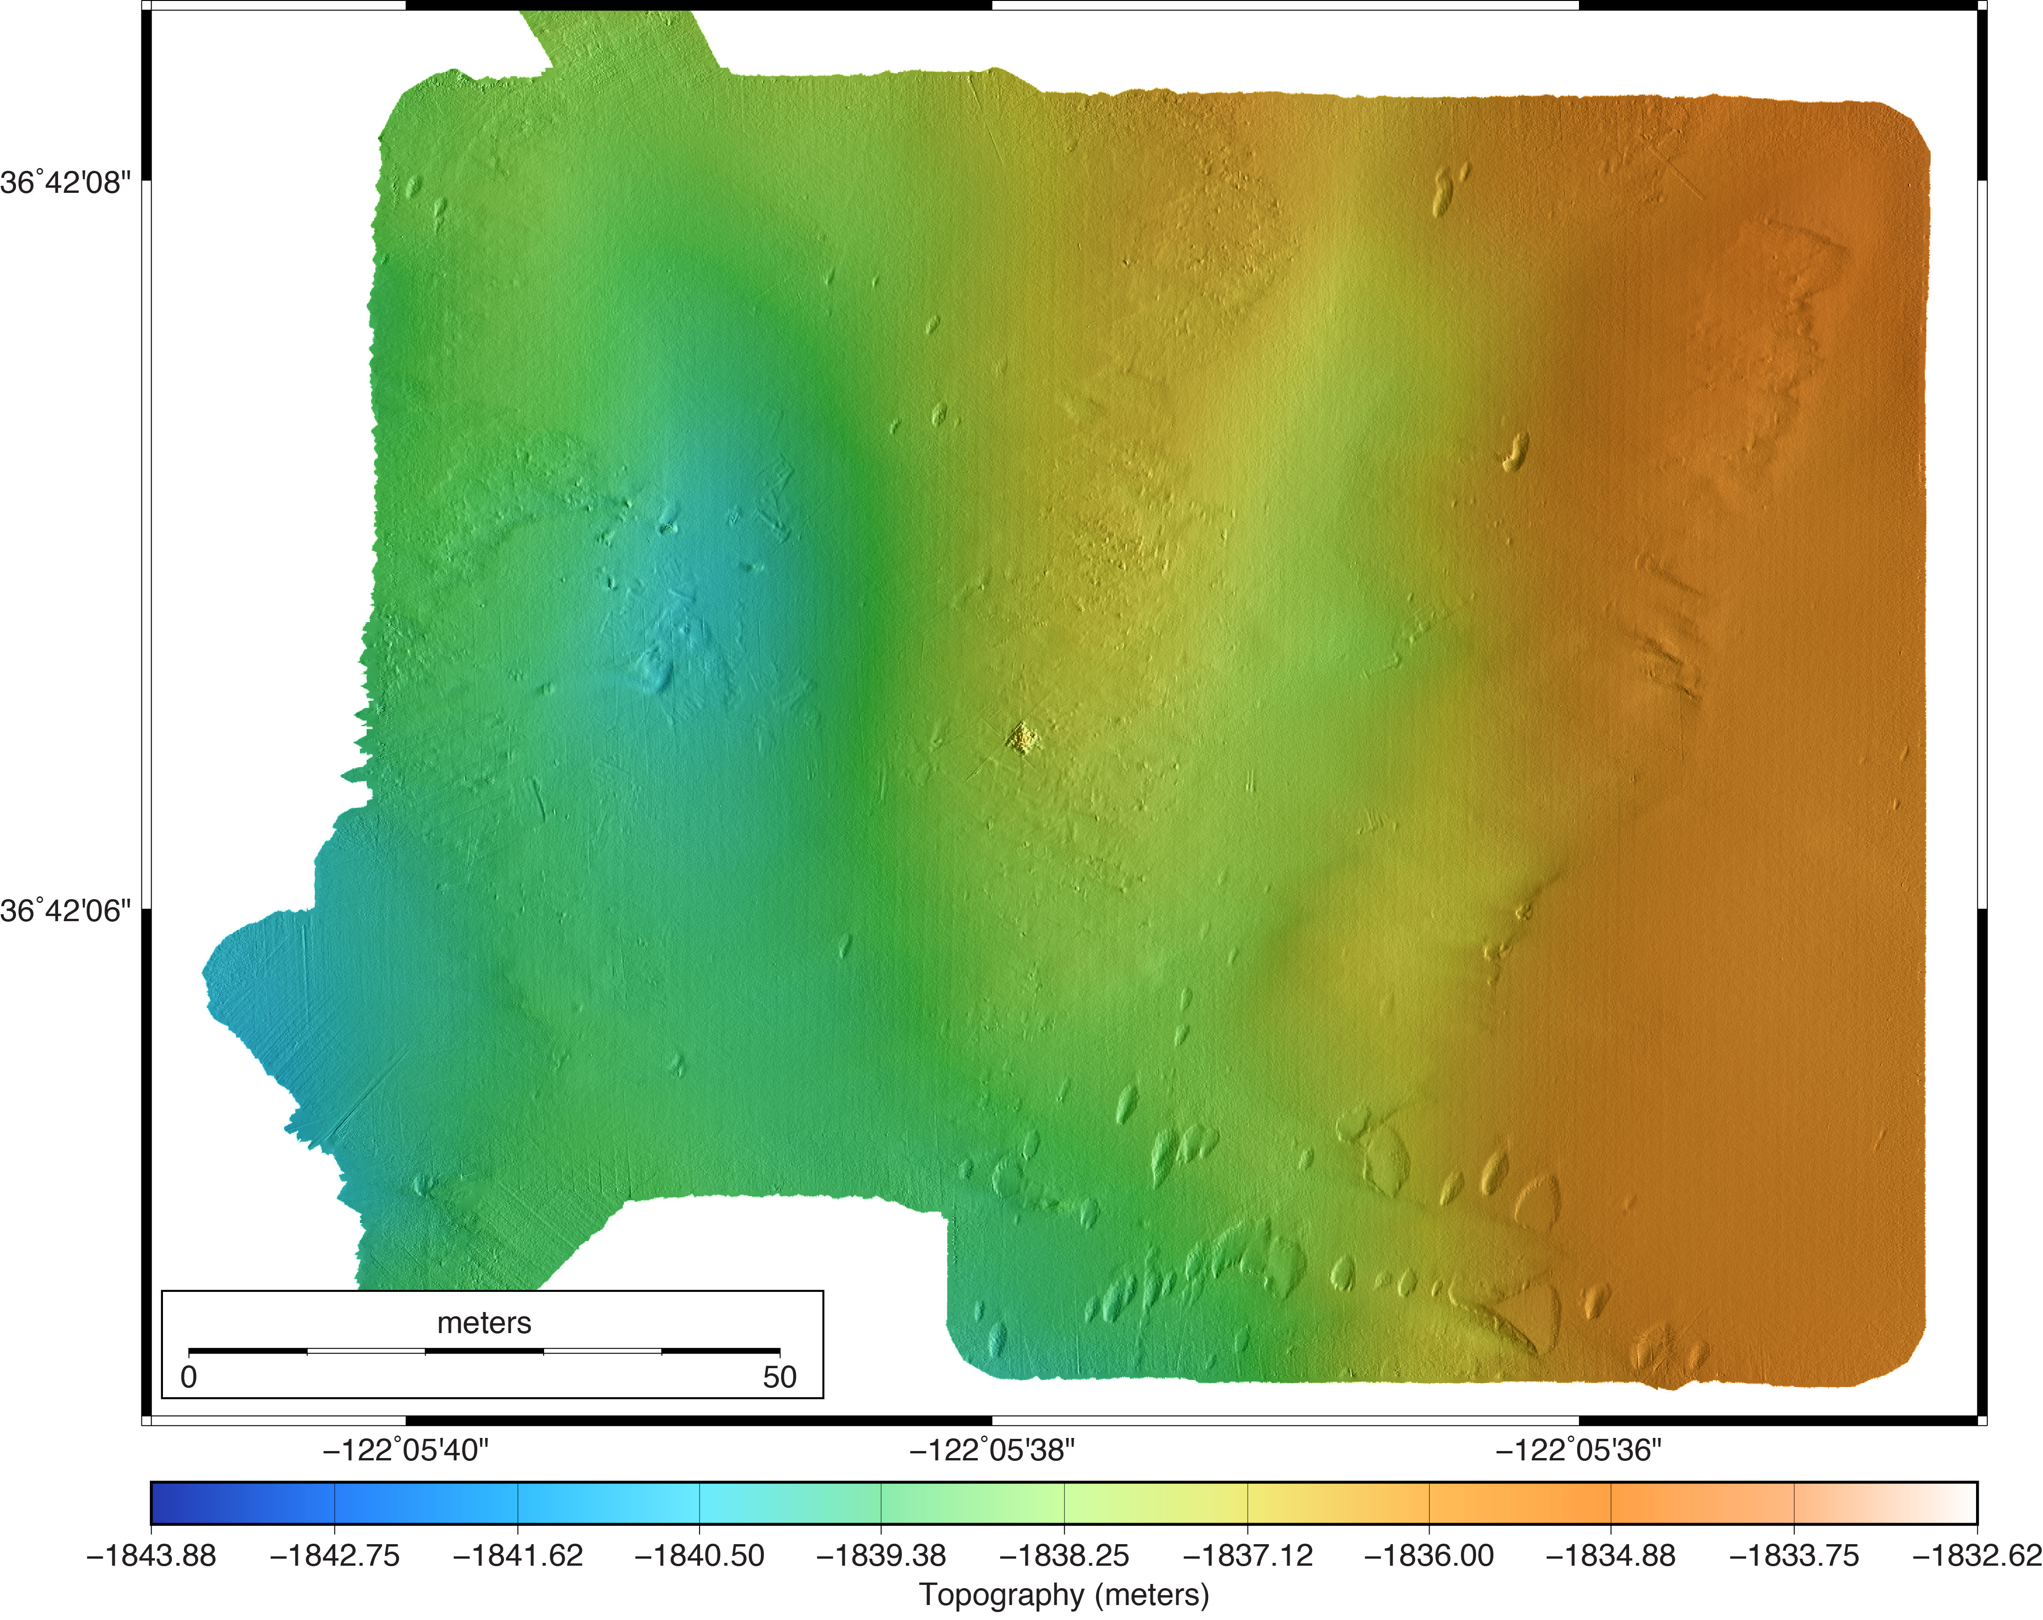
2017 Ocean Imaging Project
Coordinated Canyon Experiment (CCE)
Fifth 1-cm-scale repeat mapping of the 1850-m BIN site in Monterey Canyon
March 2017 on R/V Western Flyer w/ ROV Doc Ricketts
Quantitative measurement of sediment deposition and erosion
Project joined by new Postdoc Monica Wolfson-Schwehr (geophysicist/seafloor mapping)
1-m Mapping AUV Bathymetry
5-cm Multibeam Bathymetry

Slide 2
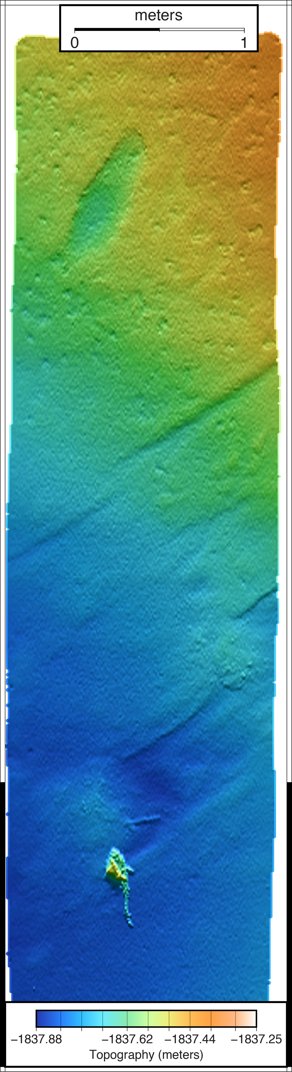
May 2016 Survey of CCE BIN Site
5-cm multibeam bathymetry
1-cm lidar bathymetry

Slide 3
2017 Ocean Imaging Project:
Wide Swath Lidar Development w/ 3DatDepth
Successful Critical Design Review August 2016
  90°field of view, 1-cm resolution from 3-m altitude moving at 0.5 m/s
Factory Acceptance Test expected late April 2017
Testing & calibration in test tank May 2017
Sea trials on R/V Rachel Carson w/ ROV Ventana using the new articulating mount for surveying flat to vertical terrain
Two optical head design achieves 90°swath = 2 X altitude wide

