Slide 1
Enabling New Techniques in Environmental Assessment Through Multi-Sensor Hydrography
Eric J. Martin, David W. Caress, Hans Thomas, Brett Hobson, Richard Henthorn, Michael Risi, Charles K. Paull, and James P. Barry*, and Giancarlo Troni

Slide 2
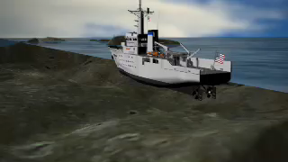
Current Practices
Ship Based Sonar (~5m)
AUV Based Multibeam Sonar (1m)
ROV Target Investigation
http://www.nauticalcharts.noaa.gov/staff/education_animations.htm

Slide 3
Problem
Current systems do not provide enough detail to observe small-scale change in practical periods of time.

Slide 4
Why is Small Change Important?
Biological community assessment
Ocean Deposition
Geomorphic change

Slide 5
Hypothesis
A domain of survey study exists in the sub-meter space, that traditional ROVs and many AUVs are not equipped to handle. Use of multiple sensors can aid in generating a comprehensive assessment of the environment under study.

Slide 6
Development Goals
Assemble a system that can provide maps at resolutions no larger than 1-cm
Conduct planned surveys in a controlled manner using MBARI ROVs.
Provide autonomy where possible.
Navigation be accurate enough to conduct repeat mapping efforts.

Slide 7
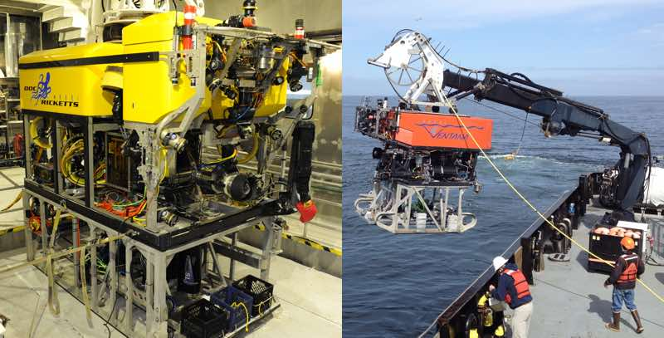
ROV Tool-Sled Solution
Mounts underneath ROV
Carries Mission Specific Payload components
Simplified interface to ROV
  Power and 1Gbps Ethernet

Slide 8
Core Sled Sensor Components
Inertial Navigation Sensor with DVL aiding (Kearfott SeaDeViL)
400kHz multibeam sonar (Reson Seabat 7125)
Stereo Cameras with Xenon flash strobes (In house cameras, OIS Strobes)
Time of Flight Lidar (3DatDepth SL-1)

Slide 9
Applications
Fine Scale Surveys
Repeat Mapping
Benthic Organism Detection

Slide 10
Fine Scale Surveys

Slide 11
Survey Parameters
ROV Based Survey – 12 hour dive limit (MBARI)
  About 10 hours of bottom time on average
100m x 100m survey area
2-4 meter altitudes
No Data Limitations – Real time control and acquisition
Xenon Strobes limit
Automated station keeping with scripted input

Slide 12
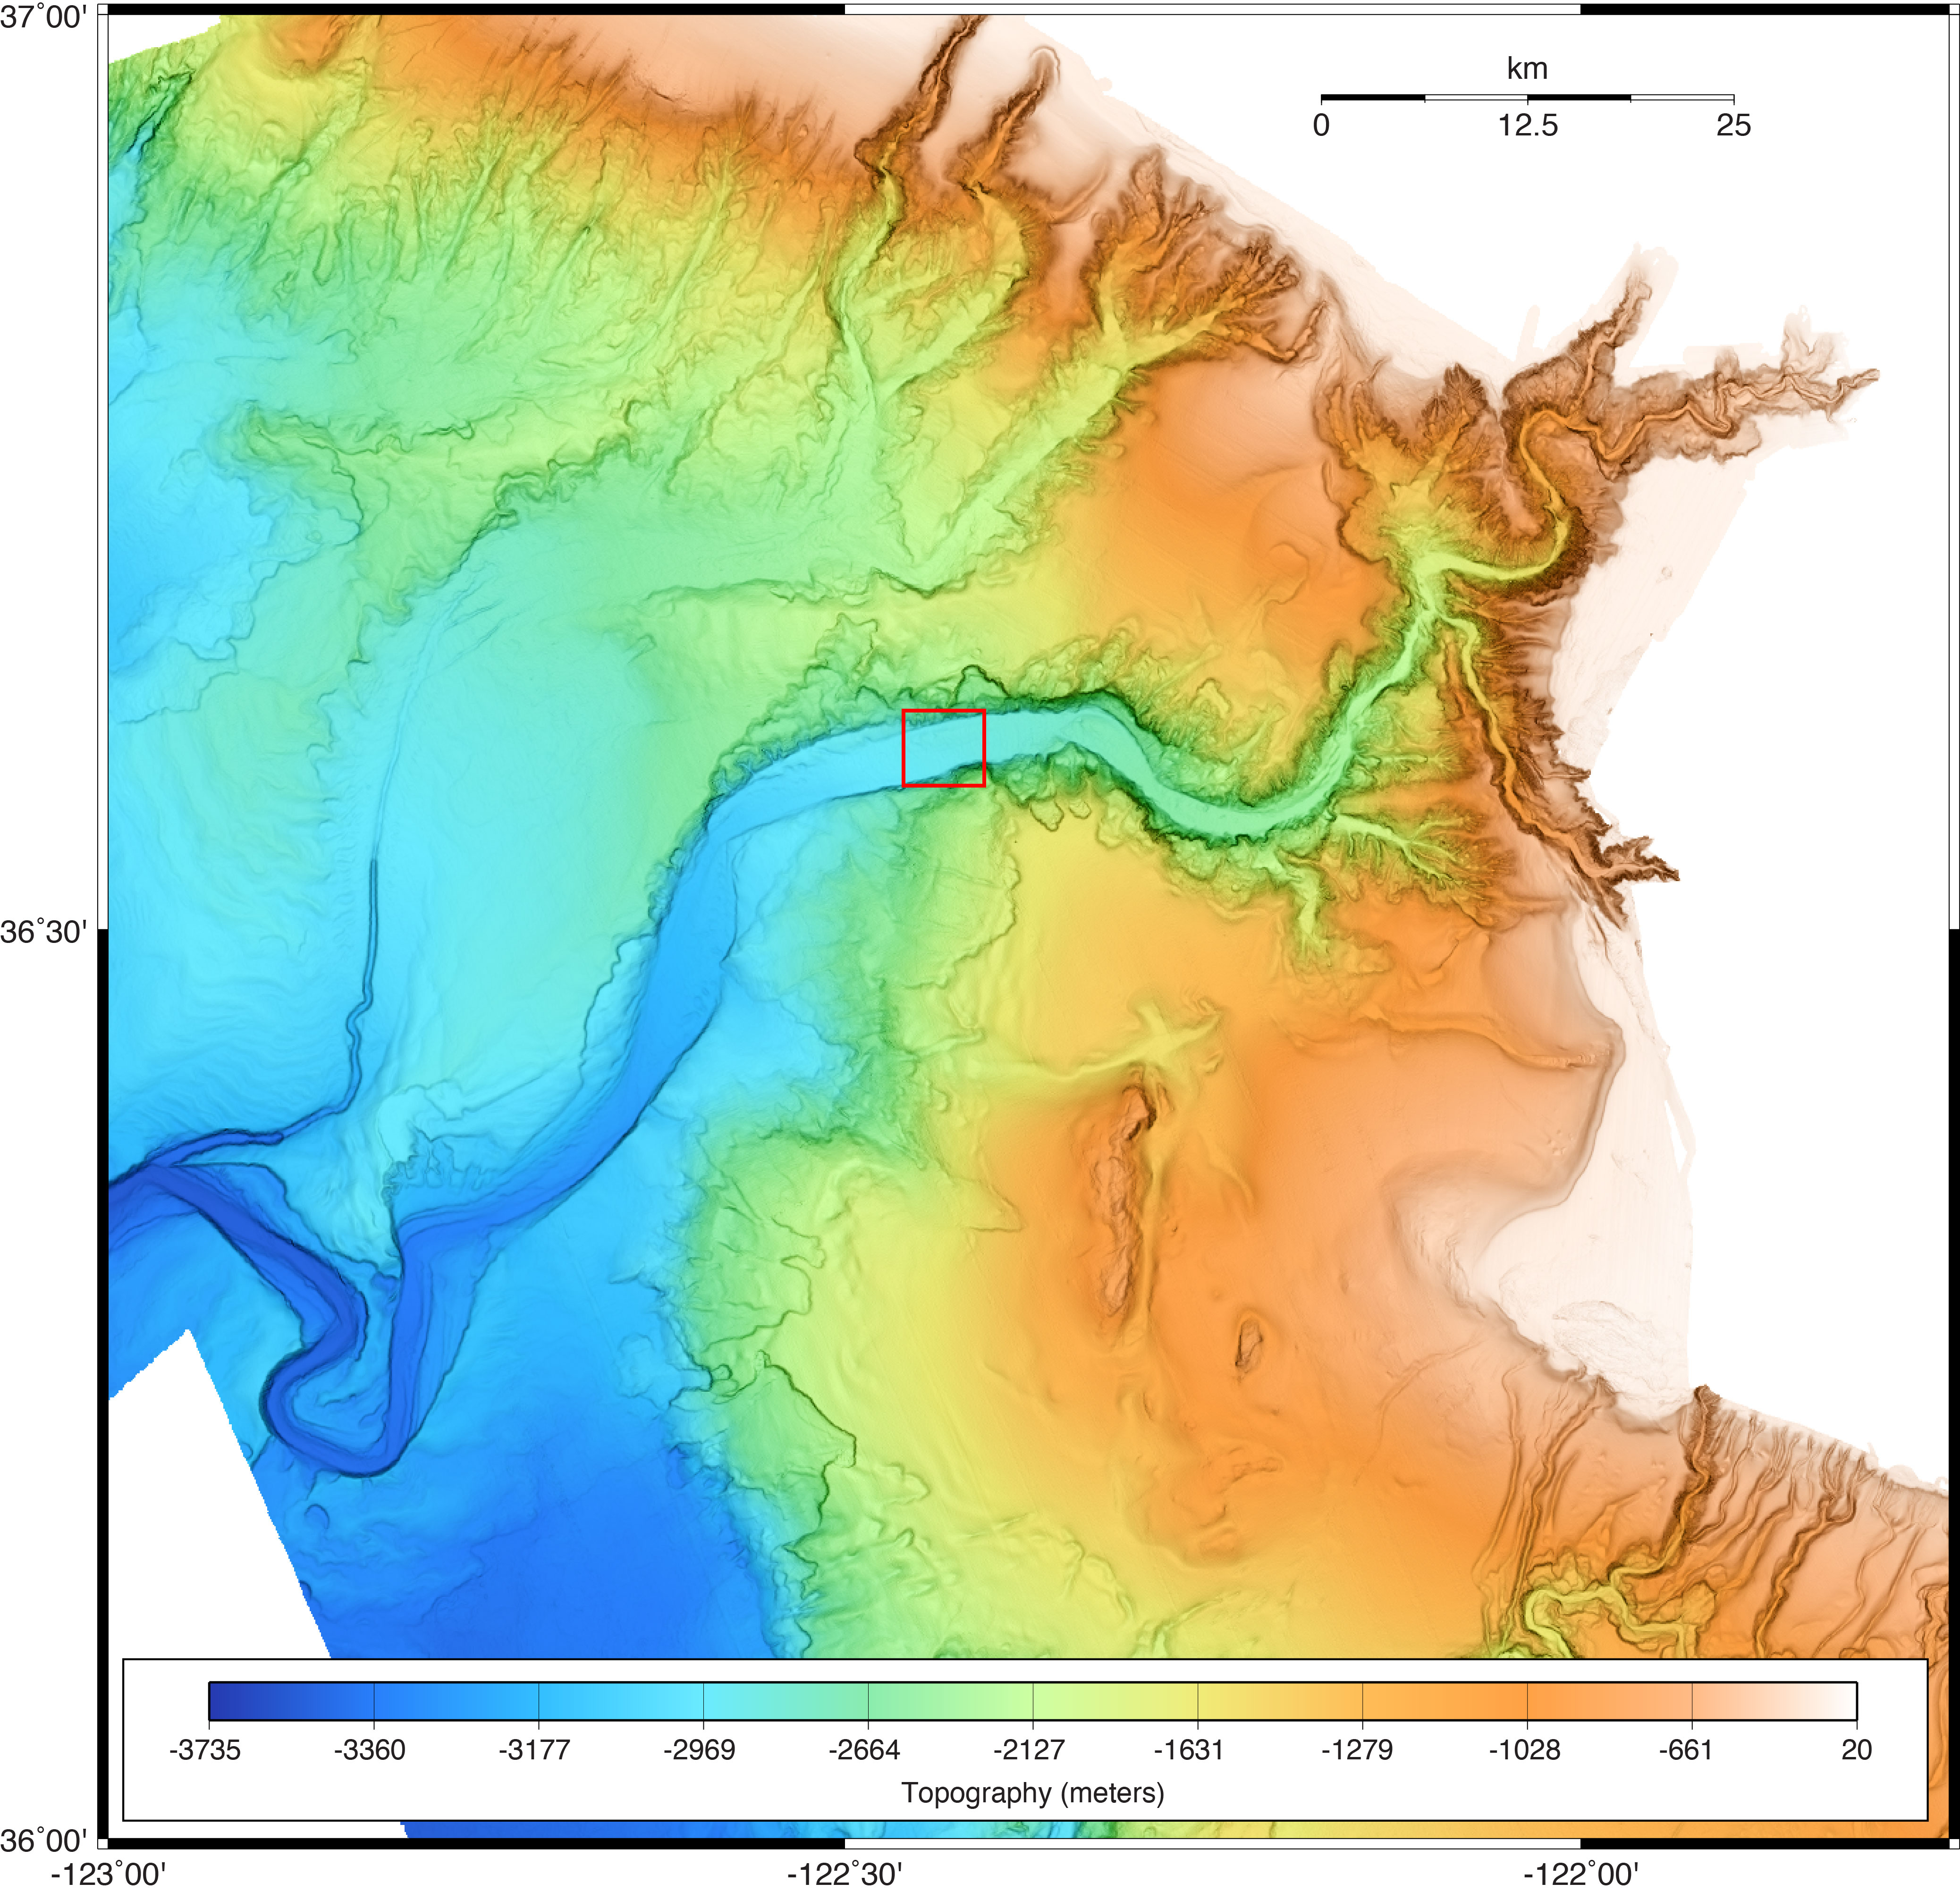
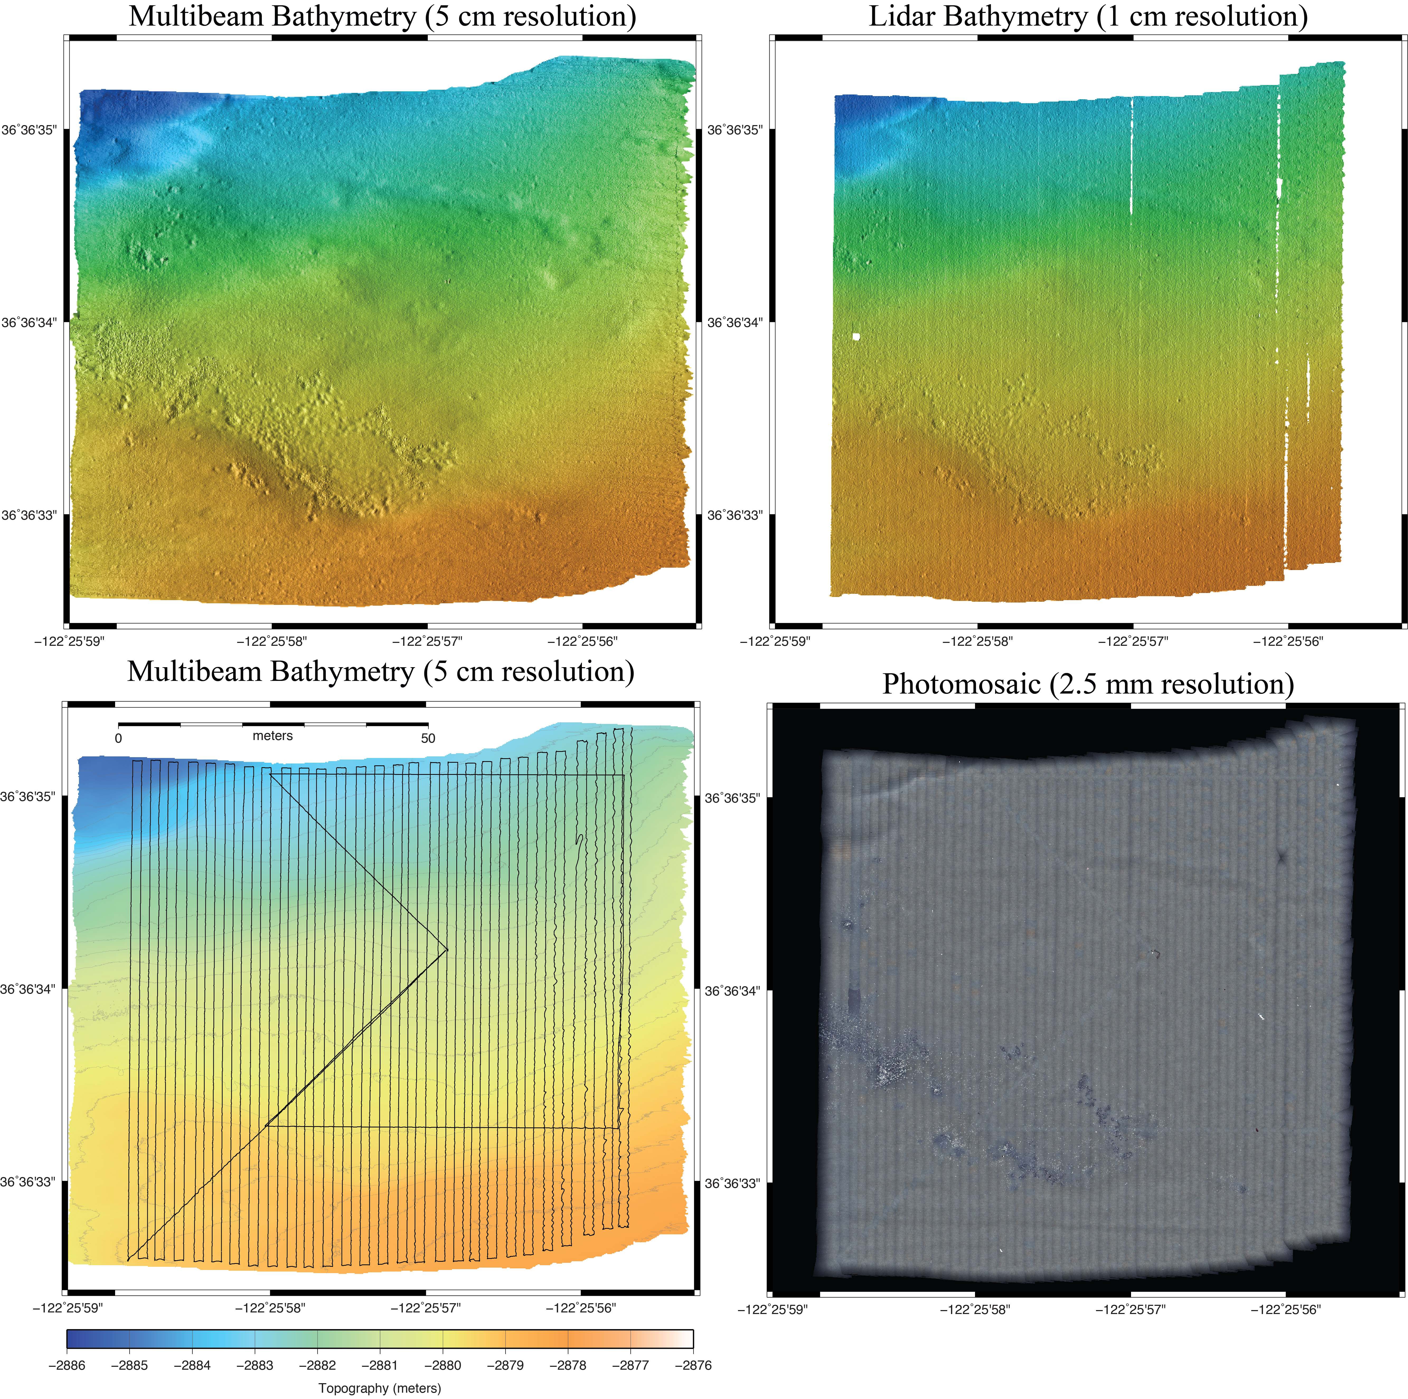
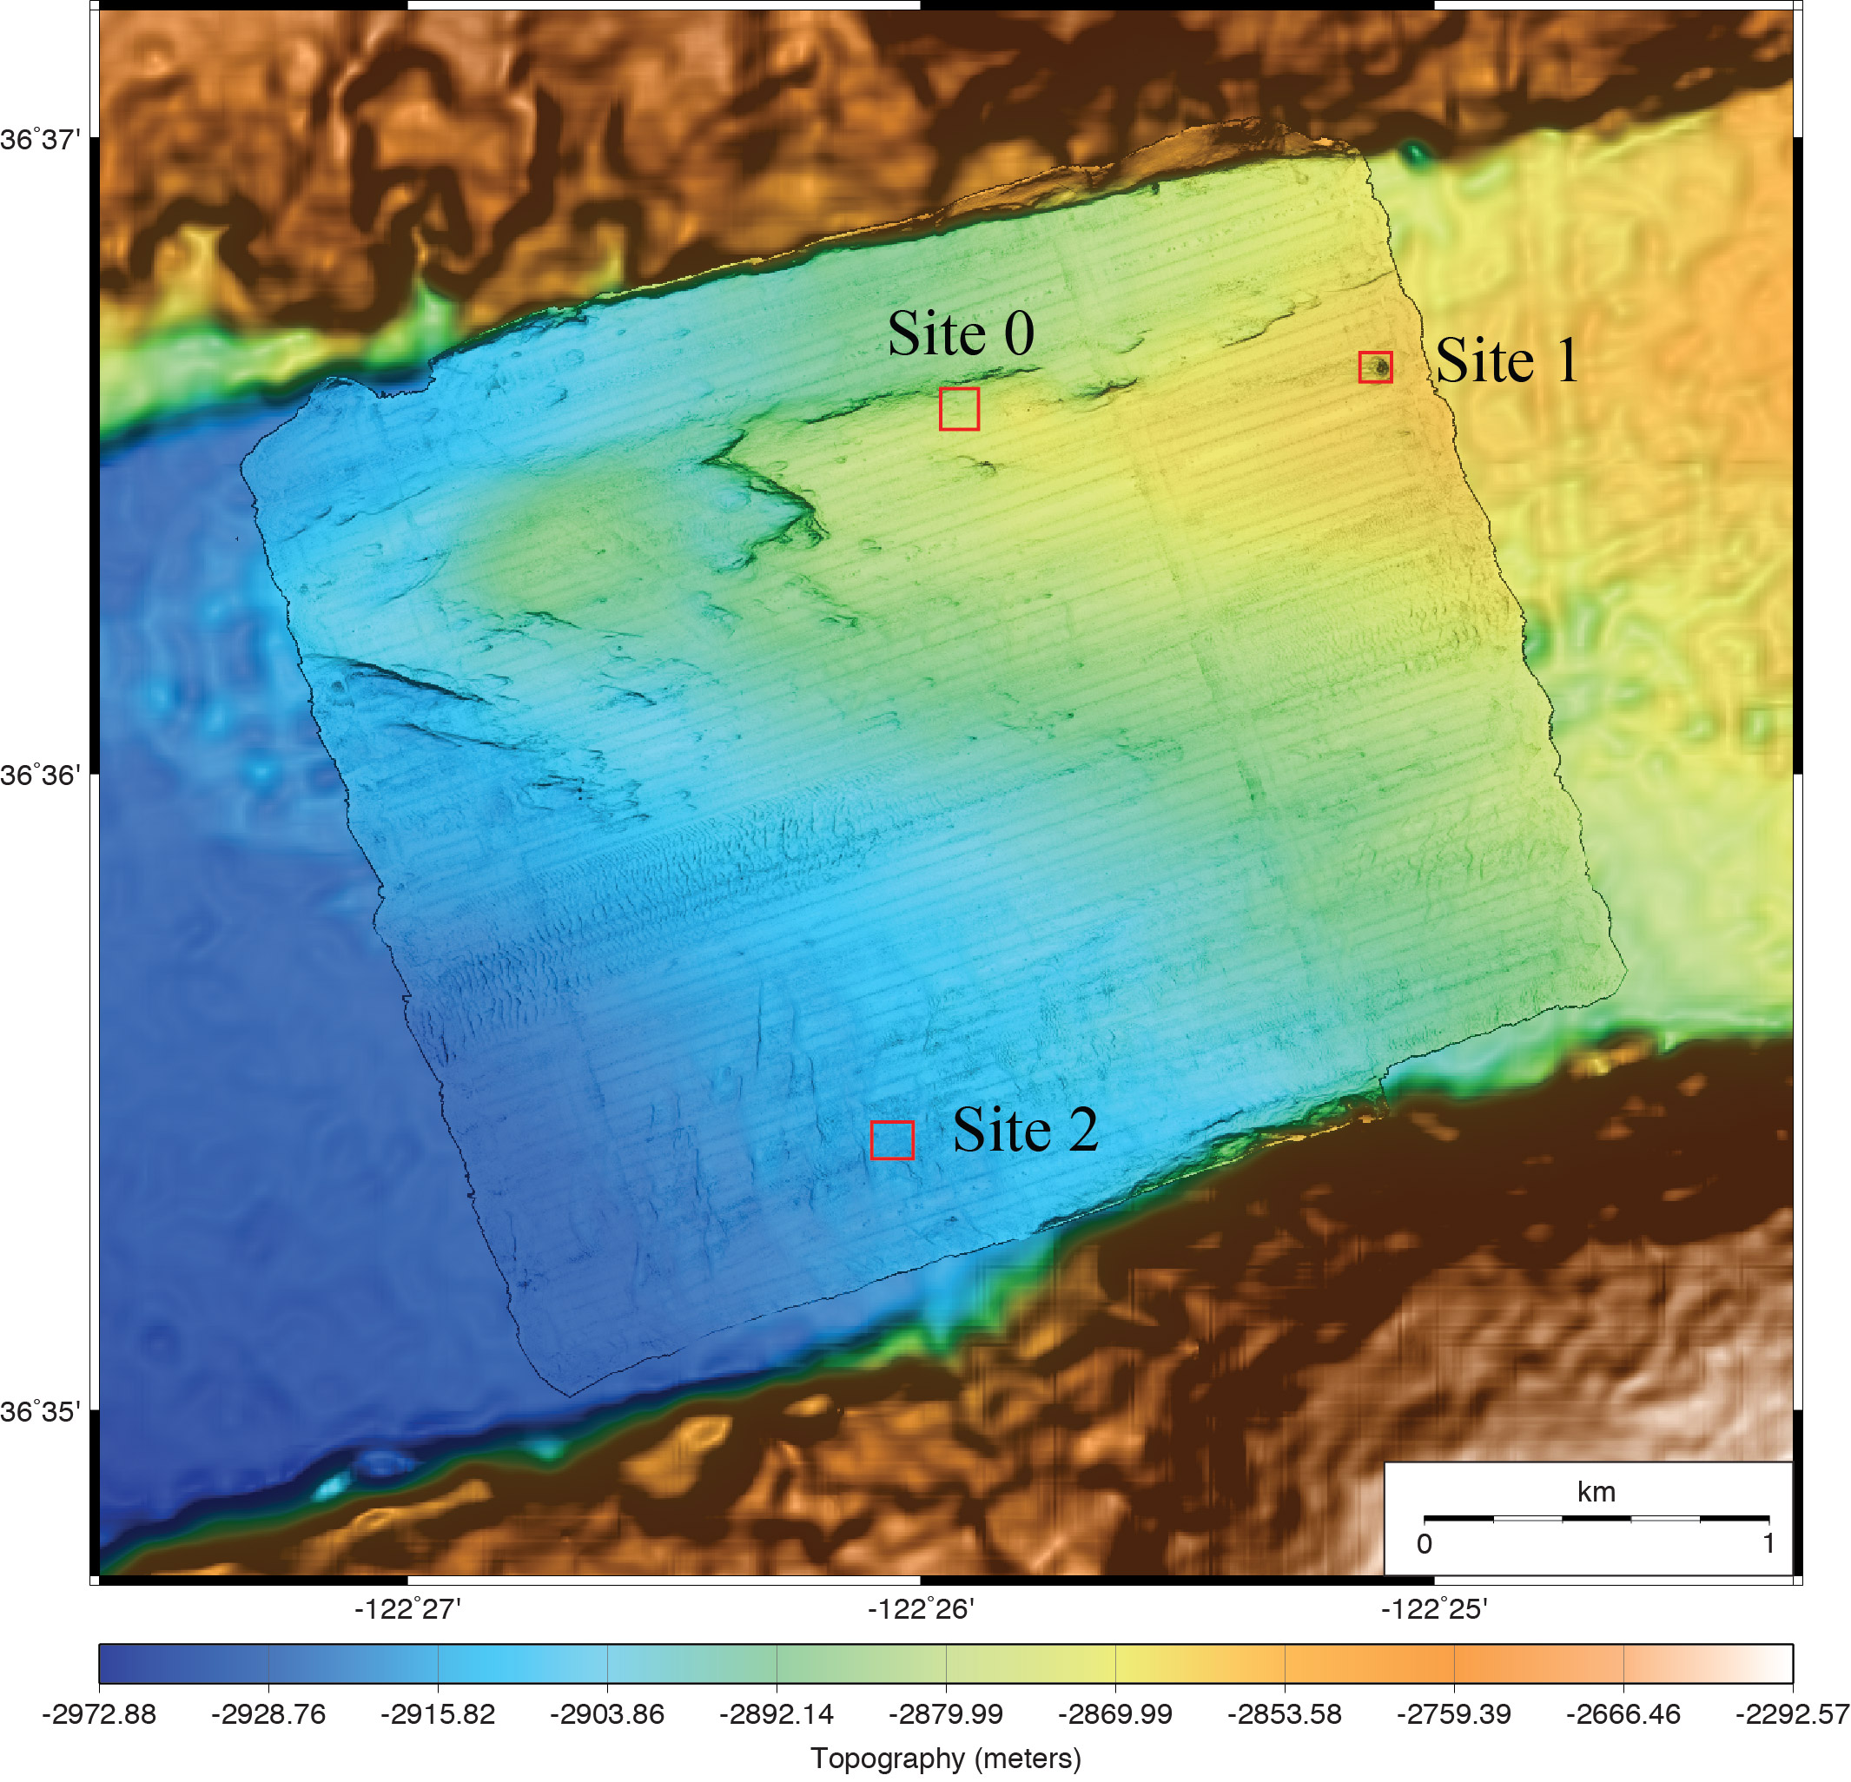
Chemosynthetic clam community in Monterey Canyon axis at 2850-m depth
50 meters

Slide 13
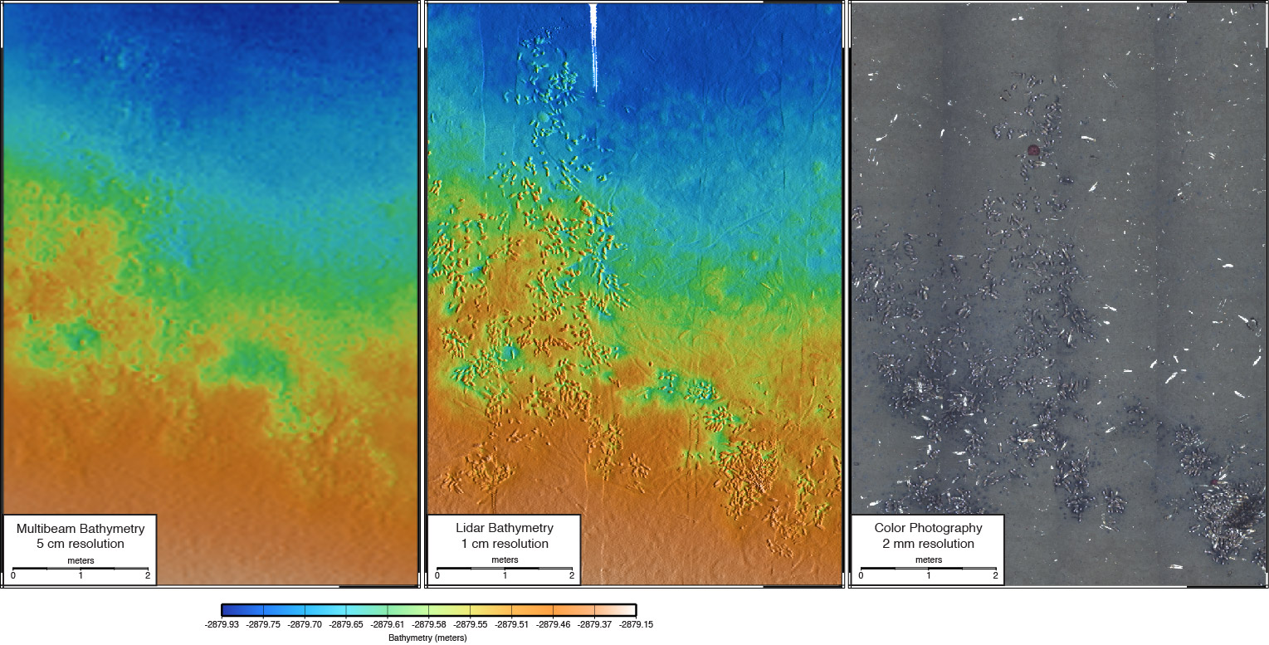

Slide 14
Repeat Mapping
Conducting multiple surveys over practical periods of time with the goal of measuring change.
Impresses requirement for highly accurate, self consistent maps that can be colocated.

Slide 15
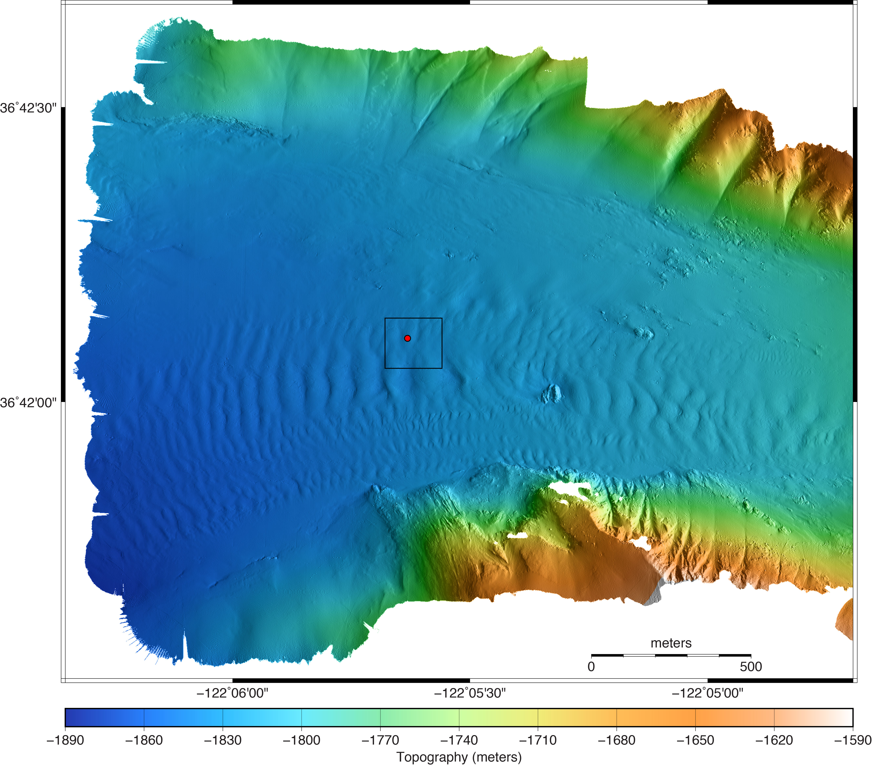
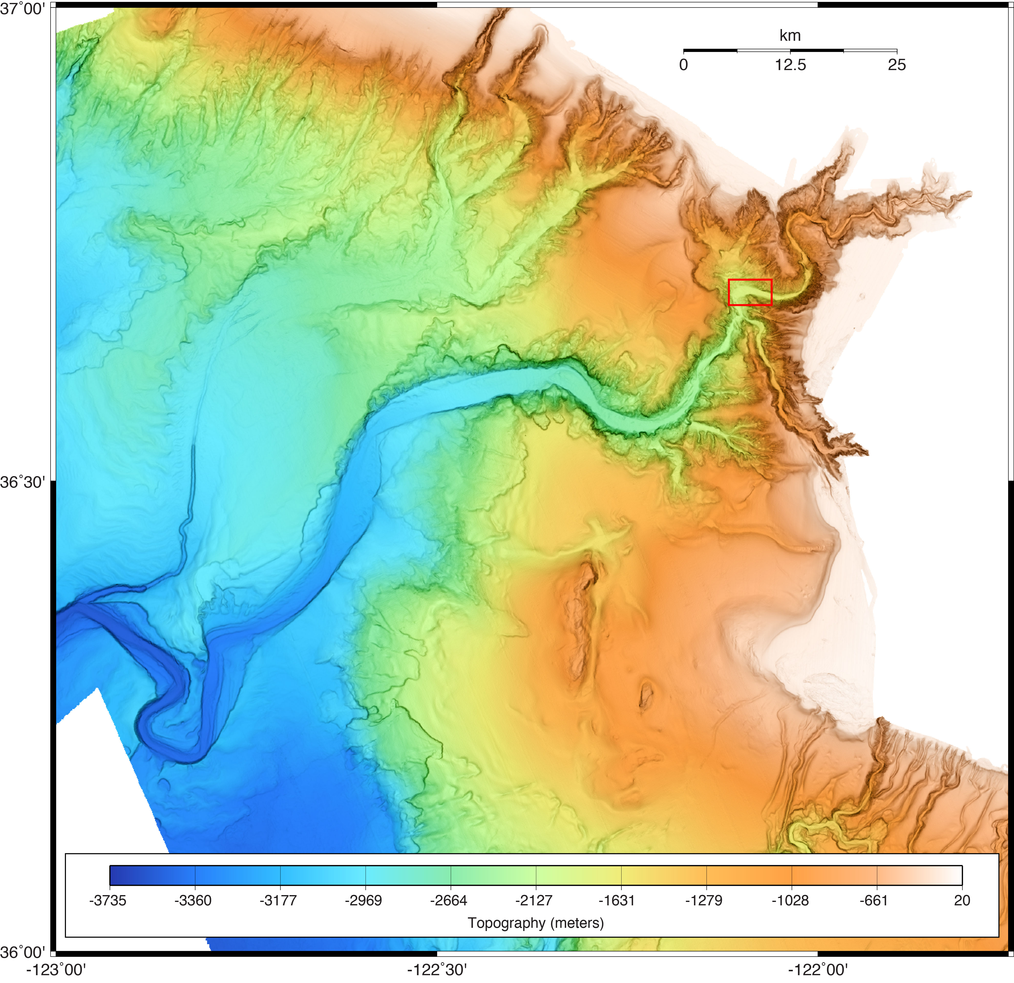
Coordinated Canyon Experiment Site

Slide 16
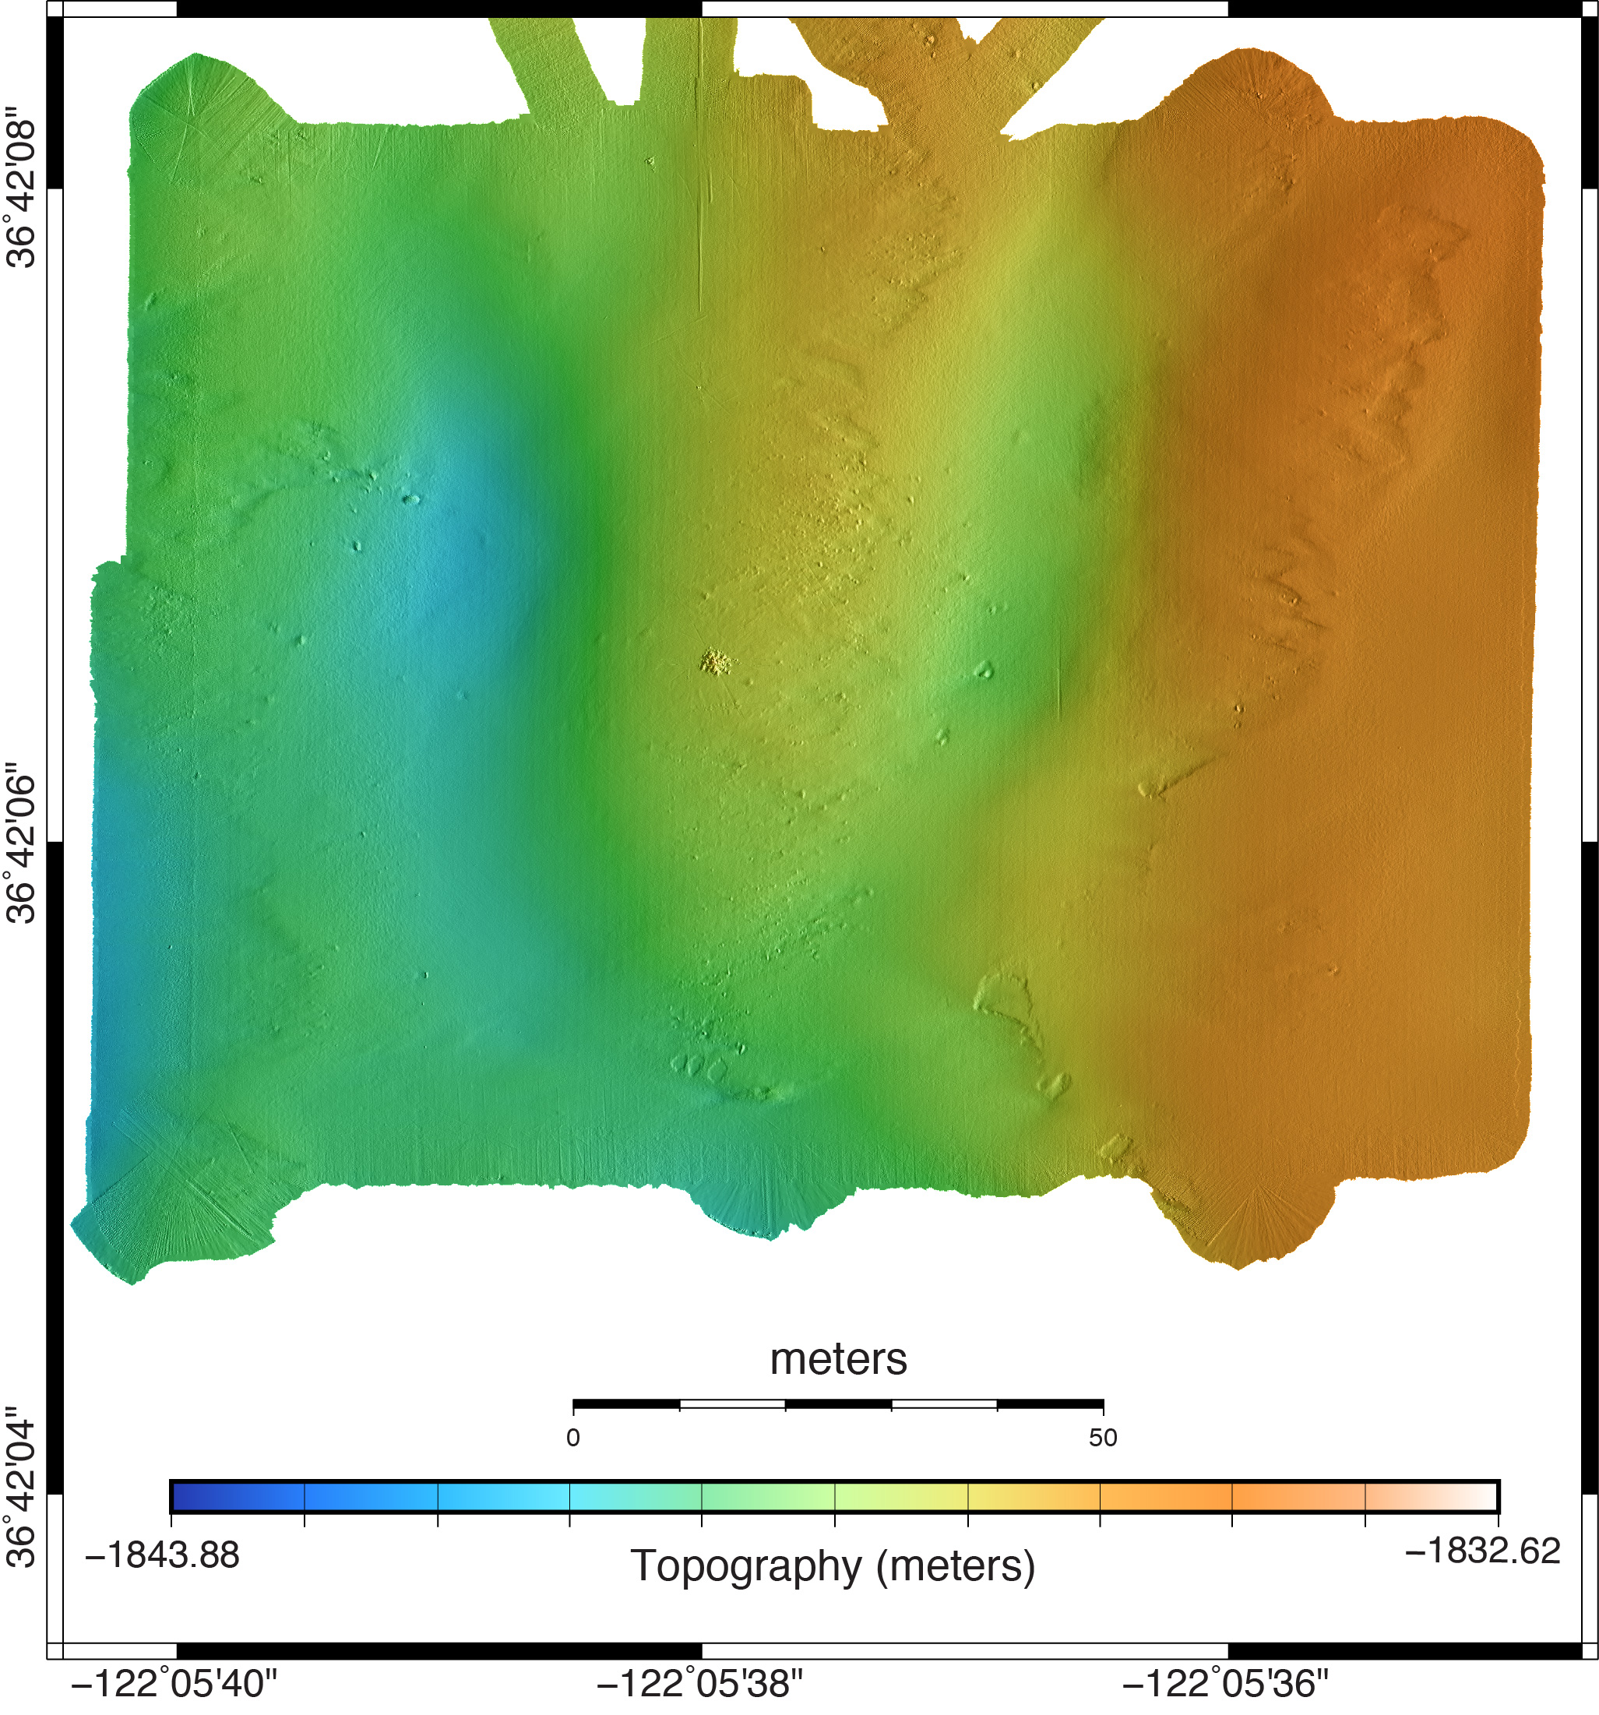

Slide 17
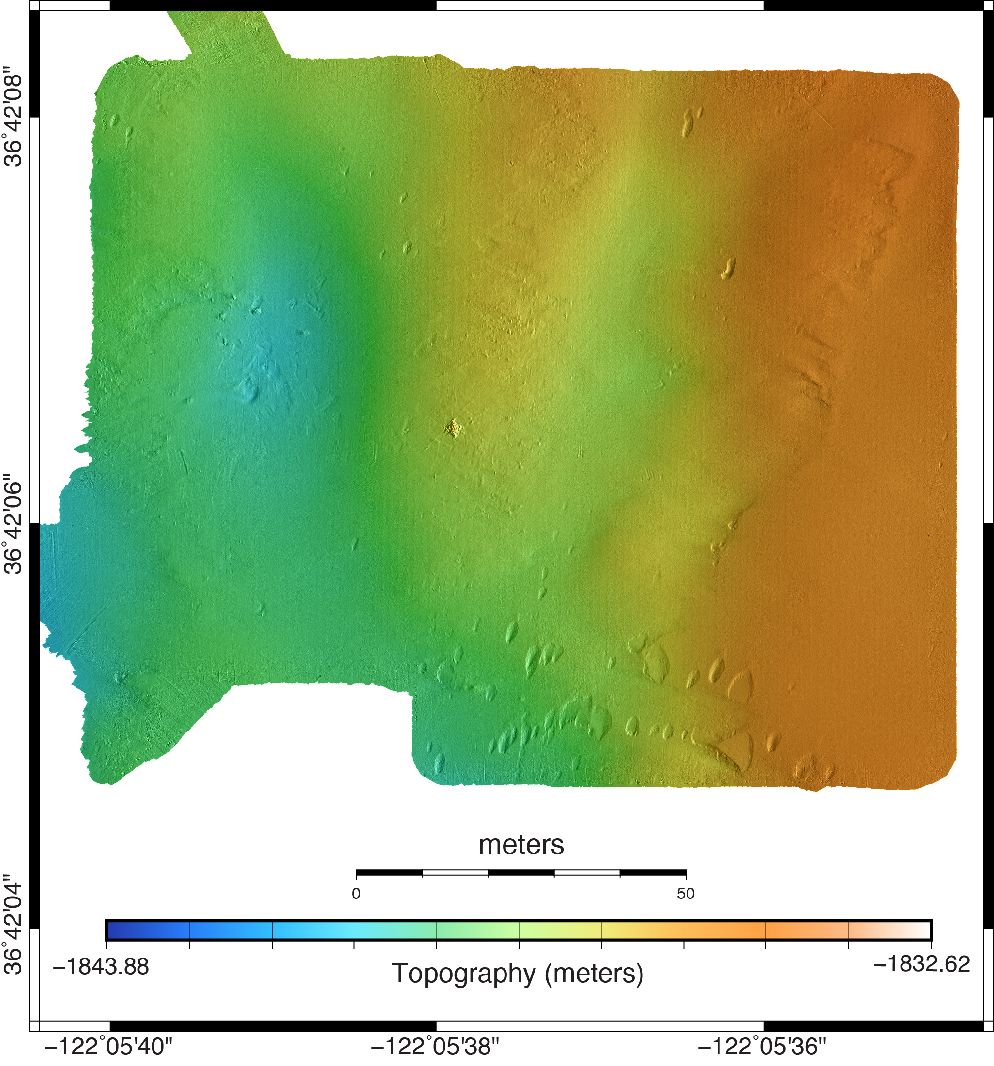

Slide 18
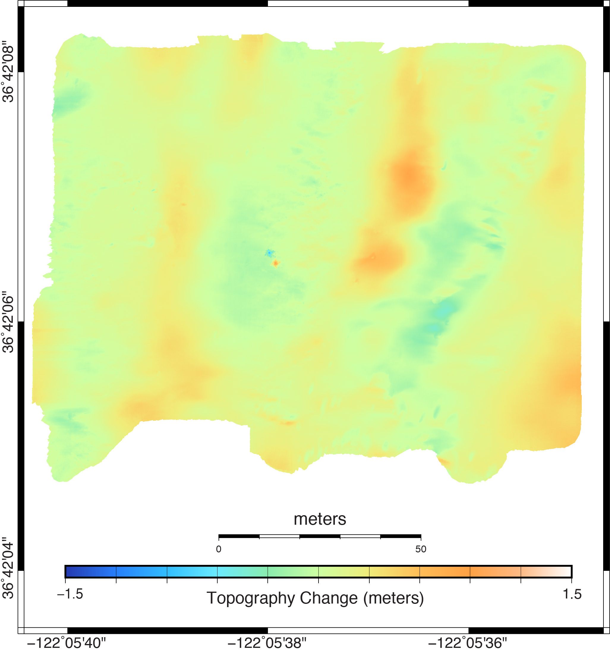

Slide 19
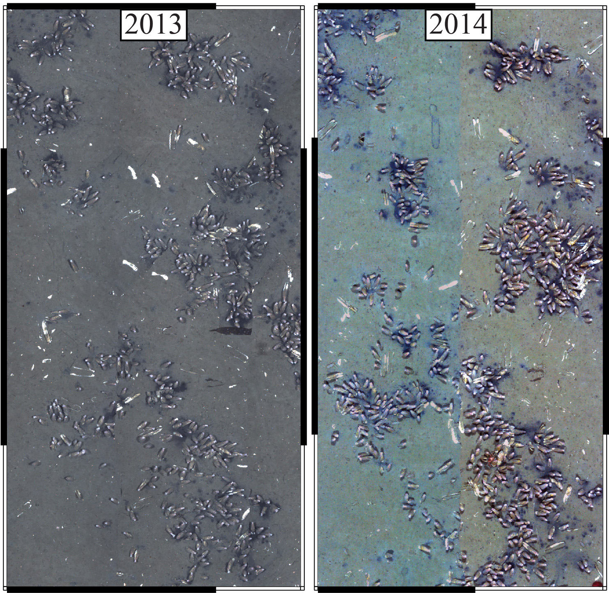
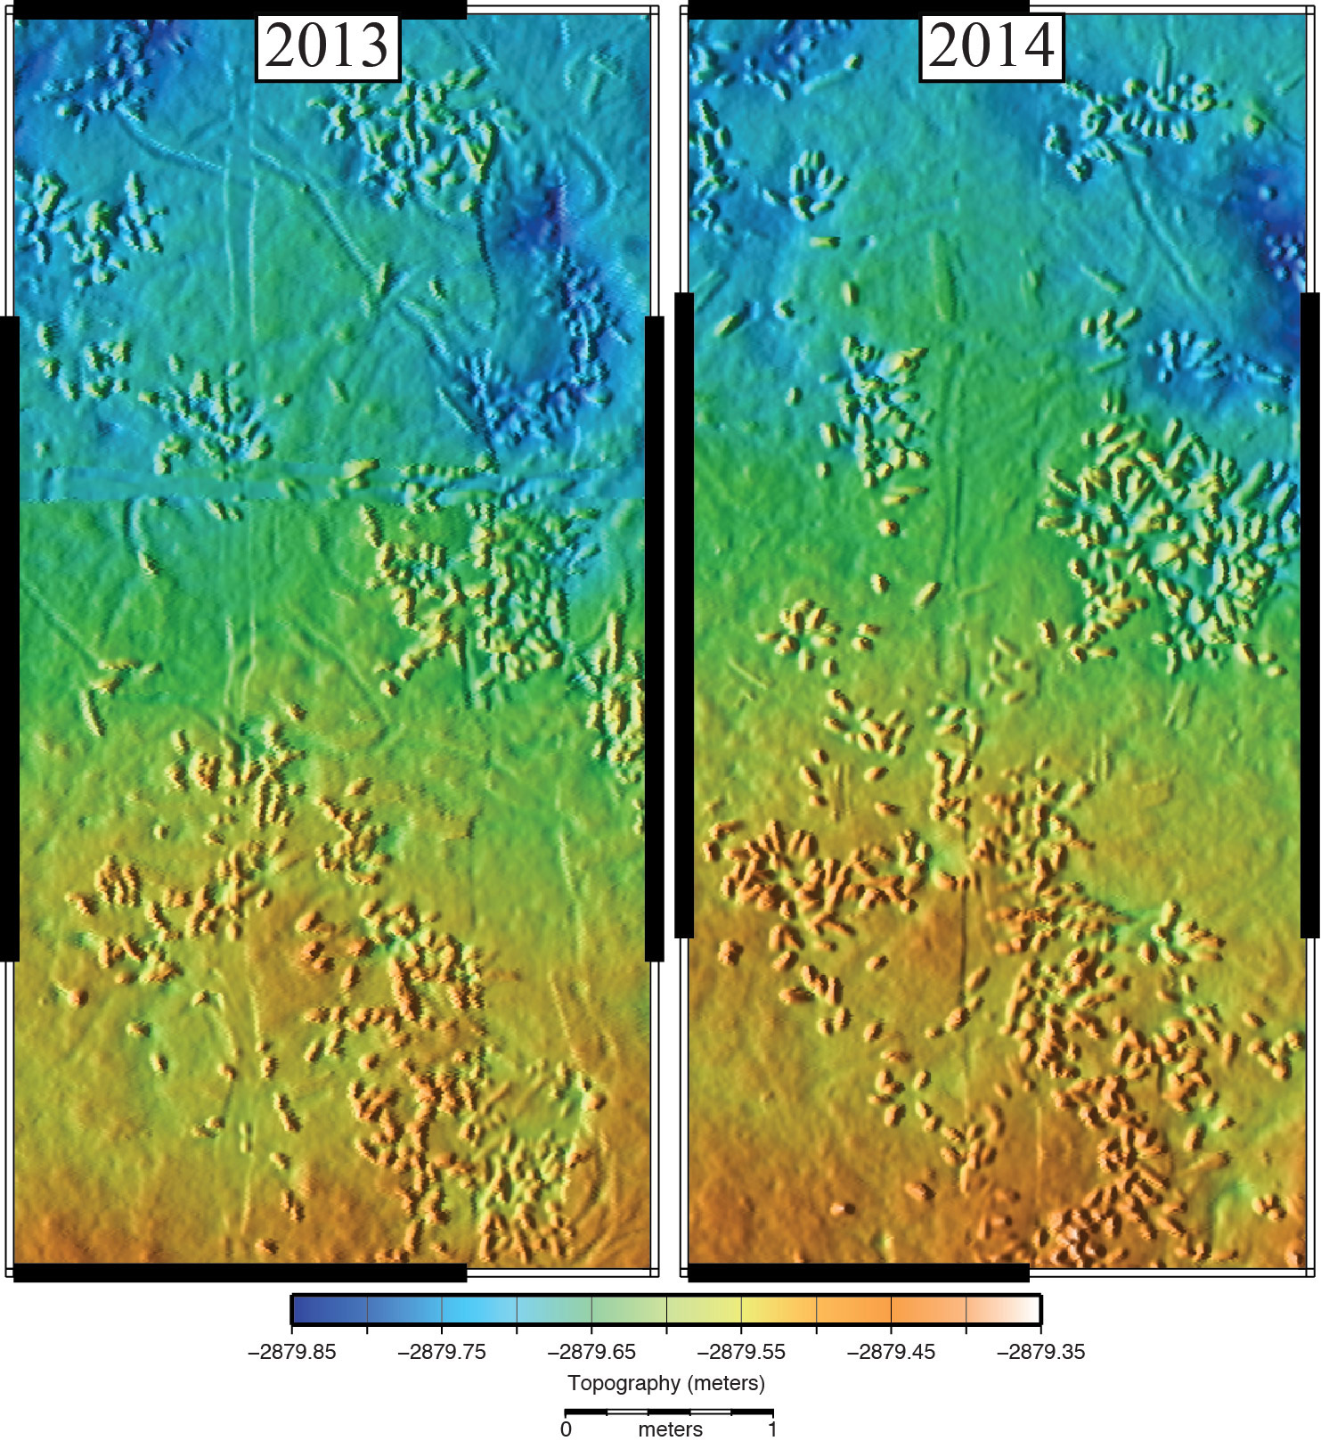
??

Slide 20
Benthic Organism Detection
Another application comparing two datasets
Instead of looking for change in time, look for change within simultaneously collected data sets
Many organisms are acoustically transparent, thus compare lidar to sonar data
Photography provides immediate ground truthing

Slide 21

Sur Ridge

Slide 22
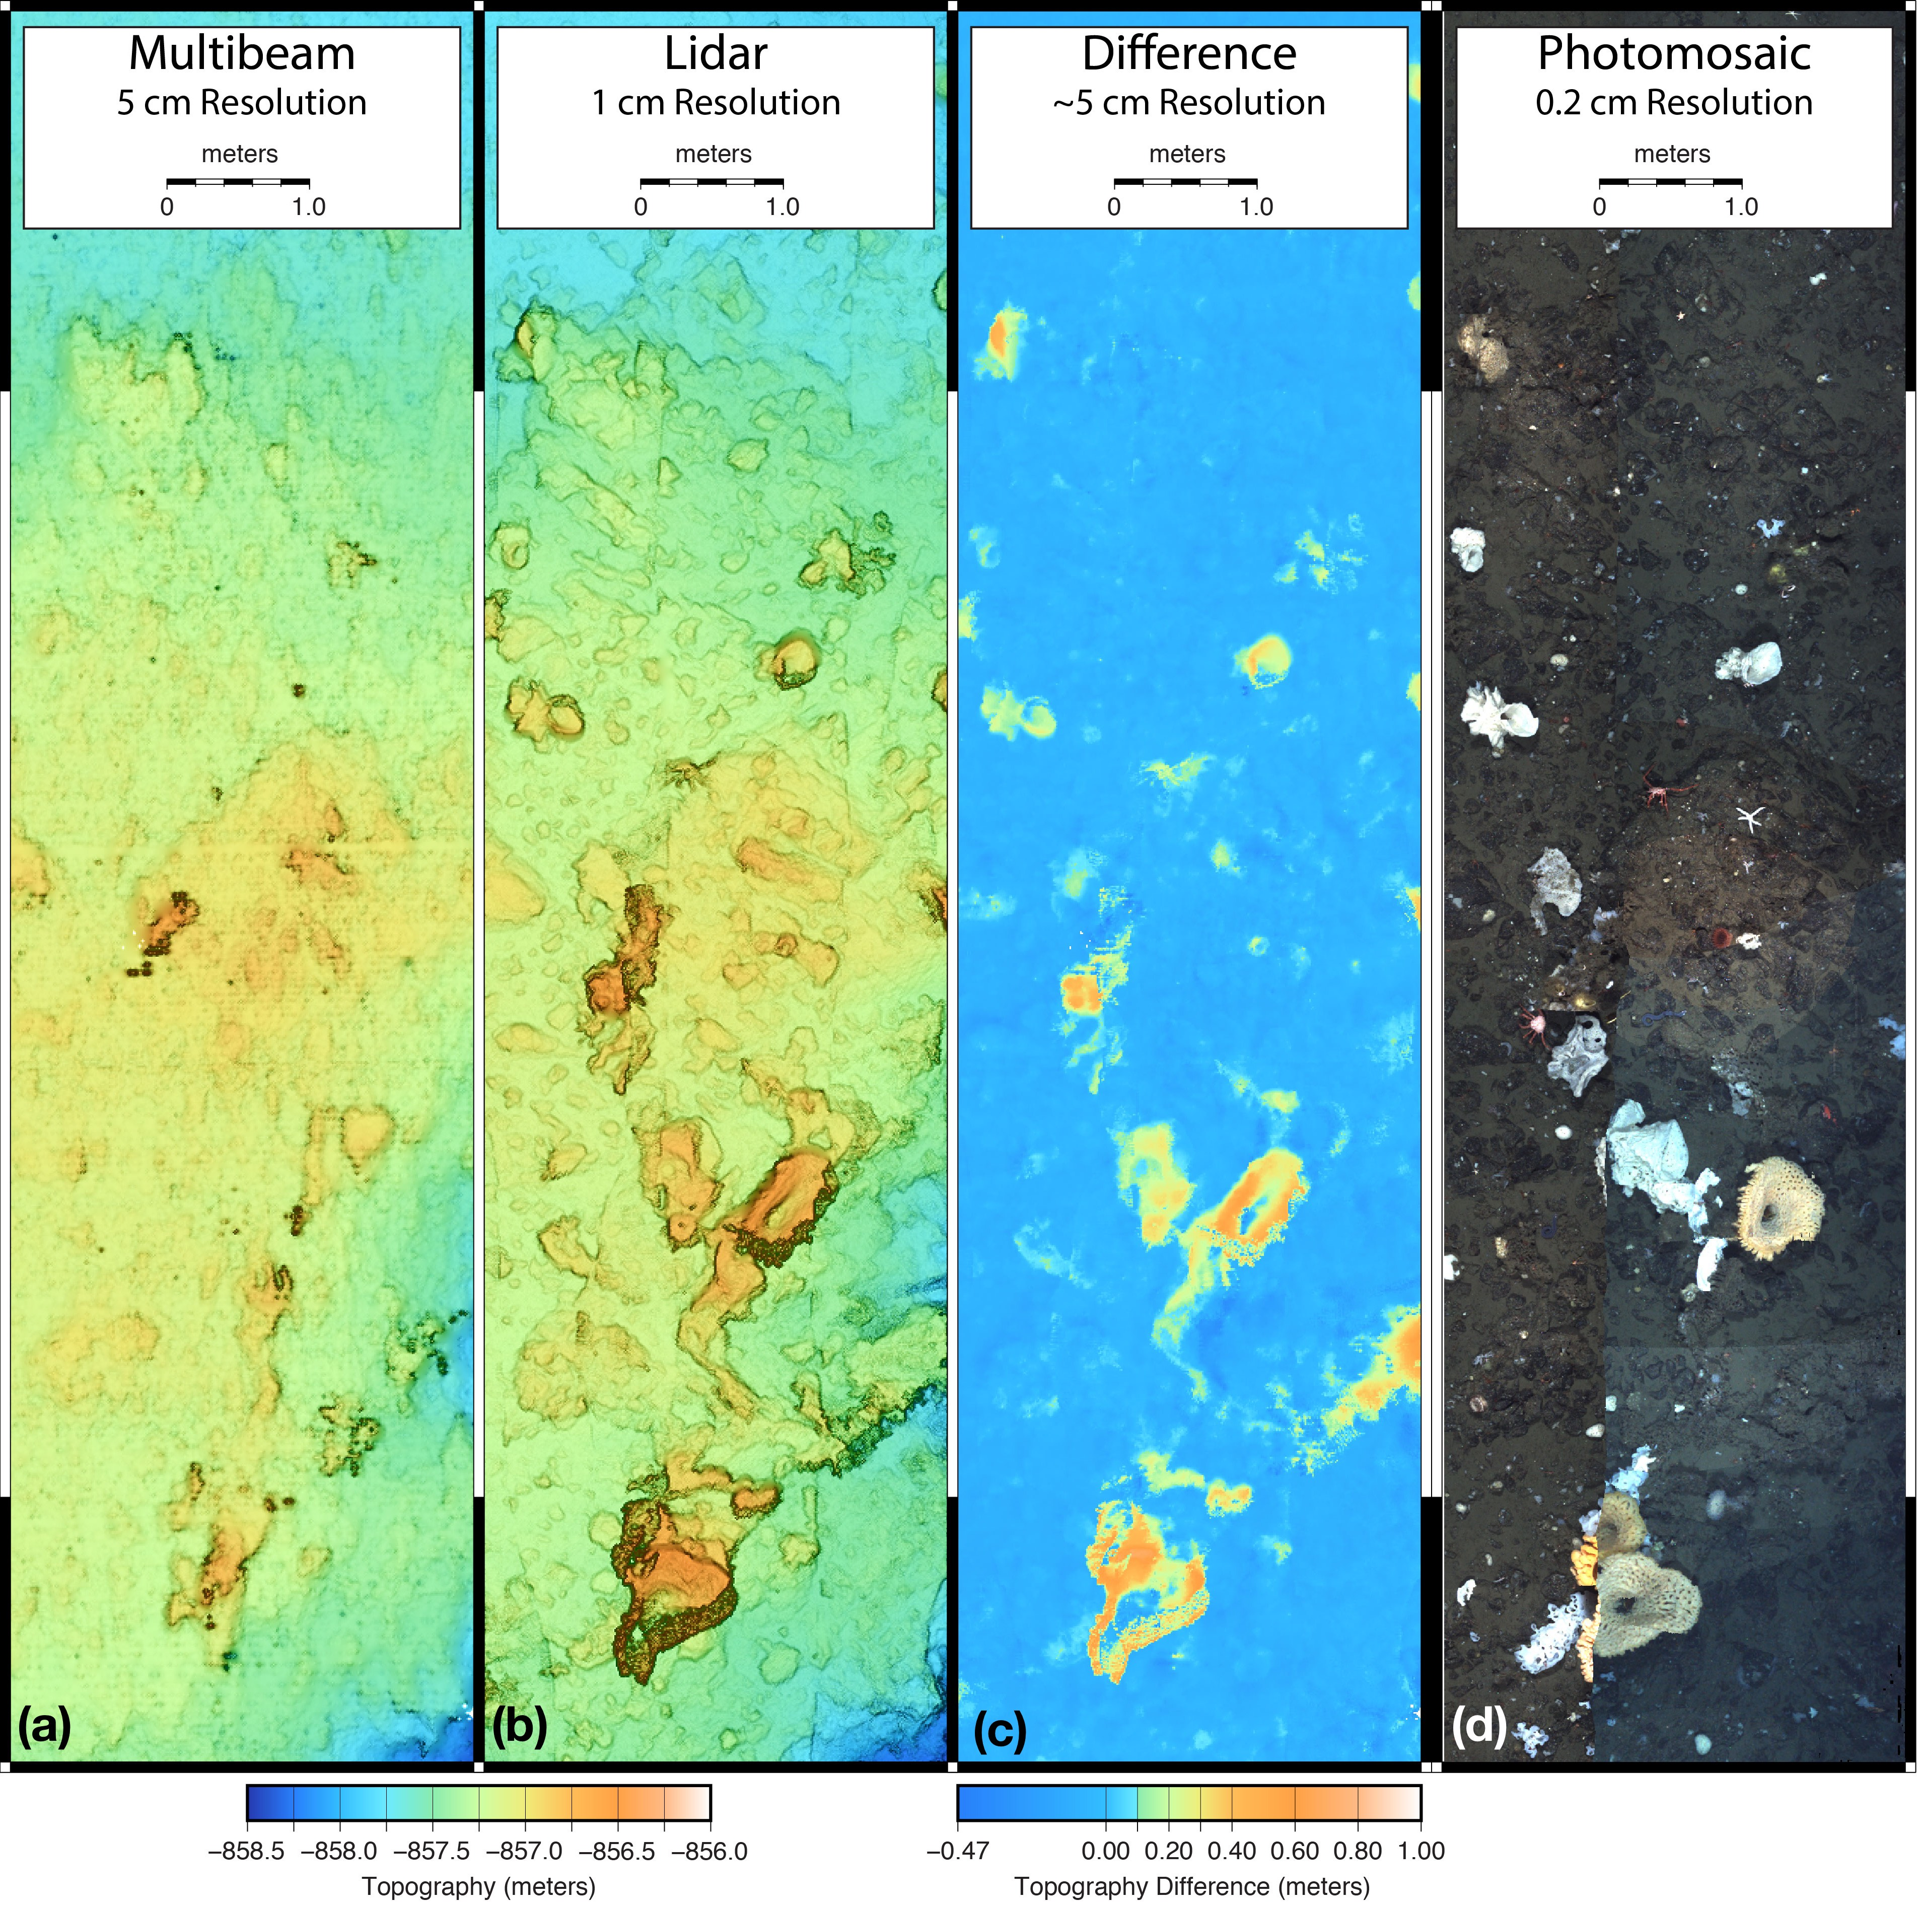

Slide 23
Conclusions
Individual systems enable high detail collection for targeted areas.
Comparisons of data yield signficant results for both geological and biological applications.
This survey domain is worthwhile, and can enable studies of long term change over practical time periods.

Slide 24
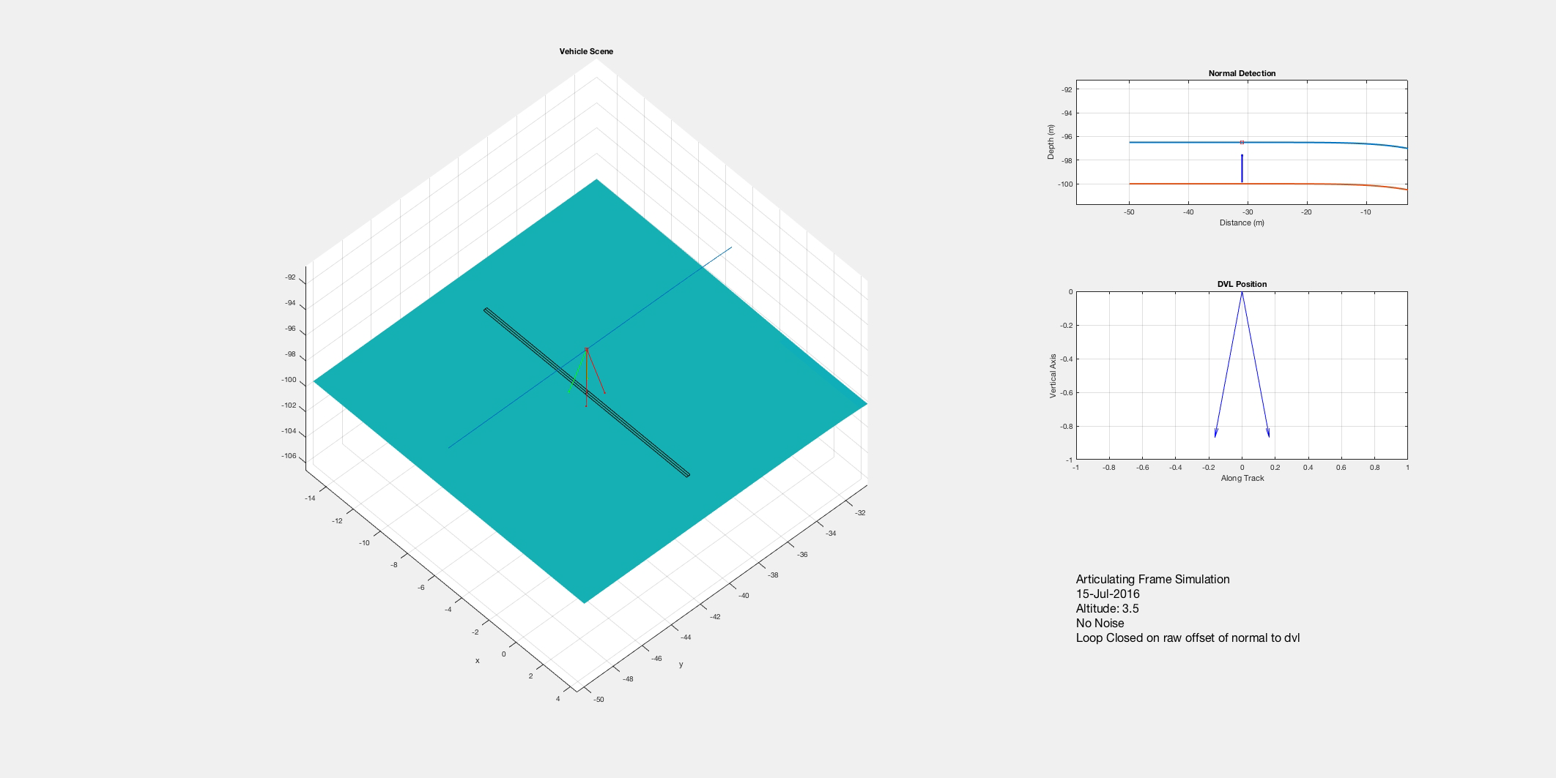
Future Direction: Articulated Frame Concept

