Slide 1

Camera Evaluation Review
Tuesday May 24 2016

Slide 2
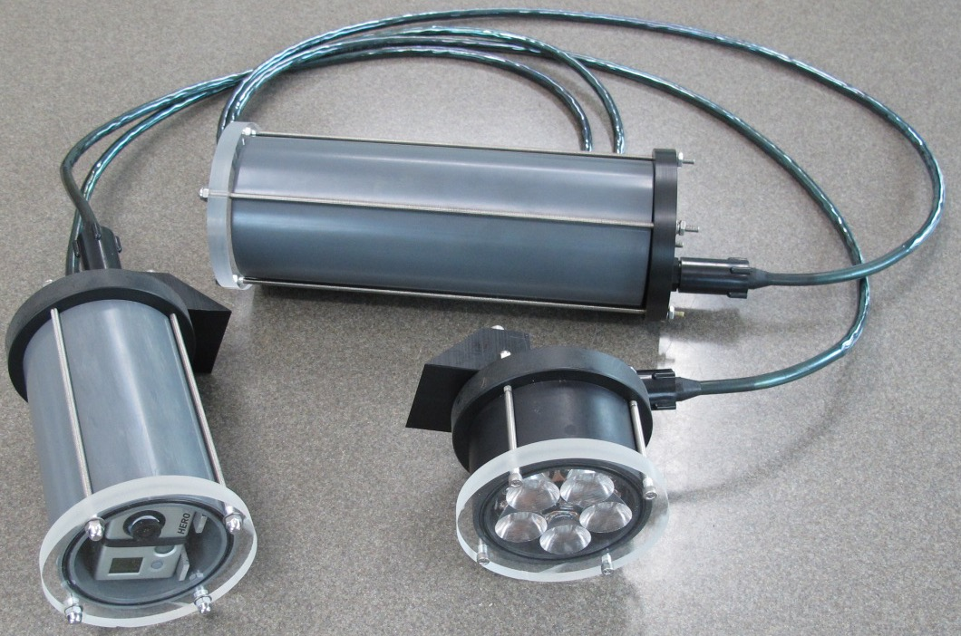
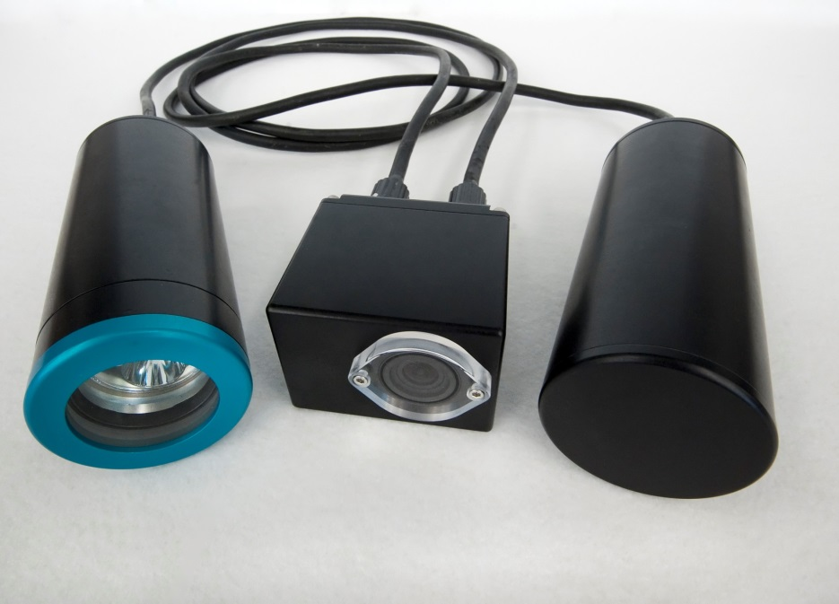
Previous SeeStar Versions
SeeStar I
SeeStar II
Open source documentation for both available on our repository:
https://bitbucket.org/mbari/seestar

Slide 3
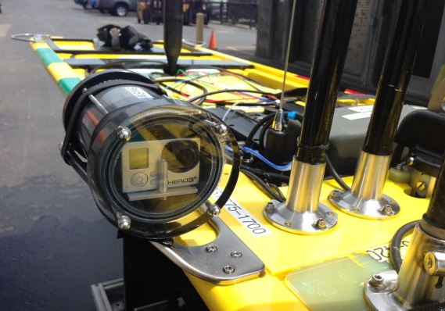
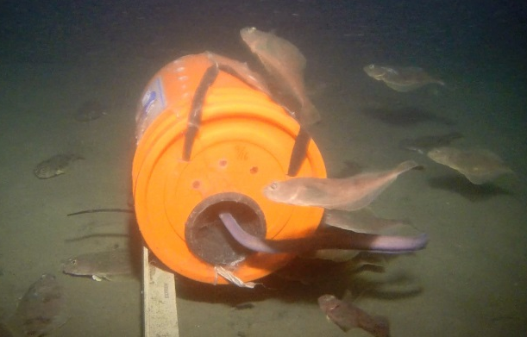
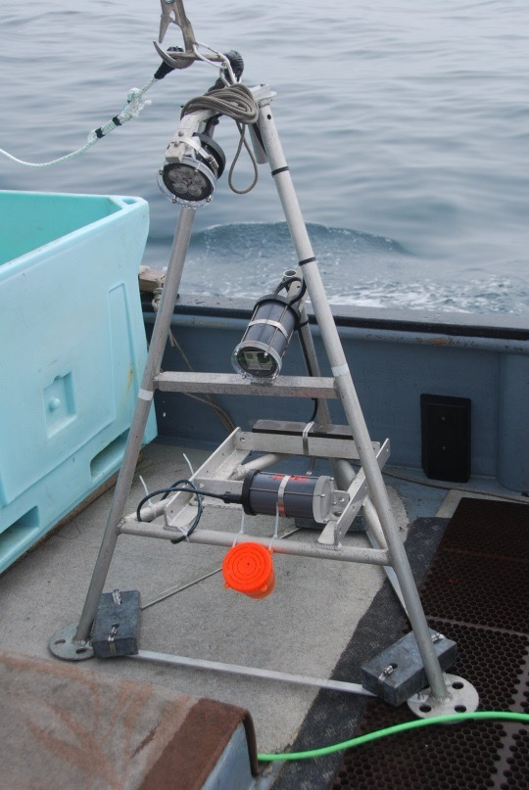
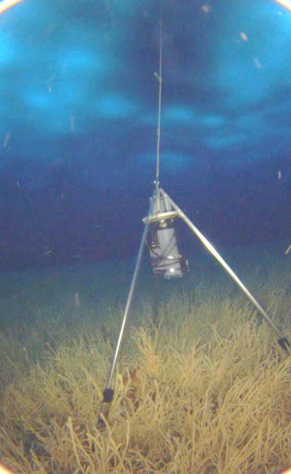

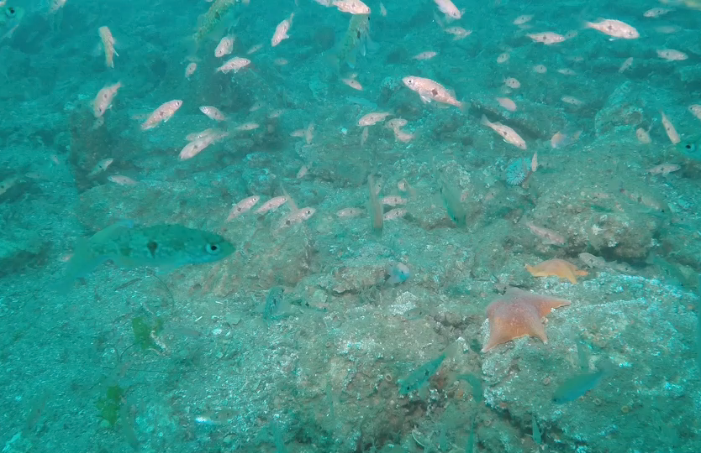
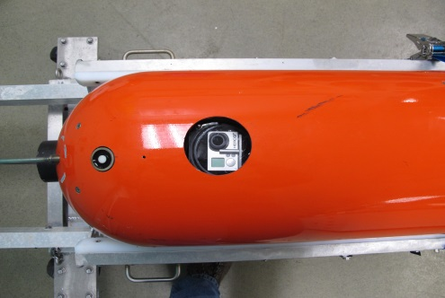
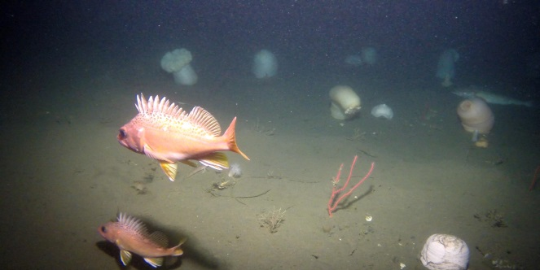
SeeStar Users and Use Cases
Some Users
LRAUV (MBARI)
Waveglider (MBARI)
Steve Haddock (MBARI)
The Nature Conservancy
Stacy Kim (MLML)
California Fish & Wildlife
CA Wetfish Producers Assn.

Slide 4
SeeStar III Camera Requirements
General / Physical
Connectivity / Storage
Ability to take stills and video
Full manual control
Small physical size
Low power consumption
Low cost (<$1500)
Long term availability
Ability to interface via hardware (remote controllable)
SDK/API available
Internal recording of stills and video
HDMI out (Live feed option)

Slide 5
SeeStar III Camera Requirements
Imaging (Stills)
Video
Manual focus
Ability to resolve 1cm sized targets
5MP minimum
External flash available
1920x1080p at 60FPS
4K 30FPS (optional)

Slide 6
List of Candidate Cameras
1 - GoPro Hero 3+
2 - Z Camera E1
3 - Blackmagic Design Micro Cinema Camera
4 - Sony DSC-RX10 II
5 - Sony UMC-S3C

Slide 7
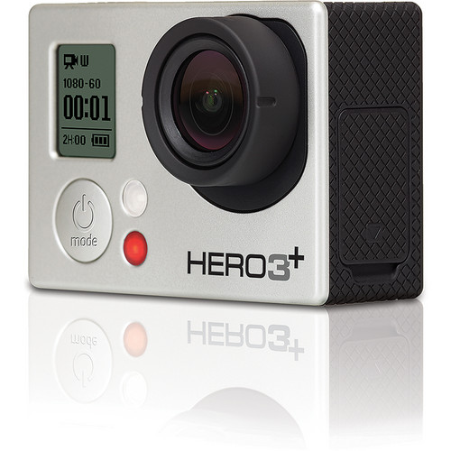
GoPro Hero 3+
Used on SeeStar 2
Lens not interchangeable, very wide angle
Poor low light performance
Capable of HD 1920x1080p recording at 60FPS
Sensor size: 1/2.3
10MP stills
No manual control of exposure settings (all automatic)
No LCD display
Size 2.3”x1.6”x1.1”
Cost $200 - $400
https://gopro.com/update/hero3_plus

Slide 8
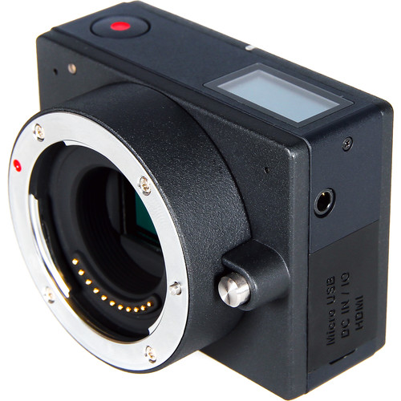
Z Camera E1
Micro 4/3 sensor and lens mount
Max ISO 25600
4K recording at 24FPS
1920x1080p at 60FPS
16MP stills
Sensor size: Micro Four Thirds (CMOS)
Full control of camera settings…
LCD display
Size 3” x 2.2” x 2”
Designed and manufacturer by new Chinese company
Cost $700
http://z-cam.com/

Slide 9
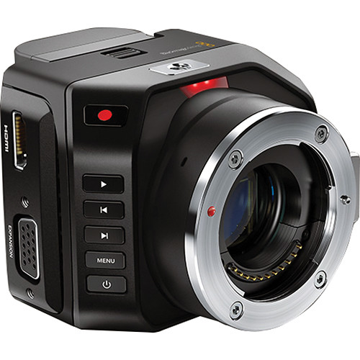
Blackmagic Design Micro Cinema Camera
Super 16mm-size sensor
4/3 lens mount
1920x1080p 60FPS recording
Sensor size: 12.48mm x 7.02mm (Super 16)
No stills
Controlled via extension port using LANC or S.Bus, or PWM.
No LCD display, no settings display
Size 3.25” x 2.74” x 2.52”
Cost $1000
https://www.blackmagicdesign.com/products/blackmagicmicrocinemacamera

Slide 10
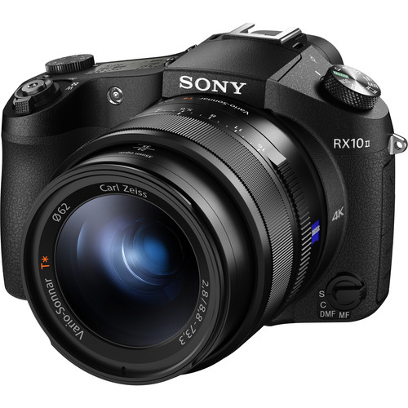
Sony DSC-RX10 II
20 MP 1” CMOS sensor
Zeiss 24-200mm lens, f/2.8
4K recording at 30FPS
1920x1080p at 60FPS
20MP stills
Sensor size: 1”
Up to 25600 ISO
Controlled via multi terminal, including micro USB compatible devices, remote controls or compatible software.
3” LCD display
Size 5.1” x 3.5” x 4.0”
Cost $1200
http://www.sony.com/electronics/cyber-shot-compact-cameras/dsc-rx10m2

Slide 11
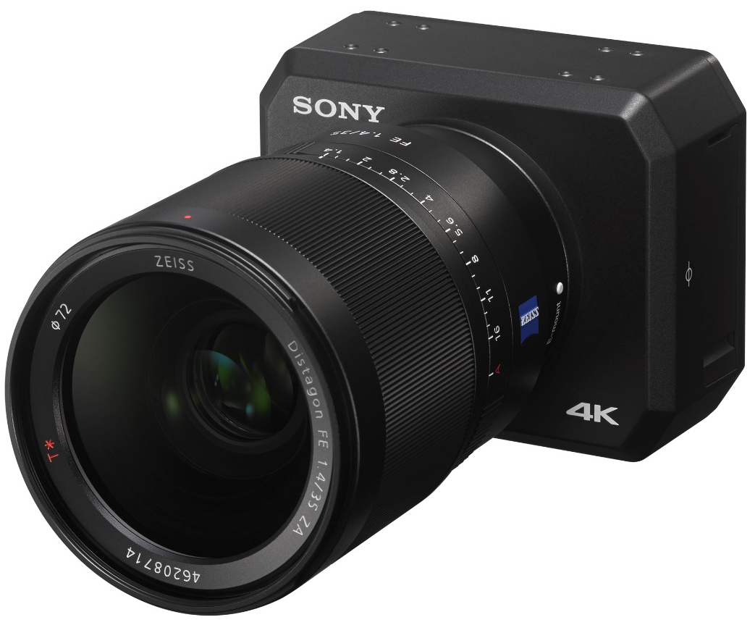
Sony UMC-S3C
Announced April 2016 at NAB.
To be released in August 2016.
Sensor size: Full frame 35mm (same sensor as A7S)
E-mount for interchangeable lenses
4K recording at 30FPS
12MP stills
Up to 409600 ISO
Controlled via multi terminal, including micro USB compatible devices, remote controls or compatible software.
No LCD display
Weight 400g (size appears to be similar to blackmagic).
Cost unknown
http://www.newsshooter.com/2016/04/05/sony-announce-full-frame-e-mount-4k-action-cam/

Slide 12
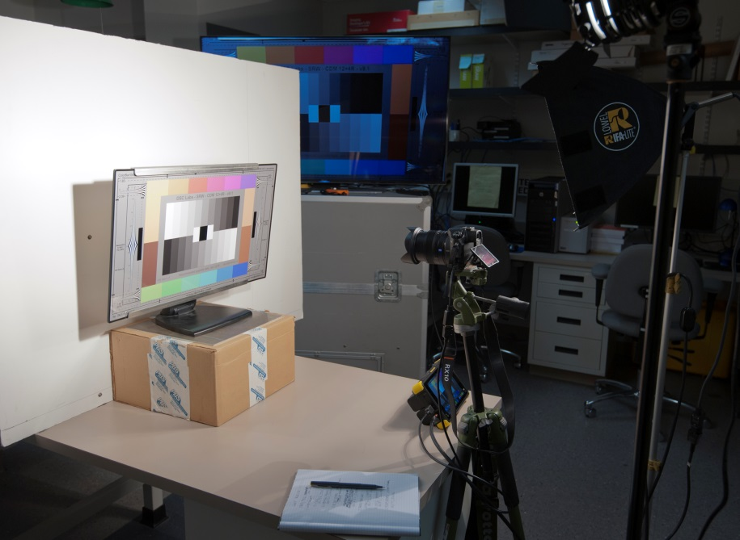
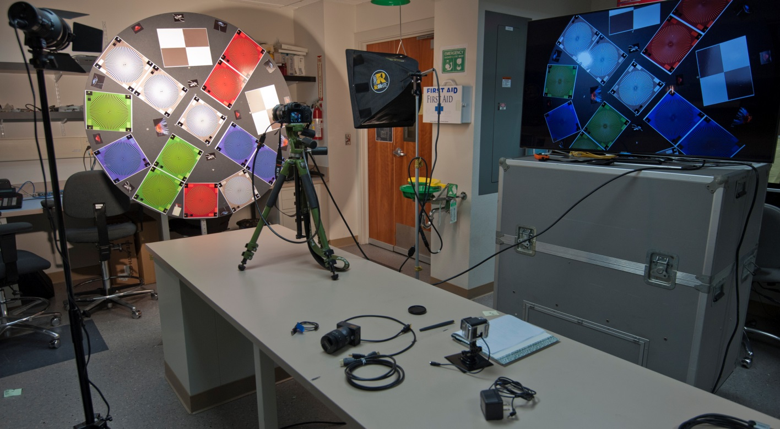
Testing Configurations

