Slide 1
Plankton Imager Lighting Options

Slide 2
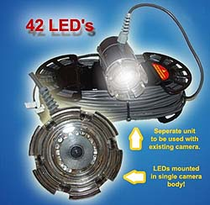
SeaViewer Sea-Light
xx lumens
1000 feet
12V / xxmA
$190

Slide 3
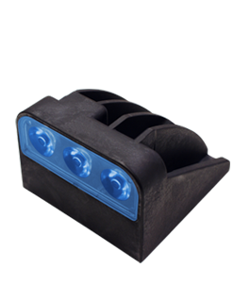
Aqualuma - TrimTab
xx lumens
1300 feet
12V/500mA
$300

Slide 4
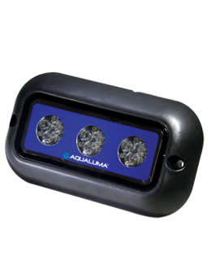
Aqualuma – FF9
xx lumens
12V / 1.4A
1300 feet
$500

Slide 5
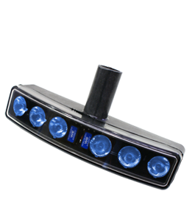
Aqualuma - Marina
xx lumens
1300 feet
12V/1.3A
$700

Slide 6
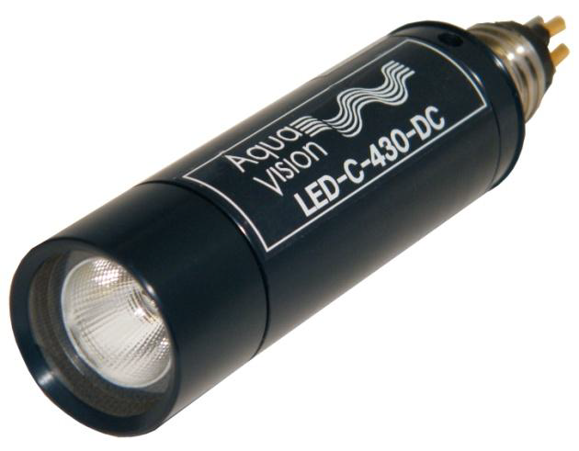
Bowtech UK – LED-C
430 lumens
24Vdc/350mA
300m
$723

Slide 7
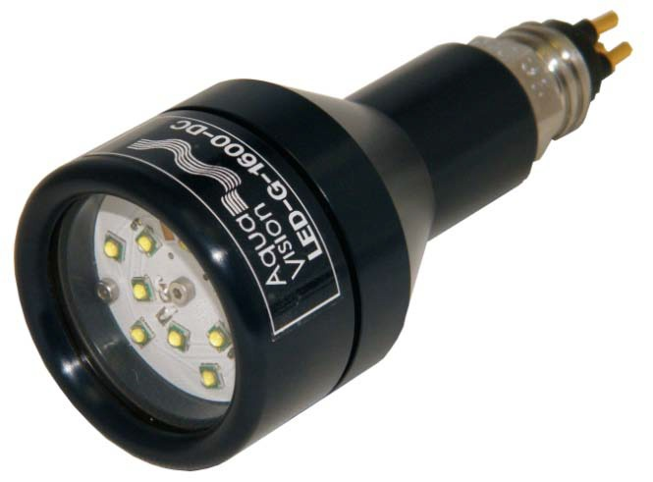
BowTech UK – LED-G
800, 1000, 1600 lumens
24Vdc/350, 450, 700mA
300m
$650

Slide 8
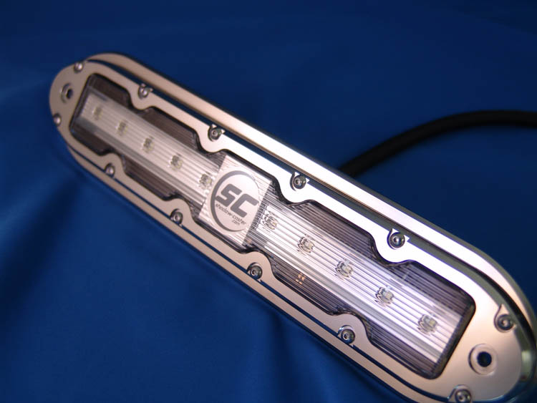
ShadowCaster – SCM-10 (XPR)
2500 lumens
12Vdc/3.5A
? Depth (Potted)
$599

Slide 9
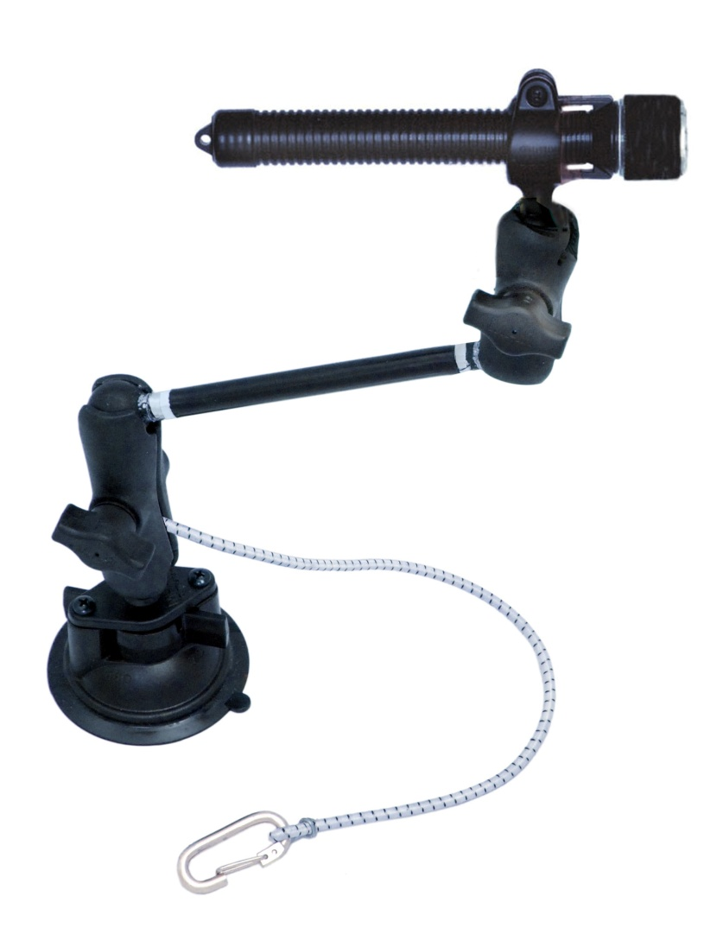
Kayalu – NavBeam XL
38 lumens
300m
3AA (4.5Vdc)
$120

Slide 10
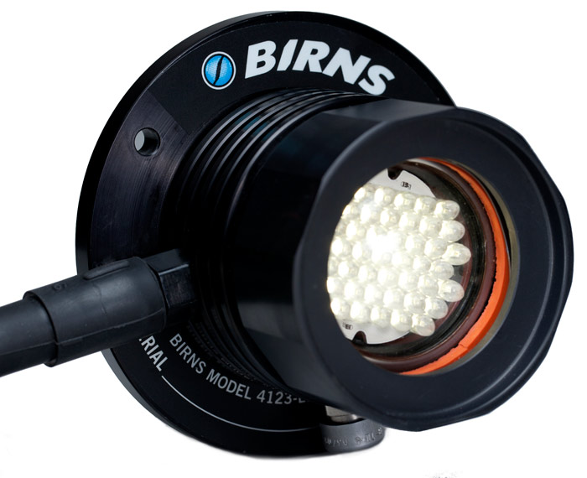
Birns – Model 4123
117 lumens
12-24Vdc/0.33, 0.66mA
300m
$??

