Slide 1
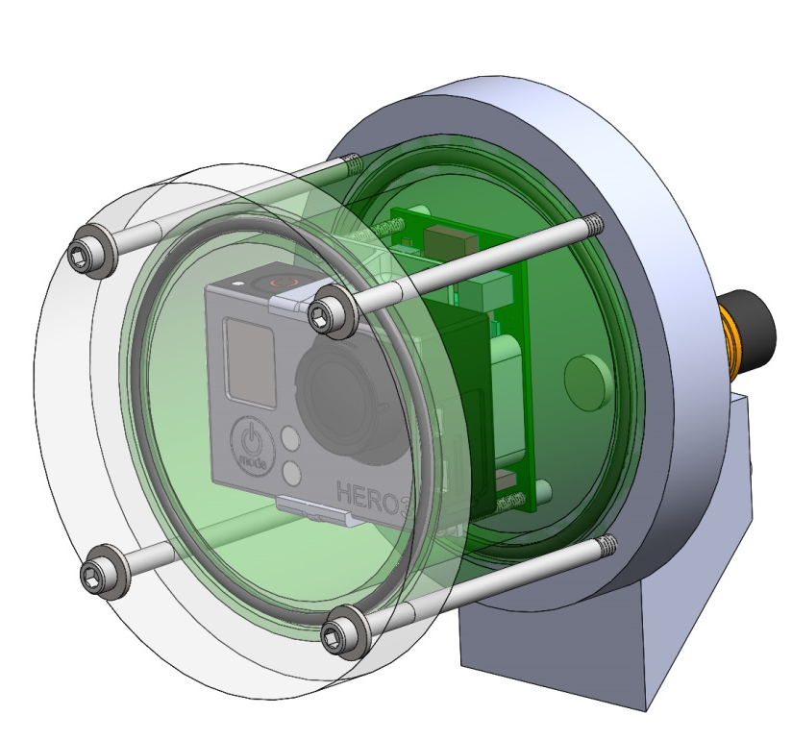
Shallow seestar camera
- New 3d printed chassis
Shorter housing
Should be ready for maker faire

Slide 2
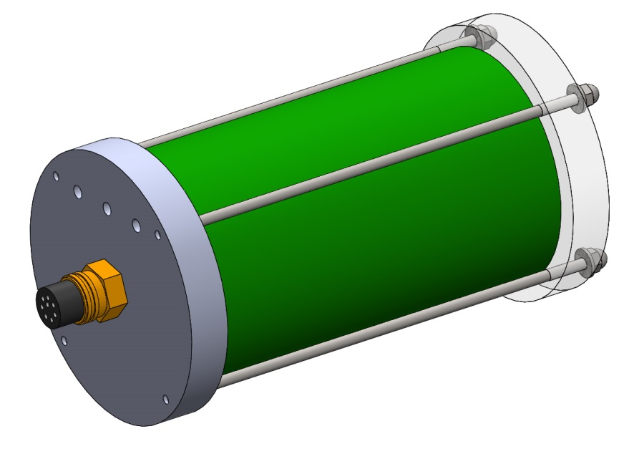
Shallow Seestar Battery module
Same design
New battery pack
Modify existing battery pack for maker faire

Slide 3
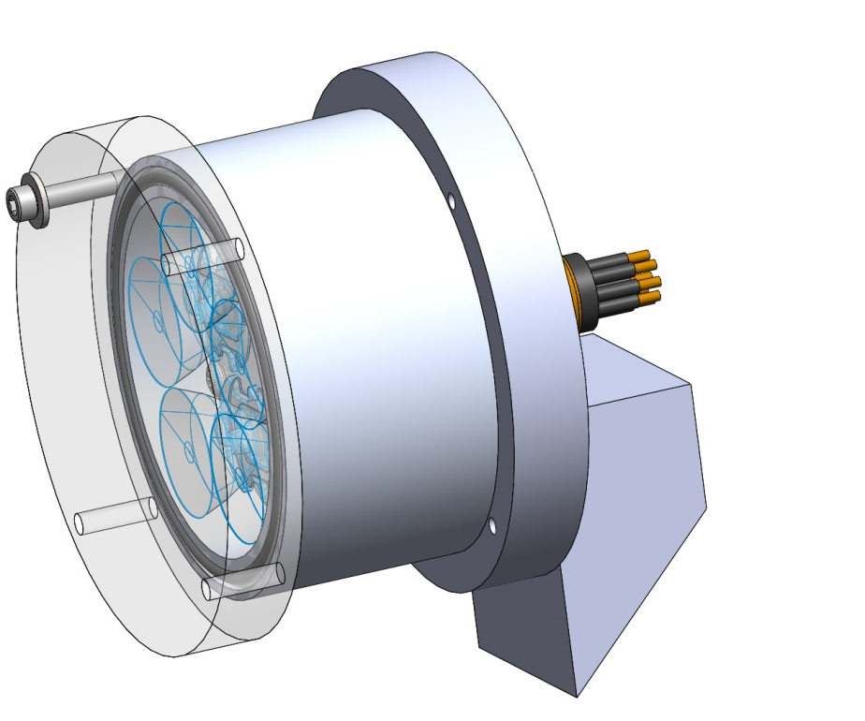
Shallow Seestar Light module
- Old LED housing will be displayed at maker faire.
- For long term solution, evaluate the possibility of using a PVC housing with
the new LED light

Slide 4
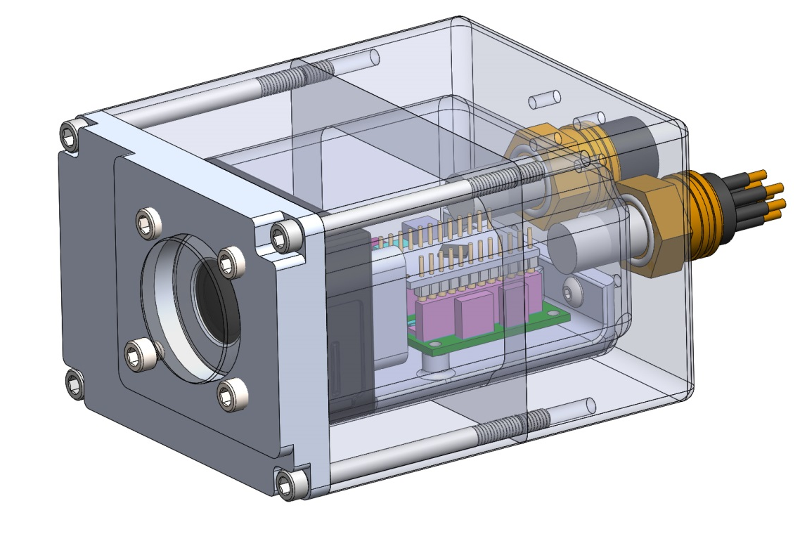
Deep seestar camera –
Temporary version for Maker Faire
-groupb housing with extension.
- New 3d printed chassis

Slide 5
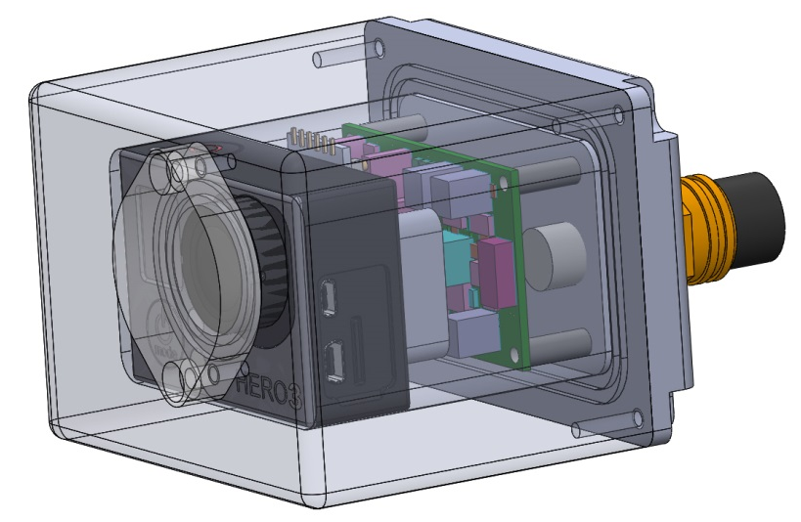
Deep seestar camera –
Final version

Slide 6
Deep Seestar Battery module
Group B’s GPH modified:
-1” longer than standard version
-connector on end cap
-2 metal endcap
-new battery pack
- For maker faire?

Slide 7
Deep Seestar light module
GroupB’s BPH, with modified LED light.
For maker faire?

