Slide 1
SCPI Concept Review
Camera and Light Configuration, Light Design, Camera Requirements, Energy Budget, Housing Design
Mark Chaffey

Slide 2
Topics Covered
Camera and Light Configuration
  Minimizing common volume scattering
  View and lighting angles to image required target
  Configurations with different reflectors
  Configurations with flat plate dome (angle <60deg)
  Configurations with dome port (angle >60deg)
Light design
  How much light is needed on target?
  Can LED’s provide enough? (yes if imaging area is small enough and camera produces a good image at higher ISO #’s)
  LED light and reflector arrangements
  LED driver circuits
  LED power dissipation
  LED efficiency vs. strobe
Camera requirements based on light design and configuration
  Good image at ISO 800 and fast lens (f2.8-f4).
  Ability to control aperture and shutter speed.
  Flash synchronization would be nice..
  Focal length with 1/2.3” (GoPro) imager = ?
  Focal length with larger Imager = ?
  Prime lens?
Energy budget
  Lights vs. camera usage.
  How many batteries for x images.
  Battery housing size.
Housing design

Slide 3
Camera and Light Configuration
Minimizing common volume scattering
View and lighting angles to image required target
Configurations with different reflectors
Configurations with flat plate dome (angle <60deg)
Configurations with dome port (angle >60deg)

Slide 4
Light design
How much light is needed on target?
Can LED’s provide enough? (yes if imaging area is small enough and camera produces a good image at higher ISO #’s)
LED light and reflector arrangements
LED driver circuits
LED power dissipation
LED efficiency vs. strobe

Slide 5
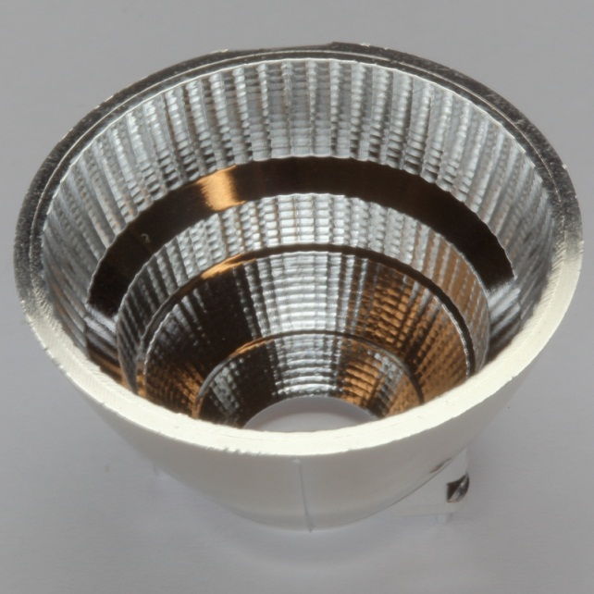
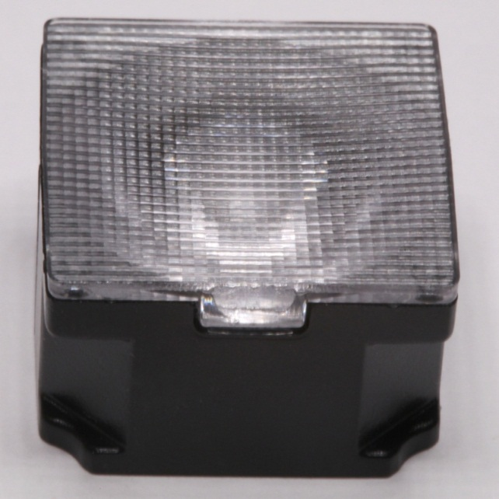
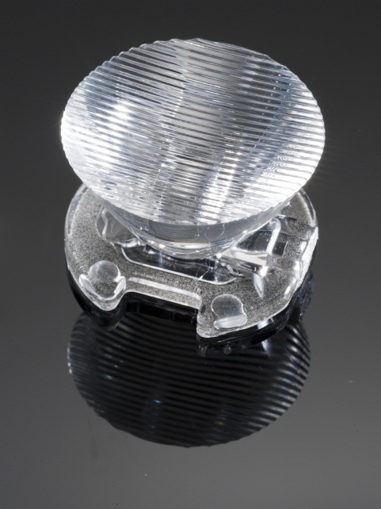
LED reflector examples
52 degree conical beam
43x20 degree oval beam
44x9 degree oval beam
For Cree Xlamp® MP-L series
For Cree Xlamp® MC-E series
For Xlamp® XR-E series

Slide 6
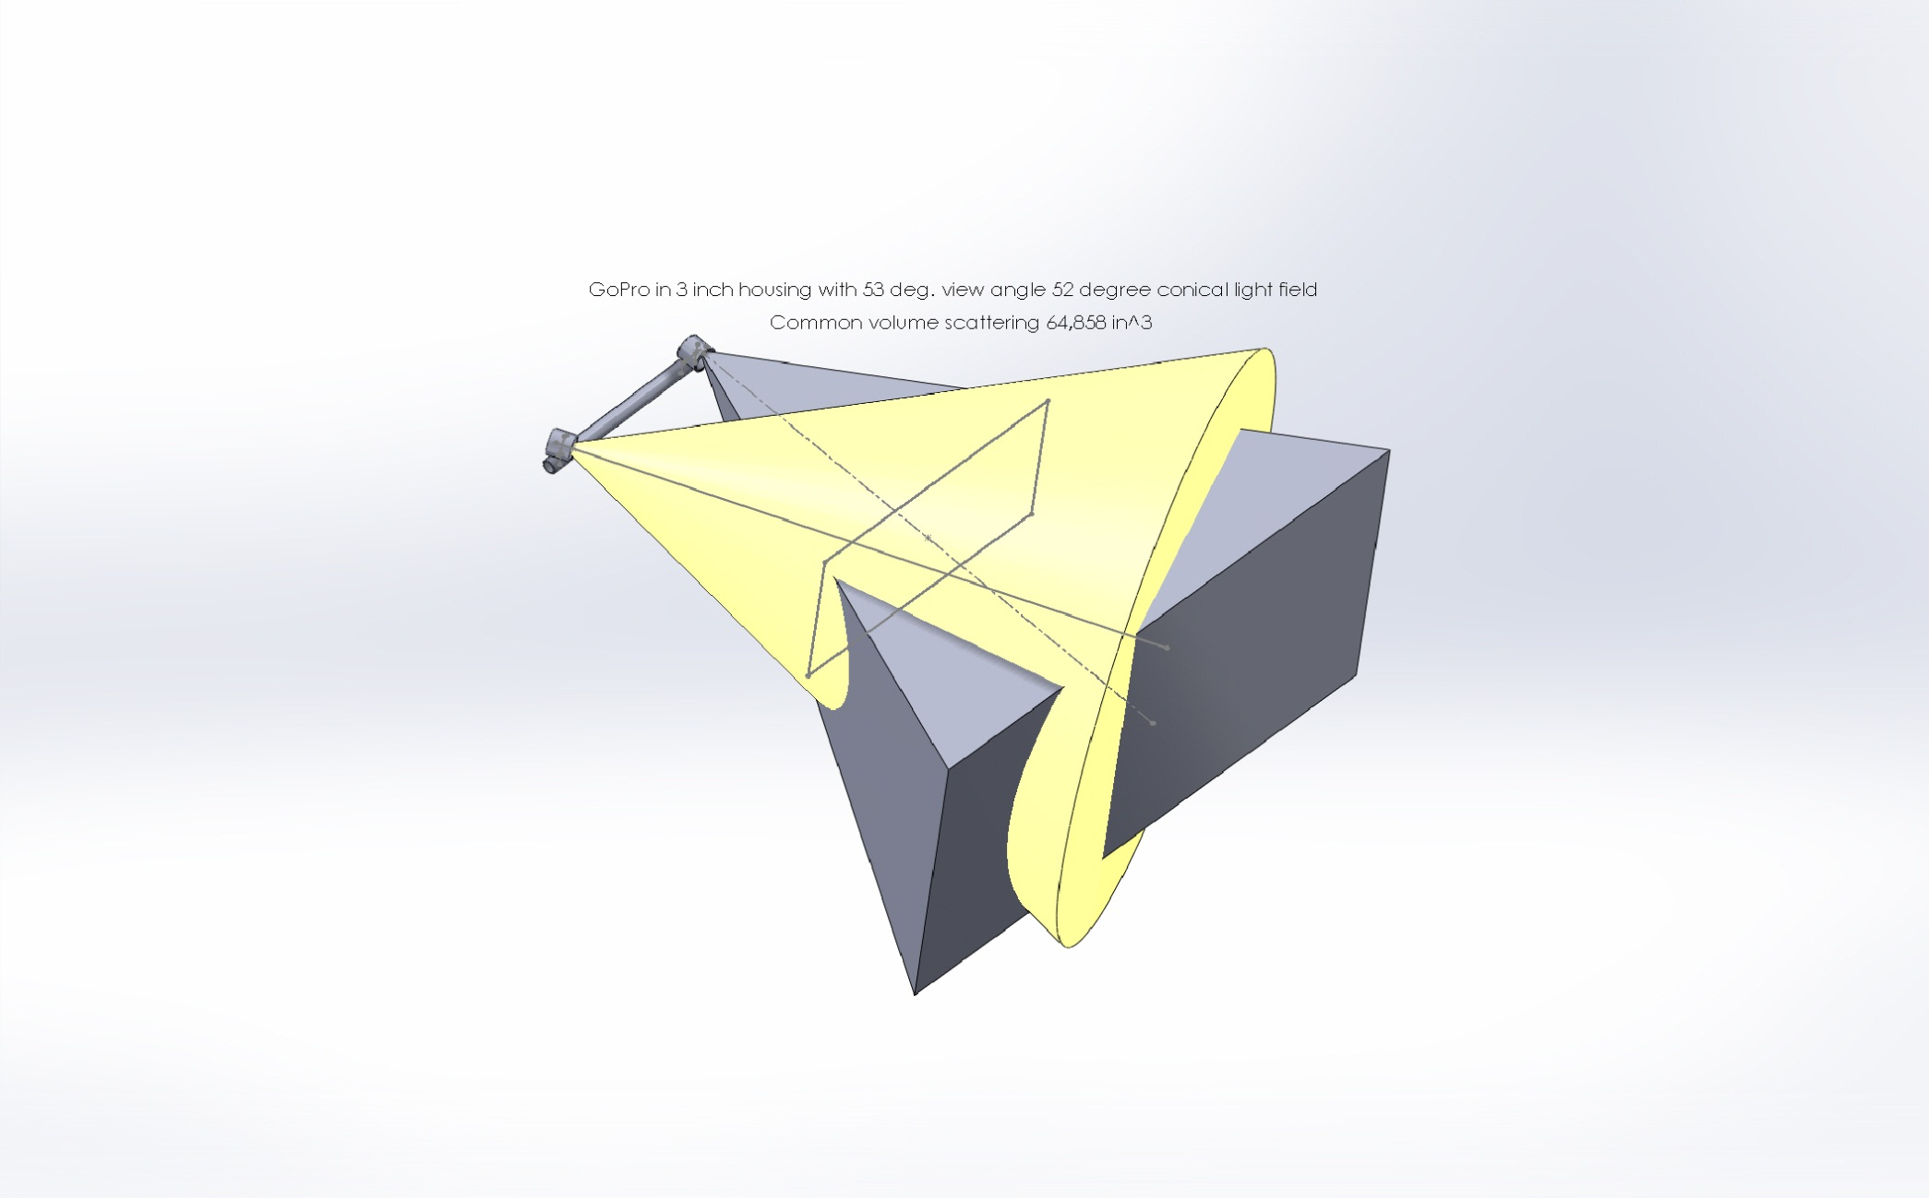
GoPro w/ 53 degree FOV (70 in air)
52 degree conical reflector common volume = > 65,000 in.^3

Slide 7
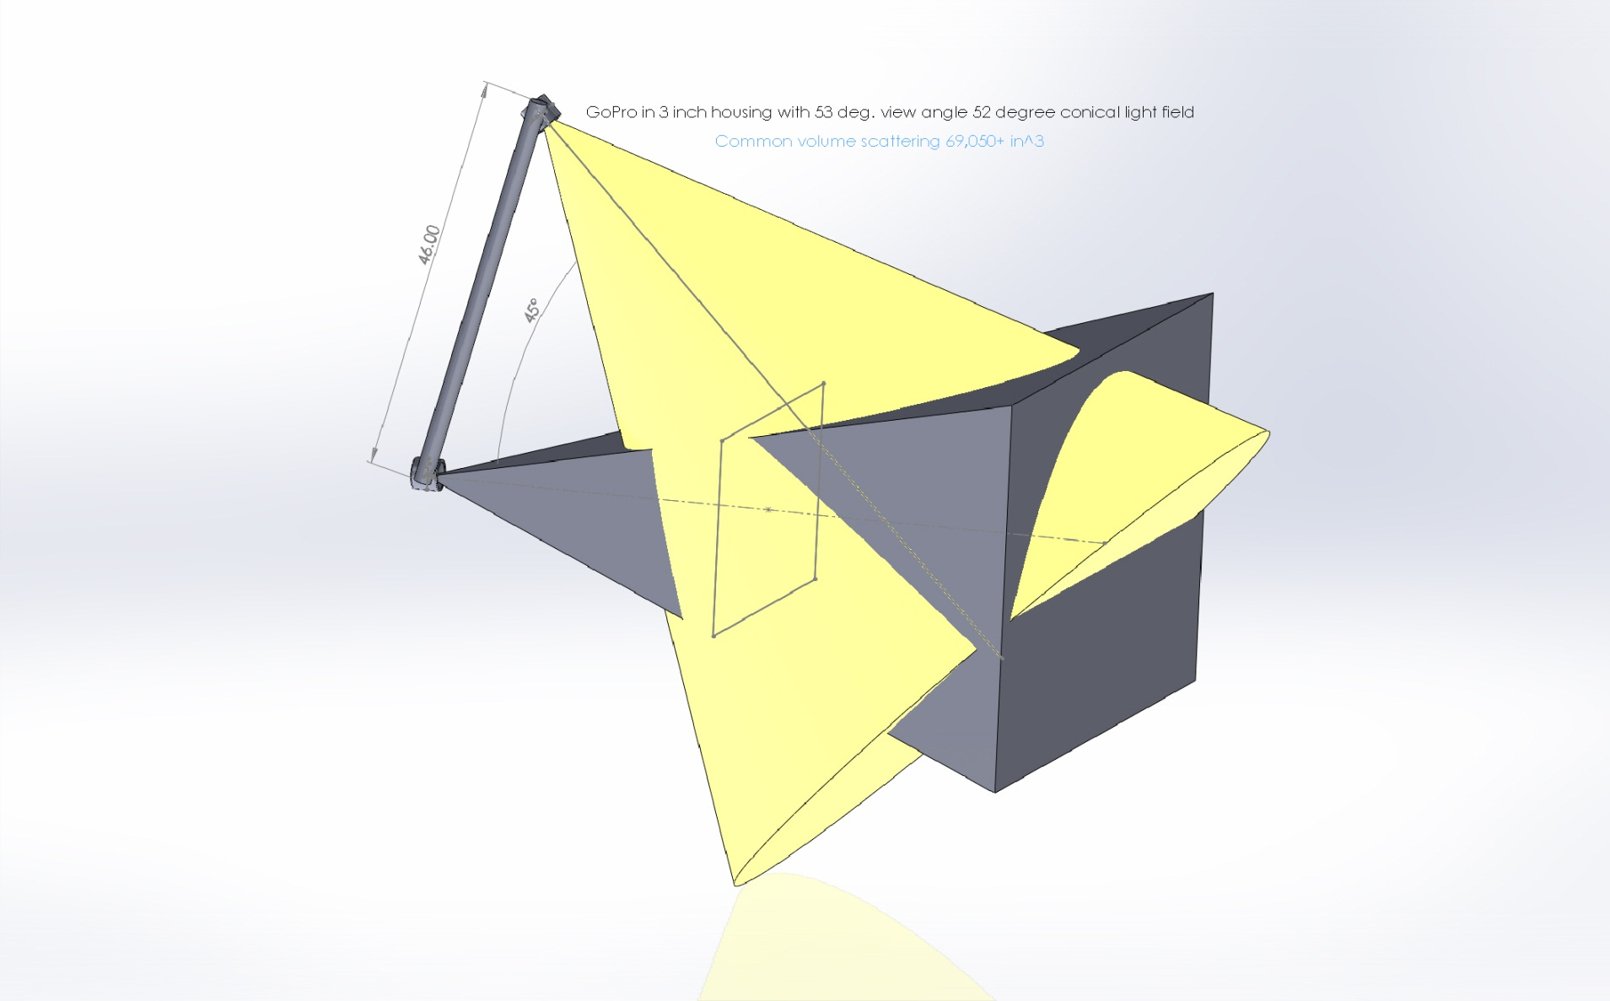
GoPro w/ 53 degree FOV (70 in air)
52 degree conical reflector common volume = > 70,000 in.^3

Slide 8
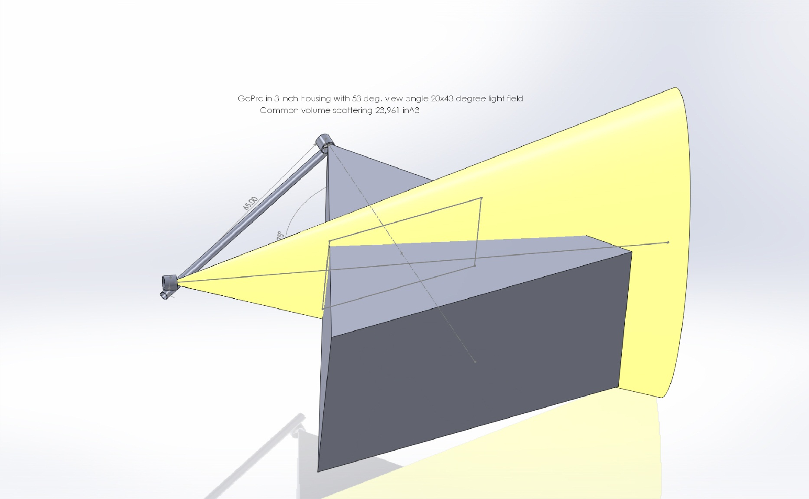
GoPro w/ 53 degree FOV (70 in air)
20x43 degree oval reflector common volume = 24,000in.^3

Slide 9
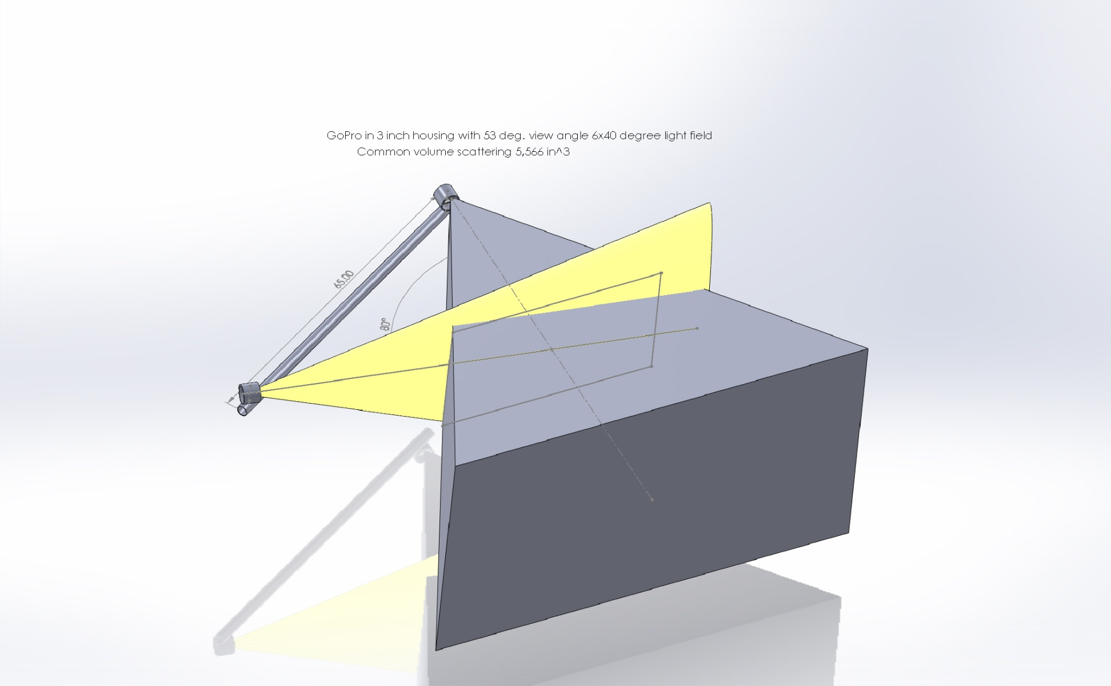
GoPro w/ 53 degree FOV (70 in air)
6x40 degree conical reflector common volume = 5,600 in.^3

Slide 10
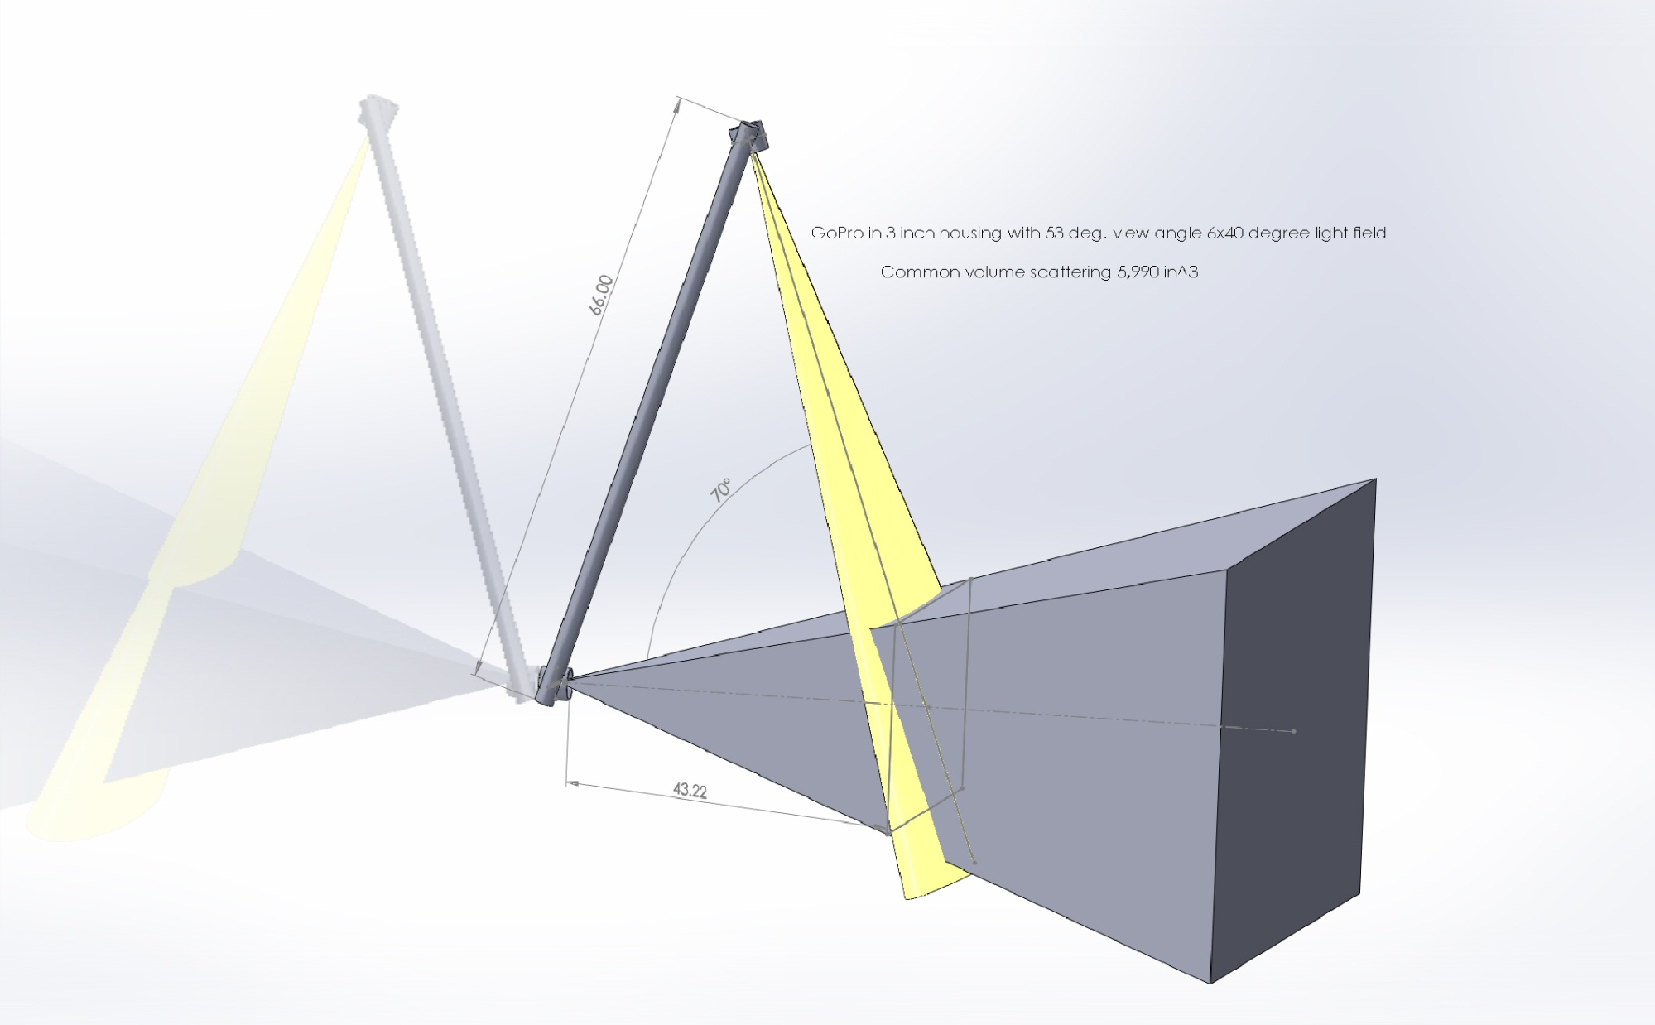
GoPro w/ 53 degree FOV (70 in air)
6x40 degree conical reflector common volume = > 6,000 in.^3

Slide 11
Camera requirements based on light design and configuration
Good image at ISO 800 and fast lens (f2.8-f4).
Ability to control aperture and shutter speed.
Flash synchronization would be nice..
Focal length with 1/2.3” (GoPro) imager = ?
Focal length with larger Imager = ?
Prime lens?

Slide 12
Energy budget
Lights vs. camera usage.
How many batteries for x images.
Battery housing size.

Slide 13
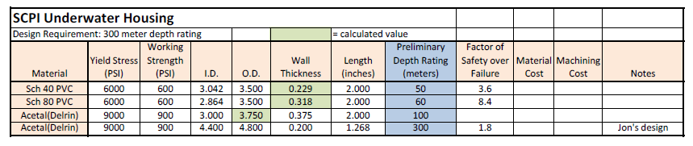
Pressure Housing Rating Estimates

