Slide 1
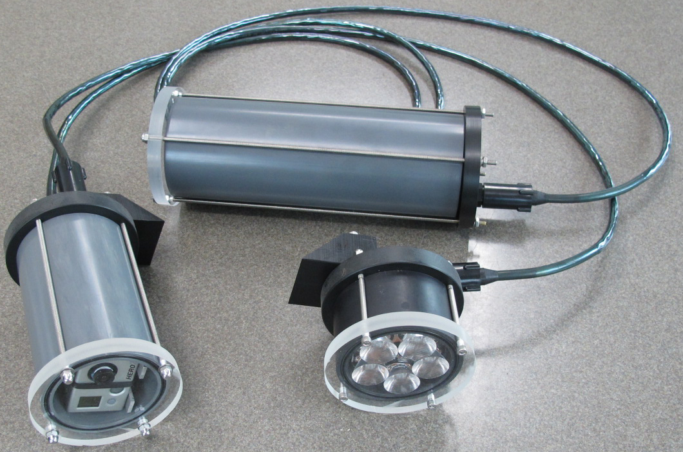
What is SeeStar?
Portable imaging system (stills/videos)
Platform independent
Autonomous or tethered

Slide 2
Motivation
Why another camera project at MBARI?
Differs from existing systems which:
  Require dedicated cables, ships, and winches
  Are difficult to deploy, maintain, and operate
  Are high cost
Desire to develop a camera system for oceanographic work that meets the following:
  Low cost
  Easy to fabricate
  Open source
  Portable (& platform independent)

Slide 3
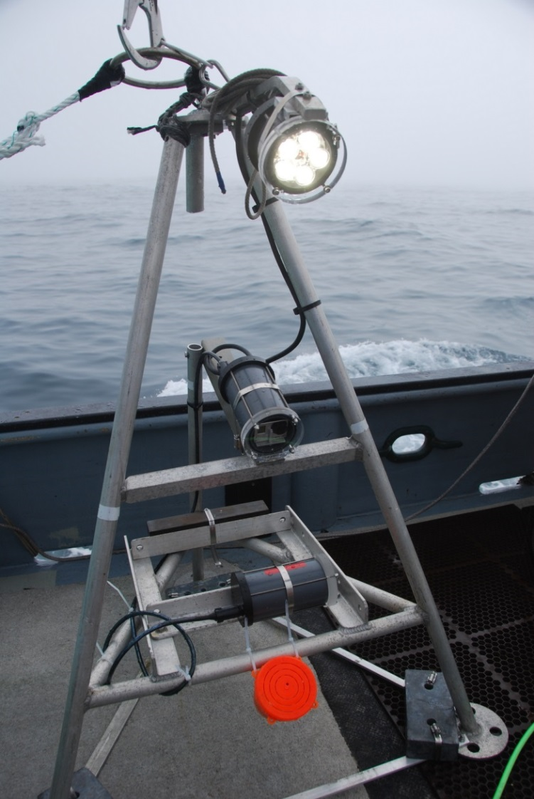
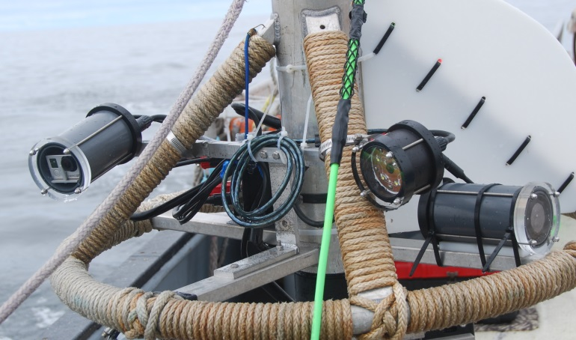
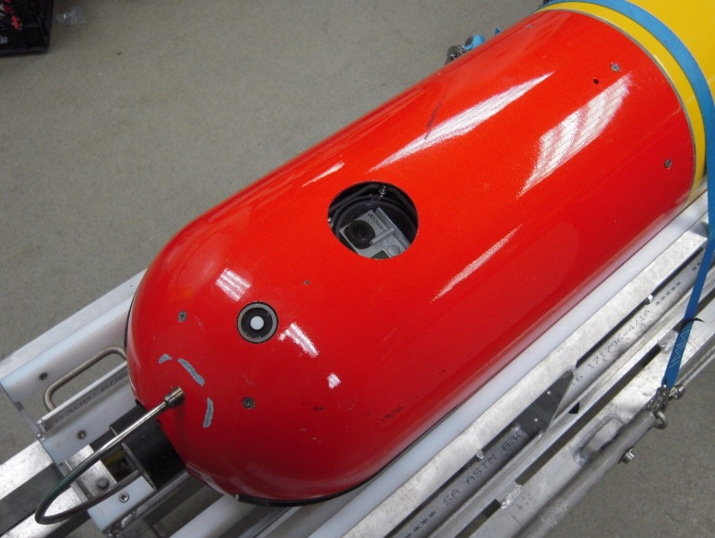
Early Adopters of SeeStar
The Nature Conservancy
Ca Wetfish Producers Association
Tethys Class AUVs (MBARI)

