Slide 1
Camera and Light Layouts looking at common volume scattering
13APR12 chma

Slide 2
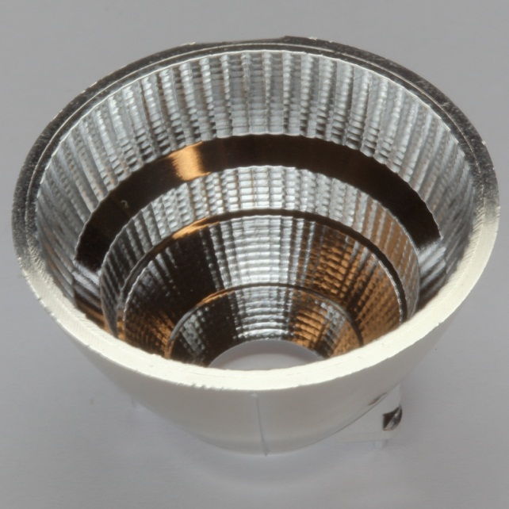
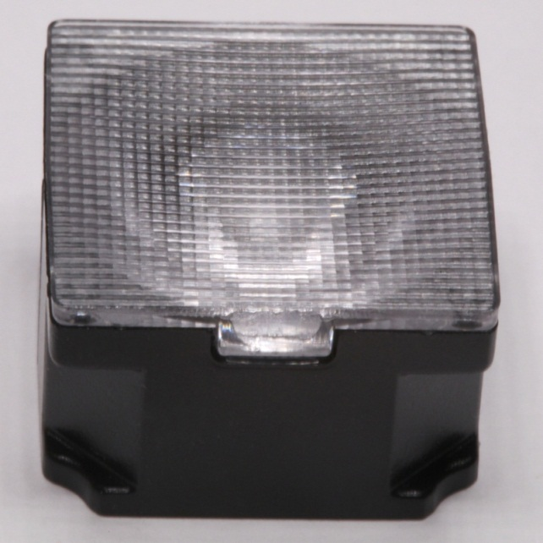
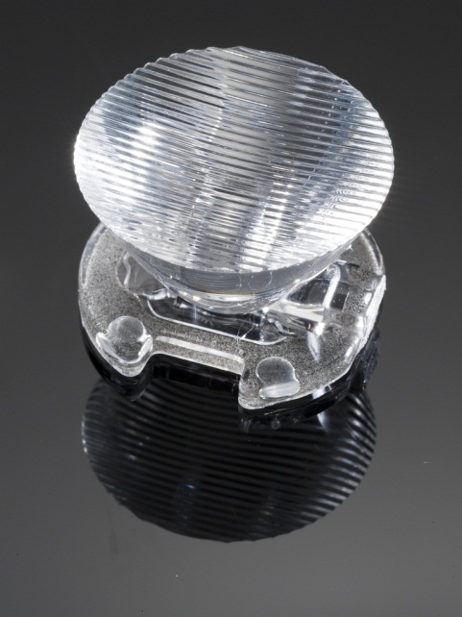
LED reflector examples
52 degree conical beam
43x20 degree oval beam
44x9 degree oval beam
For Cree Xlamp® MP-L series
For Cree Xlamp® MC-E series
For Xlamp® XR-E series

Slide 3
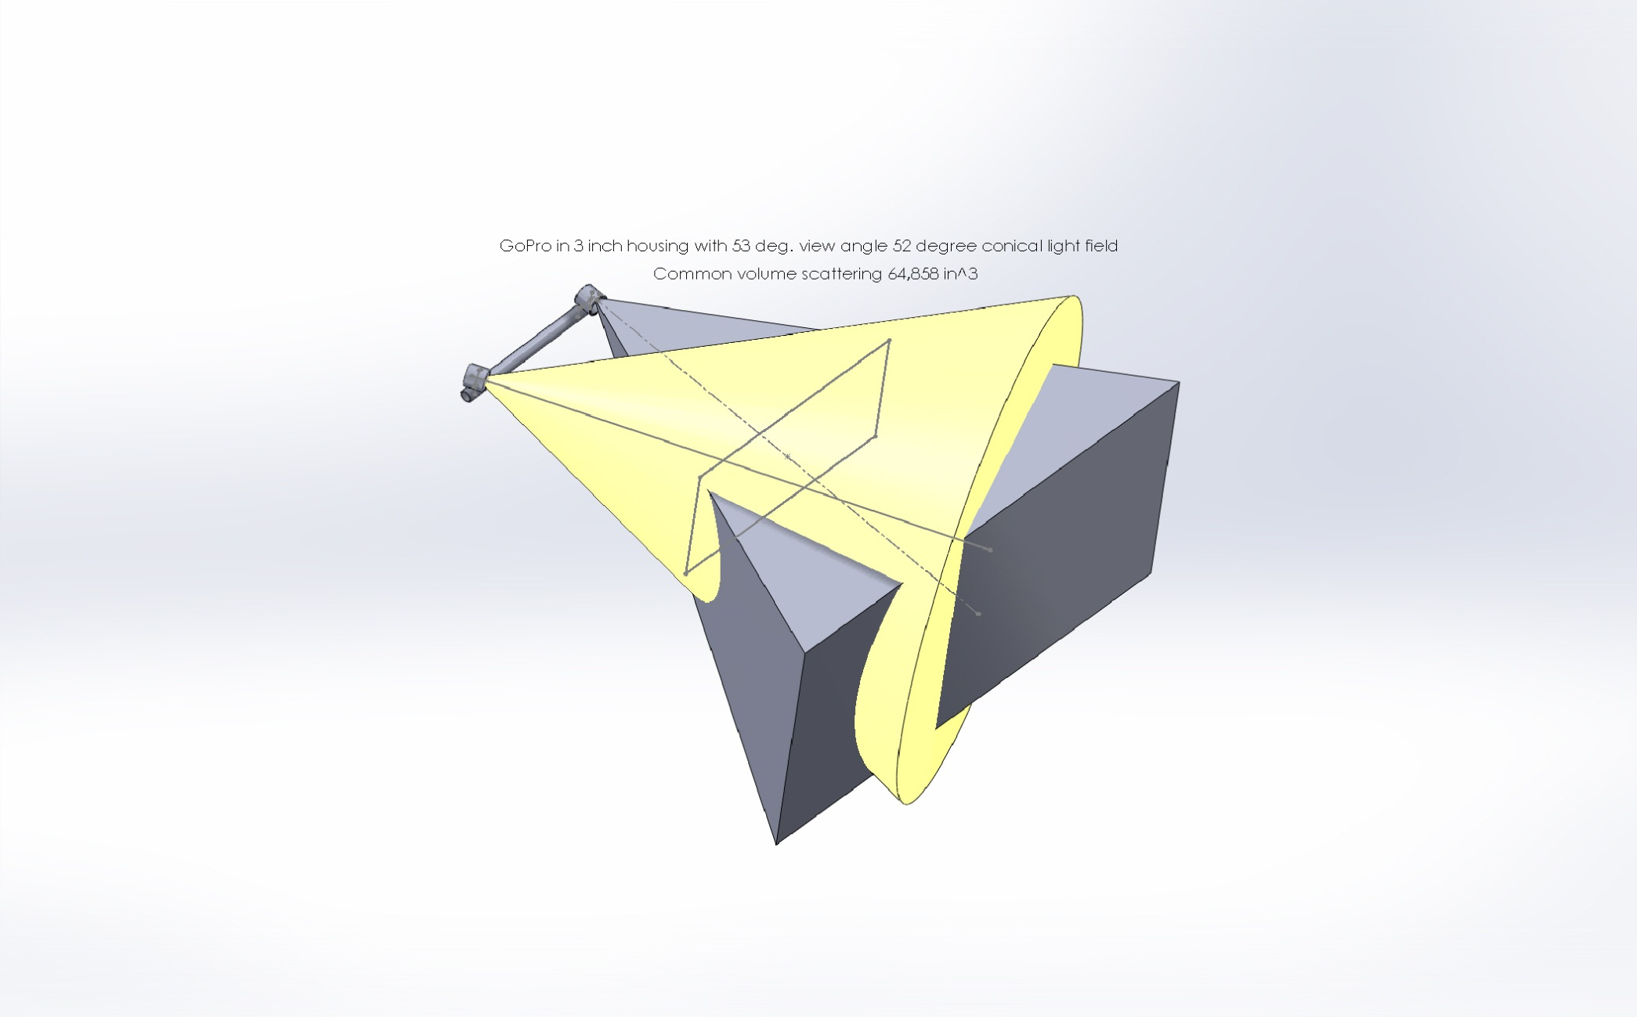
GoPro w/ 53 degree FOV (70 in air)
52 degree conical reflector common volume = > 65,000 in.^3

Slide 4
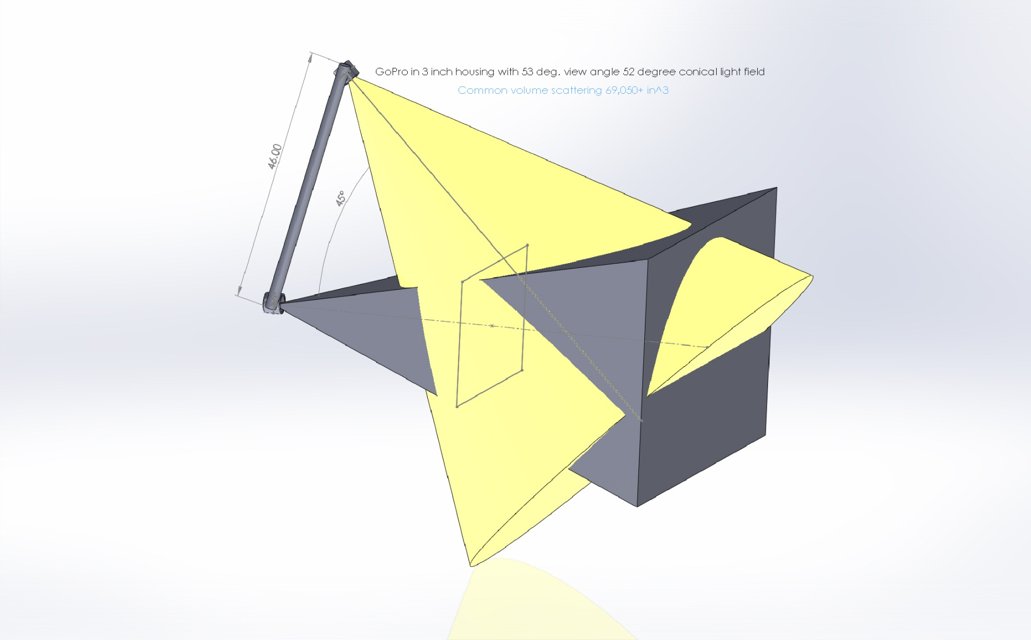
GoPro w/ 53 degree FOV (70 in air)
52 degree conical reflector common volume = > 70,000 in.^3

Slide 5
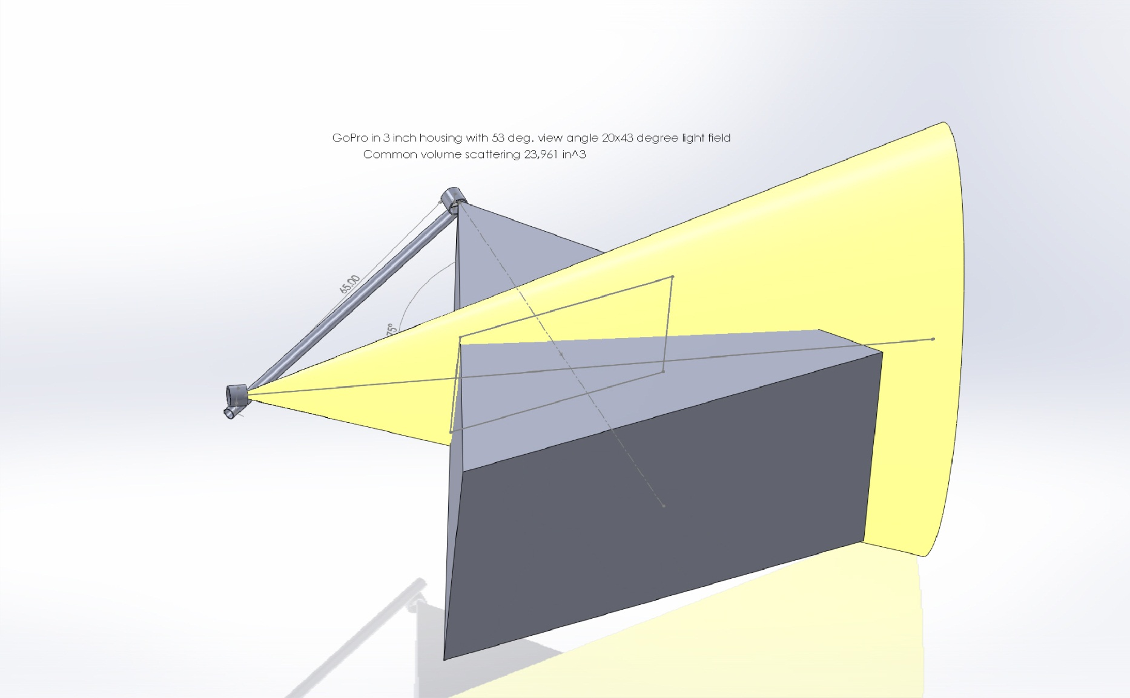
GoPro w/ 53 degree FOV (70 in air)
20x43 degree oval reflector common volume = 24,000in.^3

Slide 6
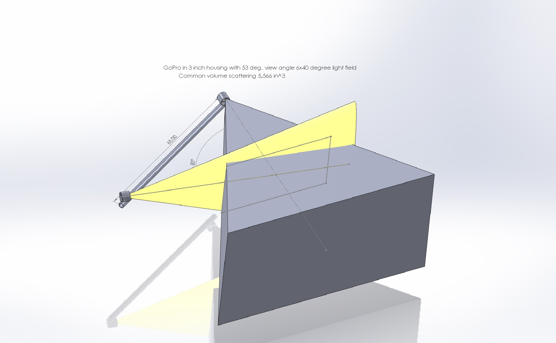
GoPro w/ 53 degree FOV (70 in air)
6x40 degree conical reflector common volume = 5,600 in.^3

Slide 7
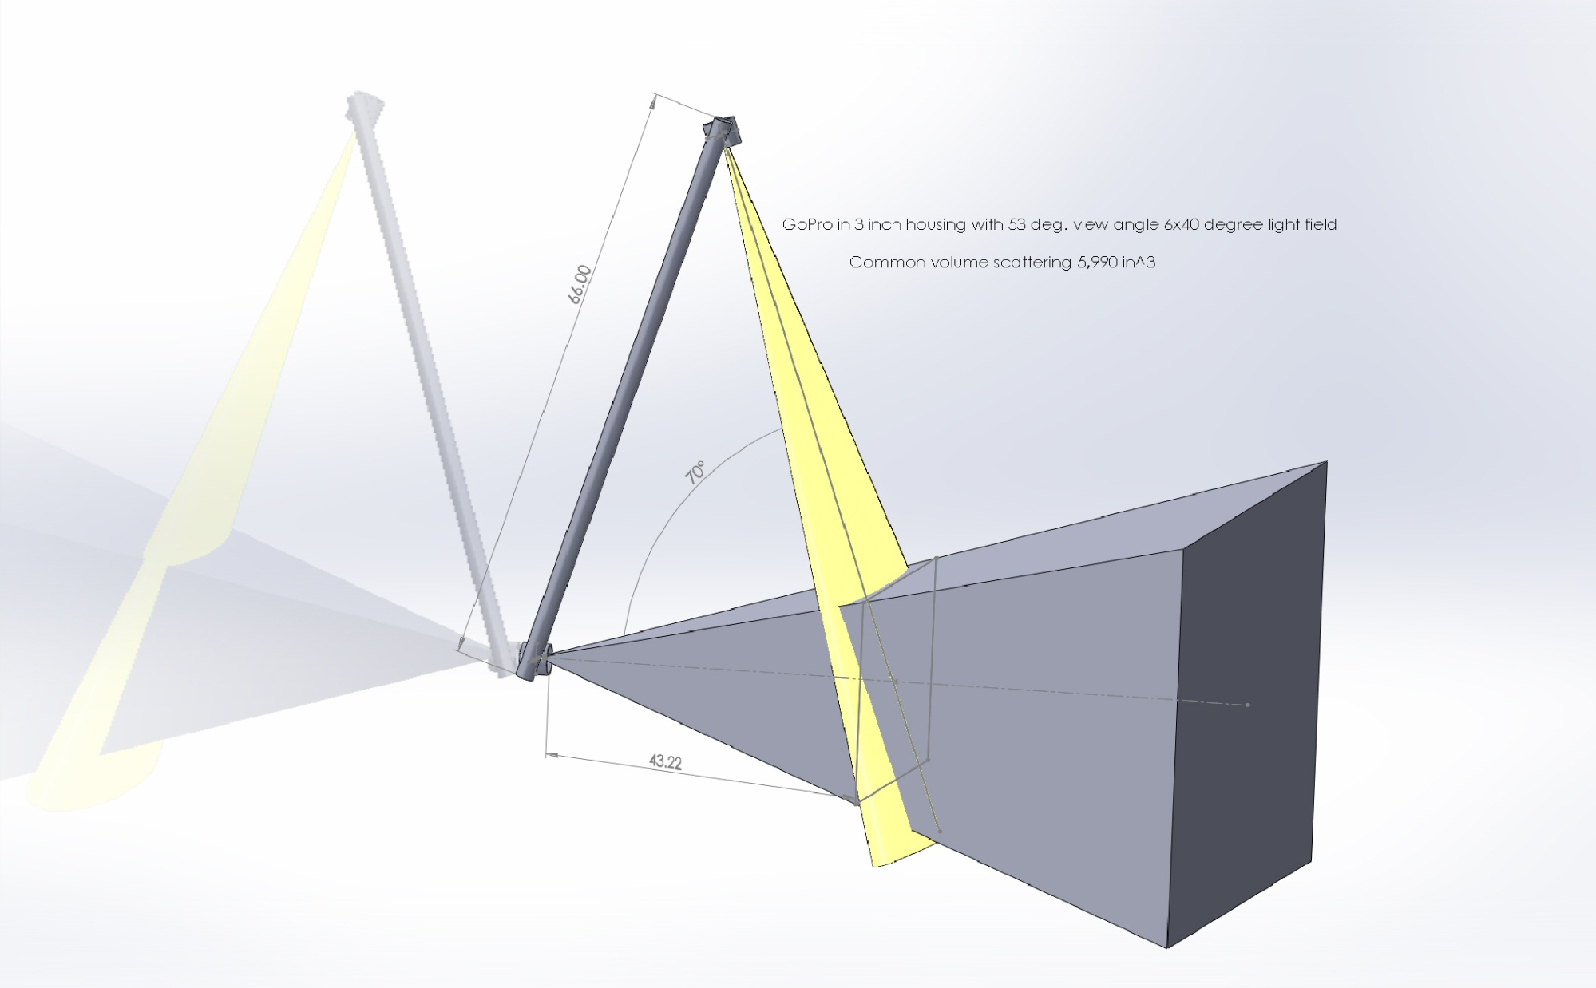
GoPro w/ 53 degree FOV (70 in air)
6x40 degree conical reflector common volume = > 6,000 in.^3

Slide 8
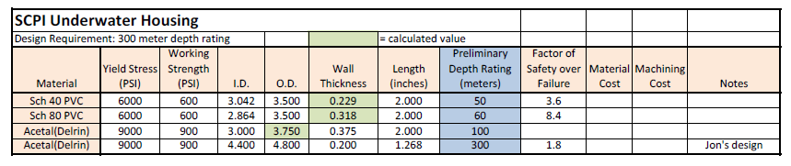
Pressure Housing Rating Estimates

