Slide 1
Lighting Selection
Challenges
  Can enough light be provided for good images.
  Will the energy required for the required number of images result in a reasonable battery volume.
  What configuration of camera and lighting will produce the best images.
Design method
  Calculate existing underwater and SLR strobe output.
  Review image examples and calculate illumination intensity.
    Use measured underwater strobe guide number values(1) and durations.
    Read metadata from exif files for aperture and shutter values.
  Determine if xenon strobe or LED lighting will best meet requirements.
  Determine camera requirements based on specific lighting options.
    Lens aperture needed
    Camera sensitivity (ISO)
    Shutter (or strobe) speed
(1) Strobe exposure guide number is distance X f-stop value at ISO 100.

Slide 2


Illuminance and Lighting System Calculation Methods
Step 1, calculate exposure value (EV) at ISO 100. EV represents all combinations of shutter speed and aperture that give the same exposure.
Exposure value is a base-2 logarithmic scale defined by Ray (2000, p. 318):
where
N is the relative aperture (f-number)
t is the exposure time (“shutter speed”) in seconds^{[2]}
Note: For strobe exposures the strobe duration was measured and is used for t. The strobe guide number can be used for N
Step 2, calculate illuminance value in Lux (Lumens m^) on target at different ISO values from EV.
C = meter constant of 250
S is the ISO arithmetic speed
E is the illuminance
(lumens per sq. meter)
To solve for E formula becomes: E =2^(EV-LOG2(ISO/250)
Note: assumes cosine responding meter and target reflectance of 12.5% corresponding to neutral grey.
Step 3, Design LED lighting system to provide similar illuminance to example images.
Step 4, Reverse calculations to specify aperture, shutter speed and ISO (camera sensitivity) for a given lighting design.
Good reference for exposure value calculations here:
http://en.wikipedia.org/wiki/Exposure_value

Slide 3
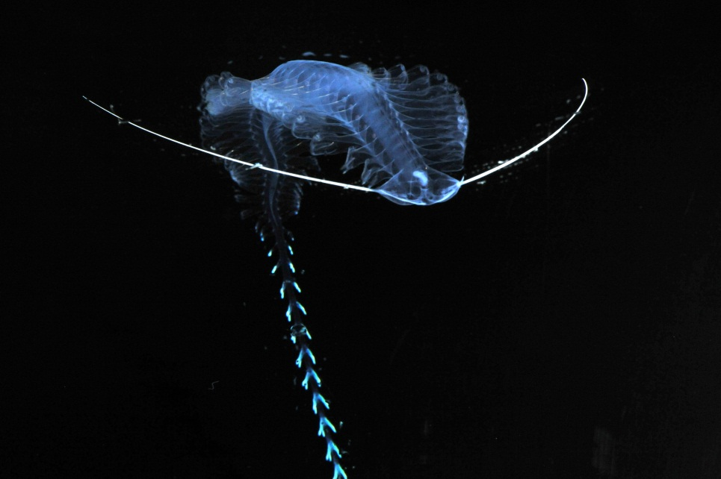
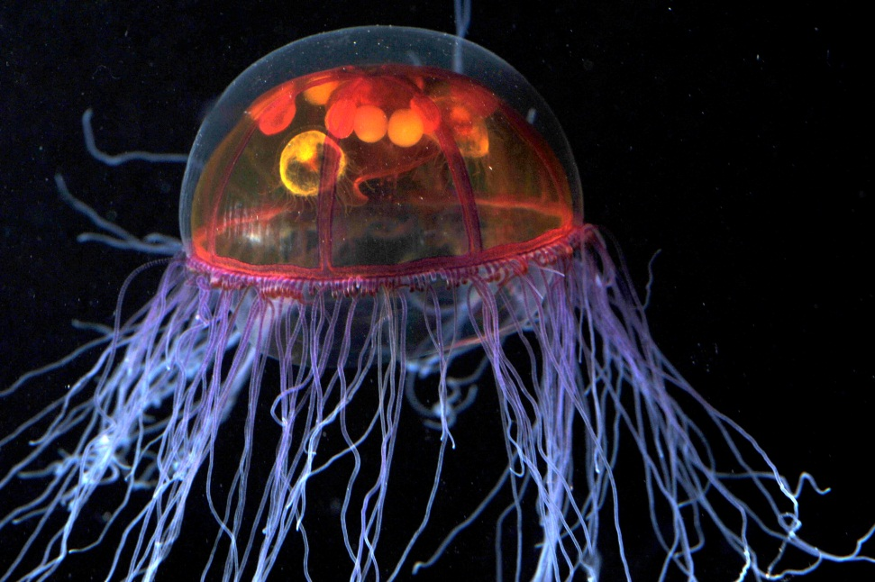
Lighting Calculation Examples
DSC_6164.jpg
DSC_3391.jpg
Actual Exposure Calculation |  |  | Calculated Illuminance
Image | F-Stop | Exposure Time (seconds) | ISO 800 | ISO 1600
Lab image DSC_6164.JPG | 5.6 | 0.0002 | 2450 | 1225
Lab image DSC_3391.JPG | 2.8 | 0.0002 | 2450 | 1225
Equivalent Exposure Calculation |  |  | Calculated Illuminance
Image | F-Stop | Exposure Time (seconds) | ISO 800 | ISO 1600
Lab image DSC_6164.JPG | 5.6 | 0.0005 | 980 | 490
Lab image DSC_3391.JPG | 2.8 | 0.0005 | 980 | 490
LED Equivalent Exposure Calculation | 2.8 | 0.00245 | 1000 | 500
Number of LED's needed |  |  | 7.4 | 3.7

Slide 4
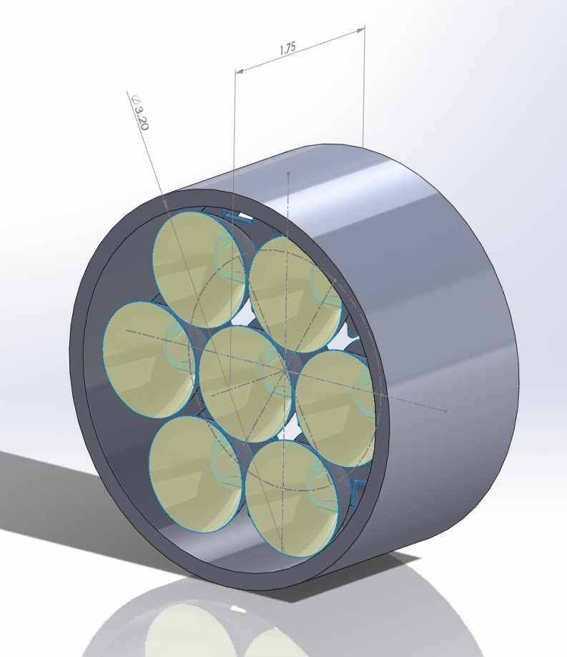
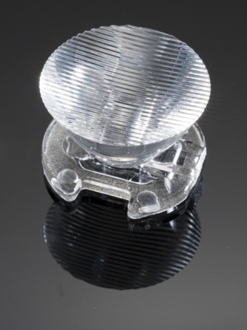
Strobe vs. LED Illumination
At ISO 800
LED vs Xenon Strobe | Wh per shot | Watt hours 1440 shots
Strobe (IkeliteDS 51) | 0.036 | 52
LED in Strobe mode (.00245 sec. on) | 9.8478E-06 | 0.015
LED in light mode (1 second on) | 0.00401952 | 5.8
40x6 degree oval beam reflector
For Cree Xlamp® XR-E series
Efficency 86%
Note: Calculations need to be verified with illumination and exposure value test!

Slide 5
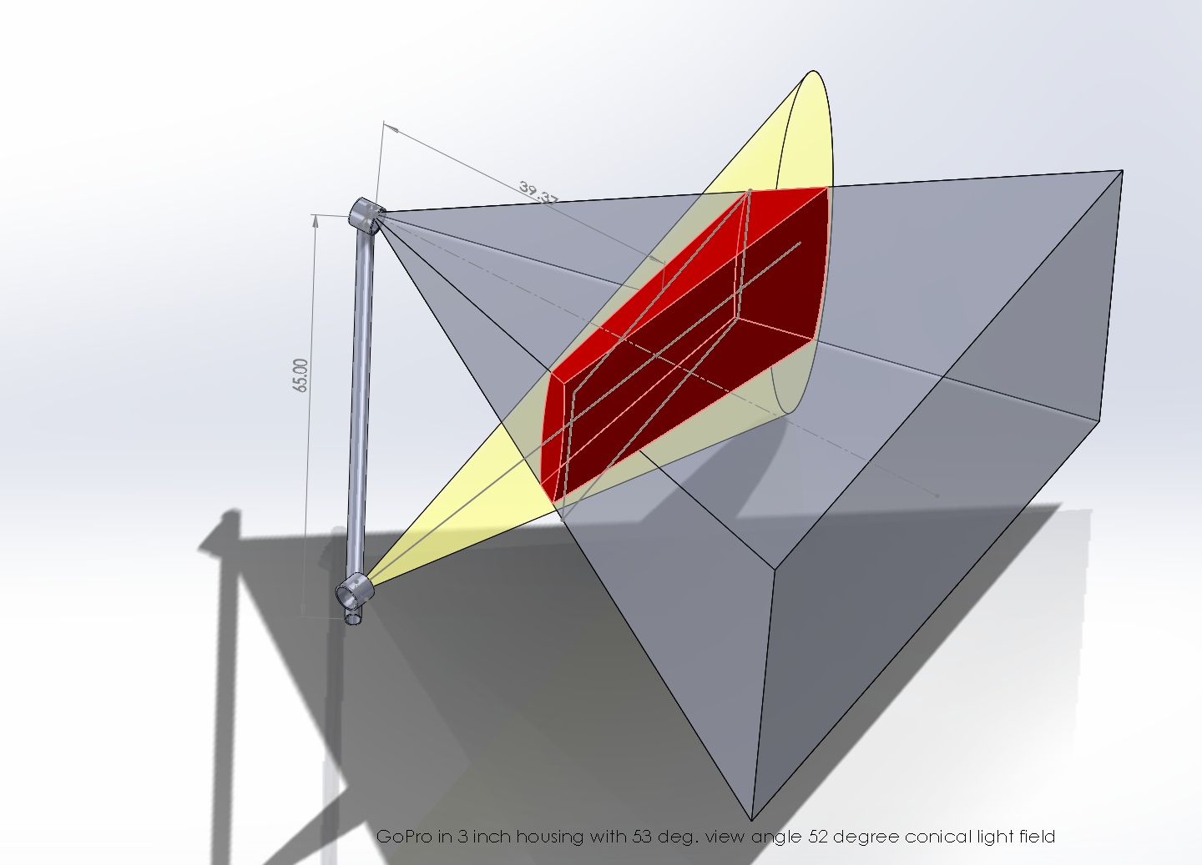
Example of 6x40 degree Conical Reflector
(Red is common volume between imager and light field)

Slide 6
Energy Budget
Strobe Lighting for .008 second per shot (req. strobe trigger)
 |  |  | Camera only (wH) |  |  | Whole System (wH) |  |  |  | Number of batteries (80% PS Eff.)
 |  | wH per shot | per 100 shots |  | per 1000 shots | Tot per Shot | Tot per 100 shots | Tot per 1000 shots | Tot per 1440 shots | Alkaline D Cell | Lithium D Cell
GoPro | Hero2 | 0.006 | 0.6 |  | 6 | 0.042 | 4.20 | 42.00 | 60.48 | 6 | 2
Canon | G12 | 0.021 | 2.1 |  | 21 | 0.057 | 5.70 | 57.00 | 82.08 | 8 | 3
Nikon | 1 V1 | 0.03325 | 3.325 |  | 33.25 | 0.069 | 6.93 | 69.25 | 99.72 | 9 | 3
Contour | Plus |  | 0 |  | 0 |  |  |  | 51.84 | 5 | 2
Ricoh | GXR | 0.0185 | 1.85 |  | 18.5 | 0.055 | 5.45 | 54.50 | 78.48 | 7 | 2
LED Lighting for 1 second per shot (for motion requires fast shutter speed)
 |  |  | Camera only (wH) |  |  | Whole System (wH) |  |  |  | Number of batteries (80% PS Eff.)
 |  | wH per shot | per 100 shots |  | per 1000 shots | Tot per Shot | Tot per 100 shots | Tot per 1000 shots | Tot per 1440 shots | Alkaline D Cell | Lithium D Cell
GoPro | Hero2 | 0.006 | 0.6 |  | 6 | 0.011 | 1.10 | 11.00 | 15.84 | 2 | 1
Canon | G12 | 0.021 | 2.1 |  | 21 | 0.026 | 2.60 | 26.00 | 37.44 | 4 | 1
Nikon | 1 V1 | 0.03325 | 3.325 |  | 33.25 | 0.038 | 3.83 | 38.25 | 55.08 | 5 | 2
Contour | Plus |  | 0 |  | 0 |  |  |  | 7.20 | 1 | 1
Ricoh | GXR | 0.0185 | 1.85 |  | 18.5 | 0.024 | 2.35 | 23.50 | 33.84 | 4 | 1
LED Lighting in strobe mode (.004 seconds, req. strobe trigger)
 |  |  | Camera only (wH) |  |  | Whole System (wH) |  |  |  | Number of batteries (80% PS Eff.)
 |  | wH per shot | per 100 shots |  | per 1000 shots | Tot per Shot | Tot per 100 shots | Tot per 1000 shots | Tot per 1440 shots | Alkaline D Cell | Lithium D Cell
GoPro | Hero2 | 0.006 | 0.6 |  | 6 | 0.006 | 0.60 | 6.02 | 8.67 | 1 | 1
Canon | G12 | 0.021 | 2.1 |  | 21 | 0.021 | 2.10 | 21.02 | 30.27 | 3 | 1
Nikon | 1 V1 | 0.03325 | 3.325 |  | 33.25 | 0.033 | 3.33 | 33.27 | 47.91 | 5 | 2
Contour | Plus |  | 0 |  | 0 |  |  |  | 0.03 | 1 | 1
Ricoh | GXR | 0.0185 | 1.85 |  | 18.5 | 0.019 | 1.85 | 18.52 | 26.67 | 3 | 1

Slide 7
Lighting Conclusions
  Xenon strobe would require 3 X larger battery housing for 1440 images (52 Watt-hours).
    300 meter version close to off-the-shelf (low cost, low risk would likely require repackaging)
  LED potentially uses very little power
    Would allow multiple light heads and structured lighting (better imaging?)
    Longer term deployments, smaller battery volume or many more images
    Strobe would have extremely small energy requirement (but not COTS)
      Custom design allows structured beam for lowest common volume
    Light mode would use much more power, but may be COTS
      COTS design would not have shaped beam and therefore not nearly as efficient. More common volume scattering
  LED strobe is feasible IF:
    Illumination can be efficiently directed to imaging area of ~ 1 sq. meter
    Can be synchronized to camera shutter (need strobe signal)
    LED Color properties produce acceptable color reproduction (wide spectrum variant promising)
    Thermal cycling fatigue of LED die does not become an issue
    Camera selected produces acceptable images at ISO 800 or ISO 1600
  LED lighting is feasible IF:
    Illumination can be efficiently directed to imaging area
    Can be synchronized to camera shutter so on for 1 second (requires fast shutter speed or non-moving target)
    LED Color properties produce acceptable color reproduction
    Thermal cycling fatigue of LED die does not become an issue

Slide 8
Next Steps
Test representative cameras with quantified lighting and representative targets.
  Marbles for jellies
  ?? For other applications
Down select cameras based on (not in priority order):
  Image quality
  Size
  Power (energy) requirements (battery volume required)
  Interface effort and complexity
  Cost
Select lighting system based on same criteria!
Complete to preliminary design review level.

