Slide 1
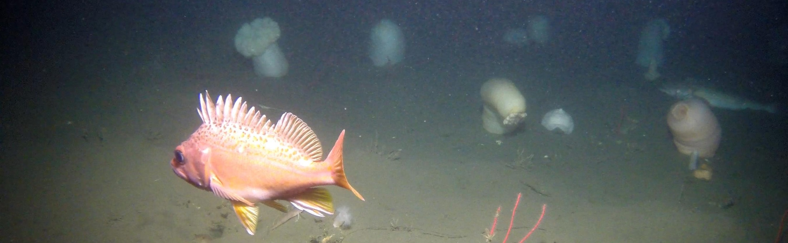
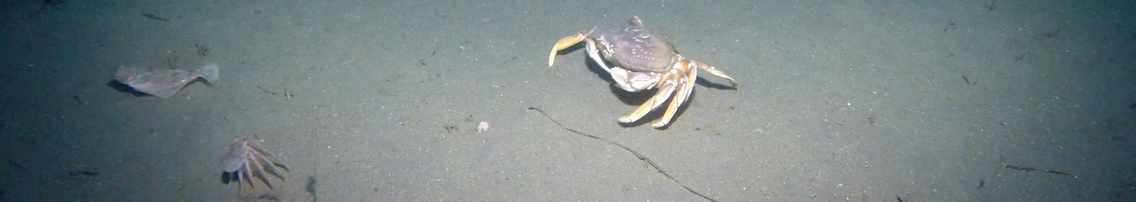
SeeStar
A Low-Cost, Modular, and
Open Source Imaging System
Chad Kecy, Michael Risi, François Cazenave, Steve Haddock
Monday August 4, 2014

Slide 2
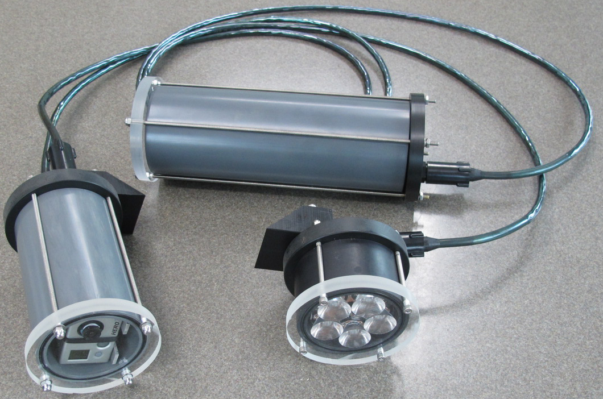
What is SeeStar?
Portable imaging system (stills/videos)
Platform independent
Autonomous or tethered

Slide 3
Motivation
Why another camera project at MBARI?
Differs from existing systems which:
  Require dedicated cables, ships, and winches
  Are difficult to deploy, maintain, and operate
  Are high cost
Desire to develop a camera system for oceanographic work that meets the following:
  Low cost
  Easy to fabricate
  Open source
  Portable (& platform independent)

Slide 4
Functional Requirements
Specification | Specified Value | SeeStar Prototype
Platform | AUV/mooring/wharf | All
Target | Large macroplankton | Large macroplankton
Target size | >1 cm | > 10 cm
Rate of Images | Once/10 min, Once/Hour | Once/2 sec
Color vs. B&W | color important | Color
Image Trigger | Optional | Not yet implemented
Depth | 200m | 300m
Field of View | 1 x 1.5 m | 1 x 1.5 m
Lighting | Side illumination | Side illumination
Deploy Duration | 2 months | 2 months +
Total # of Images | 1440 | 2900
Other | Hibernation, biofouling | Hib: Y Biofoul: N

Slide 5
Modular Approach
Schedule 80 PVC (3” Diameter)
Common 8-pin electrical bus

Slide 6
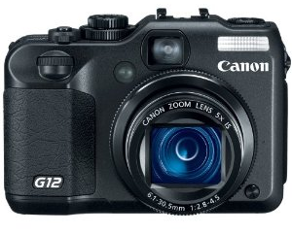
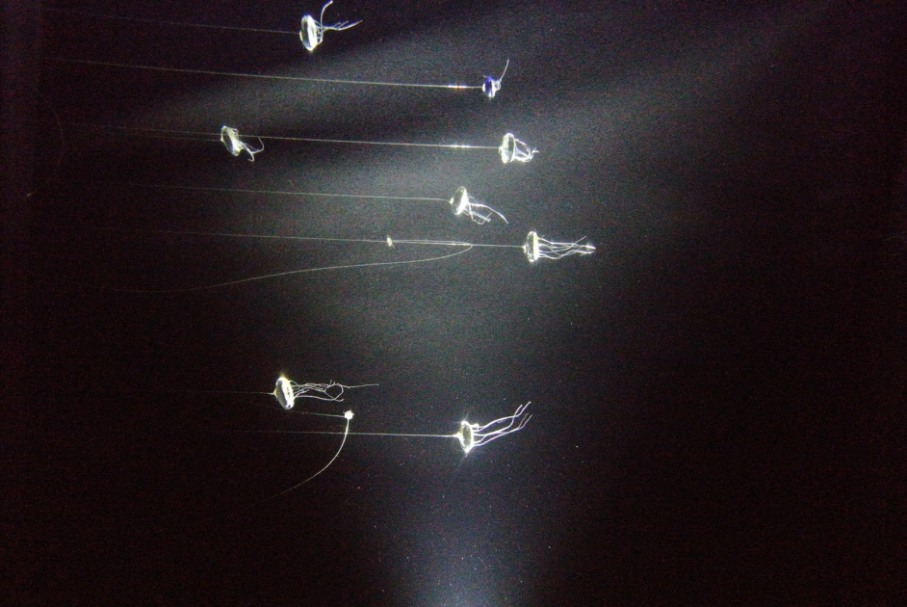
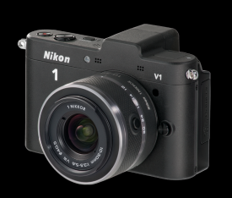
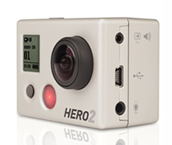
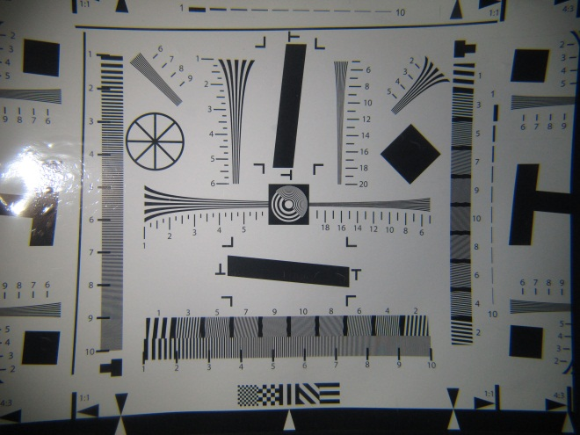
Camera Evaluation
Canon G12
Nikon 1V1
GoPro Hero 2

Slide 7
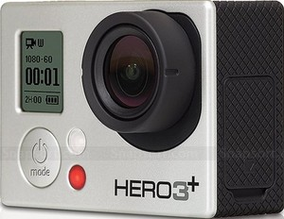
GoPro Hero 2/3
The Good:
  Good images with proper light
  Form factor
  Availability & cost
  Relatively easy to interface (via hardware)
The Bad:
  No manual control of exposure
  Poor low light camera
  No SDK or API available

Slide 8
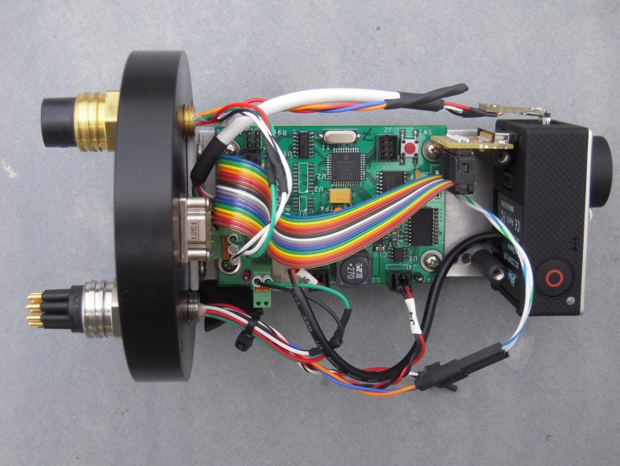
Camera Module
GoPro Hero 3+
Custom control board
  Programmable
  Real-time clock
  Power to Camera
  Power to LED module
USB
Serial
Up to 128GB storage

Slide 9
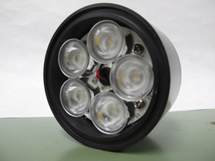
Lighting Modules
5-LED Module
  3” Diameter
  2000 lumens
  300m rated
9-LED Module
  4.5” Diameter
  3675 lumens
  100m rated
Both use beam shaping lenses

Slide 10
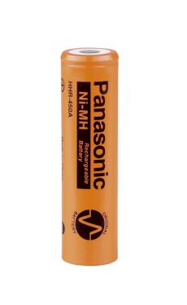
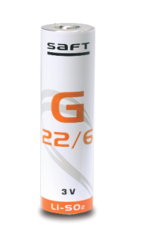
Battery Modules
Rechargeable: NiMH (4.5 AH)
  16 cells (fat A) in series [1.2V/cell]
  Bus voltage of 12.8Vdc to 19.2Vdc
Primary: LiSO₂ (16.5 AH)
  6 cells (DD) in series [2.8V/cell]
  Bus voltage of 13.2Vdc to 16.8Vdc

Slide 11
SeeStar Capabilities
Depth rating of 300m (9 LED module 100m)
Total onboard energy of 4500mAh
Energy per shot = 1.4mAh (includes LEDs)
Total # of shots = 2900
Maximum duration dependent on shot interval
User settable parameters:
  Image taking interval (Maximum once/2 sec)
  Total number of images
Still images & video
Dry weight: 18lbs, wet weight: 6.5lbs (with frame)
Autonomous or tethered applications

Slide 12
Cost per SeeStar System
Camera module: $1180
Lighting module: $ 900
Battery module : $ 415
System cables : $ 430
Total : $2925

Slide 13
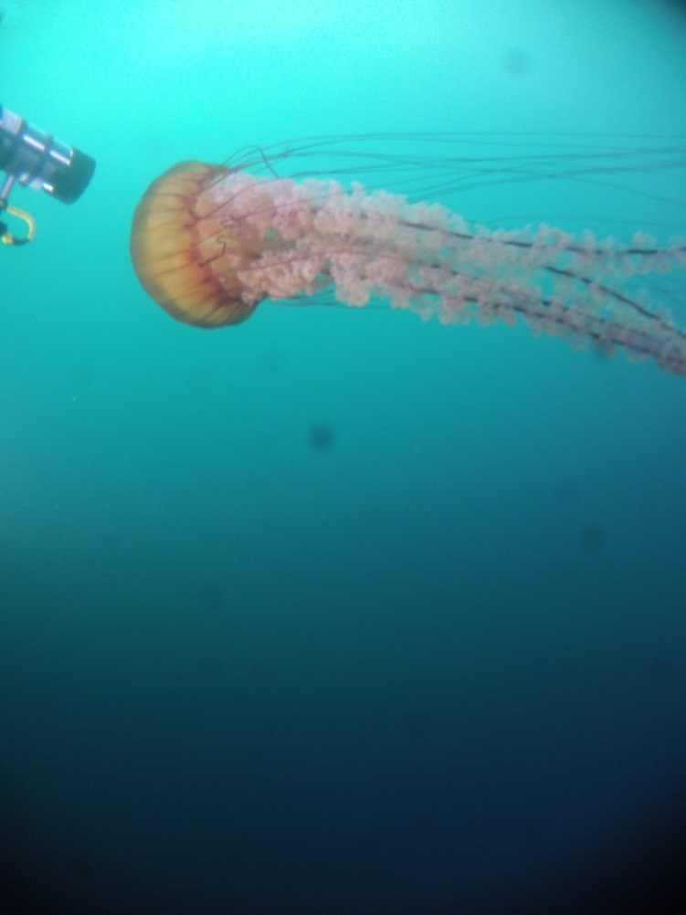
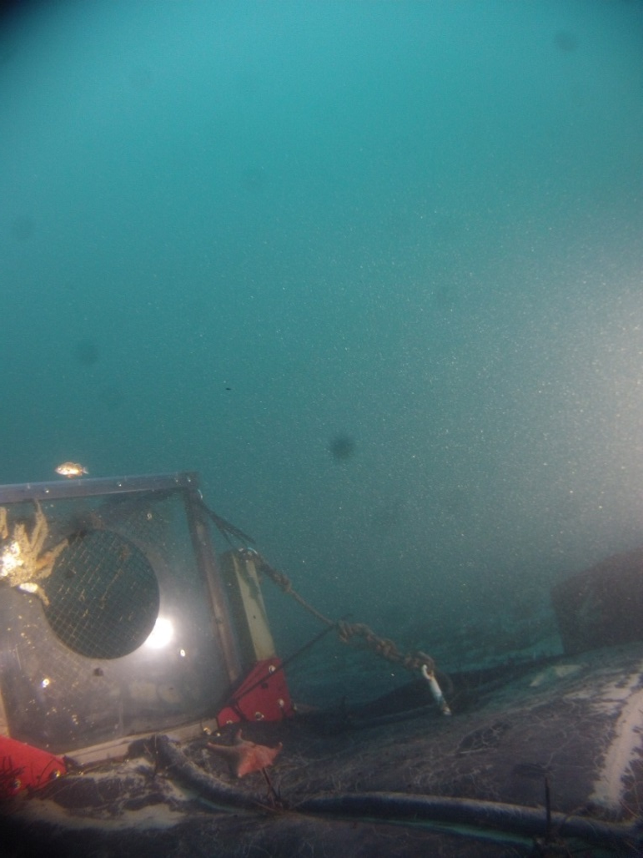
Engineering Testing
ROV Ventana
KFA/swFOCE site
- Series of depths (to 300m)
Image every 60 sec for 48 hours
Depth of 15m

Slide 14
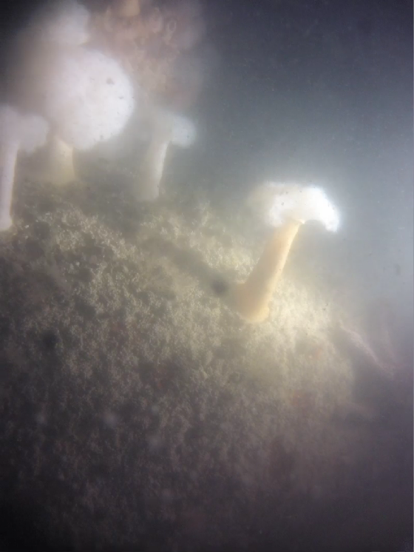
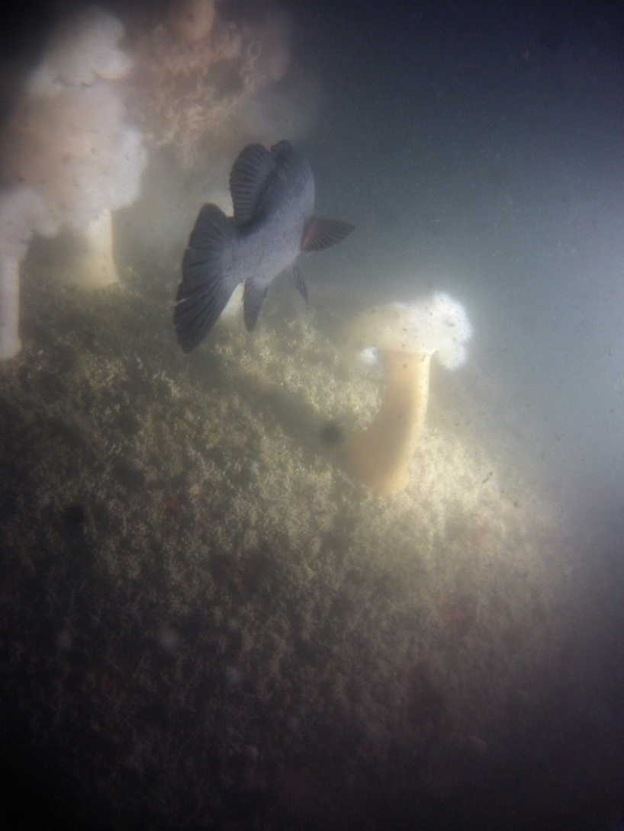
Engineering Testing
Offshore MBARI
Image every 60 sec for 48 hours
Depth of 20m

Slide 15
Deployments
The Nature Conservancy
Tethys Class AUVs
Ca Wetfish Producers Association
MBA Kelp Forest
MLML Antarctica (10/14 – 1/15)

Slide 16
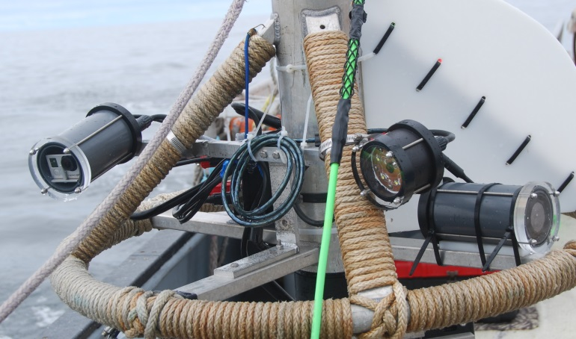
The Nature Conservancy & MLML
Fishery Study
Density, size, and habitat association data for fish in the fishery closure areas

Slide 17
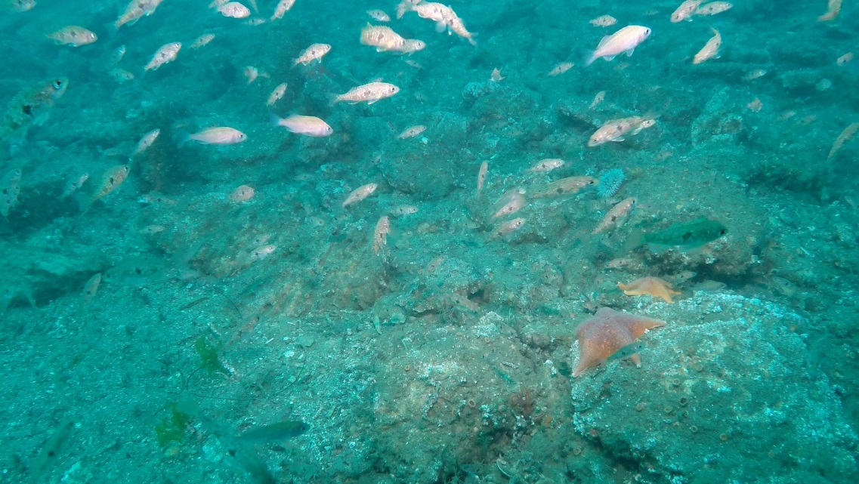
The Nature Conservancy & MLML
Fishery Study

Slide 18
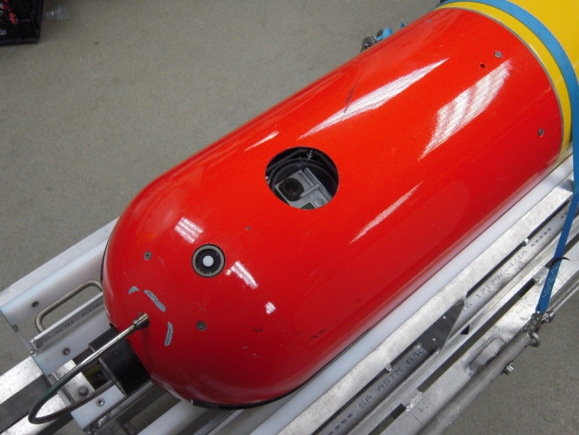
Tethys Class Vehicles
Wave Glider Tracking
Zooplankton Detection
Camera module only
Uses vehicle power
Communicates to vehicle over serial bus

Slide 19
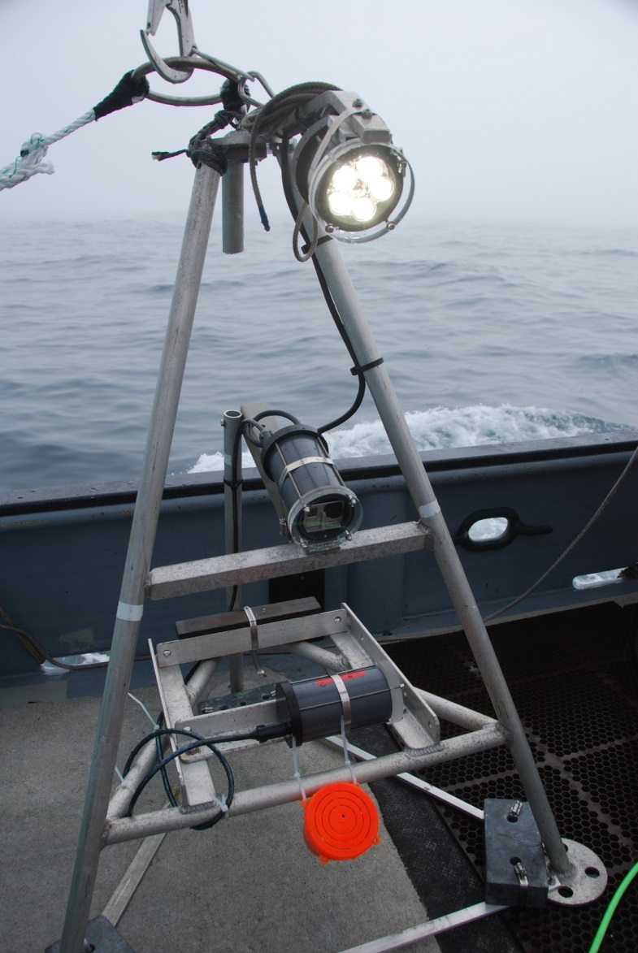
Ca Wetfish Producers Association
Filming squid eggs on seafloor
Filming squid larvae in water column

Slide 20
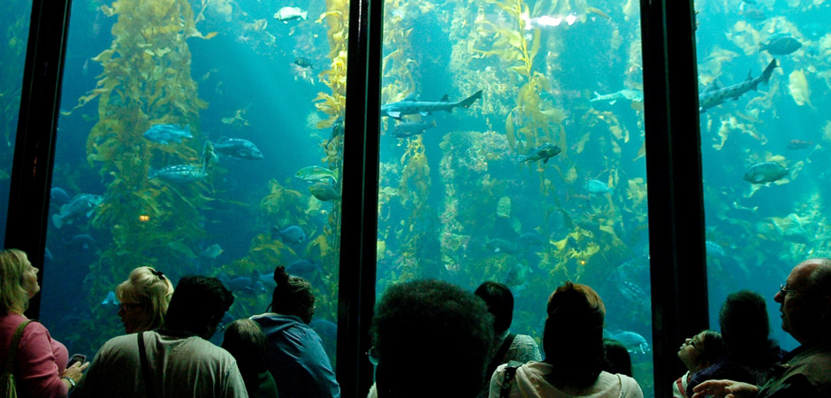
MBA Kelp Forest
Kelp Forest Study
  Comparing larvae settling in tank to that of the actual kelp forest.

Slide 21
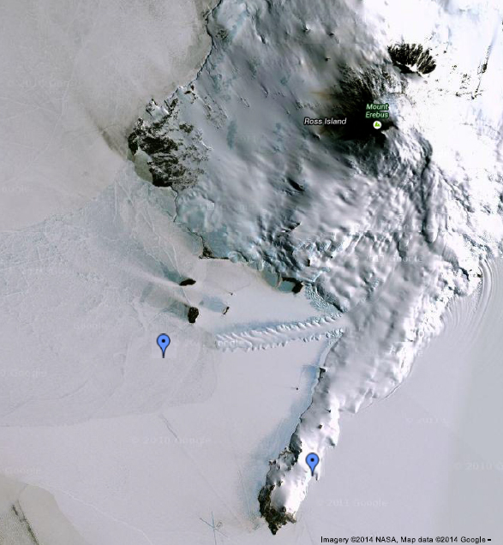
MLML Antarctica
Benthic ecology (Stacy Kim of MLML)
Two sites under the ice near McMurdo
2 SeeStar systems at each site
  1 month at Mystery Peak
  3 months at Erebus Glacier Tongue

Slide 22
Future work
Want to develop a higher resolution camera module
  Full manual control of imaging functions
  Image targets of 1cm
Want to make the system more COTS (Commercial Off The Shelf)
  Arduino-based control board
  Commercially available lighting solution

Slide 23
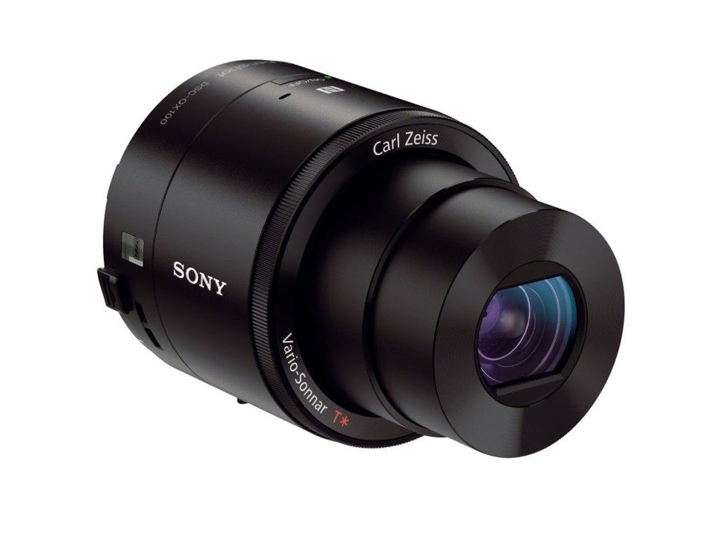
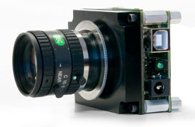
Higher Resolution Version
Sony QX-100
Board Level Camera
  Lumenera
  Leopard Imaging
  Baumer

Slide 24
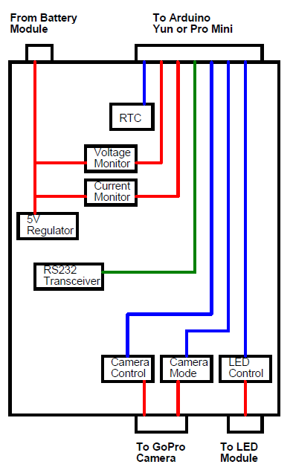
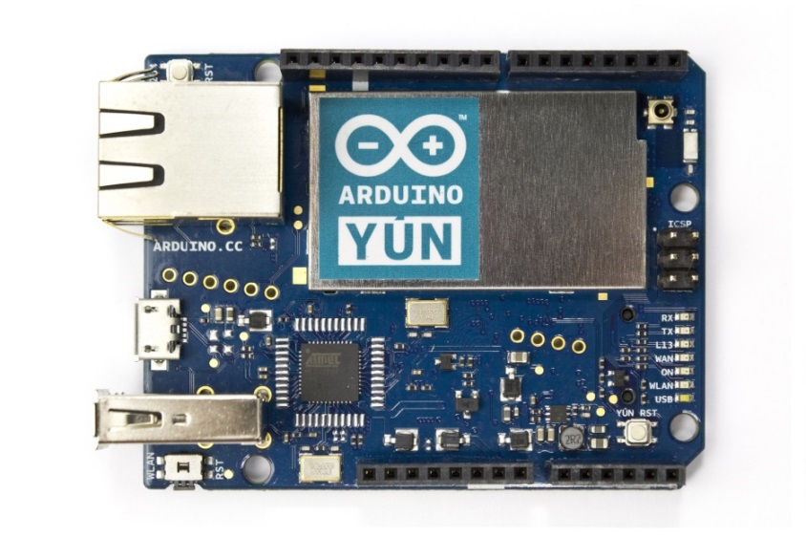
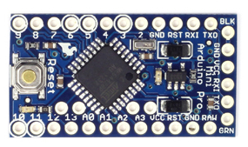
Arduino Based GoPro Version
Open Source Arduino Shield Board
  Will interface the Yun and ProMini
Arduino Yun
  Wifi enabled
  Linux router
  High power
Arduino Pro Mini
  Low power
  Basic functionality

Slide 25
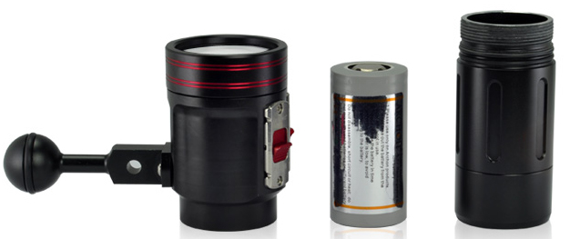
Commercial Lighting
Equivalent illumination
  2000 lumens
Small & portable
  Targeting 3” Diameter or less
Low cost
  Targeting $500 or less
Able to integrate easily onto SeeStar
  Must work with our 8-pin bus

Slide 26
Conclusions
SIZE
Moored
Camera Sys
Time-Lapse
Camera
Imaging AUV
Ocean Imaging
LRAUV
Verification Cam
SeeStar
Shark Cam
COST
Unlike many projects, motivated by cost and size vs. technical capabilities
Envision broad network of sensors around the world
Open source and easy availability has already led to rapid adoption

Slide 27
Resources
www.mbari.org/seestar
https://bitbucket.org/mbari/seestar
  Schematics
  Mechanical drawings
  Assembly instructions
  Operating manual
  Firmware
“SeeStar: A low-cost, modular, and open source imaging system”, François Cazenave, Chad Kecy, Michael Risi, Steven H.D. Haddock, Oceans 2014 – IEEE Newfoundland, Sept 2014

Slide 29
SeeStar Module Costs
Camera Housing | Qty | Cost | Total Cost
Camera Housing Tube | 1 | 60 | 60
Front Endcap | 1 | 50 | 50
Rear Endcap | 1 | 65 | 65
Camera & Board Support | 1 | 80 | 80
2-151 Buna N O-ring | 2 | 9 | 18
Screws & Hardware | 1 | 20 | 20
SAE-5 Plug | 1 | 5 | 5
Subconn MCBH8F | 1 | 105 | 105
Subconn MCBH8M | 1 | 95 | 95
USB Connector | 1 | 12 | 12
SCPI Control Board | 1 | 250 | 250
SD Memory Card | 1 | 20 | 20
GoPro Camera | 1 | 300 | 300
Hero Bus Adapter Board | 1 | 100 | 100
 |  |  | 0
 |  | TOTAL | 1180
Battery Housing | Qty | Cost | Total Cost
Camera Housing Tube | 1 | 60 | 60
Front Endcap | 1 | 50 | 50
Rear Endcap | 1 | 65 | 65
Screws & Hardware | 1 | 20 | 20
Battery Pack | 1 | 115 | 115
Subconn MCBH8M | 1 | 95 | 95
Foam Padding | 1 | 10 | 10
 |  |  | 0
 |  | TOTAL | 415
Lighting Housing | Qty | Cost | Total Cost
Camera Housing Tube | 1 | 60 | 60
Front Endcap | 1 | 50 | 50
Rear Endcap | 1 | 65 | 65
Screws & Hardware | 1 | 20 | 20
LED Drive Board | 1 | 300 | 300
LED Mounting Board | 1 | 300 | 300
Subconn MCBH8F | 1 | 105 | 105
 |  |  | 0
 |  | TOTAL | 900
System Level | Qty | Cost | Total Cost
Subconn M-F Cable | 2 | 215 | 430
 |  |  | 0
 |  | TOTAL | 430
Total System Cost |  |  | 2925

Slide 30
Relevance to Strategic Plan
Research Themes: Ocean Visualization
  SeeStar allows for realizing four-dimensional visualizations – repeated spatial renderings over time.
Institutional Objectives: (2) Increase Institutional Flexibility
  Rapid prototype
Institutional Objectives: (3) Enhance Collaborations
  Low cost of SeeStar eases ability of outside organizations to build their own, thus increasing the spatial network

