Slide 1
Self Contained Plankton Imager
Prototype

Slide 2
Housing Tubes
3 inch tube
6 inch tube
9 inch tube

Slide 3
Housing End Caps
Solid End Cap
Flat Port End Cap
Connector End Cap
  Note: any end cap fits on either end of tube

Slide 4
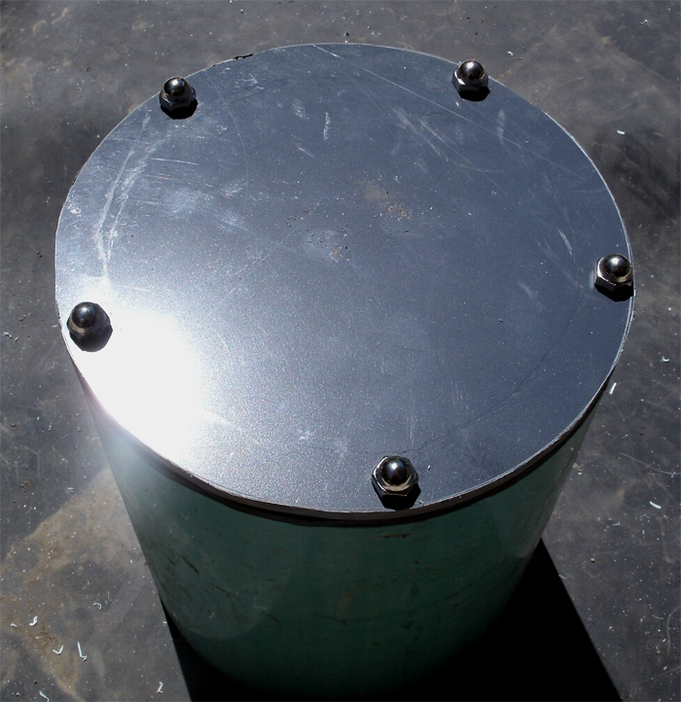
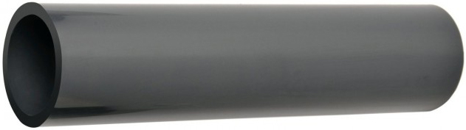
Schedule 80 PVC Pipe

Slide 5
Split Functionality
LED
Camera
LED
Battery

Slide 6
System Level Block Diagram
Camera
Battery
LED
LED
Camera
Bank 1
BacPac
Bank 2
Relay Bd
Bank 3
Relay Bd
LED
LED

Slide 7
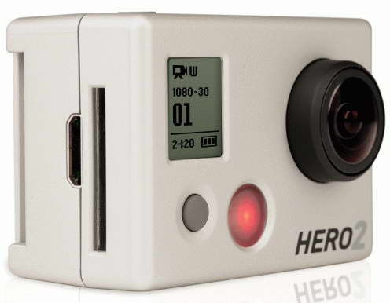
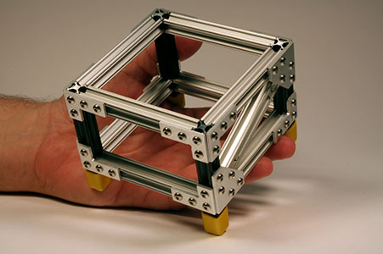
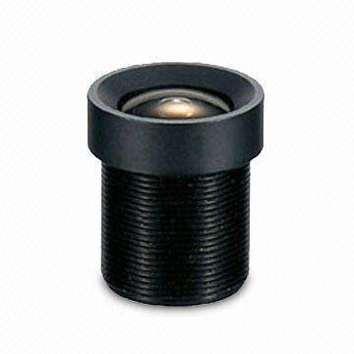
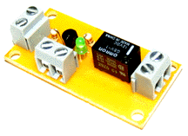
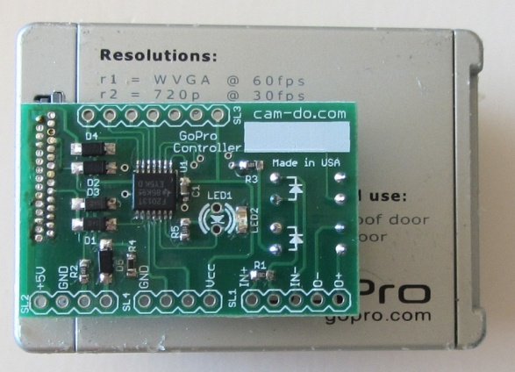
Camera Housing Components
GoPro Hero2 Camera
MicroRax Internal Framing
Optional
3rd Party
Lens
TTL Driven Relay Board (2)
MBARI Custom Controller

Slide 8
Camera Housing Block Diagram
Custom
BacPac
USB
Port?
Hero
Bus
Battery Voltage
30
TTL
Control
To Battery
Housing
To LED
Housing
To LED
Housing

Slide 9
Custom BacPac Block Diagram
Hero
Bus
Prog
EEPROM
Micro
Controller
Debug
RS-232
Xcvr
I2C Bus
To
GoPro
Hero
Camera
Power On Signal
To Relay
Board(s)
LED Control (2)
Digital Inputs (4)
Power Status
USB
Port?
USB
?
Volt
Scaling
12V to 3.3V
12V to 4.0V
Camera Power
To Batt
Housing

Slide 10
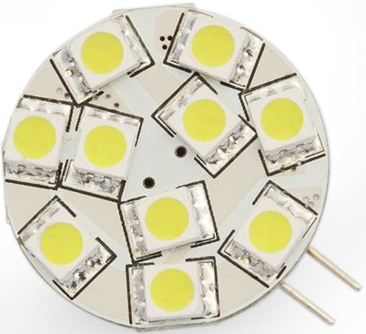
LED Housing Components
LED Replacement Board
MicroRax Internal Framing

Slide 11
LED Housing Block Diagram
Battery Voltage

Slide 12

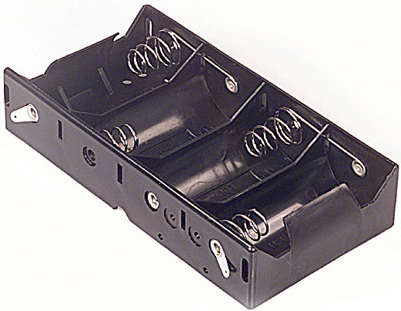
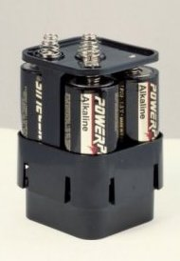
Battery Housing Components
Standard D-Cells (12)
Battery
Holders
MicroRax Internal Framing

Slide 13
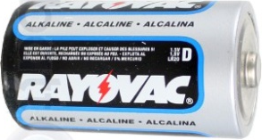
Battery Housing Block Diagram
Battery Voltage

Slide 14
Parts Availability
Camera: Direct from GoPro
Optional Lens: From [need solid 2nd source]
Custom BacPac: MBARI design; available thru Sparkfun (or alternate)
Relay Board: Blue Point Engineering
LED Module: Available from amazon.com [TBD]
Batteries: Any hardware/drug store
Battery Holders: amazon.com or digikey
Internal Framing: MicroRax [Sparkfun or other]
Connectors: Impulse or SubConn [TBD]
Cabling: [TBD]
External Connecting Frame: [TBD]

Slide 15
Price Breakdown
Item | Notes | Manufacturer | Manuf PN# | Distributor | Dist PN# | Quan | Unit Price | Tot Price
Camera |  | GoPro | Hero2 | GoPro |  | 1 | $299.00 | $299.00
Lens | 8mm M12 Mount |  |  |  |  | 1 | $50.00 | $50.00
Custom BacPac
Relay Board | TTL - 1 Ch Relay Board (1A) | Blue Point Engineering | TRB-0020 | Blue Point Engineering | TRB-0020 | 2 | $28.50 | $57.00
Internal Framing |  | MicroRax |  | Sparkfun
Connectors | 2-Pin |  |  |  |  | 3
Connector ?? | Multi-Pin (Debugging)
Housing Body | Length TBD
Housing Endcap, Front | Clear Port
Housing Endcap, Rear | Connectorized
LED |  |  |  | Amazon
Internal Framing |  | MicroRax |  | Sparkfun
Connectors | 2-Pin |  |  |  |  | 2
Housing Body | Length TBD
Housing Endcap, Front | Clear Port
Housing Endcap, Rear | Connectorized
Batteries | 12-Pack | Ray-O-Vac |  | Amazon |  | 1 | $15.00 | $15.00
Battery Holders
Internal Framing |  | MicroRax |  | Sparkfun
Connectors | 2-Pin |  |  |  |  | 2
Housing Body | Length TBD
Housing Endcap, Front | Connectorized
Housing Endcap, Rear | Solid
Cables
External Framing
 |  |  |  |  |  |  |  | $421.00

