Slide 1
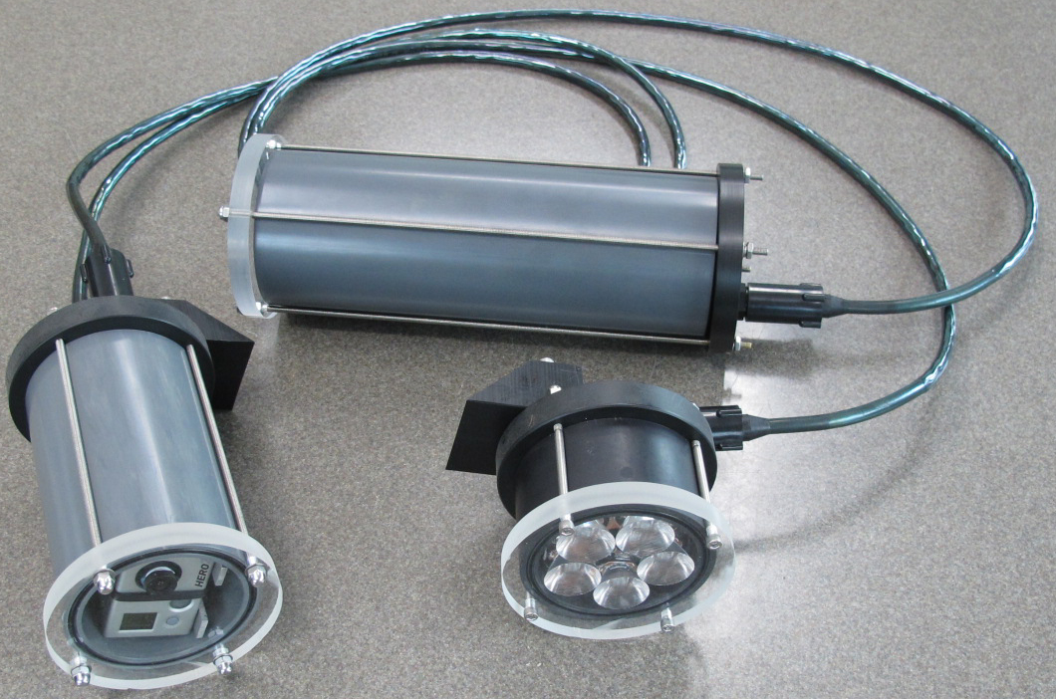
SeeStar:
Chad Kecy
Engineering an open source hardware design
Chad Kecy
Jan 20, 2015
Tuesday Jan 20, 2015

Slide 2
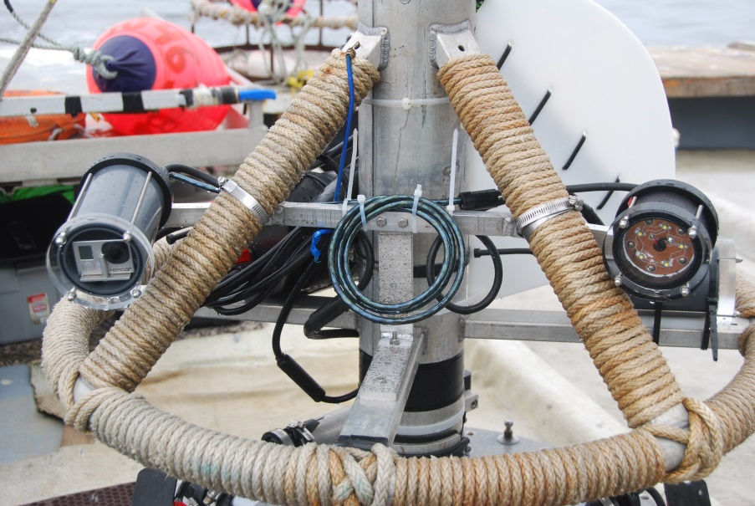
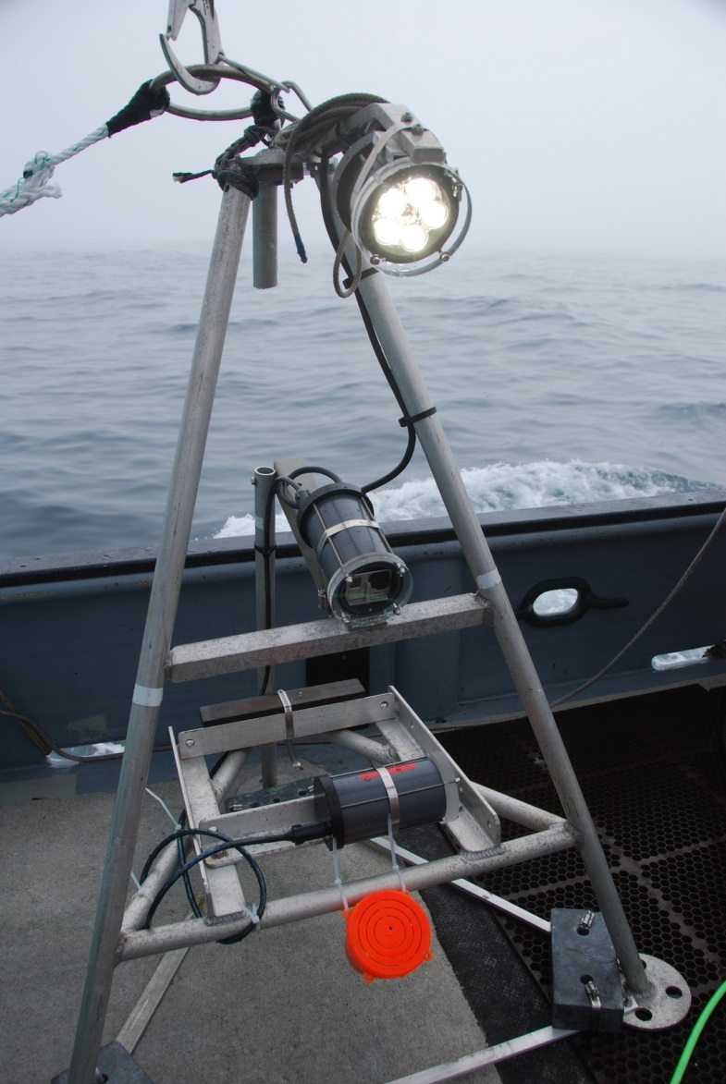
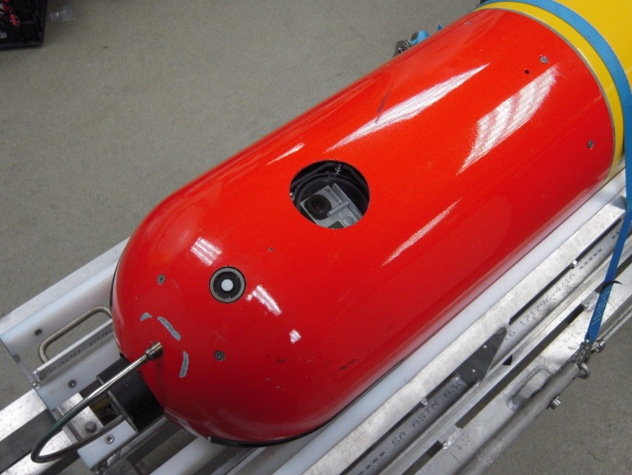
What is SeeStar and What Does it Do?

Slide 3
The Engineering Process
Define the problem
Specify system requirements
  Preliminary Design Review
Perform background research / evaluations
Choose a potential solution
  Concept Design Review
Develop a prototype solution
Test the solution
Refine the solution as necessary

Slide 4
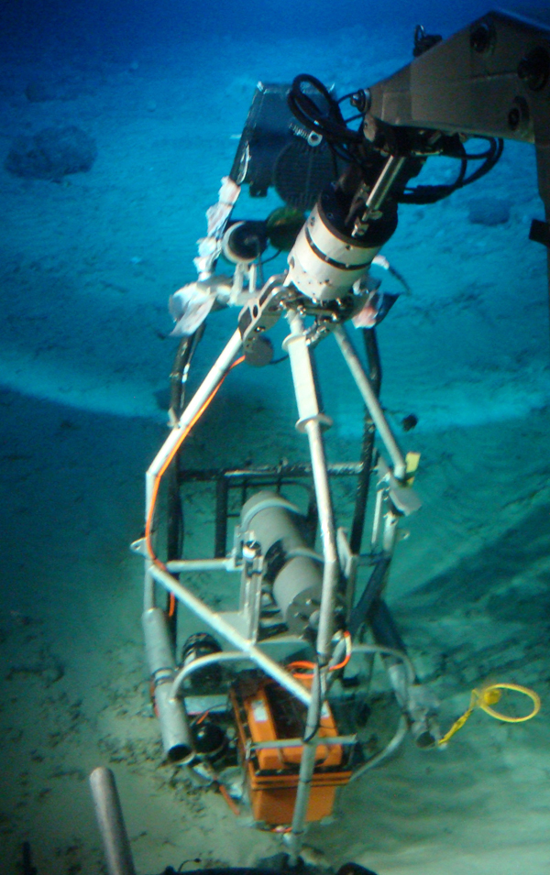
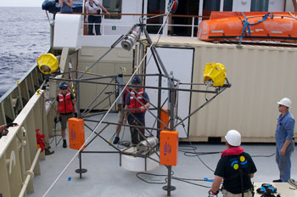
Define the Problem
Existing MBARI Cameras
  Large, difficult to deploy camera systems
  Expensive

Slide 5
Functional Requirements
Specification | Specified Value | SeeStar Prototype
Platform | AUV/mooring/wharf | All
Target | Large macroplankton | Large macroplankton
Target size | >1 cm | > 10 cm
Rate of Images | Once/10 min, Once/Hour | Once/2 sec
Color vs. B&W | color important | Color
Image Trigger | Optional | Not yet implemented
Depth | 200m | 300m
Field of View | 1 x 1.5 m | 1 x 1.5 m
Lighting | Side illumination | Side illumination
Deploy Duration | 2 months | 2 months +
Total # of Images | 1440 | 2900
Other | Hibernation, biofouling | Hib: Y Biofoul: N

Slide 6
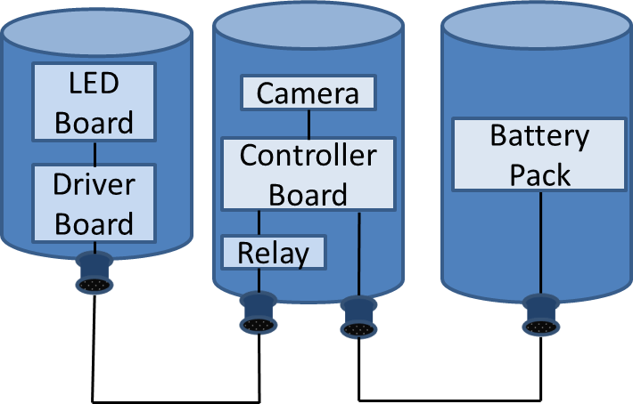
Preliminary Design Review
Present proposed idea
Doesn’t have to be a complete design

Slide 7
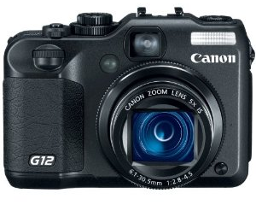
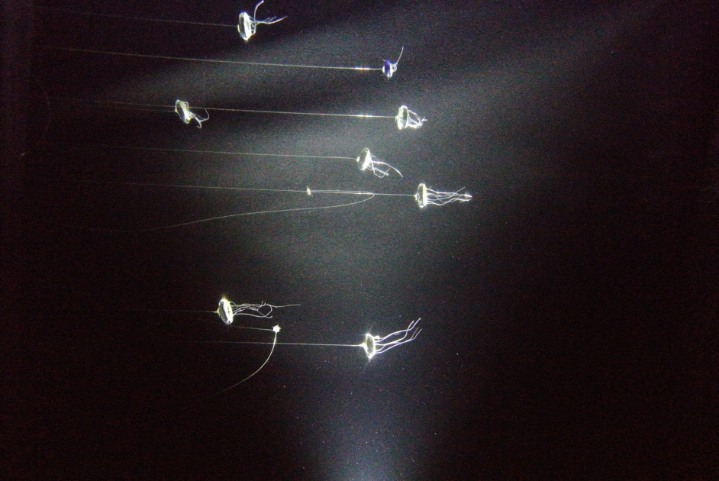
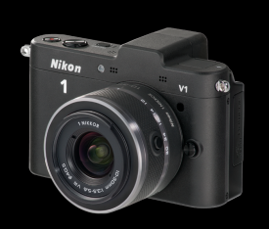
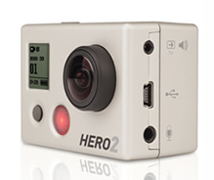
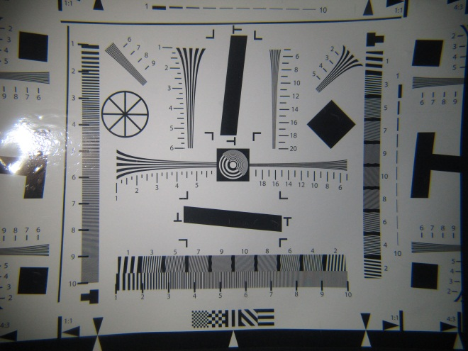
Background Research
Canon G12
Nikon 1V1
GoPro Hero 2
Camera selection drove the design of the lights and batteries

Slide 8
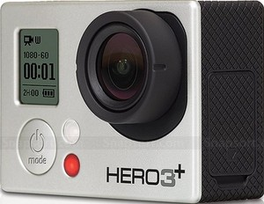
Choose a Solution
The Good:
  Good images with proper light
  Form factor
  Availability & cost
  Relatively easy to interface (via hardware)
The Bad:
  No manual control of exposure
  Poor low light camera
  No SDK or API available

Slide 9
Concept Design Review
Proposed hardware/software
  Block diagrams
  Concept sketches
Schedule
Personnel tasks
Cost

Slide 10
Develop the Prototype

Slide 11
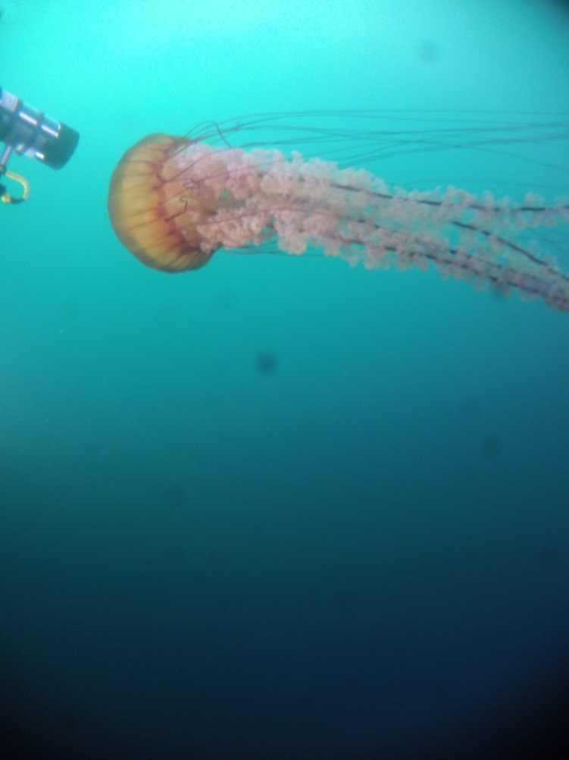
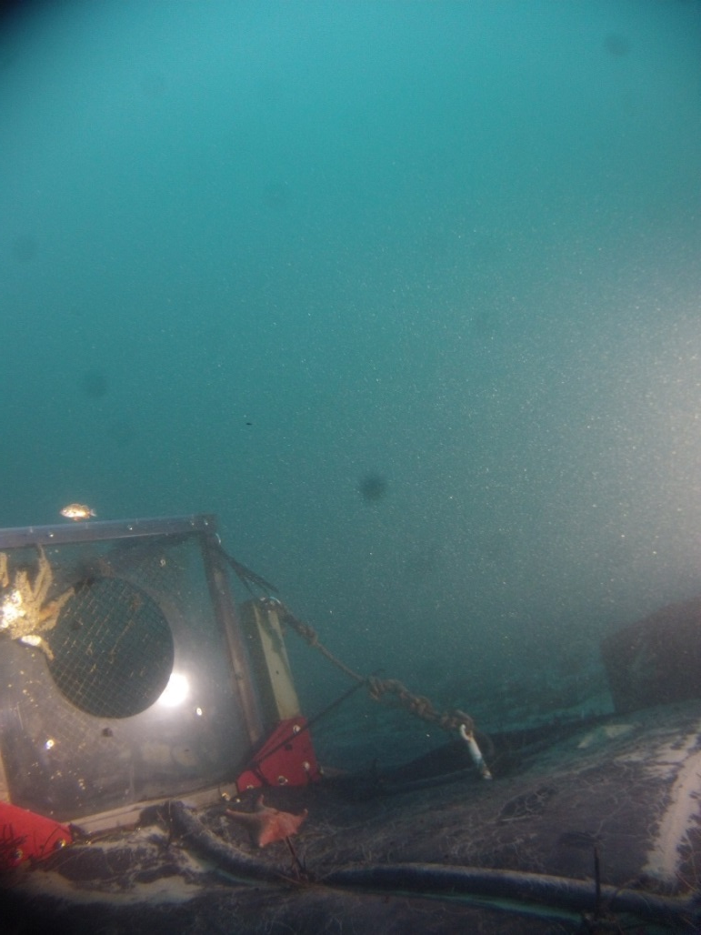
Prototype Testing
ROV Ventana
KFA/swFOCE site
- Series of depths (to 300m)
Image every 60 sec for 48 hours
Depth of 15m

Slide 12
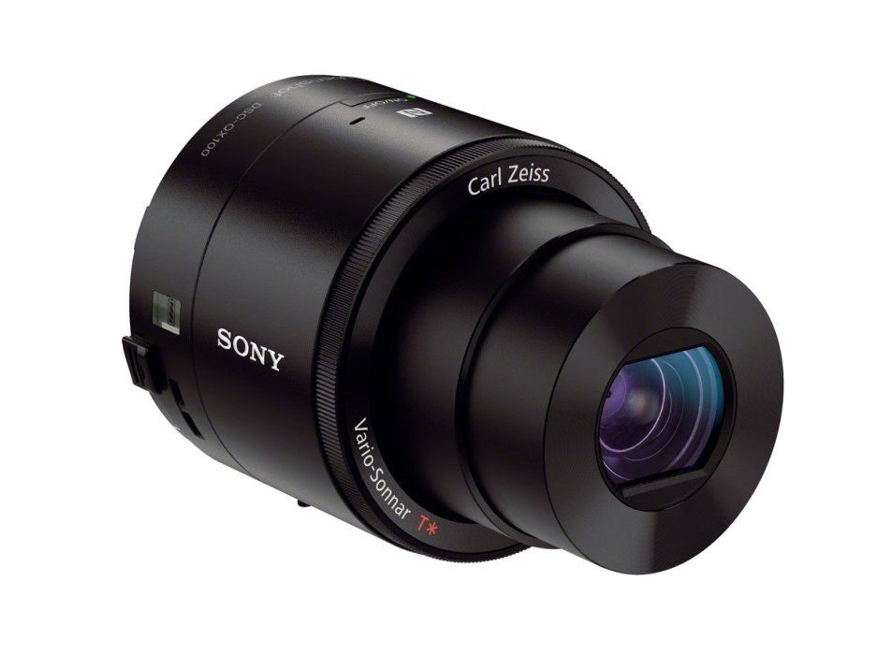
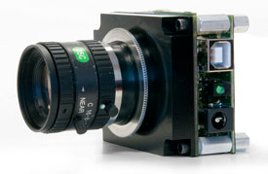
Refine/Upgrade System
Better imager
Reduce production cost further
Simpler electronic control board

Slide 13
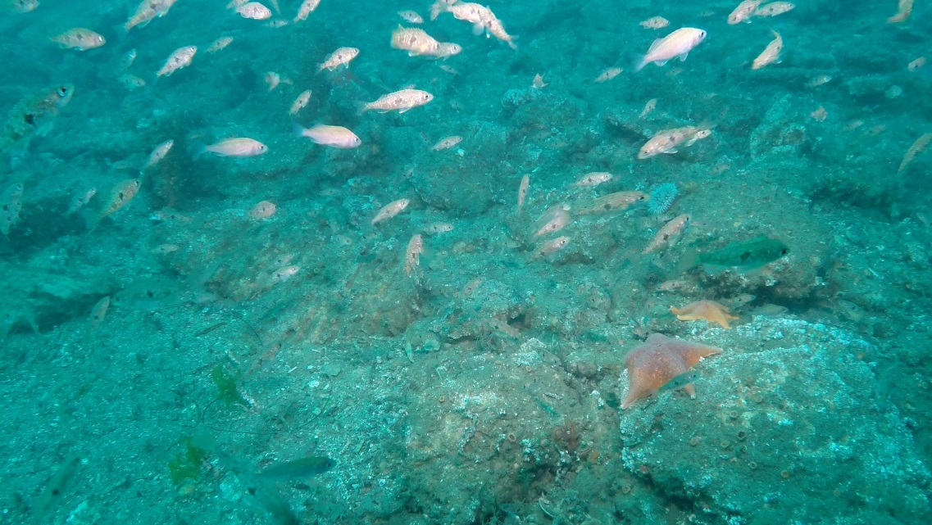
Questions?

