Slide 1
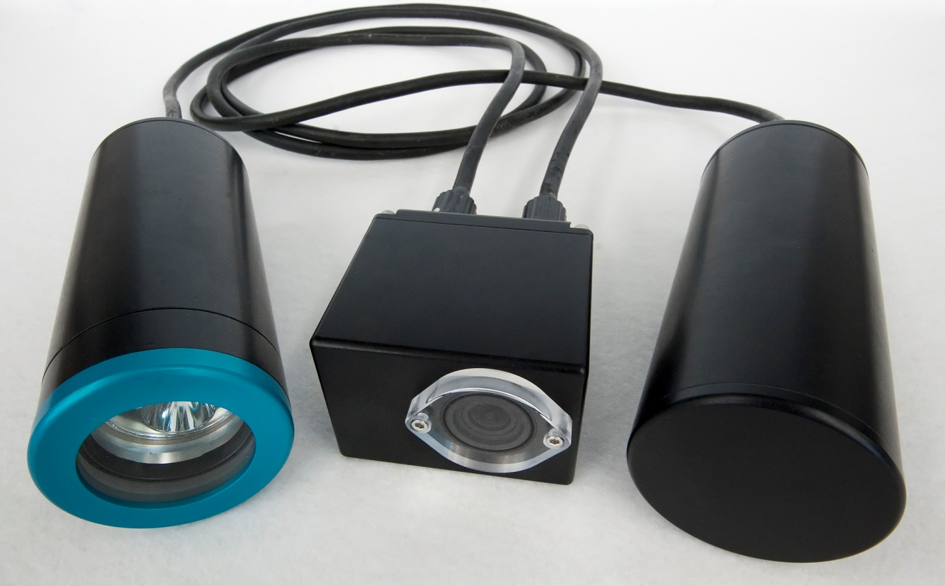

An Open-Source, Low-Cost Imaging System

Slide 2
Motivation for SeeStar
Why SeeStar is Important
Most commercial underwater camera systems are expensive, large, and difficult to deploy.
SeeStar is:
  Inexpensive
  Easy to build
  Can be deployed on virtually any platform
  Open source design
  Modifiable
Current and potential external users
  The Nature Conservancy
  Ca Fish and Wildlife
  Ca Wetfish Producers Association
  MESTECH & Irish Marine Institute
  Noyo Center for Marine Science
  National Wildlife Health Center
  Oakland University
  MLML
MBARI Users
  Steve Haddock
  LRAUV
  Wave Glider
  Power Buoy

Slide 3
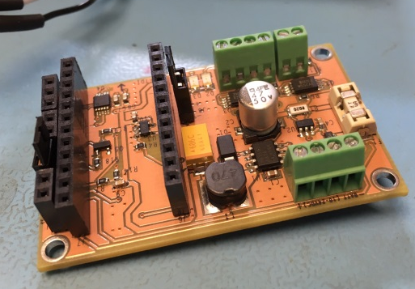
SeeStar Progress
Future of SeeStar
MBARI engineering:
  Reduce design complexity and make easy to build
  Translate fabrication steps into an easy “how-to” build document
Have designed and built 2 versions of SeeStar
  Open source plans are online
  Supplier of commercial underwater housings found
  Custom controller board finished
Beginning design of Gen3 system
Continue to support users of Gen 1 and 2 systems
Designing Gen3 version:
  More capable imager (Live view, stereo imaging)
  Ability to add oceanographic sensors
  Data logging

