Slide 1
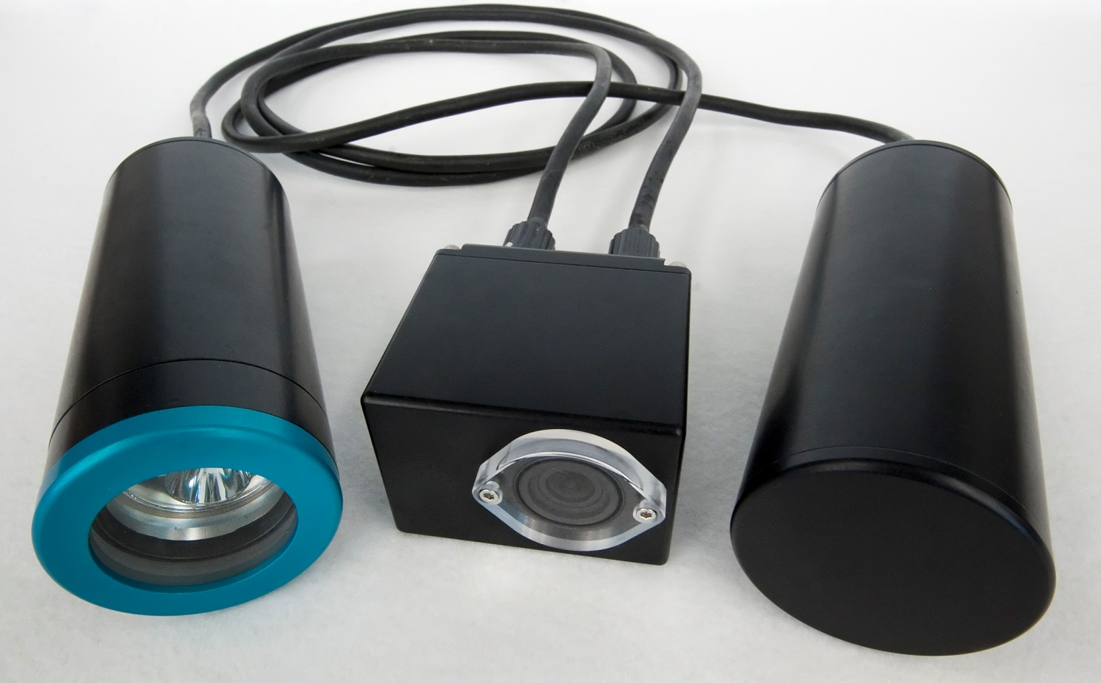

An Open-Source, Low-Cost Imaging System

Slide 2
Motivation for SeeStar
Why SeeStar is Important
Most commercial underwater camera systems are expensive, large, and difficult to deploy.
SeeStar is:
  Inexpensive ($2500)
  Easy to build
  Can be deployed on virtually any platform
  Open source design
  Modifiable
Current and potential external users
  The Nature Conservancy
  Ca Fish and Wildlife
  Ca Wetfish Producers Association
  MESTECH & Irish Marine Institute
  Noyo Center for Marine Science
  National Wildlife Health Center
  Oakland University
  MLML
MBARI Users
  Steve Haddock
  LRAUV
  Wave Glider
  Power Buoy

Slide 3
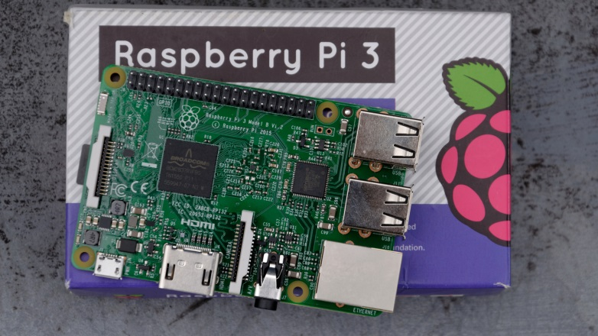
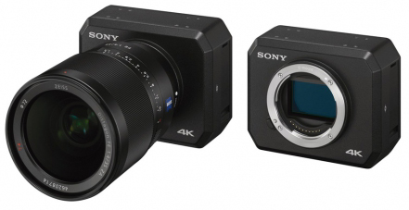
Future of SeeStar
Continue to support users of Gen 1 and 2 systems
All documentation online
Designing Gen3 version:
  Sony UMC-S3C camera
  All parts over-the-shelf (no custom hardware)
  Sensor module allows ability to add oceanographic sensors
  Data logging
  Autonomous or tethered

