Slide 1
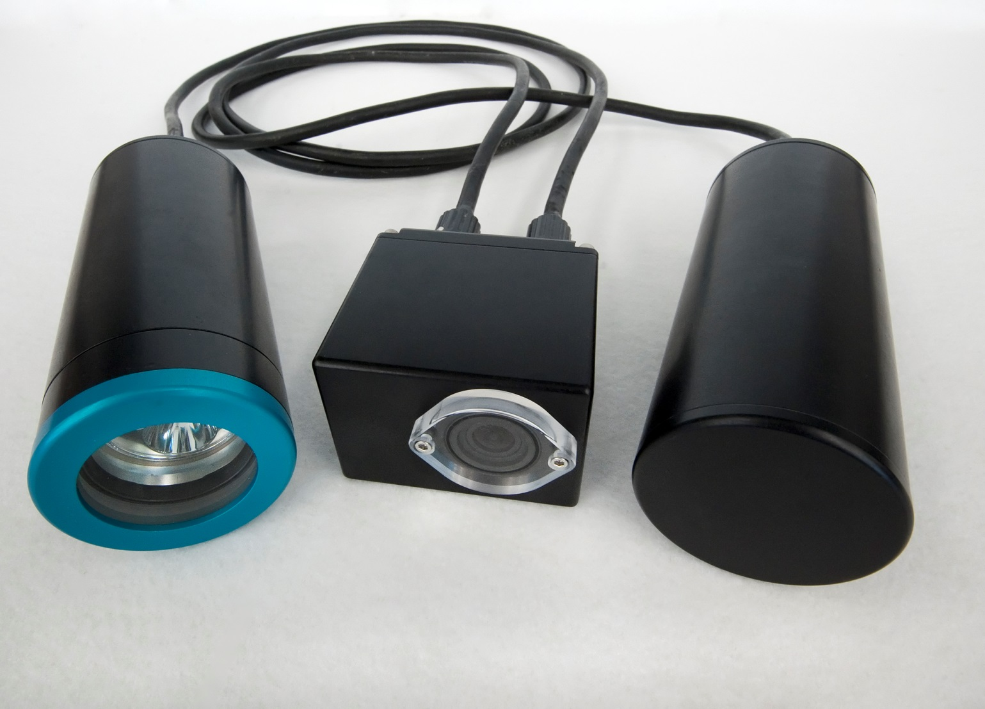
SeeStar
A Low Cost Imaging System

Slide 2
Motivation for SeeStar
Why SeeStar is Important
Most commercial underwater camera systems are expensive, large, and difficult to deploy.
SeeStar is:
  Inexpensive
  Easy to build
  Can be deployed on virtually any platform
  Open source design
  Modifiable
Large number of small-scale researchers in need of an underwater imaging system
  The Nature Conservancy
  Ca Fish and Wildlife
  Ca Wetfish Producers Association
  MESTECH & Irish Marine Institute
  Noyo Center for Marine Science
  National Wildlife Health Center
  Oakland University
  MLML
MBARI Users
  Steve Haddock
  LRAUV
  Wave Glider
  Power Buoy

Slide 3
SeeStar Progress
Future of SeeStar
MBARI engineering:
  Absorb NRE costs
  Translate fabrication steps into an easy “how-to” build document
Have designed and built 2 versions of SeeStar
  Open source plans are online
Begin design of Gen3 system in 2016
Continue to support users of Gen 1 and 2 systems
Designing Gen3 version; To include:
  More capable imager (Live view, stereo imaging)
  Ability to add oceanographic sensors
  Data logging

Slide 5
Fundamental problem/question
Most commercial underwater camera systems are expensive, large, and difficult to deploy.
SeeStar is:
  Inexpensive
  Easy to build
  Can be deployed on virtually any platform
  Open source design
More

Slide 6
Why is it important?
Large number of small-scale researchers in need of an underwater imaging system
  The Nature Conservancy
  Ca Fish and Wildlife
  Ca Wetfish Producers Association
  MESTECH & Irish Marine Institute
  Noyo Center for Marine Science
  National Wildlife Health Center
  Oakland University
  MLML
MBARI Users
  Steve Haddock
  LRAUV
  Wave Glider
  Power Buoy

Slide 7
Doing about it?/MBARI’s unique contribution?
Utilizing MBARI engineering to:
  Absorb NRE costs
  Translate fabrication steps into an easy
  “how-to” document
Have designed and built 2 versions of SeeStar
  Open source plans are online
Designing a more capable 3rd version
More

Slide 8
Future/Where are we Going?
Continue to support users of Gen1/2 systems
Designing Gen3 version; To include:
  More capable imager (Live view, stereo imaging)
  Ability to add oceanographic sensors
  Data logging
More

Slide 9
What’s the fundamental problem or question, or issue you are addressing?
Why is it important/why should anyone care?
What are we doing about it/what’s MBARI’s unique contribution?
What does the future hold/where is it going?

