Slide 1
Self-Contained Plankton Imager
2013 Abstract Presentation
Monday July 9 2012

Slide 2
What is SCPI?
Differs from existing systems which are:
  Require dedicated cables, ships, and winches
  Difficult to deploy, maintain, and operate
  High cost
Widely distributed

Slide 3
SCPI Users and Use Cases
Users
Platforms
Steve Haddock
Ken Smith
Jim Bellingham
CANON
AUVs
Profilers
Moored (Plankton Vane)
Sediment Traps
Observatory (Cabled Option)
Manually dropped or towed
Ships of opportunity
Pier mounted

Slide 4
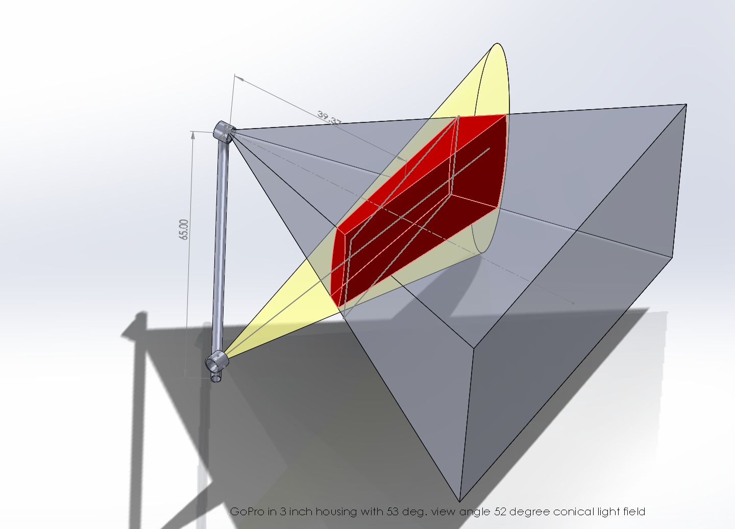
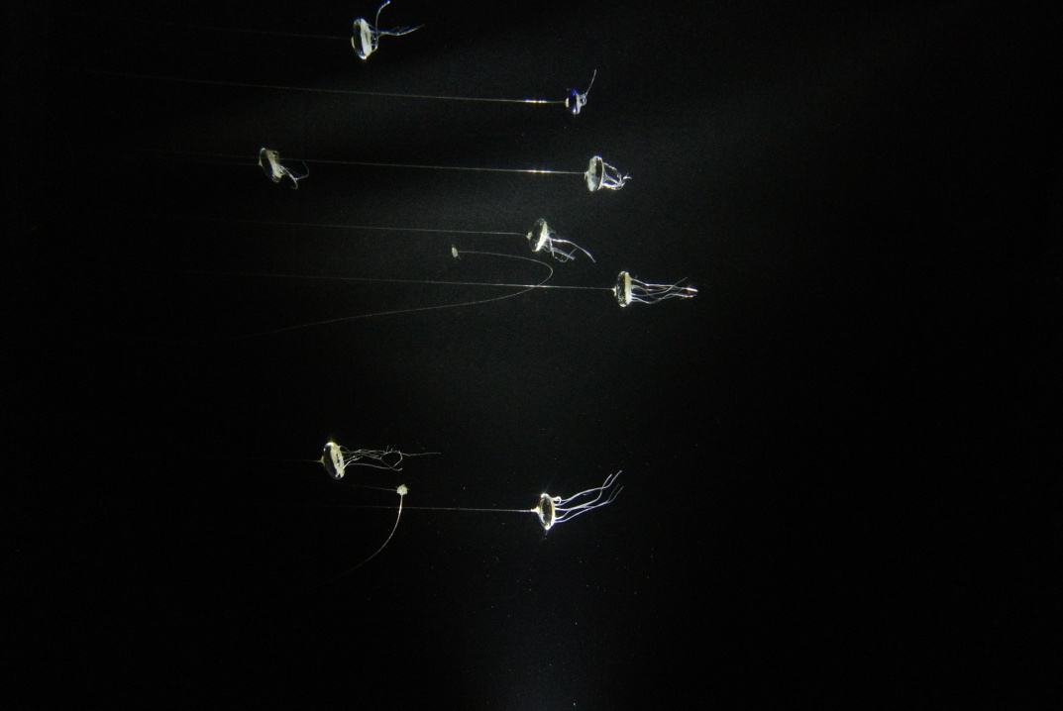
Why we need more time in 2013
SCPI was originally a two year project started in 2011.
Due to other commitments, work did not start in earnest until the Fall of 2011.
Rigorous engineering testing of cameras and lights took 1st half of 2012.

Slide 5
Where are we now?
Have a set of functional requirements
Have completed initial camera evaluation
Completed lighting requirement calculations and power budget
Completed Concept Design Review
Have a modular housing design concept
Camera
Battery
Light

Slide 6
Where will we be at the end of 2012
We plan to build a prototype SCPI unit by the end of 2012.
This prototype will be based on the GoPro Hero2 camera.

Slide 7
Meets requirements of:
This prototype will allow:
LaGrangian Sediment Trap (Smith Lab)
Macro Zooplankton (Haddock Lab)
Testing of modular concept
Testing of image quality in real world conditions under various light levels
Testbed for higher image quality SCPI sytem

Slide 8
The prototype will not yet have:
  Full manual control
  Embedded metadata
  Network transfer and control
  Optimal image quality for some targets

Slide 9
Proposed schedule for 2013
1st Quarter: Perform multiple field tests
1st/2nd Quarter: Based on test results, find alternate camera and make modifications/upgrades to system
2nd Quarter: Develop higher image quality camera module
3rd Quarter: Build two complete SCPI systems
4th Quarter: Testing and deployment.

Slide 10
Where does SCPI fall within MBARI Camera Projects?
Moored
Camera Sys
Time-Lapse
Camera
Imaging AUV
Ocean Imaging
LRAUV
Verification Cam
SIZE
SCPI
Shark Cam
COST

Slide 11
Relevance to Strategic Plan
Research Themes: Ocean Visualization
  SCPI allows for realizing four-dimensional visualizations – repeated spatial renderings over time.
Institutional Objectives: (2) Increase Institutional Flexibility
  Rapid prototype
Institutional Objectives: (3) Enhance Collaborations
  Low cost of SCPI eases ability of outside organizations to build their own, thus increasing the spatial network

Slide 12
End

Slide 13
Science Motivation
Macroplankton Quantification
  Physical Sensors: relatively easy. “Biology” = fluorometry
  Increase spatial coverage and time series
Sedimentation and marine snow flux
Ground-truthing acoustical biomass
Reconfigurable target size via optics
Primary users: MBARI principal investigators
Affordable for cities, individuals & small institutes
Widely available for diverse applications
Uses:
Users:

Slide 14
How is it Different?
Many existing systems
  All “Oceanographic” scale
  Requires dedicated cables, ships, and winches
  Packages difficult to deploy, maintain, and operate
  High cost
Crittercams
  Not available for plankton-sized targets

Slide 15
Low-Cost, Widely Distributed
Off the shelf parts
  Available online or locally
Low cost
  Total system cost <$3000
Easy to manufacture
Open source
  Meets needs of MBARI PIs first
  All schematics, software, plans posted on web

Slide 16
Deployment Modes
AUVs
Profiling
Moored (Plankton vane)
Sediment traps
Observatory (Cabled option)
Manually dropped or towed
Ships of opportunity
Pier mounted

Slide 17
Modular Functionality
Light
Camera
Light
Battery

Slide 18
Example of 6x40 degree Conical Reflector
(Red is common volume between imager and light field)

Slide 19
