Slide 1

2016 Abstract Presentation
Tuesday July 7 2015

Slide 2
What is SeeStar?
System description
  Low-cost imaging system (<$3000)
  Easy to build
  Off-the-shelf components
  Open source design
Overarching goals
  Make underwater imaging more affordable and easier for researchers
  Enable large scale surveys that require many cameras

Slide 3
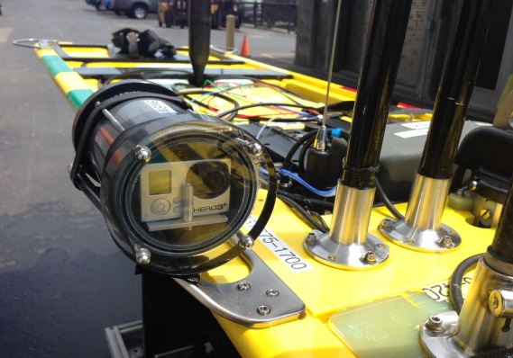
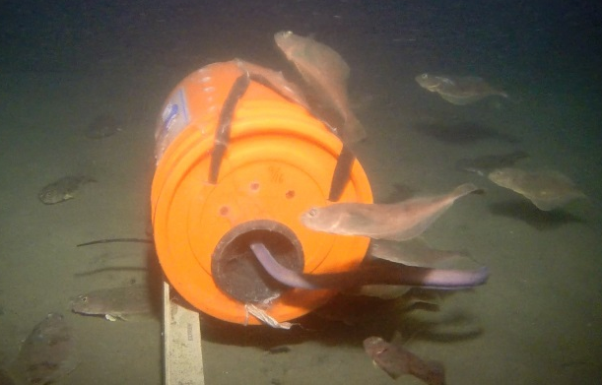
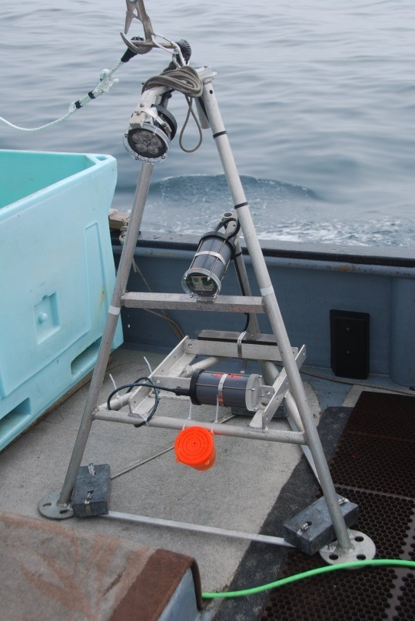
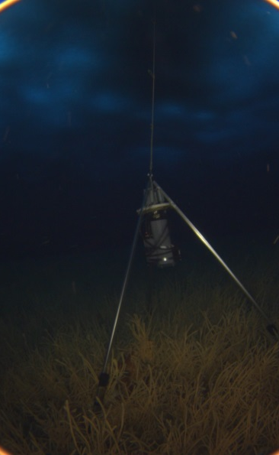

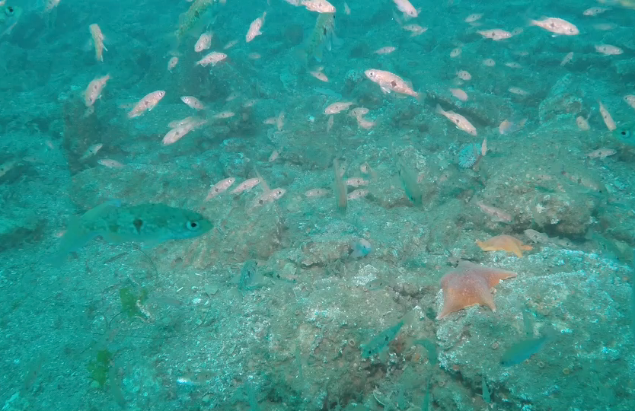
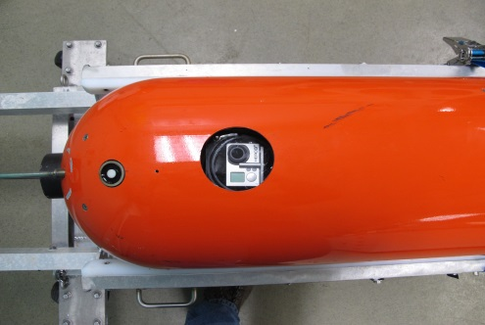
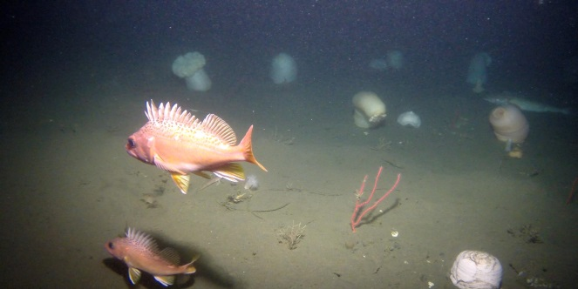
SeeStar Users and Use Cases
Some Users
LRAUV (MBARI)
Waveglider (MBARI)
Steve Haddock (MBARI)
The Nature Conservancy
Stacy Kim (MLML)
California Fish & Wildlife
CA Wetfish Producers Assn.

Slide 4
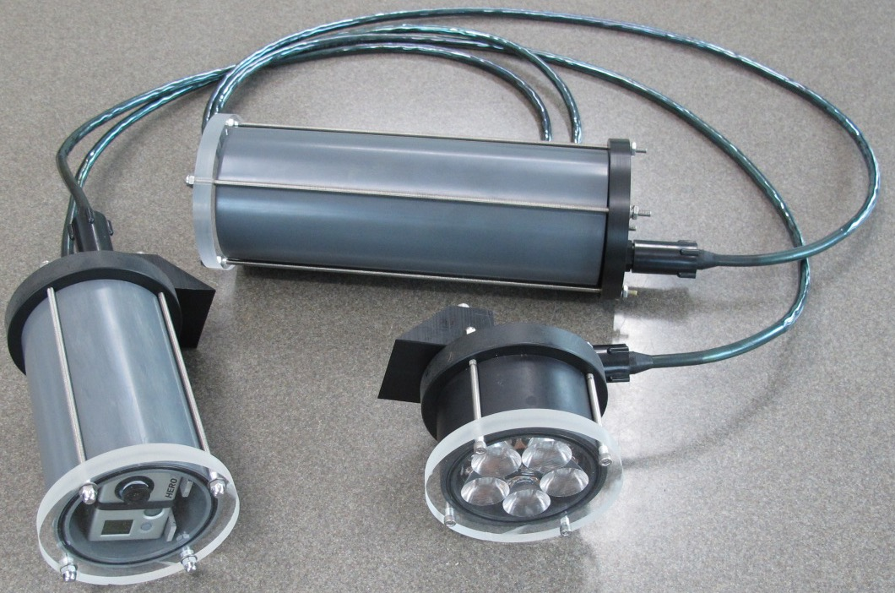
SeeStar I
Completed and plans posted online
Has been deployed multiple times in various locations

Slide 5
SeeStar II
Same functionality as SS 1 but easier to build thanks to more off-the-shelf components
Still based on the GoPro Hero 3/3+
Simpler to program thanks to Arduino based control board
1500m off-the-shelf aluminum housings
Same cost or less than SS 1
Finalizing design of SS2 during 3rd/4th quarter of 2015

Slide 6
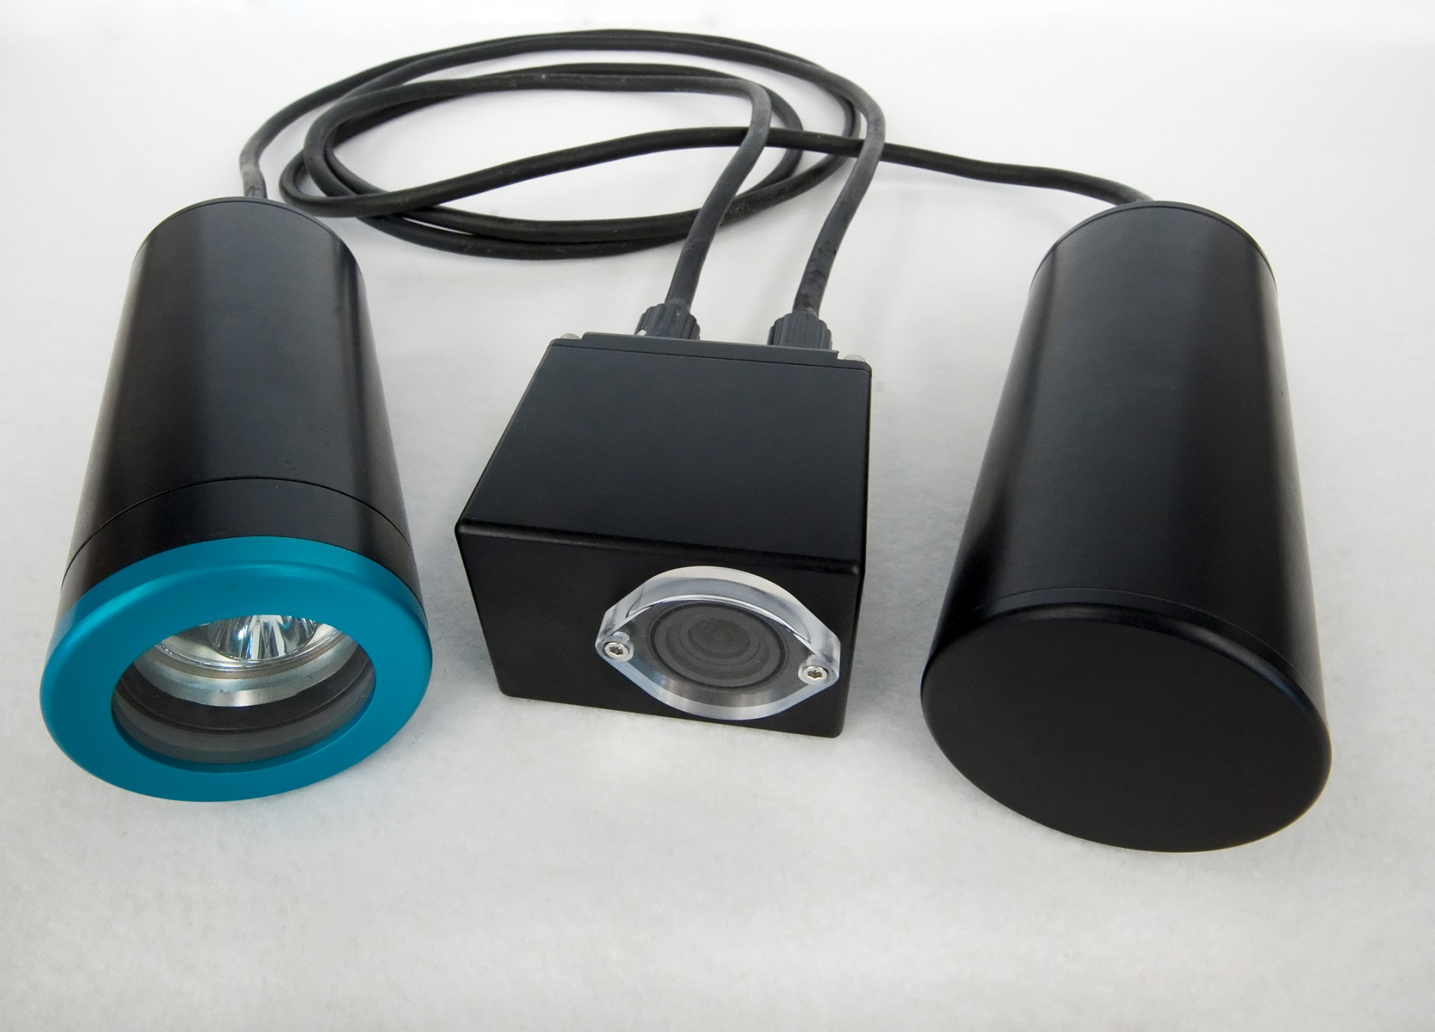
SeeStar II

Slide 7
Visual Tools Workshop (April 2015)
Steve Haddock and Chad Kecy participated in the Nature Conservancy led Visual Tools Workshop
Consisted of users of visual tools from multiple organizations with many overlapping operational needs
Drafted a set of functional requirements for a low-cost imaging system with the ability to add external sensors

Slide 8
Workshop requirements met by SeeStar
 | SeeStar II | Workshop Requirements
Image Resolution | 12MP | 5MP
Video Resolution | Up to 4K | 2.7K
Image Storage | 3000 | 720
Platform | Multi-Platform | Multi-Platform
Depth Rating | 1500m | 300m
Tethered or Autonomous | Both | Both
Deployment Duration | Several months | 30 Days
Mass/Size | 18 lbs in air | Hand Deployable
Cost | <$3000 | <$5000

Slide 9
Workshop requirements not met by SeeStar
 | SeeStar II | Workshop Specs
Camera Control | Automated | Fully Manual
External Sensors | No | Depth, Time, Temp
Data Logging | No | Yes
Live Stream | No | Optional
Stereo Imaging | No | Optional

Slide 10
Proposed SeeStar III
Imager
  High resolution stills and video
  Full manual control of camera settings (ISO, shutter, etc...)
  Ability to sync a second camera
  Strobe output
  Long term availability of imager from manufacturer
  Manufacturer software available
Control Board
  Commercial off the shelf
  Analog inputs for external sensors
  Real time clock
  Ethernet support (for camera control and live viewing)
  Logging of time and sensor data
Power
  Can be powered with battery or tether

Slide 11
SeeStar III Block Concept
Power +
Ethernet
Light
Depth & Temp
Sensors
New functions:
  External sensors: Depth, Temp, and possibly Oxygen
  Data is time stamped and logged onboard
  Ability to add a second camera for stereo imaging
  Live streaming
  Control via tether
Master
Camera
Slave
Camera
Batt
Blue: Core system
Green: Optional Modules

Slide 12
Proposed schedule for 2016
1st Quarter
  Evaluate imagers and control board options
2nd Quarter
  Imager & control board selected, start of electrical design
  Start housings design
3rd Quarter
  System integration
4th Quarter
  Bench top version tested and operational

Slide 13
Data Management
SeeStar Project will not generate much data
External users manage their own data
MBARI users may use the same tools as miniROV & I2MAP.
  Storage, access & annotation
  In contact with B. Schlining & R. Schramm

Slide 14
Summary
SeeStar I completed, plans posted online.
SeeStar II nearly completed:
  simplified design
  1500m rated off-the-shelf housings
  plans to be posted online in late 2015
SeeStar III planned for 2016:
  New imager
  Capable of logging external sensors
  Prototype built and tested by end of 2016

