Slide 1

2016 Abstract Presentation
Tuesday July 7 2015

Slide 2
What is SeeStar?
Low-cost imaging system
Open source
Easy to build
Off the shelf components

Slide 3
SeeStar Users and Use Cases
Users
Platforms
Steve Haddock (MBARI)
Tethys class LRAUVs (MBARI)
The Nature Conservancy
Stacy Kim (MLML)
California Fish & Wildlife
California Wetfish Producers Association
Waveglider (MBARI)
AUVs
Profilers
Moored (Plankton Vane)
Sediment Traps
Observatory (Cabled Option)
Manually dropped or towed
Ships of opportunity
Pier mounted

Slide 4
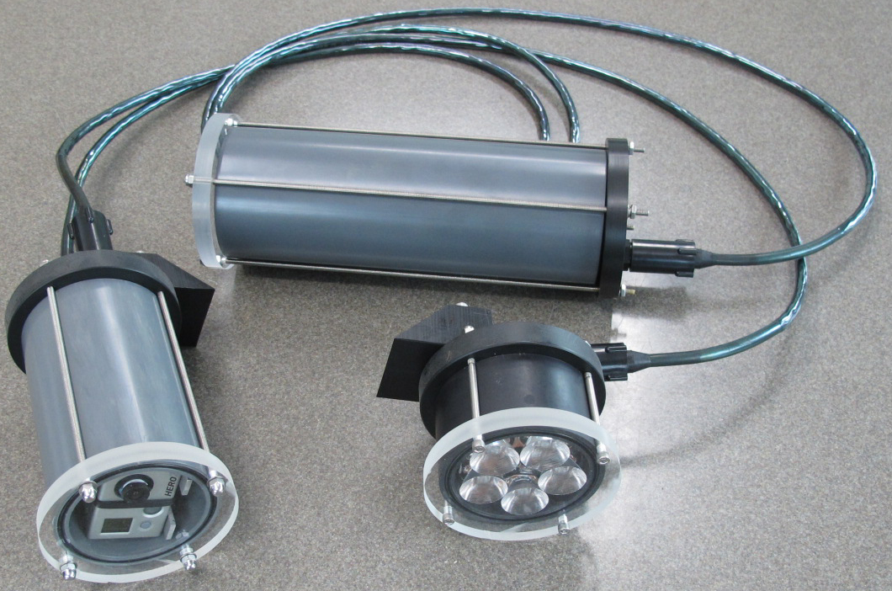
SeeStar 1.0
Completed and plans posted online
Has been deployed multiple times in many locations

Slide 5
SeeStar 2.0
Same functionality as 1.0 but easier to build due to using more off-the-shelf components
Still based on the GoPro Hero 3/3+
Simpler to program due to using an Arduino based control board
Deeper rated (1500m) due to off-the-shelf aluminum housings
Same cost or less than 1.0
Making final (small) changes to 2.0 during 3rd/4th quarter of 2015

Slide 6
SeeStar 2.0
Insert picture of complete Gen2 system

Slide 7
Visual Tools Workshop (4/28/2015)
Steve Haddock and Chad Kecy participated in the Nature Conservancy led Visual Tools Workshop
Consisted of users of visual tools from multiple organizations with many overlapping operational needs
End result was a set of functional requirements for a low-cost imaging system with the ability to add external sensors

Slide 8
Functional Requirements
 | SeeStar 1.0 | SeeStar 2.0 | Workshop Specs | SeeStar 3.0
Optical
Target Size | >10cm | >10cm | >15cm
Field of View | 1m x 1.5m | 1m x 1.5m | 90-100 deg
Video vs Stills | Both | Both | Both
Image Resolution | 12MP | 12MP | 5MP
Video Resolution | 2.7K | 4K | 2.7K
Image Storage | 2900 | 2900 | 720
Video Storage | 2 Hours (@ 2.7K) | 2 Hours (@ 2.7K) | 24 Hours
Rate of Images | Once/2 sec | Once/2 sec | Once/60 min
Camera Control | Automated | Automated | Fully Manual

Slide 9
Functional Requirements
 | SeeStar 1.0 | SeeStar 2.0 | Workshop Specs | SeeStar 3.0
Physical
Platform | Any | Any | Multi-Platform
Depth Rating | 300m | 1500m | 300m
Deployment Duration | 2 Months+ | 2 Months+ | 30 Days
Mass/Size | 18lbs dry 6lbs wet | 18lbs dry 6lbs wet | Hand Deployable
Tethered or Autonomous | Both | Both | Both
Cost | $2,950 | $2,950 | <$5000
Lighting | Any angle | Any angle | Required
Other
External Image Trigger | No | No | Optional
External Sensors | No | No | Depth, Time, Temp
Data Logging | No | No | Yes
Live Stream | No | No | Optional
Stereo Imaging | No | No | Optional

Slide 10
Proposed SeeStar 3.0
Imager
  High resolution stills and video
  Full manual control of optical settings (ISO, shutter, etc...)
  Ability to sync a second camera
  Flash (strobe) output
  Multi-year availability of imager from manufacturer
  Manufacturer software available (SDK, API...)
Control Board
  Commercial off the shelf
  Analog inputs for external sensors
  Real time clock
  Ethernet support (for live viewing)
  Data logging of time and sensor data
Power
  Can be controlled with battery or shore power

Slide 11
SeeStar 3.0 Block Concept
Power +
Ethernet
Retains all of the functionality of SeeStar 1.0
Adds the following functions:
  External sensors: Depth, Temp, and possibly Oxygen
  Realtime clock with current time and logged
  Data is time stamped and logged onboard
  Ability to add a second camera for stereo imaging
  Live streaming over optional shore tether
  Auto-start at programmed depth or via optional shore tether
  Ability to take initial picture onshore before deployment
Light
Depth & Temp
Sensors
Master
Camera
Slave
Camera
Batt
Blue: Core system
Green: Optional Modules

Slide 12
Data Management
Nearly identical needs as miniROV & I2MAP?
  Storage/access & annotation
  Brian Schlining & Rich Schramm
MBARI Cloud Computing project

Slide 13
Proposed schedule for 2016
1st Quarter
  Evaluate imagers and control board options
2nd Quarter
  Select imager/control board
  Begin housing design
3rd Quarter
  System integration
4th Quarter
  Bench top version operational

Slide 14
Questions for M-Team
The Nature Conservancy as collaborators
  Help form requirements
  Beta testing
Can we build a second system (in parallel with ours) for them to evaluate?
  Will they need to contribute $$ for this?
Separate data management work?

Slide 15
Relevance to Strategic Plan
Research Themes: Ocean Visualization
  SeeStar allows for realizing four-dimensional visualizations – repeated spatial renderings over time.
Institutional Objectives: (2) Increase Institutional Flexibility
  Rapid prototype
Institutional Objectives: (3) Enhance Collaborations
  Low cost of SeeStar eases ability of outside organizations to build their own, thus increasing the spatial network

Slide 16
End

