Slide 1

2018 Abstract Presentation
Wednesday May 24 2017

Slide 2
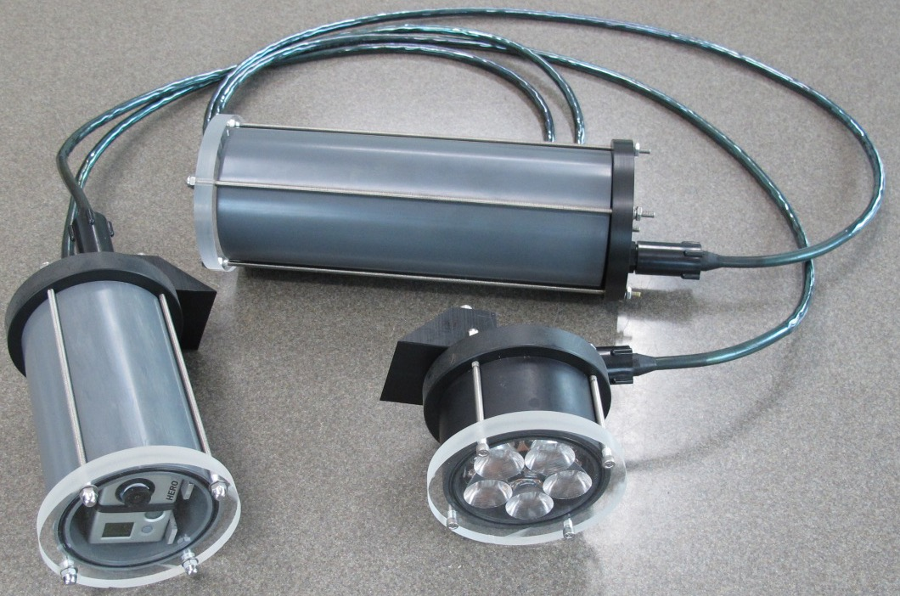
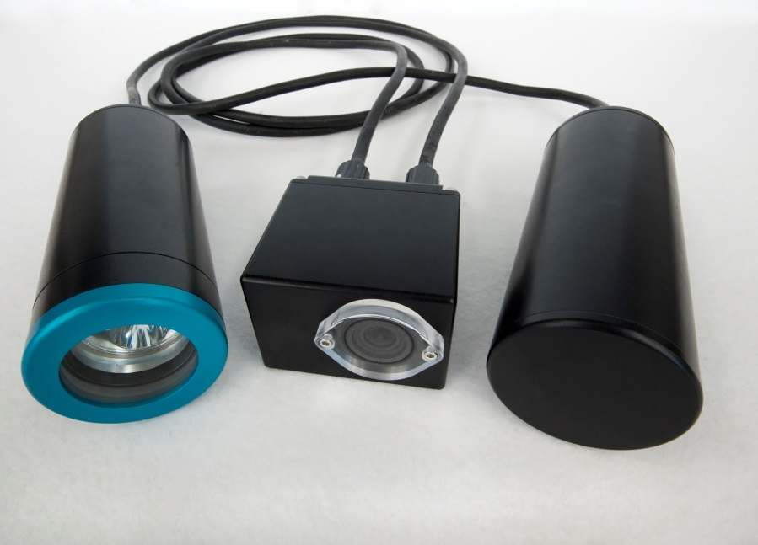
What is SeeStar?
System description
  Open source design
  Low-cost imaging system (<$3000)
  Easy to build
  Off-the-shelf components
Overarching goals
  Make underwater imaging more affordable and easier for researchers
  Enable large scale surveys that require many cameras

Slide 3
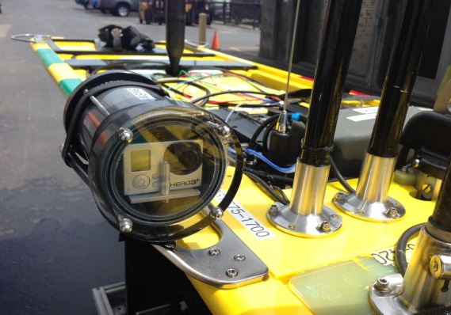
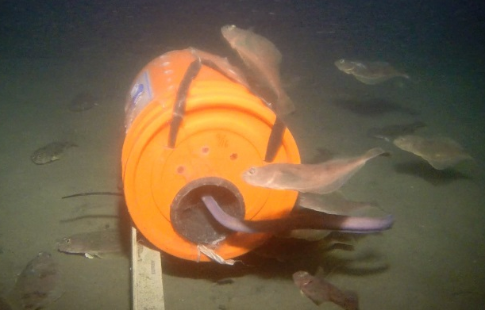
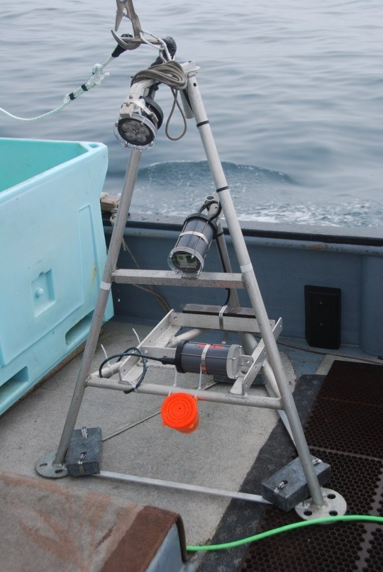
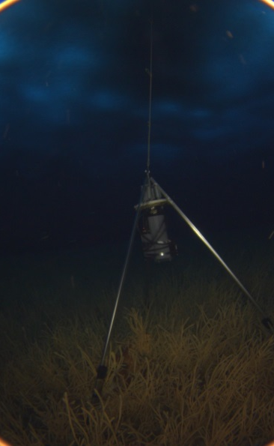

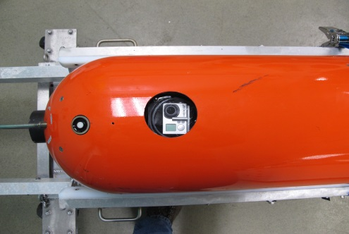
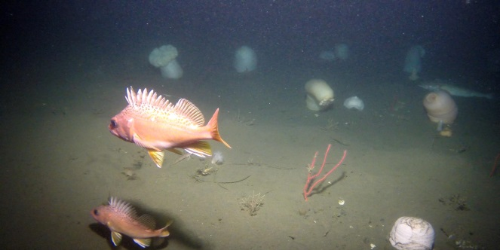
SeeStar Users and Use Cases
Some Users
Henk-Jan Hoving (Geomar)
Jonas Folleso (Researcher, Norway)
Amy Mueller (UW/USGS)
Cory Melanson (NSCC, Applied Oceans Research Group)
Jeffery Dorman (Farallon Institute)
Power Buoy (MBARI)
LRAUV (MBARI)
Waveglider (MBARI)
Steve Haddock (MBARI)
The Nature Conservancy
Stacy Kim (MLML)
California Fish & Wildlife
CA Wetfish Producers Assn.

Slide 4
Development in 2016-17
Camera evaluations
  Tight criteria; none that we evaluated met all of our specs
  Sony UMC-S3C met all requirements, but too expensive
Control board selection
  All Commercial-Off-The-Shelf (COTS), low power
  Ease of programming
Sensor module design/testing (Cal Poly)
  All COTS, low power
  Initial SW driver written for RBR Temp probe
Input from existing user base

Slide 5
SeeStar III Block Diagram
Shore
Tether
Camera Module
  Compatible with majority of Sony cameras
  Control board: Sleepy Pi2 + Raspberry Pi Zero
  Low power
  All COTS parts (no custom)
Sensor Module
  Ability to communicate with camera module
  Ability to interface up to 4 external instruments
Light
  SeeStar II module or
  Commercial LED module
Power
  Battery powered or
  Tethered to shore
Light
Camera
Module
Sensor
Module
Batt

Slide 6
SeeStar III Users/Use Cases
Smith Lab (MBARI)
  4000 meter version
Prof. Bob Miller, UCSB
  Bio fouling research & fish surveys
  Potential collaboration
  Sony UMC-S3C implementation
Thomas Reidl/Brent Roman
  Underwater acoustic modem evaluation
MARE
AUV Docking (MBARI)
LRAUV Integration (MBARI)

Slide 7
Activities for 2018-19
Build, test, and deploy the 4000 meter version for Ken Smith
Integrate the Sony UMC-S3C camera in conjunction with Bob Miller of UCSB
Finalize design of the tethered version of SeeStar III
  Streaming video interface
Work with Brent Roman & Thomas Reidl to interface SeeStar III with underwater acoustic modems
Work with GroupB Inc. (or other manufacturer) to build and sell SeeStar III housings
Complete open source documentation to be published online (add URL)
Continue to support both internal and external users

Slide 8
Summary
SeeStar III prototype finished in 2017
Many new use cases in 2018-19
2018-2019 is planned to be last two years of SeeStar development;
Beyond 2019, only support
moar

Slide 11
Visual Tools Workshop (April 2015)
Steve Haddock and Chad Kecy participated in the Nature Conservancy led Visual Tools Workshop
Consisted of users of visual tools from multiple organizations with many overlapping operational needs
Drafted a set of functional requirements for a low-cost imaging system with the ability to add external sensors

Slide 12
Workshop requirements met by SeeStar
 | SeeStar II | Workshop Requirements
Image Resolution | 12MP | 5MP
Video Resolution | Up to 4K | 2.7K
Image Storage | 3000 | 720
Platform | Multi-Platform | Multi-Platform
Depth Rating | 1500m | 300m
Tethered or Autonomous | Both | Both
Deployment Duration | Several months | 30 Days
Mass/Size | 18 lbs in air | Hand Deployable
Cost | <$3000 | <$5000

Slide 13
Workshop requirements not met by SeeStar
 | SeeStar II | Workshop Specs
Camera Control | Automated | Fully Manual
External Sensors | No | Depth, Time, Temp
Data Logging | No | Yes
Live Stream | No | Optional
Stereo Imaging | No | Optional

