Slide 1

2018 Abstract Presentation
Wednesday May 24 2017

Slide 2
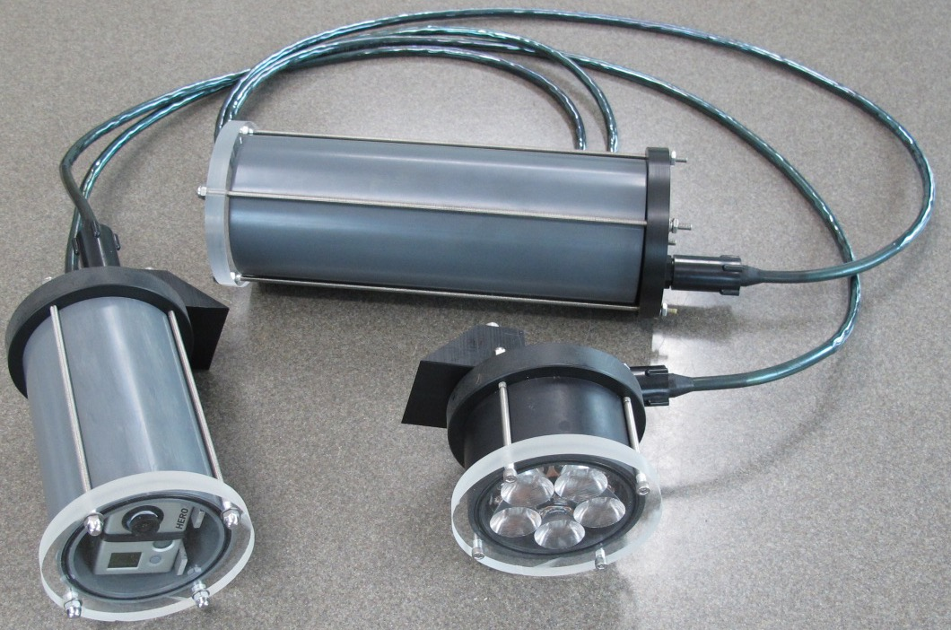
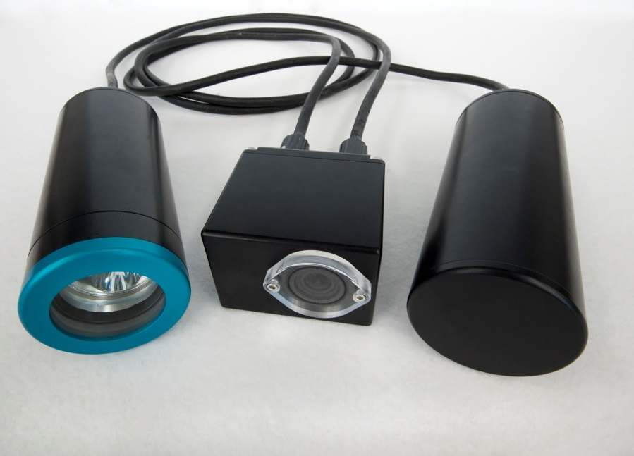
What is SeeStar?
SeeStar I
System description
  Open source design
  Low-cost imaging system (<$3000)
  Easy to build
  Off-the-shelf components
  Platform Independent
Overarching goals
  Make underwater imaging more affordable and easier for researchers
  Enable large scale surveys that require many cameras
SeeStar II

Slide 3
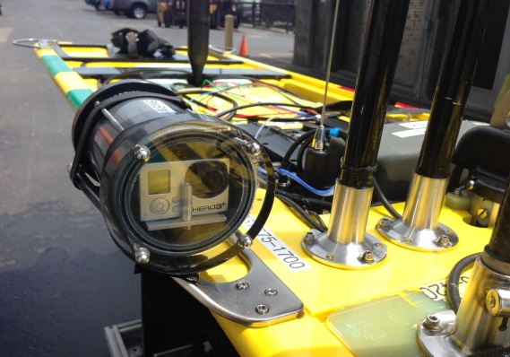
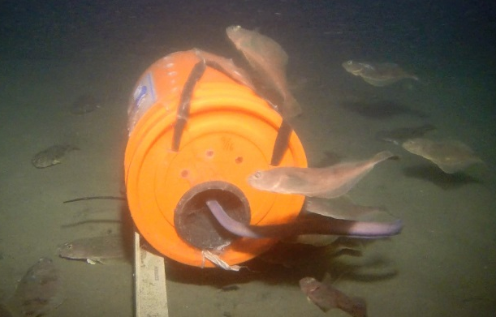
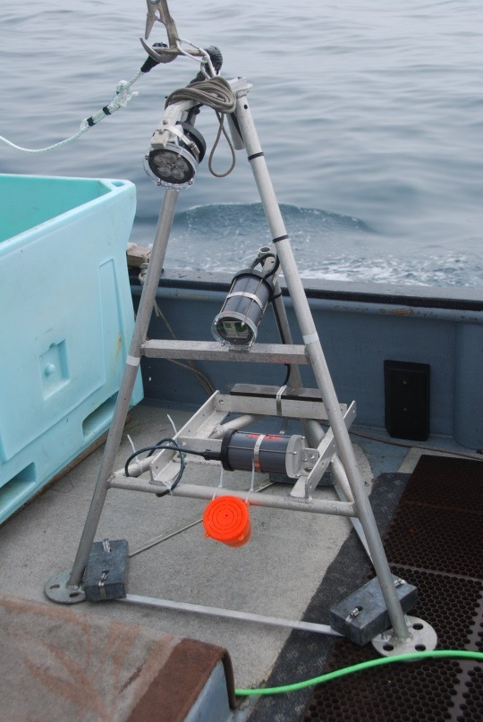
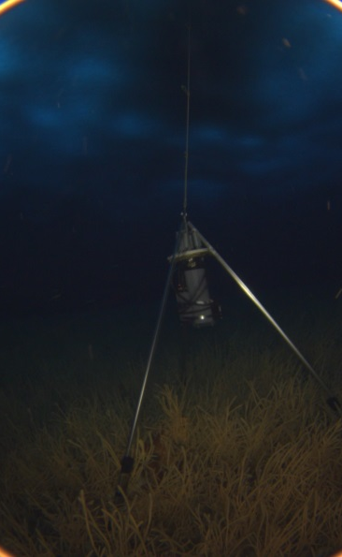

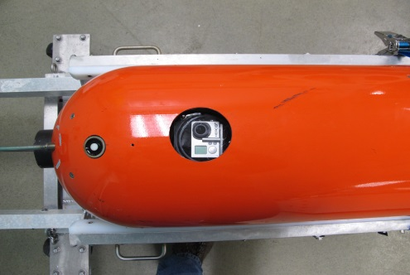
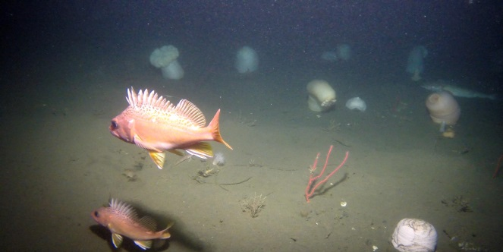
SeeStar Users and Use Cases
Some Users
Henk-Jan Hoving (Geomar)
Jonas Folleso (Researcher, Norway)
Amy Mueller (UW/USGS)
Cory Melanson (NSCC, Applied Oceans Research Group)
Jeffery Dorman (Farallon Institute)
Power Buoy (MBARI)
LRAUV (MBARI)
Waveglider (MBARI)
Steve Haddock (MBARI)
The Nature Conservancy
Stacy Kim (MLML)
California Fish & Wildlife
CA Wetfish Producers Assn.

Slide 4
Development in 2016-17
Camera evaluations
  Tight criteria; none that we evaluated met all of our specs
  Sony UMC-S3C met all requirements, but too expensive
Control board selection
  All Commercial-Off-The-Shelf (COTS), low power
  Ease of programming
Sensor module design/testing (Cal Poly)
  All COTS, low power
  Initial SW driver written for RBR Temp probe
Input from existing user base

Slide 5
SeeStar III Block Diagram
Camera Module
  Compatible with majority of Sony cameras
  Control board: Sleepy Pi2 + Raspberry Pi Zero
  Low power
  All COTS parts (no custom)
Sensor Module
  Ability to communicate with camera module
  Ability to interface up to 4 external instruments
Light
  SeeStar II module or
  Commercial LED module
Power
  Battery powered or
  Tethered to shore
Shore
Tether
Light
Camera
Module
Sensor
Module
Batt

Slide 6
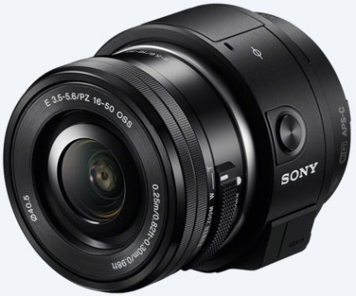
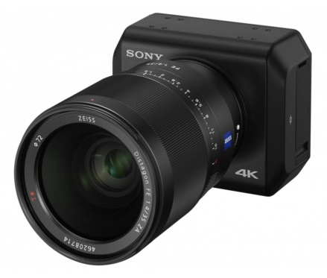
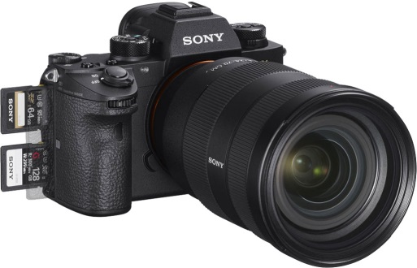
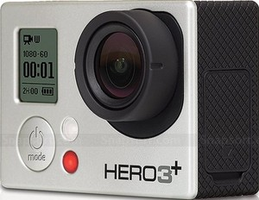
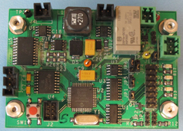
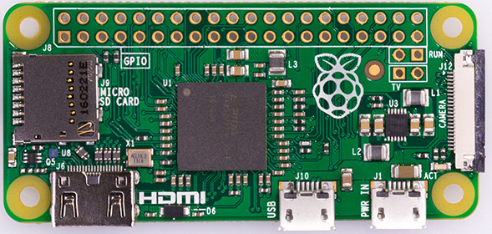
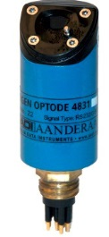


SeeStar III Upgrades
1. Camera
2. Control Board
3. Addition of a Sensor Module
Sensor
Module

Slide 7
SeeStar III Users/Use Cases
Smith Lab (MBARI)
  4000 meter version
Prof. Bob Miller, UCSB
  Bio fouling research & fish surveys
  Potential collaboration
  Sony UMC-S3C implementation
WetWiFi (Thomas Reidl/Brent Roman/Mathieu Kemp)
  Underwater acoustic modem evaluation
AUV Docking (MBARI)
LRAUV Integration (MBARI)

Slide 8
Where we are now
Camera Module
  All components selected & purchased
  Bench testing & power reduction on control boards (software)
Sensor Module
  Cal Poly student handed project off to Thom for refinement

Slide 9
Activities for 2018-19
Build, test, and deploy the 4000 meter version for Ken Smith
Integrate the Sony UMC-S3C camera in conjunction with Bob Miller of UCSB
Finalize design of the tethered version of SeeStar III
  Streaming video interface
Work with Brent Roman & Thomas Reidl to interface SeeStar III with underwater acoustic modems
Work with GroupB Inc. (or other manufacturer) to build and sell SeeStar III housings
Complete open source documentation to be published online (https://bitbucket.org/mbari/seestar)
Continue to support both internal and external users

Slide 10
Summary
SeeStar III prototype finished in 2017
Many new use cases in 2018-19
2018-2019 is planned to be last two years of SeeStar development
Beyond 2019, only support

