Slide 1
Self Contained Plankton Imager
Concept Design Review
Friday May 11 2012

Slide 2
Science Motivation
Macroplankton Quantification
  Physical Sensors: relatively easy. “Biology” = fluorometry
  Increase spatial coverage and time series
Sedimentation and marine snow flux
Ground-truthing acoustical biomass
Reconfigurable target size via optics
Primary users: MBARI principal investigators
Affordable for cities, individuals & small institutes
Widely available for diverse applications
Uses:
Users:

Slide 3
How is it Different?
Many existing systems
  All “Oceanographic” scale
  Requires dedicated cables, ships, and winches
  Packages difficult to deploy, maintain, and operate
  High cost
Crittercams
  Not available for plankton-sized targets

Slide 4
Low-Cost, Widely Distributed
Off the shelf parts
  Available online or locally
Low cost
  Total system cost <$3000
Easy to manufacture
Open source
  Meets needs of MBARI PIs first
  All schematics, software, plans posted on web

Slide 5
User Requirements
Lab | Vrijenhoek and Julio | Godin/Jim B. | Ken S. | Steve
Platform | Auv | LRAUV | LST | AUV/mooring/wharf
Target | Copepoda, larvae | Large organisms | particulates | Large macroplankton
Target size | 250 micron-2cm | 1 cm | 0.1cm to 1cm | >1 cm
Rate of Images | Burst at certain rate | Every 5-10 seconds | Once/Hour to Once/Day | Once/10 min, Once/Hour
Color vs. B&W | color important |  | color | color important
Special needs |  | Transfer images to CPU, low-drag housing
Image Trigger |  | External trigger | Trigger with acoustics
Depth | 250 m | 300 m | 1500 m (200m for Canon) | 200m
Power Limit |  | 1watt
Field of View |  |  | 1" Diam Circle 1m Dist | 1 x 1.5 m
Lighting | white |  | white
Better options than SCPI | LISST-HOLO would better meet reqs |  | SES camera system better to meet reqs
Deploy Duration |  | 1 week- 1 mo | 2 weeks | 2 months
Total # of Images |  |  | 336 | 1440-8640
Other |  | external camera trigger | very small payload | no adaptive triggering hybernation, biofouling issues

Slide 6
Functional Requirements
Optical Requirements
1. System shall be able to image a target of 1cm at 1m distance.
2. System shall have a field of view of 1m x 1.5m in water.
3. System shall have a depth of field of 20cm
4. System shall take color images.
5. System shall provide sufficient lighting for proper imaging.

Slide 7
Functional Requirements
Mechanical Requirements
1. System shall be rated for 300m.
2. System shall be autonomously deployable.
a. Maximum deployment: Two months
3. Physical size must accommodate LST and LRAUV.
a. LST: <1kg in water (no batteries)
b. LRAUV:

Slide 8
Functional Requirements
Electrical/Software Requirements
1. System shall have onboard power.
2. System shall be operable from an external power source.
3. System shall have onboard image storage.
a. Maximum number of images: 8640
4. System shall have a programmable sample rate.
a. Minimum sample time : One picture per day
b. Maximum sample time: One picture per two seconds
5. Images shall be time stamped.
a. Accuracy to one second per day
b. Resolution of one second
6. System shall be able to respond to an external trigger
7. System shall be able to retrieve photos without opening housing.

Slide 9
Deployment Modes
AUVs
Profiling
Moored (Plankton vane)
Sediment traps
Observatory (Cabled option)
Manually dropped or towed
Ships of opportunity
Pier mounted

Slide 10
Modular Housings and Endcaps
Short tube
Medium tube
Long tube
Solid End Cap
Flat Port End Cap
Connector End Cap
  Note: any end cap fits on either end of tube

Slide 11
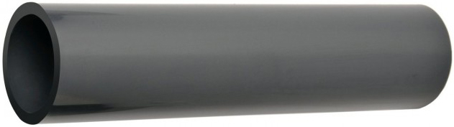
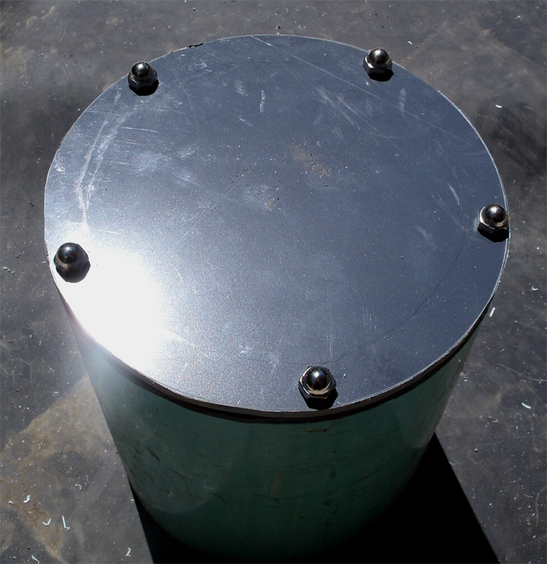
Housing Material
SCPI Underwater Housing
Design Requirement: 300 meter depth rating |  |  |  |  |  | calculated value
Material | Yield Stress (PSI) | Working Strength (PSI) | I.D. | O.D. | Wall Thickness | Length (inches) | Preliminary Depth Rating (meters) | Factor of Safety over Failure | Notes
Sch 40 PVC | 6000 | 600 | 3.042 | 3.500 | 0.229 | 2.000 | 50 | 3.6
Sch 80 PVC | 6000 | 600 | 2.864 | 3.500 | 0.318 | 2.000 | 60 | 8.4
Acetal(Delrin) | 9000 | 900 | 3.000 | 3.750 | 0.375 | 2.000 | 100
Acetal(Delrin) | 9000 | 900 | 4.400 | 4.800 | 0.200 | 1.268 | 300 | 1.8 | Jon's design

Slide 12
Modular Functionality
Light
Camera
Light
Battery

Slide 13
Camera Selection
GoPro Hero2
Contour
Nikon 1 V1
Canon G12
Ricoh GXR
Lytro

Slide 14
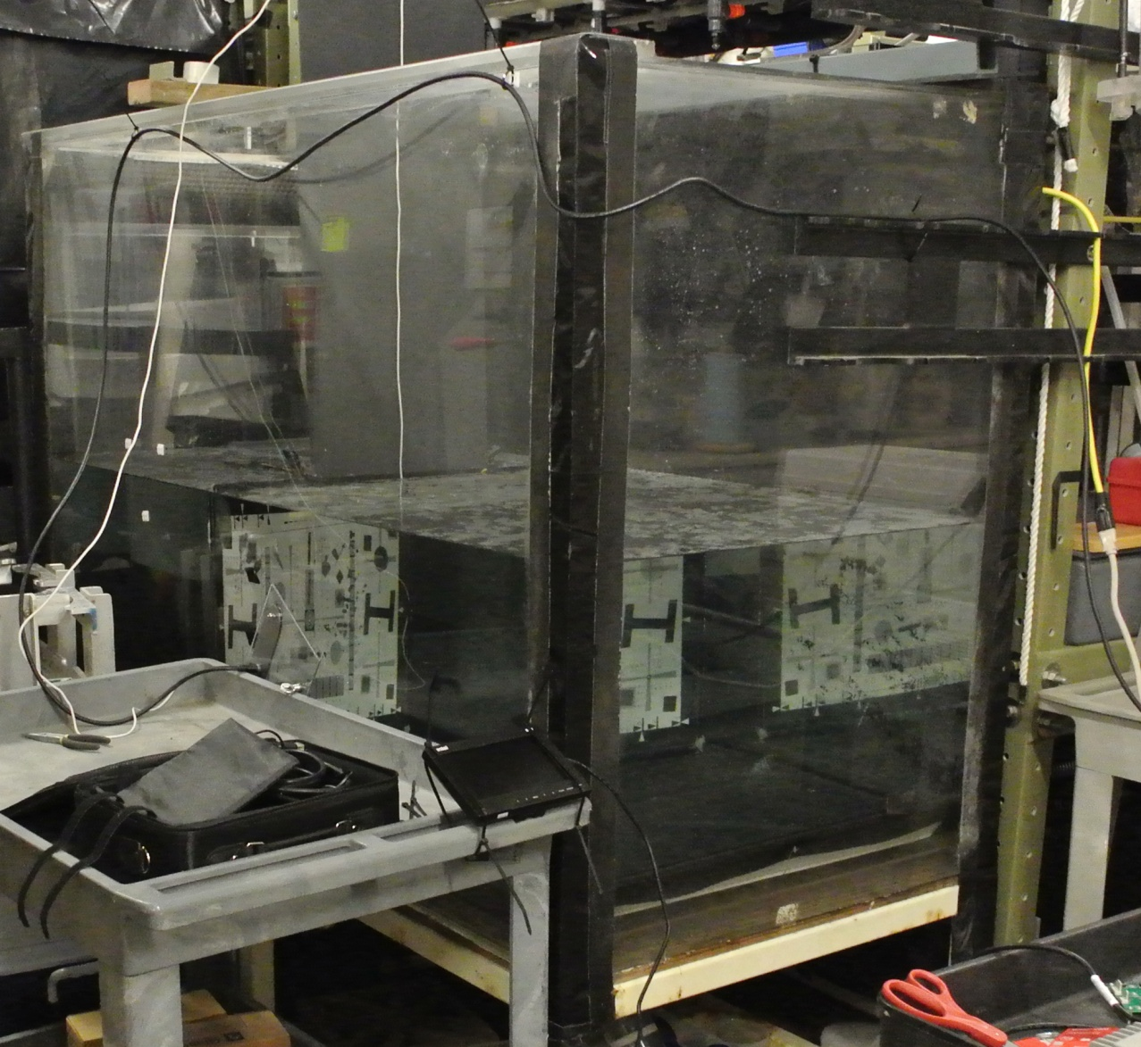
Camera Testing

Slide 15
Camera Selection
 | GoPro Hero2 | Nikon 1 V1 | Canon G12 | Contour | Ricoh GXR
Interfacing – control⁽¹⁾
Interfacing – settings⁽²⁾
Size (W x H) | 1.6” x 2.4” | 4.4” x 3” | 4.4” x 3” | 2” (Diam) | 4.6” x 2.8”
Cost | $299 | $799 | $450 | $199 | $599
Energy Per Image | 6 mWH | 33 mWH | 21 mWH |  | 18 mWH
Energy Standby
Image Quality
Accessibility⁽³⁾
Bottom Line⁽⁴⁾
(1) Ease with which the camera can be controlled as in, power up, power down, take pictures, etc.
(2) Ease with which camera settings can be set and controlled as in f-stop, ISO, shutter speed, etc.
(3) How accessible is this camera to the larger oceanographic community?
(4) Are the images good enough for the PIs to do their research?

Slide 16
Lighting Selection
Challenges
  Can enough light be provided for good images?
  Will the energy required for the required number of images result in a reasonable battery volume?
  What configuration of camera and lighting will produce the best images?
Design method
  Calculate existing underwater and SLR strobe output.
  Review image examples and calculate illumination intensity.
    Use measured underwater strobe guide number values(1) and durations.
    Read metadata from exif files for aperture and shutter values.
  Determine if xenon strobe or LED lighting will best meet requirements.
  Determine camera requirements based on specific lighting options.
    Lens aperture needed
    Camera sensitivity (ISO)
    Shutter (or strobe) speed
(1) Strobe exposure guide number is distance X f-stop value at ISO 100.

Slide 17


Illuminance and Lighting System Calculation Methods
Step 1, calculate exposure value (EV) at ISO 100. EV represents all combinations of shutter speed and aperture that give the same exposure.
Exposure value is a base-2 logarithmic scale defined by Ray (2000, p. 318):
where
N is the relative aperture (f-number)
t is the exposure time (“shutter speed”) in seconds^{[2]}
Note: For strobe exposures the strobe duration was measured and is used for t. The strobe guide number can be used for N
Step 2, calculate illuminance value in Lux (Lumens m^) on target at different ISO values from EV.
C = meter constant of 250
S is the ISO arithmetic speed
E is the illuminance
(lumens per sq. meter)
To solve for E formula becomes: E =2^(EV-LOG2(ISO/250)
Note: assumes cosine responding meter and target reflectance of 12.5% corresponding to neutral grey.
Step 3, Design LED lighting system to provide similar illuminance to example images.
Step 4, Reverse calculations to specify aperture, shutter speed and ISO (camera sensitivity) for a given lighting design.
Good reference for exposure value calculations here:
http://en.wikipedia.org/wiki/Exposure_value

Slide 18
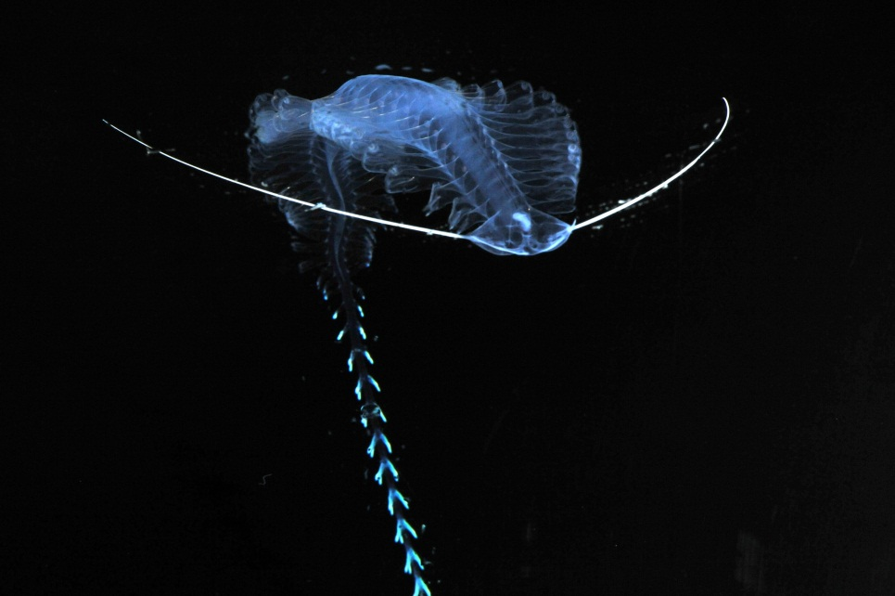
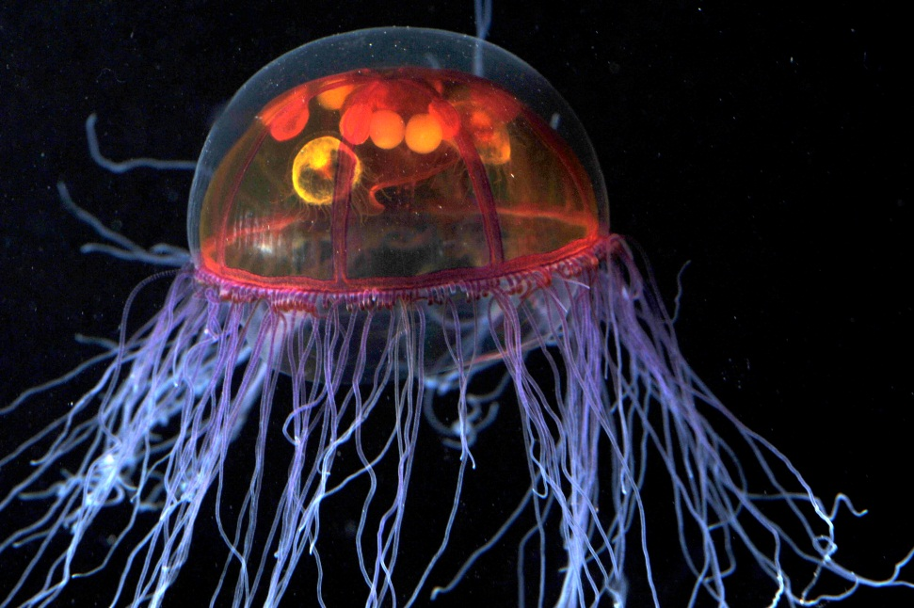
Lighting Calculation Examples
DSC_6164.jpg
DSC_3391.jpg
Actual Exposure Calculation |  |  | Calculated Illuminance
Image | F-Stop | Exposure Time (seconds) | ISO 800 | ISO 1600
Lab image DSC_6164.JPG | 5.6 | 0.0002 | 2450 | 1225
Lab image DSC_3391.JPG | 2.8 | 0.0002 | 2450 | 1225
Equivalent Exposure Calculation |  |  | Calculated Illuminance
Image | F-Stop | Exposure Time (seconds) | ISO 800 | ISO 1600
Lab image DSC_6164.JPG | 5.6 | 0.0005 | 980 | 490
Lab image DSC_3391.JPG | 2.8 | 0.0005 | 980 | 490
LED Equivalent Exposure Calculation | 2.8 | 0.00245 | 1000 | 500
Number of LED's needed |  |  | 7.4 | 3.7

Slide 19
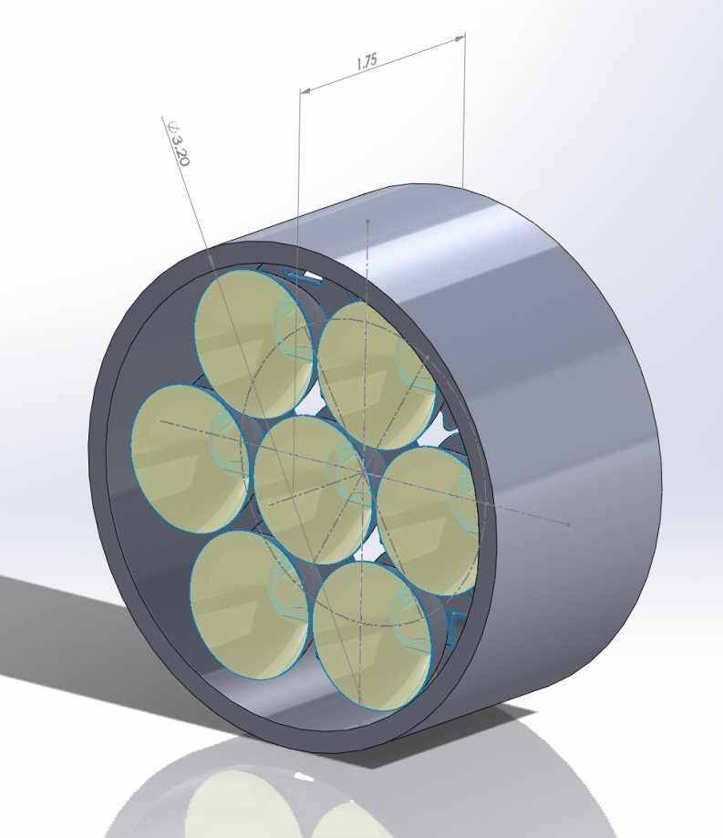
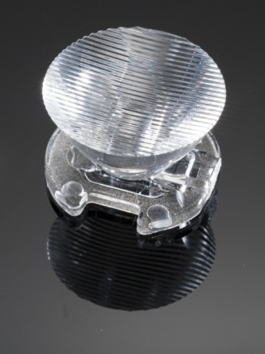
Strobe vs. LED Illumination
At ISO 800
LED vs Xenon Strobe | Wh per shot | Watt hours 1440 shots
Strobe (IkeliteDS 51) | 0.036 | 52
LED in Strobe mode (.00245 sec. on) | 9.8478E-06 | 0.015
LED in light mode (1 second on) | 0.00401952 | 5.8
40x6 degree oval beam reflector
For Cree Xlamp® XR-E series
Efficency 86%
Note: Calculations need to be verified with illumination and exposure value test!

Slide 20
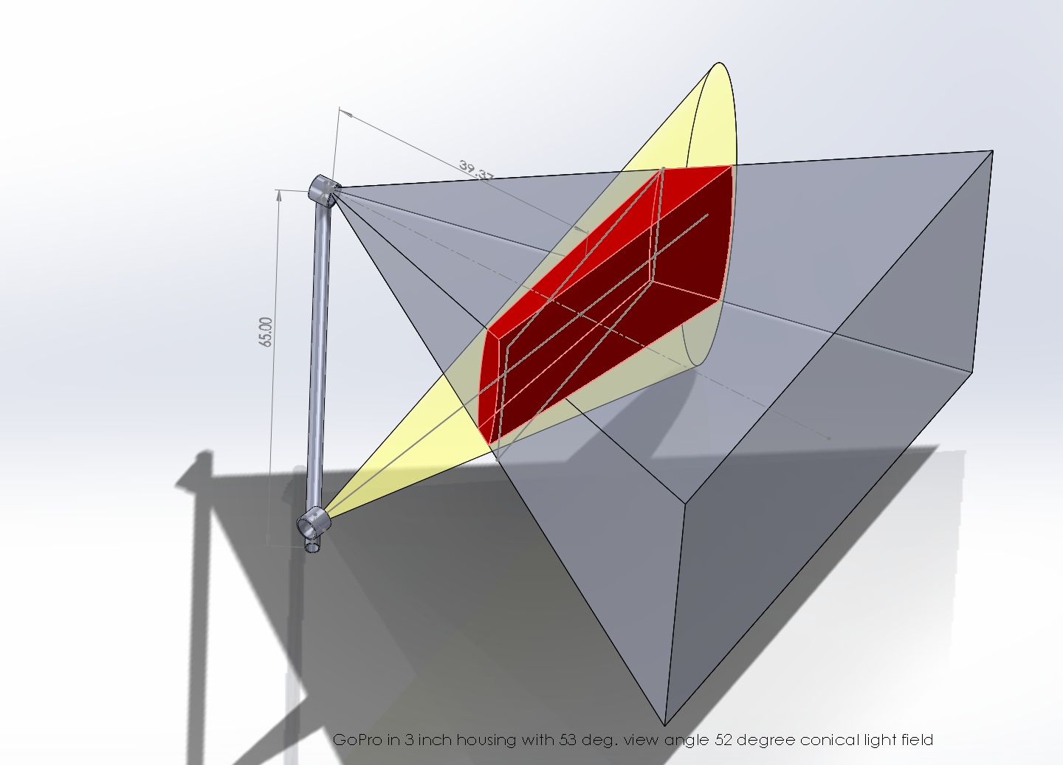
Example of 6x40 degree Conical Reflector
(Red is common volume between imager and light field)

Slide 21
Energy Budget
Strobe Lighting for .008 second per shot (req. strobe trigger)
 |  |  | Camera only (wH) |  |  | Whole System (wH) |  |  |  | Number of batteries (80% PS Eff.)
 |  | wH per shot | per 100 shots |  | per 1000 shots | Tot per Shot | Tot per 100 shots | Tot per 1000 shots | Tot per 1440 shots | Alkaline D Cell | Lithium D Cell
GoPro | Hero2 | 0.006 | 0.6 |  | 6 | 0.042 | 4.20 | 42.00 | 60.48 | 6 | 2
Canon | G12 | 0.021 | 2.1 |  | 21 | 0.057 | 5.70 | 57.00 | 82.08 | 8 | 3
Nikon | 1 V1 | 0.03325 | 3.325 |  | 33.25 | 0.069 | 6.93 | 69.25 | 99.72 | 9 | 3
Contour | Plus |  | 0 |  | 0 |  |  |  | 51.84 | 5 | 2
Ricoh | GXR | 0.0185 | 1.85 |  | 18.5 | 0.055 | 5.45 | 54.50 | 78.48 | 7 | 2
LED Lighting for 1 second per shot (for motion requires fast shutter speed)
 |  |  | Camera only (wH) |  |  | Whole System (wH) |  |  |  | Number of batteries (80% PS Eff.)
 |  | wH per shot | per 100 shots |  | per 1000 shots | Tot per Shot | Tot per 100 shots | Tot per 1000 shots | Tot per 1440 shots | Alkaline D Cell | Lithium D Cell
GoPro | Hero2 | 0.006 | 0.6 |  | 6 | 0.011 | 1.10 | 11.00 | 15.84 | 2 | 1
Canon | G12 | 0.021 | 2.1 |  | 21 | 0.026 | 2.60 | 26.00 | 37.44 | 4 | 1
Nikon | 1 V1 | 0.03325 | 3.325 |  | 33.25 | 0.038 | 3.83 | 38.25 | 55.08 | 5 | 2
Contour | Plus |  | 0 |  | 0 |  |  |  | 7.20 | 1 | 1
Ricoh | GXR | 0.0185 | 1.85 |  | 18.5 | 0.024 | 2.35 | 23.50 | 33.84 | 4 | 1
LED Lighting in strobe mode (.004 seconds, req. strobe trigger)
 |  |  | Camera only (wH) |  |  | Whole System (wH) |  |  |  | Number of batteries (80% PS Eff.)
 |  | wH per shot | per 100 shots |  | per 1000 shots | Tot per Shot | Tot per 100 shots | Tot per 1000 shots | Tot per 1440 shots | Alkaline D Cell | Lithium D Cell
GoPro | Hero2 | 0.006 | 0.6 |  | 6 | 0.006 | 0.60 | 6.02 | 8.67 | 1 | 1
Canon | G12 | 0.021 | 2.1 |  | 21 | 0.021 | 2.10 | 21.02 | 30.27 | 3 | 1
Nikon | 1 V1 | 0.03325 | 3.325 |  | 33.25 | 0.033 | 3.33 | 33.27 | 47.91 | 5 | 2
Contour | Plus |  | 0 |  | 0 |  |  |  | 0.03 | 1 | 1
Ricoh | GXR | 0.0185 | 1.85 |  | 18.5 | 0.019 | 1.85 | 18.52 | 26.67 | 3 | 1

Slide 22
Lighting Conclusions
  Xenon strobe would require 3 X larger battery housing for 1440 images (52 Watt-hours).
    300 meter version close to off-the-shelf (low cost, low risk would likely require repackaging)
  LED potentially uses very little power
    Would allow multiple light heads and structured lighting (better imaging?)
    Longer term deployments, smaller battery volume or many more images
    Strobe would have extremely small energy requirement (but not COTS)
      Custom design allows structured beam for lowest common volume
    Light mode would use much more power, but may be COTS
      COTS design would not have shaped beam and therefore not nearly as efficient. More common volume scattering
  LED strobe is feasible IF:
    Illumination can be efficiently directed to imaging area of ~ 1 sq. meter
    Can be synchronized to camera shutter (need strobe signal)
    LED Color properties produce acceptable color reproduction (wide spectrum variant promising)
    Thermal cycling fatigue of LED die does not become an issue
    Camera selected produces acceptable images at ISO 800 or ISO 1600
  LED lighting is feasible IF:
    Illumination can be efficiently directed to imaging area
    Can be synchronized to camera shutter so on for 1 second (requires fast shutter speed or non-moving target)
    LED Color properties produce acceptable color reproduction
    Thermal cycling fatigue of LED die does not become an issue

Slide 23
Proposed System Bus
Camera
LED
Control
Bank 1
Relay
CAP
Relay
Bank 2
5 - Cond
5 - Cond
1 Batt+
2 Gnd
3 Sync / Trig - Can be used to activate relay or fire a strobe
4 A - Future undefined comm bus. 485/232 for use in Tethys.
5 B Or for use with a “smart” module in LED/Batt Housing.

Slide 24
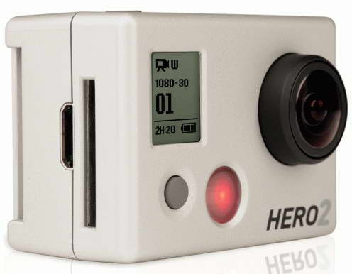
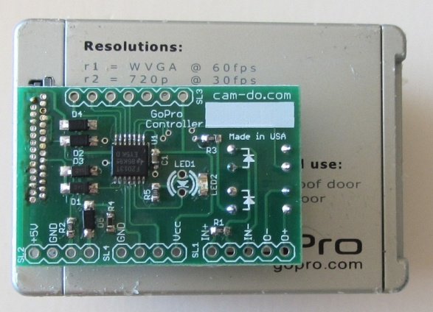
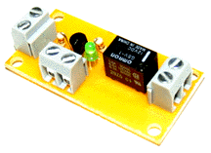
Camera Housing Electronics
Custom
Board
USB
Port
Camera
Control
Battery Voltage
TTL
Control
To Battery
Housing
To LED
Housing
To LED
Housing

Slide 25
Software
What functional requirements impact software?
  System shall have a programmable sample rate
  a. Minimum sample time: once per day
  b. Maximum sample time: once per ten seconds
  System shall respond to an external trigger
  System shall be self-contained with onboard power and storage.
    a. Maximum number of images: 8640

Slide 26
Software
What functional requirements impact software?
  System shall have be configurable without opening the housing.
  Deployment length without external power
  a. Duration of deployment: two months

Slide 27
Software
What functional requirements impact software?
  Images shall be accurately time stamped,
  a. Resolution of one second
  b. Accuracy to one minute per month
  System shall provide sufficient lighting for proper imaging

Slide 28
Software
The controller needs the following capabilities to meet these requirements
– Setup and trigger of camera at required rates
– Manage power to minimize energy per image and standby consumption
– Support communications with host (e.g. serial port)

Slide 29
Software
The controller needs the following capabilities to meet these requirements
– A time source with better than 20 ppm accuracy
– Ability to coordinate lighting with image capture

Slide 30
Software
What could possibly do all this?
– Many microcontrollers are up to the task.
– We are considering Microchip PICs, Arduino, etc.

Slide 31
Software
SCPI will use the work from other MBARI projects that have met many of these requirements.
– Raymond Autonomous Tissue Sampler
– Time Lapse Camera Project
– Ken Smith Camera Tripods

Slide 32
Next Steps
Test representative cameras with quantified lighting and representative targets.
  Marbles for jellies
  ?? For other applications
Down select cameras based on (not in priority order):
  Image quality
  Size
  Power (energy) requirements (battery volume required)
  Interface effort and complexity
  Cost
Select lighting system based on same criteria!
Complete to preliminary design review level.

