Slide 1
Self-Contained Plankton Imager
Progress Update Review
Friday April 12, 2013

Slide 2
What is SCPI?
Flexible and portable camera system
  Low cost
  Easy to fabricate
  Widely distributed
Differs from existing systems which:
  Require dedicated cables, ships, and winches
  Are difficult to deploy, maintain, and operate
  Are high cost

Slide 3
SCPI Users and Use Cases
Identified Users
Potential Platforms
Steve Haddock
Ken Smith
Jim Bellingham
CANON
Steve Rock’s ARL Group
AUVs
Profilers
Moored (Plankton Vane)
Sediment Traps
Observatory (Cabled Option)
Manually dropped or towed
Ships of opportunity
Pier mounted

Slide 4
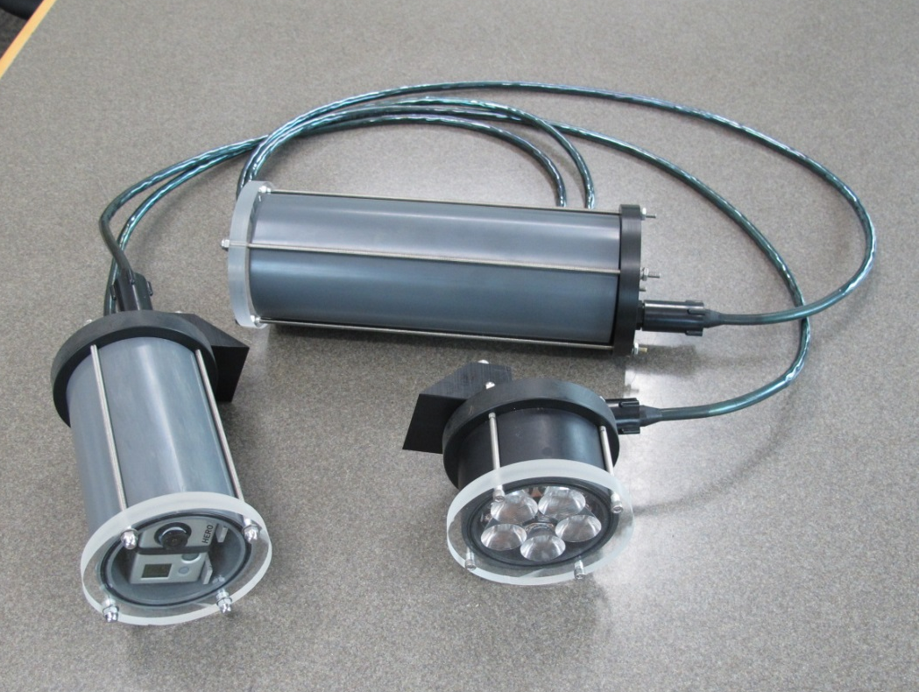
SCPI Prototype System

Slide 5
SCPI Prototype Capabilities
Depth rating of 300m (9 LED module 100m)
Total onboard energy of 4500mAh
Energy per shot = 1.4mAh
Total # of shots = 2900
User settable parameters:
  Image taking interval (Maximum once/2 sec)
  Total number of images
Still images & video
Dry weight: 18lbs, wet weight: 6.5lbs

Slide 6
Functional Requirements
Specification | Specified Value | SCPI Prototype
Platform | AUV/mooring/wharf | All
Target | Large macroplankton | Large macroplankton
Target size | >1 cm | > 10 cm
Rate of Images | Once/10 min, Once/Hour | Once/2 sec
Color vs. B&W | color important | Color
Image Trigger | Optional | Not yet implemented
Depth | 200m | 300m
Field of View | 1 x 1.5 m | 1 x 1.5 m
Lighting | Side illumination | Side illumination
Deploy Duration | 2 months | 2 months +
Total # of Images | 1440 | 2900
Other | Hibernation, biofouling | Hib: Y Biofoul: N

Slide 7
Cost per SCPI System
Camera module: $1180
Lighting module: $ 900
Battery module : $ 415
System cables : $ 430
Total : $2925

Slide 8
SCPI Module Costs
Camera Housing | Qty | Cost | Total Cost
Camera Housing Tube | 1 | 60 | 60
Front Endcap | 1 | 50 | 50
Rear Endcap | 1 | 65 | 65
Camera & Board Support | 1 | 80 | 80
2-151 Buna N O-ring | 2 | 9 | 18
Screws & Hardware | 1 | 20 | 20
SAE-5 Plug | 1 | 5 | 5
Subconn MCBH8F | 1 | 105 | 105
Subconn MCBH8M | 1 | 95 | 95
USB Connector | 1 | 12 | 12
SCPI Control Board | 1 | 250 | 250
SD Memory Card | 1 | 20 | 20
GoPro Camera | 1 | 300 | 300
Hero Bus Adapter Board | 1 | 100 | 100
 |  |  | 0
 |  | TOTAL | 1180
Battery Housing | Qty | Cost | Total Cost
Camera Housing Tube | 1 | 60 | 60
Front Endcap | 1 | 50 | 50
Rear Endcap | 1 | 65 | 65
Screws & Hardware | 1 | 20 | 20
Battery Pack | 1 | 115 | 115
Subconn MCBH8M | 1 | 95 | 95
Foam Padding | 1 | 10 | 10
 |  |  | 0
 |  | TOTAL | 415
Lighting Housing | Qty | Cost | Total Cost
Camera Housing Tube | 1 | 60 | 60
Front Endcap | 1 | 50 | 50
Rear Endcap | 1 | 65 | 65
Screws & Hardware | 1 | 20 | 20
LED Drive Board | 1 | 300 | 300
LED Mounting Board | 1 | 300 | 300
Subconn MCBH8F | 1 | 105 | 105
 |  |  | 0
 |  | TOTAL | 900
System Level | Qty | Cost | Total Cost
Subconn M-F Cable | 2 | 215 | 430
 |  |  | 0
 |  | TOTAL | 430
Total System Cost |  |  | 2925

Slide 9
Proposed schedule for 2013
1st Quarter: Perform multiple field tests
2nd Quarter: Investigate higher image quality camera module based on test results
3rd Quarter: Build 2nd Gen SCPI system
4th Quarter: Testing and deployment

Slide 10
Completed Testing 2013
ROV Ventana
  Series of depths (to 200m)
  5-LED module flooded
Kelp Forest Array / swFOCE
  48 Hours, image every 60 seconds
  Depth of 15m
Offshore MBARI (Discarded pipe)
  48 Hours, image every 60 seconds
  Depth of 20m

Slide 11
Additional potential deployments
Use on Tethys in video mode during docking testing (May 2013)
Additional ROV dives
Deployments of opportunity

Slide 12
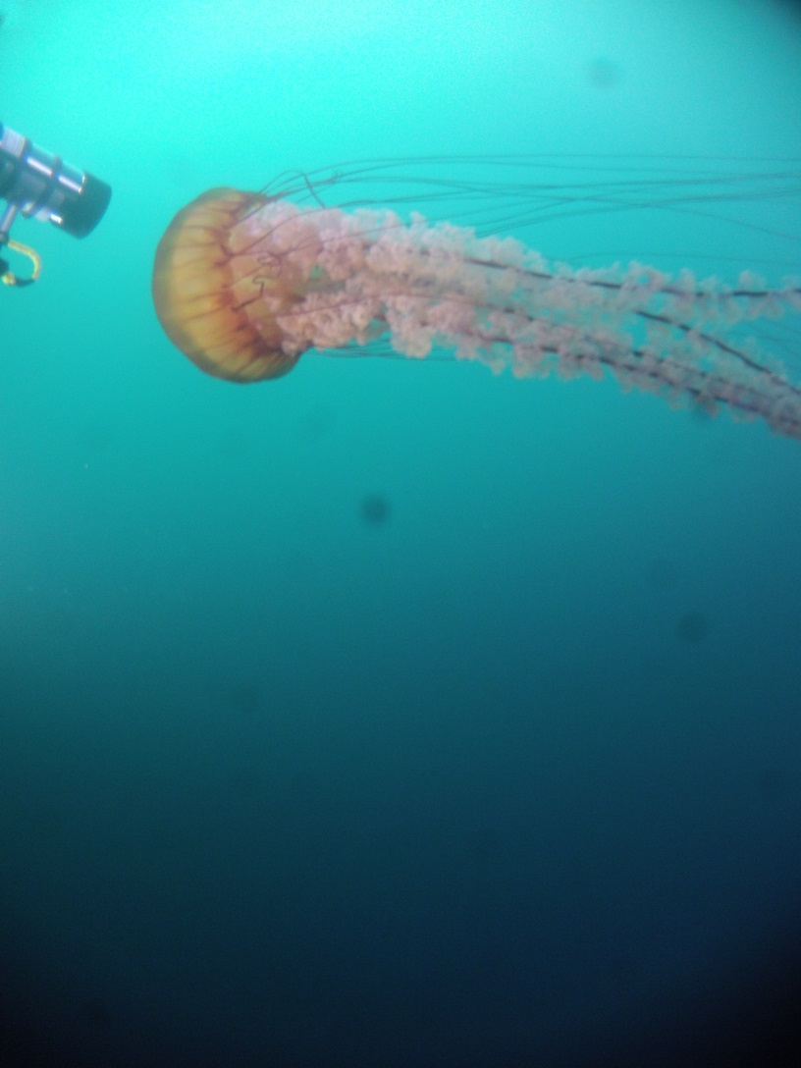
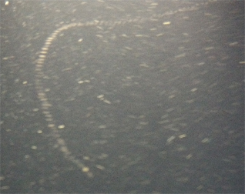
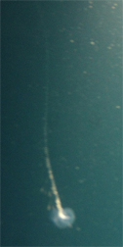
Testing Results: ROV Ventana

Slide 13
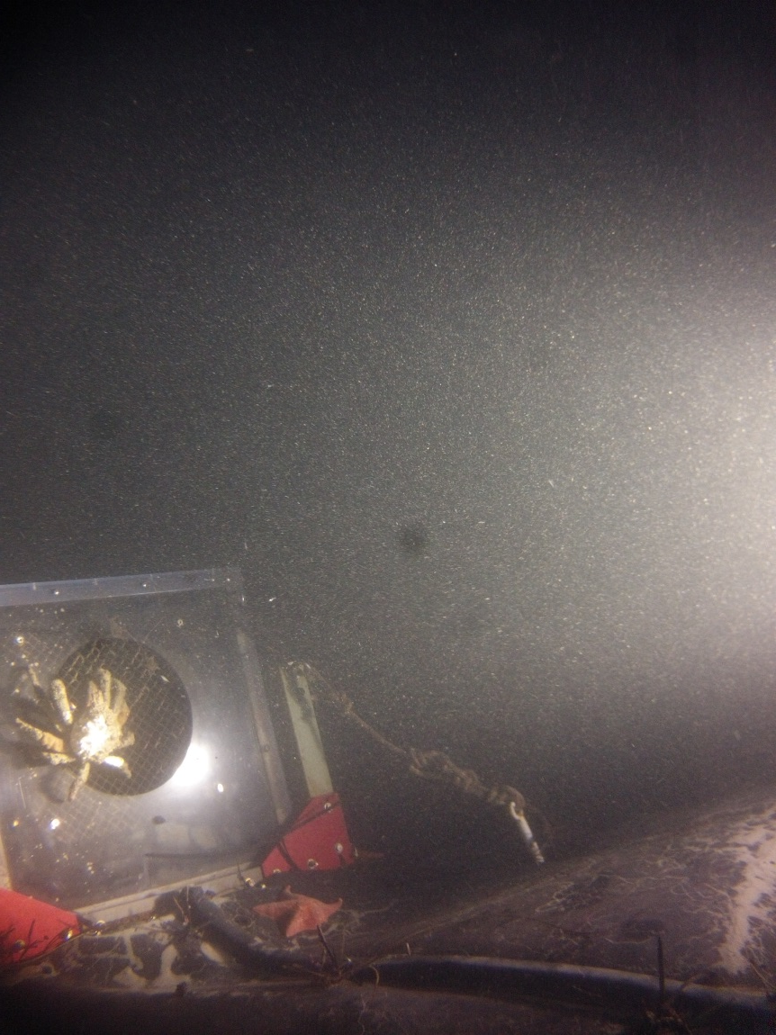
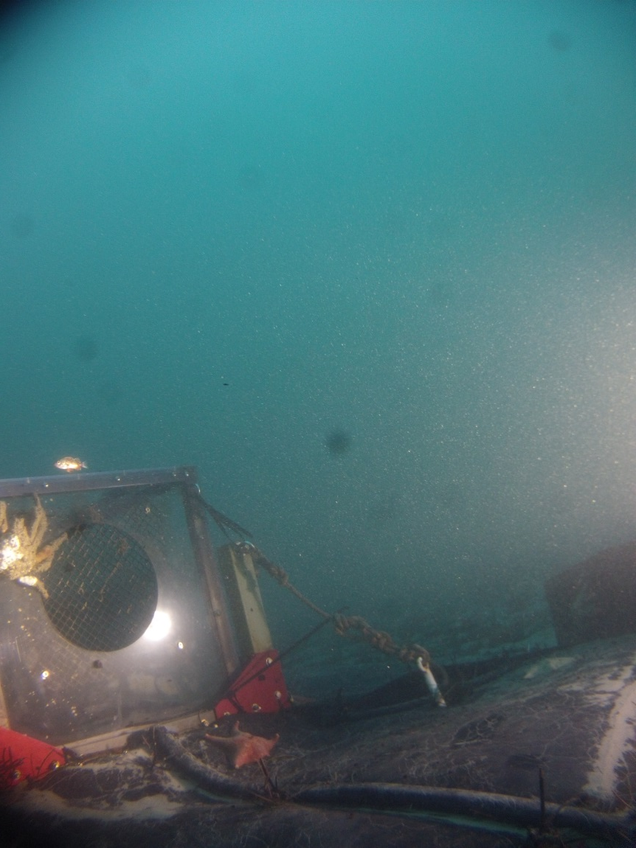
Testing Results: KFA/swFOCE

Slide 14
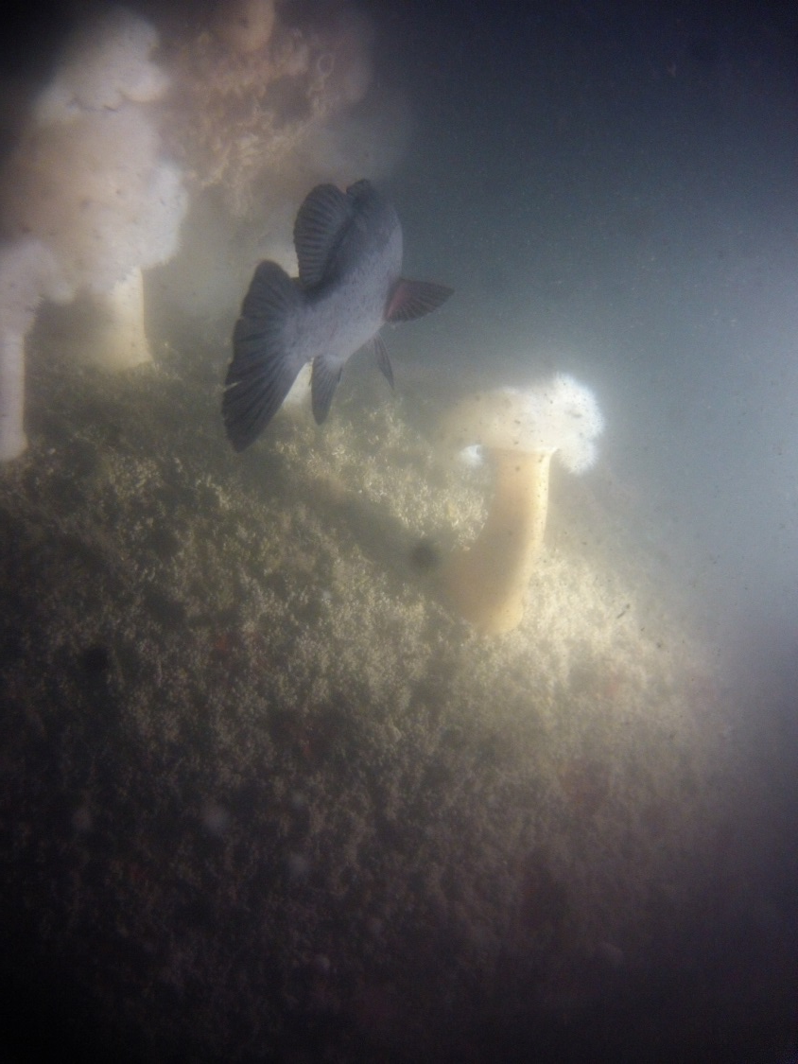
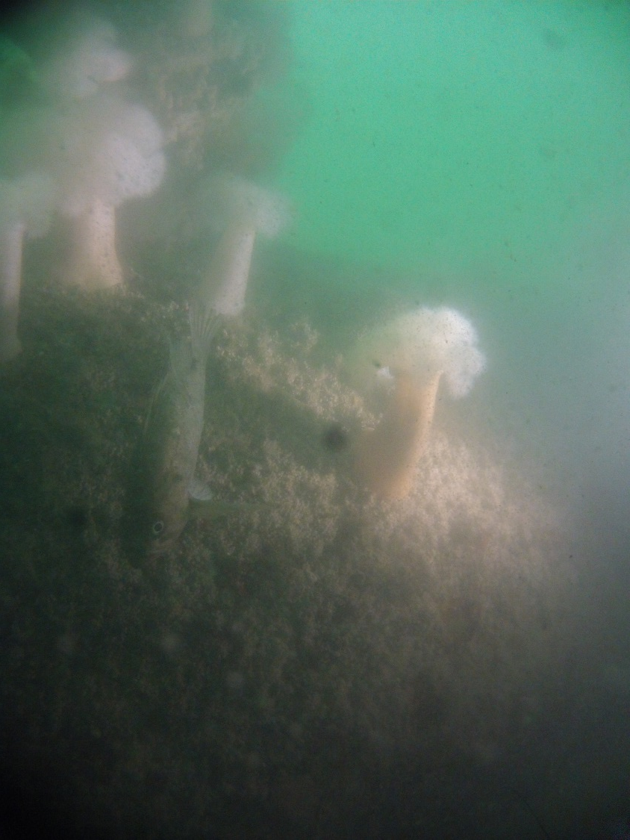
Testing Results: Offshore MBARI

Slide 15
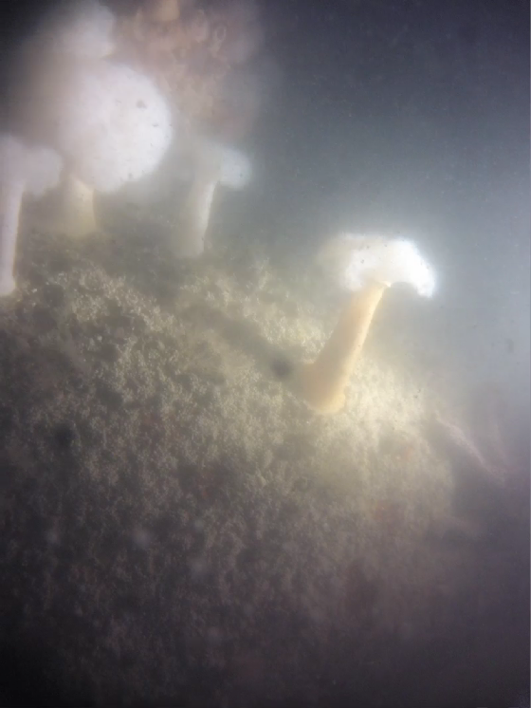
Nighttime TimeLapse

Slide 16
GoPro as an Imager
Advantages
  Good images with proper subject & lighting
  Form factor
  Availability, cost
  Existing hardware will work with Hero3
Disadvantages
  Automated image taking
  Poor low light camera

Slide 17
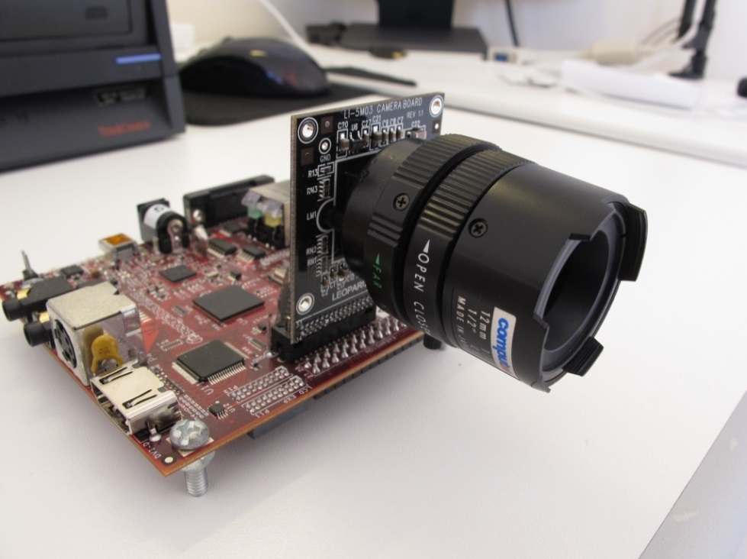
Potential New Imagers
Leopard Imaging board level camera
  BeagleBoard XM
  Open source Linux code available
Lumenera
  Higher end board level cameras
  SDKs available
Baumer

Slide 18
Development Paths
GoPro Hero3 based camera module
  Easy to integrate, minimal effort
  Supported for foreseeable future
  Good imaging with proper lighting
  Excellent video
Higher resolution camera module
  Necessary for smaller target sizes
  Full control over imaging parameters

Slide 19
Next Steps
Modify GoPro based camera module to Hero3
  Minimal effort, hardware is compatible
Investigate board level camera system(s)
  Candidates identified but still looking
Side by side comparison of both camera systems
  Can test each in-situ
Proceed with open source plans

Slide 20
2013 Milestones
 | Milestone 1 | Milestone 2 | Milestone 3 | Milestone 4 | Milestone 5 | Milestone 6 | Total Resources for each resource category for all milestones listed here
Milestone Date | 3/13 | 5/13 | 6/13 | 9/13 | 10/13 | 11/13
Milestone Description | Field Testing | Bench Test Upgrades | Design Review | Build Gen2 Unit | Integration & Testing | Deliver Gen2 Unit
EE | 100: CK | 40: CK 60: MC | 20: CK 20: MC | 50: CK | 40: CK 20: MC | 50: CK | 300: CK 100: MC
SE |  | 100 | 40 | 60 | 100 | 50 | 350: MR
ME | 25: AH 25: FC | 25: AH 25: FC | 20: AH 20: FC | 50: AH 50: FC | 30: AH 30: FC | 25: AH 25: FC | 175: AH 175: FC
EE Tech |  | 50 |  | 125 |  |  | 175
SE Tech
ME Tech |  |  |  | 125 |  |  | 125
Machine Shop |  |  |  | 50 |  |  | 50
Divers

Slide 21
Labor – April 2013
 |  | Used | Requested | Remaining | Percentage
 | Name | 2013 | 2013 | 2013 | Remaining
EE | Chaffey, Mark | 6.5 | 100 | 93.5 | 93.5%
 | Kecy, Chad | 98 | 300 | 202 | 67.3%
SE | Risi, Michael | 130 | 350 | 220 | 62.9%
ME | Cazenave, Francois | 53 | 175 | 122 | 69.7%
 | Hamilton, Andrew | 0 | 175 | 175 | 100%
EE Tech | Coenen, Paul | 2.5
 | Marion, Tom | 4
 | Montgomery, Jim | 29
 | Rosal, Jose | 24
 |  | 59.5 | 175 | 115.5 | 66%
ME Tech |  | 0 | 125 | 125 | 100%
Mach Shop |  | 0 | 50 | 50 | 100%
 | Hobson, Brett | 22 | 0 | (22)
 | Von Thun, Susan | 1 | 0 | (1)

Slide 22
Budget – April 2013
Description | Budget Amount | Paid Amount | Total Commitment | Available | Percent Available
6000-000: Direct Labor | 82,848 | 19,793.03 |  | 63,054.97 | 76%
Subtotal Salaries | 82,848 | 19,793.03 |  | 63,054.97 | 76%
Budgeted Fringe - All Labor Types | 47,563 |  |  | 47,563.00 | 100%
Pool 1 : Fringe - Full |  | 12,607.75 |  | (12,607.75)
Subtotal Benefits | 47,563 | 12,607.75 |  | 34,955.25 | 73%
5320-000: Supplies - Eng. Lab |  | 266.12 |  | (266.12)
5330-000: Non-Capitalized Equipment | 20,168 | 1,224.96 | 2.91 | 18,940.13 | 94%
5360-000: Supplies - General |  | 475.43 |  | (475.43)
Subtotal Expenses | 20,168 | 1,966.51 | 2.91 | 18,198.58 | 90%
Total 901107 | 150,579 | 34,367.29 | 2.91 | 116,208.80 | 77%

Slide 23
Any Questions?

Slide 24
Where does SCPI fall within MBARI Camera Projects?
Moored
Camera Sys
Time-Lapse
Camera
Imaging AUV
Ocean Imaging
LRAUV
Verification Cam
SIZE
SCPI
Shark Cam
COST

Slide 25
Relevance to Strategic Plan
Research Themes: Ocean Visualization
  SCPI allows for realizing four-dimensional visualizations – repeated spatial renderings over time.
Institutional Objectives: (2) Increase Institutional Flexibility
  Rapid prototype
Institutional Objectives: (3) Enhance Collaborations
  Low cost of SCPI eases ability of outside organizations to build their own, thus increasing the spatial network

