Slide 1
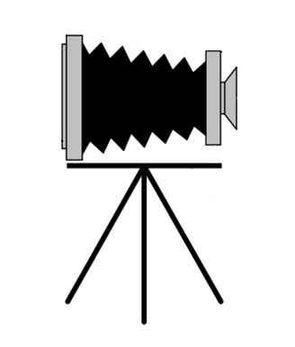
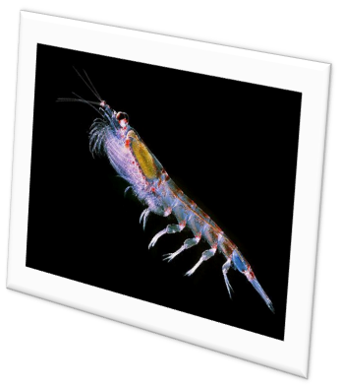
SCPI and Open Source
November 2, 2011

Slide 2
Open Source at MBARI
MB System – Dave Caress
SSDS – Kevin Gomes
VARS – Brian Schlining

Slide 3
MB System – Dave Caress
Why GPL?
  Over 10 years ago that was pretty much all there was. Considering a more permissive MIT or BSD style license, but in no big rush.
Advice for SCPI
  Consider how your project might be used when picking a license. Are you going to be OK with different uses that may come about with a more permissive license?
  Take a look at the Arduino project. It has both hardware and software and is very widely used. The creators of the project probably thought very carefully about the licenses they chose.

Slide 4
SSDS – Kevin Gomes
Why?
  Wanted to distribute SSDS to Ocean Observatories Initiative (OOI) and potentially others organizations. Did not want to craft different agreements with different organizations. Open Source was a good option for getting it out to OOI, as well as others.
Why LGPL?
  Talked to Brian Schlining and he recommended it based on his experience with VARS.

Slide 5
VARS – Brian Schlining
Why?
  If you want to get your technology out the door you need to go open source. Many organizations just aren’t taking closed projects too seriously.
Why LGPL?
  Wanted to get VARS out to the public, but also wanted to preserve options to license it differently in the future. The group at Stanford that helps MBARI with licensing and patenting did a study of the open source licenses that would best fulfill these goals and narrowed in on LGLP.

Slide 6
VARS – Brian Schlining
Advice for SCPI
  Documentation is key to getting people to adopt your open source project. Without good documentation, people probably won't even try to use it. If someone does try to use it and your documentation is poor, it could become a headache having to constantly respond to requests for support.

Slide 7
More Permissive vs Less Permissive
More Permissive
  A more permissive license allows the licensee to essentially do whatever they want. This can even include taking your design as is and reproducing it for commercial gain.
Less Permissive
  Very restrictive on how the project is used. Often does not allow technology to be used for commercial gain. Licenses like GPL don’t even allow you to use the software or technology in combination with some more permissively licensed technologies.
Open source community seems to be trending to more permissive licensing

Slide 8
More Permissive vs Less Permissive
Less Permissive
More Permissive
GPL
LGLP
MIT & Creative Commons

Slide 9
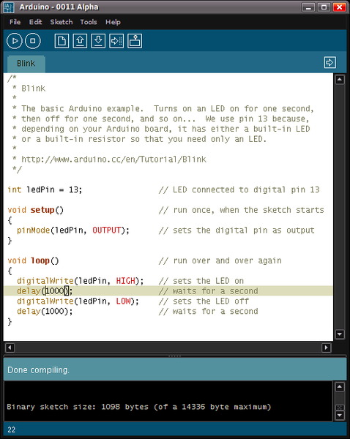
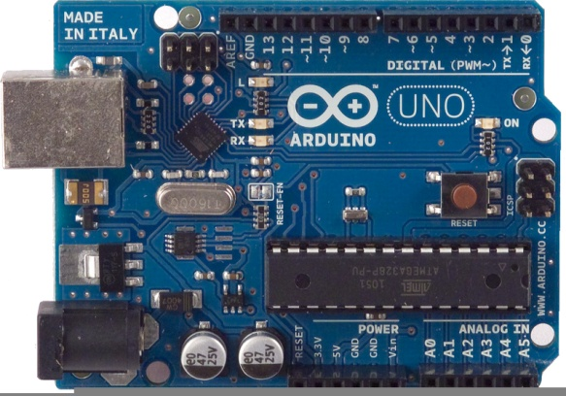
Arduino
What’s an Arduino?
  The Arduino is an integrated development Environment (IDE) and associated hardware and firmware used for embedded development.

Slide 10
Arduino
Hardware
  The hardware for Arduino is licensed under Creative Commons which is very permissive. Several companies (e.g. Spark Fun) have taken the design and manufacture the hardware to sell for a profit.
Microcontroller Firmware
  The firmware that runs on the board is LGPL. Companies can put the firmware on boards they manufacture. If a company modifies the firmware they have to make those modifications available for free.

Slide 11
Arduino
Integrated Development Environment (IDE)
  The IDE is licensed under GPL. It’s always free, all changes have to be made available for free, and it can only be mixed with other free software.

Slide 12
What Should the SCPI Project Do?
It Depends on…
  – What we end up making
  – What the goals for the technology are

