Slide 1
SCPI Camera Test Results and Tradeoffs
6/19/2012
Mark Chaffey

Slide 2
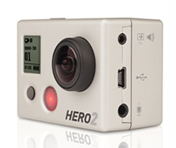
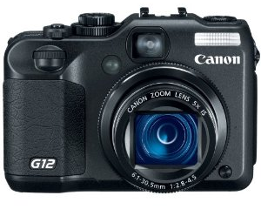
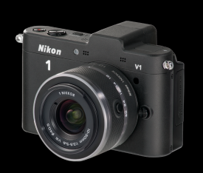
Camera Model Under Test
 |  | GoPro Hero 2 | Canon G12 | Nikon 1V1
Imager size |  | 1/2.3" (6.17mmX4.55mm) | 1/1.7" (7.6mmX5.7mm) | CX (13.2mmX8.8mm)
Lens focal length |  | 4mm | 6.1-30.5mm (used 6.1mm) | 10mm
Target distance from acrylic |  | 0.9 meter | 1.0 meter | 1.05 meter
Camera lens from acrylic |  | ~1-2 mm | ~1-2 mm | ~1-2 mm
Target size |  | 1.0 X 0.8m | 0.9 X 0.7m | 0.9 X 0.7m
File format |  | jpeg | jpeg fine | jpeg fine (1:4)
Picture size |  | see below | 3648 X 2736 | 3872 X 2592
White Balance setting |  | Auto | Auto set to LED illum. | Auto set to LED illum.
Auto noise reduction |  | NA | Off | Off
Focus |  | NA | Manual | Manual
Picture Control |  | Exposure : spot off | NA | Standard
Light reading umol m^2 LED 300 Lumen setting | Front light Jellies, facing light source | 3.5 (259 Lumens m^2) | “ | “
 | Side light Jellies, facing light source | 140 (10,360 Lumens m^2) | “ | “
Light reading umol m^2 LED 600 Lumen setting | target, facing light source | 6.5 (481 Lumens m^2) | “ | “
 | Jellies, facing light source | 265 (19,610 Lumens m^2) | “ | “
Light reading umol m^2 LED 1200 Lumen setting | target, facing light source | 15 (1,110 Lumens m^2) | “ | “
 | Jellies, facing light source | 3140 (232,360 Lumens m^2) | “ | “

Slide 3
The Importance of Shutter Speed
Application | Object velocity cm per second | Distance traveled in 1/250 second in millimeters (at 1 meter) | Recommended shutter speed for Nikon CX format with 20 micron "circle of confusion", ~ 6 pixels in hundredths of a second
Mooring or Wharf | 100 | 4 | 500
AUV (side looking) | 100 | 4 | 500
Profiling (CTD), upper 50m | 50 | 2 | 250
Profiling (CTD), below 50m | 100 | 4 | 500
Sediment trap looking upward | 5 | 0.2 | 25
Sediment trap looking downward | 0 | 0 | 0

Slide 4
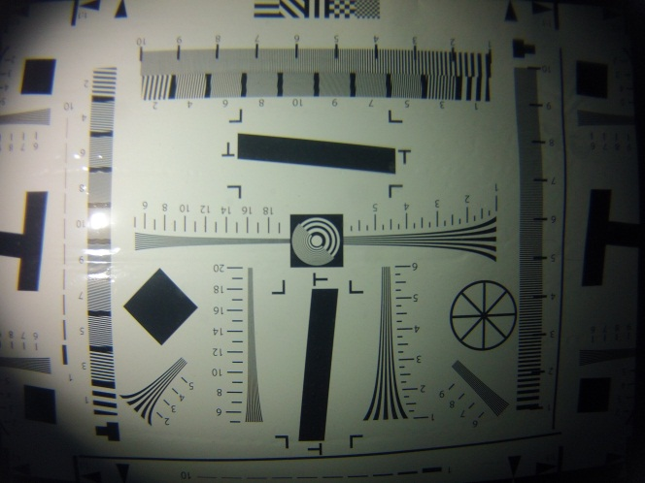
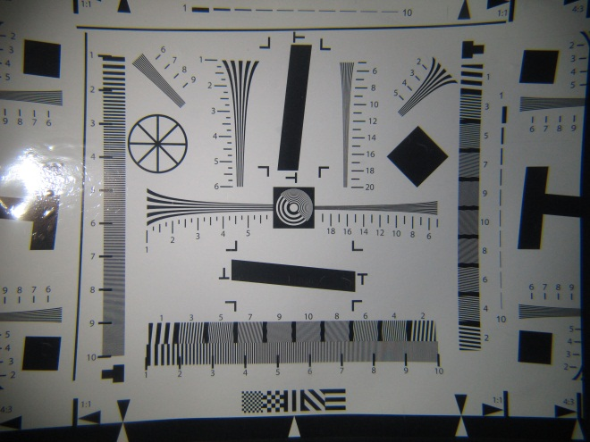
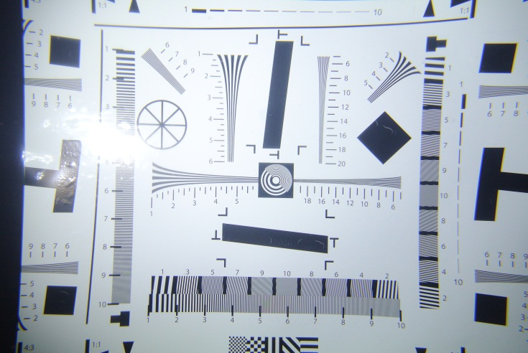
Performance With Test Target – ISO 400
GoPro 4mm Lens
Canon G12 6.1mm Lens
Nikon 1 V1 10mm Lens
GOPRO_5MP_W_LEDPower3.JPG
CanonG12_ISO400_f2.8__250thS_LEDPower3.JPG
Nikon1V1_ISO400_f4.5__250thS_LEDPower3.JPG
LED Power: 3
Shutter: 1/155 second
ISO: 100
f-Stop: 2.8
LED Power: 3
Shutter: 1/250 second
ISO: 400
f-Stop: 2.8
LED Power: 3
Shutter: 1/250 second
ISO: 400
f-Stop: 4.5
Note: Nikon 1V1 is > 1 stop faster.

Slide 5

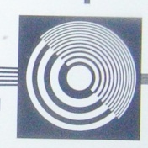
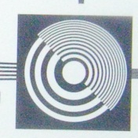
The Effect of High ISO Settings
Nikon 1 V1 10mm Lens
Nikon 1 V1 10mm Lens
Nikon 1 V1 10mm Lens
Nikon1V1_ISO400_f4.5__250thS_LEDPower3.JPG
Nikon1V1_ISO1600_f9__250thS_LEDPower3.JPG
Nikon1V1_ISO3200_f9__250thS_LEDPower2.JPG
LED Power: 3
Shutter: 1/250 second
ISO: 400
f-Stop: 4.5
LED Power: 3
Shutter: 1/250 second
ISO: 1600
f-Stop: 9
LED Power: 2
Shutter: 1/250 second
ISO: 3200
f-Stop: 9

Slide 6
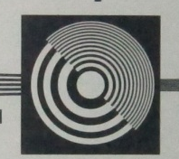
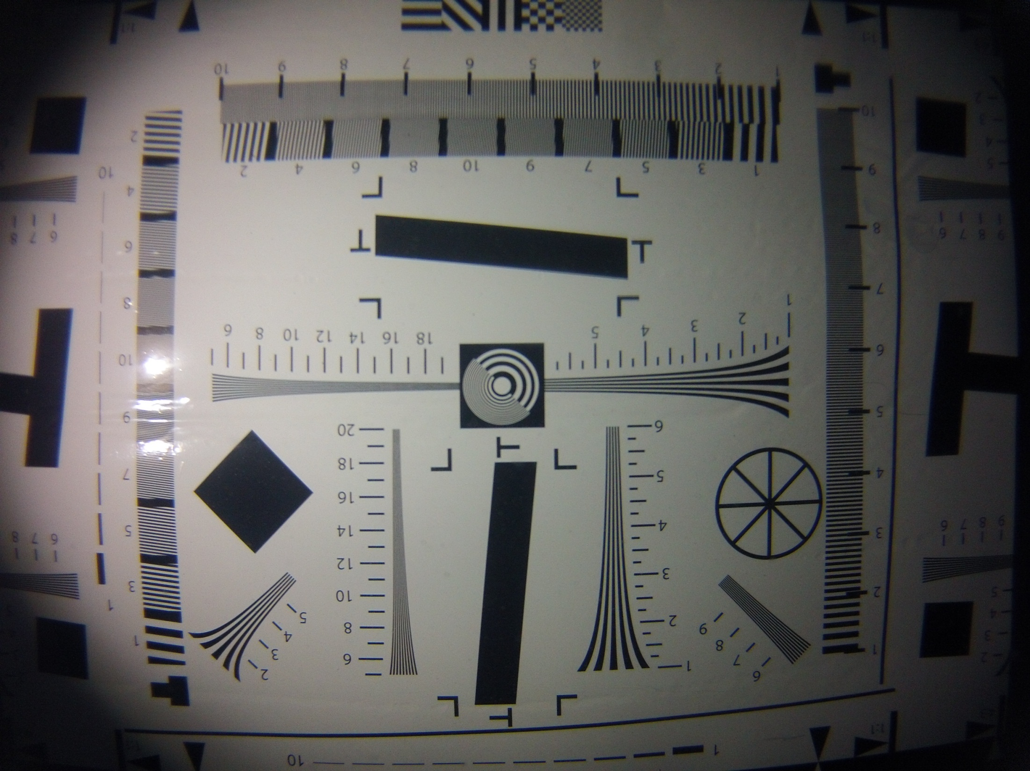
Performance Comparison at High ISO Settings
GoPro 4mm Lens
Canon G12 6.1mm Lens
Nikon 1 V1 10mm Lens
GOPRO_5MP_W_LEDPower1.JPG
CanonG12_ISO1600_f2.8_250thS_LEDPower3.JPG
Nikon1V1_ISO1600_f9__250thS_LEDPower3.JPG
LED Power: 1
Shutter: 1/60 second
ISO: 115
f-Stop: 2.8
LED Power: 3
Shutter: 1/250 second
ISO: 1600
f-Stop: 2.8
LED Power: 3
Shutter: 1/250 second
ISO: 1600
f-Stop: 9
Note: Nikon 1V1 is 3 + stops faster.

Slide 7
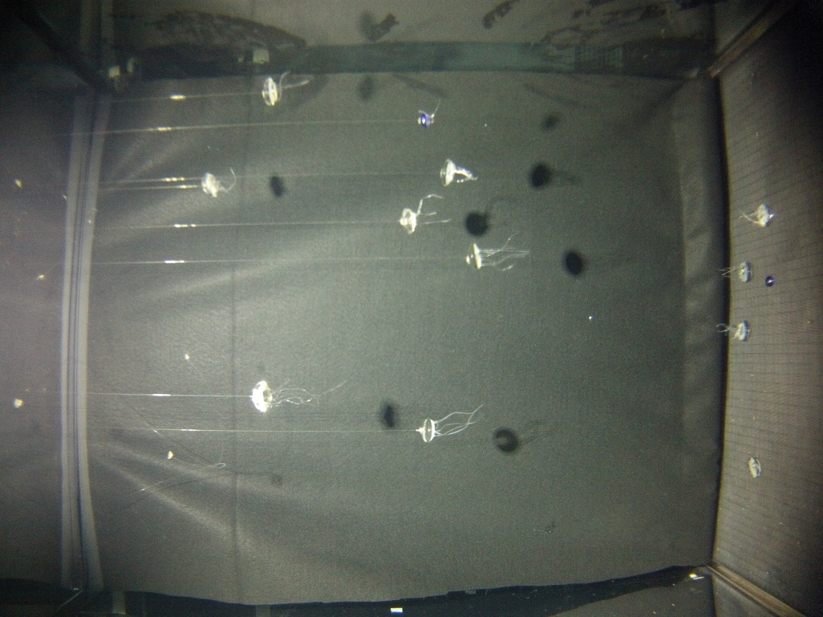
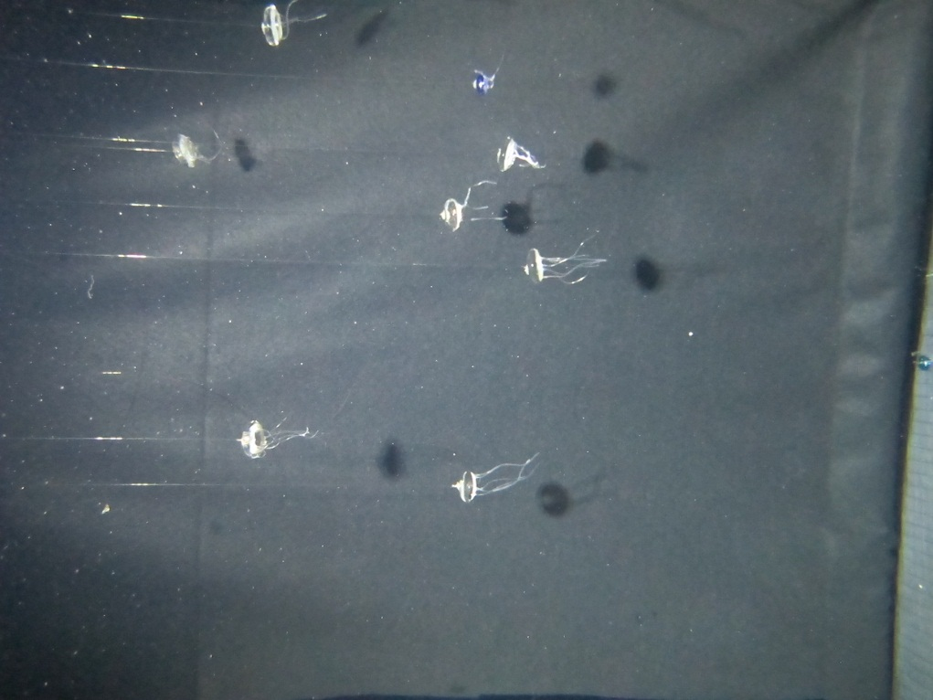
Performance Comparison
Front Lighting “Jellies” Camera in Auto Exposure
GoPro 4mm Lens
Canon G12 6.1mm Lens
GOPR0_Jelly_5MP_W_LEDPower3.JPG
CanonG12_Jelly_ISO3200_f2.8_40thS_LEDPower3.JPG
LED Power: 3
Shutter: 1/7 second
ISO: 400
f-Stop: 2.8
5 MP mode
LED Power: 3 (1,110 Lumens m^2)
Shutter: 1/40 second
ISO: 3200
f-Stop: 2.8
Note: Canon is ~ 0.5 stops faster.

Slide 8
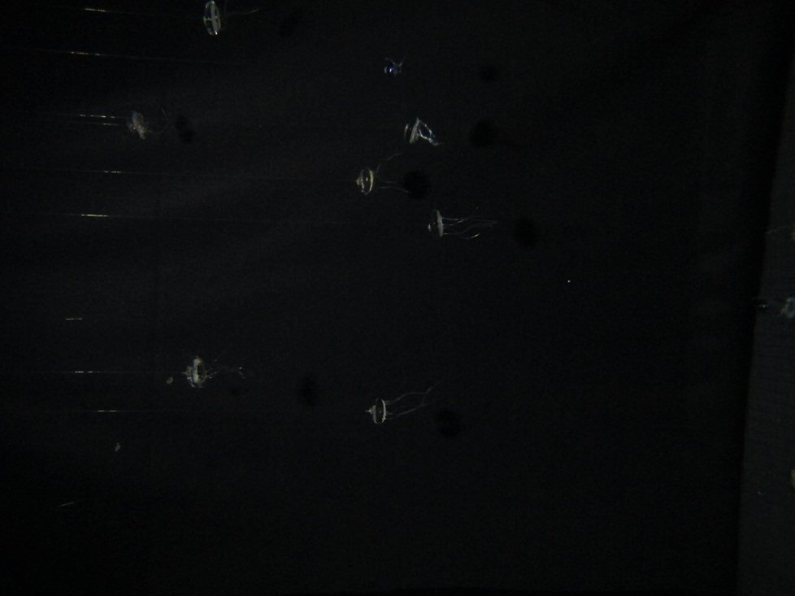
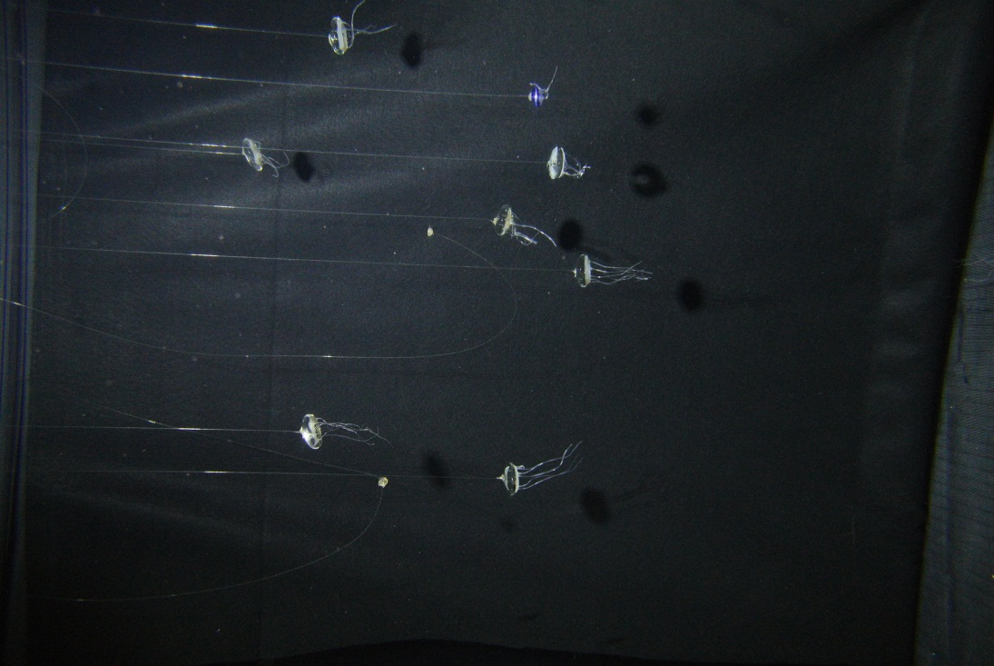
Performance Comparison
Front Light Jellies 1/125 Second Exposure
Canon G12 6.1mm Lens
Nikon 1 V1 10mm Lens
CanonG12_Jelly_ISO800_f2.8_125thS_LEDPower3.JPG
Nikon1V1__Jelly_ISO800_f2.8__125thS_LEDPower3.JPG
LED Power: 3
Shutter: 1/125 second
ISO: 800
f-Stop: 2.8
LED Power: 3 (1,110 Lumens m^2)
Shutter: 1/125 second
ISO: 800
f-Stop: 2.8

Slide 9
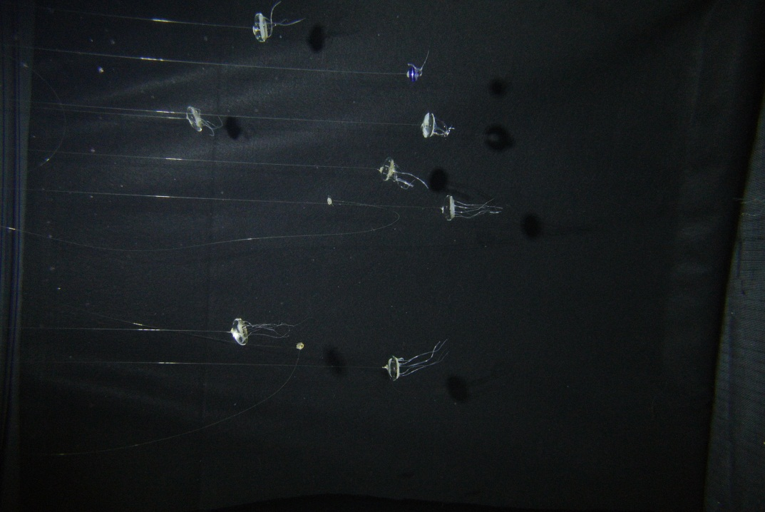
Performance Comparison
Front Light Jellies 1/250 Second Exposure
Canon G12 6.1mm Lens
Nikon 1 V1 10mm Lens
No Useful Image!
Nikon1V1__Jelly_ISO800_f2.8__250thS_LEDPower3.JPG
LED Power: 3
Shutter: 1/250 second
ISO: 800
f-Stop: 2.8
LED Power: 3 (1,110 Lumens m^2)*
Shutter: 1/250 second
ISO: 800
f-Stop: 2.8
* Same as previously calculated light and power budget value

Slide 10
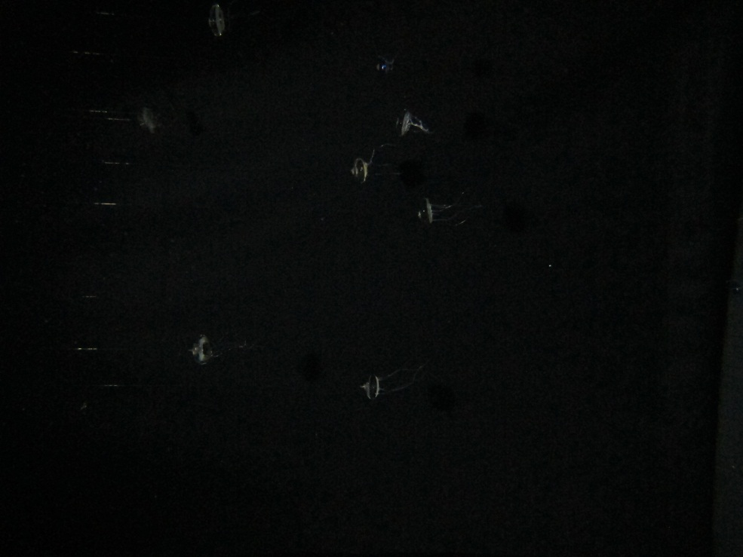
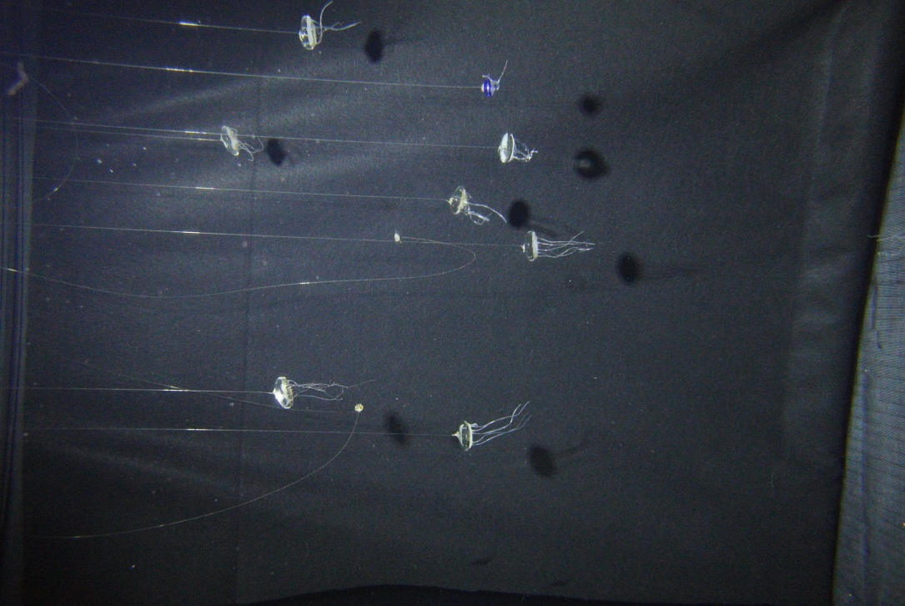
Performance Comparison
Front Light Jellies 1/250 Second Exposure
Canon G12 6.1mm Lens
Nikon 1 V1 10mm Lens
CanonG12_Jelly_ISO1600_f2.8_250thS_LEDPower3.JPG
Nikon1V1__Jelly_ISO1600_f2.8__250thS_LEDPower3.JPG
LED Power: 3
Shutter: 1/250 second
ISO: 1600
f-Stop: 2.8
LED Power: 3 (1,110 Lumens m^2)* Shutter: 1/250 second
ISO: 1600
f-Stop: 2.8
* This is 1 f-stop (2X) greater than initial lighting and power budget calculations

Slide 11
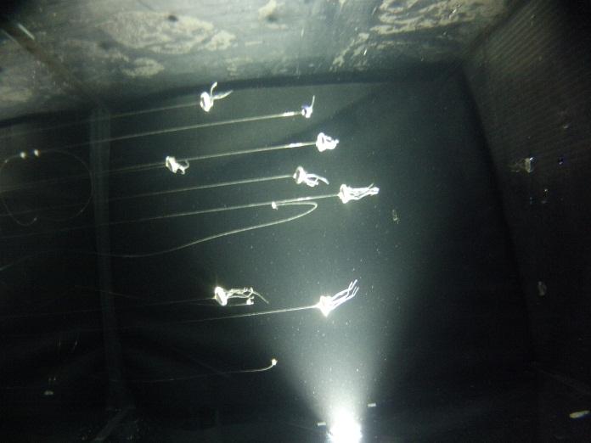
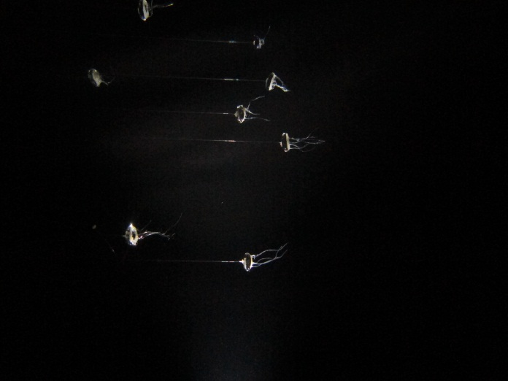
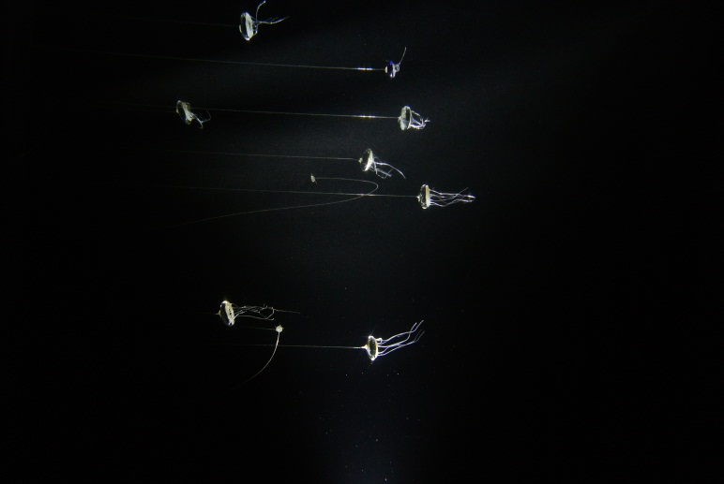
Performance Comparison
With Side Lighting
GoPro 4mm Lens
Canon G12 6.1mm Lens
Nikon 1 V1 10mm Lens
GOPR0_Jelly_Sidelight_11MP_W_LEDPower3.JPG
CanonG12_Jelly_SideLight_ISO1600_f2.8_250thS_LEDPower3.JPG
Nikon1V1_Jelly_SideLight_ISO400_f3.2_250thS_LEDPower3.JPG
LED Power: 3
Shutter: 1/3 second
ISO: 400
f-Stop: 2.8
LED Power: 3
Shutter: 1/250 second
ISO: 1600
f-Stop: 2.8
LED Power: 3 (232,360 Lumens m^2!)
Shutter: 1/250 second
ISO: 400
f-Stop: 3.2
Note: Nikon 1V1 is 4 + stops faster.

Slide 12
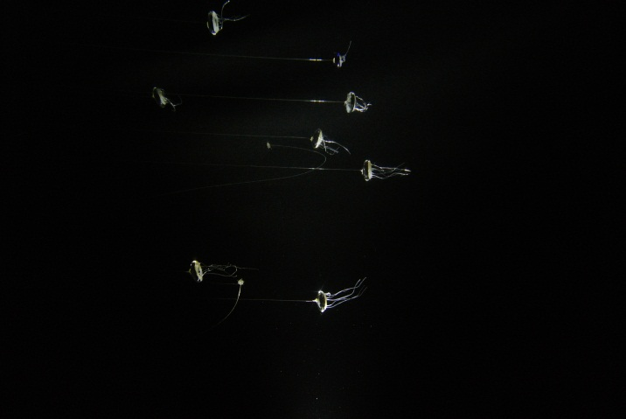
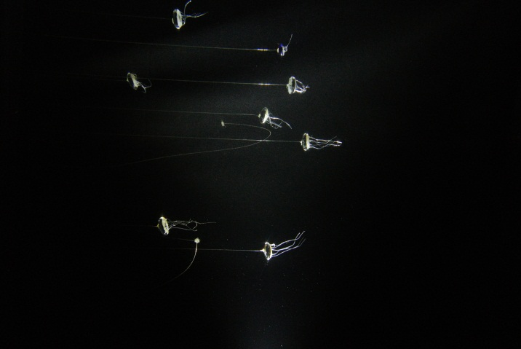
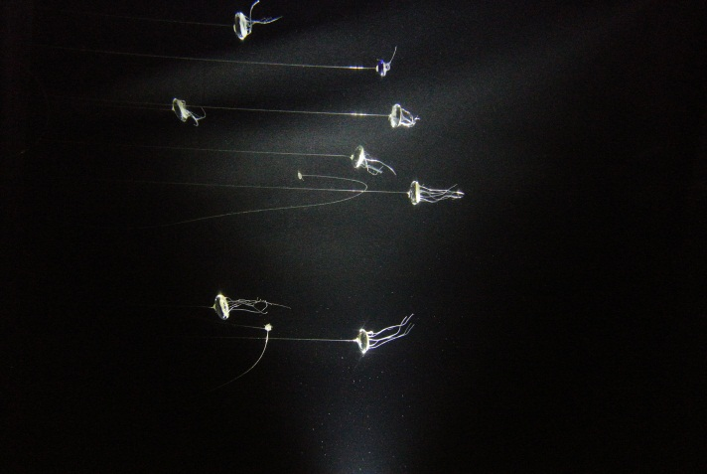
Performance Comparison
How Low Can You Go (Lighting)?
Nikon 1 V1 10mm Lens
Nikon 1 V1 10mm Lens
Nikon 1 V1 10mm Lens
Nikon1V1_Jelly_SideLight_ISO800_f3.2_250thS_LEDPower1.JPG
Nikon1V1_Jelly_SideLight_ISO1600_f3.2_250thS_LEDPower1.JPG
Nikon1V1_Jelly_SideLight_ISO3200_f3.2_250thS_LEDPower1.JPG
LED Power: 1 (10,360 Lumens m^2)
Shutter: 1/250 second
ISO: 800
f-Stop: 3.2
LED Power: 1
Shutter: 1/250 second
ISO: 1600
f-Stop: 3.2
LED Power: 1
Shutter: 1/250 second
ISO: 3200
f-Stop: 3.2

Slide 13
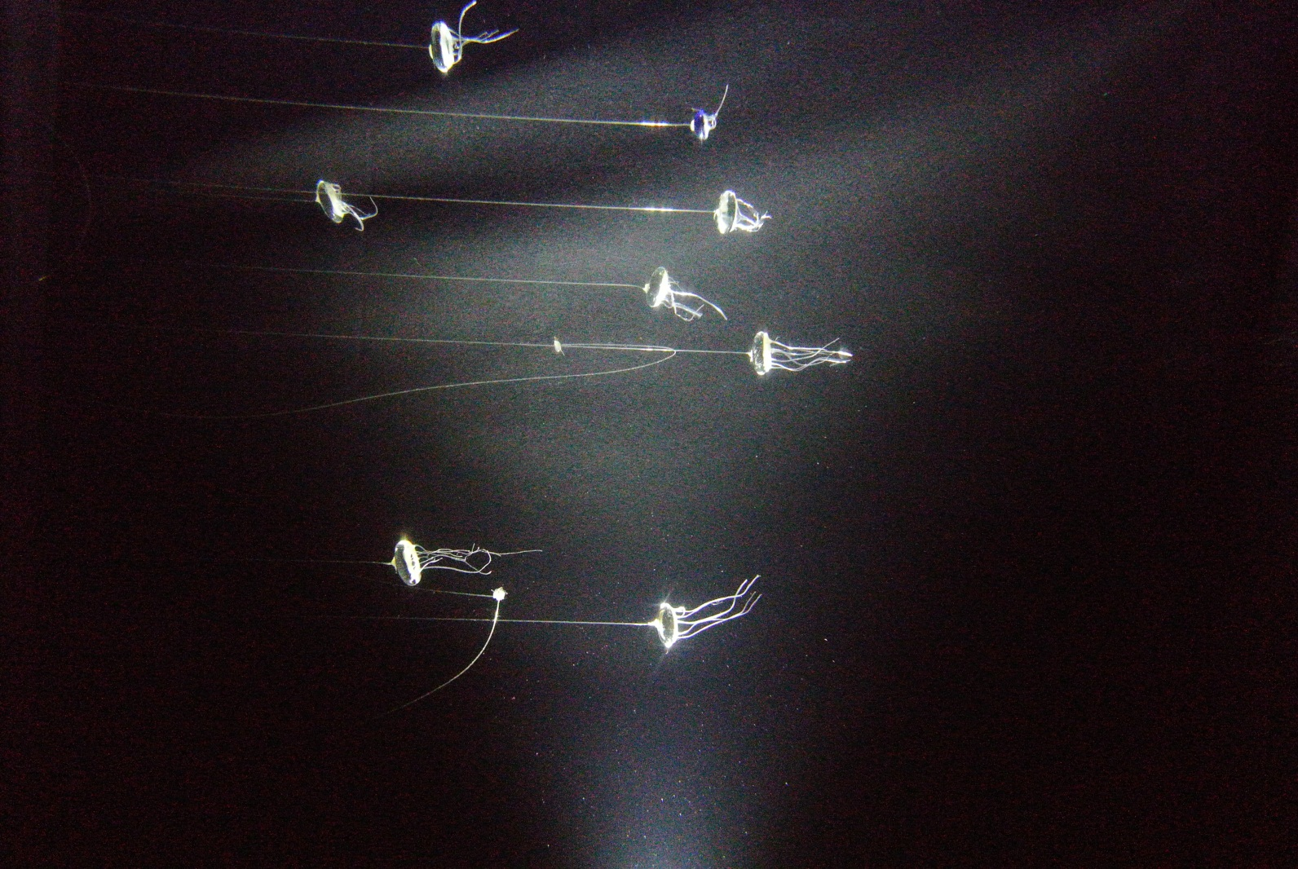
Performance Comparison 2
How Low Can You Go (Lighting)? Really Low!
Nikon 1 V1 10mm Lens
LED Power: 1 (10,360 Lumens m^2)
Shutter: 1/250 second
ISO: 6400!
f-Stop: 3.2
Nikon1V1_Jelly_SideLight_ISO6400_f3.2_250thS_LEDPower1.JPG

Slide 14
Conclusions From Camera Testing
Nikon 1V1 is superior to GoPro and G12 in image quality and sensitivity.
  Allows less lighting or faster shutter speeds or lower ISO (better quality image).
  Greater sensitivity ultimately results in lower overall power budget (even though camera may use slightly more energy).
Canon G12 is a non-starter anyway – camera must have a prime lens for housing size and mechanical wear issues.
GoPro image quality is probably acceptable for some SCPI applications where the target is static (LST Drifter?) but lack of manual control over the image makes the prediction of the final results unpredictable.
GoPro suffered from poor lens alignment.
Nikon 1 V1 Electronic lens focusing can be a problem – need to make sure it can be set controllably, auto focus, or can use a manual focus lens.
System Lighting design and power budget needs some tweaking based on the camera results.
  Increase lighting to ensure shutter speeds of 1/250th second +.
  Distributed lighting?
Other similar performance cameras that may be less expensive or already have PTP or gphoto support should be checked out, …if we can agree that we now that we know exactly what we are looking for…
  E.g. Olympus 12mm ƒ/2 ED M.Zuiko lens on a Olympus PEN E-PL1 four thirds camera body? – high end manual focus lens. $950
  Other low end options? I do not know of any except perhaps in the Canon PowerShot line. Cameras will not be as sensitive, have mechanical lens extensions, and no strobe support.

Slide 15
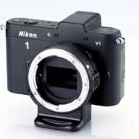
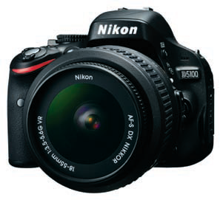
More Nikon 1 V1 Information
Camera control options
  Control shutter through PTP (USB) interface with extensions to gphoto or Aurdinio PTP driver.
  Use remote IR control for shutter trigger?
Has autofocus lens that does not hold focus position through power cycle.
  Will auto focus work for application?
  Might focus at the wrong distance in daylight.
Can use Mount Adapter FT1 lens adapter and DX format Nikon 20mm f/2.8 AI-s prime lens with manual focus.
  Increases overall size (then why not a D series camera with full Nikon SDK support such as Nikon D5100?).
  Provides equivalent of 11mm FL in CX format.
  Adapter info. http://www.robgalbraith.com/bins/content_page.asp?cid=7-11668-12212
Camera power management
  auto powers down after 15 seconds.
  Use mini solenoid to actuate power switch?

Slide 16
Updated Power Budget - GoPro
 | Number of batteries (80% PS Eff.)
 | Alkaline D Cell RayOVac MAX 813 | Lithium D Cell - Primary, SAFT LSH20 | Lithium D Cell - Secondary SAFT VL 32600-125
Lamp mode | 4 | 2 | 4
Strobe mode | 3 | 1 | 3

Slide 17
Updated Power Budget – Nikon 1 V1
 | Number of batteries (80% PS Eff.)
 | Alkaline D Cell RayOVac MAX 813 | Lithium D Cell - Primary, SAFT LSH20 | Lithium D Cell - Secondary SAFT VL 32600-125
Lamp Mode | 7 | 3 | 7
Strobe Mode | 6 | 2 | 6

Slide 18
Cost Budget Example
SCPI Cost Budget Allocation (example)
 | Quantity | Cost Each | Total Cost
Camera System
Nikon 1 V1 | 1 | $650.00 | $650.00
10mm Lens | 1 | $249.00 | $249.00
 |  | subtotal | $899.00
Camera Housing
Acrylic camera port material (flat port) | 1 | $15.00 | $15.00
Acrylic camera port machining | 3 | $100.00 | $300.00
Camera housing barrel material | 1 | $25.00 | $25.00
Camera housing barrel machining | 3 | $100.00 | $300.00
Impulse penetrator | 1 | $90.00 | $90.00
 |  | subtotal | $730.00
System Controller
components | 1 | $150.00 | $150.00
Batteries (alkaline) | 5 | $1.50 | $7.50
Batteries (Lithium) | 3 | $28.00
PC board and assembly | 1 | $300.00 | $300.00
 |  | subtotal | $457.50
Lighting System
LED | 14 | $4.62 | $64.68
Reflectors | 14 | $1.65 | $23.10
Acrylic port material | 1 | $15.00 | $15.00
Acrylic port machining | 3 | $100.00 | $300.00
Light housing barrel material | 1 | $25.00 | $25.00
Light housing barrel machining | 3 | $100.00 | $300.00
PC board and assembly | 1 | $300.00 | $300.00
Impulse penetrator | 1 |  | $0.00
subtotal |  | subtotal | $1,027.78
Interconnect cabling
Camera to light cable and connectors | 1 | $150.00 | $150.00
 |  | subtotal | $150.00
 |  | Total Cost | $3,264.28

Slide 19
Recommendations
Camera Interface
  Develop a robust driver extension for chosen camera using the PTP interface specification standard.
    Leverages from existing PTP driver development.
    Will work with almost any modern camera.
      Preserves development effort and expertise as cameras continue to evolve.
      Expertise can be leveraged by other camera projects.
    Note: GoPro does not appear to support the PTP interface.
Lighting and Interface
  Likely best to use LED’s in “lamp mode”, turning on for one second and using camera shutter to control exposure – energy saving (~ 1 D cell) for LED strobe does not seem to justify the additional design effort.
    Effort better spent reducing camera power demand?
      Decision can be revisited during detailed lighting design stage, depends on design effort required.
  Use the ISO 10330 camera strobe interface standard for the light cable
    Allows the use of commercial strobes for some applications that require super short exposure (high speed motion).
    Lighting “lamp mode” can use the “aiming light” circuit of the interface.

