Slide 1
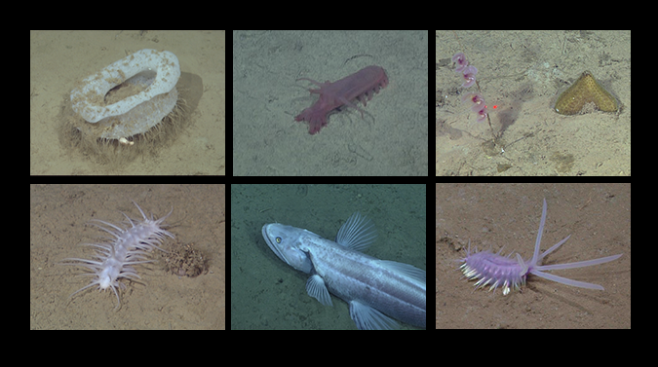
Rapid changes and long-term cycles in an abyssal benthic megafaunal community observed over 29 years in the northeast Pacific
Linda A. Kuhnz, Henry A. Ruhl, Christine L. Huffard, Kenneth L. Smith, Jr.
Abstract
Results
The seafloor community on the Monterey Fan in the NE Pacific (Station M, 4000 m depth) was studied between 2006–2018 using remotely operated vehicles (ROVs) as part of a continuing 29-year time-series study. New patterns continue to be revealed, showing that the deep-sea is dynamic on short time scales, rather than static over long periods. Early in the study, megafaunal diversity was high, yet the community was depauperate in terms of density compared to later periods. In just over two years the community shifted from a sessile, suspension-feeding, sponge-dominated community to a mobile, detritus-feeding, holothurian-dominated assemblage. Changes in the megafaunal community continue, and we explore the dynamic abundance and diversity of individual groups of organisms over time. Large variations over decadal-scales indicate that remote abyssal communities are dynamic and are likely subject to impacts from anthropogenic changes like ocean warming, acidification, and pollution manifested in the upper ocean. The degree of dynamism indicates that one-time or short-term investigations are not sufficient for assessing biological community structure in conservation or exploitation studies in the deep sea.
We identified nearly 120,000 animals representing over 112 species during the ROV portion of this study
Long-term tracking of 10 specific echinoderm species shows a circular pattern of community structure, appearing to return toward the original state observed in the 1990’s and early 2000’s. (Fig. 2)
Overall megafaunal densities ranged from a mean of 0.67 ind. m⁻² ± 0.048 (± SE) in December 2006 to 6.46 ind. m⁻² ± 0.81 in November 2012, an order of magnitude increase
Studies of the whole community from 2006–2009 revealed a depauperate, but high diversity community dominated by sessile sponges and echinoderms (Fig. 3, Fig. 5, cluster A)
During 2011–2014 there were high particulate organic matter (POC) flux years, resulting in dense aggregations of highly mobile holothurians (Fig. 3, Fig. 4, Fig. 5, cluster B)
Decreasing overall community abundance does not match the increasing occurrence of large episodic POC flux events between 2015–2018 (Fig. 3, Fig. 4, Fig. 5, cluster C). Ophiuroids and sponges begin to dominate
Some species nearly vanished at times (Elpidia sp. A), while others (Abyssocucumis abyssorum) exhibited a persistent presence with little fluctuation in abundance.
Figure 5. Shade plot showing the 25 megafaunal taxa that most defined biological community states at Station M from 2006–2018). A, B, and C are the three main time periods that cluster together. Darker-shaded areas indicate greater influence on community structure over the 13 years. These specific taxa represent > 88% of site abundance. See legend for taxonomic group designations. Tjalfiella = benthic siphonophore; Smithsonius dorothea = bryozoan; Psamminidae = xenophyophore.
Conclusions
﻿This long-term study shows that time-series investigations are important for understanding abyssal megafaunal community structure and that short-term investigations cannot characterize an overall setting. Major changes in the density and diversity of species at Station M suggest that there is no constant community state, probably due to disturbance in the form of episodic food events from the far-removed overlying water column. With further study we expected to see a cyclical pattern of overall diversity like that suggested for dominant echinoderms (1989–2018), however it is clear that food partitioning (via the quantity and quality of carbon arriving on the seafloor) controls specific community states. Many questions remain as to how this abyssal site and others will change with continued, and perhaps increasing, anthropogenic change in the upper ocean.
Figure 2. Multidimensional scaling (MDS) plot for 10 select echinoderm taxa followed from 1989–2018.
Figure 3. MDS plot for the entire megafaunal community from 2006–2018.
Figure 1. Map showing Station M in the northeast Pacific, 220 km off the California coast. Inset: areas sampled during investigations. Black circles indicate the start point of transects from 1989–2004 where camera sled sampling took place about 40–50 km to the southwest. The paths of ROV studies conducted from 2006–2018 are shown to the northeast.
Methods
Between 2006–2018, Station M was surveyed 18 times using the Monterey Bay Aquarium Research Institute’s (MBARI) R/V Western Flyer, equipped with ROV’s Tiburon (2006–2007) and Doc Ricketts (2009–2018; Fig. 1). We conducted video transects within a 40 km² area of seafloor at 4000 m depth (±40 m). The average transect length per time period was >2000 km. All benthic and demersal animals >1 cm were quantified. Observed taxa were assigned a mobility category (sessile, functionally sessile, mobile) and a feeding-type category (suspension feeder, surface deposit feeder, subsurface deposit feeder, or predator/scavenger), based on stable isotope analysis for select deep-living benthic organisms. We compared the density of organisms observed in these ROV surveys with the densities of 10 mobile megafaunal organisms quantified from towed camera-sled images during previous Station M studies conducted between 1989–2004.
Upcoming work
Figure 4. Images showing seafloor conditions during various ROV surveys.
A) Seafloor with little to no organic debris. B) In June 2007, detrital aggregates (white arrows) are apparent. C) Three months later, the density and size of detrital aggregates (white arrows) became larger. D) In February 2009, the seafloor had no detrital aggregates present. E) In June 2012, dense numbers of dead/dying pelagic salps sank to the seafloor (white polygons). F) Six months later organic debris was nearly gone G) A large pulse of pyrosomes (left) and detrital aggregates (right) reached the seafloor in March, 2017 H) Eight months later a large pulse of phytodetritus was present. Minimal seafloor detritus of any kind was observed in April 2018.
The megafaunal community at Station M as a whole has not responded, in terms of abundance, to recent high POC flux events. Analysis of how individual species populations are affected by the quantity and quality of food is our next step. Cross correlation functions will be applied using ranked population densities and organic variables to help identify which taxa may be utilizing specific organic matter supplied from shallow water (see posters 84 and 324).
Abstract 325

