Slide 1
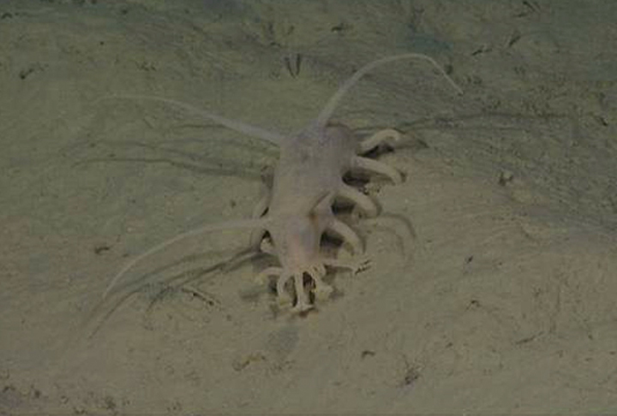

Deep Sea Holothuroid Responses to
Nutrient Fluctuations:
Life and Death in the Deep Sea
Larissa Clary
MBARI Summer Intern
August 14, 2013

Slide 2
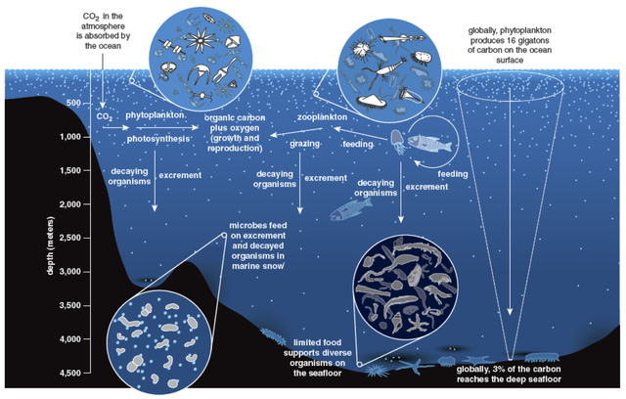
Notes:
Deep sea…not a lot known. Hydrothermal vents are focused on but the majority is not that environment
Primary production driven
Picture of one of our transect pictures
Map

Slide 3
Notes:
Diversity is high in deep sea holouthrians…henry’s paper

Slide 4
Notes:
SHORT review of transects and ROVs
Pic of ROV and transect graphic??
map

Slide 5
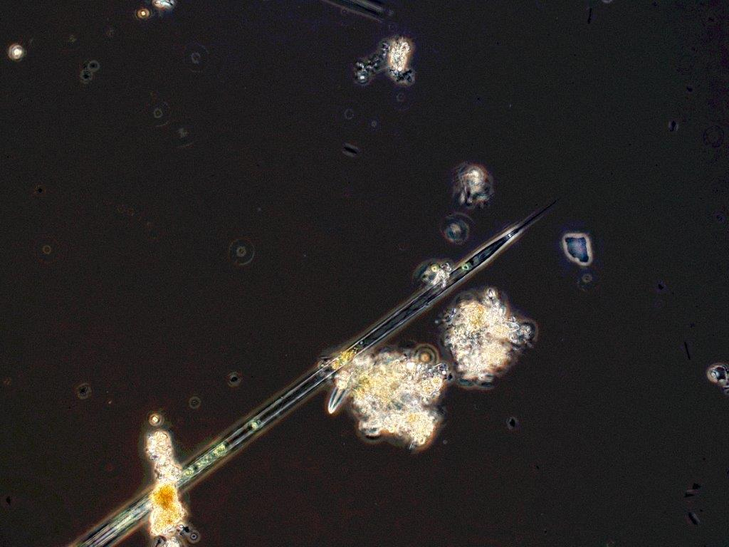
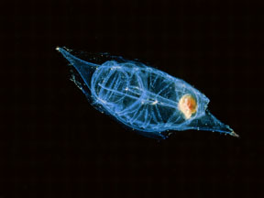
Sampling Period
Sampling Period
Sampling Period
Sampling Period
Sampling Period
Sampling Period
Sampling Period
Sampling Period
Sampling Period
Rhizolenia sp.
David Worbel
DEC 2006
FEB 2007
FEB 2009
MAY 2011
JUNE 2007
NOV 2011
NOV 2012
SEPT 2007
JUNE 2012
Notes:
Timeline….talk about the three food pulses and the sampling

Slide 6
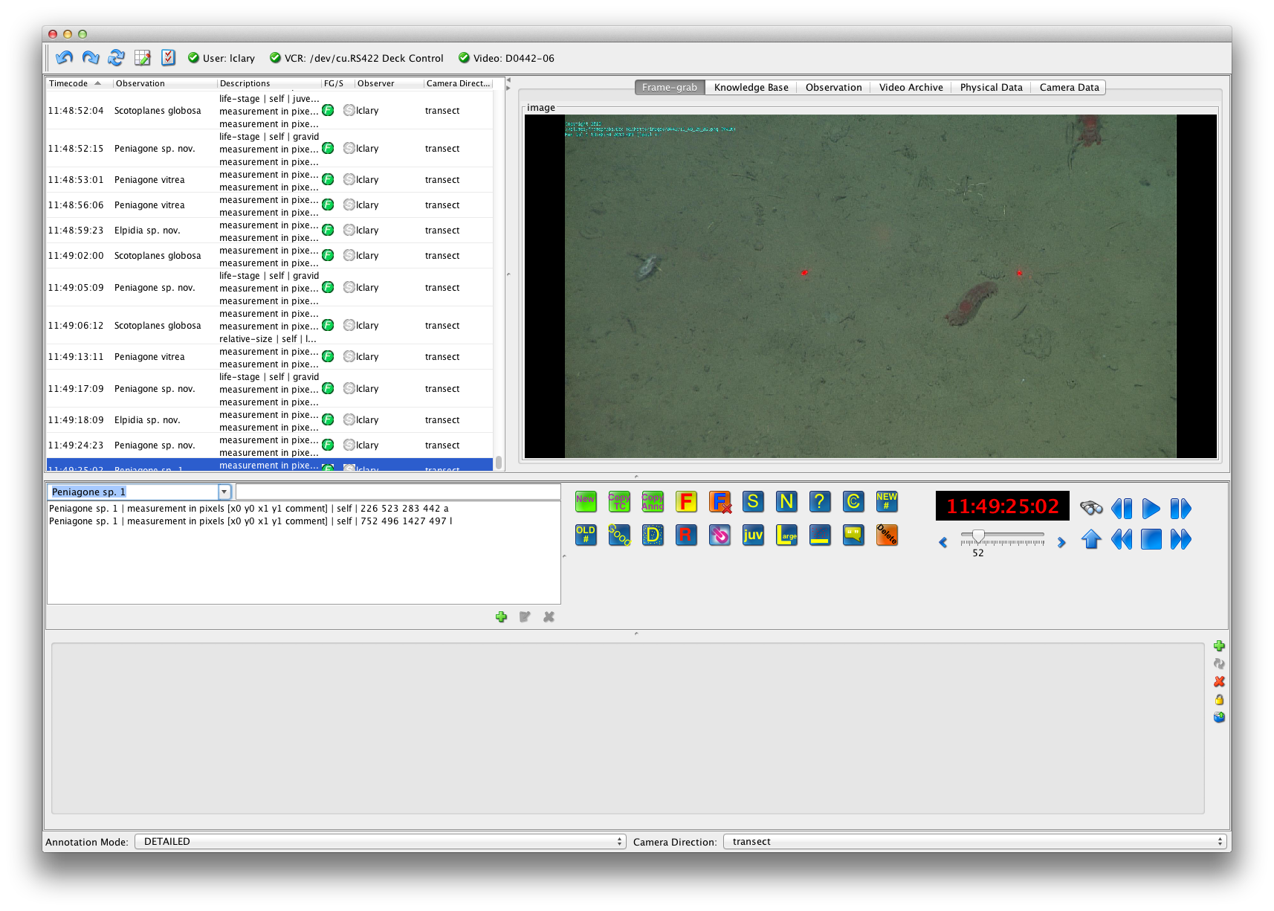
Notes:
Vars processes…measuring

Slide 7
Notes:
Results :all graphs….doesn’t that just make you want to cry!

Slide 8
Notes:
Focus on three species: scotoplanes, peniagone sp 1 and peniagone sp nov

Slide 9
Notes:
Focus on three species: scotoplanes, peniagone sp 1 and peniagone sp nov

Slide 10
Notes:
Focus on three species: scotoplanes, peniagone sp 1 and peniagone sp nov

Slide 11
Notes:
Peniagone sp 1 graphs/gif??

Slide 12

Notes:
Peniagone sp 1

Slide 13
Notes:
Peniagone sp 1 graphs/gif??

Slide 14
Notes:
Peniagone sp 1 graphs/gif??

Slide 15
Notes:
Peniagone sp 1 graphs/gif??

