Slide 1
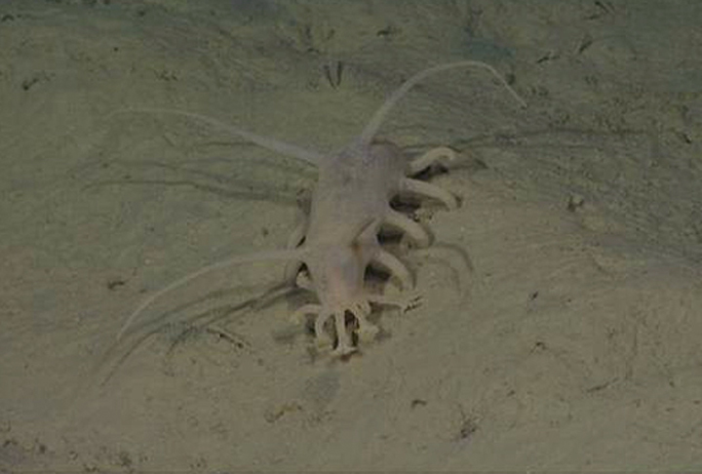

Deep Sea Holothuroid Responses to
Nutrient Fluctuations:
Life and Death in the Deep Sea
Larissa Clary
MBARI Summer Intern
August 14, 2013

Slide 2
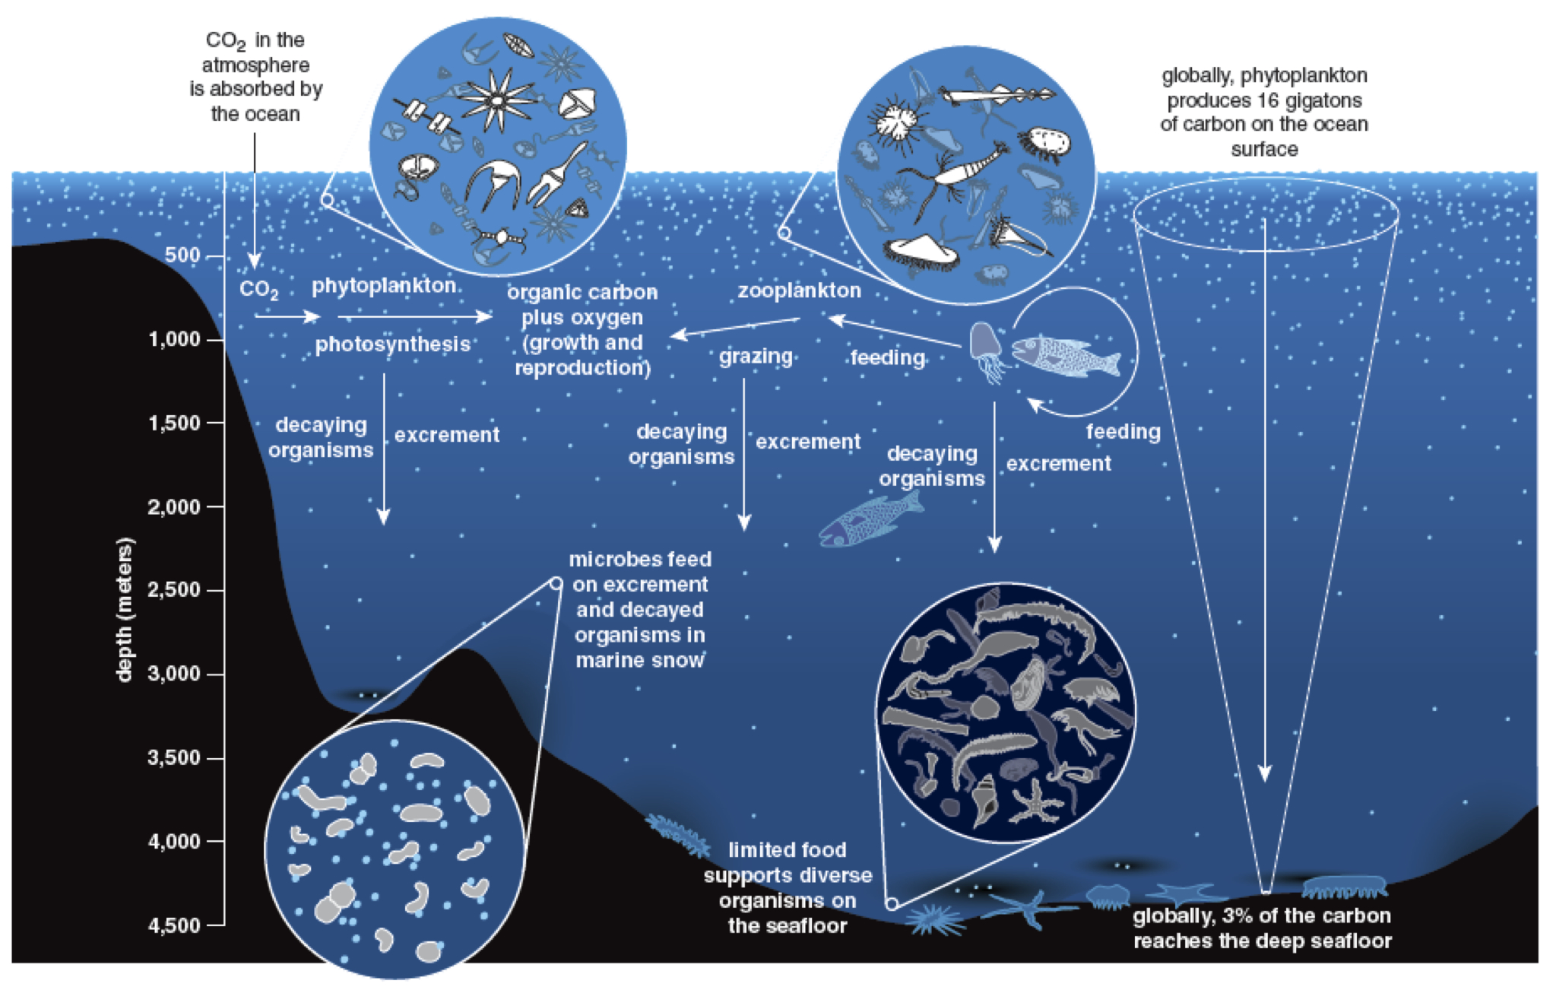
Primary Production and the Deep Sea
American Scientist
Notes:
Deep sea…not a lot known. Hydrothermal vents are focused on but the majority is not that environment
Primary production driven
Picture of one of our transect pictures
Map

Slide 3
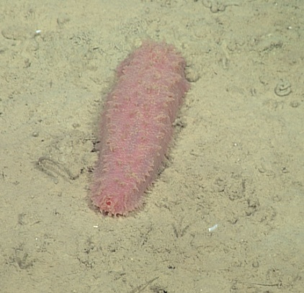
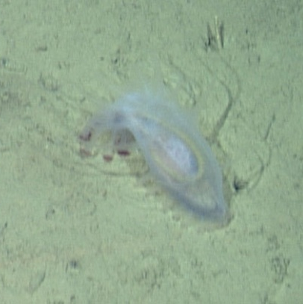
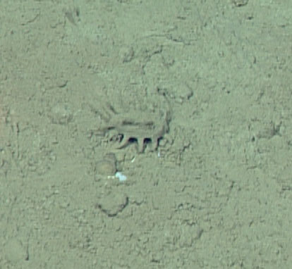
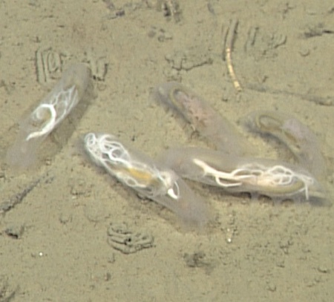
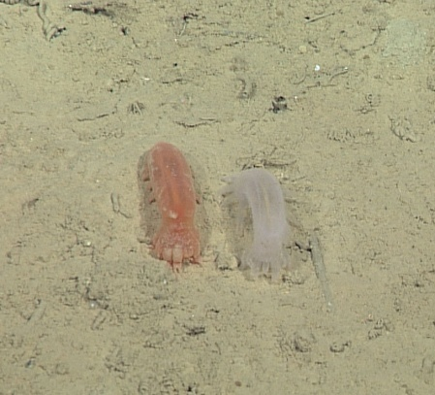
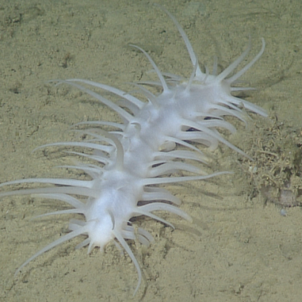
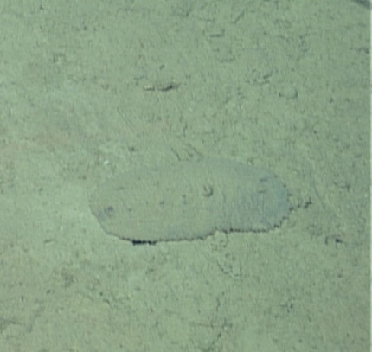
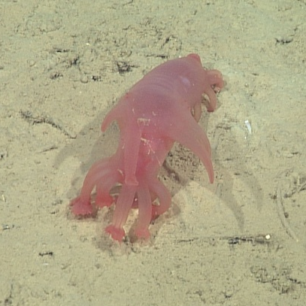
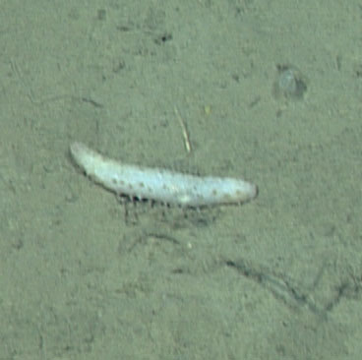
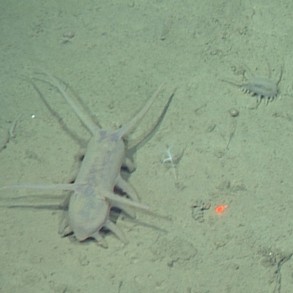
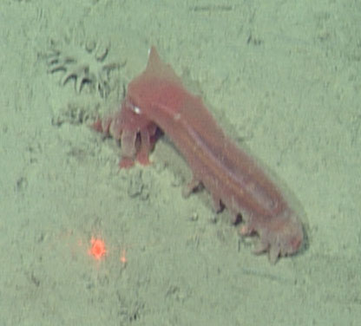
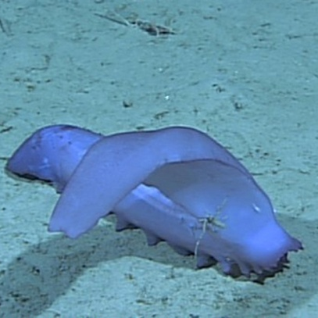
High Diversity in Deep Sea Holothurians
Notes:
Diversity is high in deep sea holouthrians…henry’s paper

Slide 4
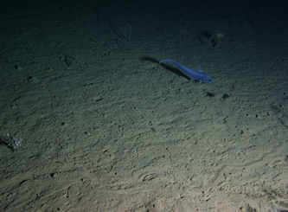
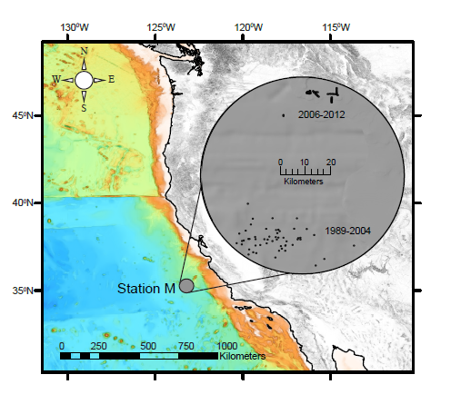
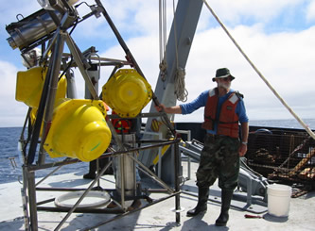

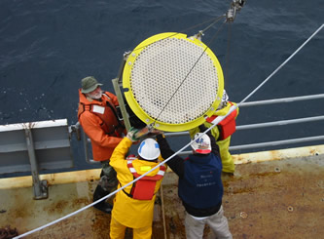
Station M
Linda Kuhnz
Notes:
SHORT review of transects and ROVs
Pic of ROV and transect graphic??
map

Slide 5
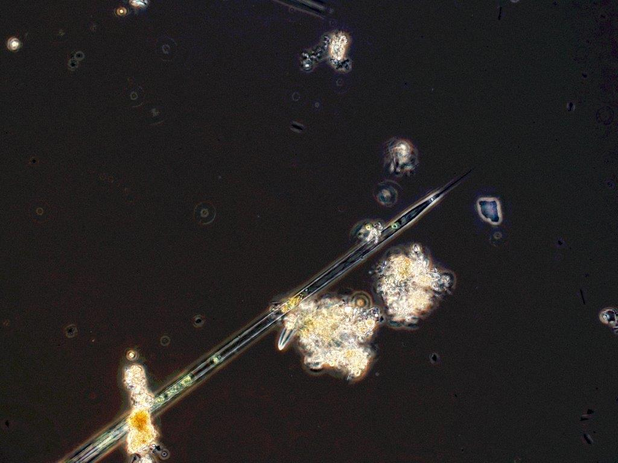
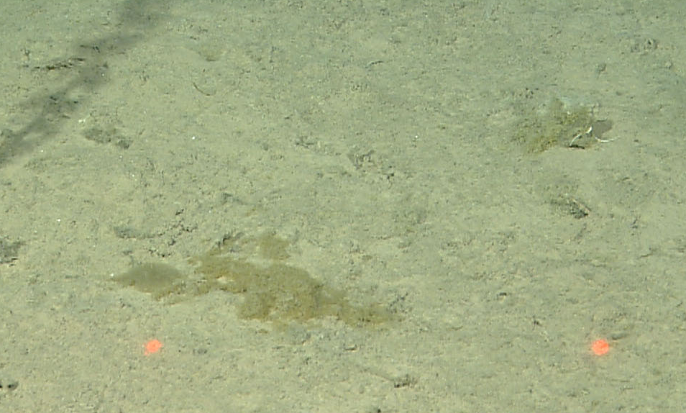
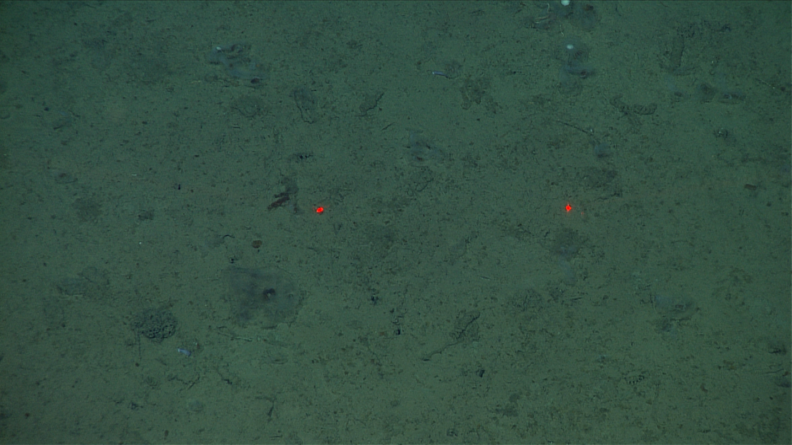
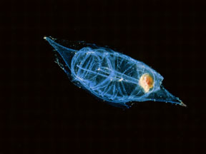
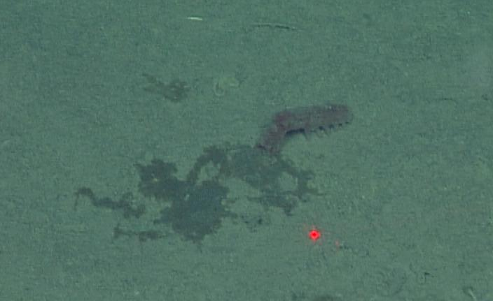
SamplingPeriods
Sampling Period
Sampling Period
Sampling Period
Sampling Period
Sampling Period
Sampling Period
Sampling Period
Sampling Period
Sampling Period
David Worbel
Rhizolenia sp.
DEC 2006
FEB 2007
FEB 2009
MAY 2011
JUNE 2007
NOV 2011
NOV 2012
SEPT 2007
JUNE 2012
Notes:
Timeline….talk about the three food pulses and the sampling

Slide 6
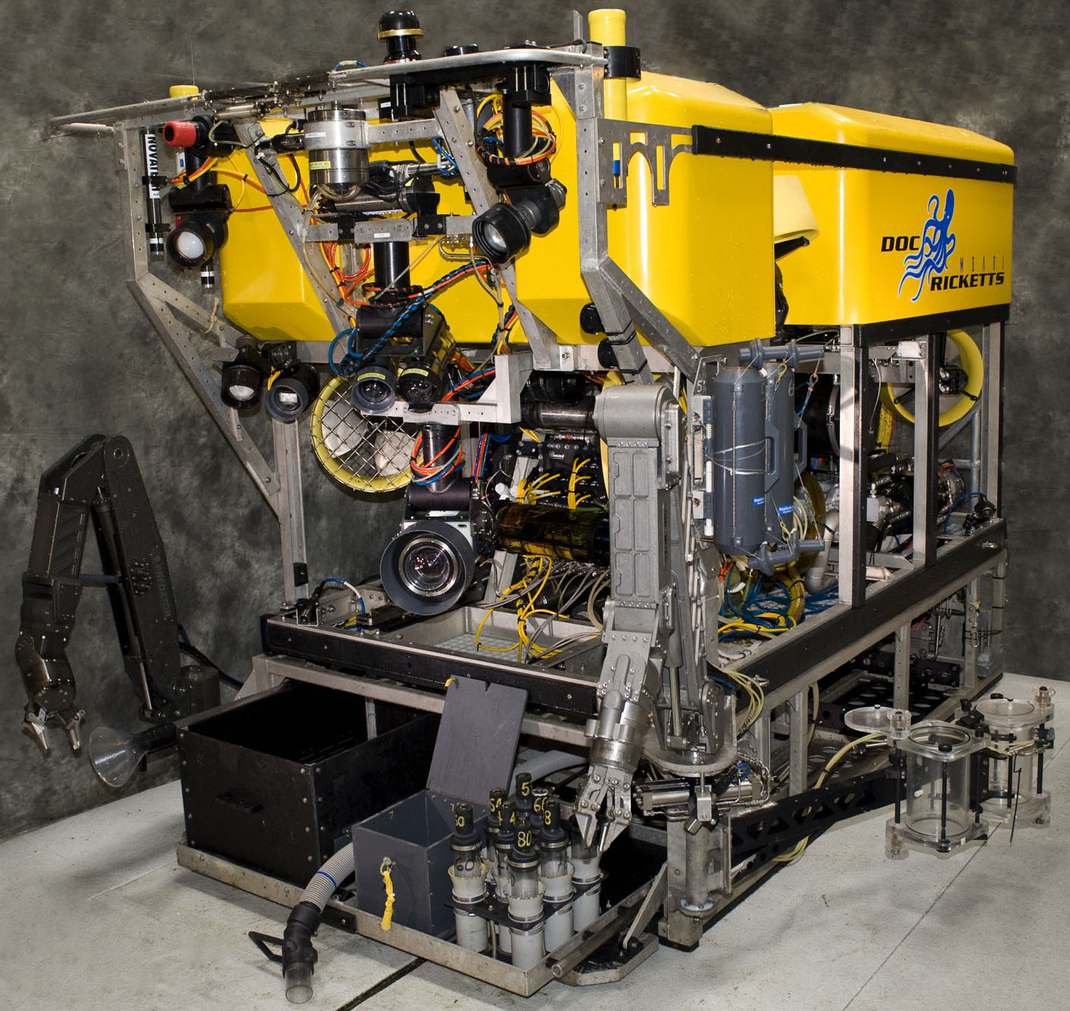
ROV Transects

Slide 7
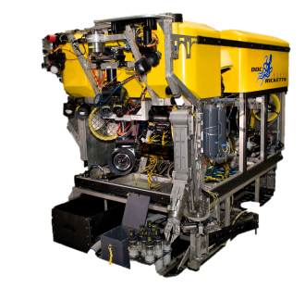
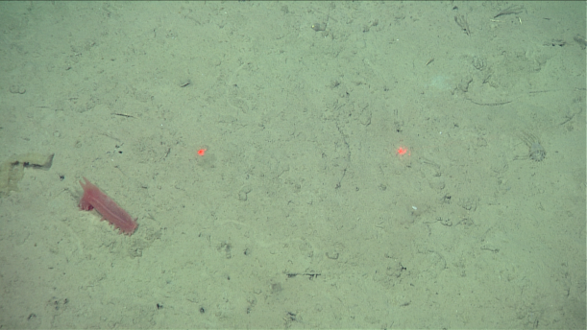
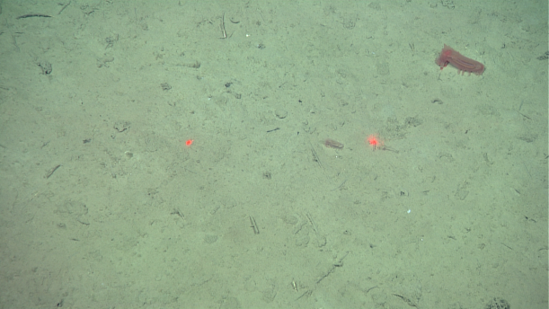
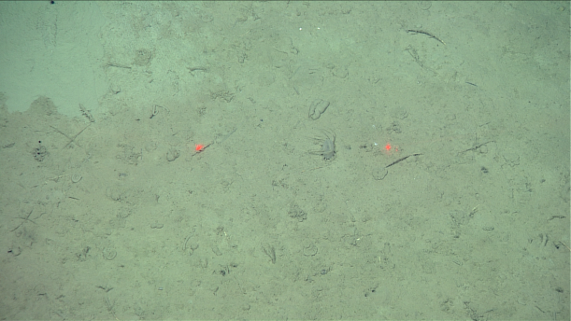
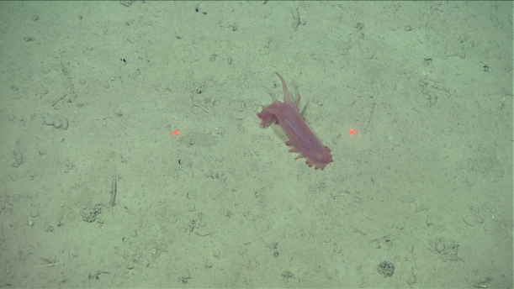

ROV Transects

Slide 8
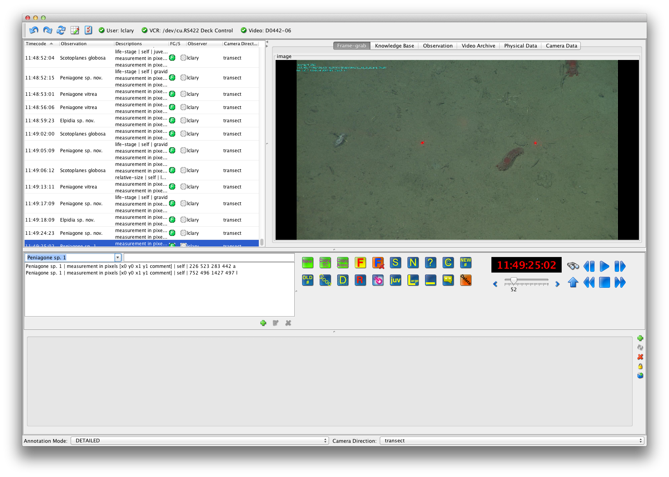
Data Collection Using VARS
Notes:
Vars processes…measuring

Slide 9
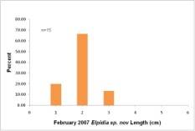
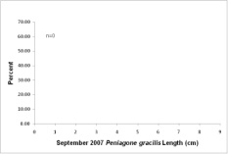
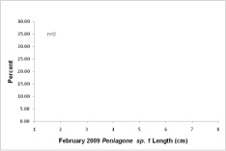
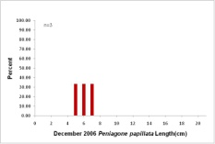
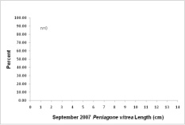
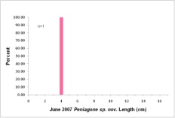
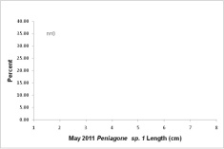
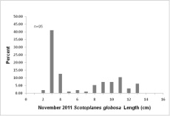
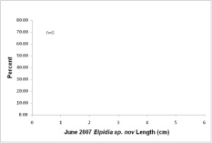
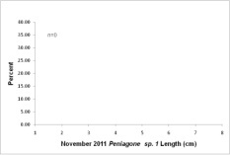
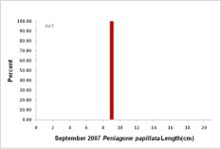

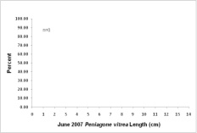
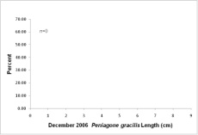
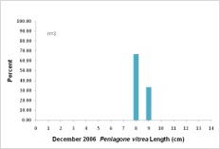
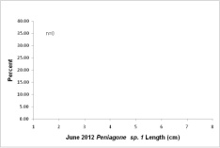
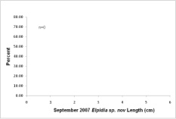
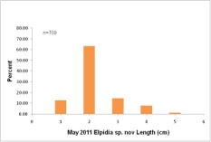
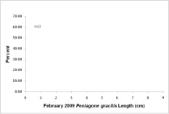
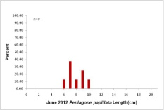
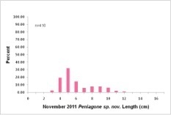










































Size Distributions
Notes:
Results :all graphs….doesn’t that just make you want to cry!

Slide 10



















Peniagone sp. nov.
DEC 2006
FEB 2007
FEB 2009
MAY 2011
JUNE 2007
NOV 2011
NOV 2012
SEPT 2007
JUNE 2012
Notes:
Focus on three species: scotoplanes, peniagone sp 1 and peniagone sp nov

Slide 11



















Scotoplanes globosa
DEC 2006
FEB 2007
FEB 2009
MAY 2011
JUNE 2007
NOV 2011
NOV 2012
SEPT 2007
JUNE 2012
Notes:
Focus on three species: scotoplanes, peniagone sp 1 and peniagone sp nov

Slide 12



















Peniagone sp. 1
DEC 2006
FEB 2007
FEB 2009
MAY 2011
JUNE 2007
NOV 2011
NOV 2012
SEPT 2007
JUNE 2012
Notes:
Peniagone sp 1 graphs/gif??

Slide 13

Peniagone sp. 1
Notes:
Peniagone sp 1

Slide 14

Biomass Conversions
n= 9752
Notes:
Peniagone sp 1 graphs/gif??

Slide 15

Acknowledgments
Dr. Ken Smith, Linda Kuhnz, Dr. Christine Huffard
The rest of the Pelagic-Benthic Coupling Lab: Richard Henthorn, John Ferreira, Paul McGill, Alana Sherman
MBARI Video Lab: Lonny Ludsten, Susan Von Thun
George Matsumoto
Claire Languionie-Marchais and the other summer interns
Dr. Henry Ruhl, deepseagroup at Southampton University

