Slide 1
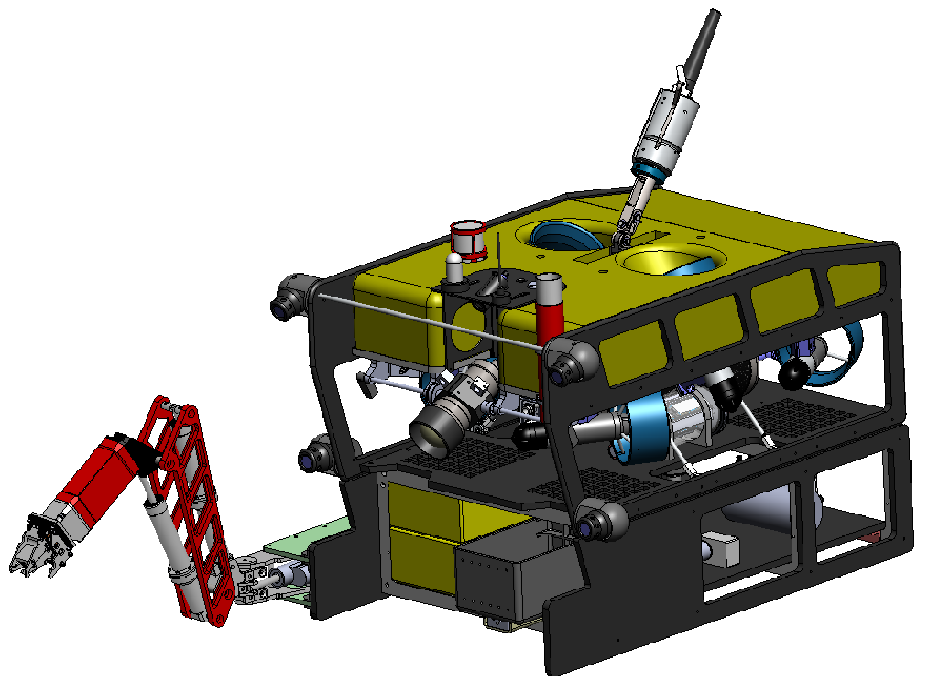
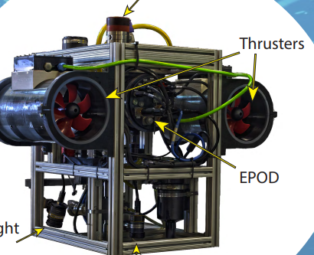
Door
20’ Control Van
Door
Connects to
Ship Power
L= Xm
3 Phase
Nominal ~400 VAC (wide input 200 - 500 VAC, 40 - 70 Hz)
Needs >50 A circuit
Connects to Winch
Cable Bundle (l= X m) contains:
- Winch power ~240 VAC single phase
ROV power ~208 VAC 3 phase, 15 A mac
ROV fiber optics in jacketed cable
Comms to winch electronics

Slide 2
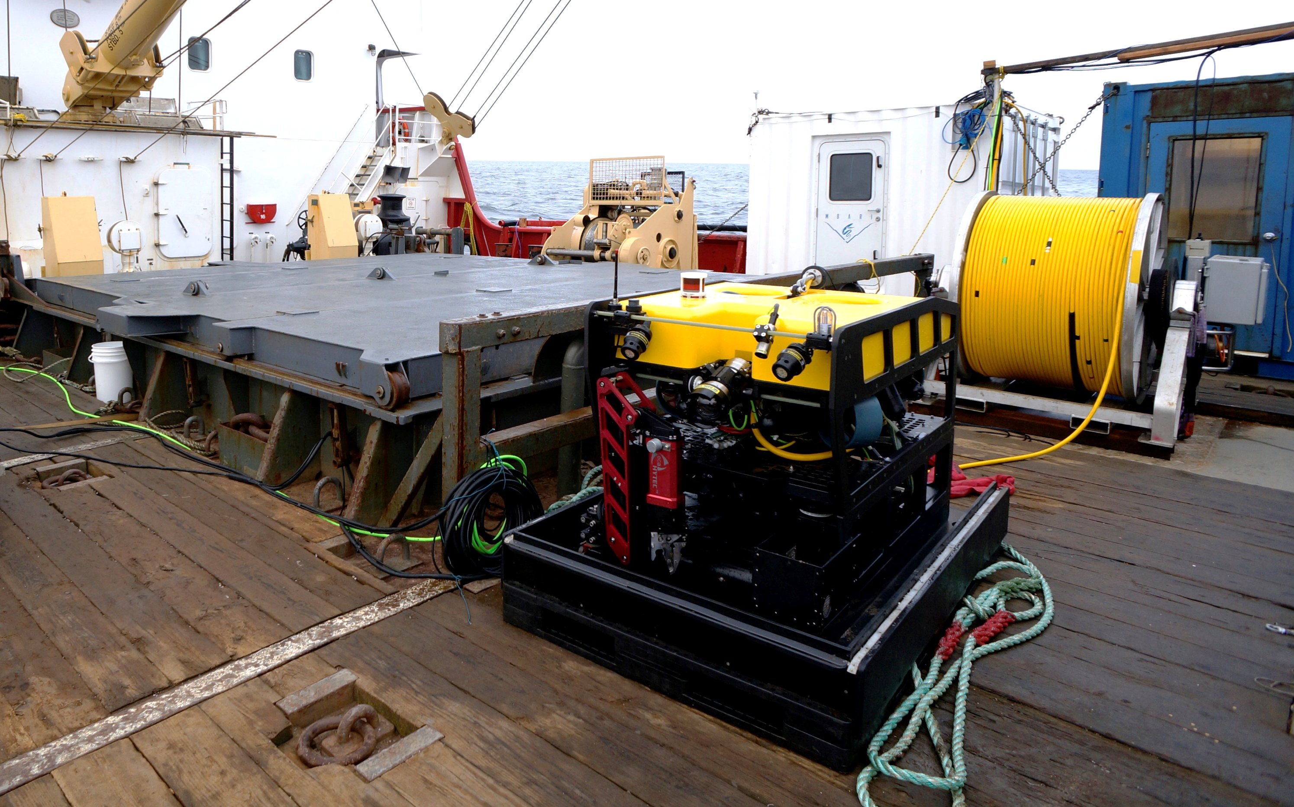
MiniROV System
3500 lbs
900 lbs

