Slide 1
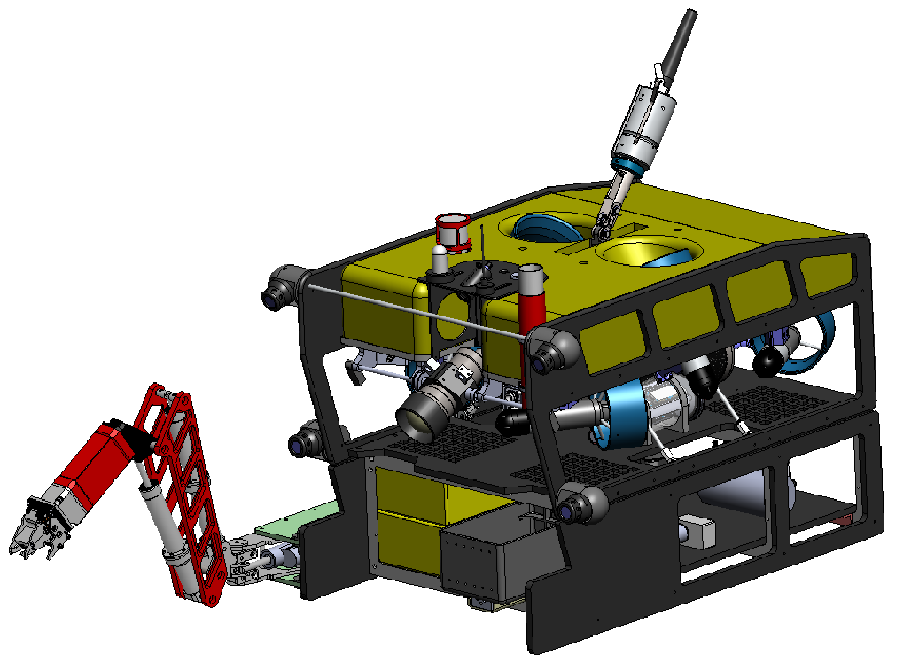
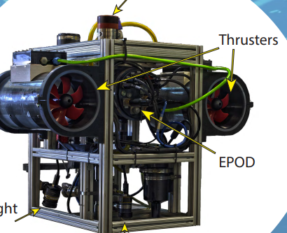


MiniROV System Components and Cable Lengths
50 m Umbilical
Door
20’ Control Van
The MiniROV
The Smart Clump
Door
Connects to
Ship Power
L= 30 m
3 Phase
Nominal ~400 VAC (wide input 200 - 500 VAC, 40 - 70 Hz)
Needs >50 A circuit
1700 m Umbilical
Connects to Winch
Cable Bundle (l= 21 m) contains:
Power provided by converter in van:
  Winch power ~240 VAC single phase
  ROV power ~208 VAC 3 phase, 15 A mac
ROV fiber optics in jacketed cable
Comms to winch electronics

Slide 2
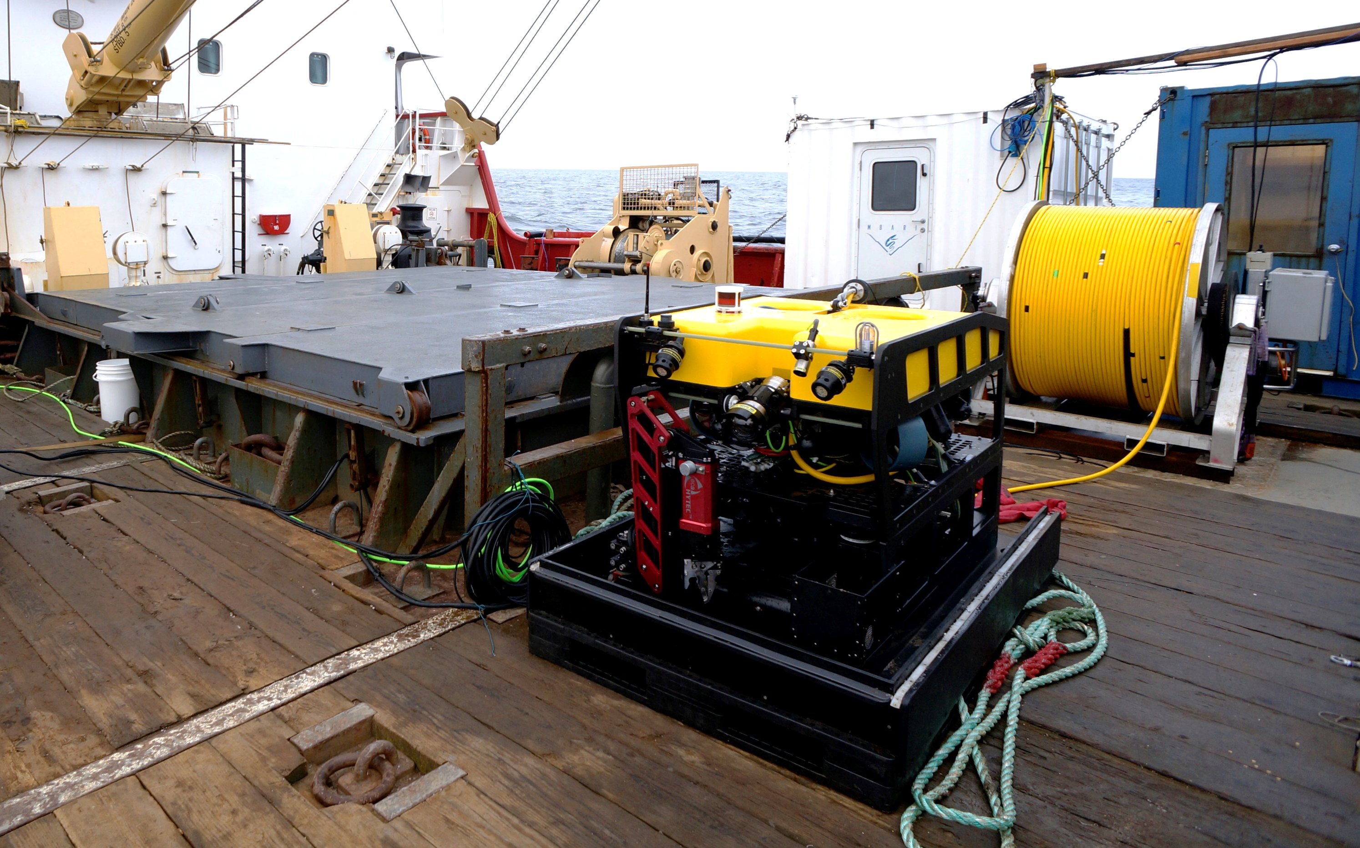
MiniROV System
3500 lbs
900 lbs

Slide 3
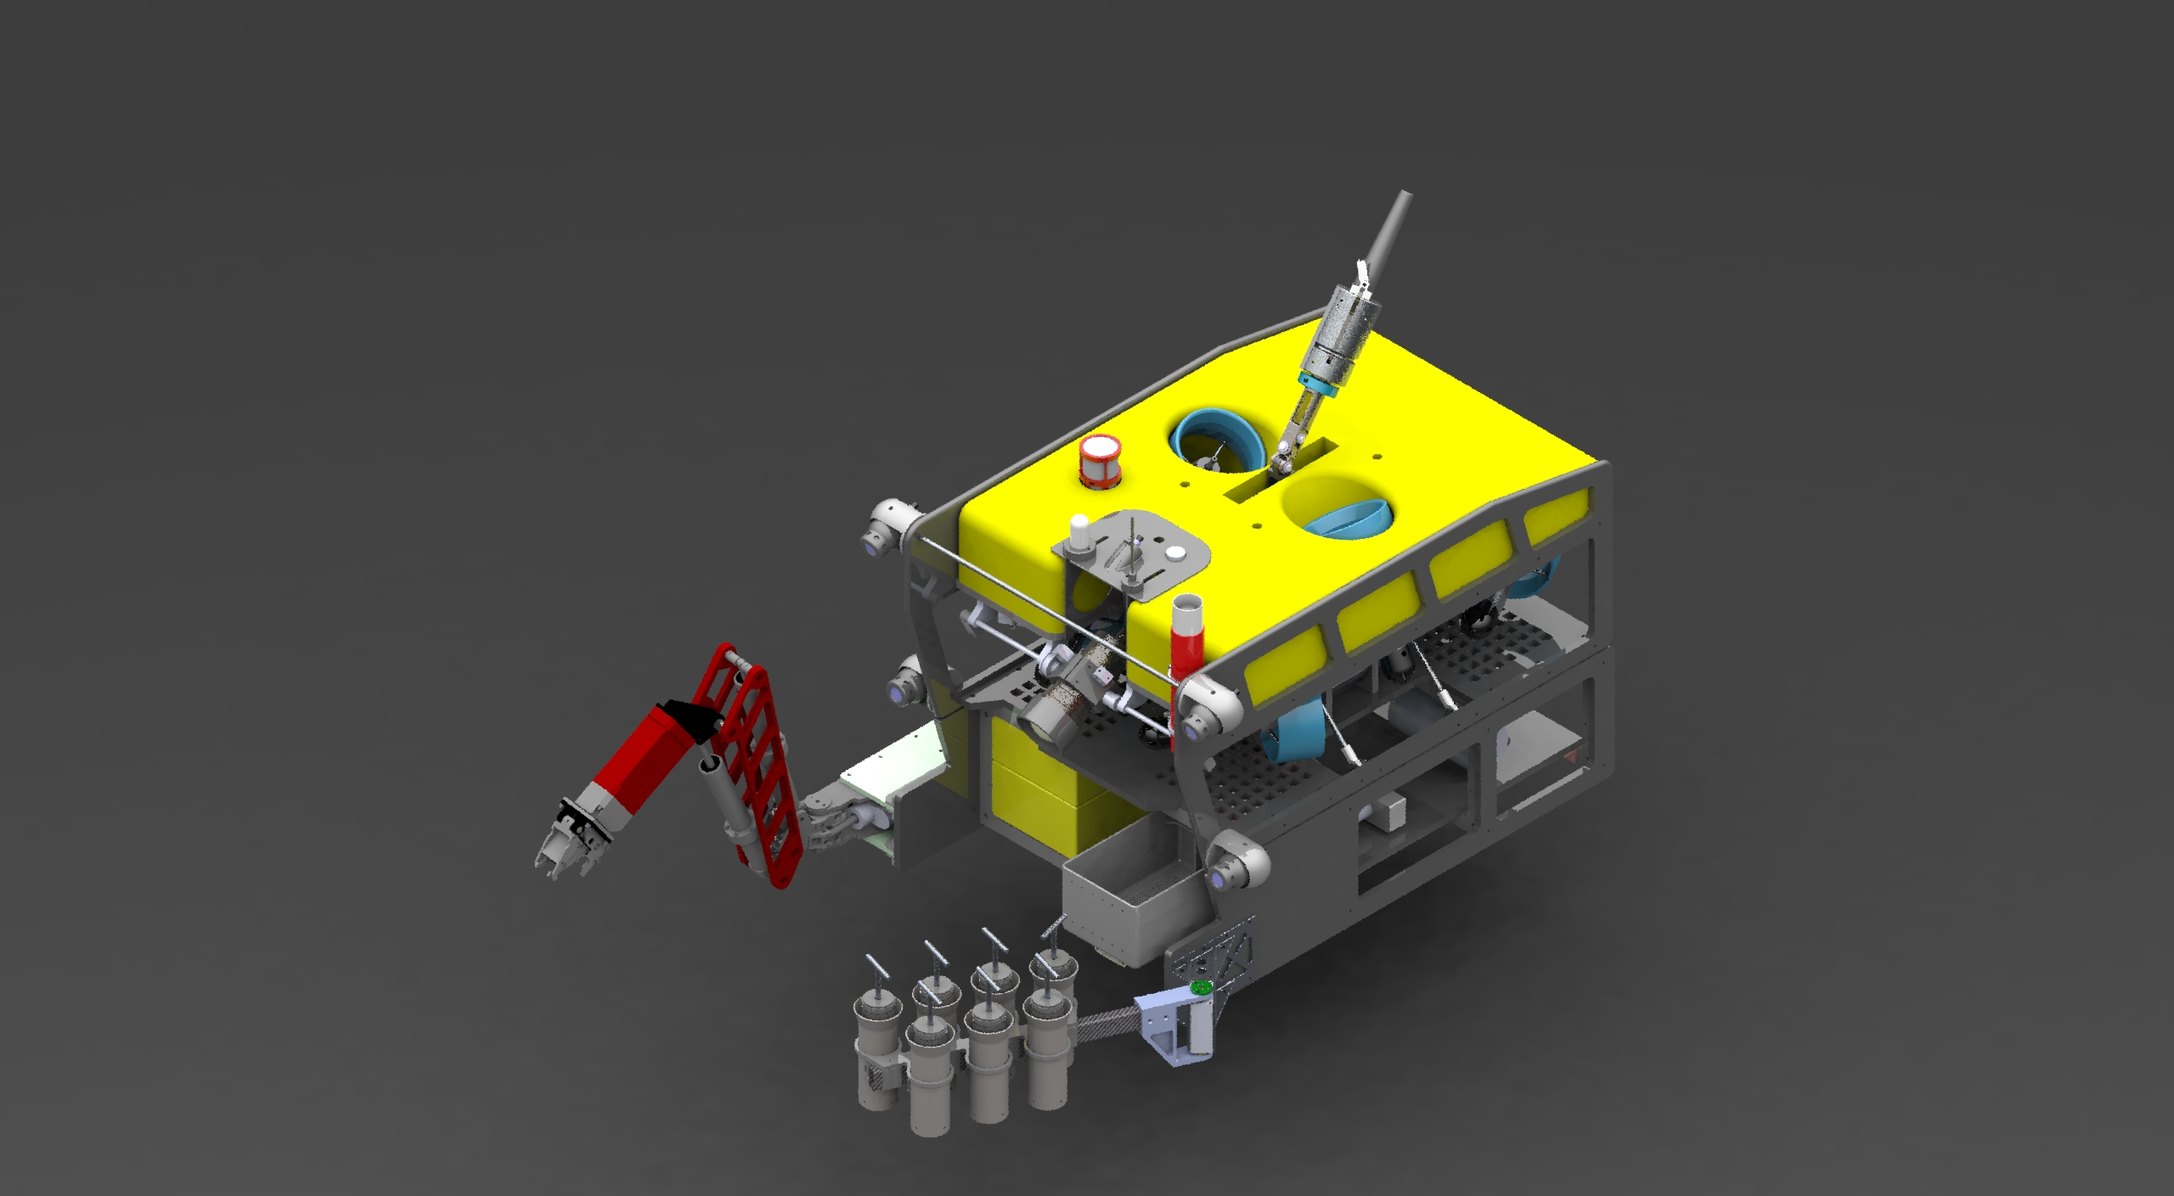
MiniROV drawing with manip and cores

